Slide 1
Classifying Spam emails

Slide 2

Data set overview
The spambase dataset contains 4601 rows and 58 columns. The variable we are interested in, "Spam" is a binary variable that either takes on 0 (not a spam email) or 1 (spam email) for each observation. All 57 predictors take on a numeric structure (there are no categorical predictors in the dataset).Overall, there are 2788 0's (not spam) and 1813 1's (spam emails).
Some variables that are meant to represent the percent of characters that match a certain symbol were changed when the data was imported into R, so renamed those variables with a meaningful name so that we can see the character they represent:

Slide 3
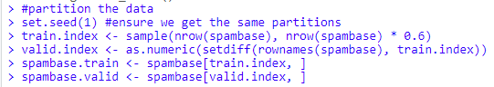
Partition Data
After renaming the variables, we partitioned the data, with 60% of the rows as the training dataset and the remaining 40% as the validation dataset.

Slide 4
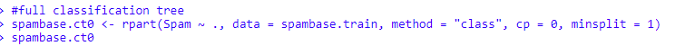
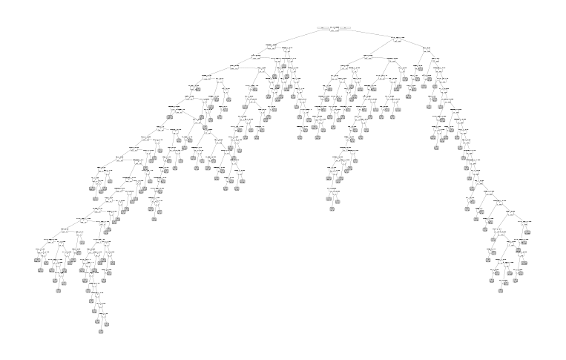
Full classification tree
The full classification tree uses all predictors to predict whether an email is spam.
For this classification tree, the cp (complexity parameter) was 0 and minsplit was set to 1.
A full tree is likely to overfit the data, which can lead to low predictive accuracy when trying to classify new data.

Slide 5
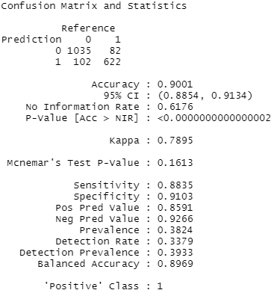
Full Classification Tree: Confusion MAtrix
The predict() function was used in order to evaluate the performance of the full classification tree on validation data.
The confusion matrix shows us that the full classification tree is 90.01% accurate. Of the validation data, 1035 0's (not spam) were correctly classified as 0's, and 622 1's (spam) were correctly classified as 1's.
The sensitivity was 0.8835, meaning about 88.35% of spam emails were correctly classified as spam, while the specificity was 0.9103, meaning about 91.03% of non-spam emails were correctly classified as not spam.
A higher specificity than sensitivity tells us that the full classification tree is better at correctly classifying non-spam emails as non-spam than it is at correctly classifying spam emails as spam.

Slide 6
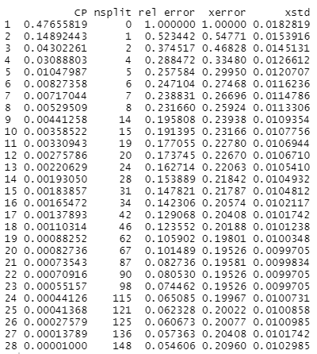
Pruning the Tree
As stated previously, the full classification tree is so complex that it overfits the training data, which can lead to lower accuracy when predicting on validation data.The table to the right shows that xerror (cross-validation error) does decrease as the tree becomes more complex, but only to a certain point. If the tree becomes too complex, overfitting will occur and xerror will increase. We want to choose a tree size that gives the lowest cross-validation error and does not overfit the training data.
Based on the table, cp = 0.00082736 with 67 splits seems to be the simplest tree size with the lowest cross-validation error at xerror = 0.19526. However, if we want to get an even simpler tree, we can add the standard deviation xstd = 0.0099705 to the xerror to get a cushioned xerror value of 0.2052305.
The best pruned tree is the the smallest tree within one standard error of the minimum error, so we are looking for xerror less than or equal to 0.2052305. Therefore, we choose the tree with cp = 0.00137893 with 42 splits as our best pruned tree.

Slide 7
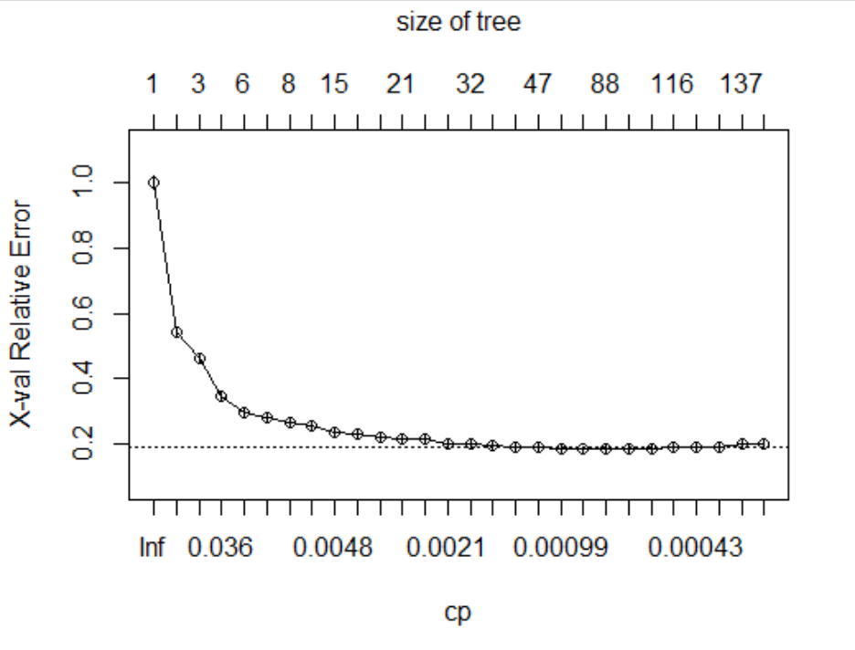
CROSS VALIDATION ERROR
Observing from the above graph that the cross-validation error (x-val) does not always decrease when the tree becomes more complex. A good choice of cp for pruning is often the leftmost value for which the mean error lies below the horizontal line.
In the Spambase dataset, we conclude that having a tree model with 14 splits is not helpful.

Slide 8
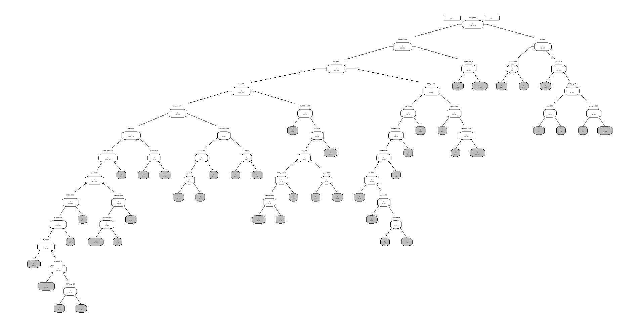
best pruned tree
The best pruned tree has a complexity parameter of 0.00137893 and has 43 leaves, or terminal nodes where the classification value is noted.
Relative to the full classification tree, the best pruned tree is much simpler due to the higher cp value.

Slide 9
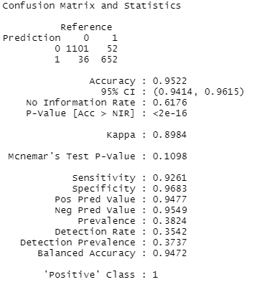
Best Pruned Tree confusion matrix
The predict() function was used in order to evaluate the performance of the best pruned tree on validation data.
Looking at the confusion matrix, we see that the best pruned tree is 95.22% accurate, compared to the 90.01% accuracy of the full classification tree. This means that our best pruned tree is not only simpler, but it performs better than the full classification tree when predicting spam in the validation data.
Sensitivity is 0.9261, meaning about 92.61% of spam emails were correctly classified as spam, and specificity is 0.9683, meaning about 96.83% of non-spam emails were correctly classified as not spam.
While both sensitivity and specificity have increased compared to the full classification tree, we still observe a higher specificity than sensitivity.

Slide 10
Classifying a New Record
We will use our best pruned tree to classify a new record with the following predictor values:
our = 0.94, you = 1.88, your = 2.83, C! = 0.428, CAP_avg = 4.652, CAP_long = 31, CAP_tot = 107. All other predictors are 0.
In order to classify the new record, we typed the name of our best pruned tree model pruned.ct into R to view the list of rules for classification. We then went down the list of rules using the given predictor values. Another way to do this is to simply follow the plot of the best pruned tree – we needed to export the plot and zoom in in order to read the rules properly since the tree is fairly large.
Using either method, we came to the conclusion to classify the new record as a 1, meaning that the rules from our best pruned tree led us to classify the record as a spam email.
The probability that our classification is correct is 0.9522.

Slide 11

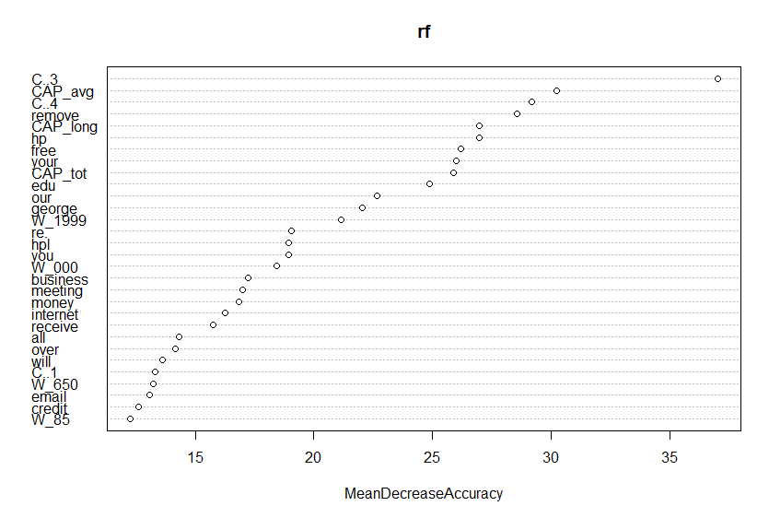
Random forest and Variable Importance Plot
Before creating a random forest, our data was reloaded into R and partitioned again to remove the special characters that were used when renaming variables.
We then created the random forest using 500 trees selecting a random subset of 4 predictors at each decision node and plotted the variable importance.
We see that the variable C..3, which represents the exclamation point character (!), was most important in improving the accuracy of the random forest model, followed by CAP_avg, C..4 (dollar sign character $), and remove.

Slide 12
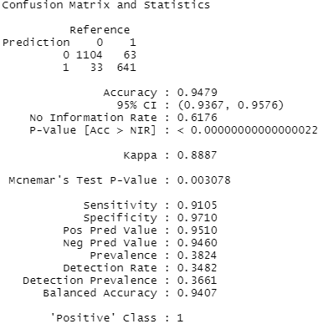
random forest Confusion Matrix
The confusion matrix shows that our random forest is 94.79% accurate when classifying validation data. This model has a higher accuracy than our full classification tree, but a lower accuracy than our best pruned tree.
The sensitivity was 0.9105, meaning about 91.05% of spam emails were correctly classified as spam.
The specificity was 0.9710, meaning about 97.10% of non-spam emails were correctly classified as not spam.
Again we observe a higher specificity than sensitivity, meaning the random forest model is better at correctly classifying 0's as 0's (non-spam) than it is at correctly classifying 1's as 1's (spam).

Slide 13
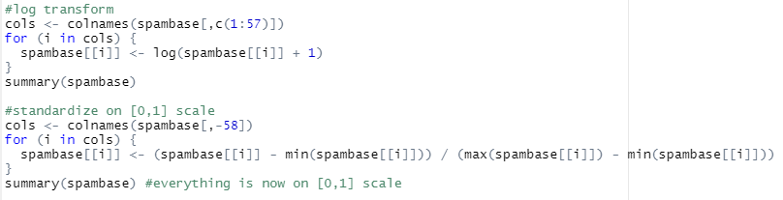
Neural Net Pre-Processing
By calling the skewness() function in the moments package in R, we can see that all 57 predictors are highly skewed – all predictor variables have a skewness coefficient greater than 1. Prior to creating our neural net models, we performed a log transformation on all predictors using the formula x = log(x + 1).
After log transformation of predictors, we standardized all predictors on a [0,1] scale using the formula x = (x−min(x)) / (max(x)−min(x)).

Slide 14
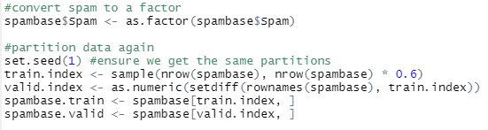
Neural Net Partitioning
Because our outcome variable Spam returns either a 0 or a 1, we want to make sure to first convert it to a factor before creating our neural nets so that R will interpret it as classification and not numerical outcomes.
We are now ready to partition the data into 60% for the training dataset and the remaining 40% for the validation dataset:

Slide 15
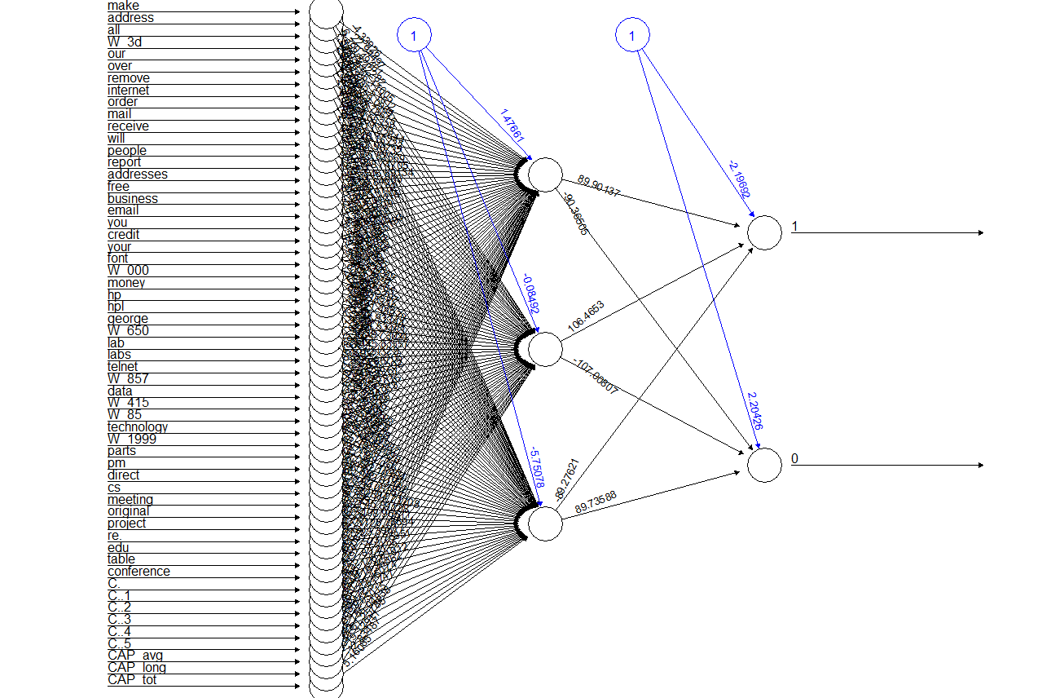
NEURAL NET WITH 1 HIDDEN LAYER CONTAINING 3 NODES

Slide 16
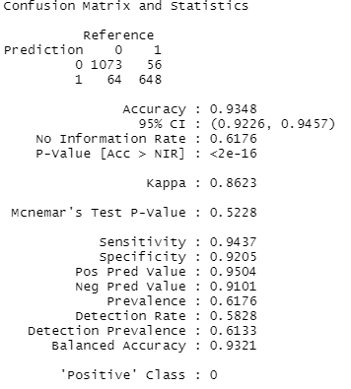
CONFUSION matrix
Based on the confusion matrix, we can see that the neural net model with 1 hidden layer containing 3 nodes was 93.48% accurate. Of the validation data, 1073 0's were correctly classified as 0's, and 648 1's were correctly classified as 1's.
The sensitivity was 0.9437, meaning about 94.37% of spam emails were correctly classified as spam while the specificity was 0.9205, meaning that about 92.05% of non-spam emails were correctly classified as not spam.
Unlike the previous three models, we see that the neural net model with 1 hidden layer containing 3 nodes has a higher sensitivity than specificity; it is better at correctly classifying spam emails as spam opposed to correctly classifying non-spam emails as non-spam.

Slide 17
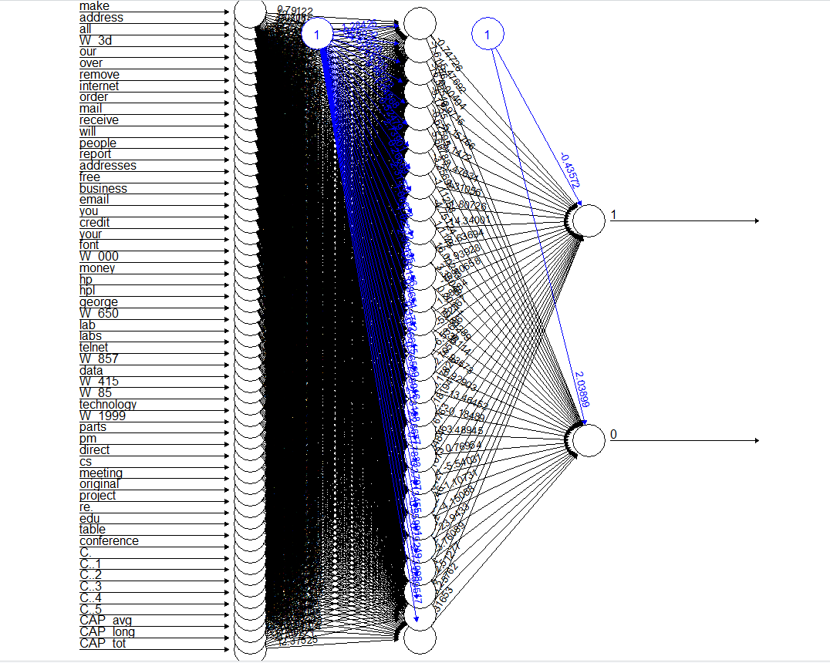
NEURAL nET WITH 1 HIDDEN LAYER CONTAINING 28 NODES

Slide 18
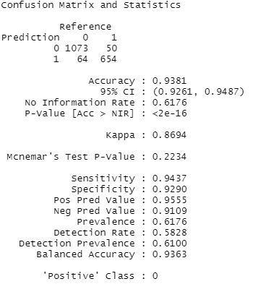
Confusion Matrix
Based on the confusion matrix, we can see that the neural net model with 1 hidden layer containing 28 nodes was 93.81% accurate, which is just slightly higher than the accuracy of the neural net model that has 1 hidden layer with 3 nodes which had an accuracy of 93.48%.
Sensitivity was 0.9437, which is the same as the sensitivity of the neural net model containing 1 hidden layer and 3 nodes. Specificity was 0.9290, meaning that about 92.9% of non-spam emails were correctly classified as not spam.
We also see that the positive predictive value, also known as precision, of this model is 0.9555, which is slightly higher than our previous neural net and is the highest precision we have seen from any of our models so far.

Slide 19
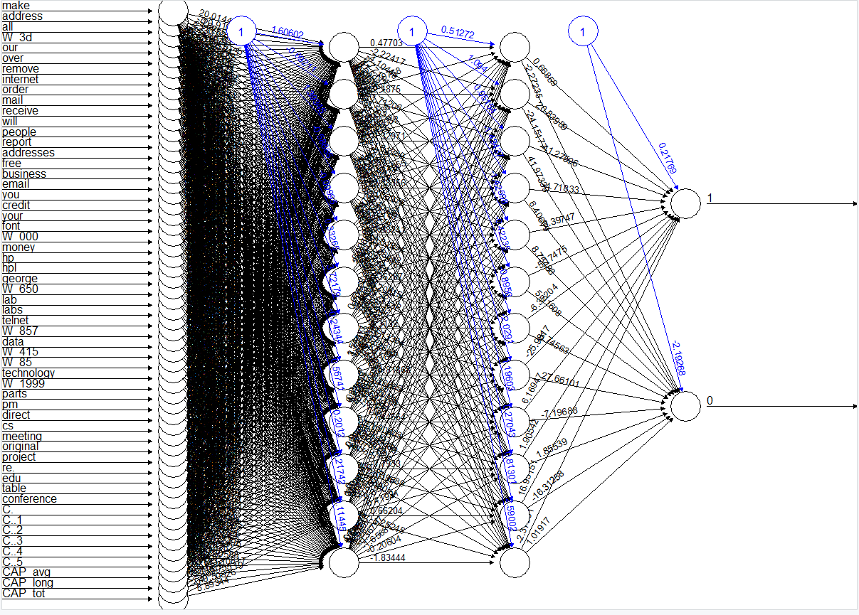
NEURAL NET WITH 2 HIDDEN LAYERS EACH CONTAINING 12 NODES

Slide 20
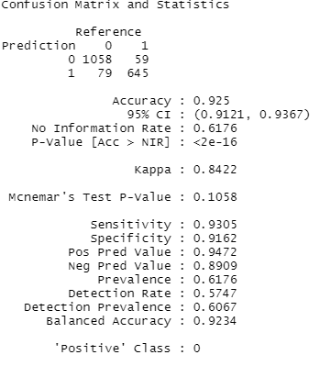
Confusion Matrix
Based on the confusion matrix, the neural net model with 2 hidden layers and 12 nodes is 92.50% accurate. This model had a lower accuracy than either the neural net model containing 1 hidden layer with 3 nodes and the neural net model containing 28 nodes.
Sensitivity is 0.9305 meaning about 93.05% of spam emails were correctly classified as spam, and specificity was 0.9162, meaning that about 91.62% of non-spam emails were correctly classified as not spam.
Like the neural net model with 1 hidden layer and 3 nodes and the neural net model with 1 hidden layer and 28 nodes, this model has a higher sensitivity than specificity.

Slide 21
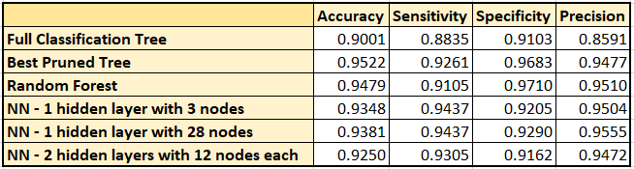
COMPARISON TABLE
Of the 6 models, our best pruned tree has the highest accuracy, while both our neural nets with 1 hidden layer have the highest values for sensitivity. Our random forest model has the highest specificity, and our neural net with 1 hidden layer containing 28 nodes has the highest precision.

Slide 22
SUMMARY
In the case of spam email classification, specificity may be more important than sensitivity, because while most people are able to recognize spam when they see it, we do not want to have important non-spam emails incorrectly identified as spam – this could result in users missing out on critical information.
The random forest model has the highest specificity (true positive rate), as well as the second highest values out of all 6 models for both accuracy and precision. Therefore, we would choose the random forest model to predict whether an email is spam.

