Slide 1
Final Project: Credit Card Approvals

Slide 2
Introduction
While credit usage in America is widespread and most Americans have at least one credit card, the application process required to open a card can be tiresome. In order to get approved for a credit card, applicants are often evaluated on not only their credit score, but other factors such as income, expenditures, family, and history.
The goal of our final project was to use data mining techniques to classify credit card applications as approved or denied based on the values of their predictors. We attempted to classify records using a reduced logistic regression model, discriminant analysis, and classification trees, and compared performance in order to find the best model for our data.
Overall, our reduced logistic regression model using forward selection performed relatively well, but our best pruned tree and random forest had the highest accuracy, specificity, and precision. Discriminant analysis had the highest sensitivity of all our models, but had very low specificity meaning it performed poorly in correctly classifying denied credit card applications as denied.

Slide 3
Dataset Overview
Our credit card dataset contains 1319 observations of 12 variables. Overall, there are 1023 credit card applicants in the dataset who were approved and 296 who were denied approval.
The outcome variable in which we are interested is card, which returns a "yes" if the applicant was approved and a "no" if denied. We converted this to a binary variable to return 1 if approved and 0 if denied.
There are 2 categorical predictors (owner and selfemp), and 9 numeric predictors (reports, age, income, share, expenditure, dependent, months, majorcards, and active). Descriptions of each variable are on the next slide.

Slide 4
Variable Descriptions
card: categorical variable that takes on "yes" if the application was approved or "no" if the application was denied
reports: number of derogatory item reports
age: age in years of the applicant
income: annual income of the applicant, divided by 10,000
share: ratio of monthly credit card spending compared to annual income
expenditure: applicant's average monthly credit card spending
owner: categorical variable that takes on "yes" if the applicant owns their home and "no" if the applicant does not
selfemp: categorical variable that takes on "yes" if the applicant is self-employed and "no" if the applicant is not
dependents: the number of dependents claimed by the applicant
months: number of months applicant has been living at their current address
majorcards: number of major credit cards the applicant has
active: number of active credit accounts the applicant has

Slide 5
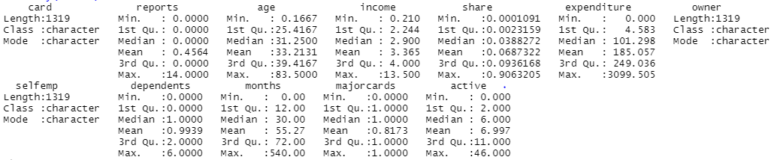
Summary Statistics
Looking at the summary statistics, we see that there are 3 categorical variables for which we will need to create binary dummy variables.
We also notice that our numeric predictors can take on some very different magnitudes - for example, expenditure can range from 0 to over 3000, share is a ratio variable on a 0-1 scale.
The summary statistics also show us that there are no NAs or missing data to be handled.

Slide 6

Creating Dummy Variables
As stated previously, we will need to manually create dummy variables for the three categorical variables in our dataset. Each of the variables card, owner, and selfemp take on a "yes" or a "no" which we want to convert to a 1 or 0.
We create the dummy variables and then drop one dummy variable for each group.
We are left with cardyes, our outcome variable which returns 1 if approved and 0 if denied, owneryes, which returns 1 if the applicant is a homeowner and 0 otherwise, and selfempyes, which returns 1 if the applicant is self-employed and 0 otherwise.

Slide 7
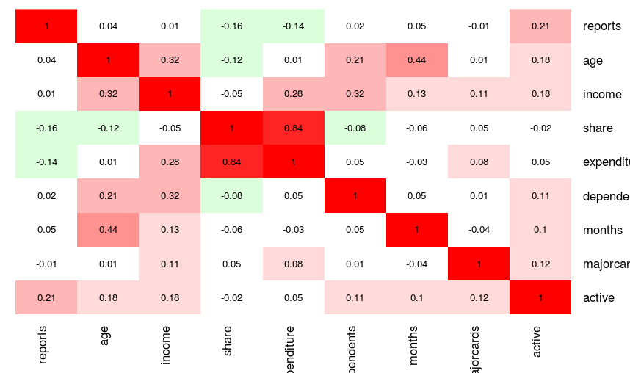
Heat Map
Looking at a correlation heatmap of our numeric predictors, we see that share and expenditure have a strong positive correlation (0.84), which makes sense because as someone spends more using their credit card, we would expect the ratio of their credit card expenditure to annual income to increase as well.
There is moderate positive correlation between age and months - the older an applicant is may be somewhat related to how long they have lived at their current address, but the relationship is not very strong.
Many of the variables actually seem to have little correlation with others.

Slide 8
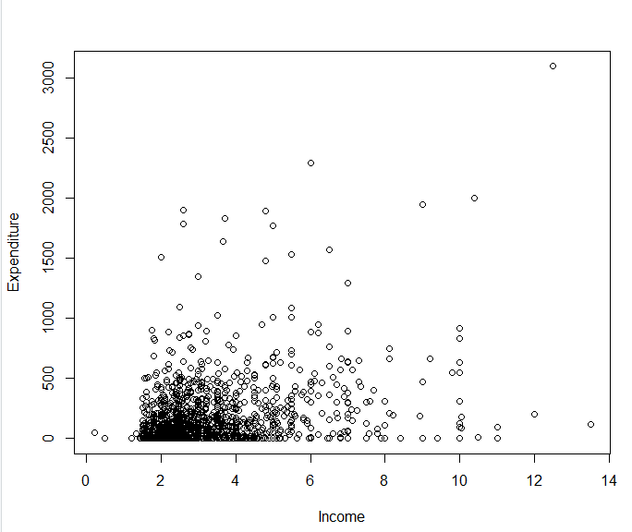
Scatterplot for Income and Expenditure
A scatterplot was created in order to examine the relationship between income and expenditure.
It appears there is a slight positive association between income and expenditure – someone who makes more money may spend more on their credit card, but this relationship is rather weak.
We notice that there are some applicants with high incomes who spend very little compared to others, and there are some applicants who make less but spend more on credit. While there may be a slight positive relationship between these two variables, income and expenditure are not very strongly correlated.

Slide 9
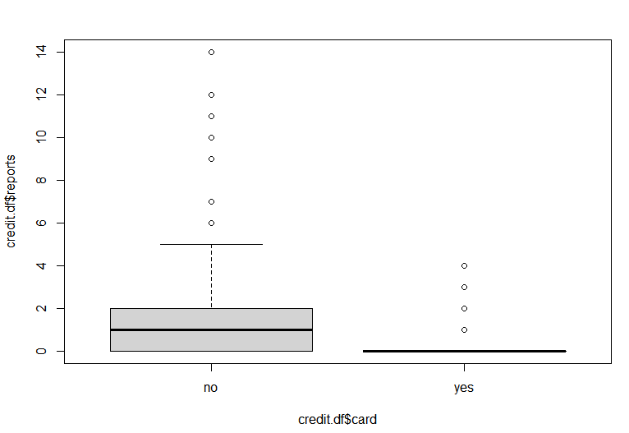
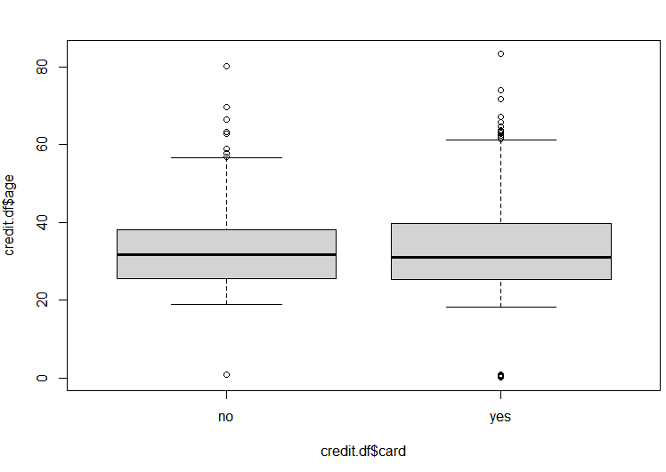
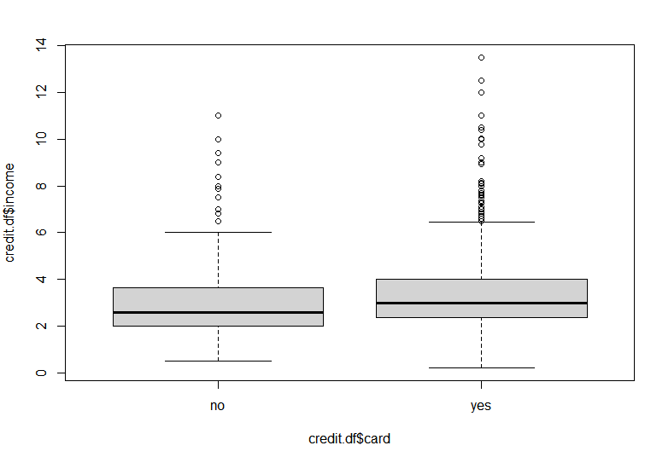
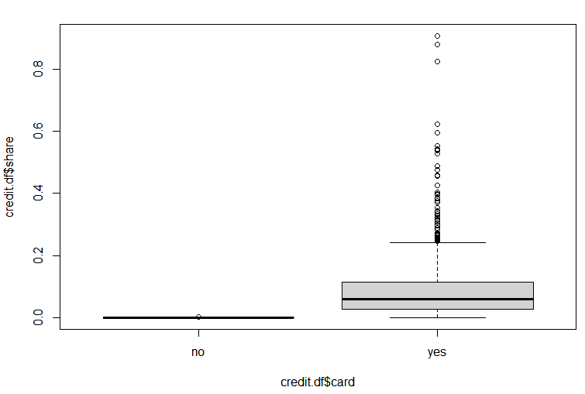
Side-by-Side Box Plots
Side-by-side box plots were created to show the distribution of numerical predictors reports, age, income, and share by whether the applicant was approved, shown below:
We see that the box plots for age and income do not show much difference in distribution between "no" and "yes" for the card outcome variable, so they may not be the most useful in predicting whether an applicant is approved. It appears that, of the four numerical predictors above, reports and share have the most distinct differences between "no" and "yes" distributions, and it seems that the medians are further away from each other. Therefore, based on the box plots we believe # derogatory reports and share ratio may be useful predictors in determining credit card application approval.

Slide 10

EDA: Approved vs Not Approved Averages
In order to examine how each predictor's values differ between approved and denied credit card applications, we aggregated the data into approved (1) and denied (0) averages, then calculated the difference between the approved and denied averages for each predictor.
The predictors were sorted by highest to lowest difference in approved vs. denied average. The predictor with the largest difference between classes was expenditure, followed by reports and active.
Based on these results, we should be interested in monthly credit card expenditure, number of derogatory reports, and number of active credit accounts as good possible predictors for determining credit card application approval.

Slide 11

Partition Data
After gaining an understanding of our dataset and how the variables are distributed through EDA, we partitioned the data, with 60% of the rows as the training dataset and the remaining 40% as the validation dataset.
We will be creating our reduced logistic regression model by forward selection using the training dataset. The forward selection model will begin with a null model with no predictors, then it will add predictors one at a time until the next predictor's contribution is no longer statistically significant. Our goal is to find a parsimonious model - the simplest model that performs sufficiently well, and using forward selection will give us a simpler model than a full logistic regression model.

Slide 12
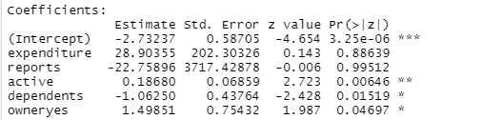
Reduced Logistic Regression Model Using Forward Selection
Our formula for the reduced logistic regression model includes 5 of the original 11 predictors. The variables that were chosen to be included based on significance were expenditure, reports, active, dependents, and owneryes.
Looking step by step, it appears that expenditure was the first variable to be added to the model. If we were to make a logistic regression model with just 1 predictor, it would be expenditure. The second most significant predictor which was added next was reports, and so on.
Of the 5 predictors included, it appears that active has the lowest p value and is most statistically significant. dependents and owneryes also have p values < .05, whereas expenditure and reports have high p values which show less statistical significance.

Slide 13
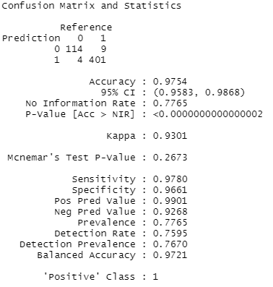
Forward Selection: Confusion Matrix
Overall, the reduced logistic regression model using forward selection is 97.54% accurate.
The model does well in correctly classifying both approved and denied applications – sensitivity was 0.9780, meaning 97.8% of credit card application approvals in the validation data were correctly classified as approved, and specificity was 0.9661, meaning 96.6% of the denied credit card applications in the validation data were correctly classified as denied.
The forward selection model's precision, or positive predictive value, was .9901, meaning 99% of the records that the model classified as approved were actually approved.

Slide 14
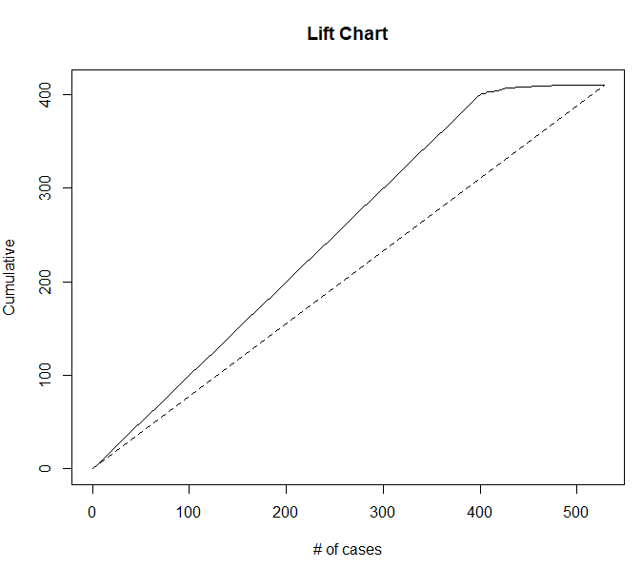
Forward Selection: Lift Chart
The lift chart shows that the reduced logistic regression model performs better than if we were to use random selection.
We notice that the area between the lift curve and the random selection baseline is generally increasing as we look at more cases; we would prefer for this area between curves to be a bit greater towards the left side of the chart as well.
At 400 cases, the logistic regression model correctly classifies about 100 more applications than random selection does.

Slide 15
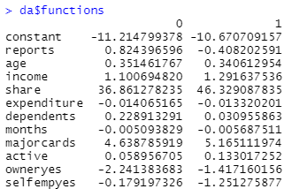
Discriminant Analysis
After logistic regression, we performed discriminant analysis modeling cardyes as a function of all predictors. The resulting functions for 0 (application denied) and 1 (application approved) are shown.

Slide 16
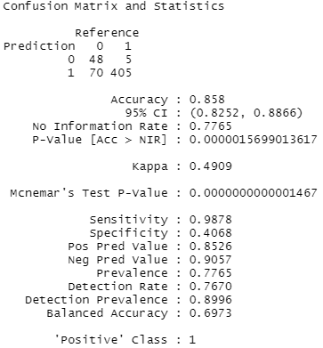
Discriminant Analysis: Confusion Matrix
The confusion matrix shows that discriminant analysis had accuracy of 0.858, so 85.8% of records were classified correctly in the validation data.
Sensitivity was 0.9878, meaning 98.8% of credit card application approvals in the validation data were correctly classified as approved.
On the other hand, specificity was only 0.4068; only about 40.7% of the denied credit card applications in the validation data were correctly classified as denied. This means that, using discriminant analysis, we are far better at correctly classifying approvals than we are at correctly classifying denied credit card applications. Specificity < 0.5 tells us that discriminant analysis is not performing as desired when predicting denied applications, and random selection may correctly predict denials better.
Precision was 0.8526, so about 85.3% of the predicted approvals were actually approved.

Slide 17
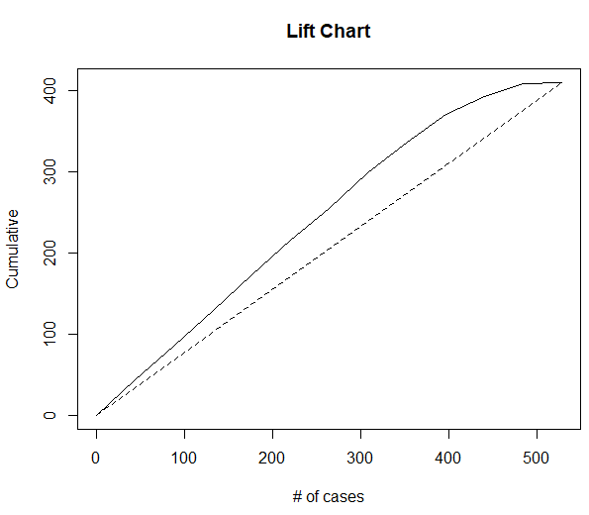
Discriminant Analysis: Lift Chart
The lift chart shows that discriminant analysis tends to perform better than random selection to predict application approval.
Again, the area between the lift curve and the random selection baseline is generally increasing as we look at more cases; we would prefer for this area between curves to be a bit greater towards the left side of the chart as well.
At 400 cases, the logistic regression model correctly classifies about 50 more applications than random selection does.

Slide 18
Classification Trees
After trying logistic regression and discriminant analysis, we wanted to examine the performance of classification trees in determining whether a credit card application will be approved.
While we believe that a random forest model would perform better than a single tree, we also want to take a look at the full classification tree and the best pruned tree.

Slide 19
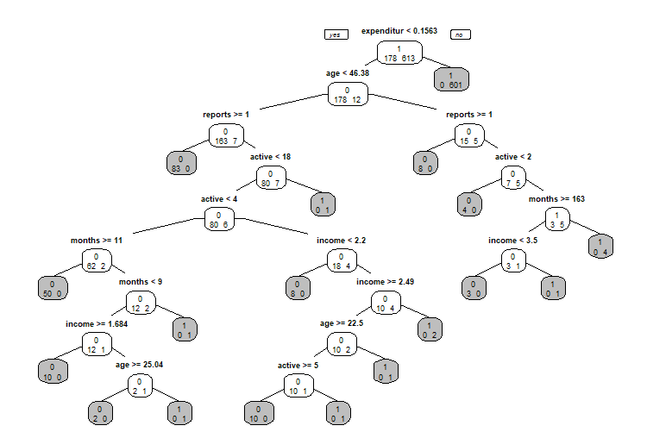
Full Classification Tree
The full classification tree uses all predictors to predict whether an application is approved. There are only 18 leaves in this tree, which is a fairly low amount for a full tree.
A full tree is likely to overfit the training data, which can lead to low predictive accuracy when trying to classify new data.

Slide 20
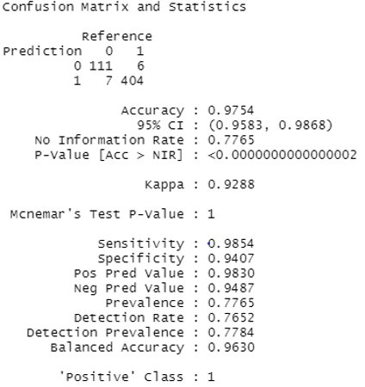
Full Classification Tree: Confusion Matrix
The full classification tree is 97.54% accurate when classifying credit card applications in the validation data.
Sensitivity was 0.9854, meaning 98.54% of credit card application approvals in the validation data were correctly classified as approved. Specificity was 0.9047, meaning 94.07% of the denied credit card applications in the validation data were correctly classified as denied.
The full classification tree has precision of 0.9830, meaning 98.3% of the records that the model classified as approved were actually approved.

Slide 21

Pruning the Tree
Cross-validation error (xerror) does decrease as the tree becomes more complex, but only to a certain point. If the tree becomes too complex, overfitting will occur and xerror will increase.
Based on the table, cp = 0.002809 with 6 splits seems to be the simplest tree size with the lowest cross-validation error at xerror = 0.067416. However, if we want to get an even simpler tree, we can add the standard deviation xstd = 0.019313 to the xerror to get a cushioned xerror value of 0.086729.
The best pruned tree is the the smallest tree within one standard error of the minimum error, so we are looking for xerror less than or equal to 0.086729. Therefore, we can use the tree with cp = 0.005618 with only one split as our best pruned tree.

Slide 22
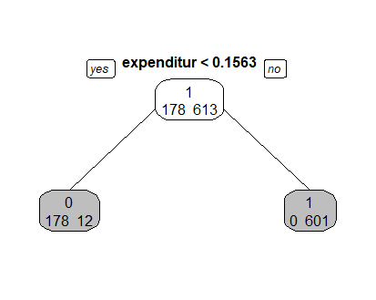
Best Pruned Tree
The best pruned tree is extremely simple, with one split taking only the expenditure predictor into consideration. There are only 2 leaves in the best pruned tree.
The fact that these trees include such few leaves indicates that the algorithm that was actually used by the credit card company to determine application approval is very likely based on the predictors provided in our dataset.

Slide 23
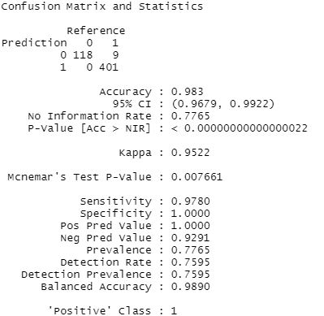
Best Pruned Tree: Confusion Matrix
Looking at the confusion matrix for our best pruned tree, we see that it is 98.3% accurate, which is the highest accuracy we have seen so far.
Sensitivity was 0.9780, meaning 97.8% of credit card application approvals in the validation data were correctly classified as approved. Specificity was 1.00, meaning 100% of the denied credit card applications in the validation data were correctly classified as denied.
We also notice that precision is 1.00, which means 100% of the records that the random forest classified as approved were actually approved. The only misclassification was seen in the 9 approved applications that the random forest incorrectly classified as denied.
The fact that specificity and precision are at 100% using our best pruned tree further supports our idea that the credit card company is using some algorithm based on these predictors in order to approve credit card applications, and expenditure is likely the most important predictor in this algorithm.

Slide 24
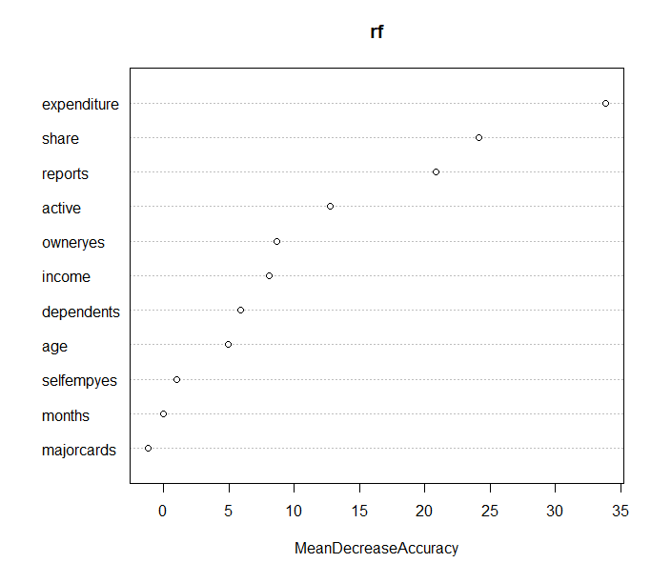
Random Forest
With only 11 total predictors in the dataset, we chose to create a random forest with 500 trees and set mtry = 3 so that 3 predictors were randomly sampled as candidates at each split.
According to the variable importance plot, expenditure is the most important predictor in determining whether a credit card application will be approved, followed by share and reports.

Slide 25
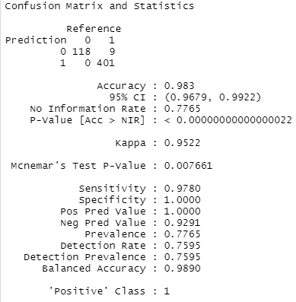
Random Forest: Confusion Matrix
Surprisingly, our random forest model had the same performance on validation data as our best pruned tree.
This makes sense, seeing as expenditure is the most important variable in our random forest variable importance plot and the only split in the best pruned tree was for the expenditure variable.

Slide 26
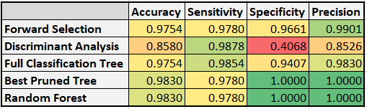
Comparison Table
Overall, our best pruned tree and random forest (which had the same classification performance) had the highest accuracy, specificity, and precision when classifying new records.
Discriminant analysis had the highest sensitivity, but very low specificity. This method is sensitive to outliers, which may explain its poor performance in correctly classifying denied credit card applications.

Slide 27
Conclusions
Using multiple different techniques, expenditure was consistently found to be the most important variable when classifying a record as approved or denied.
Based on the small number of leaves in our classification trees, and the fact that our best pruned tree using only one split for expenditure had perfect specificity and precision, we believe the credit card company uses some algorithm based on the predictors in our dataset to approve credit card applications, and we would expect expenditure to be a very important predictor in this algorithm.
While the best pruned tree and random forest had the same performance on our validation data, we would recommend the random forest as the best model for classifying credit card applications in the future. The reason for this is that the random forest model draws multiple random samples and produces a tree using a random subset of predictors for each sample, which can lead to better predictive performance than that of a single tree, especially one that relies on just one variable. Although the random forest performed the same as the best pruned tree on our validation data, if we had more credit card application records we may see better performance using random forest than our best pruned tree.

Slide 28
References
The credit card dataset was uploaded to Kaggle by user DanB and was originally published with the 5th edition of economist William Greene's book Econometric Analysis. The dataset can be found at the following link: https://www.kaggle.com/dansbecker/aer-credit-card-data

