Slide 1
Predicting spam emails

Slide 2
EDA: Dataset Overview
The spambase dataset contains 4601 rows and 58 columns. "Spam" is a binary variable that either takes on 0 (not a spam email) or 1 (spam email) for each observation. All variables take on a numeric structure (there are no categorical variables in the dataset).
Overall, there are 2788 0's (not spam) and 1813 1's (spam emails). In R, we used mean(spambase$Spam) to see that the proportion of spam emails in the dataset is around 39.4%.

Slide 3

EDA: RENAMING VARIABLES
The names of some variables which are meant to represent the percent characters that match a certain symbol were changed when the data was imported into R, so we want to rename those variables with a meaningful name so that we can see the character they represent. This was done using the rename() function, shown below:

Slide 4

EDA: Spam Vs Non-Spam Averages
In order to examine how each predictor differs between spam and non-spam emails, we wanted to compare the spam class average and the non-spam class average for each predictor. This was achieved by first aggregating data into spam and non-spam averages, then calculating the difference between the spam and non-spam averages for each predictor and storing these differences in the data frame meandiff:
As shown above, the predictors were sorted by the highest to lowest difference in spam vs. non-spam average. The 10 predictors with the largest differences between spam and non-spam emails were: CAP_tot, CAP_long, CAP_avg, george, you, your, hp, free, hpl, and C!
Of these predictors, there are 7 predictors that occur more frequently in spam than in non-spam emails:
CAP_tot, CAP_long, CAP_avg, you, your, free, and C!
These give us an idea of some predictors that we might be interested in when identifying spam vs. non-spam emails.

Slide 5
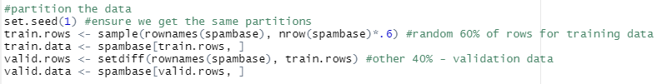
Partition data
After completing EDA, we partitioned the data, with 60% of the rows as the training dataset and the remaining 40% as the validation dataset:

Slide 6
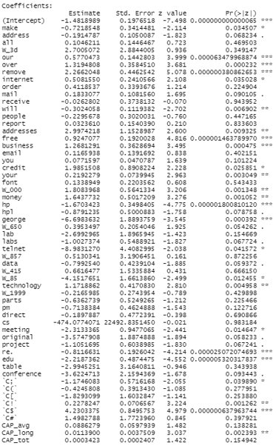
Full Model
The full logistic regression model contains all 57 possible predictors in order to predict whether an email is spam.
At a 95% confidence level, 32 variables are not significant: address, all, W_3d, order, mail, receive, people, report, email, you, font, hpl, W_650, lab, labs, W_857, data, W_415, W_1999, parts, pm, direct, cs, original, project, table, conference, C(, C[, C#, CAP_avg, and CAP_tot
Deviance for this model: 1060.731
AIC for this model: 1176.731
BIC for this model: 1520.264

Slide 7
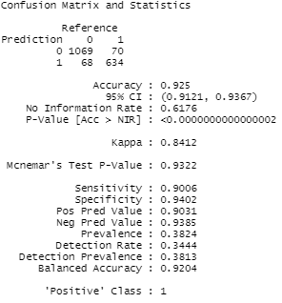
Full Model: Confusion Matrix
Based on the confusion matrix, we can see that the full model was 92.5% accurate. Of the validation data, 1069 0's (not spam) were correctly classified as 0's, and 634 1's (spam emails) were correctly classified as 1's.
The sensitivity (true positive) rate was 0.9006, meaning about 90% of spam emails were correctly identified as spam emails.
The specificity (true negative) rate was 0.9402, meaning about 94% of non-spam emails were correctly identified as not spam.
In this case, specificity may be more important than sensitivity, because while most people are able to recognize spam when they see it, we do not want to have important non-spam emails incorrectly identified as spam – this could result in users missing out on critical information.

Slide 8

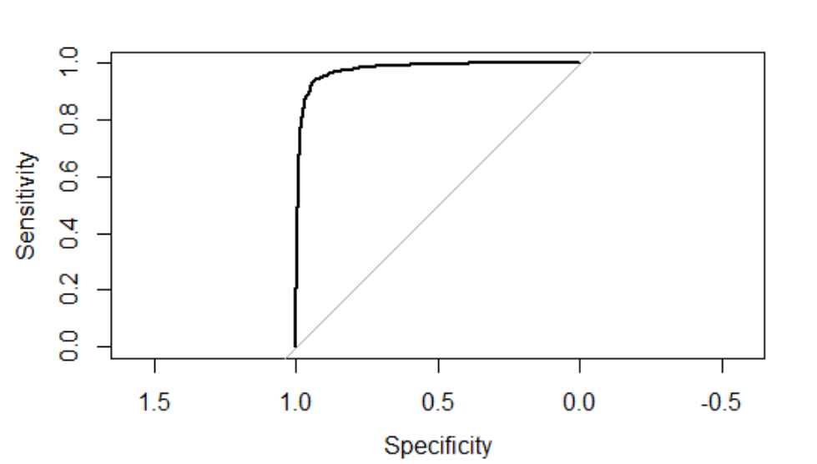
ROC & auc - IN_sample prediction
We used train.data to run the ROC curve for in_sample prediction.
The AUC = 0.9788 indicating a very good model if using the training dataset to determine whether an email is spam or not.

Slide 9
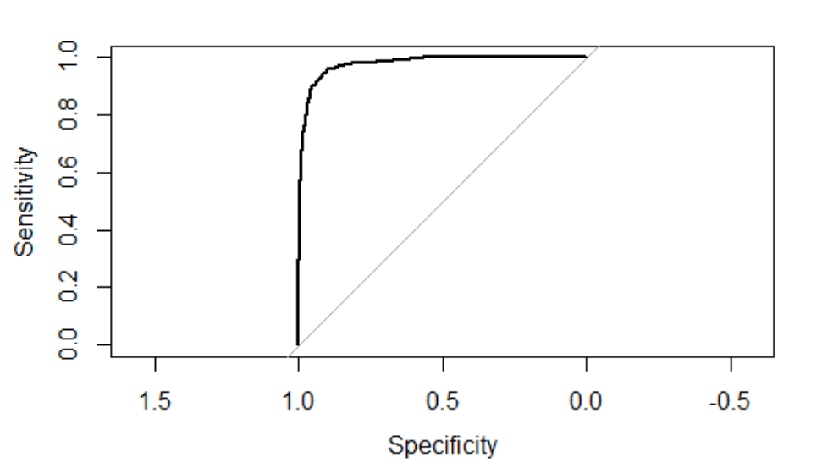
ROC & auc - out_sample prediction
We use valid.data to run the ROC curve for out_sample prediction.
The AUC = 0.9697 is a very good model if using validation dataset for future predictions.

Slide 10
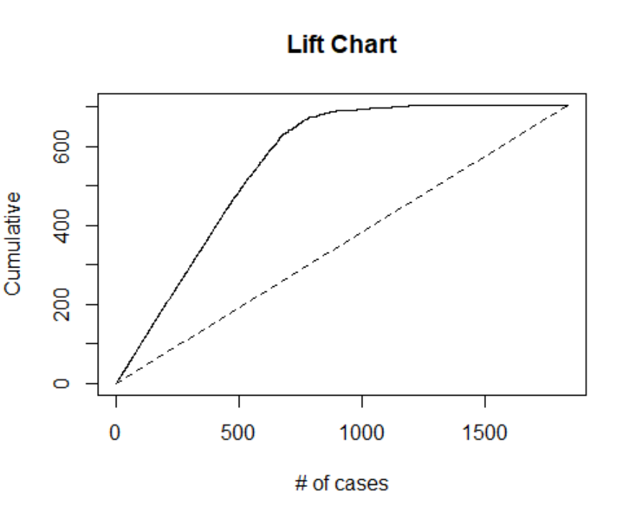
Full Model: LIFT CHART
If we select 500 most likely spam emails using the full model, we correctly identify about 490 spam emails.
If we were to randomly select 500 most likely spam emails, we only correctly identify about 180 spam emails.
Random selection delivers a huge misclassification of 310 spam emails.

Slide 11
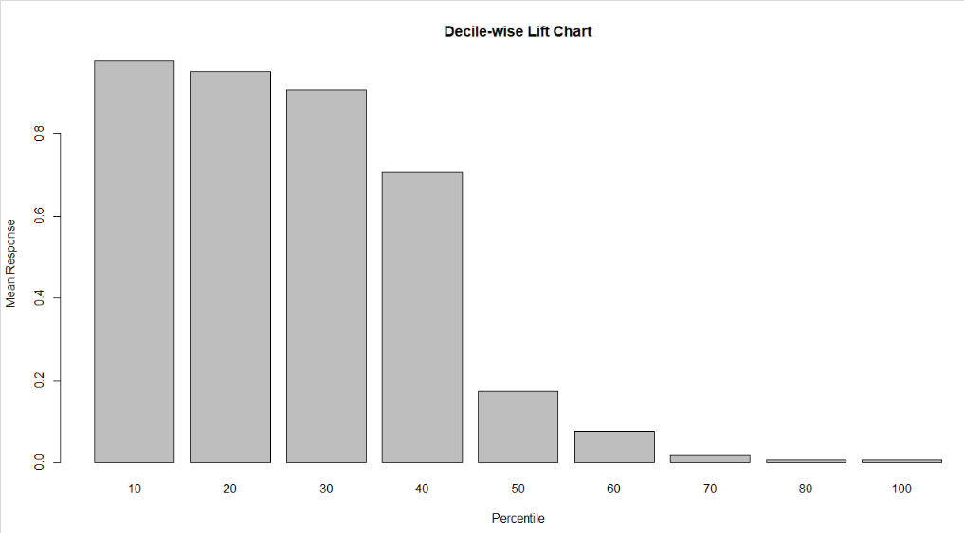
Full Model: Decile-Wise lift Chart
By selecting the top 30% of the most likely spam emails , we correctly identify spam emails more than 0.86 times than random selection.

Slide 12
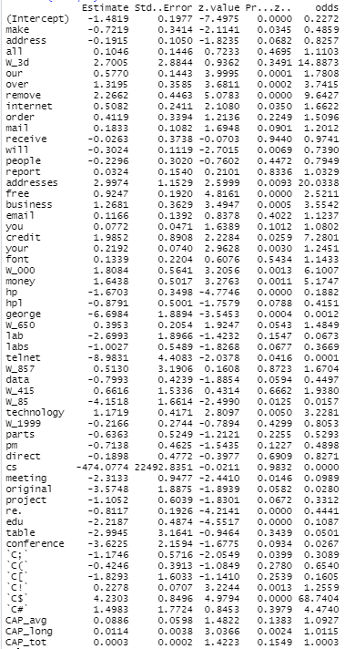
Full Model: odds
The odds coefficients for the full model can take on any nonnegative value.
The make predictor has an odds coefficient of 0.4859. The odds coefficient being less than 1 suggests that this variable is less likely to occur in spam emails. An odds coefficient of 0.4859 indicates that, all other things kept constant, a one-unit increase in the make variable would mean that an email is about half as likely to be spam.
The addresses predictor has an odds coefficient of 20.0338. The odds coefficient being greater than 1 suggests that this variable is more likely to occur in spam emails. An odds coefficient of 20.0338 indicates that, all other things kept constant, a one-unit increase in the address variable would mean that an email is about 20 times more likely to be spam.

Slide 13
Variable selection methods
Our goal is to find a parsimonious model – we will use two different variable selection methods in an attempt to find a reduced model that performs sufficiently well.
The variable selection methods we will use are forward selection and stepwise regression.

Slide 14

Reduced Model: Forward Selection
In order to find a reduced model using forward selection, we first created a null logistic model with no predictors. The forward selection method then added predictors to the model one at a time until the next predictor's contribution was no longer statistically significant. The image below shows our resulting formula for the reduced model, which includes 45 of the original 57 predictors:
Deviance for this model: 1067.125
AIC for this model: 1159.125
BIC for this model: 1431.583
Although the deviance is slightly higher than that of the full model when using forward selection, we see that the AIC and BIC are lower, which is preferrable. This is likely due to the fact that we are using less predictors in this reduced model.

Slide 15
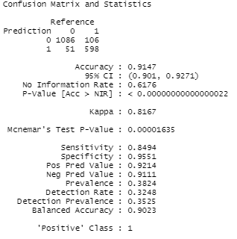
Forward SELECTION MODEL: CONFUSION MATRIX
Based on the confusion matrix, we can see that our reduced model using forward selection was 91.47% accurate. Of the validation data, 1086 0's were correctly classified as 0's, and 5981's were correctly classified as 1's.​
The sensitivity (true positive) rate was 0.8494, meaning about 85% of spam emails were correctly identified as spam emails.
The specificity (true negative) rate was 0.9551, meaning about 96% of non-spam emails were correctly identified as not spam.
We can see that the sensitivity of this model was lower than that of the full model, but the specificity was slightly higher. This means that the reduced model using forward selection performed somewhat better than the full model in correctly identifying non-spam emails as not spam but was not as good at correctly identifying spam emails as spam.

Slide 16
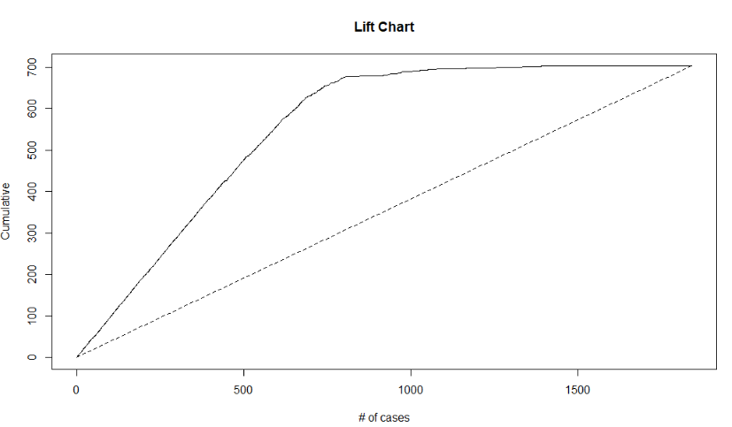
Forward Selection Model: LIFT CHART
If we select 500 most likely spam emails using the full model, we correctly identify about 460 spam emails.
If we were to randomly select 500 most likely spam emails, we only correctly identify about 170 spam emails.
Random selection delivers a huge misclassification of 290 spam emails.

Slide 17
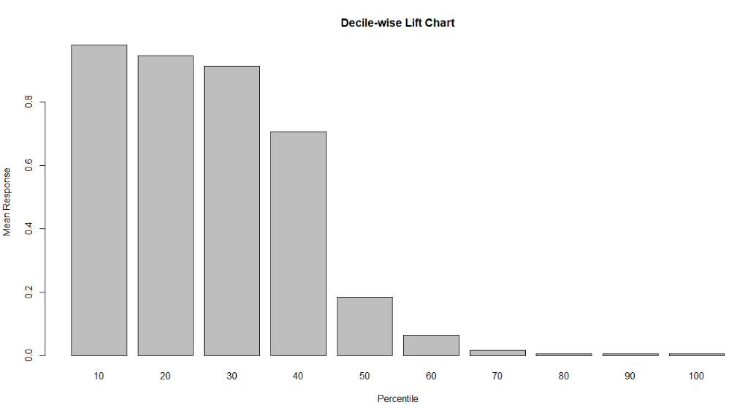
Forward Selection Model: Decile-wise Lift Chart
By selecting the top 30% of most likely spam emails , we correctly identify spam emails more than 0.85 times than random selection.

Slide 18

Reduced Model: Stepwise Regression
Similar to forward selection, the stepwise regression method begins with a full model and adds predictors one at a time. However, at each step it also considers dropping predictors that aren't statistically significant. The resulting model included 45 of the 57 original predictors:
This is the same model that resulted from forward selection.
Deviance for this model: 1067.125
AIC for this model: 1159.125
BIC for this model: 1431.583

Slide 19
Stepwise Regression: CONFUSION MATRIX
As expected, this confusion matrix looks the same as that of the forward model, which contained the same 45 predictors.
Based on the confusion matrix, we can see that our reduced model using stepwise regression was 91.47% accurate. Of the validation data, 1086 0's were correctly classified as 0's, and 5981's were correctly classified as 1's.​
The sensitivity (true positive) rate was 0.8494, meaning about 85% of spam emails were correctly identified as spam emails.
The specificity (true negative) rate was 0.9551, meaning about 96% of non-spam emails were correctly identified as not spam.
Again, we that the sensitivity of this reduced model was lower than that of the full model, but the specificity was slightly higher.

Slide 20
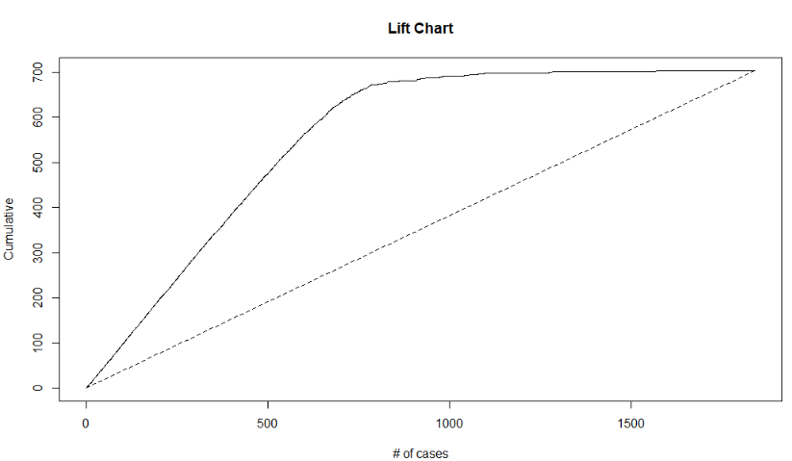
STEPWISE REGRESSION: LIFT CHART
If we select 500 most likely spam emails using the full model, we correctly identify about 460 spam emails.
If we were to randomly select 500 most likely spam emails, we only correctly identify about 170 spam emails.
Random selection delivers a huge misclassification of 290 spam emails.

Slide 21
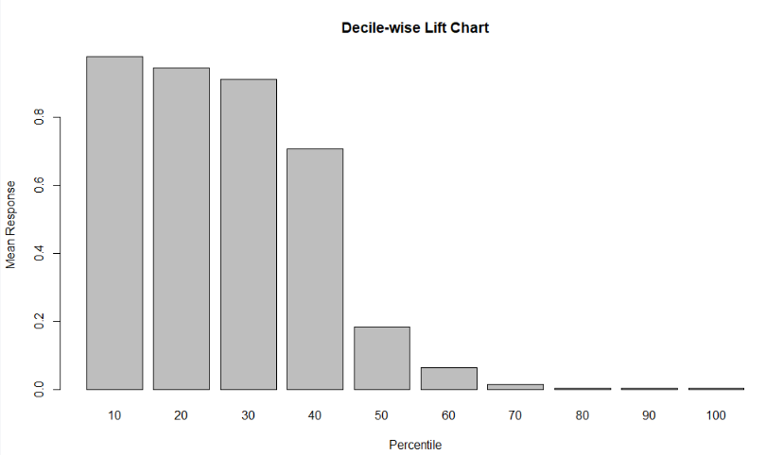
STEPWISE REGRESSION: DECILE-WISE LIFT CHART
By selecting the top 30% of most likely spam emails , we correctly identify spam emails more than 0.85 times than random selection.

Slide 22

Comparison table
Of the three models tested, the reduced models using forward selection and stepwise regression were the same in their predictors, deviance, AIC, BIC, sensitivity and specificity, while the full model had a slightly higher AIC, BIC, and sensitivity, and a slightly lower deviance and specificity.

Slide 23
summary
Of the three logistic regression models, either of the reduced models would be best to use when predicting whether or not an email is spam. The two reduced models contain the same set of predictors and therefore have the same accuracy, so it would ultimately be up to the user to choose between the forward selection and stepwise regression methods in this case.
Both reduced models contain 45 predictors, so they are simpler than the full model which contains all 57 predictors. We want to find a parsimonious model, so we prefer these simple models over the full model. Moreover, the reduced models have a lower AIC and BIC than the full model, which is favorable.
Even though the reduced models have a slightly lower sensitivity than the full model, they have a higher specificity, and in the case of spam vs. not spam we have decided that specificity (true negative rate) is more important as we do not want to risk misclassifying important non-spam emails as spam. The reduced models are better at correctly identifying non-spam as non-spam, so we would want to choose one of these as the best model.

