Slide 1
What Drives First-Year MLB Arbitration Salaries for Starting Pitchers?
A Fangraphs + Spotrac + Statcast Econometric Analysis (2016-2026)
Nicholas Hutchison

Slide 2
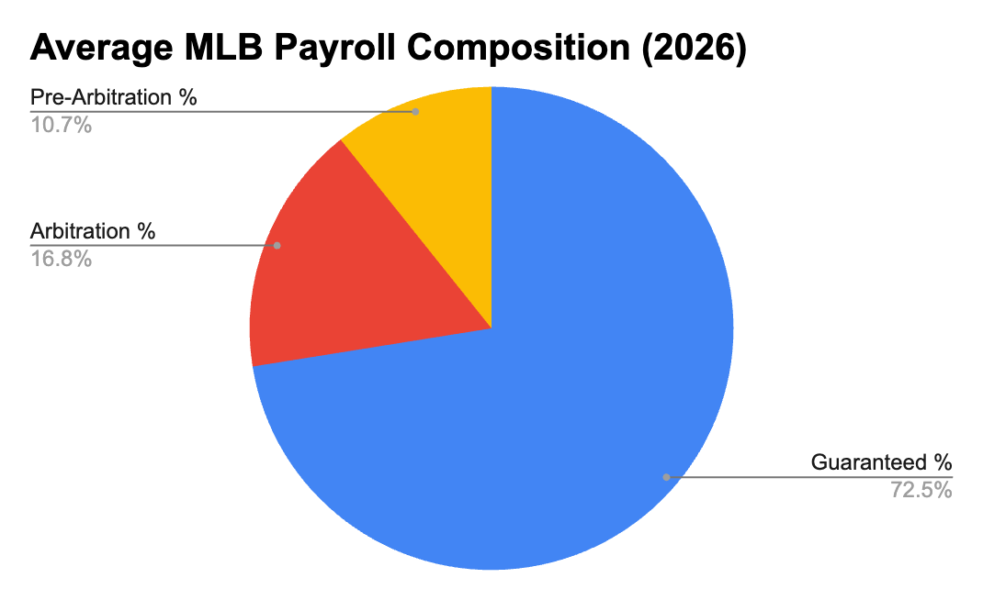
Why This Matters?
MLB arbitration affects millions in payroll decisions. Teams and players argue using performance metrics, but which metrics influence first-year salaries?

Slide 3
Data
Component | Source
Arbitration Salaries | Spotrac
Pitching Performance | Statcast
Sample | Arbitration 1 + Super Two SP
Years | 2016-2026
Observations | 124

Slide 4
Descriptive Statistics
Variable | Mean | SD | Min | Max
Salary | $2.89M | $1.09M | $0.88M | $7.25M
IP | 132 | 43 | 51 | 232
K% | 22.8 | 4.81 | 12.6 | 35.6
BB% | 7.6 | 1.8 | 3 | 13.5
ERA | 3.96 | 0.97 | 1.78 | 6.73
Salary distributions are heavily right-skewed, motivating a logarithmic specification

Slide 5
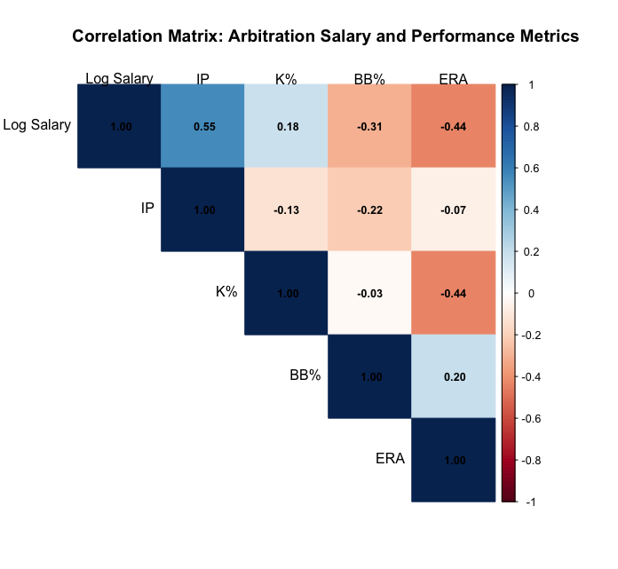
Correlation Heatmap
Innings Pitched and Log Salary exhibit the strongest positive relationship

Slide 6
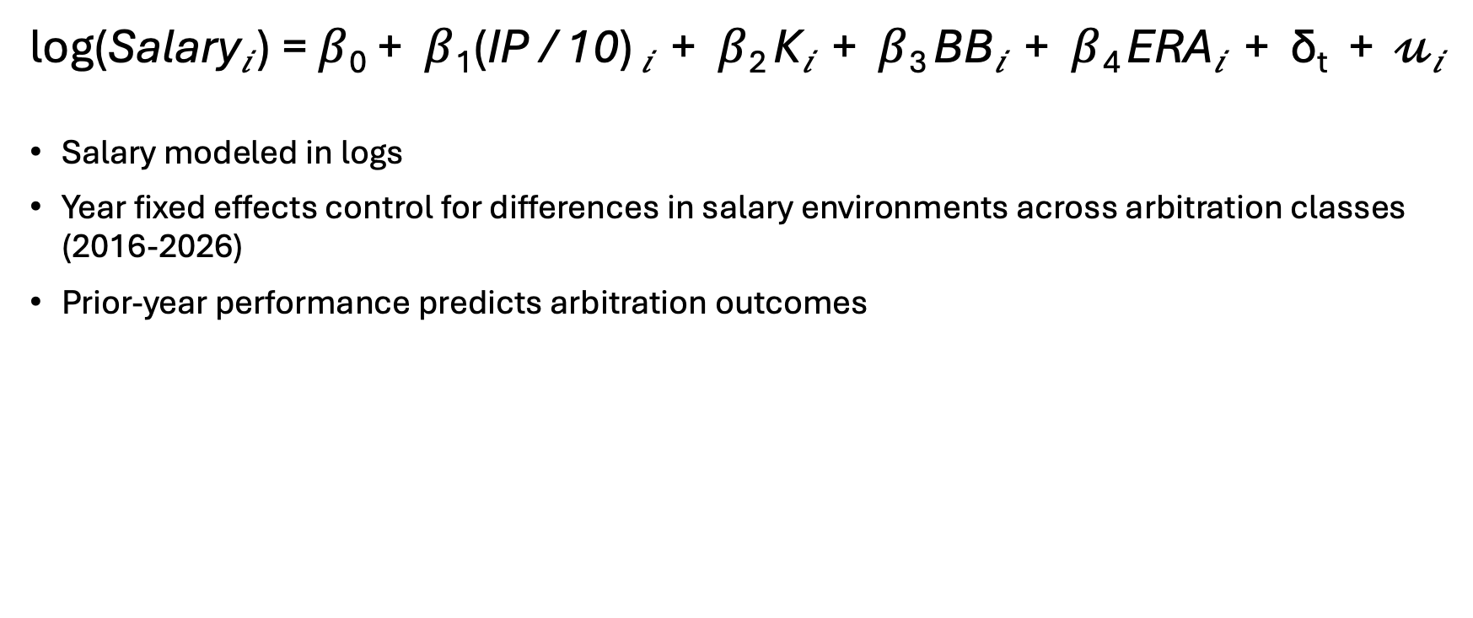
Model Specification
log(Salary_{𝑖} ) = $β$₀ + $β$₁(IP / 10) _{𝑖} + $β$₂ K_{𝑖} + $β$₃ BB_{𝑖} + $β$₄ ERA_{𝑖} + δ_{t} + 𝓊_{𝑖}
Salary modeled in logs
Year fixed effects control for differences in salary environments across arbitration classes (2016-2026)
Prior-year performance predicts arbitration outcomes

Slide 7
Results
Adjusted R² = .56
N = 124
Variable | Effect | p-value
IP (10 Innings) | +5.8% | < .001
K% | +1.05% | .055
BB% | -2.1% | .127
ERA | -11.2% | < .001

Slide 8
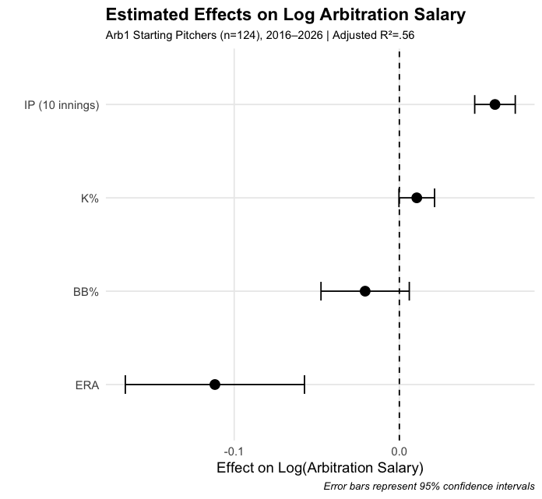
Coefficient Plot

Slide 9
Baseball Interpretation
Key Findings
Estimated average effects holding performance and season constant
Workload dominates
10 additional innings pitched → ~ 5.8% higher salary
ERA still matters
One-run ERA increase → ~ 11% lower salary
Strikeouts help
Moderate evidence
Walks appear less influential
Arbitration may reward traditional workload and run-prevention metrics more heavily than advanced indicators

Slide 10
Model Successes and Failures
Largest Underpredictions
Pitcher | Season | Predicted | Actual | Difference
Shane Bieber | 2022 | $2.65M | $6.0M | +$3.35M
Corbin Burnes | 2022 | $4.74M | $6.5M | +$1.76M
Hunter Brown | 2023 | $4.35M | $5.71M | +$1.36M
Interpretation
The largest underpredictions occur among elite pitchers, suggesting arbitration awards may incorporate factors not fully captured by traditional performance metrics

Slide 11
Model Successes and Failures
Largest Overpredictions
Pitcher | Season | Predicted | Actual | Difference
Michael King | 2023 | $2.09M | $1.3M | -$788K
Cal Quantrill | 2022 | $3.26M | $2.51 | -$752K
Interpretation
Performance metrics alone may not capture role or context

Slide 12
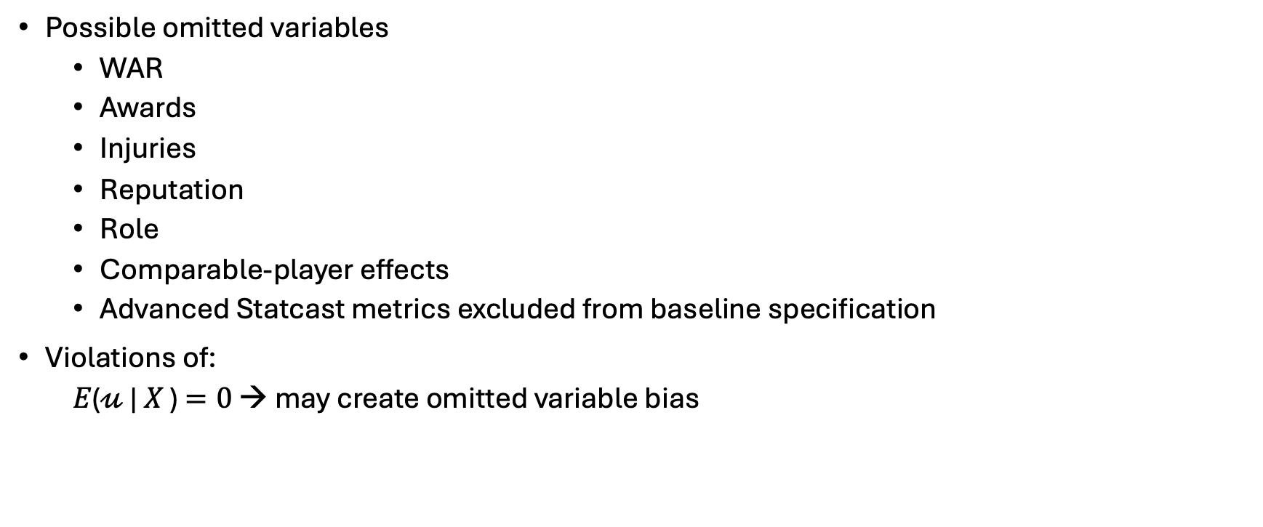
Limitations
Possible omitted variables
WAR
Awards
Injuries
Reputation
Role
Comparable-player effects
Advanced Statcast metrics excluded from baseline specification
Violations of:
𝛦(𝓊 | 𝛸 ) $=0$ → may create omitted variable bias

Slide 13
Conclusion
Workload and run prevention significantly influence first-year arbitration salaries
Arbitration appears to reward traditional performance outcomes, although advanced contact-quality metrics also demonstrate predictive value
Elite pitchers may receive premiums beyond measurable performance characteristics

Slide 14
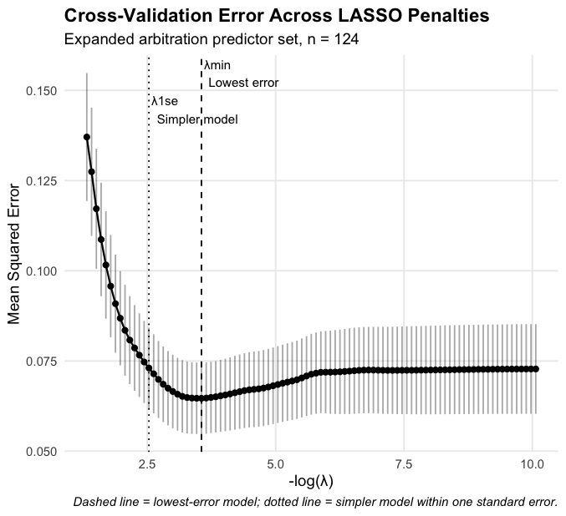
LASSO Extension
Takeaways
Cross-Validation used to select the penalty parameter (λ)
Simplest model within one standard error retained:
Quality Starts
xwOBA
Barrel Rate
RMSE = .239 (vs. .231 for OLS)
LASSO emphasized workload outcomes and contact-quality measures while shrinking traditional rate statistics toward zero

