Slide 1
Introduce
Lecturers: Phan Gia Phuoc
Group name
Le Cong Hoi
Nguyen Hoang Nhut Lam
Phan Phuong Phat
Present contents
Software Testing DMS

Slide 2
Presentation sequence
Work assignment
Introduction of DMS . Software
How to use the software
Software interface
Defect AddNew
Attachment
List defects
defect view or edit
Batch Update
Export
TestCase
Run check TestCase
Priority

Slide 3
Work assignment
Work Assignment
Numerical | FullName | Work Content | Start day | End day | Finished itemLevel
1 | Nguyen Hoang Nhut Lam, Le Cong Hoi, Phan Phuong Phat | Learn about DMS . Software | 05/04/2023 | 05/04/2023 | 100%
2 | Nguyen Hoang Nhut Lam, Phan Phuong Phat | Write TestCase defect screen AddNew | 05/04/2023 | 05/04/2023 | 90%
3 | Le Cong Hoi | Write TestCase Screen Attachment | 05/04/2023 | 05/04/2023 | 90%
4 | Nguyen Hoang Nhut Lam, Le Cong Hoi, Phan Phuong Phat | Write TestCase and screen list defects | 12/04/2023 | 12/04/2023 | 90%
5 | Nguyen Hoang Nhut Lam, Le Cong Hoi, Phan Phuong Phat | Write TestCase for defect view or edit screen | 12/04/2023 | 12/04/2023 | 90%
6 | Nguyen Hoang Nhut Lam, Phan Phuong Phat | Write TestCase for Bacth Update screen | 19/04/2023 | 19/04/2023 | 90%
7 | Le Cong Hoi | Write TestCase Screen Export | 19/04/2023 | 19/04/2023 | 90%

Slide 4

Software IntroductionDMS
A defect management system is a piece of software used to register, track, and manage bugs or errors during software development. This system allows development team members to update information about bugs, assign priority to bugs, monitor the resolution process, and check if bugs have been successfully fixed.

Slide 5
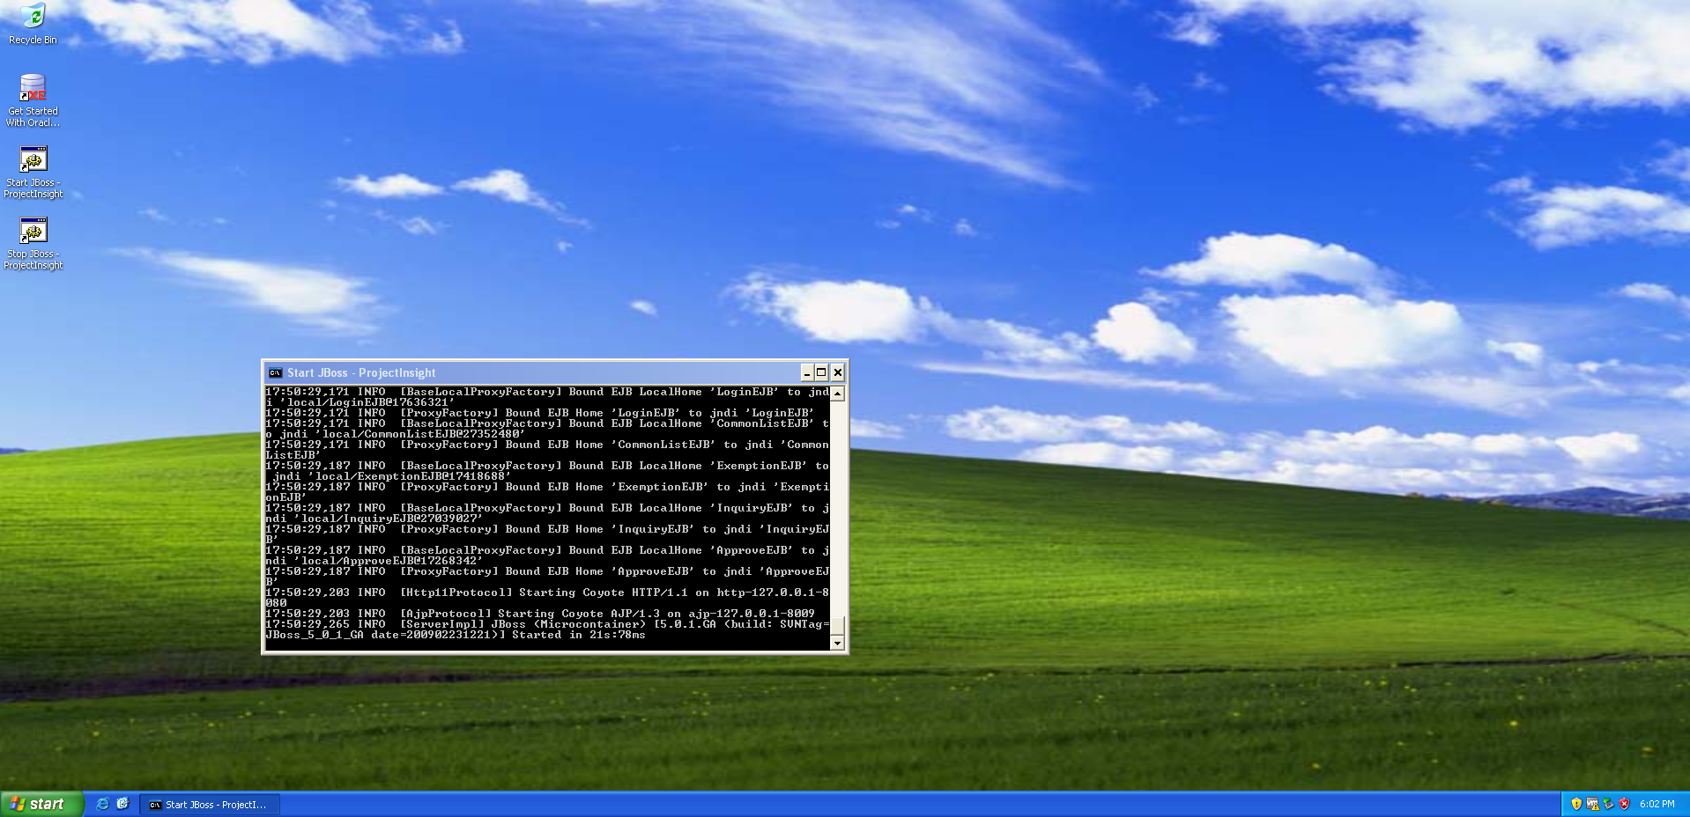
How to use the software

Slide 6
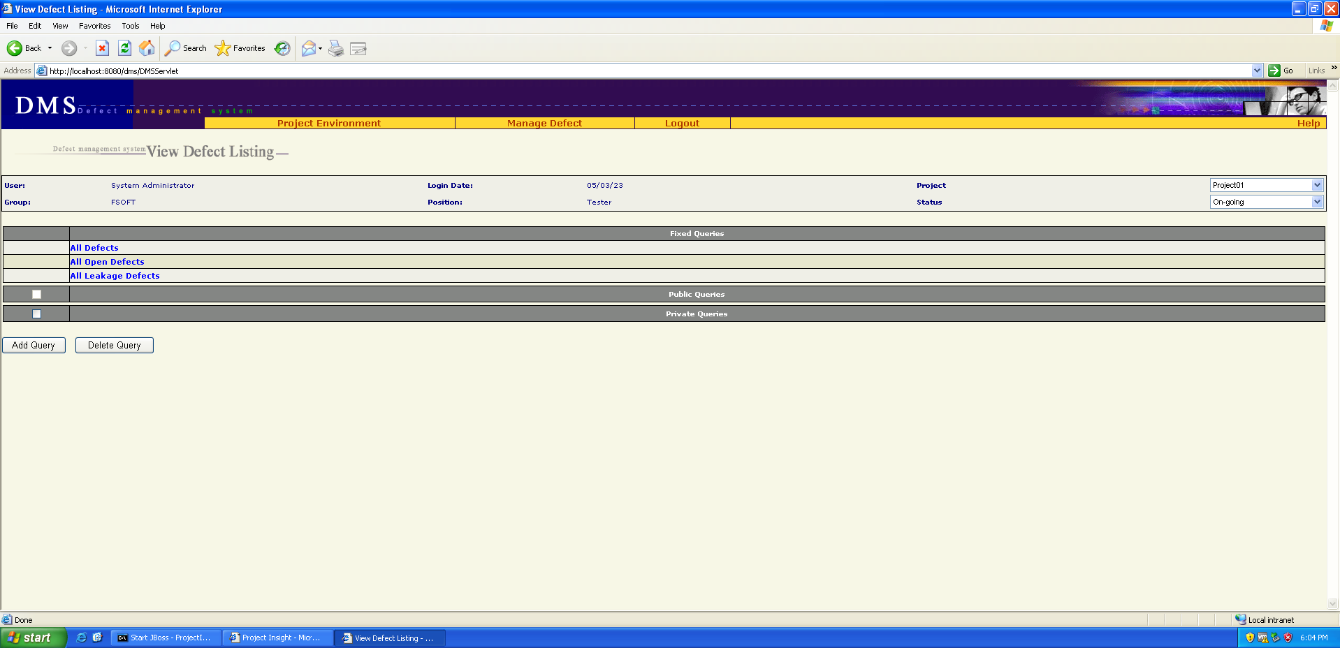
Software Interface

Slide 7
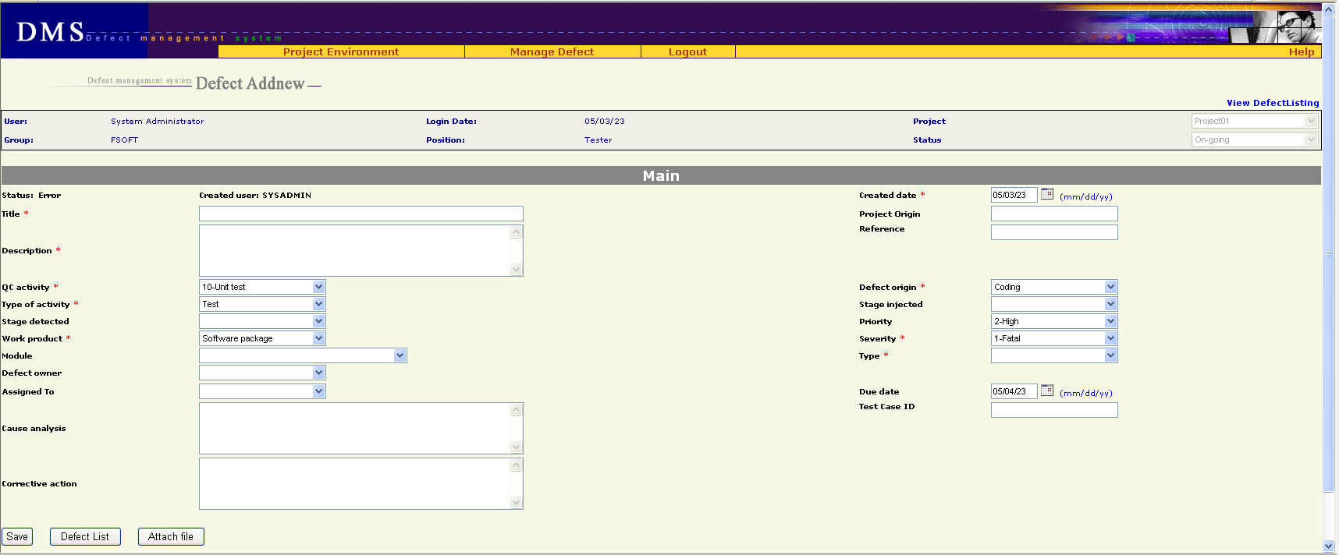
Defect addNew

Slide 8
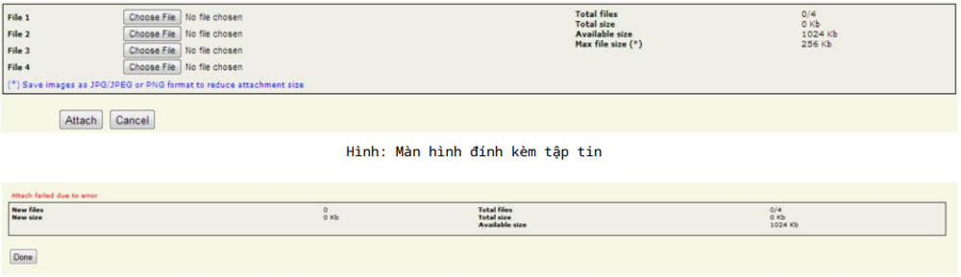
Attachment

Slide 9
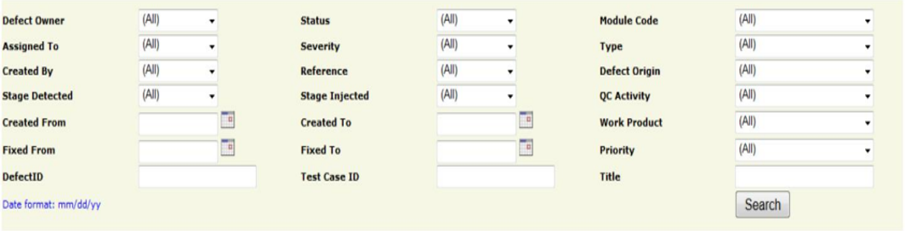
List defects

Slide 10
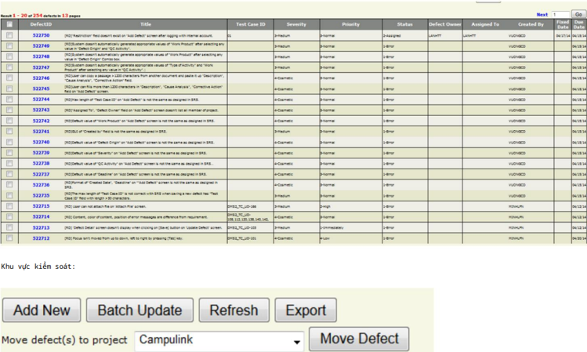
List defects

Slide 11
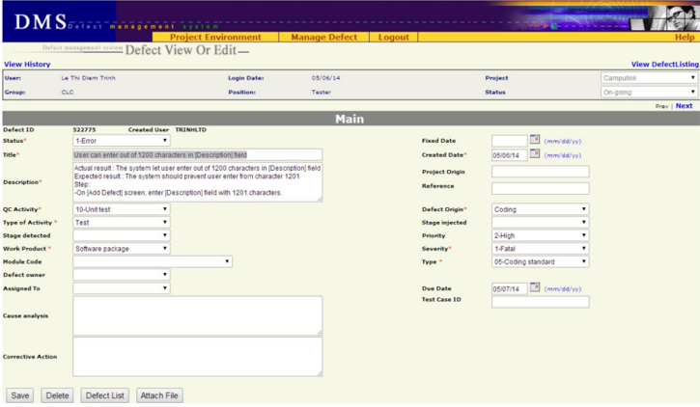
Defect view or edit

Slide 12
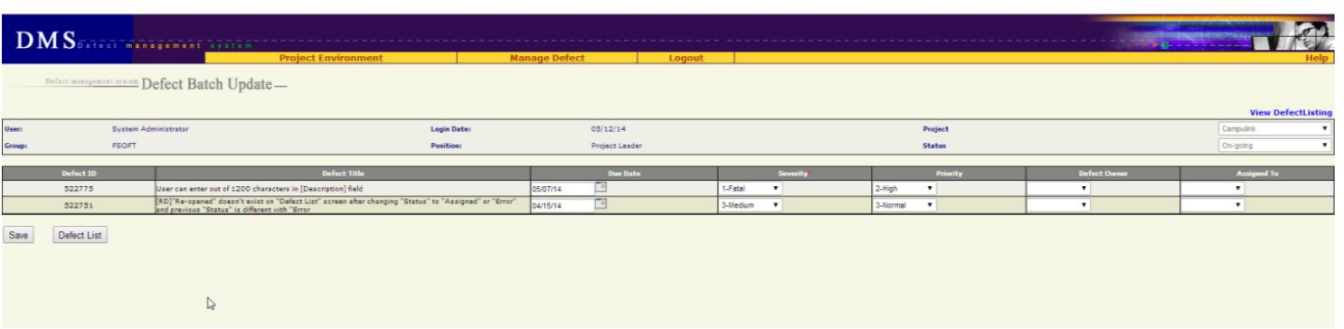
Batch Update

Slide 13
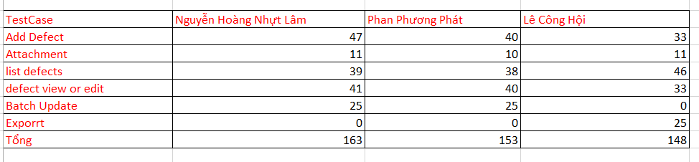
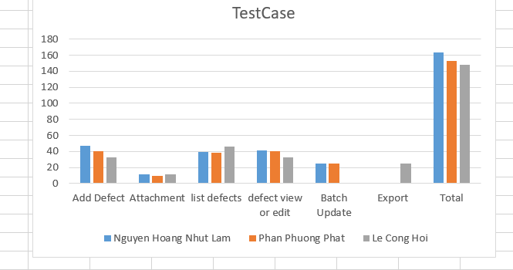
TestCase

Slide 14
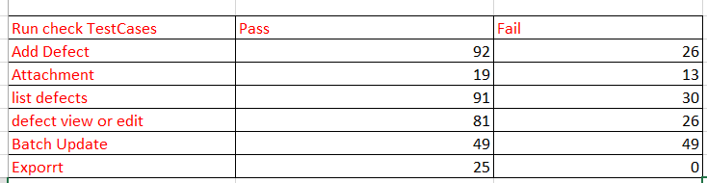
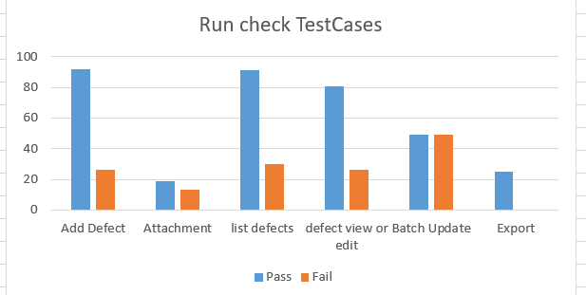
Run Check TestCase

Slide 15
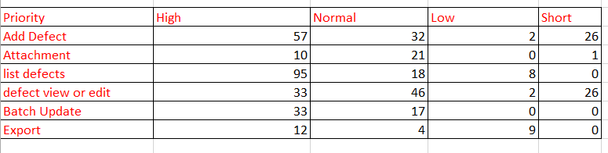
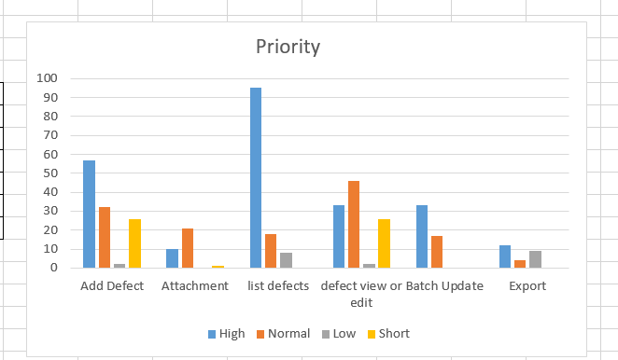
Priority

Slide 16
Thank you teacher and friends for listening

