Slide 1
NoSQL
Lam Le Software Engineer
05/22/2016

Slide 2
Agenda
I. | RDBMS | 06
II. | NoSQL | 10
III. | NoSQL Storage Types | 28
IV. | MongoDB | 42

Slide 3
Assessment Disciplines
Class Participation: 30%
Final Exam: 70%
Passing Scores: 70%

Slide 4
Duration and Course Timetable
Course Duration: 9 hrs

Slide 5
RDBMS

Slide 6
RDBMS
Data organized by tables, records and columns
Have relationship between tables
Use SQL to manipulate data
Mainly used in businesses

Slide 7
RDBMS advantages
Understandable data structure
Data Manipulation Language : SQL
Avoid anomalies data
Support multi user

Slide 8
RDBMS limitations
Issues with scaling
Performance
Development time
Complexity
Relational databases were not designed to cope new challenges, storage and processing power available today.

Slide 9
NoSQL

Slide 10
What is NoSQL?
A wide variety of different database technologies support
-massive volumes
-fast development
-high scalability
-reduce cost
The name NoSQL stands for Not Only SQL

Slide 11
NoSQL Characteristics
Large data volumes
Scalable
Queries return answers quickly
Mostly query, few updates
Asynchronous Inserts & Updates
Schema-less
Adopt CAP Theorem
Refuse ACID (RDBMS) – Adopt base BASE properties

Slide 12
CAP Theorem
Consistency: each client always has the same view of the data.
Availability: all clients can always read and write.
Partition Tolerance: system continues to function even if there is a no communications between two nodes .
CAP Theorem state states that it is impossible for a distributed computer system to simultaneously provide all three of the above guarantees

Slide 13
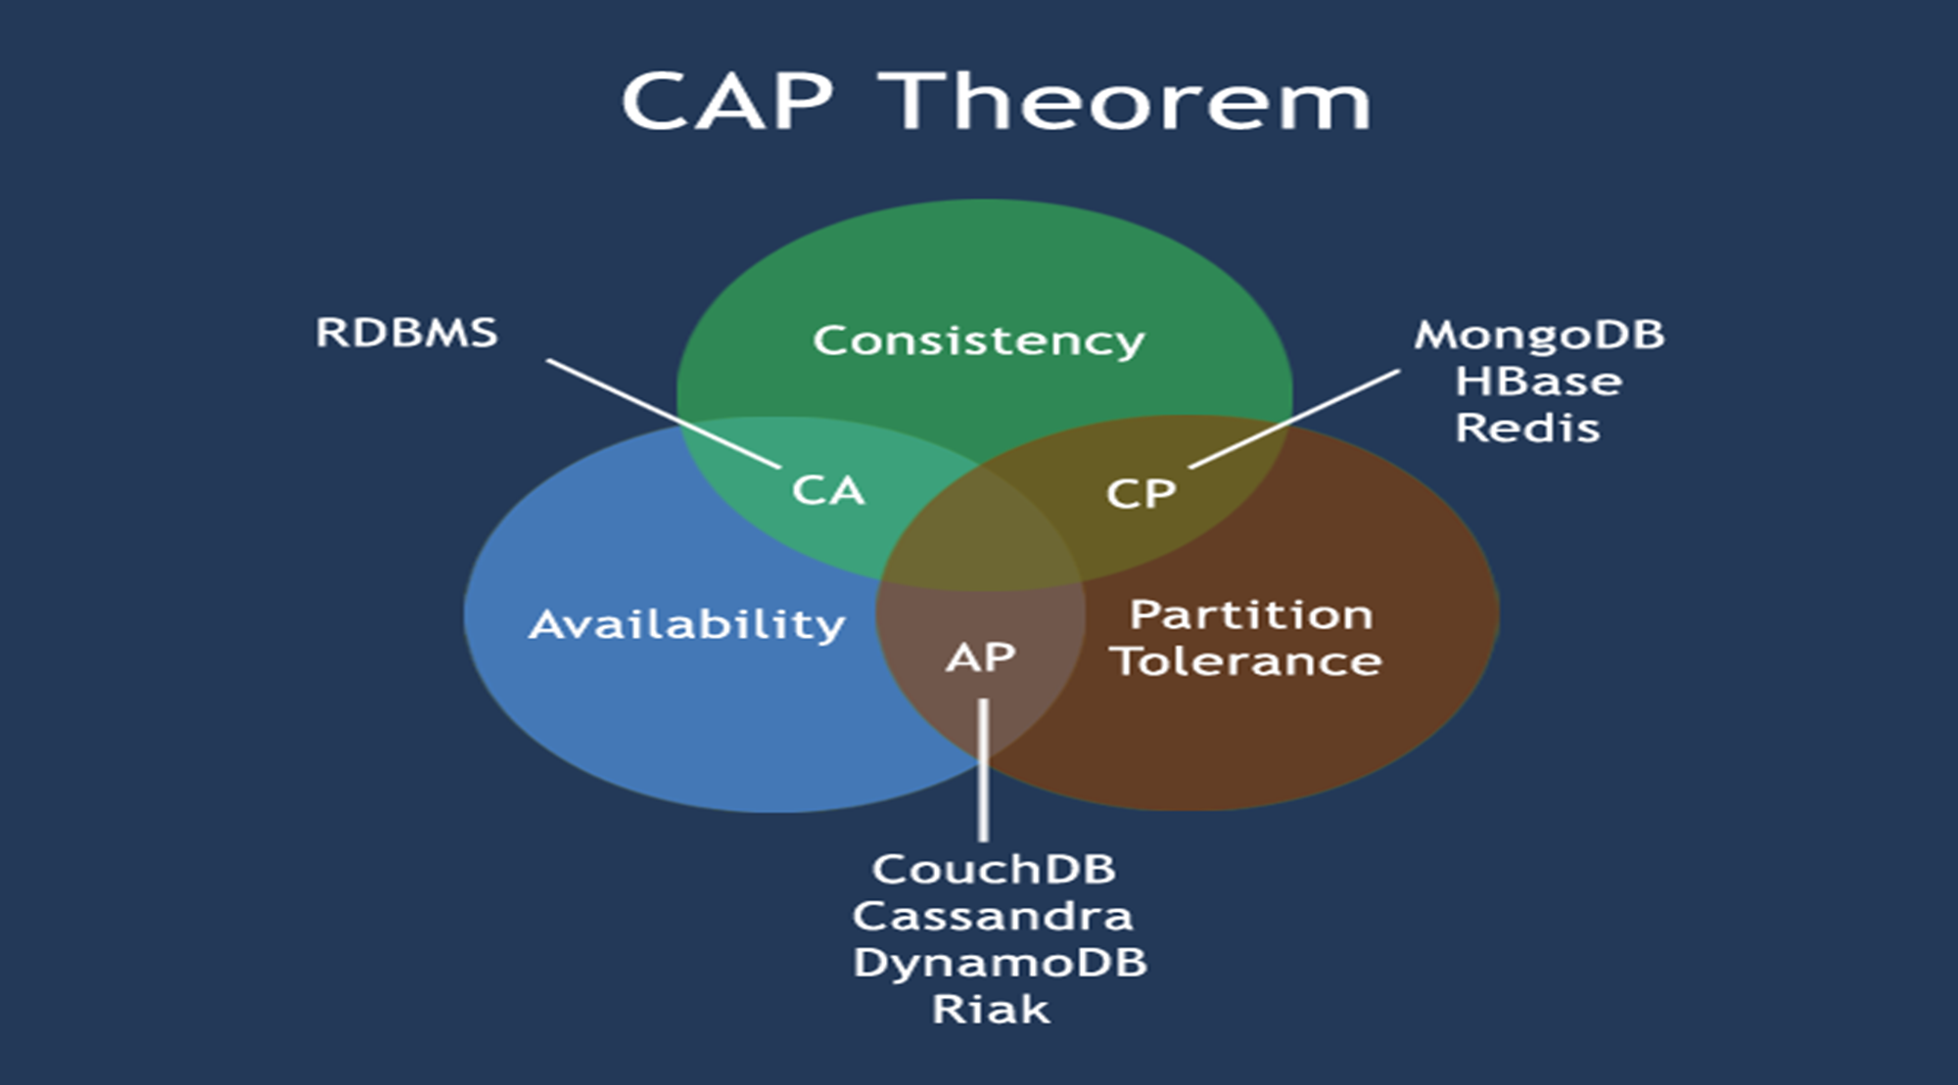
CAP Theorem

Slide 14
ACID
Atomicity: In a transaction involving two or more discrete pieces of information, either all of the pieces are committed or none are.
Consistency: A transaction either creates a new and valid state of data, or, if any failure occurs, returns all data to its state before the transaction was started.
Isolation: A transaction in process and not yet committed must remain isolated from any other transaction.
Durability: Committed data is saved by the system such that, even in the event of a failure and system restart, the data is available in its correct state

Slide 15
BASE
Basic availability: Each request is guaranteed a response—successful or failed execution.
Soft state: The state of the system may change over time, at times without any input (for eventual consistency).
Eventual consistency: The database may be momentarily inconsistent but will be consistent eventually.

Slide 16
NoSQL Storage Types

Slide 17
JSON
JSON stands for JavaScript Object Notation
JSON is a lightweight data-interchange format
JSON is language independent *

Slide 18
Why JSON?
It is used while writing JavaScript based applications that includes browser extensions and websites.
JSON format is used for serializing and transmitting structured data over network connection.
It is primarily used to transmit data between a server and web applications.
Web services and APIs use JSON format to provide public data.
It can be used with modern programming languages.

Slide 19
JSON Syntax
It includes the following
Data is represented in name/value pairs.
Curly braces hold objects and each name is followed by ':'(colon), the name/value pairs are separated by , (comma).
Square brackets hold arrays and values are separated by ,(comma).
JSON supports the following two data structures
Collection of name/value pairs − This Data Structure is supported by different programming languages.
Ordered list of values − It includes array, list, vector or sequence etc.

Slide 20
JSON Data Types
Number | double- precision floating-point format in JavaScript
String | double-quoted Unicode with backslash escaping
Boolean | true or false
Array | an ordered sequence of values
Value | it can be a string, a number, true or false, null etc
Object | an unordered collection of key:value pairs
Whitespace | can be used between any pair of tokens
null | empty

Slide 21
JSON Schema
JSON Schema is a specification for JSON based format for defining the structure of JSON data
Describes your existing data format.
Clear, human- and machine-readable documentation.
Complete structural validation, useful for automated testing.
Complete structural validation, validating client-submitted data.

Slide 22
Storage types
Column-oriented
Document Store
Key Value Store
Graph

Slide 23
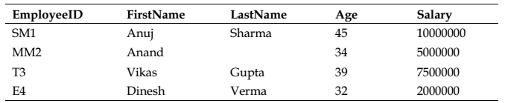

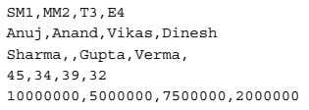
Column-oriented databases
Row-Oriented
Column-Oriented

Slide 24
Column-oriented databases
Apache Hbase
MonetDB
Amazon Redshift
Google Datastore

Slide 25
Document-oriented database
Can model more complex objects
Data model: collection of documents
Document: Using XML, JSON, BSON, or YAML, other semi-structured formats.

Slide 26
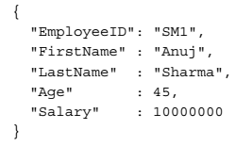
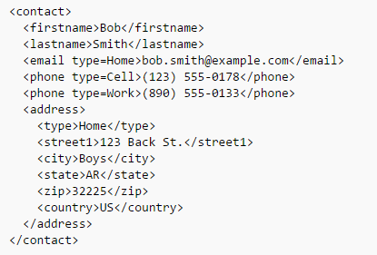
Document-oriented database

Slide 27
Document-oriented database
MongoDB
CouchDB
Apache Cassandra
Terrastore

Slide 28
Key-value store databases
Closely related to a document store
Focus on scaling to huge amounts of data
Designed to handle massive load
Based on Amazon’s dynamo paper
Data model: (global) collection of Key-value pairs
Dynamo ring partitioning and replication

Slide 29
Key-value store databases
Redis
DynamoDB
LevelDB
BerkeleyDB
Memcached
Riak

Slide 30
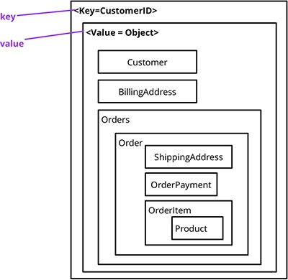
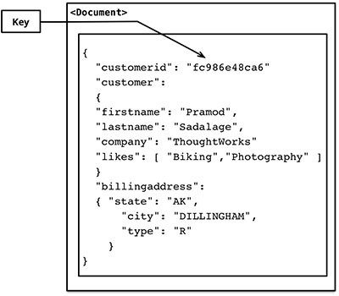
Key-value store databases

Slide 31
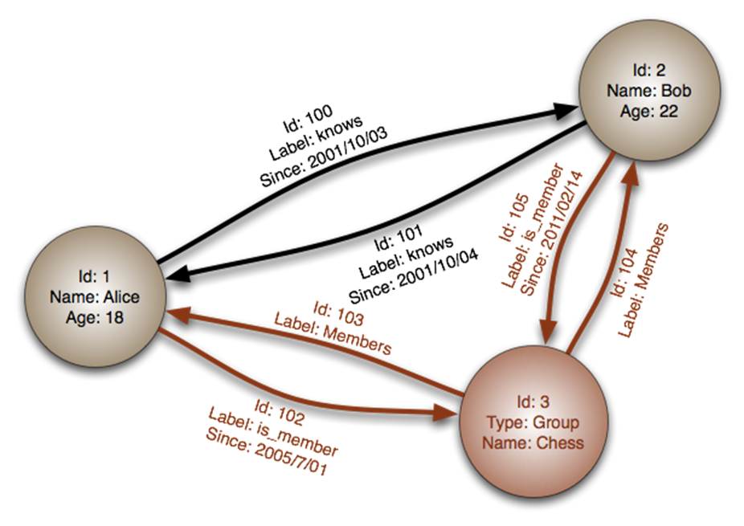
Graph store databases
A special category of NoSQL databases where relationships are represented as graphs

Slide 32
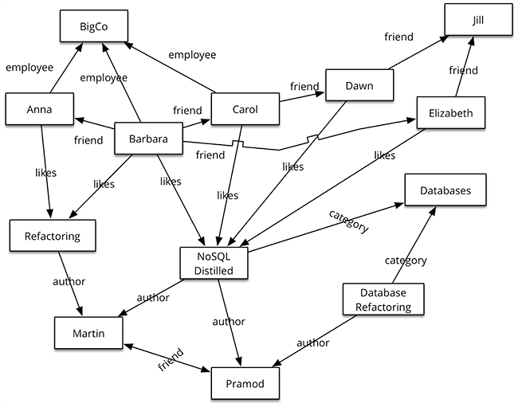
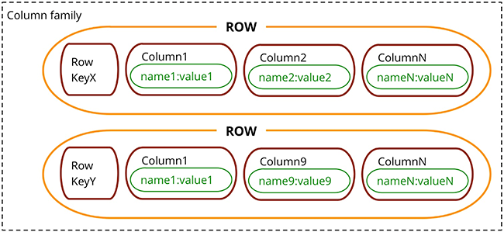
Graph store databases

Slide 33
Graph store databases
Neo4j
FlockDB

Slide 34
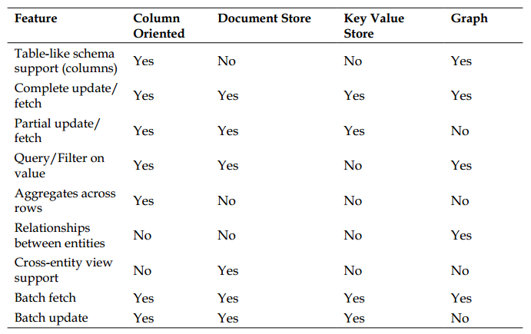
Comparing the models

Slide 35
MongoDB
Client Logo

Slide 36
What is MongoDB?
MongoDB is a scalable, high-performance, open source, schema-free, document-oriented database

Slide 37
MongoDB Philosophy
Create a database that worked with documents rather than rows and that was blindingly fast, massively scalable, and easy to use.
MongoDB is a perfect fit for resolving, such as analytics and complex data structures.
There should always be more than one copy of the database (Horizontal scaling).

Slide 38









Who's using MongoDB?
Education
Financial Services

Slide 39








Who's using MongoDB?
Government

Slide 40








Who's using MongoDB?
Healthcare

Slide 41








Who's using MongoDB?
Media and Entertainment

Slide 42





Who's using MongoDB?
Retail

Slide 43









Who's using MongoDB?
Technology

Slide 44








Who's using MongoDB?
Telecommunications
Travel and Hospitality

Slide 45
MongoDB’s features
Using Document-Oriented Storage (BSON)
BSON is an open standard
BSON is a binary form of JSON
BSON is much easier to traverse and index very quickly
BSON is easy and quick to convert BSON to a programming language’s native data format
BSON also provides some extensions to JSON (store binary data)

Slide 46
MongoDB’s features
Supporting Dynamic Queries
Compare to CouchDB
Indexing Your Documents
Leveraging Geospatial Indexes
Profiling Queries
Updating Information In-Place
MongoDB can update the data wherever it happens to be
Storing Binary Data
GridFS is MongoDB’s solution to storing binary data in the database
Replicating Data
MongoDB provided a safety net with a feature called “replica sets”

Slide 47
MongoDB’s features
Implementing Sharding
“auto-sharding” is one of MongoDB’s most significant and oft-used features
Using Map and Reduce Functions
The MongoDB Aggregation Framework

Slide 48
Data Model

Slide 49
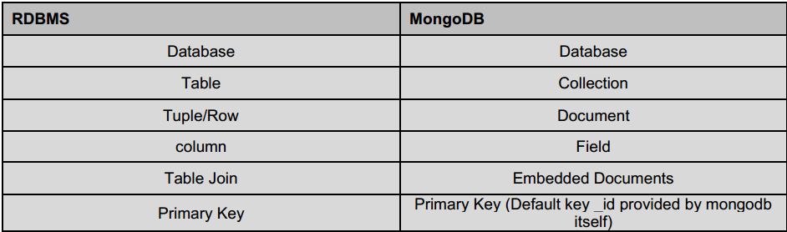
RDBMS vs MongoDB

Slide 50
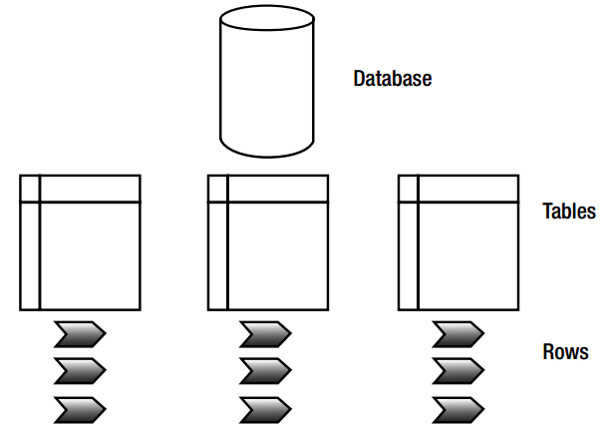
Relational database model

Slide 51
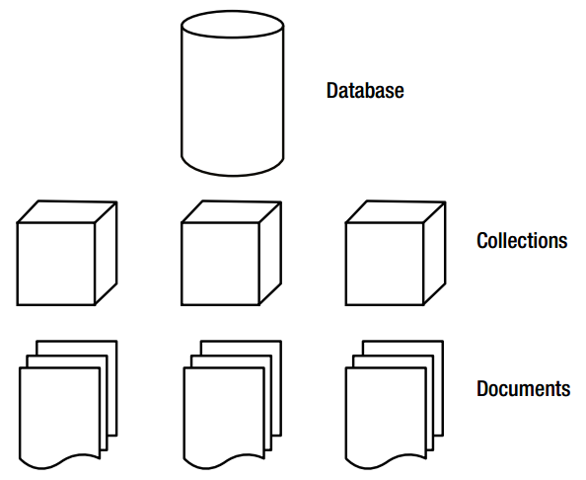
MongoDB database model

Slide 52
Database
Database is a physical container for collections.
MongoDB server typically has multiple databases

Slide 53
Collection
Collection is a group of MongoDB documents
A collection exists within a single database
Collections do not enforce a schema
Documents within a collection can have different fields
All documents in a collection are of similar or related purpose

Slide 54
Document
A document is a set of key-value pairs
Documents have dynamic schema

Slide 55
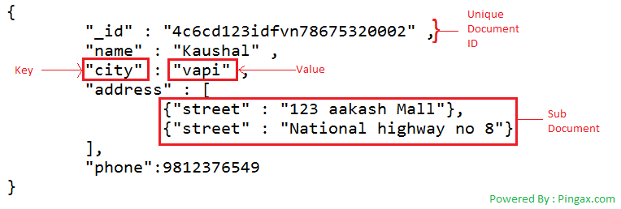
Sample Data

Slide 56
Design schema in MongoDB
One: favor embedding unless there is a compelling reason not to
Two: needing to access an object on its own is a compelling reason not to embed it
Three: arrays should not grow without bound.
Four: don’t be afraid of application-level joins:
Five: consider the write/read ratio.
Six: how you model your data depends – entirely – on your particular application’s data access patterns.

Slide 57
CRUD
Create
db.collection.insert( <document> )
db.collection.save( <document> )
db.collection.update( <query>, <update>, { upsert: true } )
Read
db.collection.find( <query>, <projection> )
db.collection.findOne( <query>, <projection> )
Update
db.collection.update( <query>, <update>, <options> )
Delete
db.collection.remove( <query>, <justOne> )

Slide 58
Inserting a document
SQL
INSERT INTO t (fn, ln) VALUES ('John', 'Doe')
MongoDB
db.t.insert({fn:'John', ln: 'Doe'})

Slide 59
Updating a document
SQL
UPDATE t SET ln='Smith' WHERE ln='Doe'
MongoDB
db.t.update({ln:'Doe'},{$set:{ln:'Smith'}})

Slide 60
Removing documents
SQL
DELETE FROM t WHERE fn='John'
MongoDB
db.t.remove({fn:'John'})

Slide 61
Dropping a collection
SQL
DROP TABLE t
MongoDB
db.t.drop()

Slide 62
Selecting all documents
SQL
SELECT * FROM t
SELECT id, name FROM t
MongoDB
db.t.find()
db.t.find({},{name:1})

Slide 63
Specifying a “WHERE” clause
SQL
SELECT * FROM t WHERE fn='John‘
SELECT id, age FROM t WHERE fn='John' AND ln='Smith'
MongoDB
db.t.find({ln:'John'})
db.t.find({fn:'John',ln:'Smith'},{age:1})

Slide 64
Counting
SQL
SELECT COUNT(*) FROM t WHERE country='US'
MongoDB
db.t.count({country:'US'})

Slide 65
Aggregation
“Means” GROUP BY, SUM(), …
2 ways to aggregate
Map-Reduce
Aggregation Framework

Slide 66
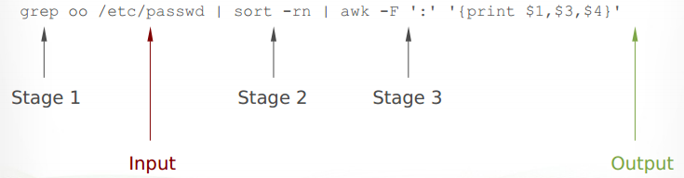
Aggregation Framework (AF)
Available from MongoDB 2.2
Easier and faster than Map-Reduce
Some limitations
AF is perfect for simple cases
Map-Reduce can be needed for complex situations
Documents are modified through pipelines

Slide 67
AF Sample
SQL
SELECT fn,count(*) AS total FROM people
WHERE fn >= 'M%' GROUP BY fn
MongoDB
db.people.aggregate({$match:{fn:{$gte:'M'}}},
{$group: {_id:"$fn",total:{$sum:1}}})

Slide 68
Other operators
$sort
{$sort: {total: -1}}
$limit
{$limit: 10}
$skip
{$skip: 100}
$unwind
Splits a document with an array into multiple documents

Slide 69
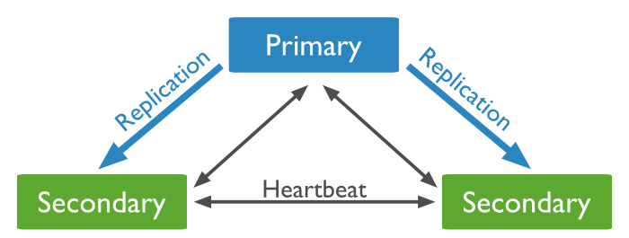
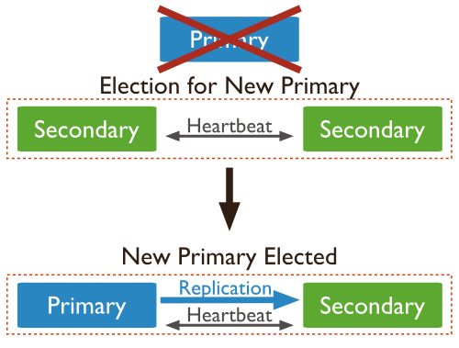
MongoDB Replication
Replication is the process of synchronizing data across multiple servers.
Replication provides redundancy and increases data high availability.

Slide 70
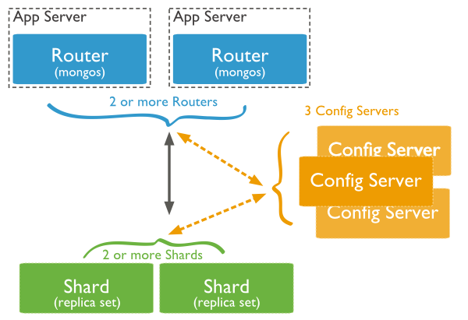
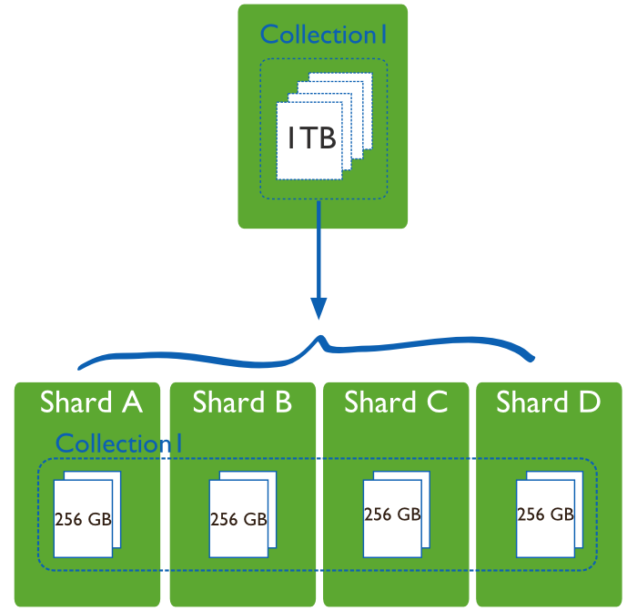
MongoDB Sharding (Horizontal scaling)
Sharding is a method for storing data across multiple machines
When HDD, CPU or RAM limits are reached.

Slide 71
Q&A
Client Logo

Slide 72
Thank you
Client Logo

Slide 73
Revision History
Date | Version | Description | Updated by | Reviewed and Approved By
11/11/2015 | 1.0 | Initial document | Kien Tran
12/1/2015 | 1.1 | Adding Sections : Introduction to XML Introduction to JSON | Phu Nguyen

Slide 74


