Slide 1
Spring Core
Kien Tran Principal Software Engineer
12/05/2015
Client Logo

Slide 2
Introduction
Your role
Your background and experience in the subject
What do you want from this course

Slide 3
Course Objectives
At the end of the course, you will have acquired sufficient knowledge to:
perform objective 1
perform objective 2

Slide 4
Agenda
I. | Introduction | xx
II. | Features of Spring | xx
III. | Spring Framework Architecture | xx
IV. | Inversion of Control in Spring | xx
V. | Spring Bean | xx
VI. | Using Spring Annotations | xx

Slide 5
Course Audience and Prerequisite
The course is for <whom>
The following are prerequisites to <course>:
<knowledge>
<experiences>
<course>
…

Slide 6
Assessment Disciplines
Mini Test: 30%
Final Exam: 70%
Passing Scores: 70%

Slide 7
Duration and Course Timetable
Course Duration: <hrs>
Course Timetable:
From <time> to <time>
Break <x> minutes from <time> to <time>

Slide 8
Further References
<Source 1>
<Source 2>
…

Slide 9
Set Up Environment
To complete the course, your PC must install:
Software 1
Software 2
…

Slide 10
Course Administration
In order to complete the course you must:
Sign in the Class Attendance List
Participate in the course
Provide your feedback in the End of Course Evaluation

Slide 11
Introduction

Slide 12

What is Spring Framework ?
The Spring Framework is an open source application framework created to simplify the development of enterprise Java software.
The framework provides developers with a component model and a set of simplified and consistent APIs that effectively insulate developers from the complexity and error-prone boilerplate code required to create complex applications.

Slide 13
Why use it?
Quality:
High-quality open source software
Well-designed web MVC framework
Modularity
About 20 modules, giving developers the freedom to choose
Using existing technologies, also other frameworks
Promotes best practices
Develop enterprise-class applications using POJOs
Modest learning curve
Consistency and simplicity of the APIs
Hundreds of resources online
Popularity
Myriad publications, websites, and job postings

Slide 14
Features of Spring

Slide 15
Features of Spring
Lightweight framework
Reducing complexity in application code
Don't have a high startup time
Don't involve huge binary dependencies

Slide 16

Features of Spring
Inversion of Control (IoC)
Providing an implementation for IoC supporting injection

Slide 17
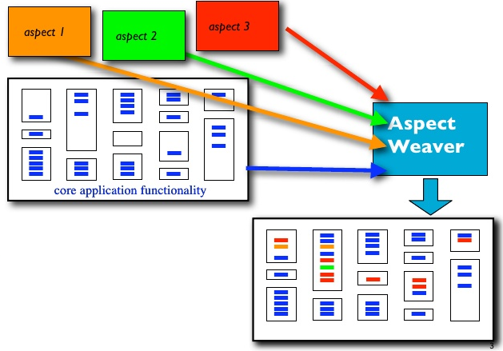
Features of Spring
Aspect-oriented Programming (AOP)
Isolates supporting functions from the main program's business logic
Other system concerns such as logging, security, auditing, locking…

Slide 18
Features of Spring
Spring MVC Framework
Building robust and maintainable web applications
Spring Security
Providing security mechanism for Spring-based applications
JDBC exception handling
Reducing the amount of boilerplate code in the exception handling

Slide 19


Other features of Spring
Spring Web Services

Slide 20
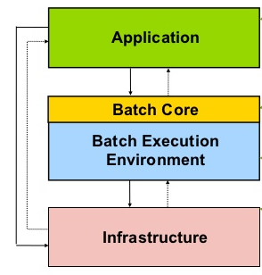
Other features of Spring
Spring Batch
Perform bulk operations on data

Slide 21






Other features of Spring
Spring Social
Integration into social-networking sites

Slide 22
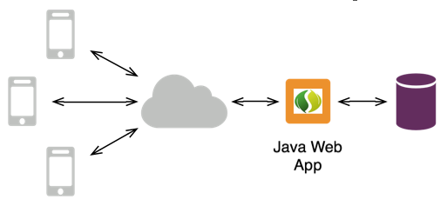
Other features of Spring
Spring Mobile
Develop mobile web applications

Slide 23
Spring Framework Architecture

Slide 24
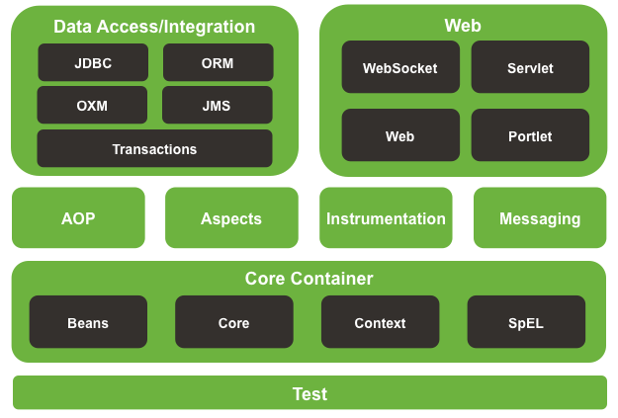
Spring Framework Architecture

Slide 25
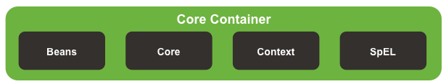
Spring Core Container
Core module
The most important component of the Spring Framework
Providing IoC and Dependency Injection
Beans module
Providing BeanFactory
Context module
ApplicationContext - loads Spring bean definitions and wires them together
Spring Expression Language (SpEL)
Providing powerful expression language supporting the features for querying and manipulating an object graph at runtime

Slide 26

The AOP module
Providing an AOP implementation
Spring integrates with AspectJ, which is an extension of AOP
The Spring Framework uses AOP for providing most of the infrastructure logic in it

Slide 27
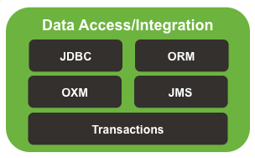
Data access/integration
JDBC module
Providing solution for various problems identified using JDBC
ORM module
Providing a high-level abstraction for ORM APIs, including JPA and Hibernate
OXM module
Supports Object/XML mapping, also integration with Castor, JAXB, XmlBeans, and the XStream framework.

Slide 28
Data access/integration
JMS module
Produce and consume messages
Java Message Oriented Middleware (MOM) API for sending messages between two or more clients.
Transaction module
Provides abstraction mechanism to supports programmatic and declarative transaction management for classes.

Slide 29
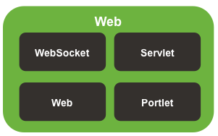
The Web module
Web module
Support for developing robust and maintainable web application in a simplified approach
Servlet module
Model-ViewController (MVC) implementation that helps to build enterprise web applications

Slide 30
The Web module
Struts module
Supports integration of Struts Web tier within a Spring application
Portlet module
Supports for easier development of web application using Spring with Portlet

Slide 31
The Test module
Helps to test applications developed using the Spring Framework
Using JUnit or TestNG, also helps in creating mock object to perform unit testing in isolation

Slide 32
Inversion of Control in Spring

Slide 33
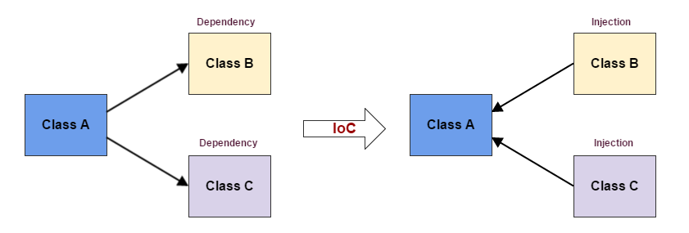
Understanding Inversion of Control
IoC is a programming technique in which object coupling is bound at runtime by an assembler object and is usually not known at compile time using static analysis
IoC is a more general concept, whereas DI is a concrete design pattern

Slide 34
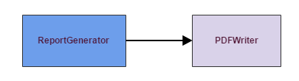
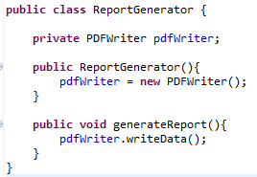



Understanding Inversion of Control

Slide 35
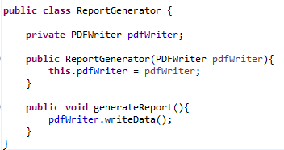
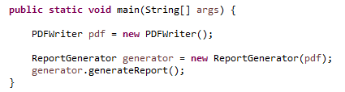
Understanding Inversion of Control
How about Excel/CSV or XML format or … ?

Slide 36
Understanding Inversion of Control
Each object is responsible for obtaining its own references to the objects it collaborates with (its dependencies)
Tight coupling
Hard-to-test code
Java components/classes should be as independent as possible.
Reusability
Flexibility
Testability

Slide 37
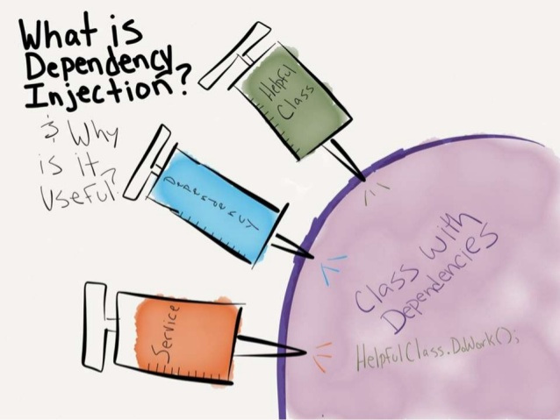
Dependency Injection
Dependency Injection (DI) is a design pattern in which an object's dependency is injected by the framework rather than by the object itself
The advantages of DI
Loosely coupled architecture.
Separation of responsibility.
Configuration and code are separate.
Improves testability.

Slide 38
Spring Bean

Slide 39
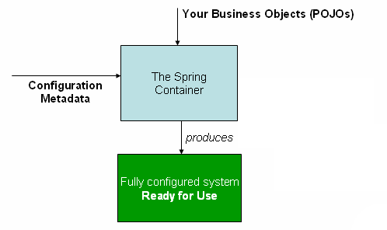
Beans
Beans are reusable software components that are managed by the Spring IoC container.

Slide 40
Spring Bean Configuration
There are following three important methods to provide configuration metadata to the Spring Container
XML based configuration file
Annotation-based configuration
Java-based configuration

Slide 41
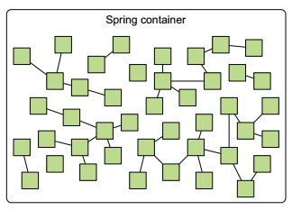
Spring Container
In a Spring application, objects are created, are wired together, and live in the Spring container.

Slide 42
Spring Container
Spring comes with several container implementations that can be categorized into two distinct types
Bean factories
Application contexts

Slide 43
Working with an application context
AnnotationConfigApplicationContext: Loads a Spring application context from one or more Java-based configuration classes
AnnotationConfigWebApplicationContext: Loads a Spring web application context from one or more Java-based configuration classes
ClassPathXmlApplicationContext: Loads a context definition from one or more XML files located in the classpath
FileSystemXmlApplicationContext: Loads a context definition from one or more XML files in the filesystem
XmlWebApplicationContext: Loads context definitions from one or more XML files contained in a web application

Slide 44
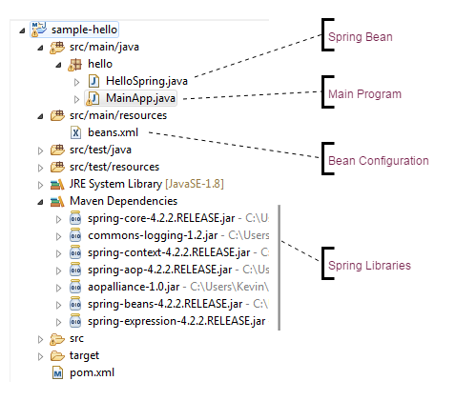
Sample Spring Application

Slide 45
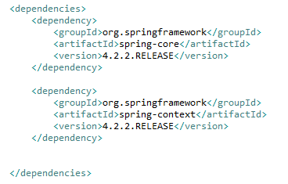
Sample Spring Application
Required Libraries

Slide 46
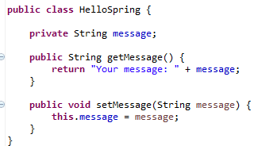
Sample Spring Application
POJO – Spring Bean

Slide 47
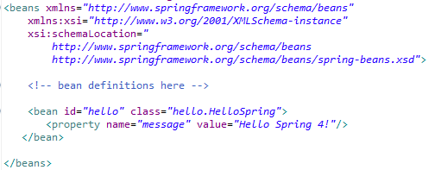
Sample Spring Application
Bean Configuration

Slide 48
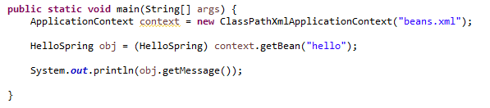
Sample Spring Application
Main Program

Slide 49
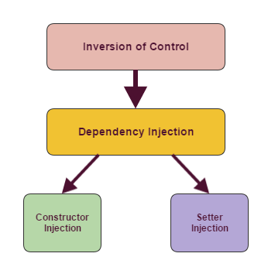
Dependency Injection in Spring

Slide 50
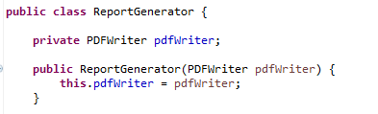
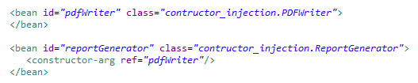
Spring Constructor-based Dependency Injection
The process of injecting the dependencies of an object through its constructor argument at the time of instantiating it.

Slide 51
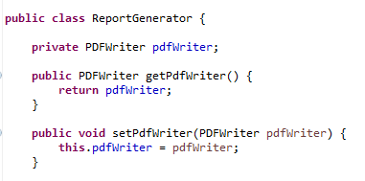
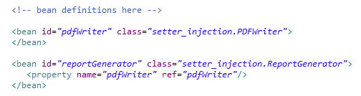
Spring Setter-based Dependency Injection
The method of injecting the dependencies of an object using the setter method

Slide 52
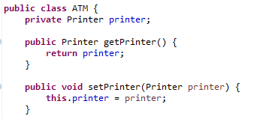
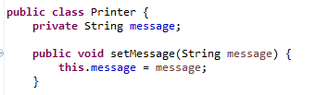
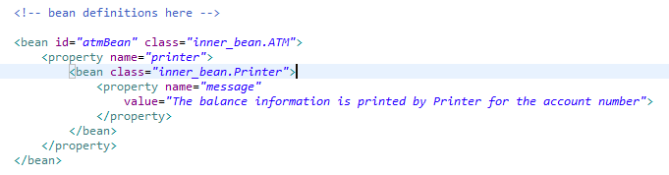
Injecting inner beans
Similar to the concept of inner classes in Java, it is also possible to define a bean inside another bean

Slide 53

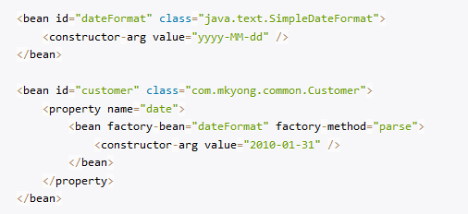
Injecting primary data types

Slide 54
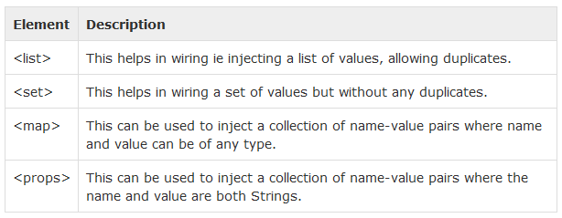
Injecting Collection

Slide 55
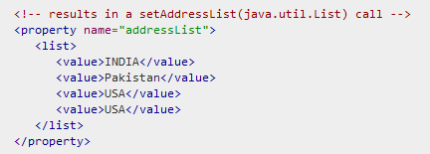
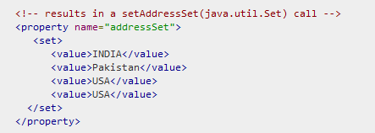
Injecting Collection
List
Set

Slide 56
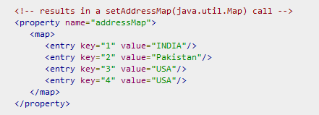
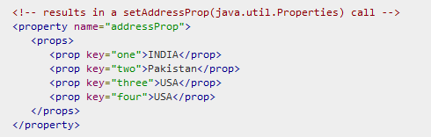
Injecting Collection
Map
Props

Slide 57
Autowiring in Spring
Spring container can automatically autowire relationships between collaborating beans by inspecting the contents of BeanFactory
Autowiring helps us reduce some of these configurations by intelligently guessing what the reference is.
Spring wires a bean's properties automatically by setting the autowire property on each <bean> tag that you want to autowire.

Slide 58
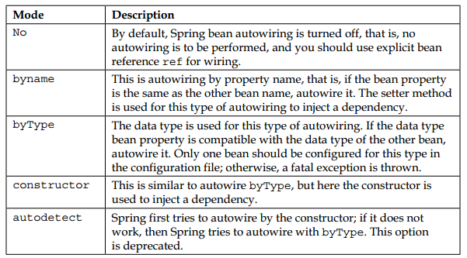
Autowiring modes

Slide 59
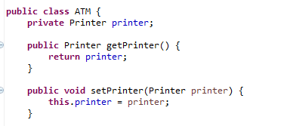
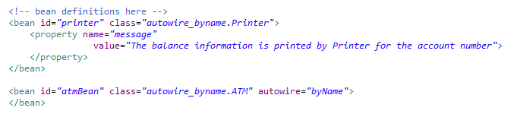
Spring Autowiring 'byName'

Slide 60
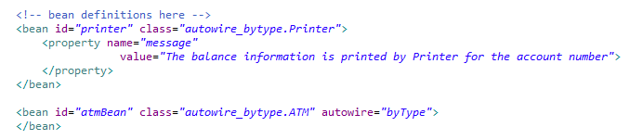
Spring Autowiring 'byType'

Slide 61
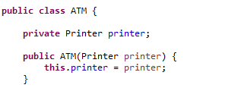
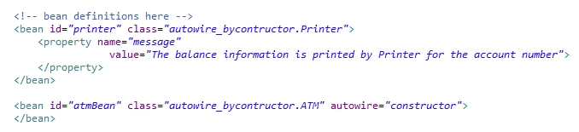
Spring Autowiring by Constructor

Slide 62
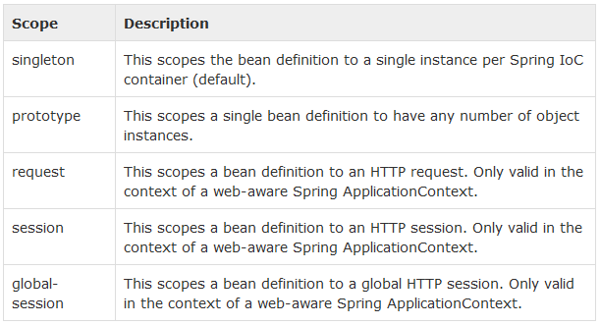
Bean's Scope

Slide 63
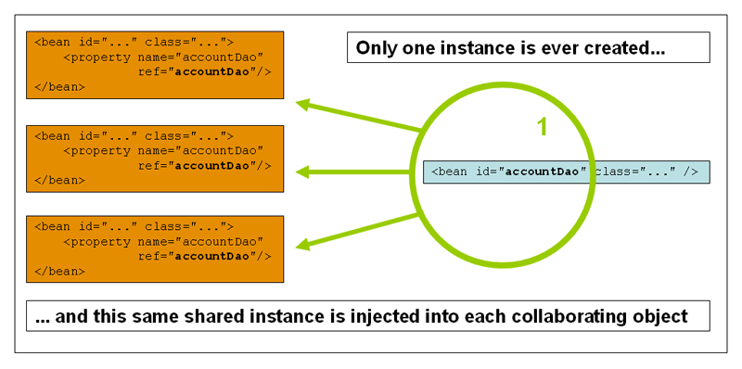

Singleton Scope

Slide 64
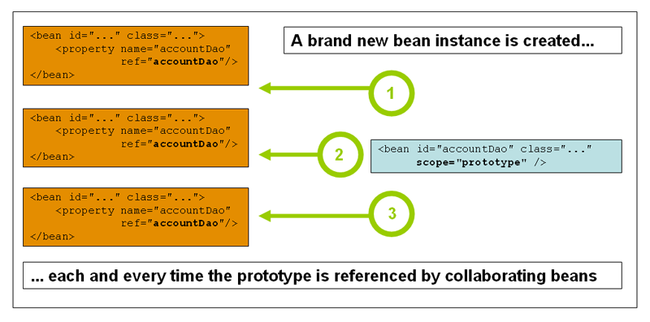

Prototype Scope

Slide 65
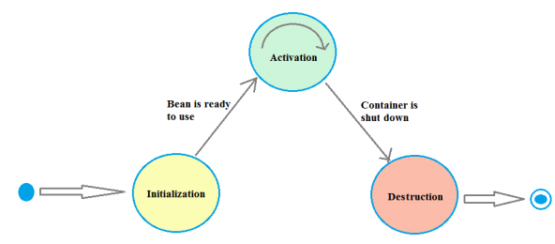
Life Cycle of Bean
Post-initialization callback methods
Pre-destruction callback methods

Slide 66
Using Spring Annotations

Slide 67
Spring Stereotypes
@Component
A generic stereotype that Spring will recognize as a Spring-managed component.
@Repository
This is a specialization of the @Component annotation and it fulfills the idea of the data access object.
@Service
This is a specialization of the @Component annotation and it fulfills the idea of a service layer.
@Controller
This is also a specialization of the @Component annotation and normally is used on a web context.

Slide 68
@Autowired
Spring container to actually create the instance and assign it to the declared variable
The @Autowired annotation can be used to autowire bean on
Setter Methods
Properties
Constructors

Slide 69
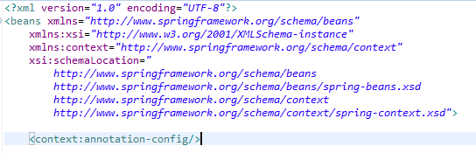
@Autowired
XML Configuration

Slide 70
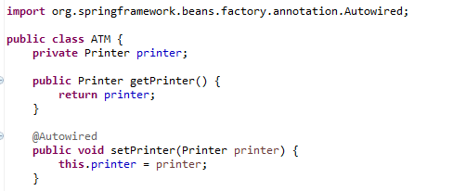
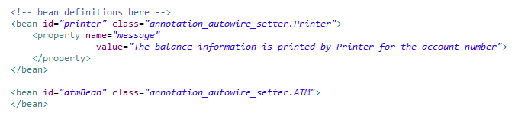
@Autowired on Setter Methods

Slide 71
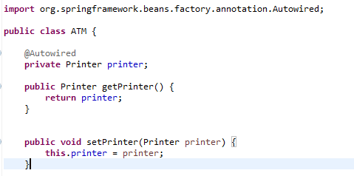
@Autowired on Properties

Slide 72
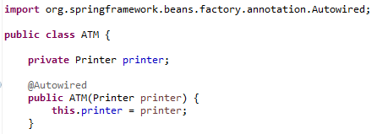
@Autowired on Constructors

Slide 73
Points to Remember

Slide 74
Q&A

Slide 75
Thank You
Client Logo

Slide 76
Revision History
Date | Version | Description | Updated by | Reviewed and Approved By
12/05/2015 | 1.0 | Initial Document | Kien Tran

Slide 77


