Slide 1
Spring Data
Kien Tran Principal Software Engineer
11/11/2015
Client Logo

Slide 2
Introduction
Your role
Your background and experience in the subject
What do you want from this course

Slide 3
Course Objectives
At the end of the course, you will have acquired sufficient knowledge to:
perform objective 1
perform objective 2

Slide 4
Agenda
I. | JDBC | xx
II. | Hibernate | xx
III. | Spring Data JDBC | xx
IV. | Spring Data Hibernate | xx

Slide 5
Course Audience and Prerequisite
The course is for <whom>
The following are prerequisites to <course>:
<knowledge>
<experiences>
<course>
…

Slide 6
Assessment Disciplines
Class Participation: <%>
Assignment: <%>
Final Exam: <%>
Passing Scores: <%>

Slide 7
Duration and Course Timetable
Course Duration: <hrs>
Course Timetable:
From <time> to <time>
Break <x> minutes from <time> to <time>

Slide 8
Further References
<Source 1>
<Source 2>
…

Slide 9
Set Up Environment
To complete the course, your PC must install:
Software 1
Software 2
…

Slide 10
Course Administration
In order to complete the course you must:
Sign in the Class Attendance List
Participate in the course
Provide your feedback in the End of Course Evaluation

Slide 11
JDBC

Slide 12
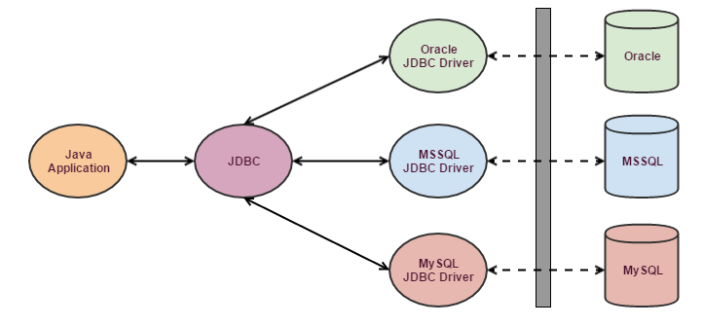
What is JDBC?
JDBC (Java Database Connectivity) is a java API to connect and execute query with the database.
JDBC API uses JDBC drivers to connect with the Relational Database.

Slide 13
Core JDBC Components
DriverManager
This class manages a list of database drivers
Connection
It uses a username, password, and a JDBC URL to establish a connection to the database and returns a connection object
A JDBC Connection represents a session/connection with a specific database

Slide 14
Core JDBC Components
Statement
Use to execute queries and updates against the database.
ResultSet
Perform a query against the database to get back a ResultSet. Then traverse this ResultSet to read the result of the query.
SQLException
This class handles any errors that occur in a database application.

Slide 15
Kinds of Statements
Statement
Execute simple SQL queries without parameters
Prepared Statement
Execute precompiled SQL queries with or without parameters
Callable Statement
Execute a call to a database stored procedure

Slide 16
JDBC: Work With MySQL
Loading the JDBC Driver
Class.forName("com.mysql.jdbc.Driver");
Opening the Connection
Connection conn = null;
conn = DriverManager.getConnection(
"jdbc:mysql://hostname:port/dbname",
"username",
"password");
Closing the Connection
conn.close();

Slide 17
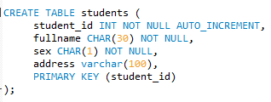
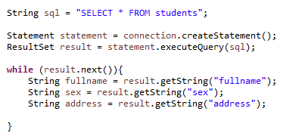
Query the Database

Slide 18


Update the Database
Update records
Delete records

Slide 19
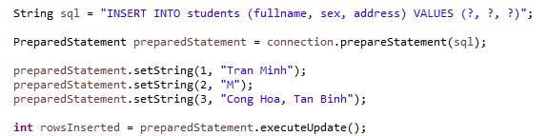
Using PreparedStatement

Slide 20
Data Access Object

Slide 21
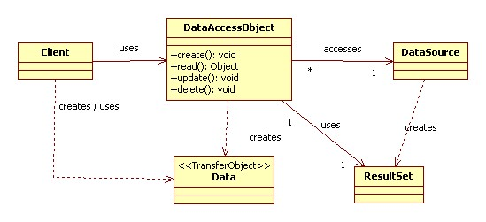
Data Access Object Pattern
DAO pattern is used to separate low level data accessing API or operations from high level business services

Slide 22
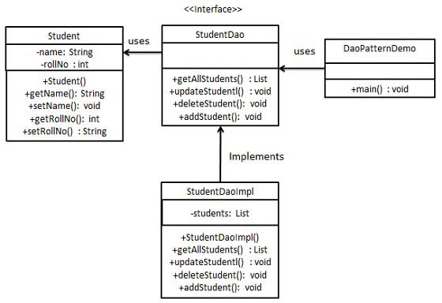
Sample

Slide 23
The participants in Data Access Object Pattern
Data Access Object Interface
This interface defines the standard operations to be performed on a model object(s)
Data Access Object concrete class
This class implements above interface.
This class is responsible to get data from a data source which can be database / xml or any other storage mechanism.
Model Object or Value Object
This object is simple POJO containing get/set methods to store data retrieved using DAO class

Slide 24
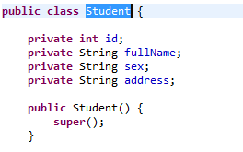
Implementation
Student

Slide 25
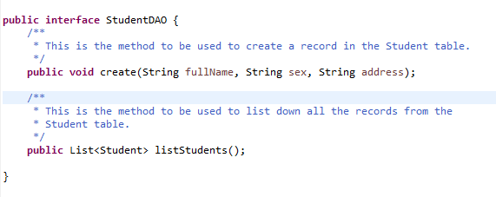
Implementation
StudentDAO

Slide 26
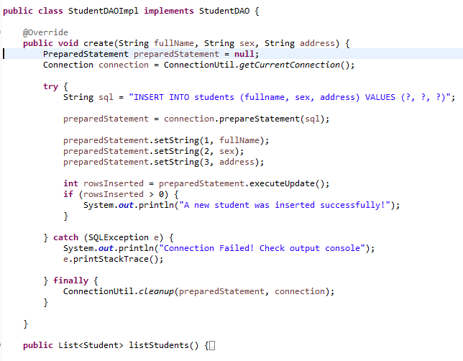
Implementation
StudentDAOImpl

Slide 27
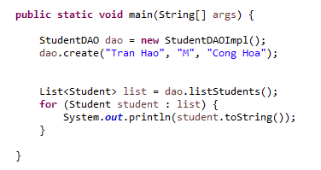
Implementation
StudentDAODemo

Slide 28
Hibernate

Slide 29
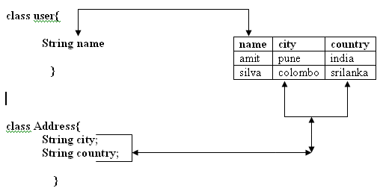
Object-Relation Impedence Mismatch
Granularity
Sometimes you will have an object model, which has more classes than the number of corresponding tables in the database (The object model is more granular than the relational model) and vice versa.

Slide 30
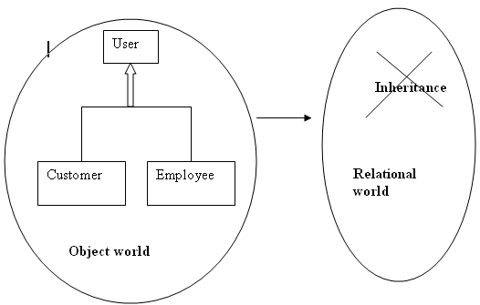
Object-Relation Impedence Mismatch
Subtypes (inheritance)
Inheritance is a natural paradigm in object-oriented programming languages. However, RDBMSs do not define anything similar on the whole.

Slide 31
Object-Relation Impedence Mismatch
Identity
An RDBMS defines exactly one notion of 'sameness': the primary key. Java, however, defines both object identity (a==b) and object equality (a.equals(b)).

Slide 32
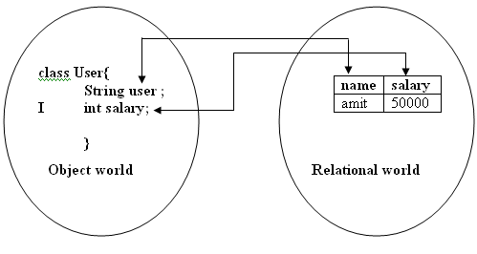
What is Object/Relation Mapping?
It means how we will map the relational world with the object world.
In the relational world, the data is in the form of a table that contains rows and column.
In the object world, the data is in the form of an object.

Slide 33
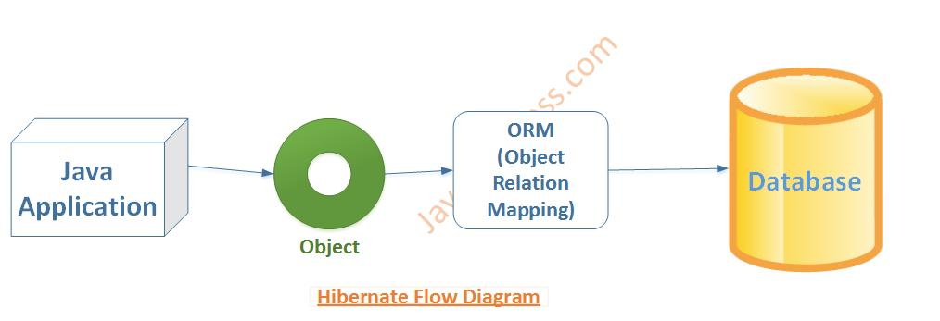
What is Hibernate?
Hibernate is one of the most popular Object/Relational Mapping (ORM) framework in the Java world
It allows developers to map the object structures of normal Java classes to the relational structure of a database
Hibernate framework simplifies the development of java application to interact with the database

Slide 34

Advantages of hibernates
Supports Inheritance, Collections (List,Set,Map)
Supports relationships like One-To-Many,One-To-One, Many-To-Many, Many-To-One
HQL (Hibernate Query Language) - database independent commands
Simplifies complex join
Supports caching mechanism - Fast performance

Slide 35
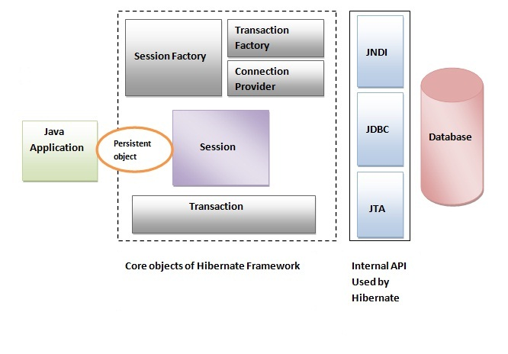
Hibernate Architecture

Slide 36
Elements of Hibernate Architecture
SessionFactory
A factory for Session and a client of ConnectionProvider.
An interface provides factory method to get the object of Session
Session
An interface between the application and data stored in the database
It is a short-lived object and wraps the JDBC connection
Provides methods to insert, update and delete the object
Provides factory methods for Transaction, Query and Criteria

Slide 37
Elements of Hibernate Architecture
Transaction
Provides methods for transaction management
Query
Query objects use SQL or Hibernate Query Language (HQL) string to retrieve data from the database and create objects

Slide 38
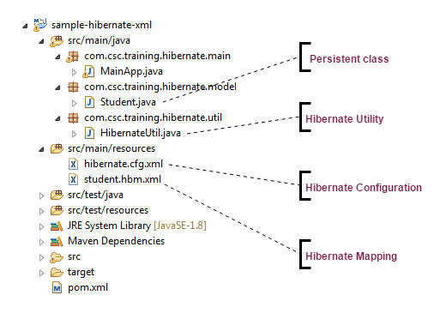
Hibernate Sample

Slide 39
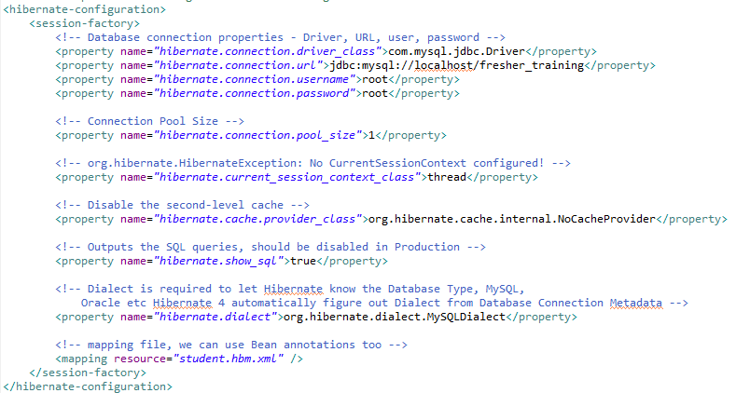
Hibernate Configuration

Slide 40
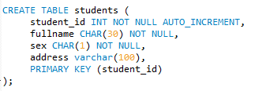
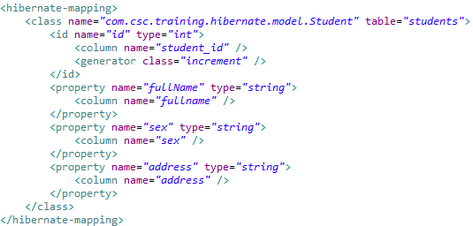
Hibernate Mapping Files

Slide 41
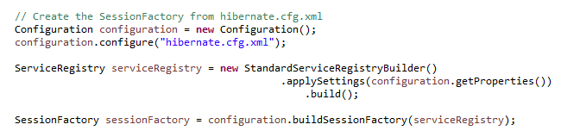
Build SessionFactory

Slide 42
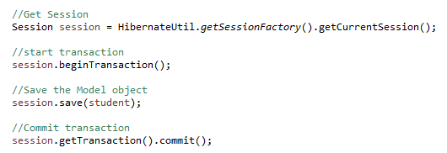
Using Hibernate to store Object to Database

Slide 43
Persistence Contexts
org.hibernate.Session API represent a context for dealing with persistent data. This concept is called a persistence context.
Persistent data has a state in relation to both a persistence context and the underlying database.

Slide 44
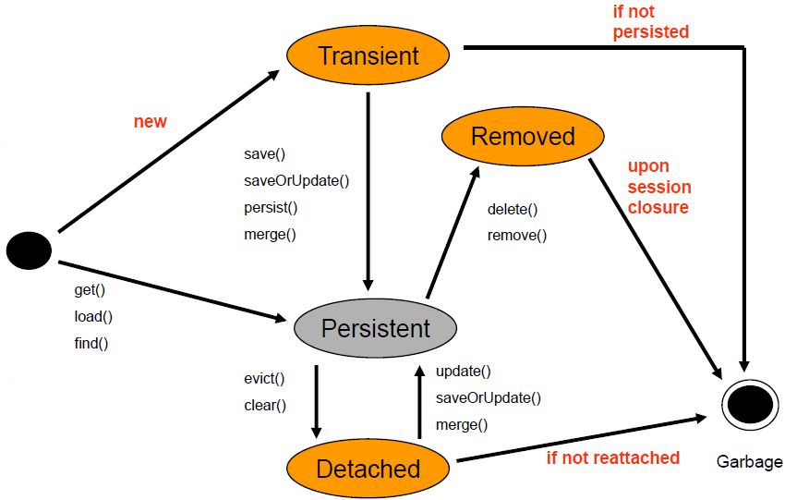
Entity states

Slide 45
Entity states
transient
The entity has just been instantiated and is not associated with a persistence context.
It has no persistent representation in the database and no identifier value has been assigned.
Persistent
the entity has an associated identifier and is associated with a persistence context.

Slide 46
Entity states
detached
the entity has an associated identifier, but is no longer associated with a persistence context
removed
the entity has an associated identifier and is associated with a persistence context, however it is scheduled for removal from the database.

Slide 47
Working with Entities
Making entities persistent
DomesticCat fritz = new DomesticCat();
fritz.setColor(Color.GINGER);
fritz.setSex('M');
fritz.setName("Fritz");
Long generatedId = (Long) sess.save(fritz);
sess.persist(fritz);
Loading an object
Cat fritz = (Cat) sess.load(Cat.class, generatedId);
Cat cat = (Cat) sess.get(Cat.class, id);
Deleting entities
session.delete( fritz );

Slide 48
Hibernate Data Manipulation
Hibernate Query Language (HQL)
The syntax is quite similar to database SQL language
HQL uses class name instead of table name, and property names instead of column name
Hibernate Criteria
An alternative to Hibernate Query Language (HQL)
It’s always a good solution in many optional search criteria
Native SQL
Use the native database SQL language directly

Slide 49
HQL Query Sample
from Cat
from Formula, Parameter
select cat.name from DomesticCat cat where cat.name like 'fri%‘
select avg(cat.weight), sum(cat.weight), max(cat.weight), count(cat) from Cat cat
from DomesticCat cat order by cat.name asc, cat.weight desc

Slide 50
Criteria Query Sample
Criteria crit = sess.createCriteria(Cat.class);
crit.setMaxResults(50); List cats = crit.list();
List cats = sess.createCriteria(Cat.class)
.add( Restrictions.like("name", "Fritz%") )
.add( Restrictions.between("weight", minWeight, maxWeight) )
.list();
List cats = sess.createCriteria(Cat.class)
.add( Restrictions.like("name", "F%")
.addOrder( Order.desc("age") )
.list();

Slide 51
Native SQL Sample
sess.createSQLQuery("SELECT * FROM CATS").list();
sess.createSQLQuery("SELECT ID, NAME, BIRTHDATE FROM CATS")
.addEntity(Cat.class)
.list();
sess.createSQLQuery("SELECT {cat.*}, {m.*} FROM CATS c, CATS m
WHERE c.MOTHER_ID = m.ID")
.addEntity("cat", Cat.class)
.addEntity("mother", Cat.class)
.list();

Slide 52
Hibernate mapping types
The types declared and used in the mapping files are not Java data types; they are not SQL database types either
Converters which can translate from Java to SQL data types and vice versa

Slide 53
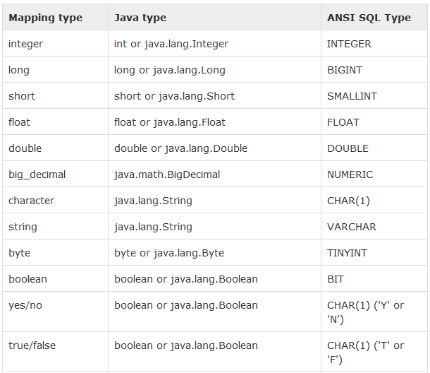
Primitive types

Slide 54
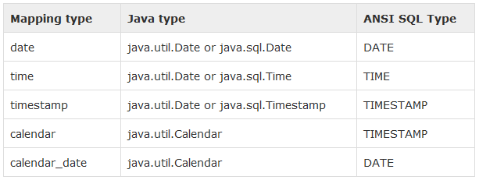
Date and time types

Slide 55
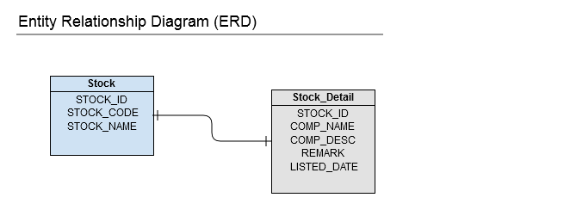
One-to-One example (XML Mapping)

Slide 56
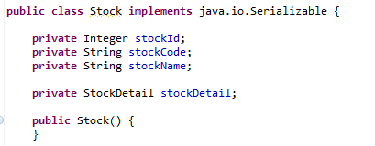
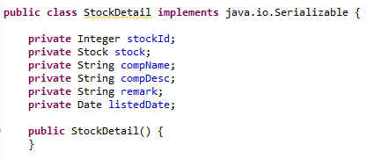
One-to-One example (XML Mapping)

Slide 57
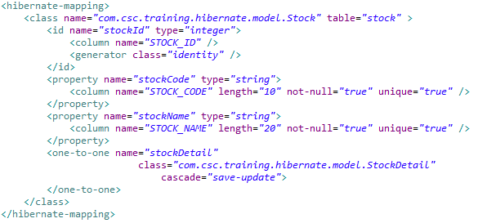
Stock.hbm.xml

Slide 58
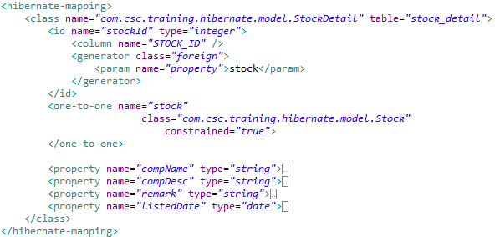
StockDetail.hbm.xml

Slide 59
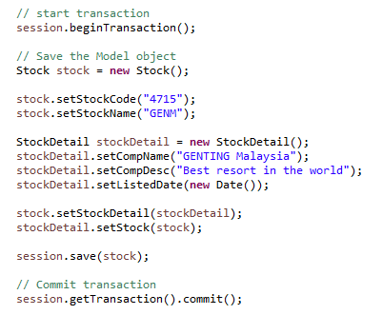
MainApp

Slide 60
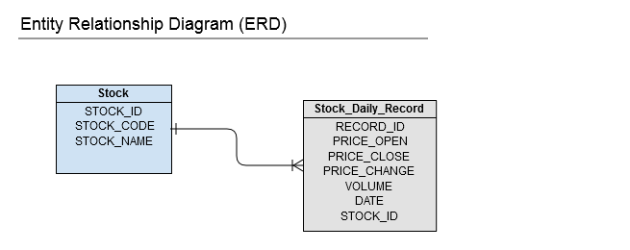
One-to-Many example (XML Mapping)

Slide 61
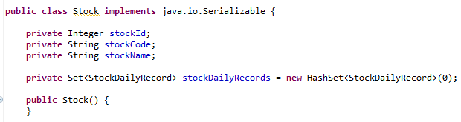
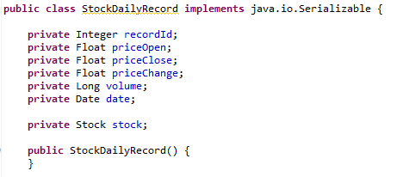
One-to-Many example (XML Mapping)

Slide 62
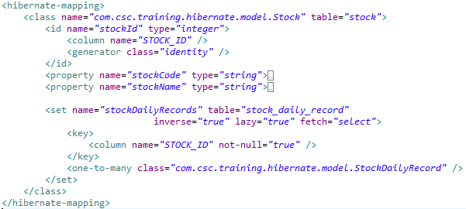
Stock.hbm.xml

Slide 63
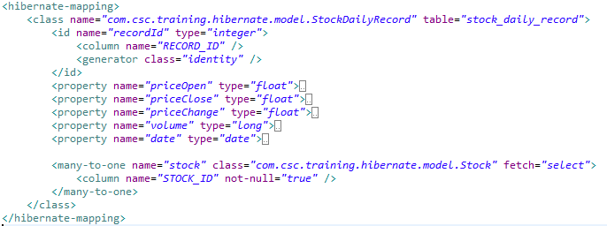
StockDailyRecord.hbm.xml

Slide 64
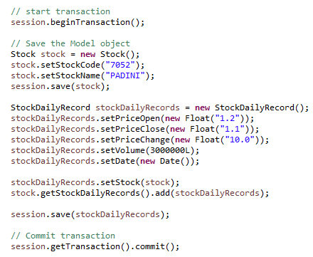
MainApp

Slide 65
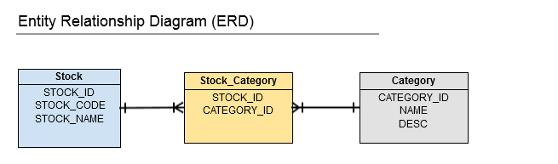
Many-to-Many example (XML Mapping)

Slide 66
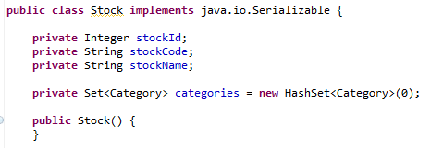
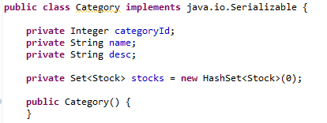
Many-to-Many example (XML Mapping)

Slide 67
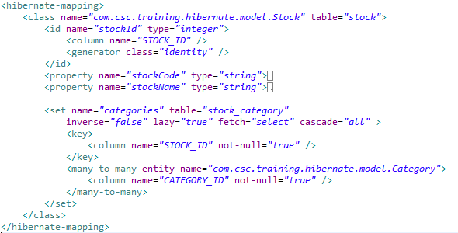
Stock.hbm.xml

Slide 68
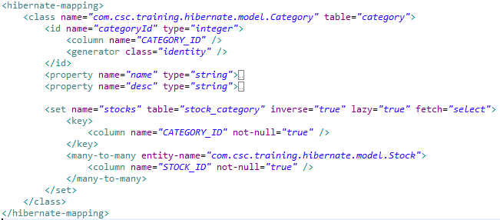
Category.hbm.xml

Slide 69
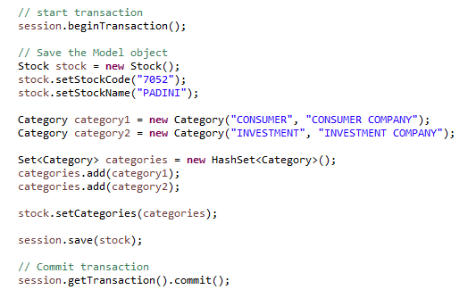
MainApp

Slide 70
Spring Data JDBC

Slide 71
Problems of JDBC API
Need to write a lot of code before and after executing the query, such as creating connection, statement, closing resultset, connection etc.
Need to perform exception handling code on the database logic
Need to handle transaction
Repetition of all these codes from one to another database logic is a time consuming task

Slide 72
What is Spring JDBC?
Spring provides a simplification in handling database access with the Spring JDBC Template.
The Spring JDBC template allows to clean-up the resources automatically, e.g. release the database connections.

Slide 73
Choosing an approach for JDBC database access
JdbcTemplate
NamedParameterJdbcTemplate
SimpleJdbcInsert and SimpleJdbcCall
RDBMS Objects including MappingSqlQuery, SqlUpdate and StoredProcedure

Slide 74
JdbcTemplate
The classic Spring JDBC approach and the most popular
Performs some tasks
Executes SQL queries, update statements and stored procedure calls
Performs iteration over ResultSets and extraction of returned parameter values

Slide 75

JdbcTemplate
Querying (SELECT)

Slide 76
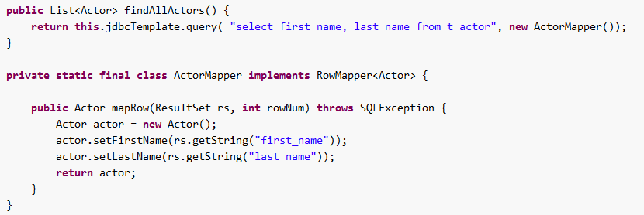
JdbcTemplate
RowMapper
Map the ResultSet data to bean object in queryForObject() method

Slide 77



JdbcTemplate
Updating (INSERT/UPDATE/DELETE) with jdbcTemplate

Slide 78

JdbcTemplate
Other jdbcTemplate operations

Slide 79
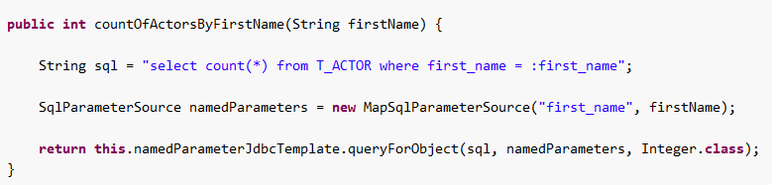
NamedParameterJdbcTemplate
Support for programming JDBC statements using named parameters

Slide 80
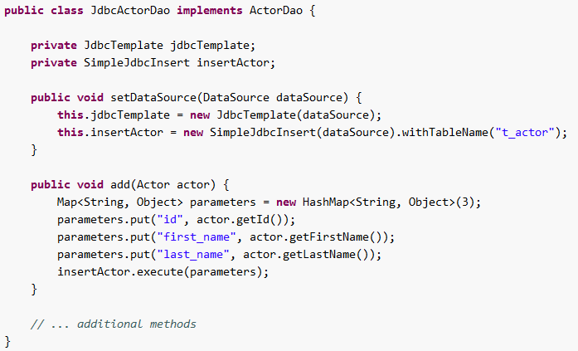
SimpleJdbcInsert
Provides a simplified configuration by taking advantage of database metadata that can be retrieved through the JDBC driver

Slide 81
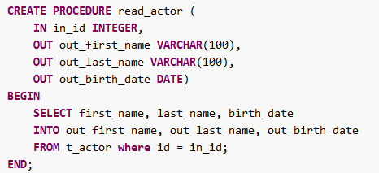
SimpleJdbcCall
Calling a stored procedure with SimpleJdbcCall

Slide 82
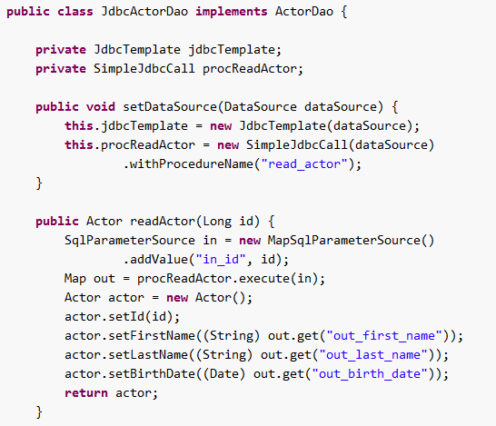
SimpleJdbcCall

Slide 83
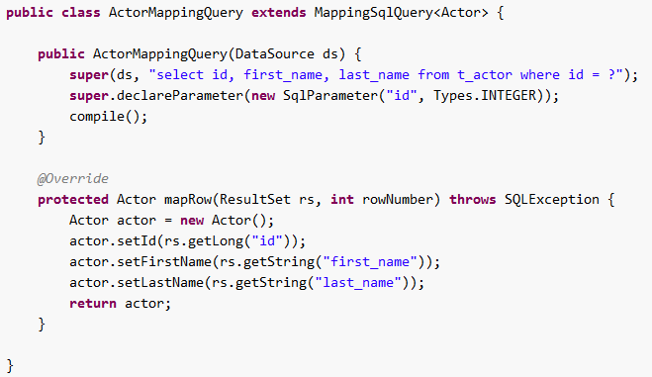
MappingSqlQuery
MappingSqlQuery is a reusable query in which concrete subclasses must implement the abstract mapRow(..) method to convert each row of the supplied ResultSet into an object of the type specified.

Slide 84
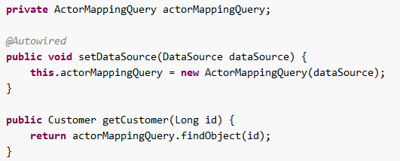
MappingSqlQuery

Slide 85
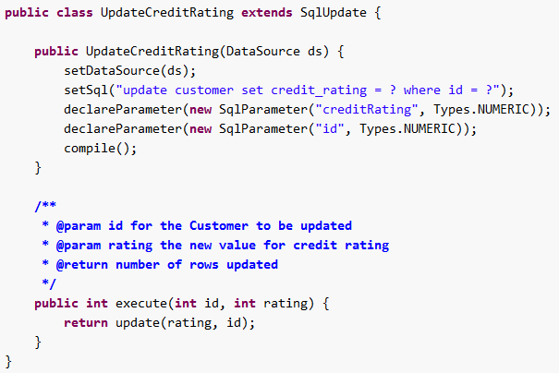
SqlUpdate
The SqlUpdate class encapsulates an SQL update.
Like a query, an update object is reusable

Slide 86

StoredProcedure
The StoredProcedure class is a superclass for object abstractions of RDBMS stored procedures

Slide 87

StoredProcedure

Slide 88
Q&A

Slide 89
Thank You
Client Logo

Slide 90
Revision History
Date | Version | Description | Updated by | Reviewed and Approved By
11/11/2015 | 1.0 | Initial Document | Kien Tran

Slide 91


