Slide 1
Spring MVC
Kien Tran Principal Software Engineer
12/13/2015
Client Logo

Slide 2
Introduction
Your role
Your background and experience in the subject
What do you want from this course

Slide 3
Course Objectives
At the end of the course, you will have acquired sufficient knowledge to:
perform objective 1
perform objective 2

Slide 4
Agenda
I. | Section One | xx
II. | Section Two | xx
III. | Section Three | xx
IV. | Section Four | xx
V. | Section Five | xx
VI. | Section Six | xx
VII. | Section Seven | xx

Slide 5
Course Audience and Prerequisite
The course is for <whom>
The following are prerequisites to <course>:
<knowledge>
<experiences>
<course>
…

Slide 6
Assessment Disciplines
Class Participation: <%>
Assignment: <%>
Final Exam: <%>
Passing Scores: <%>

Slide 7
Duration and Course Timetable
Course Duration: <hrs>
Course Timetable:
From <time> to <time>
Break <x> minutes from <time> to <time>

Slide 8
Further References
<Source 1>
<Source 2>
…

Slide 9
Set Up Environment
To complete the course, your PC must install:
Software 1
Software 2
…

Slide 10
Course Administration
In order to complete the course you must:
Sign in the Class Attendance List
Participate in the course
Provide your feedback in the End of Course Evaluation

Slide 11
Spring MVC

Slide 12
Model-View-Controller (MVC) Design Pattern
MVC is an architectural pattern used in the development of web applications
Separate your business services and domain objects (the model) from the UI (the view) and mediate their interaction through one or more controllers.
To be able to modify your UI without having to change your business logic and domain objects

Slide 13
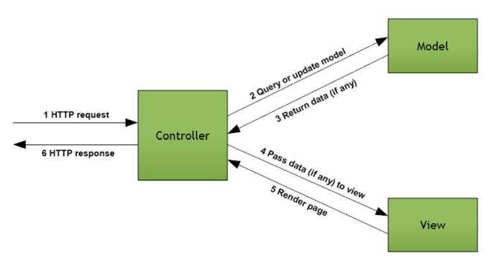
Model-View-Controller (MVC) Design Pattern

Slide 14
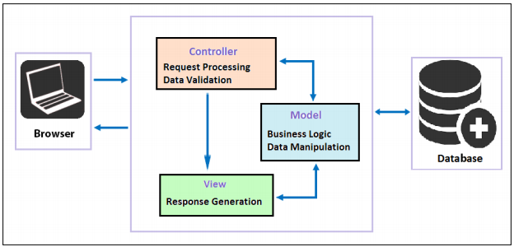
Model-View-Controller (MVC) Design Pattern

Slide 15
Model
The Model represents the business entity on which the application's data is stored
It is the conceptualization of the objects that the user works with and the mapping of those concepts into data structures: the user model and data model.

Slide 16
View
The View is responsible for preparing the presentation for the client based on the outcome of the request processing, without including any business logic
It renders the model data into the client's user interface type

Slide 17
Controller
The Controller is responsible for controlling the flow request to response flow in the middleware
It invokes backend services for businesses after receiving a request from the user, and updates the model
It prepares models for the View to present.
It is also responsible for determining which view should be rendered.

Slide 18
Front Controller Design Pattern
The Front Controller is used at the initial point of contact to handle all Hyper Text Transfer Protocol (HTTP) requests
It enables us to centralize logic to avoid duplicate code, and manages the key HTTP request-handling activities
The Front Controller design pattern enables centralizing the handling of all HTTP requests without limiting the number of handlers in the system.

Slide 19
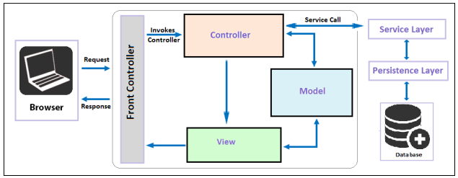
Front Controller Design Pattern

Slide 20
Spring MVC
A web framework built on the principles of the Spring Framework
Spring’s web framework is designed to address these concerns (state management, workflow, and validation)
The Spring MVC framework is implemented using standard Java technologies such as Java, Servlet, and JSP

Slide 21
Features of the Spring MVC framework
Powerful configuration of framework and application classes
It allows easier testing
It allows separation of roles. Each component of a Spring MVC framework performs a different role during request handling (Controller, Validator, Model Object, View Resolver, and HandlerMapping interfaces)
No need for the duplication of code
It allows specific validation and binding

Slide 22
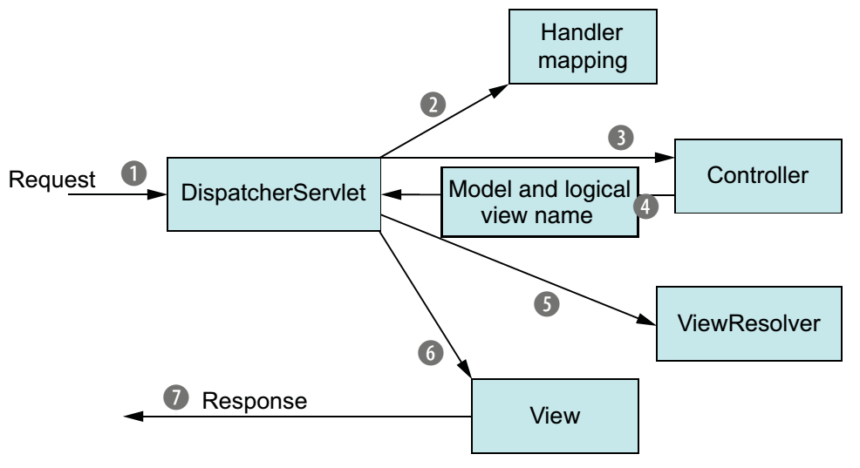
Flow of request handling in Spring MVC
Spring moves requests between a dispatcher servlet, handler mappings, controllers, and view resolvers.

Slide 23
DispatcherServlet
A single front controller servlet.
The Servlet intercepts and analyzes the incoming HTTP request and dispatches them to the appropriate controller to be processed.
It is configured in the web.xml file of any web application

Slide 24
Handler mapping
This maps the HTTP request to the handler, that is, a method within a Spring MVC controller class, based on the HTTP paths expressed through the @RequestMapping annotation at the method or type level within the controller class

Slide 25
Controller
A controller is a Spring component that processes the request
The Controller in Spring MVC receives requests from the DispatcherServlet class and performs some business logic in accordance with the client.
Package up the model data and identify the name of a view that should render the output

Slide 26
ViewResolver
The ViewResolver interface of Spring MVC supports view resolution based on the view name returned by controller
The URLBasedViewResolver class supports the direct resolution of view name to URLs.
The ContentNegotiatingViewResolver class supports the dynamic resolution of views based on the media type supported by the client, such as PDF, XML, JSON , and so on

Slide 27
View
The View components are user-interface elements which are responsible for displaying the output of a Spring MVC application.

Slide 28
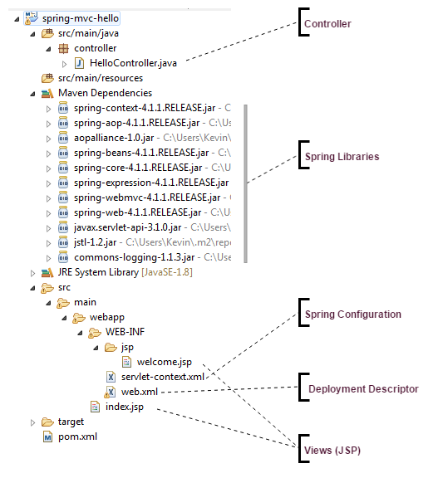
Spring MVC Sample

Slide 29
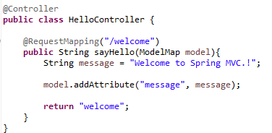
Controller

Slide 30
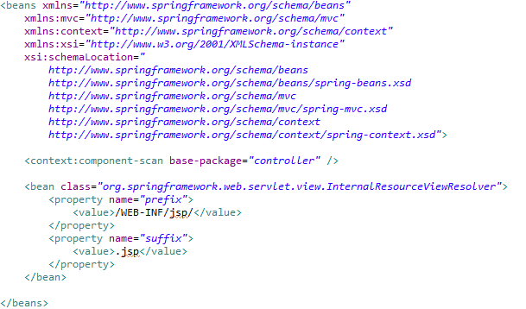
Spring Configuration

Slide 31
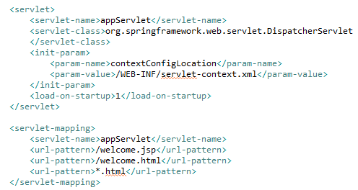
Deployment Descriptor

Slide 32

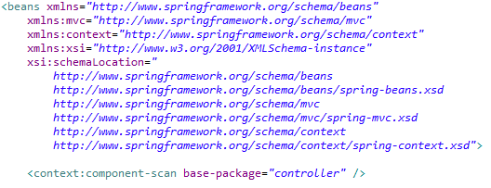
@Controller annotation
The @Controller annotation is used to define a class as a controller class without inheriting any interface or class

Slide 33

@RequestMapping annotation
The web request in Spring MVC is mapped to handlers by one or more @RequestMapping annotations declared in the controller class
http://localhost:8080/spring-mvc-hello/welcome.html
/spring-mvc-hello
/welcome.html

Slide 34
@RequestMapping - Mapping requests at the class level
@Controller @RequestMapping(value = "/employee") public class EmployeeController {
@RequestMapping("/add") public String addEmployee (Model model) { model.addAttribute("employee", new Employee()); model.addAttribute("empList", employeeService.list());
return "employeeList"; }
...
}
http://localhost:8080/spring-mvc/employee/add

Slide 35
@RequestMapping - Mapping requests at the class level
@Controller @RequestMapping(value = "/employee") public class EmployeeController {
@RequestMapping(value = {"/remove", "/delete"}",
method = RequestMethod.GET) public String removeEmployee (
(@RequestParam("employeeId") int employeeId){
employeeService.removeEmployee(employeeId); return "redirect:"; } ...
}
http://localhost:8080/spring-mvc/employee/remove
http://localhost:8080/spring-mvc/employee/delete

Slide 36
@RequestMapping - Mapping requests at the class level
@Controller @RequestMapping(value = "/employee") public class EmployeeController {
@RequestMapping(value = "/{employeeId}",
method = RequestMethod.GET) public String getEmployee (
@PathVariable("employeeId")Integer employeeId,
Model model){ //... return "employeeList"; } ...
}
http://localhost:8080/spring-mvc/employee/10121

Slide 37
@RequestParam
It can be used to bind the HTTP request parameter to the argument of the controller method
Its functionality is similar to ServletRequest.getParameter( java.lang.String)
@RequestMapping(value = {"/remove", "/delete"}",
method = RequestMethod.GET) public String removeEmployee (
(@RequestParam("employeeId") int employeeId){
employeeService.removeEmployee(employeeId); return "redirect:"; }

Slide 38
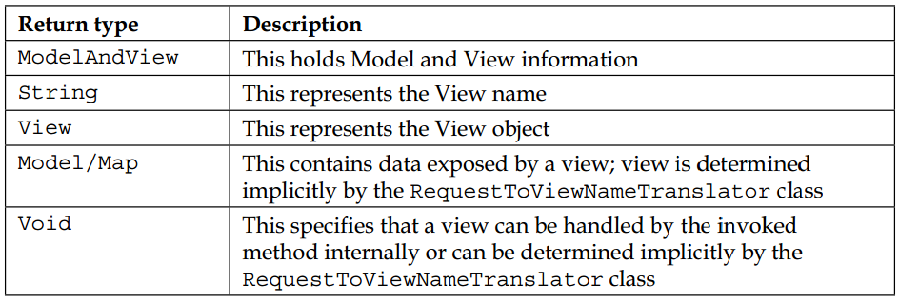
Return values in @RequestMapping annotated methods

Slide 39
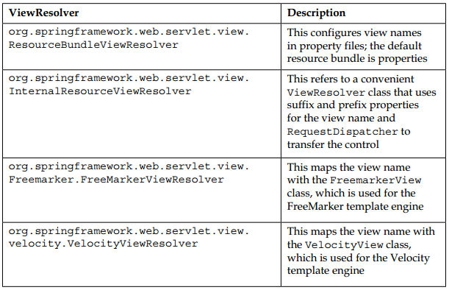
ViewResolver in Spring MVC
Spring provides a number of ViewResolver classes that are configured in the XML files

Slide 40
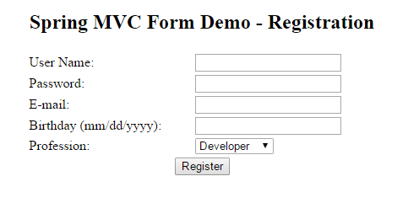
Spring MVC Form

Slide 41
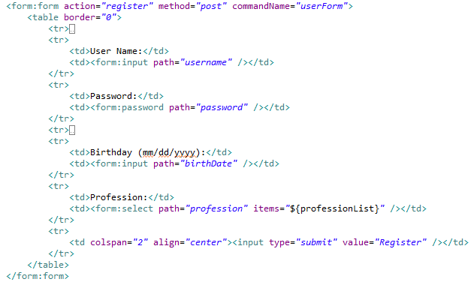
Spring MVC Form

Slide 42
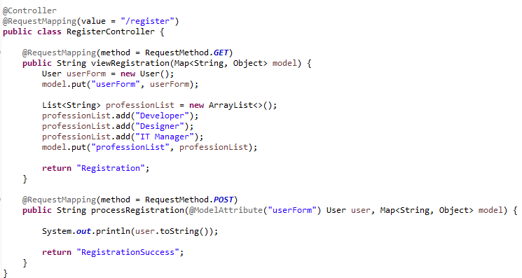
Spring MVC Form

Slide 43
@ModelAttribute in the controller class
The org.springframework.web.bind.annotation.ModelAttribute in Spring MVC is used to an annotation for the handler method or method arguments in the controller class
The @ModelAttribute annotation binds a named model attribute to any arguments in a method or to the method itself

Slide 44


Spring MVC internationalization (i18n)
Spring Configuration
Resource Bundle Files
Using on JSP

Slide 45

Spring MVC internationalization (i18n)
ReloadableResourceBundleMessageSource
Reloading properties file without restarting the JVM

Slide 46
Spring MVC internationalization (i18n)
SessionLocaleResolver
SessionLocaleResolver resolves locales by inspecting a predefined attribute in a user’s session.
If the session attribute doesn’t exist, this locale resolver determines the default locale from the accept-language HTTP header

Slide 47
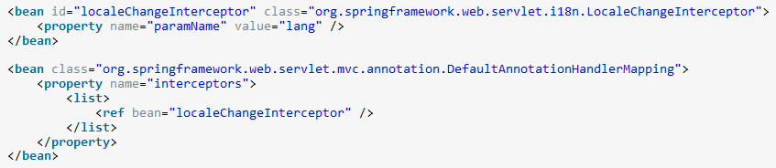
Spring MVC internationalization (i18n)
LocaleChangeInterceptor
LocaleChangeInterceptor interceptor detects if a special parameter is present in the current HTTP request.
The parameter name can be customized with the paramName property of this interceptor.
If such a parameter is present in the current request, this interceptor changes the user’s locale according to the parameter value.

Slide 48
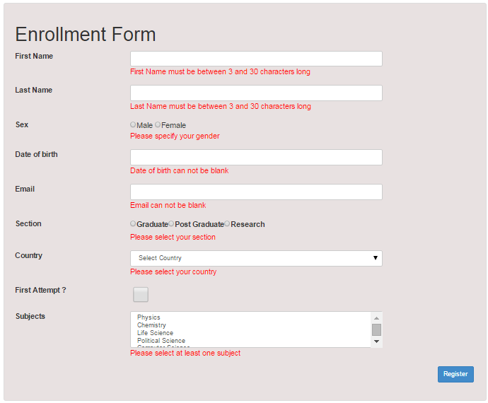
Spring MVC Form Validation Using Hibernate Validators

Slide 49
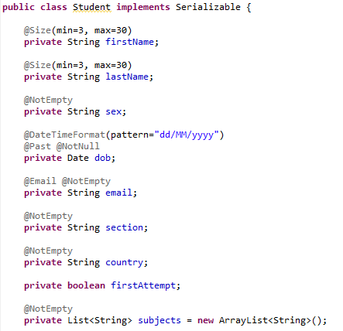
Spring MVC Form Validation Using Hibernate Validators

Slide 50
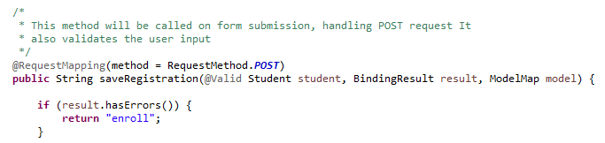
Spring MVC Form Validation Using Hibernate Validators
Controller

Slide 51
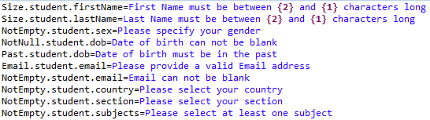
Spring MVC Form Validation Using Hibernate Validators

Slide 52
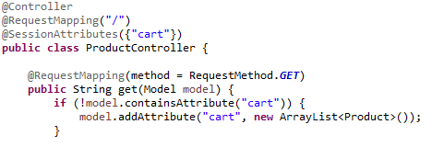
@SessionAttributes
It’s a way to add objects to Session
@SessionAttributes is used in conjunction with @ModelAttribute

Slide 53
Points to Remember

Slide 54
Q&A

Slide 55
Thank You
Client Logo

Slide 56
Revision History
Date | Version | Description | Updated by | Reviewed and Approved By
12/13/2015 | 1.0 | Initial Document | Kien Tran

Slide 57


