Slide 1
What’s new Angular 9 (Ivy)
Nat.os

Slide 2
Agenda
Smaller JavaScript bundle sizes
Improved build times, enabling AOT on by default
Lazy loading component
ProvidedIn
Better debugging
Improved CSS class and style binding
Improved type checking for HTML templates
Improved build errors
Improved Internationalization
Supported Typescript 3.7 above.
Faster testing

Slide 3
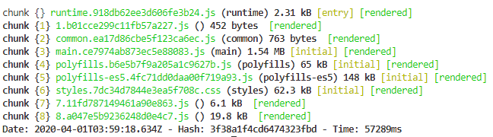
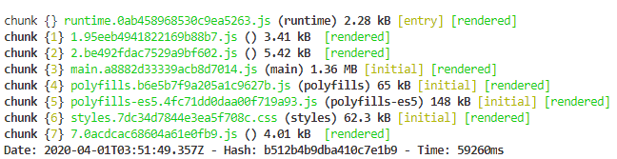
1. Smaller JavaScript bundle sizes Up to 40% smaller bundles
"angularCompilerOptions": {
"enableIvy": false
}
in tsconfig.app.json
"angularCompilerOptions": {
"enableIvy": true
}

Slide 4
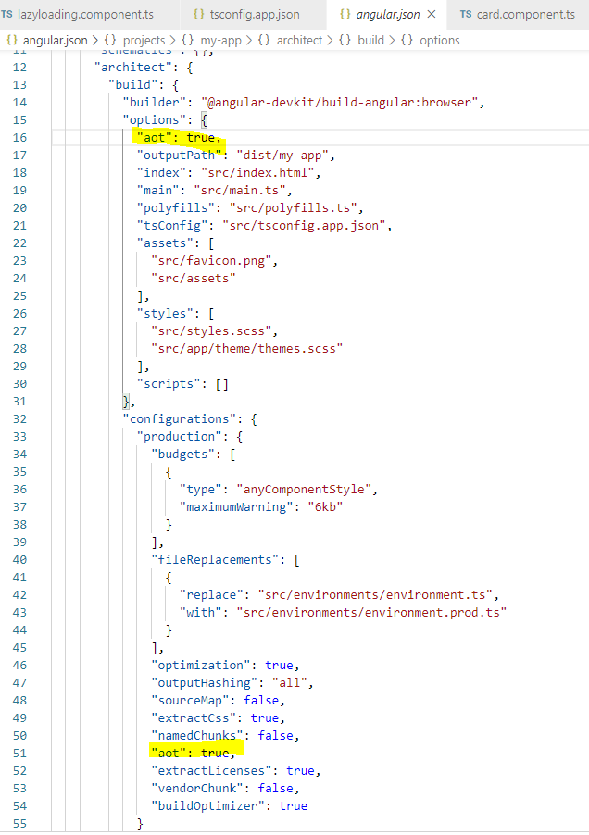
2. Improved build times, enabling AOT on by default

Slide 5
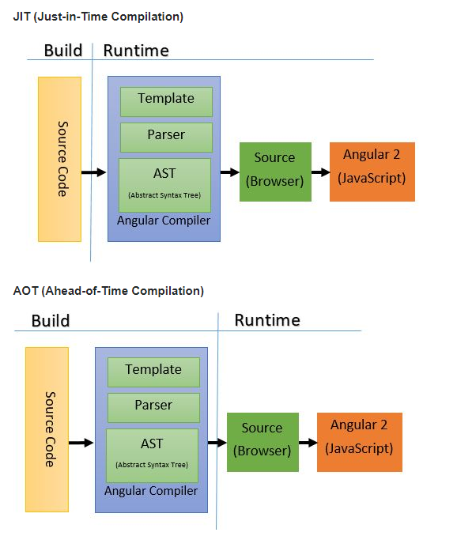
2. Improved build times, enabling AOT on by default
JIT
Compile TypeScript just in time for executing it.
Compiled in the browser.
Each file compiled separately.
No need to build after changing your code and before reloading the browser page.
Suitable for local development.
AOT
Compile TypeScript during build phase.
Compiled by the machine itself, via the command line (Faster).
All code compiled together, inlining HTML/CSS in the scripts.
No need to deploy the compiler (Half of Angular size).
More secure, original source not disclosed.
Suitable for production builds.

Slide 6
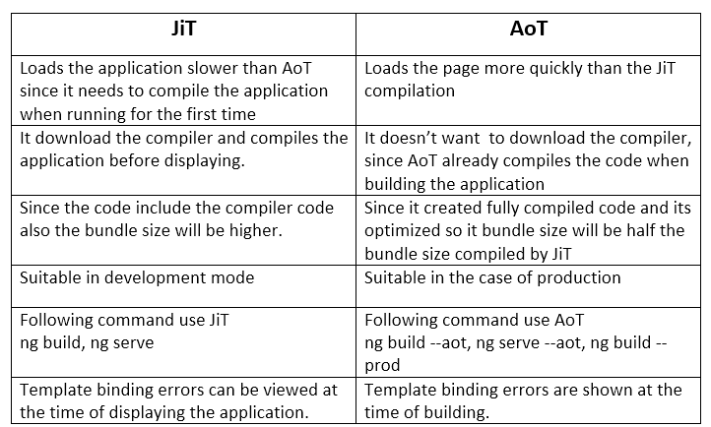
2. Improved build times, enabling AOT on by default

Slide 7

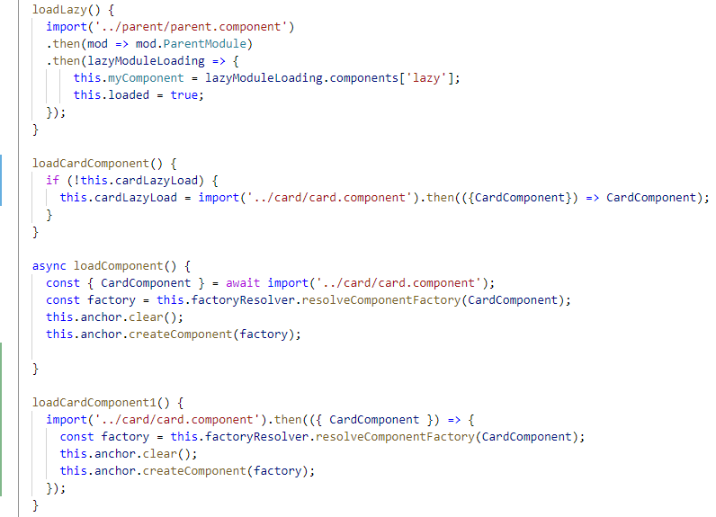
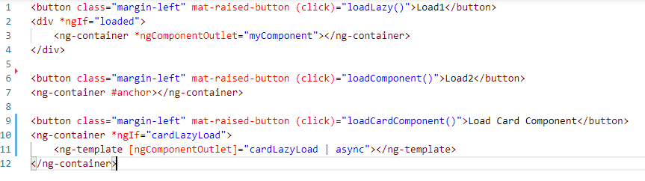
3. Lazy loading component Constructor:
Component:
Template:

Slide 8
3. Lazy loading component
ComponentFactoryResolver:
A simple registry that maps `Components` to generated `ComponentFactory` classes that can be used to create instances of components.
Use to obtain the factory for a given component type, then use the factory's `create()` method to create a component of that type.
ViewContainerRef
Represents a container where one or more views can be attached to a component.
Can contain *host views* (created by instantiating a component with the `createComponent()` method), and *embedded views*(created by instantiating a `TemplateRef` with the `createEmbeddedView()` method).
A view container instance can contain other view containers, creating a [view hierarchy](guide/glossary#view-tree).

Slide 9
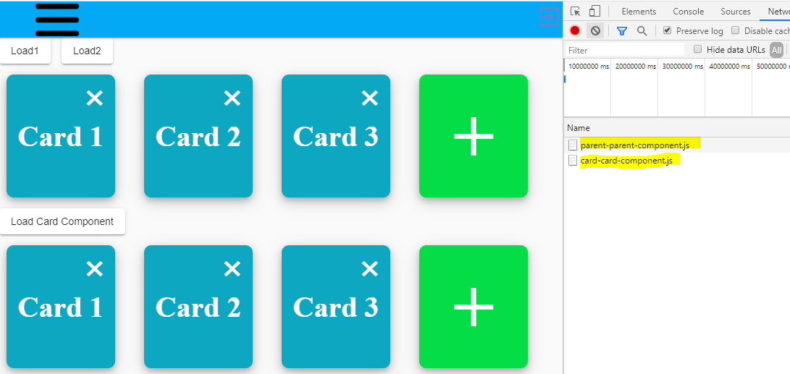
3. Lazy loading component

Slide 10
4. ProvidedIn
3 Options:
'root' : The application-level injector in most apps.
'platform' : A special singleton platform injector shared by all applications on the page.
'any' : Provides a unique instance in every module (including lazy modules) that injects the token.
Root: Angular has enough intelligent to declare provider service to bundle when building.

Slide 11
5.Better debugging
ng object to access instances of your components and call methods on them, as well as trigger change detection

Slide 12
Improved Internationalization
Build process is 10 times faster

Slide 13

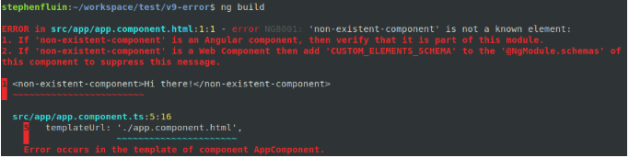
Improved build errors
More meaningful error messages in the CLI console
In version 8 or View Engine:
In version 9 with Ivy, the same error looks like:

Slide 14
Faster testing
We have also revamped the implementation of TestBed in Ivy to make it more efficient.
Previously, TestBed would recompile all components between the running of each test, regardless of whether there were any changes made to components (for example, through overrides).
In Ivy, TestBed doesn’t recompile components between tests unless a component has been manually overridden, which allows it to avoid recompilation between the grand majority of tests.
With this change, the framework’s core acceptance tests are about 40% faster. We would expect users to see their own application test speeds to be around 40–50% faster.

Slide 15
Nullish Coalescing

Slide 16
Thank you
Question?

