Slide 1

Security water cooling system
Embedded group

Slide 2

How it works

Slide 3
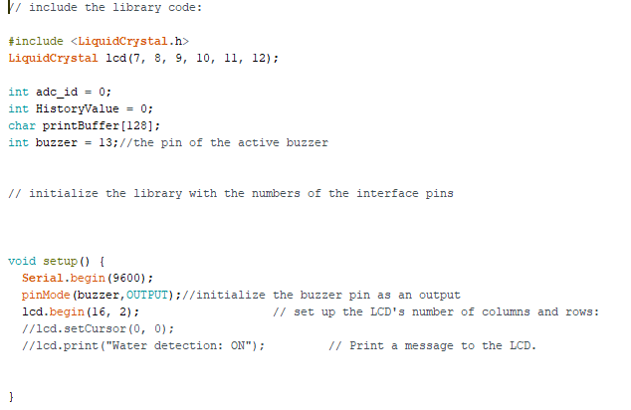
Our Code

Slide 4
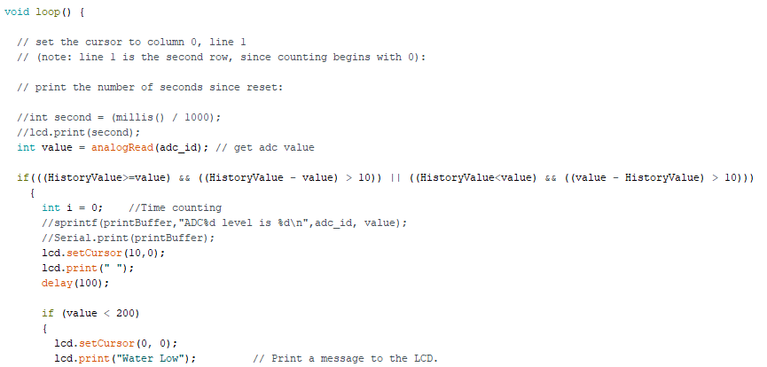
Our Code

Slide 5
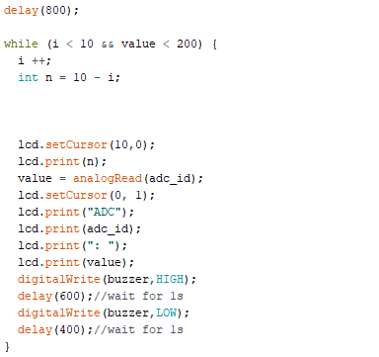
Our Code

Slide 6
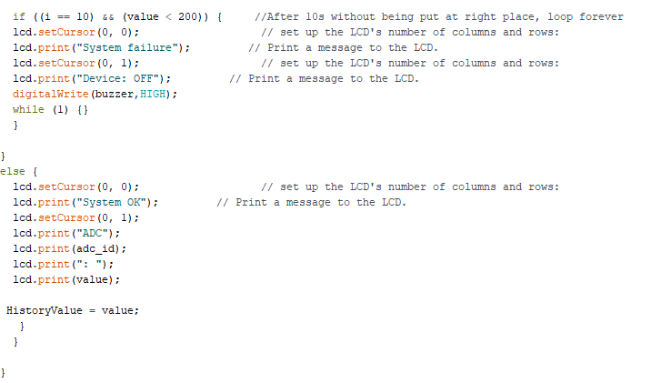
Our Code

Slide 7

What we used
Water sensor
LCD
UNO
Buzzer
Wires

Slide 8

Video of working

Slide 9

Thank you for attention

