Slide 1
Session 4
Testing basics

Slide 2
Objectives
Applying tests in SDLC
Understanding testing
Understanding and being able to use black box testing
Writing test cases
Evaluating actual test results
Understanding and being able to use white box testing
Writing test cases
Evaluating actual test results
Acceptance Testing

Slide 3
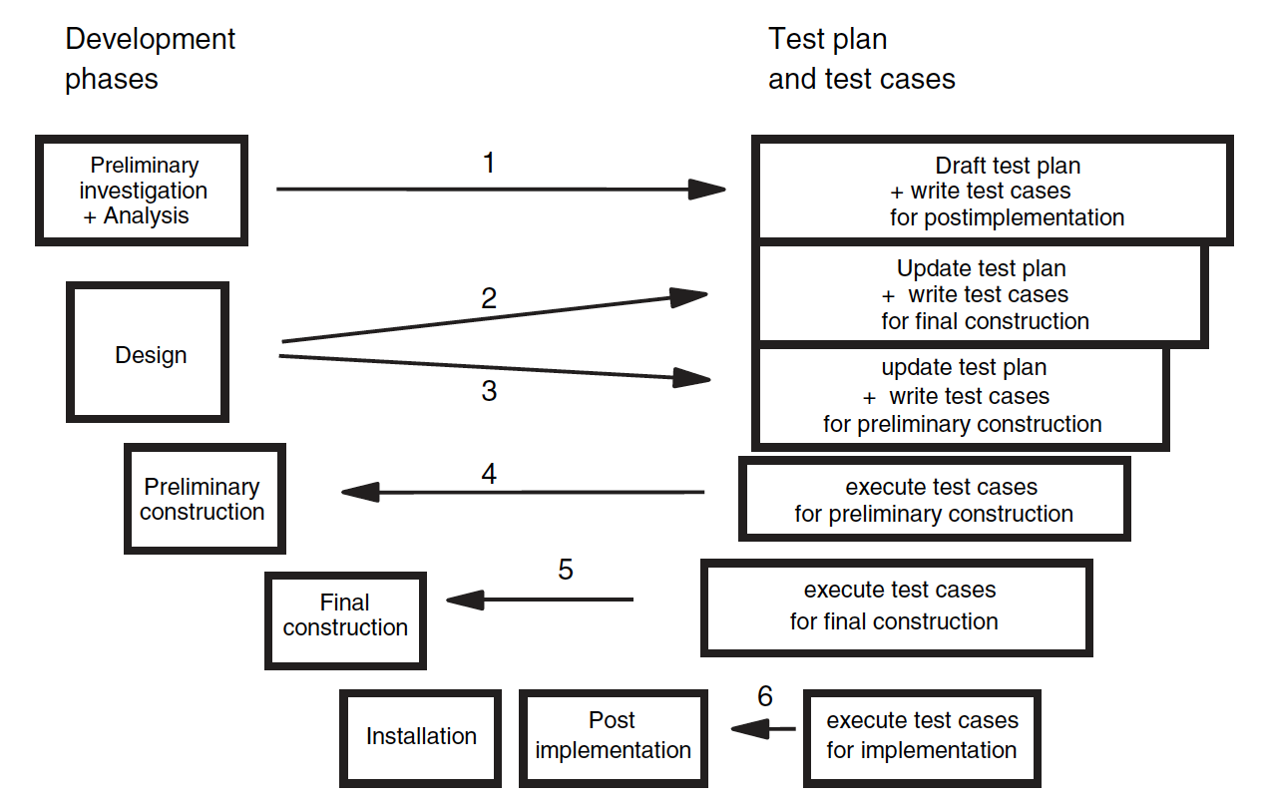
Writting tests in SDLC
Notes:
From: software testing testing across the entire software life cycle

Slide 4
Defining a test case
By IEEE documentation standard #829-2008
A set of test inputs, execution conditions, and expected results developed for a particular objective, such as to exercise a particular program path or to verify compliance with a specific requirement.
Documentation specifying inputs, predicted results, and a set of execution conditions for a test item.

Slide 5
Test approaches
One of the important phases software development life cycle is testing
The aim of testing is
To investigate whether the system meets its given specifications
To explore defects before the system is delivered
Two main types of testing include
Black box testing
White box testing

Slide 6
Black box testing
Some times called as functional testing
Tests are derived from the program specification
Does it do what it says?
The test are to explore various inputs and corresponding outputs
Without any knowledge of the working of the program itself
Test Inputs
Outputs

Slide 7
Black box testing example
Specification
Write a program called TripleNumber to triple any input integer
The only testing you can do if you do not have access to the code is to try some inputs
Unfortunately, this may not find a fault in the program
All it proves is that it works correctly for these values, at this time.

Slide 8
Specifying the inputs for test cases
To improve the chance of finding defects, the input for testing should cover
Normal cases (should be general enough)
Extreme/boundary/Validating cases

Slide 9
Black box testing – test cases example
Case No. | Input | Expected output | Actual output | Status
1 | 1 | 3 | 3 | Passed
2 | 4 | 12 | 12 | Passed
3 | 10 | 30 | 30 | Passed
4 | -1 | -3 | -3 | Passed
5 | 0 | 0 | 0 | Passed
6 | twenty | Invalid input msg | Error | Failed
7 | 9999999999999 | Overflow | Error | Failed
Cases 1 to 4 are used to test normal scenario.
Case 5, 7 is to test extreme value. Case 6 is to test validating data.
Case 6 failed because we haven’t validated our data. We should validate the input in the future development.
Case 7 The data is very large and our variable cannot hold it. We should do some validation in the future development.

Slide 10
White box testing
It is also called as structural testing
Tests are derived from the knowledge of the program code
This knowledge allows the testing of the various paths that the program execution can take
Test Input
Output

Slide 11
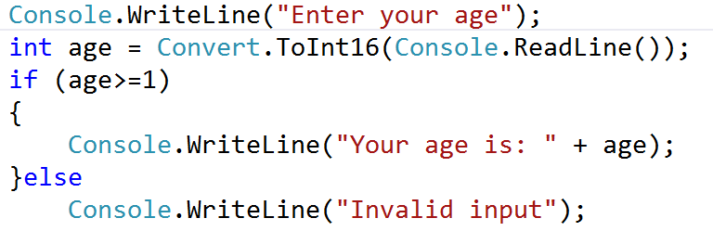
White box testing example
Now we have access to the code
In this case we can see that there is selection controlled by whether the input is >= 1 or not

Slide 12
White box testing - test cases example
White box testing will concentrate on making sure the input set is exercising every possible route through the structure
i.e., both branches of the selection in this case
age >= 1
Display age
Input age
Finish
age < 1
Display msg

Slide 13
White box testing - test cases example
Case id | Input | Expected output | Actual output | Status
1 | 10 | You are 10 year(s) old
2 | -1 | Invalid input
3 | 1 | You are 1 year(s) old
4 | twenty | Invalid input
Case 1 to cover the “if” path of the code.
Case 2 to cover the “else” path of the code.
Case 3 is the extreme/boundary case.
Case 4 is the data validating case.

Slide 14
Calculator example
Specification
Write a program which takes a number, then either invert it or take its square
E.g., if the number is 5 it produces either 1/5 (invert) or 25 (square)

Slide 15
Black box testing - calculator
Typical/normal cases
Input typical positive/negative numbers
Special/boundary/extreme cases
Input 0
Input some long numbers
Input some string such as “twenty”

Slide 16
Black box testing – invert test cases
Input | Expected output | Actual output | Status
10 | Invert result is 0.1 | Invert result is 0.1 | passed
-10 | Invert result is -0.1 | Invert result is -0.1 | passed
0 | Cannot invert 0 | Cannot invert 0 | passed
Twenty | Invalid input | Cannot invert 0 | failed
9999999999999999 | Invalid input | Wrong unexpected result | failed

Slide 17
Black box testing – square test cases
Input | Expected output | Actual output | Status
10 | Square result is 100 | Square result is 100 | passed
-10 | Square result is 100 | Square result is 100 | passed
0 | Square result is 0 | Square result is 0 | passed
Twenty | Invalid input | Square result is 0 | failed
9999999999999999 | Invalid input | Wrong unexpected output | failed

Slide 18
Successful tests of Calculator
Remember
Testing is a “success” if you find the program is faulty BEFORE you ship it to your users
Program cannot deal with large number e.g., 99999999 (giving bad output)
Program doesn’t handle text input for number properly e.g., twenty (giving bad output)

Slide 19
Error handling in Calculator
The black box testing also revealed that there is some error handling in the code
It recognized two standard errors for invert
Trying to invert 0
Trying to invert a text input
It recognized one standard error for square
Trying to square a text input

Slide 20
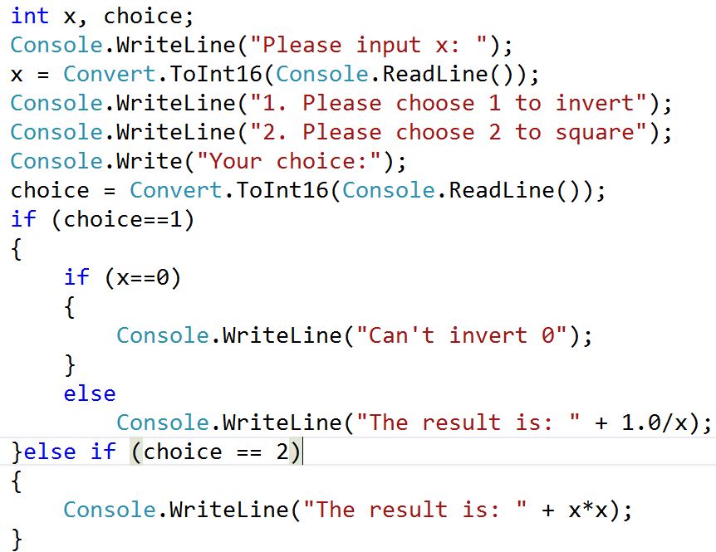
White box testing of the calculator

Slide 21
White box testing of the calculator
x = 0
Display error
choice = 1
x!=0
Display result
Finish
Input x
Input choice
choice = 2
Display result
we must consider the different paths that execution can follow
We need a systematic and organised way of writing this down in a diagram

Slide 22
White box testing of the calculator test cases
There are three different paths in the program
At the very least we must try to find out input values that will take us down each path
Case No | x | choice | Expected output | Actual output
1 | 0 | 1 | Cannot invert 0
2 | 10 | 1 | Invert result 0.1
3 | 10 | 2 | Square result 100
4 | … | … | … | …
5 | … | … | … | …

Slide 23
White box testing of the calculator test cases
Some times, you may have many variables
Too many columns
You could change the representation of the case
Case No. | Input | Expected output | Actual output
1 | x = 0; choice = 1; | Cannot invert 0 | Cannot invert 0
2 | x = 10; choice = 1; | Invert result 0.1 | Invert result is 0.100000
3 | x =10; choice = 2; | Square result 100 | Square result is 100.000000
4 | … | … | …
 | … | … | …
write some evaluations about why these are passes?

Slide 24
Strategy for the complicated case Using Whitebox testing
In reality you may have many paths
In such a case, you should
Split your code into smaller functions
Test each individual functions

Slide 25
Test strategy
You may choose only blackbox testing
If you don’t have source code or time
Make sure your cases cover all situations
You may choose only whitebox testing
If you do have source code and time
Make sure your cases cover all execution paths
You may combine the two approaches
Whitebox for the functions you suspect that there is a mistake or important functions (that you would like to test carefully)
Blackbox testing for other functions

Slide 26
Acceptance Testing
Acceptance testing is the process of comparing the program to its initial requirements and the current needs of its end users
It usually is performed by the program’s customer or end user and normally is not considered the responsibility of the development organization.

Slide 27
Activity
Write test cases for your assignment
Test your test cases and record test results
Evaluate the test results

Slide 28
Summaries
Tests in SDLC
Black box testing
White box testing
Test case inputs
Results for test cases
Test results evaluation

Slide 29
References
Software Testing Testing Across the Entire Software Development Life Cycle. Gerald D. Everett, Raymond McLeod, Jr. IEEE press

