Slide 1

Absenteeism DATA ANALYSIS
Huy Nguyen
ISM 6358
07/17/2023

Slide 2
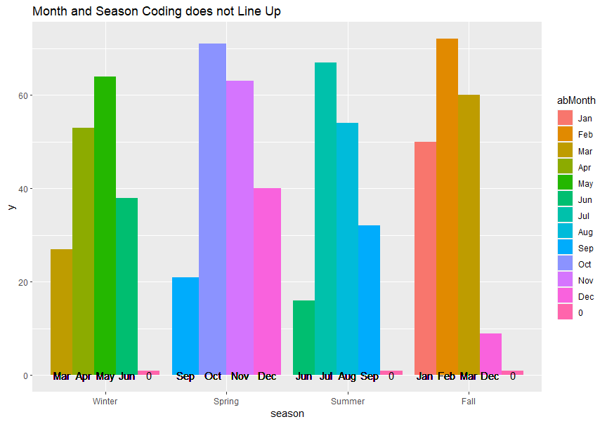
1. BAD Data ENTRY PRACTICES

Slide 3
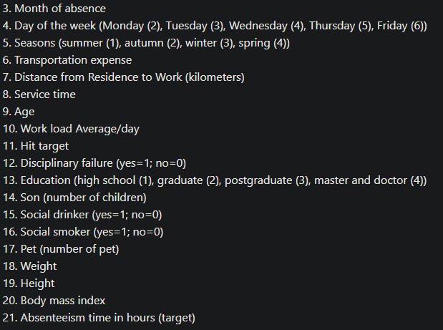
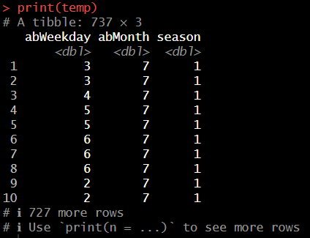
Barebone metadata
Little to None Metric Definitions
Bad Metric choice
Lack of Metric Directly Related to the Absenteeism
Overly focus on sick leaves
Better metrics might be job satisfaction, working condition
https://archive.ics.uci.edu/dataset/445/absenteeism+at+work

Slide 4
2. Findings

Slide 5
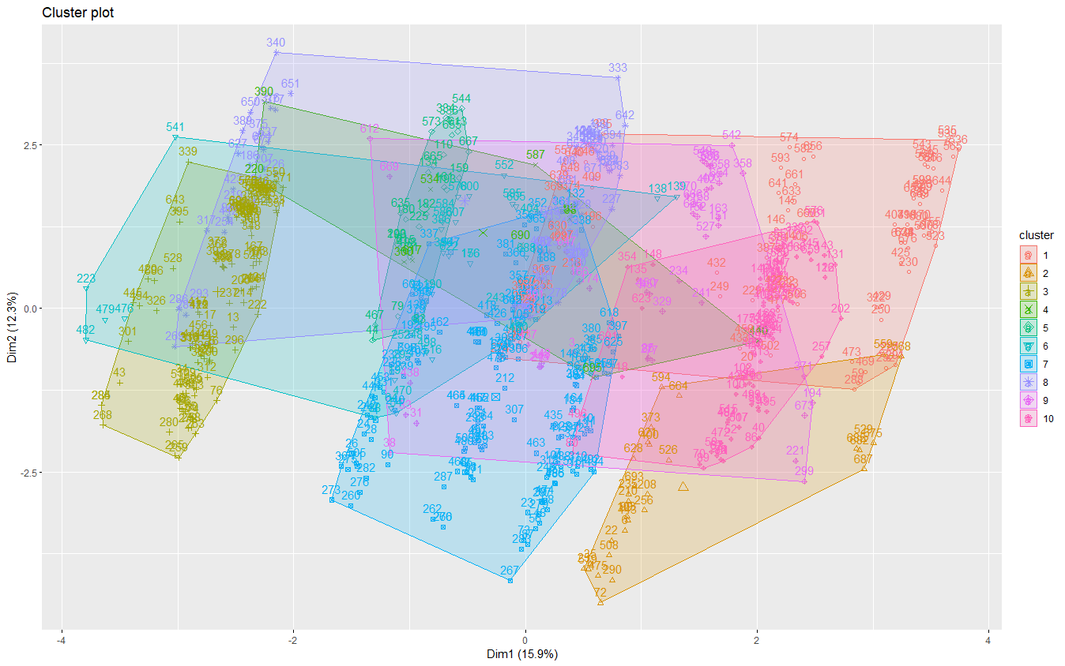
K-MEANS CLUSTERING (FAILED)

Slide 6
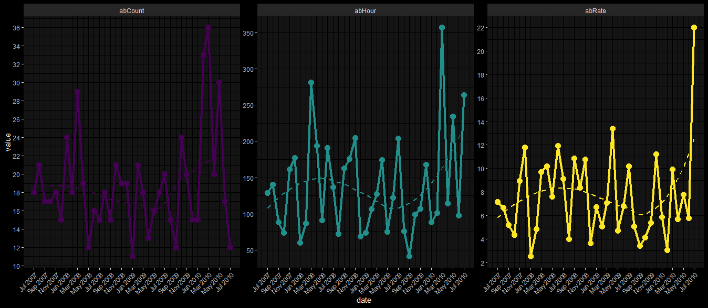
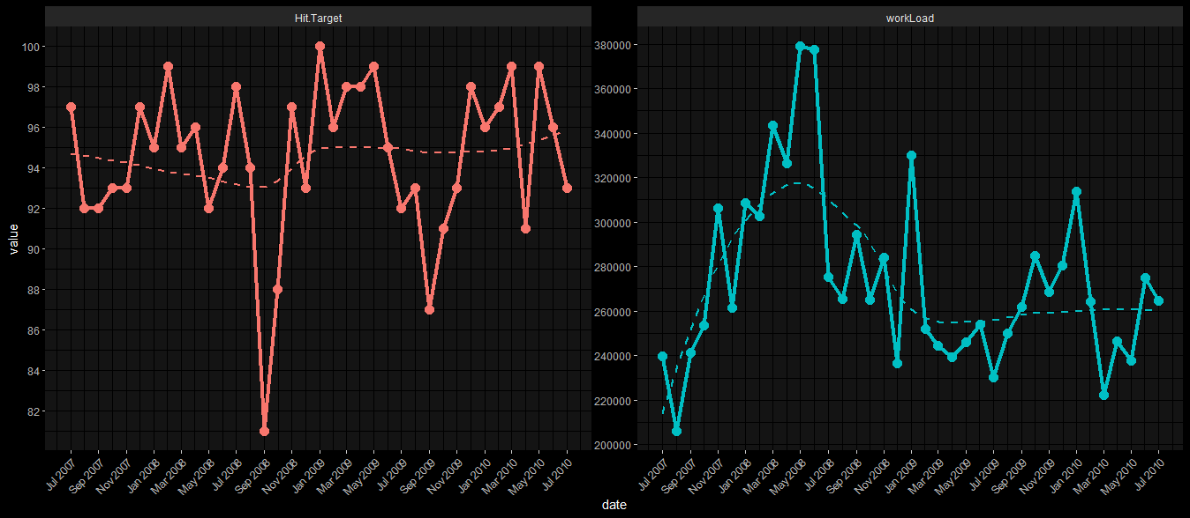
Relationship between absenteeism and work metrics
The monthly absence rate on average is 7.5 hours per absence day with an average absence count of 18 absences per month
Changes in absence patterns do not significantly impact the achievement of targets, which typically remains consistently high, often exceeding 90%.

Slide 7
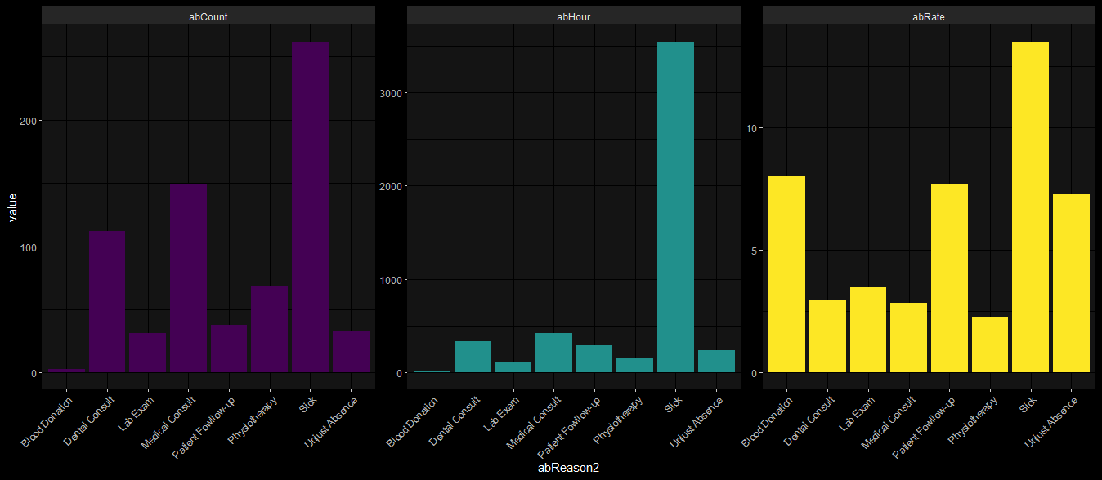
Reasons FOR ABSENCES
Sickness is the main reason for employee absences

Slide 8
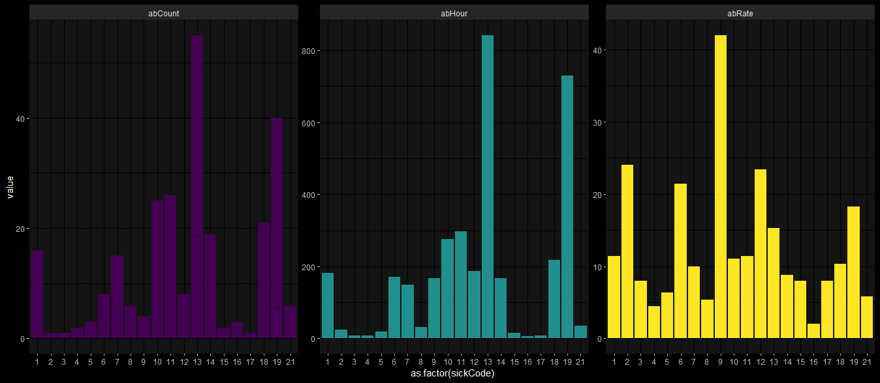
Reasons FOR ABSENCES
Most sick leaves are musculoskeletal related

Slide 9
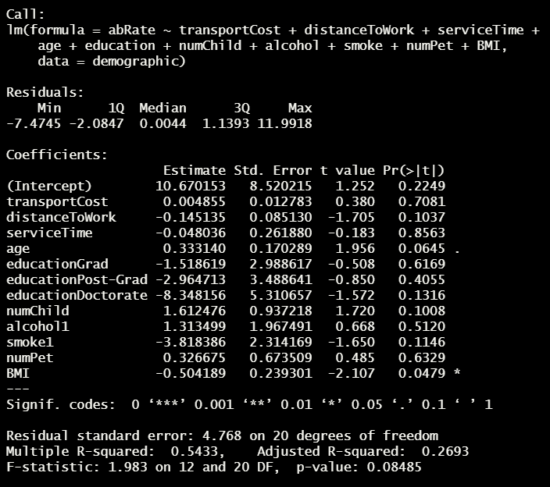
REGRESSION
Regression found two minor barely significant relationships, but the model overall is insignificant

Slide 10
3. RECOMMENDATION

Slide 11
RECOMMENDATIONS
Better Data Entry
Need younger demographic
Improve employee’s working conditions
Promote healthier lifestyles

Slide 12
DATA ETHICS

Slide 13
3Ws
Solid Analyses
Reverse engineering dataset
The acceptance of the cruel reality of data analytics in the real world
No dashboard
Clustering was too complex to implement
Setback due to bad data entry/codebook

