Slide 1

March 11, 2023
Huy Dang Nguyen
Text Mining Project
NO LONGER HUMAN
Dazai Osamu

Slide 2
BUSINESS STATEMENT
TEXT MINING PROCESS
AGENDA
ANALYSIS
3Ws

Slide 3

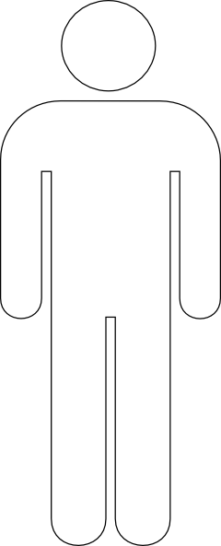

BUSINESS STATEMENT

Slide 4
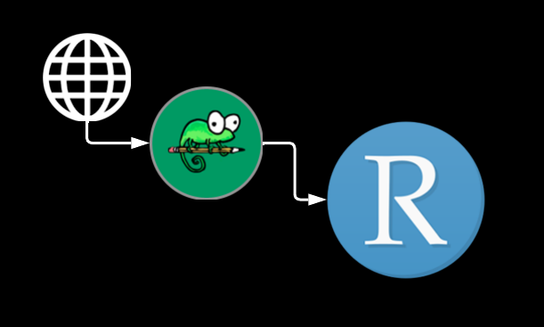
TEXT MINING PROCESS
Data Preparation
Analyses
Tokenization
Standardization
Lemmatization
Remove Stop-words
Word Frequency
N-Gram
TF-IDF
Sentiment Analysis

Slide 5
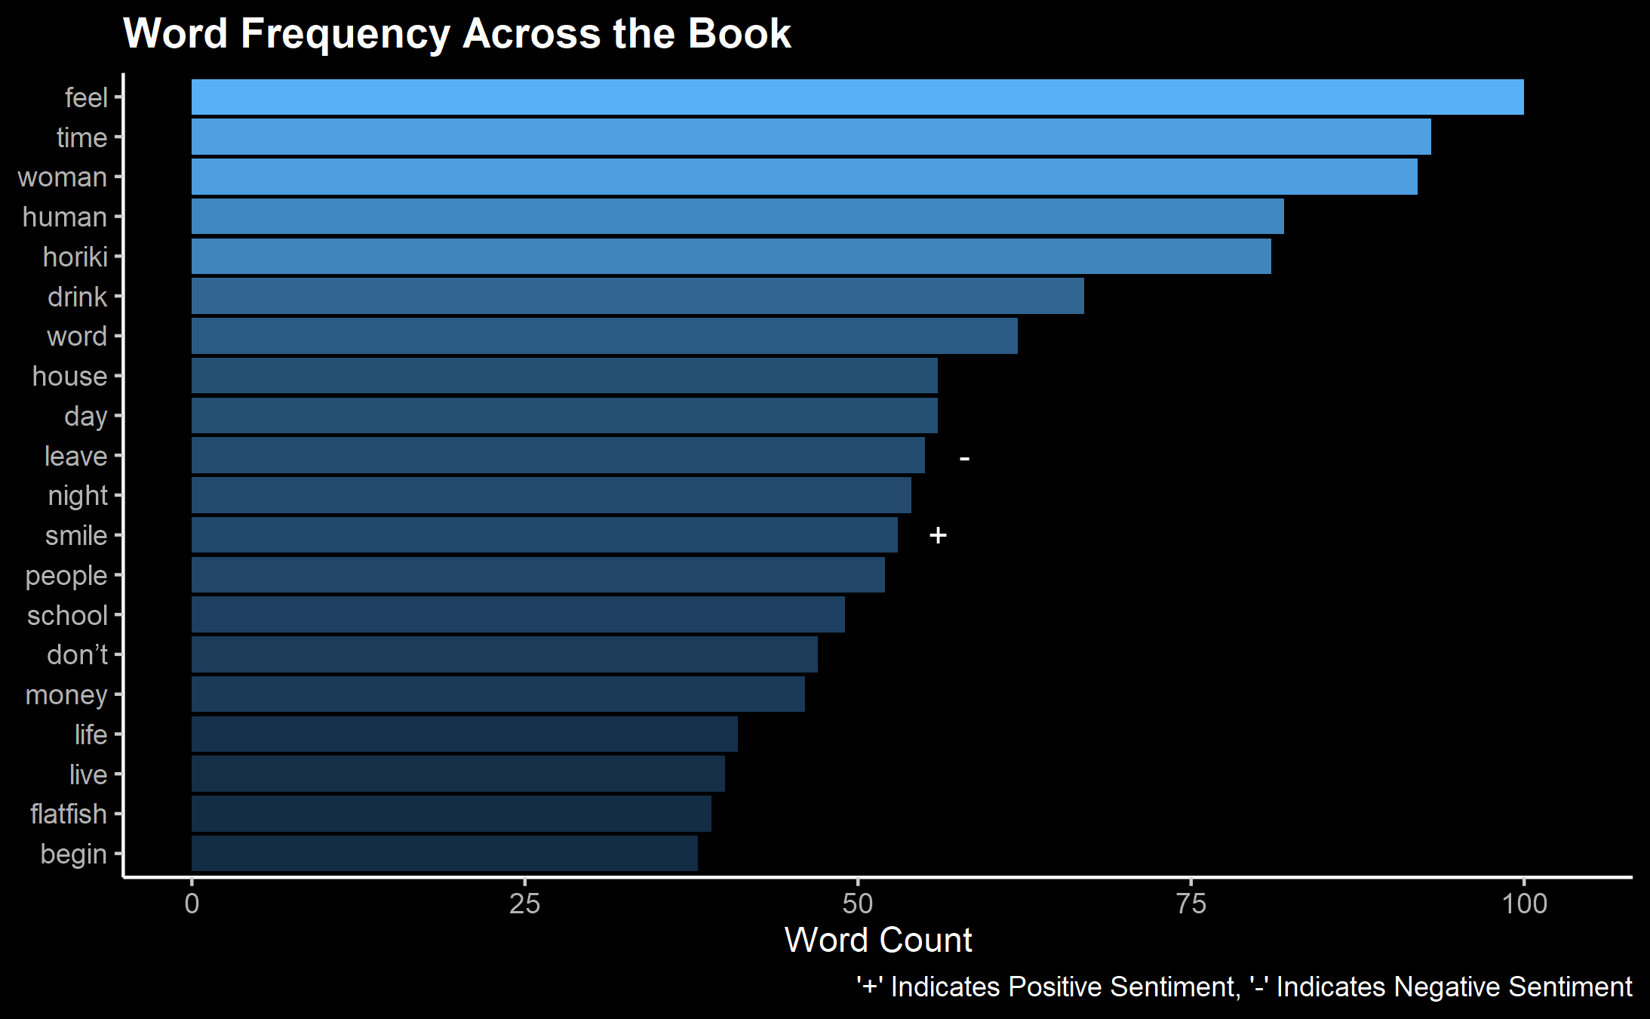
ANALYSIS – WORD FREQUENCY

Slide 6
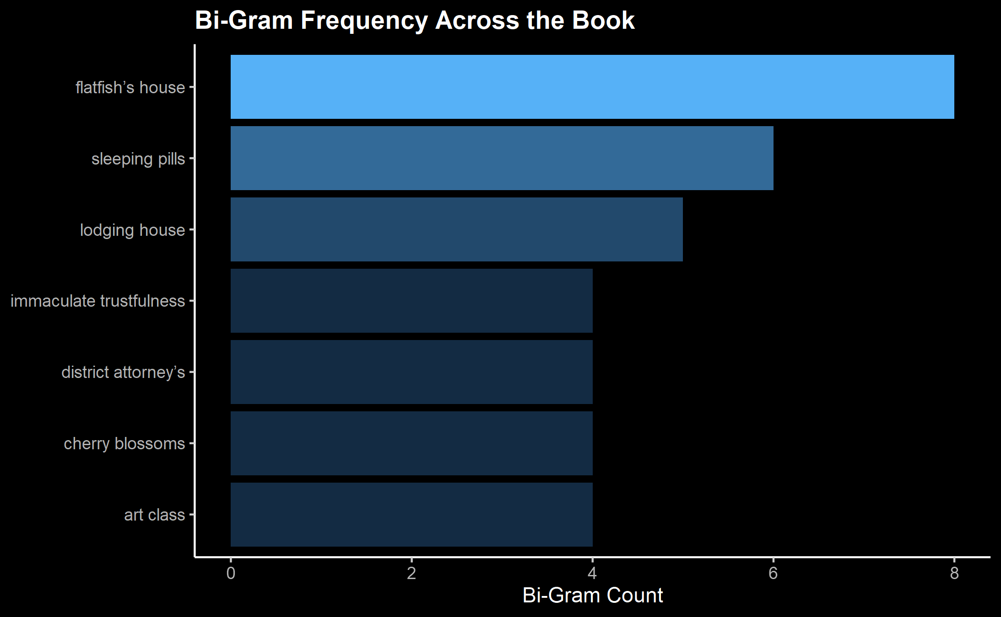
ANALYSIS – BI-GRAM FREQUENCY

Slide 7
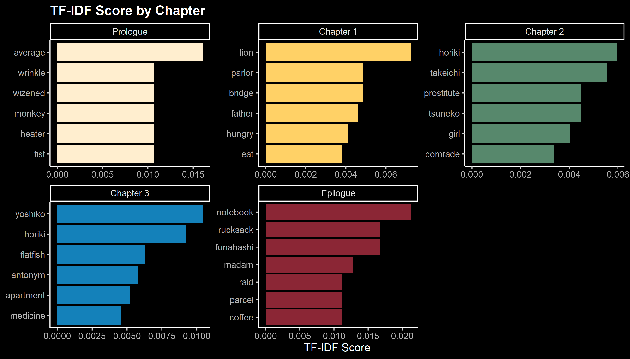
ANALYSIS – TF-IDF

Slide 8
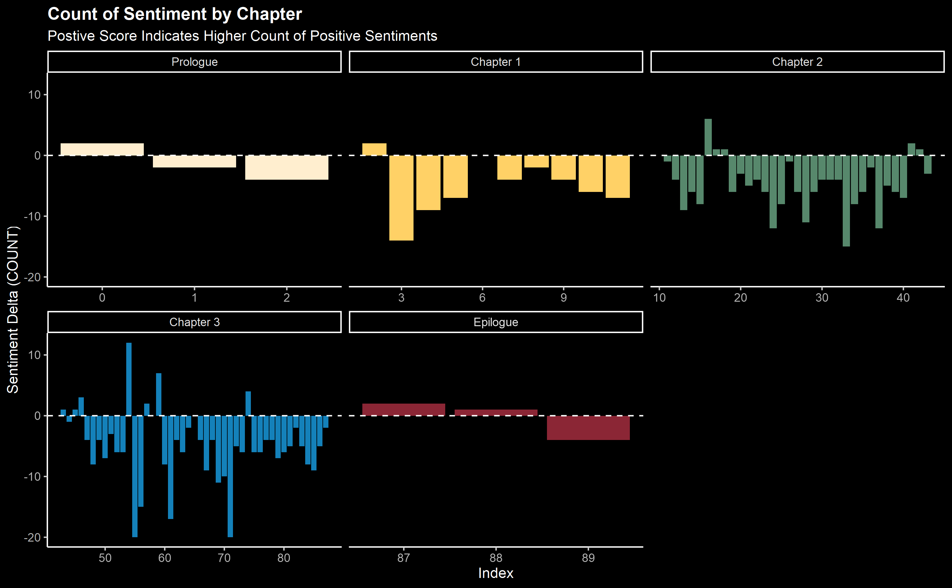
ANALYSIS – SENTIMENT ANALYSIS

Slide 9
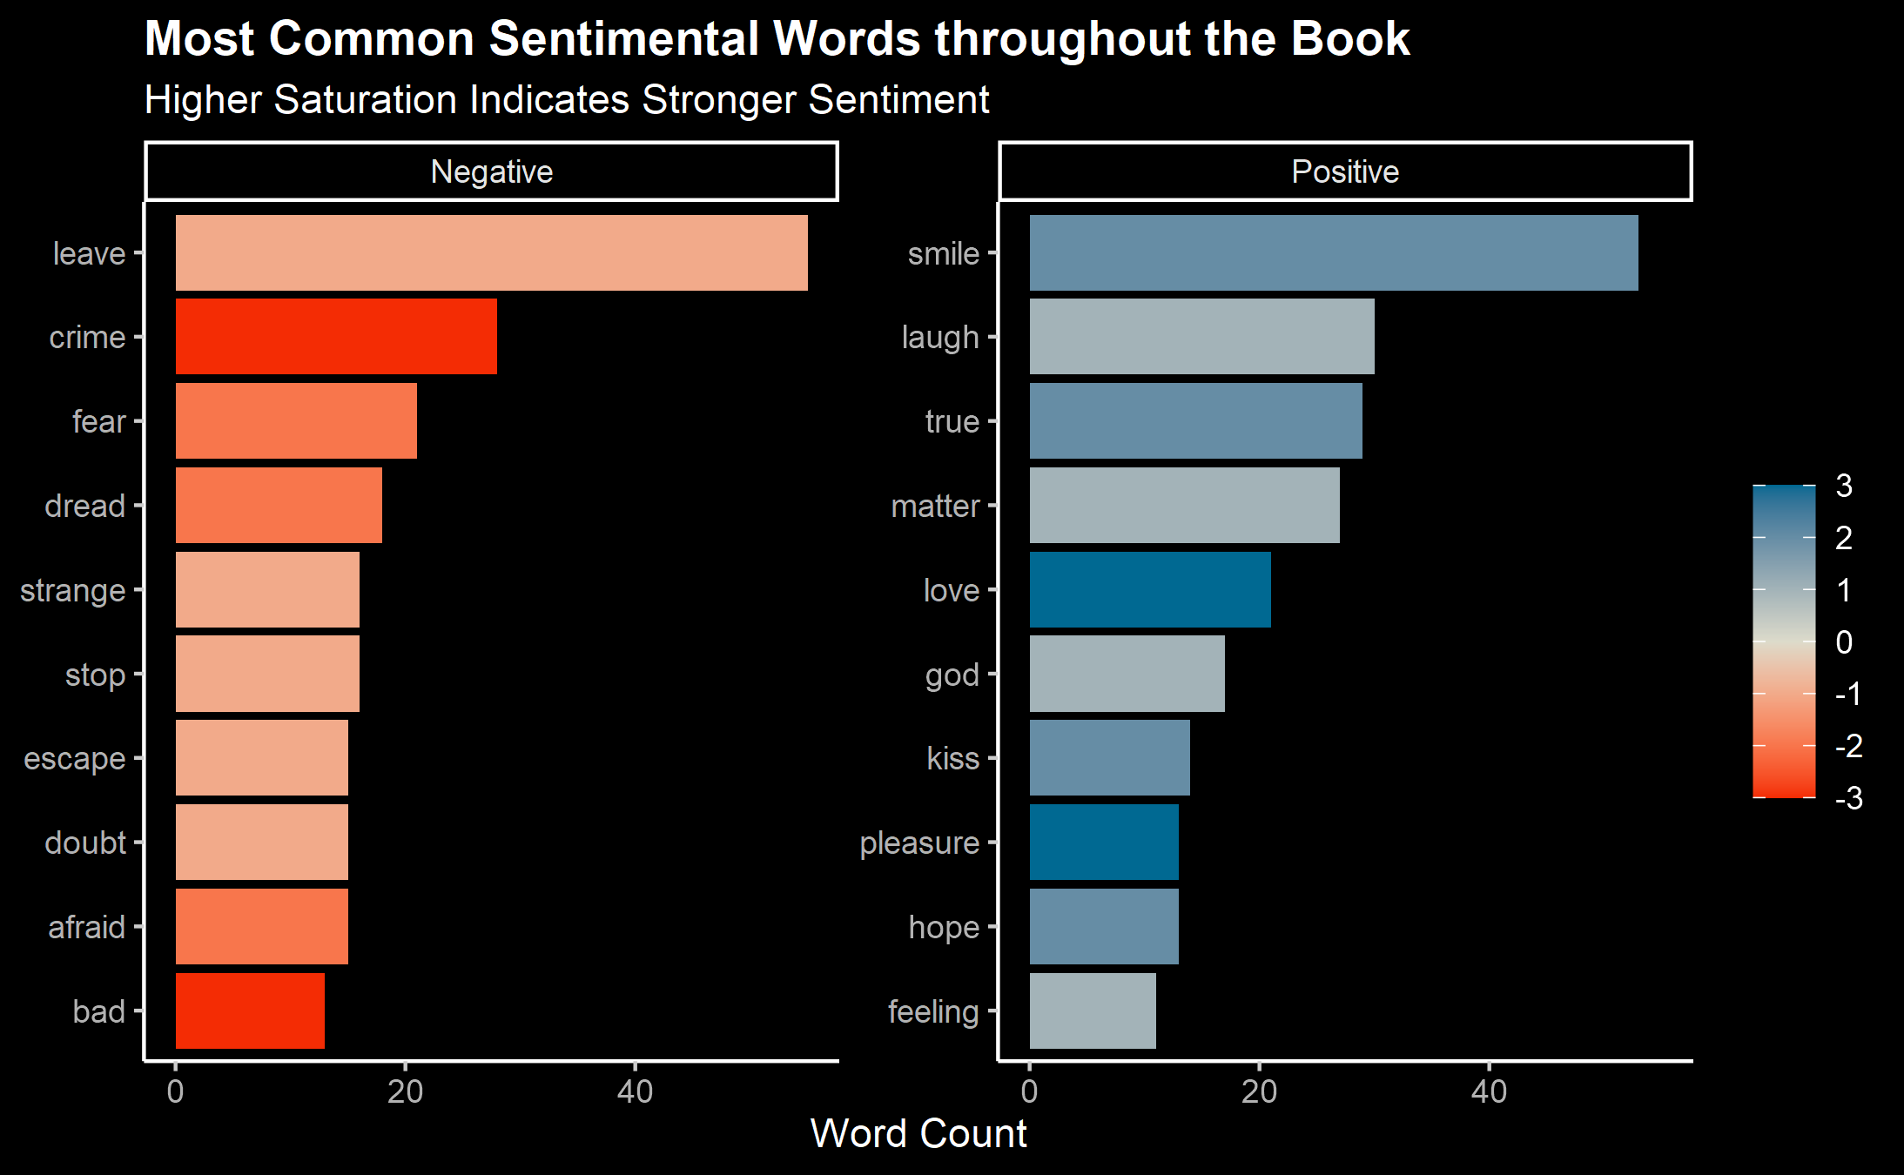
ANALYSIS – SENTIMENT ANALYSIS

Slide 10
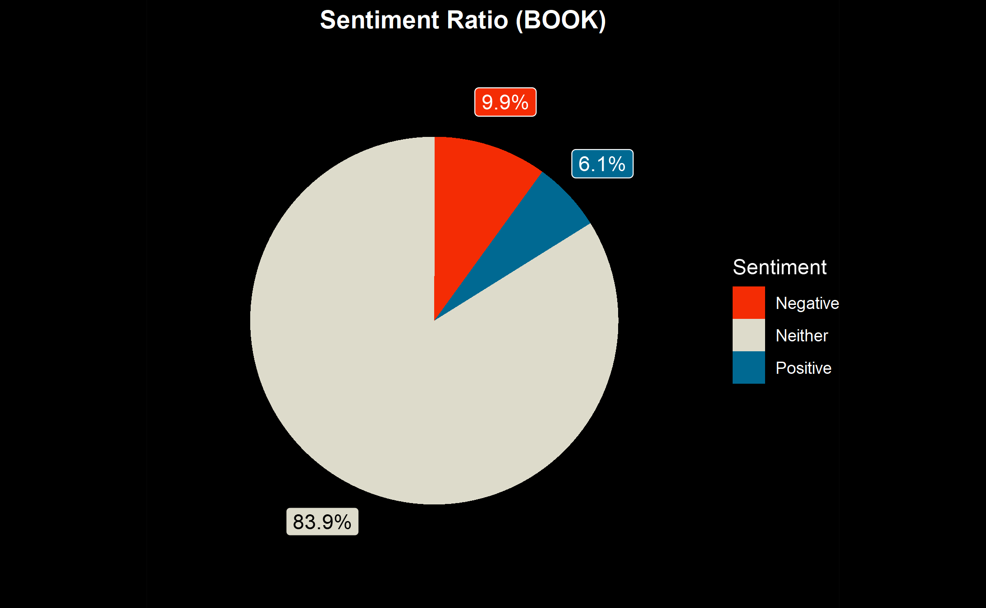
ANALYSIS – SENTIMENT ANALYSIS

Slide 11

3Ws
What Went Well
What Did Not Go Well
Potential Improvements
Sentiment analysis is context-dependent. Thus, custom sentiment libraries are always preferable over default ones
The book was too short for TF-IDF and N-Gram Analysis
Cross-referencing source materials post-sentiment analysis
Increase scope to multiple documents instead of one
More fancy graphs!

