Slide 1
Flight
Lars Lindholm
Niclas Wahlgren

Slide 2
Hur
Fre em, analys mha papper och penna
Må fm, fortsatt analys nu mha easyUML i Netbeans
Må em – To, implementering (Ti-To 2pers)

Slide 3
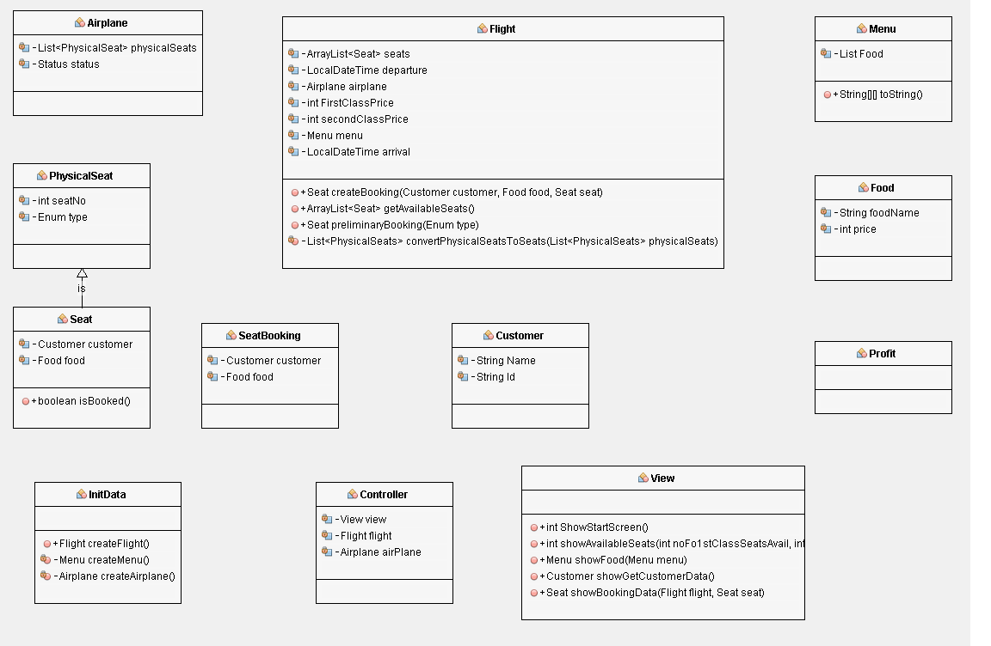
Analysresultat mha easyUML

Slide 4
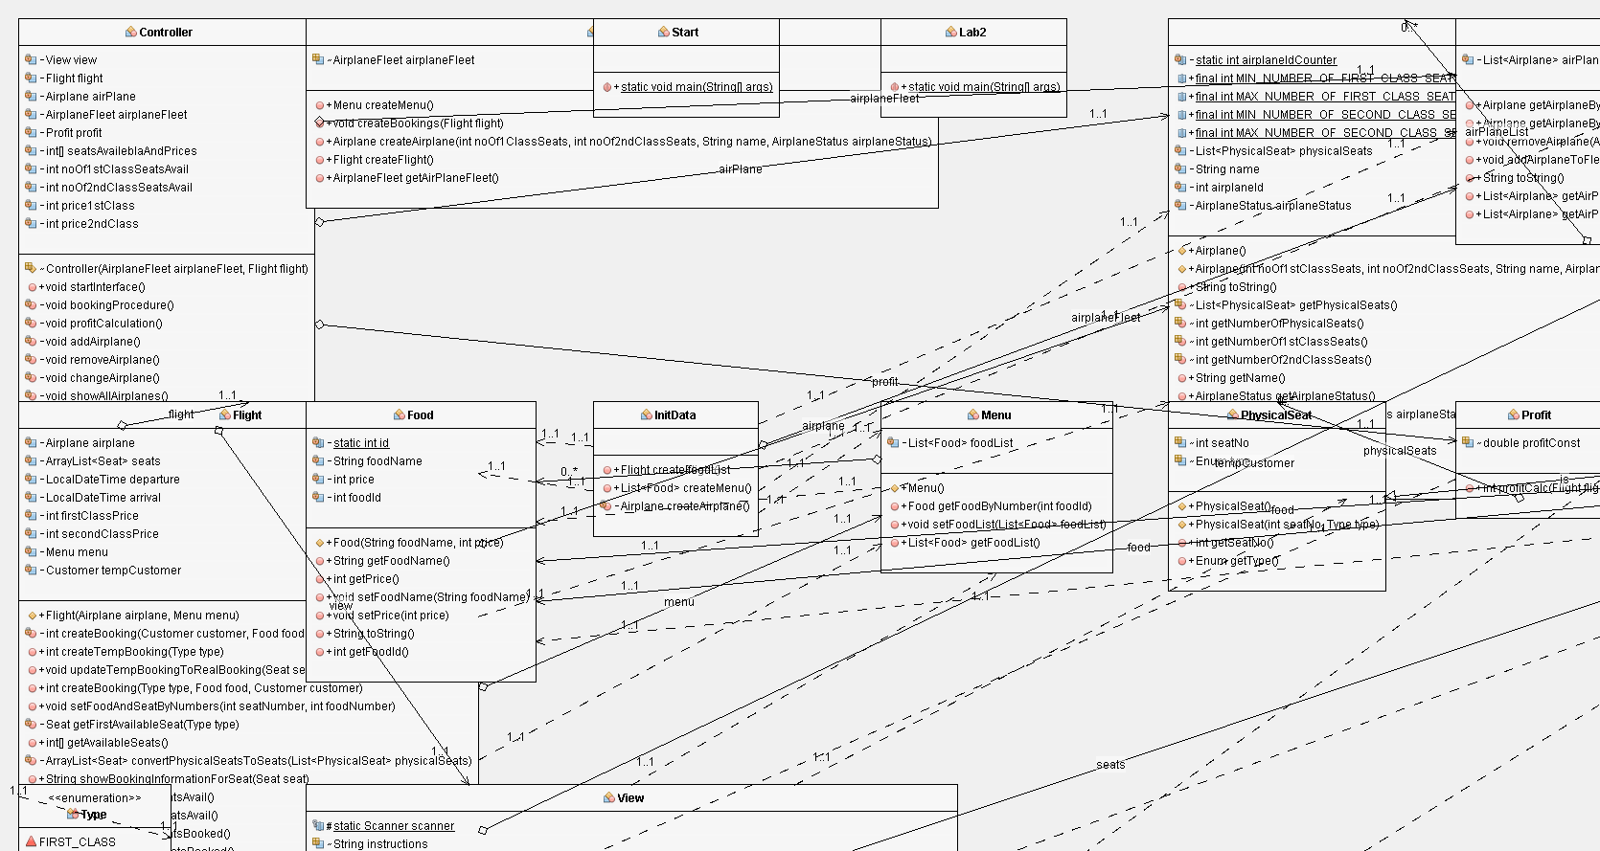
Implementering: easyUML diagram

Slide 5
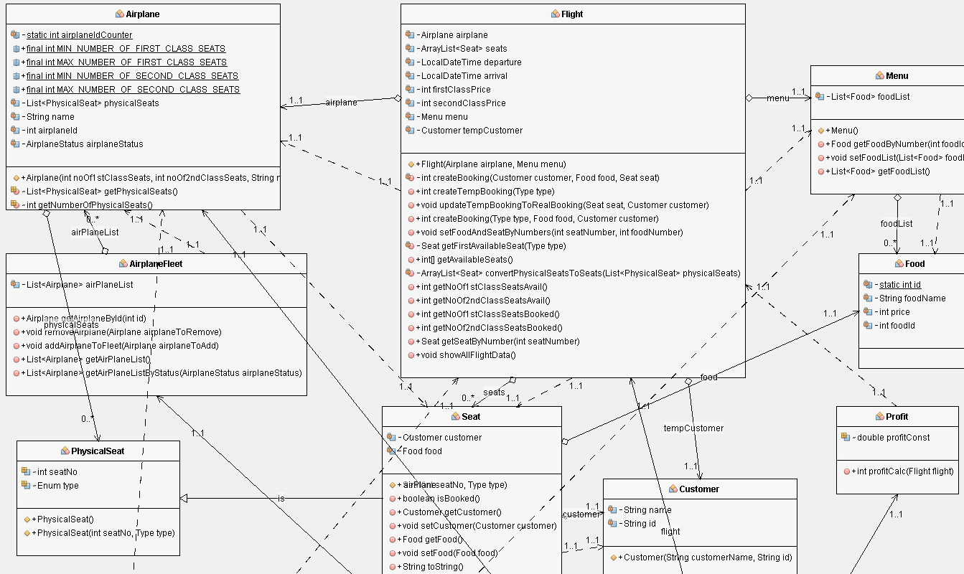
UML

Slide 6
Flight klassen
Flight
Menu
Airplane
PhysicalSeat
Food
Seat
Customer
Food

