Slide 1
SwitchExecutive App
(for InstrumentStudio 2019)
Kunal Patel
11/26/2019

Slide 2
UX Walkthrough
"If I were given one hour to save the planet, I would spend 59 minutes defining the problem and one minute resolving it“
- Albert Einstein

Slide 3
Switch Executive Background
https://www.ni.com/en-us/innovations/white-papers/06/what-is-ni-switch-executive-.html
Supports combining multiple switches into a ‘virtual device’.
Allows creating ‘routes’ that combine other routes (ex. connectArbToScope).
Configuration happens in MAX and is system wide.
Costs $
Sits on top of NI-Switch.
Built into TestStand

Slide 4
Switch Executive App
Tech week project by Kunal Patel
Simple App that plugs into InstrumentStudio 2019 as a ‘hosted application’
Can be built using just VisualStudio.
As-is with no warranty
Supports
Connecting/Disconnecting routes made in MAX.
Seeing route and channel information (in large mode)
Small and large presentations.
Monitors running code (can be disabled)
Saving/loading with the .sfp

Slide 5
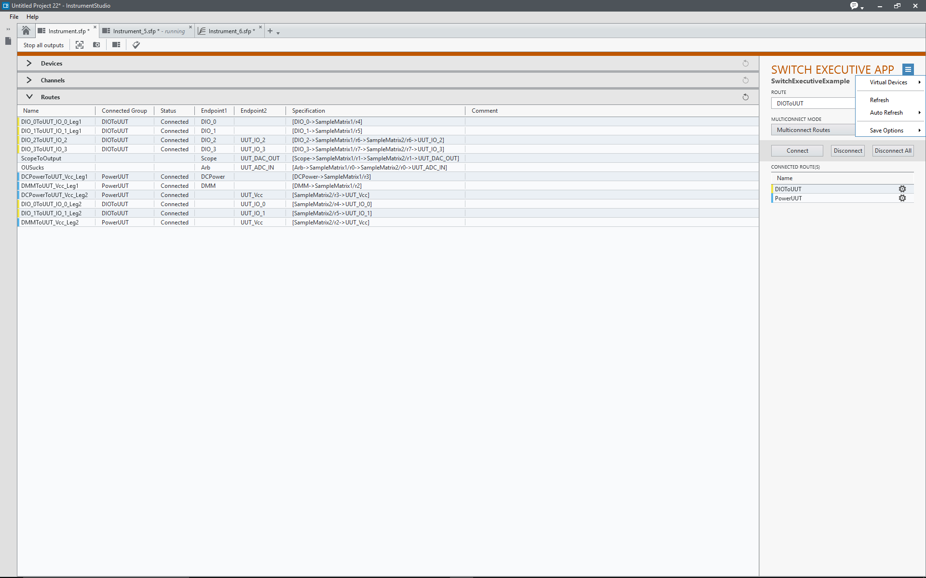
Save/load participation
Device selection
Refresh of automation code
Readonly information from MAX
Connected routes
Option to include connected routes as part of save

Slide 6
System OverView
"Make it simple, but significant."
- Don Draper, fictional character on Mad Men

Slide 7
Design
MVVM
Utilize notifiers in model because driver can change model state across many views.
Use async Tasks for driver operations that change device state.
Simple error handling
View Models
Header
Header Menu
SwitchExecutiveControl
Configuration
Connected Route Table
Channel Table
Visualization
Device Table
Route Table

Slide 8
Design
Models
NISwitchExecutiveDriverOperations
Contains most of the interaction with SwitchExecutive.
Uses notifiers to let viewmodels to notify their views.
NISwitchExecutiveInterface
Contains a few simple objects to hold information for the tables in the visualization views
NISwitchExecutiveConfigurationUtilities
Has code to lookup in the registry if SwitchExecutive is installed.

Slide 9
Design
Common (folder)
Basic classes that can be used by any app.
Local to assembly to allow apps to make changes and not impact an app from another user.
Controls (folder)
A few basic controls and XAML extracted from InstrumentStudio 2019 code base to allow for a similar look and feel as NI panels

Slide 10
Test
Very basic testing.
Integration test component that requires SwitchExecutive to be installed which operates on the ‘model’.

Slide 11
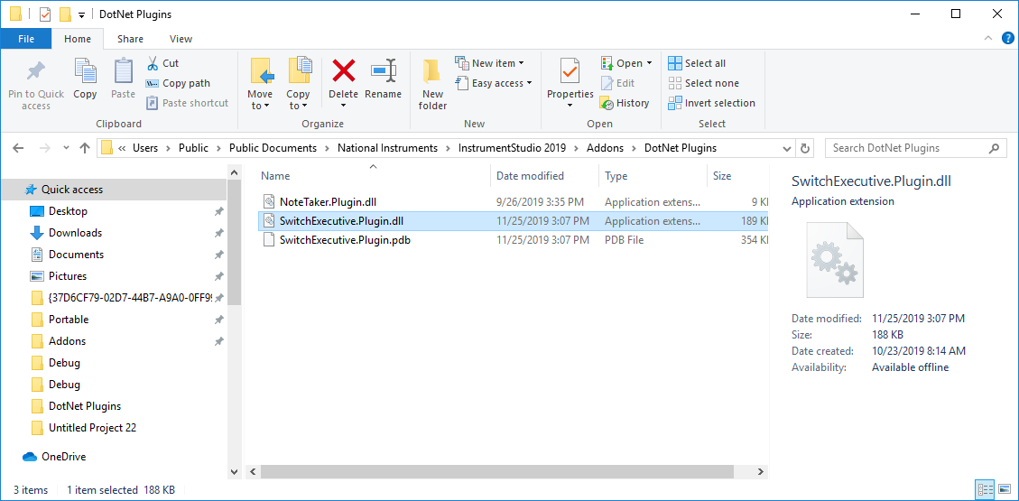
Installation
Copy the plugin to the InstrumentStudio addons folder in users/public. There is a quick link in InstrumentStudio preferences to this directory.

Slide 12
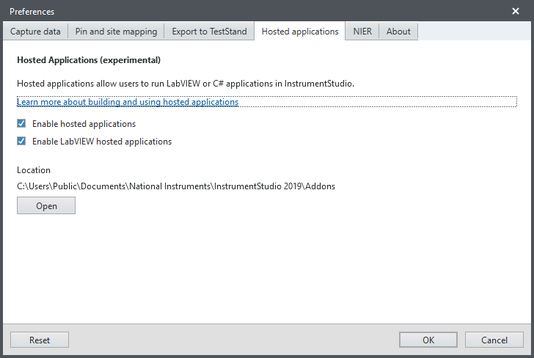
Installation
2. Enable hosted applications in InstrumentStudio preferences

Slide 13
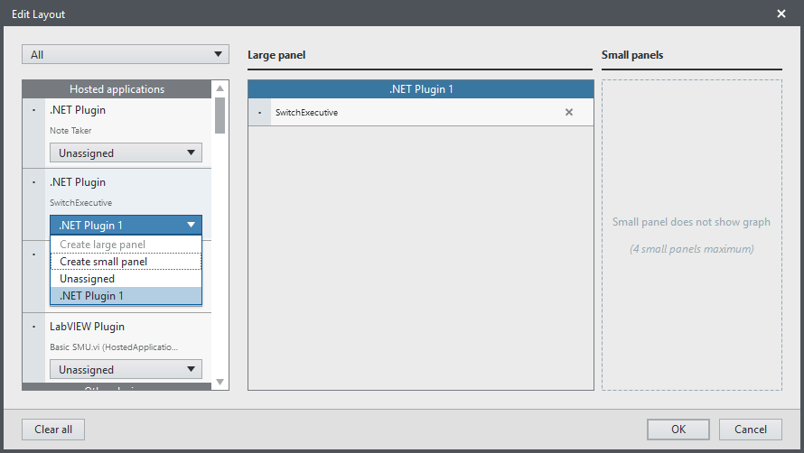
Installation
3. From the picker select the new plugin

