Slide 1

PASEO
TEAM:
Amulya Pindi 46
Naresh Goud 47
Vinutha Muthyala 36
Meghasai Reddy Bodimani 6

Slide 2
OBJECTIVE
To design a feasible application enabling the users to quickly access the available rides mentioned in application and to easily communicate with the user.
To notify and provide security to the users of the application to have a safe journey.

Slide 3
SIGNIFICANT FEATURES
PASEO
Security
Ride Trackway
Easy Interaction
Feedback/
Validations
Riders trackway.
Security.
Feedback.
User Communications.
Login with gmail.
Validations.
Notifying the Users.

Slide 4
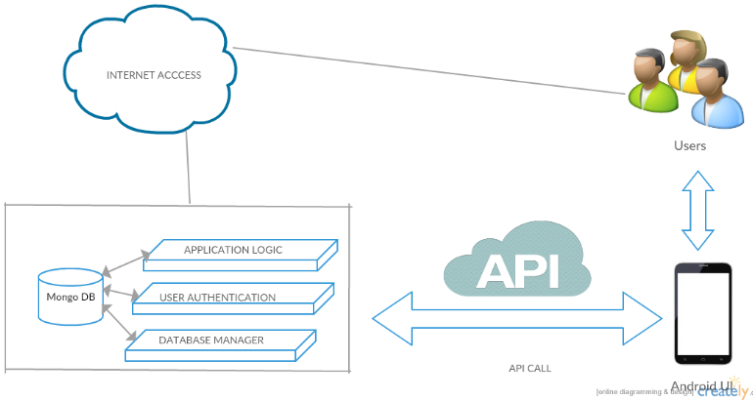
Architecture (PASEO)

Slide 5


