Slide 1
SAM-MedSeg: Improving SAM for Few-Shot Medical Image Segmentation
Deep Learning & Computer Vision — Course Project June 2026

Slide 2
Motivation: The Annotation Bottleneck
• Medical image segmentation requires pixel-level annotations
• Annotation needs radiologist expertise → expensive & time-consuming
• Few-shot segmentation: achieve good performance with very limited labels
• SAM shows impressive zero-shot on natural images — can we leverage it?
⚠ SAM zero-shot on Kvasir-SEG polyps:
Dice = 0.271, Precision = 0.175, Recall = 0.921
→ High recall but extreme false positives — clinically unusable

Slide 3
SAM-MedSeg: Three Key Components
① LoRA Adaptation (227K params, 0.25% of backbone)
• Low-rank decomposition applied to SAM's QKV/proj matrices
• Rank r=4 — injects domain knowledge with minimal overhead
② Automatic Prompt Optimization
• 32×32 grid sampling → per-point SAM inference → IoU filtering → NMS
• Fully automatic, no manual prompts needed
③ Medical Skip-Connection Decoder (30.4M params)
• U-Net style decoder with skip connections from SAM encoder layers
• Recovers fine boundary details lost in SAM's single-scale decoder
④ Learnable Fusion: M_final = σ(α)·M_sam + (1−σ(α))·M_med (α=0.623)

Slide 4
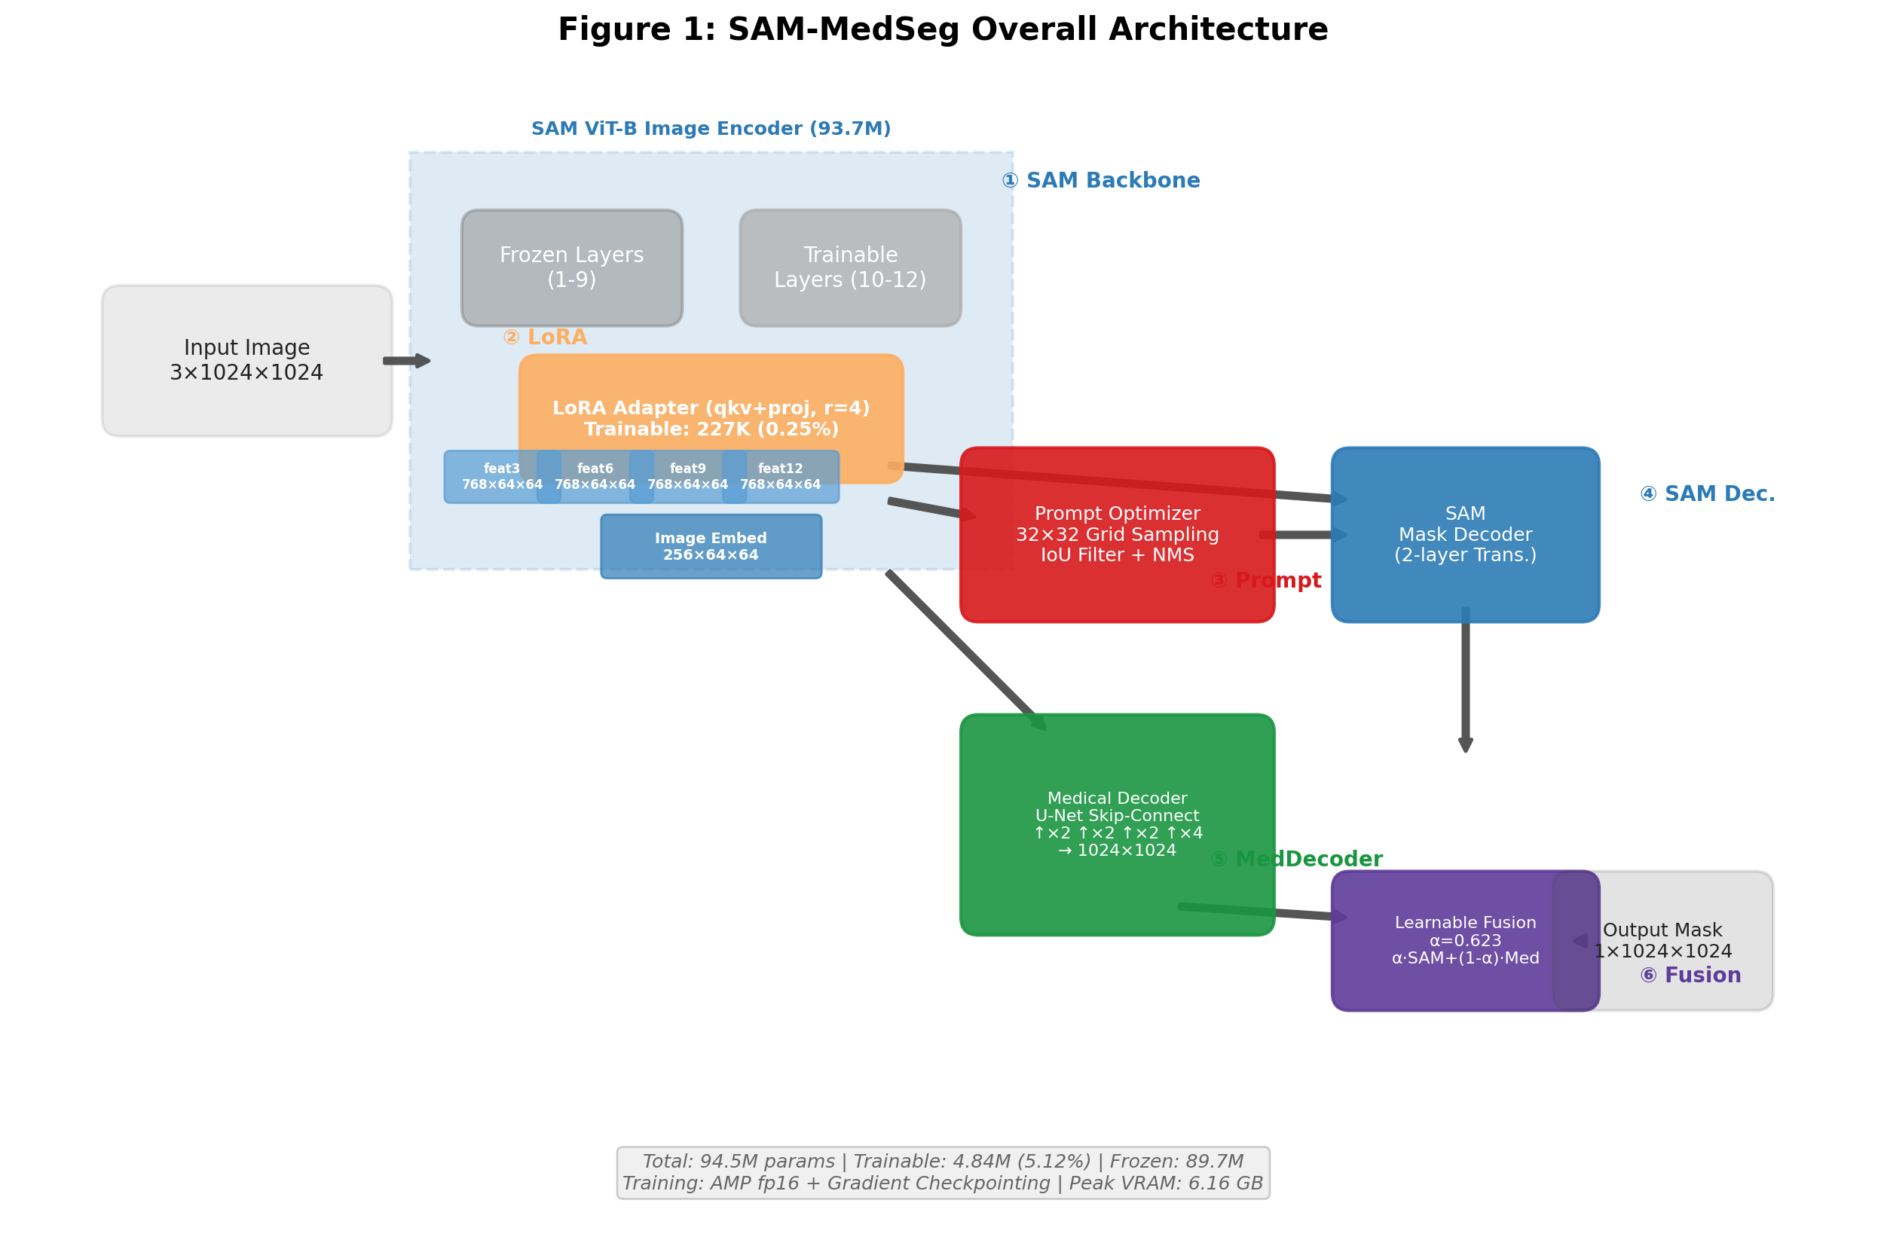
Overall Architecture

Slide 5
Experimental Setup
📊 Dataset: Kvasir-SEG (1,000 polyp images, 1024×1024)
Train/Val/Test = 800/100/100
🔬 Data Efficiency Settings:
1% (8 imgs) | 5% (40 imgs) | 10% (80 imgs) | 100% (800 imgs)
3 seeds each (42, 43, 44) → 12 + 12 + 1 + 2 = 27 experiments total
📏 Metrics: Dice, IoU, Precision, Recall
🖥 Hardware: Single NVIDIA RTX 4060 Laptop (8GB VRAM)
AMP fp16 + Gradient Checkpointing → Peak 6.16 GB
🔬 Baselines: SAM Zero-Shot | U-Net from scratch | LoRA Only | MedDecoder Only

Slide 6
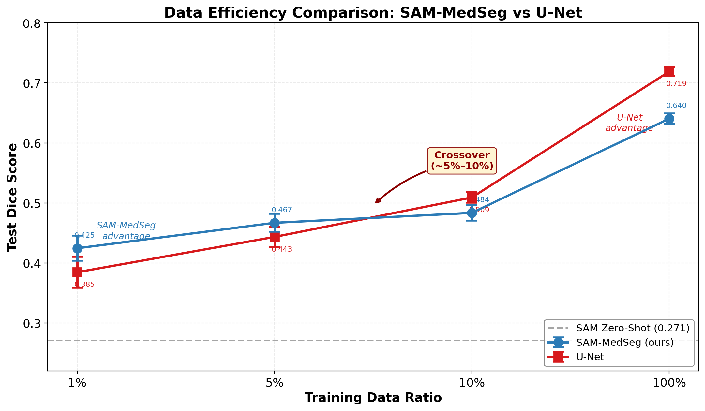
Data Efficiency: SAM-MedSeg vs U-Net

Slide 7
Key Finding: The Crossover Point
🎯 Performance crossover between 5% and 10% data
Data % | U-Net | SAM-MedSeg | Winner | Gap
───────┼───────┼────────────┼─────────────┼──────
1% | 0.385 | 0.425 | SAM-MedSeg ✅ | +4.0 pp
5% | 0.443 | 0.467 | SAM-MedSeg ✅ | +2.4 pp
10% | 0.509 | 0.484 | U-Net 🔄 | +2.5 pp
100% | 0.719 | 0.640 | U-Net | +7.9 pp
💡 Practical takeaway:
≤50 annotated images → Use SAM-MedSeg with LoRA
>50 annotated images → U-Net from scratch is better & simpler

Slide 8
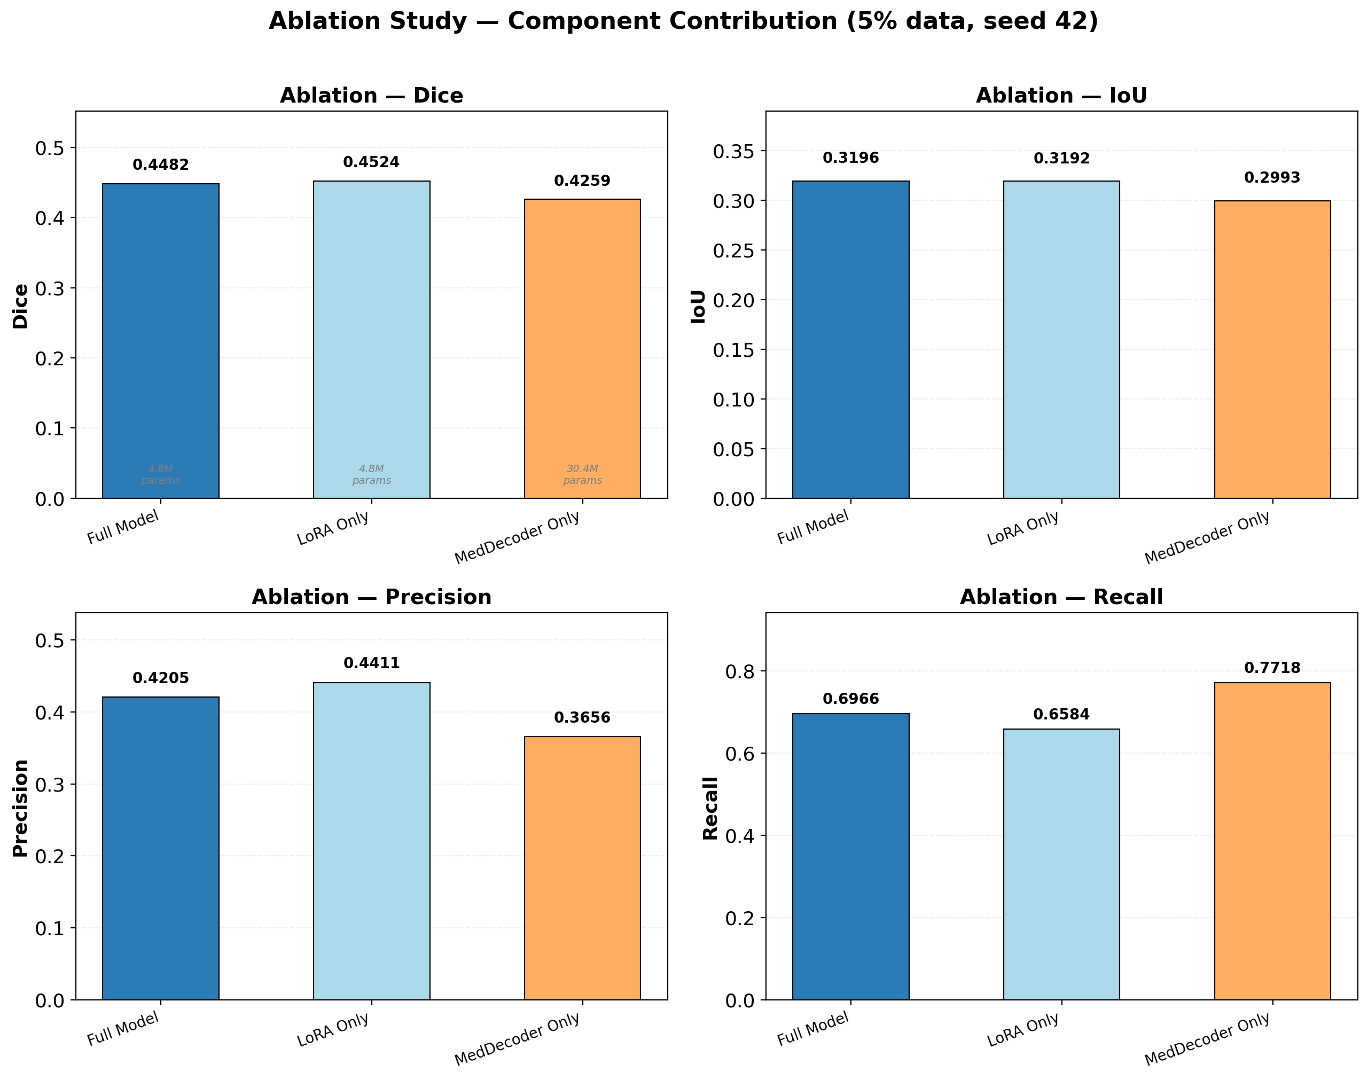
Ablation Study: Component Contributions

Slide 9
Ablation Insights
🔬 At 5% data (40 images, seed 42):
Configuration | Dice | Precision | Recall | Params
───────────────────┼───────┼───────────┼────────┼───────
Full Model | 0.448 | 0.421 | 0.697 | 4.84M
LoRA Only | 0.452 | 0.441 | 0.658 | 227K 👑
MedDecoder Only | 0.426 | 0.366 | 0.772 | 30.4M
💡 LoRA is the core driver of few-shot generalization
• 227K params alone achieve best Dice (0.452)
• MedDecoder provides complementary high recall (0.772)
• Full model balances both strengths via learnable fusion

Slide 10
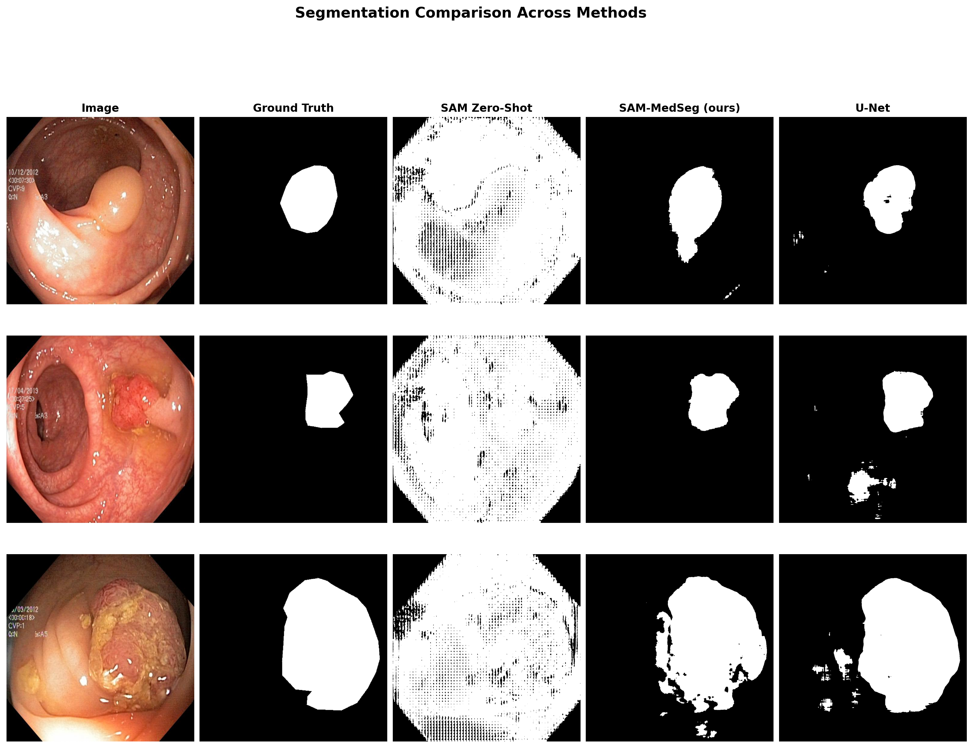
Visual Comparison: Segmentation Examples

Slide 11
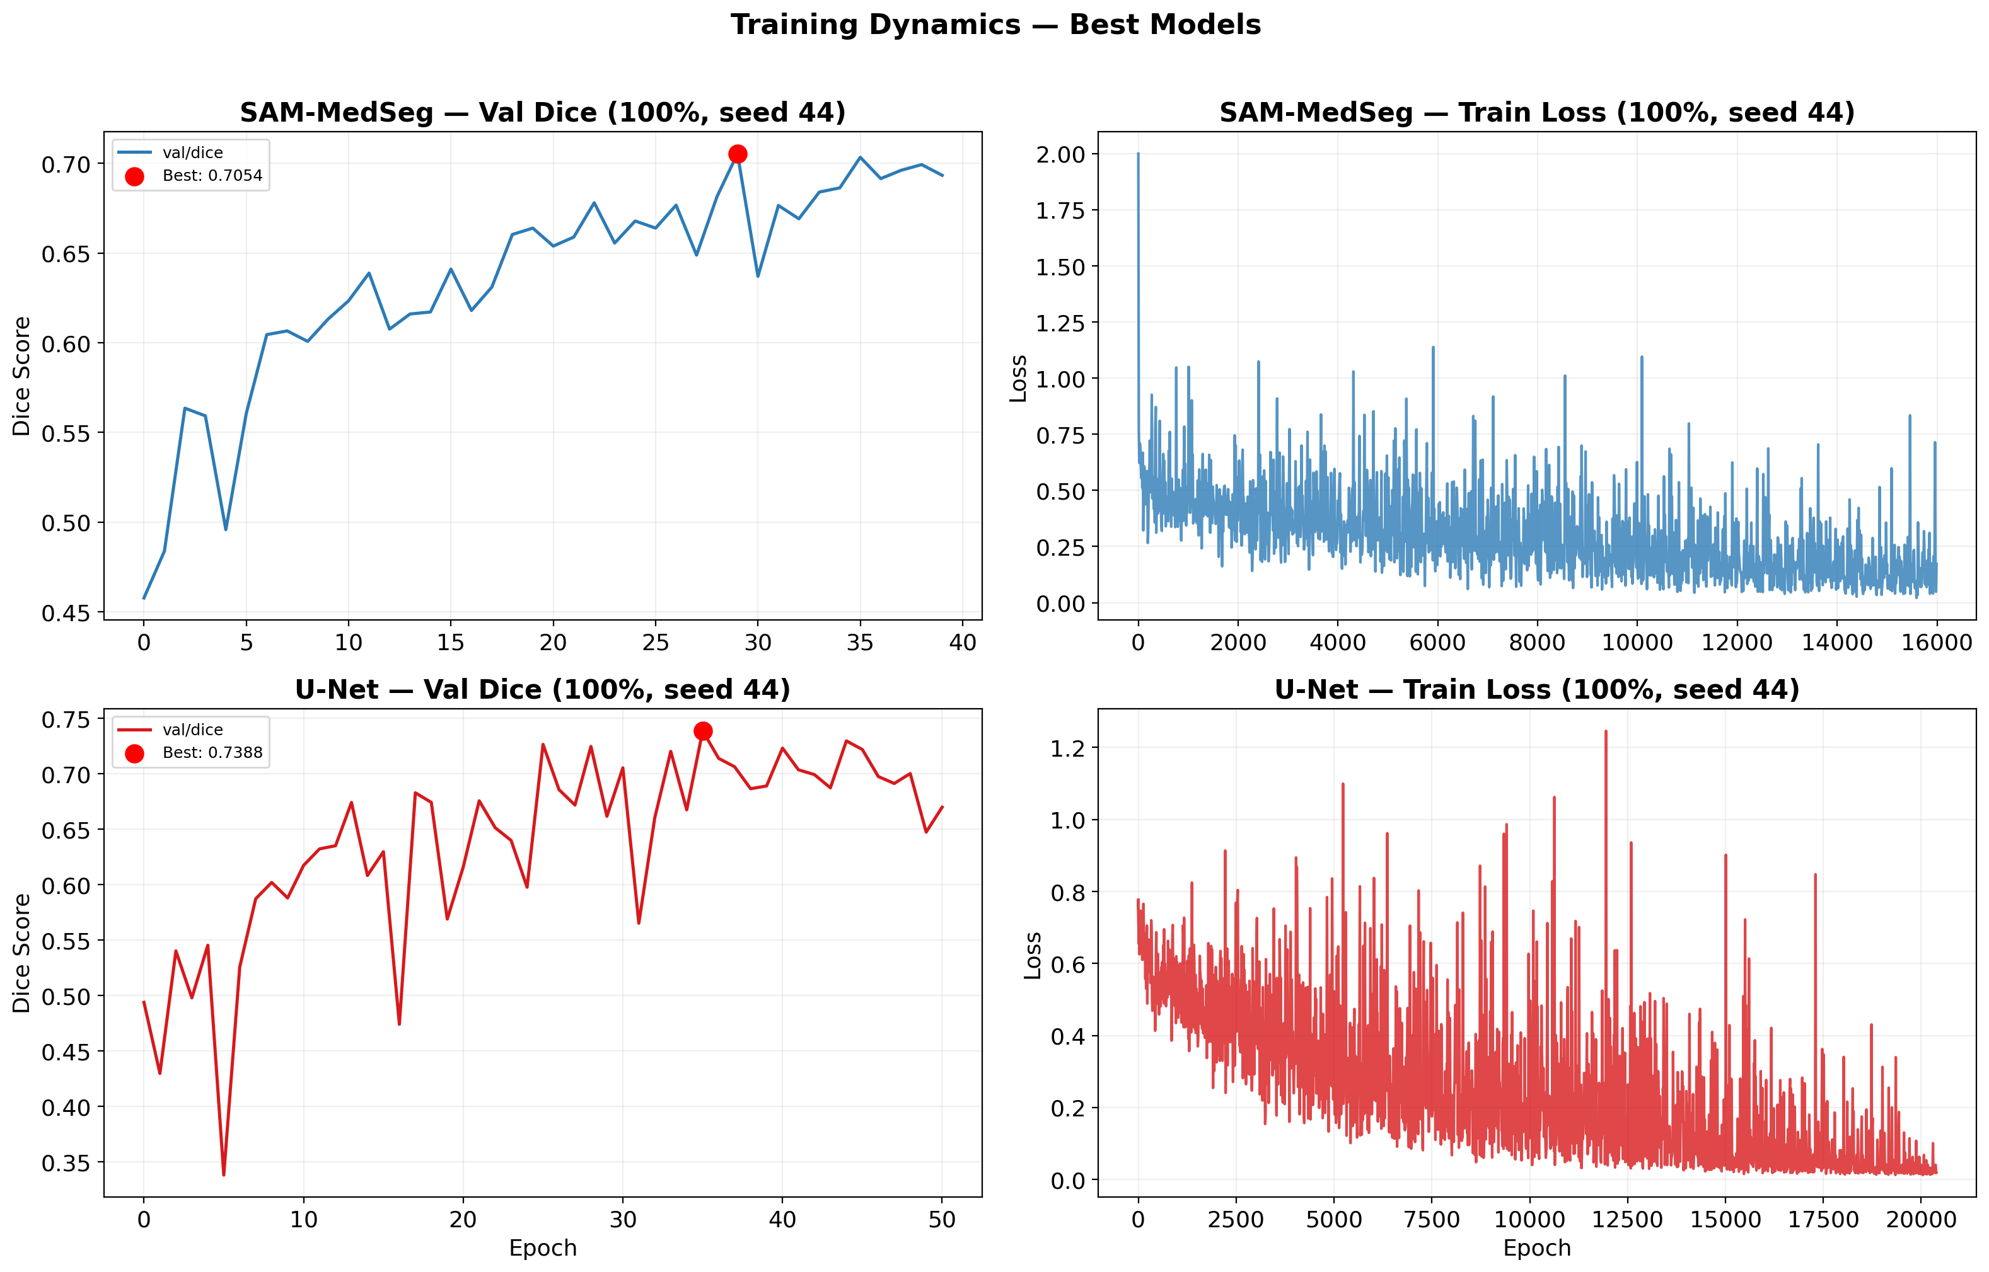
Training Curves: Best Models

Slide 12
Limitations & Future Work
⚠ Known Limitations:
• Over-segmentation of tiny polyps (<3% foreground, Dice 0.237)
• Only validated on single 2D dataset (Kvasir-SEG)
• Grid-sampling prompt strategy is computationally expensive (1024 forward passes)
• Fixed LoRA rank (r=4) — not optimized per data scale
🔮 Future Directions:
• Extend to 3D medical volumes (CT/MRI) with 3D SAM + 3D LoRA
• Lightweight prompt proposal network to replace exhaustive grid search
• Active learning for optimal sample selection within annotation budget
• Multi-center, multi-modal validation for robustness assessment
• Incorporate clinical metadata via text encoders for context-aware segmentation

Slide 13
Conclusion
✅ SAM-MedSeg: parameter-efficient framework for few-shot medical segmentation
✅ LoRA (227K params) is the dominant driver — not expensive decoders
✅ SAM-MedSeg is OPTIMAL when labeled data ≤5% (≤50 images)
✅ Crossover at 5-10% — above this, traditional U-Net is better
✅ Provides practical model selection guidance based on annotation budget
✅ All code, experiments, and figures are reproducible & publicly available
📄 Paper: ~4,400 words | 📊 8 figures | 📚 17 references | 🔬 27 experiments

Slide 14
Thank You! Questions?
Code & Paper: [GitHub Repository] Contact: [Team Members]

