Slide 1
SEP Leap Technologies
Ben Frederiksen
Chris Halvorson
Grant Kimsey
Dave Mathew
Andrew McCurry
Leon Organ
Notes:
Jon Fuller pitched the original idea.

Slide 2
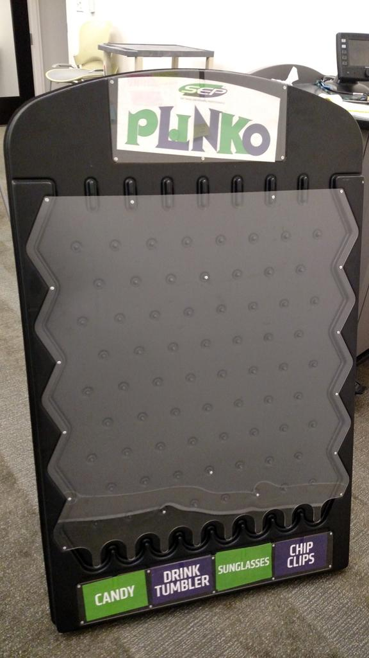
Why?
The Plinko board used by the recruiting team is not “Pro” looking and kind of cheesy.
Notes:
The idea is to retain the tactile engagement, but also showcase something that makes SEP look cool and interesting.

Slide 3
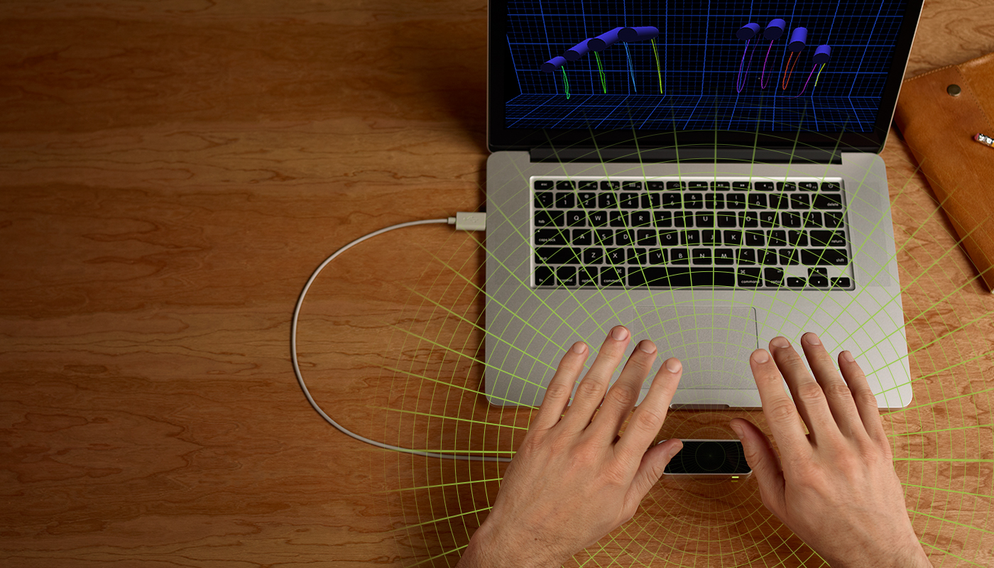
Why Indeed?
The Leap Motion!
https://www.leapmotion.com/
Notes:
From leap:
The Leap Motion Controller senses how you naturally move your hands and lets you use your computer in a whole new way. Point, wave, reach, grab. Pick something up and move it. Do things you never dreamed possible
The controller uses twin IR cameras, this is similar to a Kinect in that it uses optical sensors to detect physical presence and motion. It is designed to work from the table top or attached to VR glasses lie Occulus. It really feels like it should still be in Beta because anything complicated or intricate you would want to do isn’t reliable. One of the biggest limitations is that it can’t see both sides of your hands. It also gets incredibly confused if you touch your hands together.

Slide 4
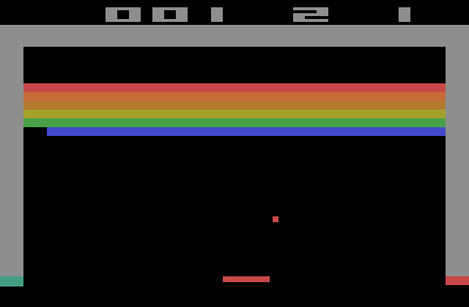
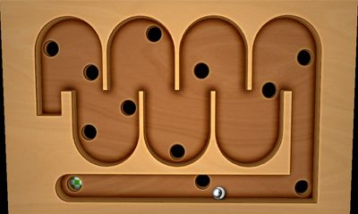
Why stop there?
When can build Breakout
When can build Labyrinth
Notes:
Developers love scope creep.

Slide 5
How do we do that!
Leap Motion
Unity 5.0
Blender
Notes:
The leap is designed to work directly with
Unity
Unreal Engine 4
Javascript
C++
Java
Python
Objective C
Unity work with a combination of proprietary binary file types and C# scripts.

Slide 6
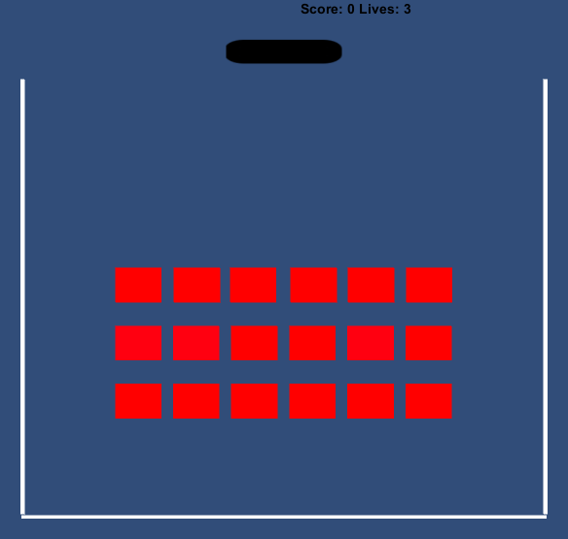
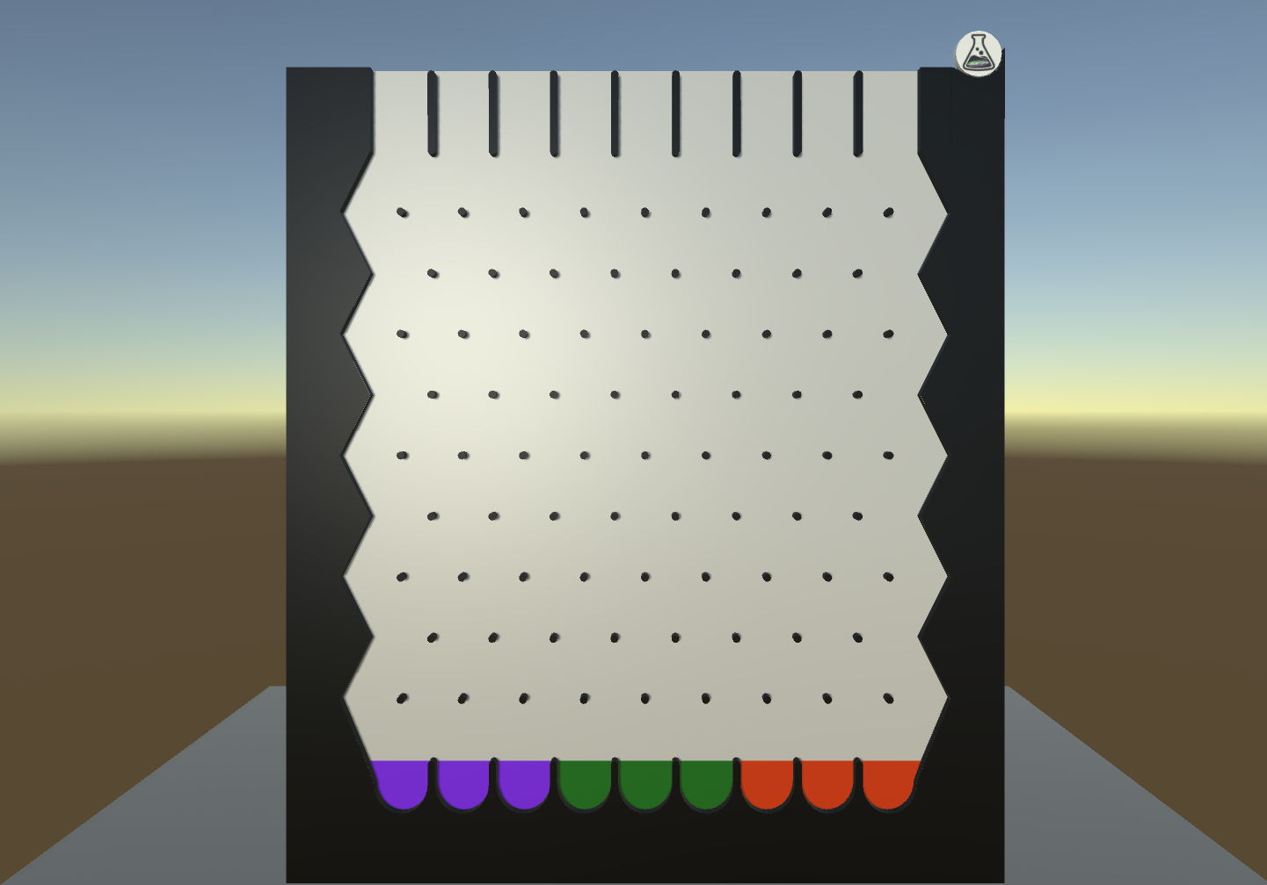
What We Did
Notes:
Demo

Slide 7



Questions Praise Criticism

