Slide 1
SEP Leap Technologies
Ben Frederiksen
Chris Halvorson
Grant Kimsey
Dave Mathew
Andrew McCurry
Leon Organ

Slide 2
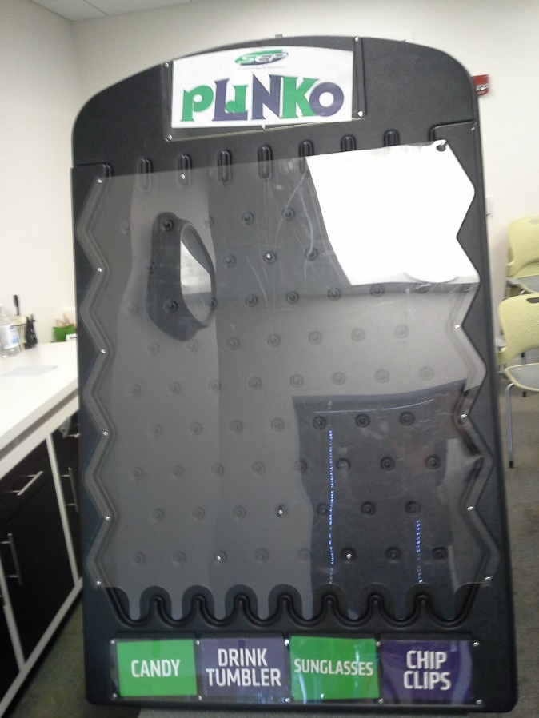
Why?
The plinko board used by the recruiting team is unprofessional looking and kind of lame.

Slide 3

Why Indeed?
The Leap Motion!
https://www.leapmotion.com/

Slide 4

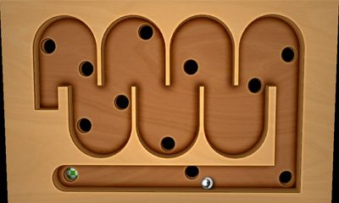
Why stop there?
When can build Breakout
When can build Labyrinth

Slide 5
How do we do that!
Leap Motion
Leap Motion SDK
Unity 5.0
Blender

Slide 6
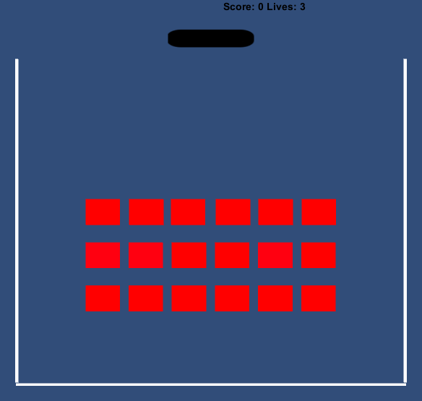
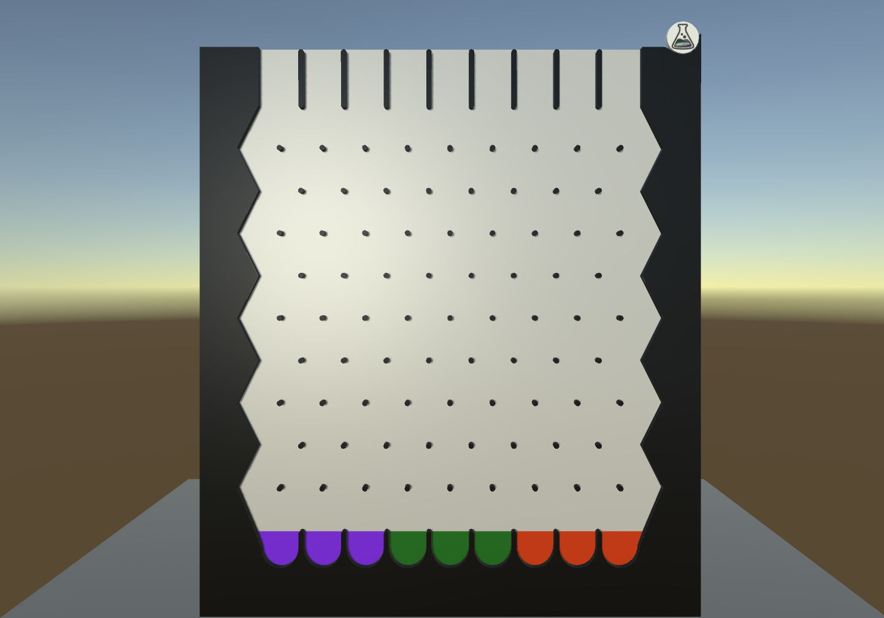
What We Did

Slide 7



Questions Praise Critisism
(?) = Untested

