Slide 1
SEP Leap Technologies
Ben Frederiksen
Chris Halvorson
Grant Kimsey
Dave Mathew
Andrew McCurry
Leon Organ

Slide 2
What
The plinko board used by the recruiting team is unprofessional looking and kinda lame.

Slide 3
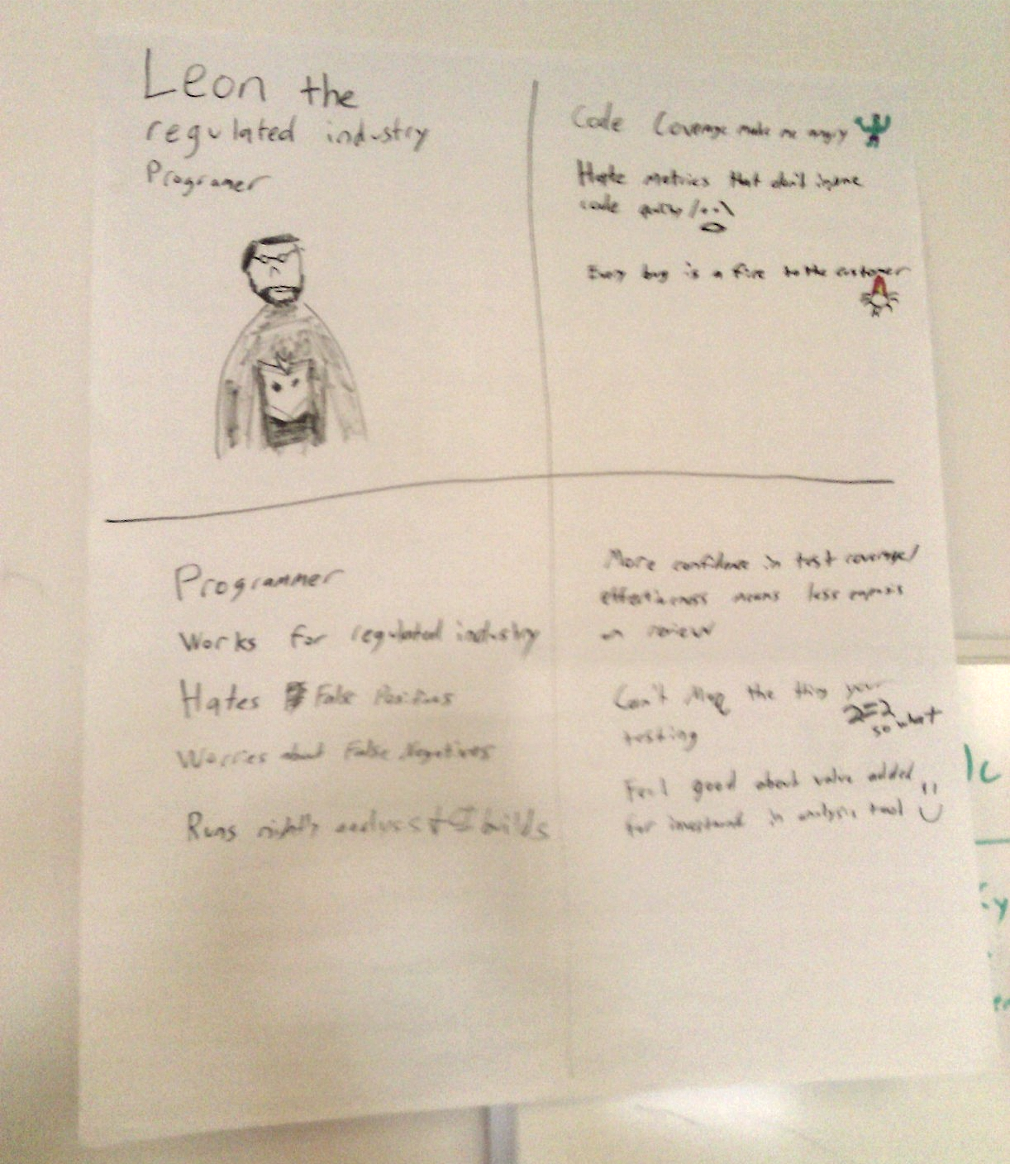
Who is affected?
Developers
Industry
Product Consumers

Slide 4
How do we fix the problem?
Determine if execution of a line of code contributes to the pass/fail result of a test
Provide reporting which allows weakly tested code to be easily identified and fixed
Pseudo-Algorithm
Find ‘covered’ lines of code
Systematically disable them
Run the covering unit tests
See if any tests fail
If not, report them in the output as ‘untested’

Slide 5

What We Did

Slide 6
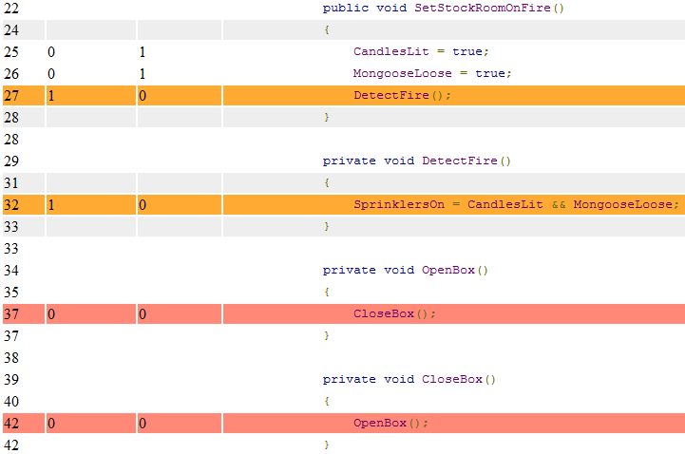
Reporting lines that are covered but not tested

Slide 7
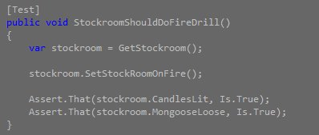
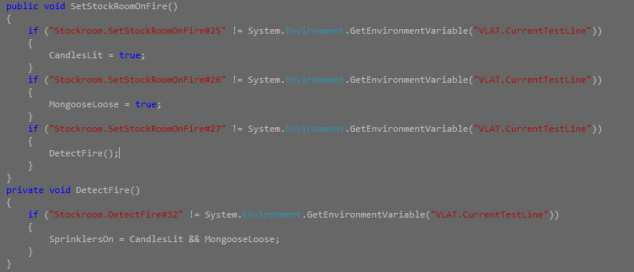
How we analyze that

Slide 8
Tools Used
Nrefactory
Nunit
OpenCover
ReportGenerator
Prettify
NPOI

Slide 9
Current Known Limitations
What we aren’t analyzing
Linq
return
throw
var
Lambda expressions
Field Initialization
Conditional evaluations
Dynamics (?)
Unary Bit Shift operator (?)
Classes declared in classes
Constant Variables
(?) = Untested

