Slide 1
SED and AWK
Amitava Roy
Bioinformatics and Computational Biosciences Branch
Office of Cyber Infrastructure and Computational Biology
29 March 2021

Slide 2
Today’s Instructor
Amitava Roy, PhD
Computational Structural Biology Specialist
Bioinformatics and Computational Biosciences Branch (BCBB), NIAID
National Institutes of Health, Bethesda, MD USA
Contact our team:
  Email: bioinformatics@niaid.nih.gov
  Instructor: amitava.roy@nih.gov

Slide 3
Text manipulation with bash
Topics to cover:
sed
awk
https://nih.box.com/s/5j37jyrhzwnzdwahmiz4m4nqtqtgo4dk
Files needed

Slide 4
Quiz
www.socrative.com
Students login
Room: ROY839

Slide 5
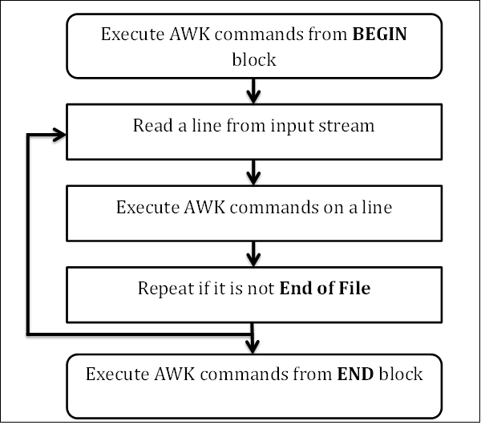
awk

Slide 6
Awk – BEGIN Block
The syntax of the BEGIN block is as follows −
Syntax
BEGIN {awk-commands}
The BEGIN block gets executed at program start-up. It executes only once. This is good place to initialize variables. BEGIN is an AWK keyword and hence it must be in upper-case. Please note that this block is optional.

Slide 7
Awk – Body Block
Body Block
The syntax of the body block is as follows −
Syntax
/pattern/ {awk-commands}
The body block applies AWK commands on every input line. By default, AWK executes commands on every line. We can restrict this by providing patterns. Note that there are no keywords for the Body block.

Slide 8
Awk – END Block
The syntax of the END block is as follows −
Syntax
END {awk-commands}
The END block executes at the end of the program. END is an AWK keyword and hence it must be in upper-case. Please note that this block is optional.
awk 'BEGIN{…} {print} END{…}'

