Slide 1
CW5 Group 15 Presentation
Scraping Job Listing Websites to Boost Leicester’s Games Industry

Slide 2
Overview of the Purpose of the Project
Rikin Bhudia
rb549
15-A

Slide 3
Leicester’s Games Industry
The world’s fastest growing sport is live video gaming
Increasing interest in gaming and esports around the UK
Leicester is becoming a global hub for esports events – ESL UK is becoming one of the best venues for esports
Larger demand of jobs in software, testing, programming etc due to increasing popularity of games and esports events.

Slide 4
Purpose of Scraping Job Listing Websites
Scraping data from games industry-specific job listing websites can help the development and boosting of Leicester’s games industry
Makes it easier for the client and other users to find job opportunities in certain fields
Helps companies to scout out experienced and qualified workers in specific skills such as programming languages
Summarises the most important and relevant data scraped from other websites
Finds industry-specific data to make it easier for the client to find the relevant job listings that match their search

Slide 5
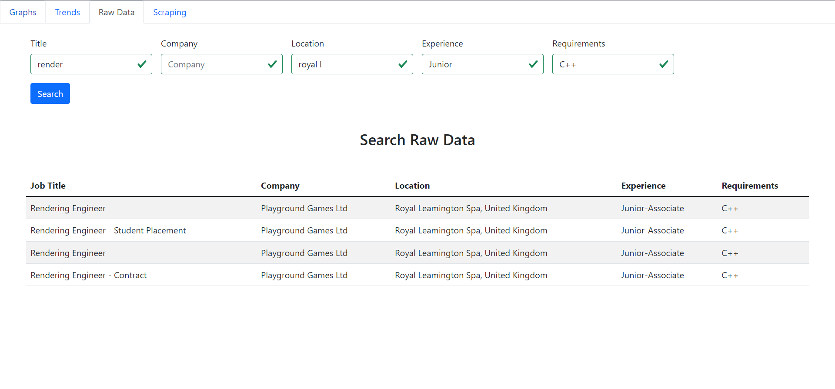
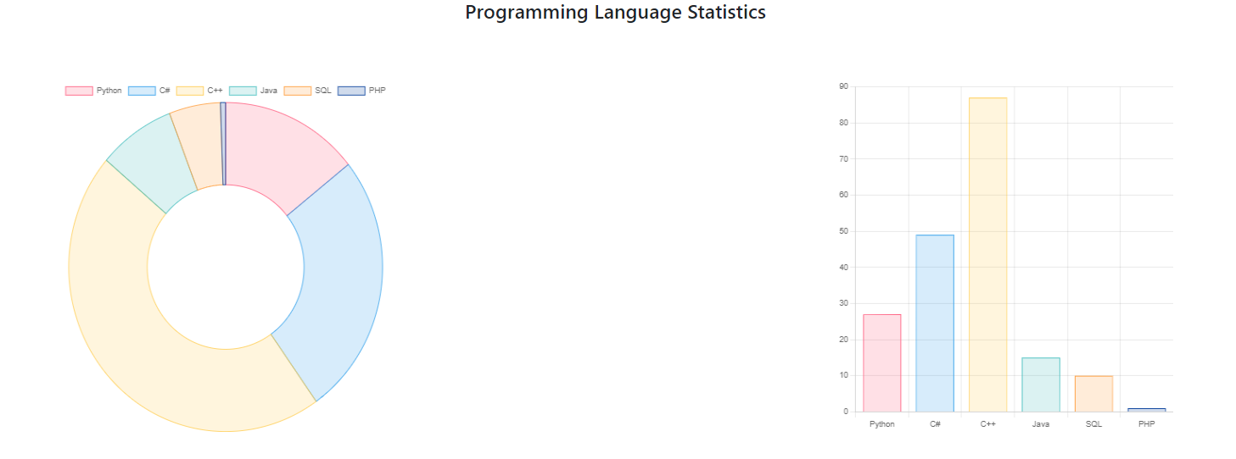
Purpose of this Project
This project allows a non-technical user to be able to scrape and analyse key data in the industry in a more efficient and simple way
Tailored to a non-technical user due to multiple features:
Simplistic front end dashboard used to scrape data from certain given websites
Filtering features such as location and skills required allow to find the most relevant listings
Current jobs available can be sorted by employer, date listed etc
Able to identify trends over time such as most requested programming languages, allowing the user to keep updated with the most requested skills and experience for jobs

Slide 6
Design Choice
Veren Damyanov
VD86
15-D

Slide 7
Multiple Website Scraping
Aardvark Swift (aswift.com)
GameIndustryBiz (jobs.gamesindustry.biz)
GamesJobDirect (www.gamesjobsdirect.com)
Amiqus (www.amiqus.com)

Slide 8
Overview of the Scraping Process
Fetch result pages information
Loop over the pages and job offers within them
From each offer extract relevant information
Save to database

Slide 9
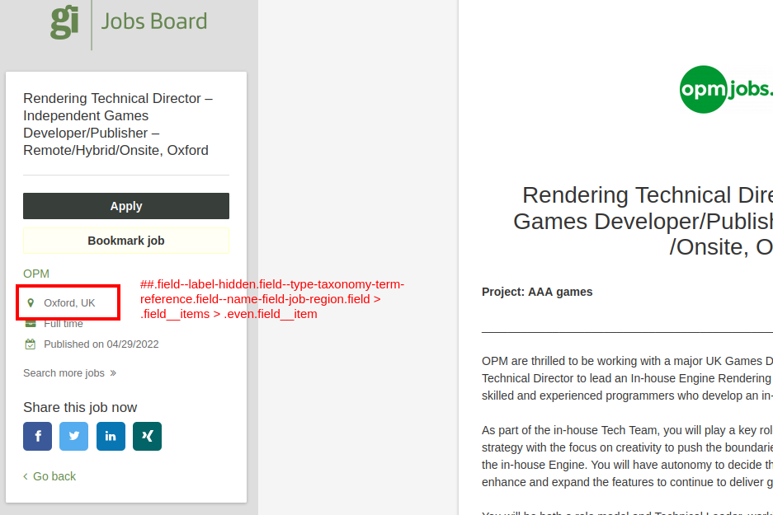
Specifics of the Scraping Process
CSS Selectors
Very specific for each website

Slide 10
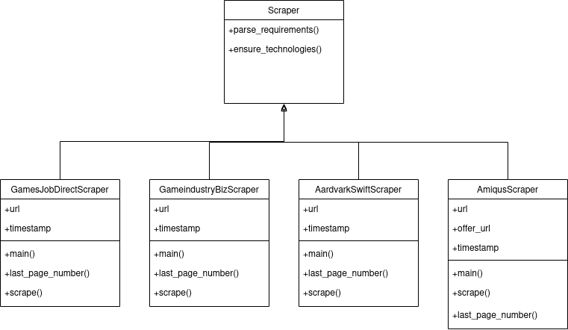
Diagram of the Scraper Classes

Slide 11
In Conclusion
The four classes are still similar
Further abstraction is possible, however..
Time constraints

Slide 12
Demonstration of Key or Interesting Features
Ali Coskun
AC834
15-C

Slide 13
What did the client request?
Parse job listings based on job title, company name, location, experience, coding language and artistic requirements.
Create a simple yet well designed interface.
Initiate parsing easily by interacting with a simple user interface.
Be able to remove and add new coding languages and artistic keywords.
Show trends on charts based on the data collected over a period of time.
Apply filters to raw data in order to view desired listings.

Slide 14
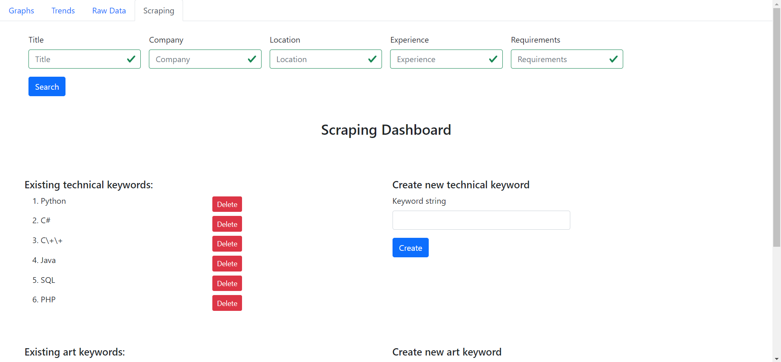
Our approach as a group
After the parsing is complete the client can apply filters to the raw data to view the relevant data they need from a mass information.
Client can enter the programming language they are looking for in a job listing. By entering the keyword and clicking “Create” button.
Client can remove the keyword they previously entered.

Slide 15
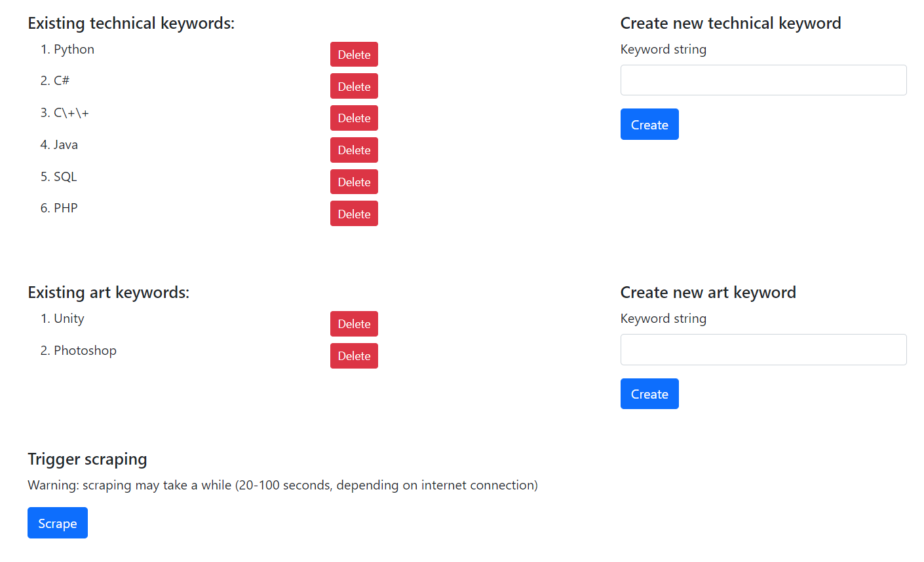
User can enter artistic keywords and add it into their search.
User can initiate parsing again using the keywords chosen above.

Slide 16
Navigation bar up top for user to switch tabs.
User views only the job listings that contain the keywords input into the filter.

Slide 17
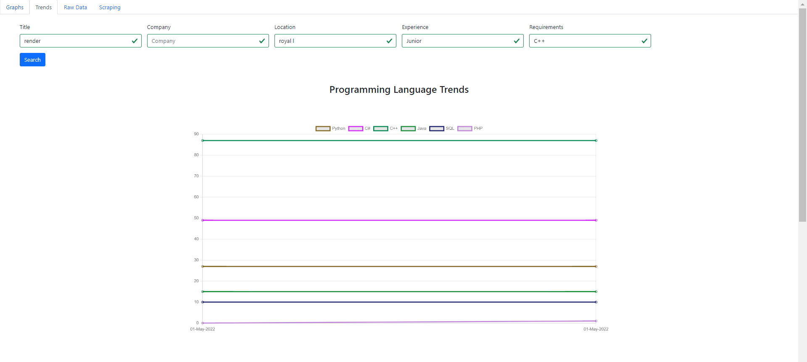
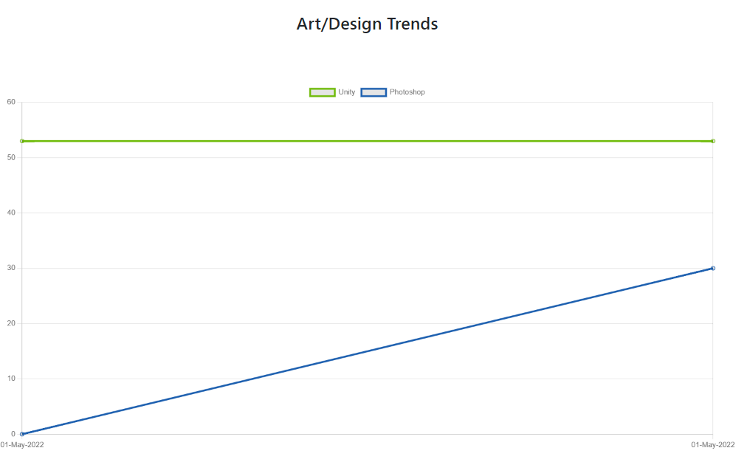
By clicking on the trends section up top, the user can view the trends separated as Programming language trends and art/design trends

Slide 18
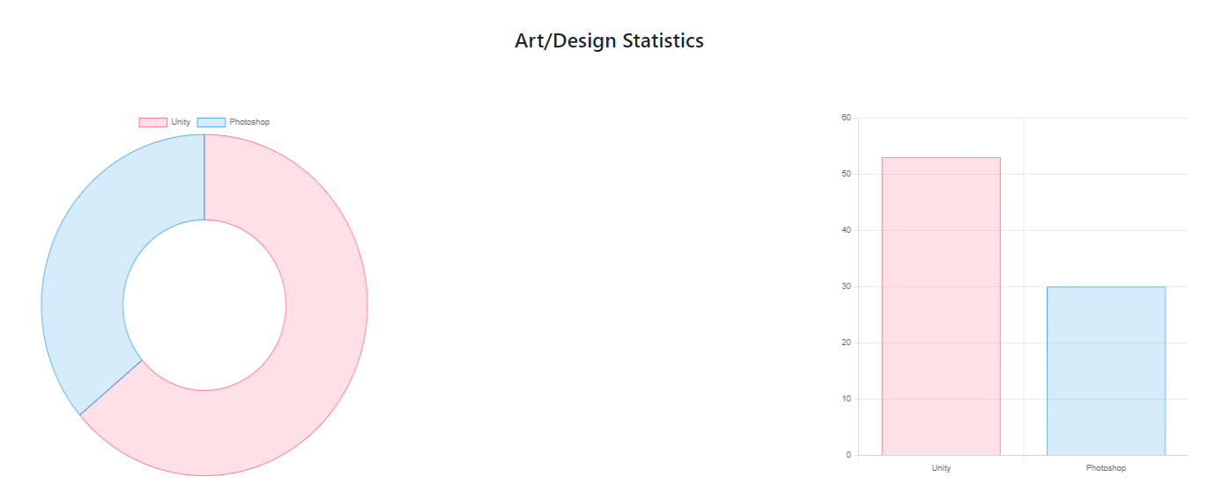

Slide 19
Project Software Architecture
NIAL DIXON (ND193)

Slide 20
How the project could be improved.
The database we used within the project was only designed for a simple development environment. If we were to pursue this project further we would setup our database on a live server.
A live server would allow us to use the exact same data on multiple devices.
We could have functions that automatically scrapes data over a period of time to generate trends so that the user doesn’t have to manually scrape themselves.

Slide 21
How the project could be improved.
The design of the project was done quickly and simply using bootstrap. We had considerations during the project to use react. If we were to continue on we would try to use react to present the data in more interesting ways.
One way would be to use heatmaps to show popular locations and programming languages etc.
Another idea we had with heatmaps was to use an actual map of the UK that a user could navigate around to see where most jobs were located.

Slide 22
How the project could be improved.
Another thing that could be improved going forward is the range and accuracy of data that we collect.
When scraping from multiple sites there is the possibility of scraping the same job multiple times, to prevent this we would have to include duplication checks.
However, we also want to scrape more unique data, so going forward we would want to find more websites that are advertising games jobs and even use social media as scraping source.

Slide 23
Group Communication
Alex Bradshaw
AJB169
15-B

Slide 24
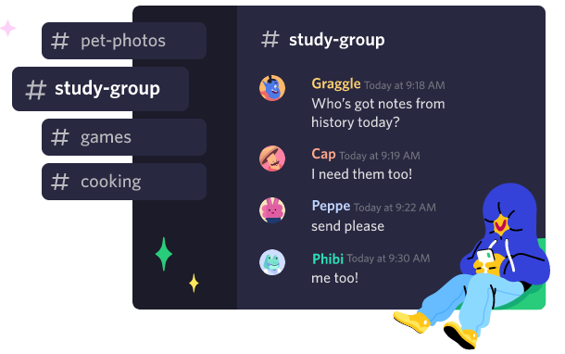
How we communicated
Maintain contact between and organize group meetings:
Different timetables
Other commitments
Three main ways we communicated:
In person – Group meetings
Discord
WhatsApp

Slide 25
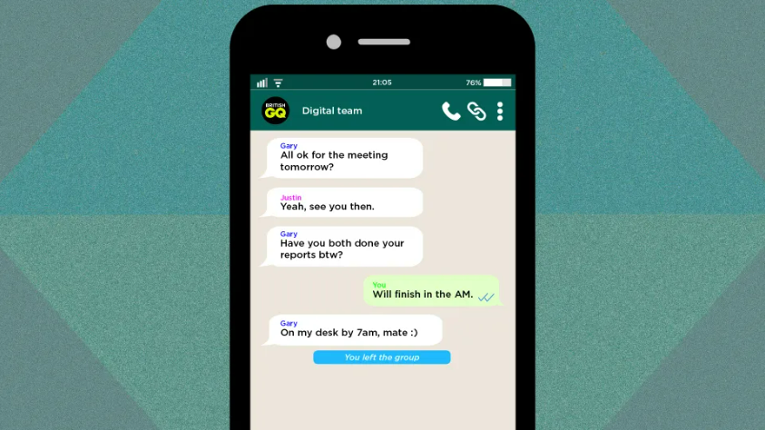
Was it successful?
Some small initial problems
Setting up the group chat
Retrieving required information and adding everyone to the group
Very successful!
Quickly share updates
Send screenshots / images
Easily accessible
Respond on mobile device / phone

Slide 26
Project Software Architecture
Kyle Dhesi (kd240)

Slide 27
The Organization of our System
The main component of our system – scraped data
The main feature of our system – filtering
Different elements structured in our system:
Scraping
Raw Data
Trends
Graphs

Slide 28
Relations amongst each element
The elements are not interactive with one another, but each individual element interacts with the scraped data
All elements operate in the same environment
Each element is dependent based off user inputs (filters)
What each element displays is based off the filters the user has input and its corresponding scrapped data
Each element contributes to the overall scope of the system - allowing the user to gain an insight on programming languages within the games industry

Slide 29

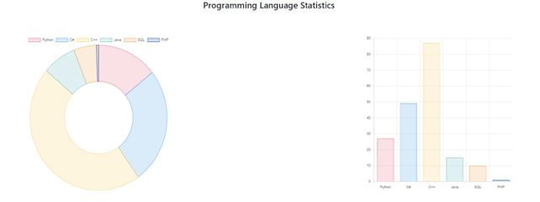
Reasoning behind our structure
Main reason as to why the system was organised this way - meet client requests:
System is used by non-technical users, our structure caters towards this:
Specific elements are easy to read/understand and use (filtering)
All visual and written aspects on the dashboard are clear and easy to follow
Back-end web scrapping allows the user to comfortably gain insight on relevant data about job listings within the gaming industry

