Slide 1
Suspicious Transaction Detection Using AWS ML & Data Pipeline
A Cloud-Based Financial Intelligence
Project By Niall Cleur

Slide 2
Project Overview
Objective: Detect potentially fraudulent financial transactions using AWS on a large dataset.
Supports business compliance, reduces false positives.
Automated low code, scalable, secure, cloud-native solution for financial intelligence.

Slide 3
Tools & AWS Services Used
Amazon S3: Store raw & processed data
AWS Glue (DataBrew) – ETL: Clean & transform dataset
SageMaker Autopilot: Train ML model without coding
Amazon QuickSight: Visualize suspicious activity and model results

Slide 4

Architecture
CSV Dataset → S3 → SageMaker → Autopilot → AWS QuickSight

Slide 5
Dataset
Data Source: Kaggle, Credit Card Fraud Detection (~284K rows)
Features: Time, V1–V28 (PCA), Amount, Class
We will use Class column as dependent variable for predictions.
Other columns are used a features.

Slide 6
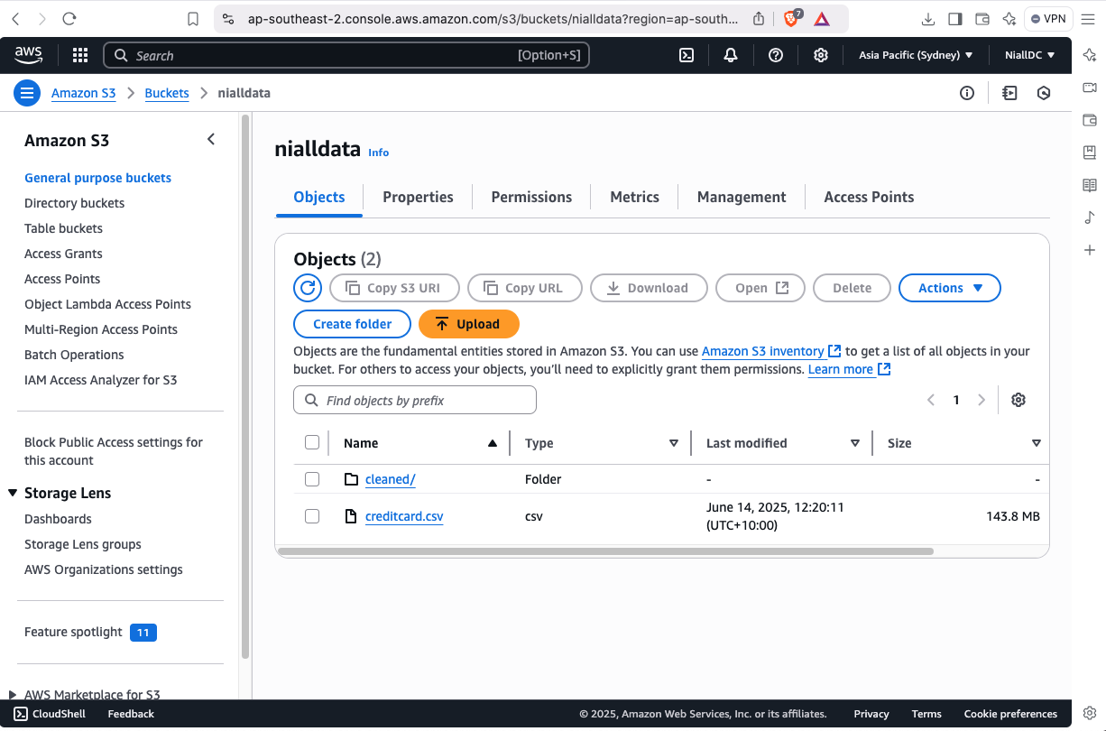
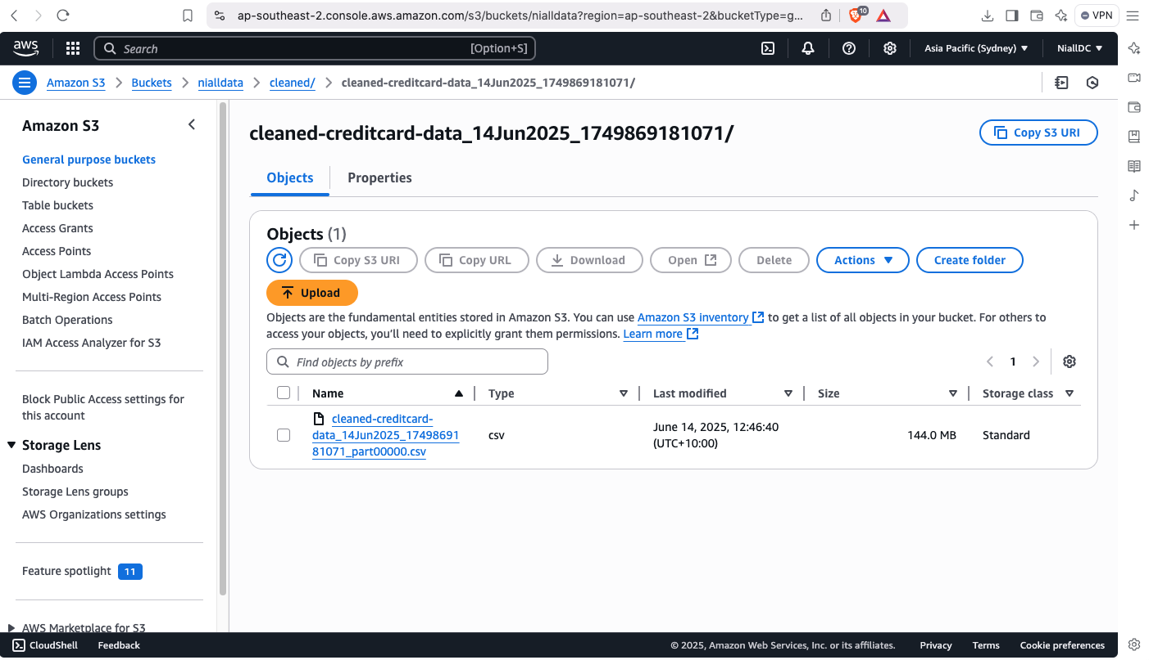

Slide 7
Model Training with SageMaker Autopilot
No-code ML with target column: Class
Input data from Glue-cleaned CSV in S3
AutoML builds & tunes classification models
Predict data and displays results.

Slide 8
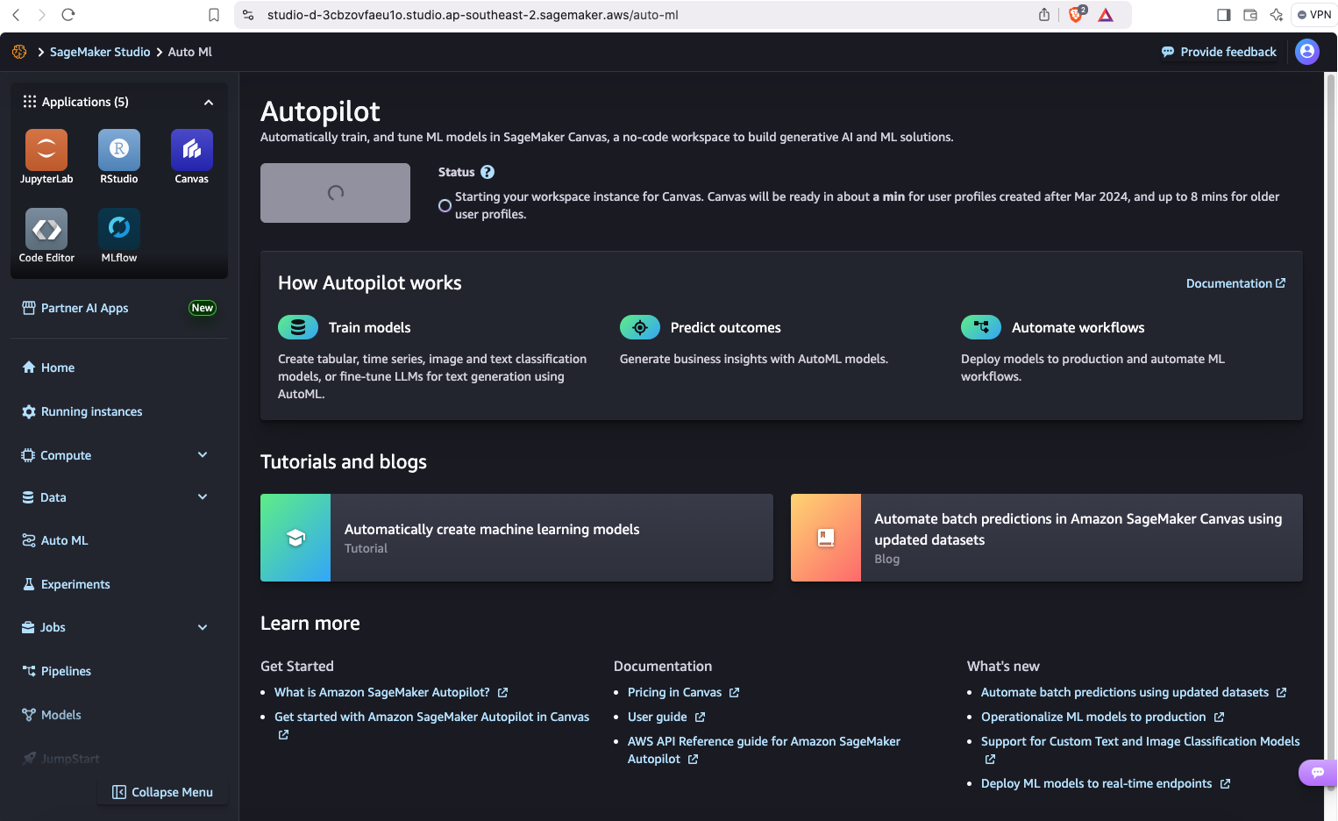
SageMaker Studio --> Auto ML

Slide 9
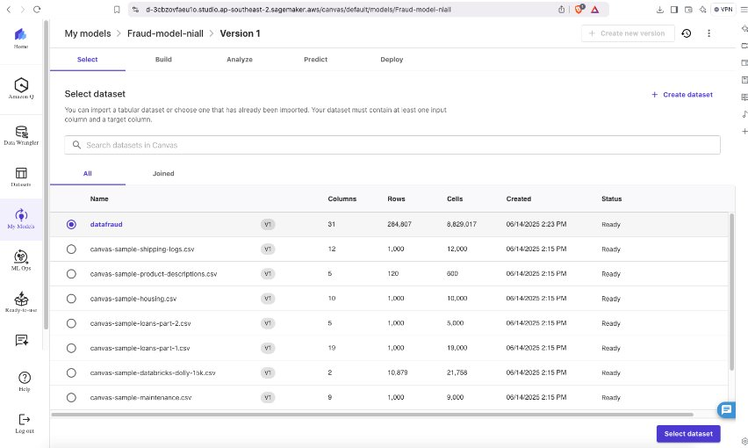
SageMaker Autopilot --> Select Data

Slide 10
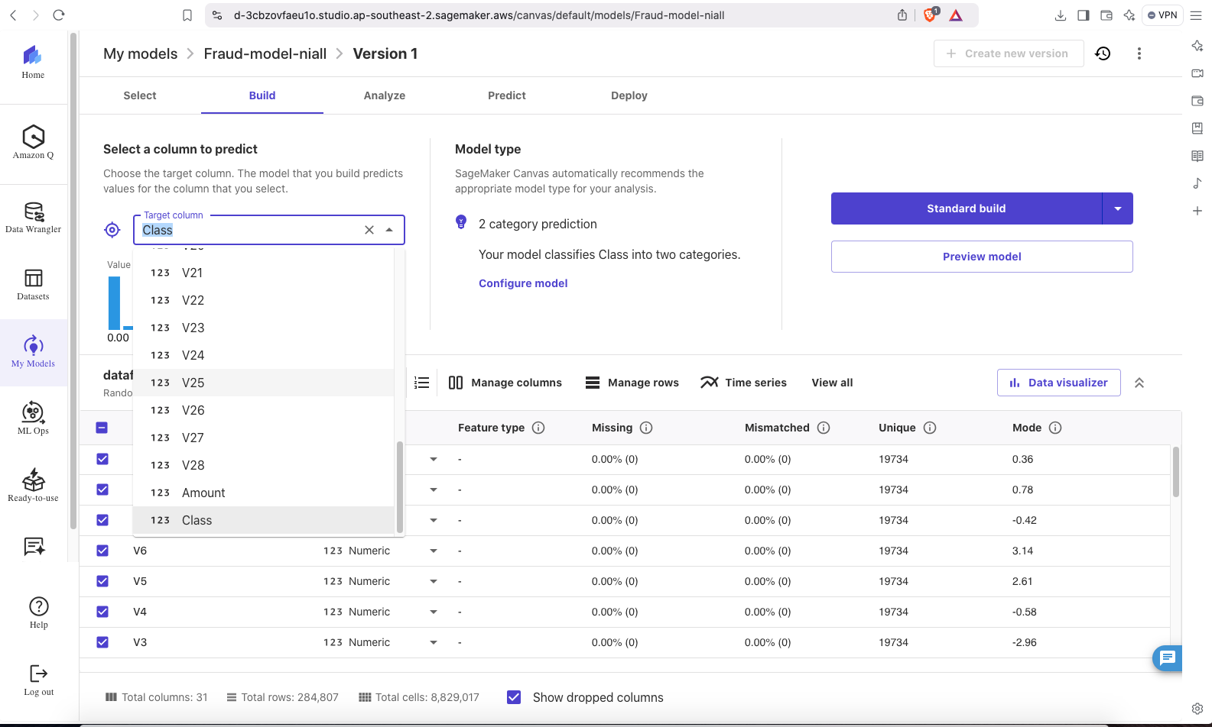
SageMaker Autopilot --> Build Model

Slide 11
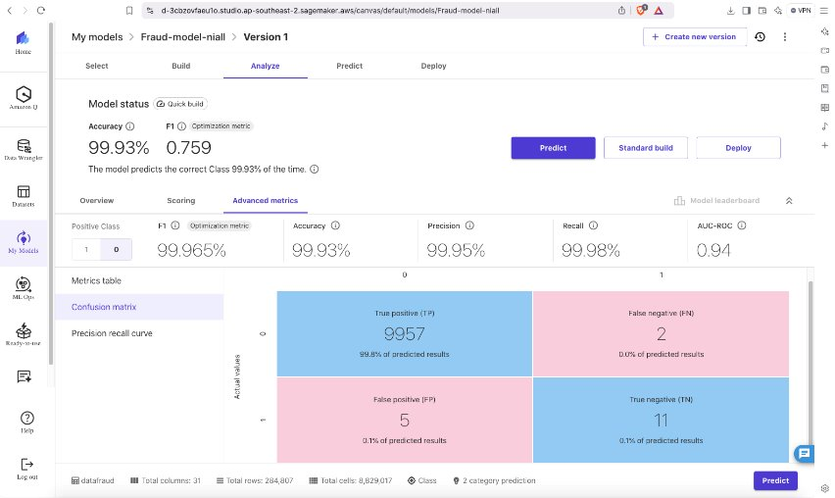
SageMaker Autopilot --> Create Model

Slide 12
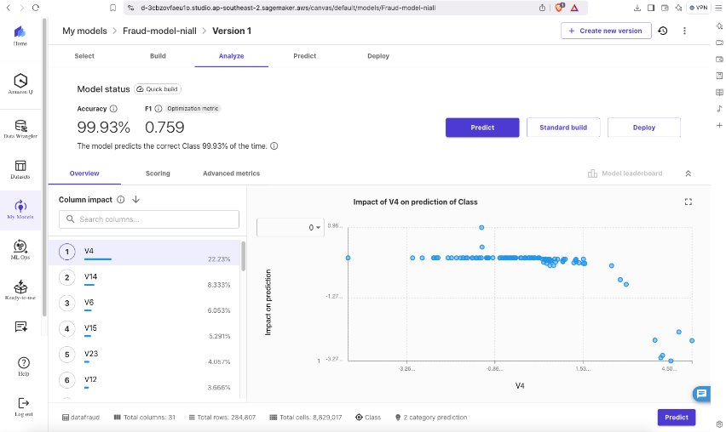
SageMaker Autopilot --> Model ready

Slide 13
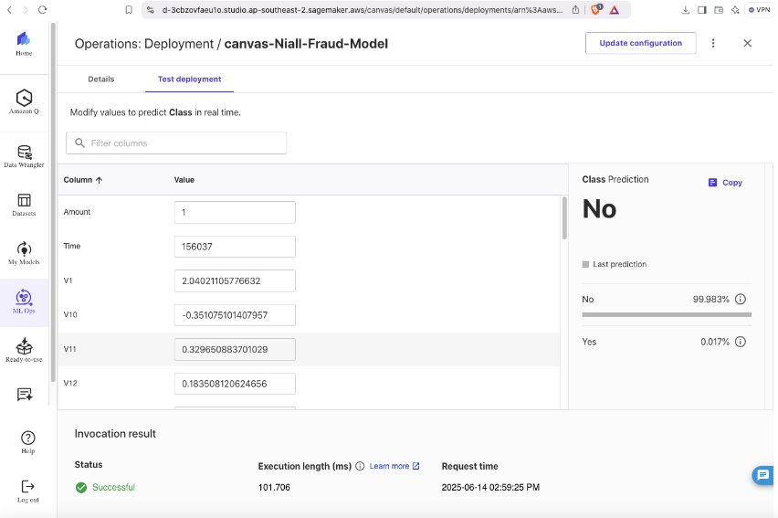
SageMaker Autopilot --> Predict Data

Slide 14
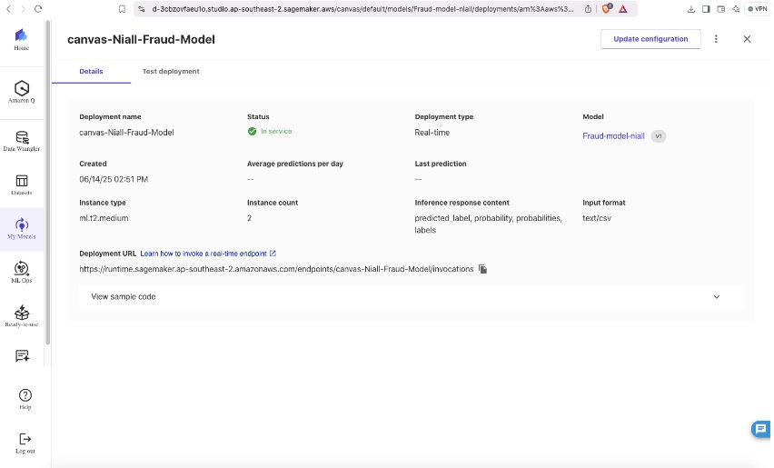
SageMaker Autopilot --> Deploy model

Slide 15
Model Performance
F1 Score: 99%
Precision: 99%
Recall: 99%
Confusion Matrix used to assess prediction quality
Good balance of fraud detection vs false alarms

Slide 16
AWS QuickSight Visualizations
Exported results to CSV and QuickSight
Visualized fields: Class, Probability
Dashboard to visualise data and anamolies.

Slide 17
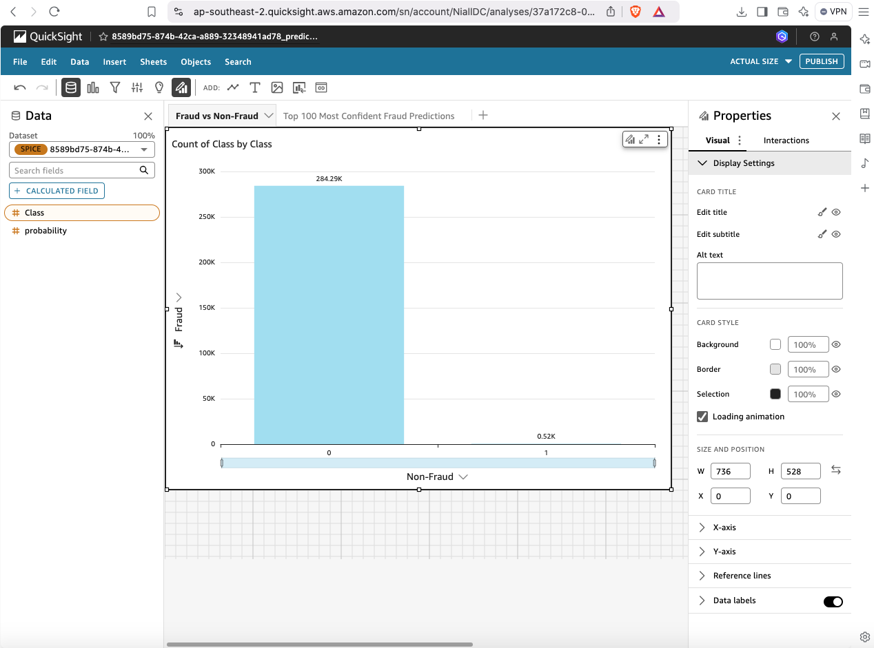

Slide 18
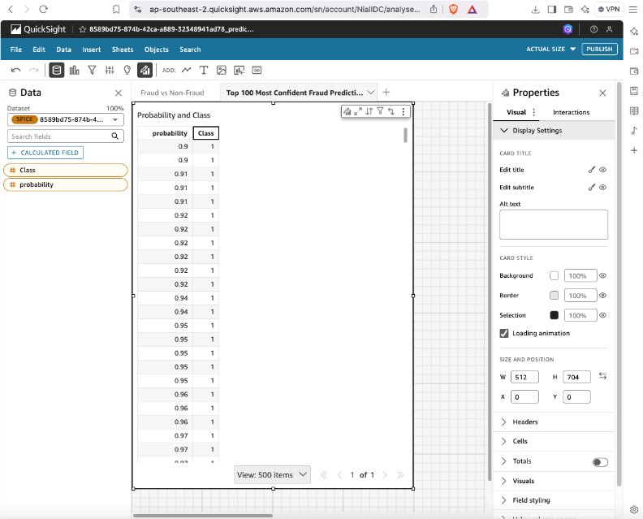

Slide 19
Business Impact Summary
Enables fraud detection and reporting
Predictions and auto ML generation
Reduces manual effort, improves accuracy
Useful for financial oversight and compliance

Slide 20
Key Takeaways
Built a complete AWS ML pipeline for fraud detection on a dataset
Demonstrated ETL, AutoML, and BI integration
Committed to cloud-native data roles

Slide 21
Thank You

