Slide 1
How to give a good presentation
Niall Deacon (MPIA)

Slide 2
What is the point of a presentation?
Get information about something across to the audience

Slide 3
But…..
There is lots of information you could communicate
The audience may not be paying attention 100%

Slide 4
So….
Tell a story
Give the audience just the right amount of background to understand the presentation
Keep information on slides clear and concise
Talk slowly and clearly

Slide 5
Penguin attacks: noisy and deadly
Niall Deacon (MPIA)
Notes:
Begin an example presentation

Slide 6
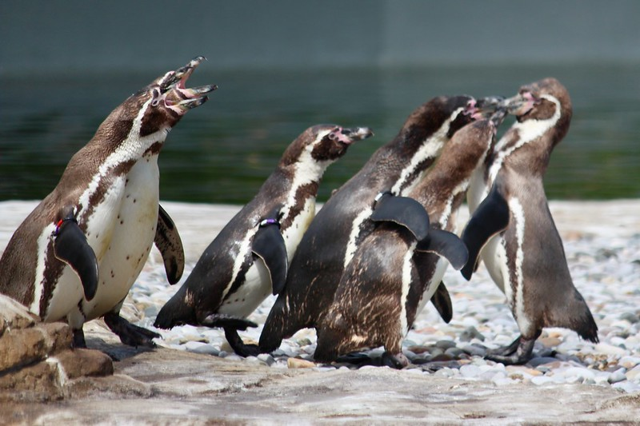
Why should I care?
Credit:
Neil Turner; License: CC-BY-SA-2.0
People being attacked by penguins is bad
Notes:
Set the scene as to scientific motivations, include credits for images

Slide 7
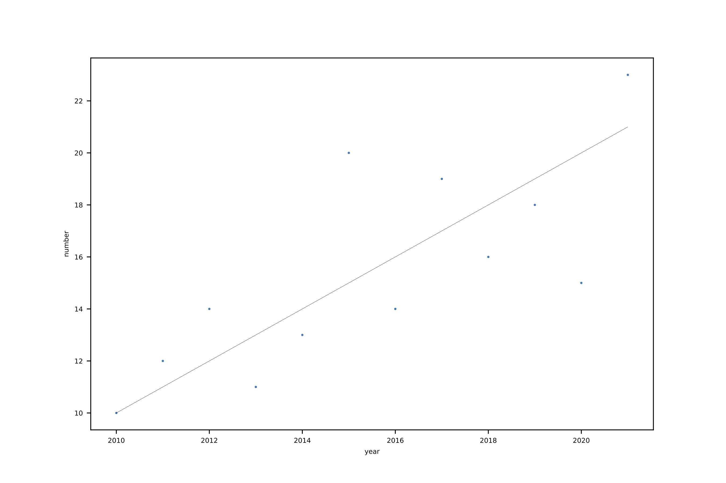
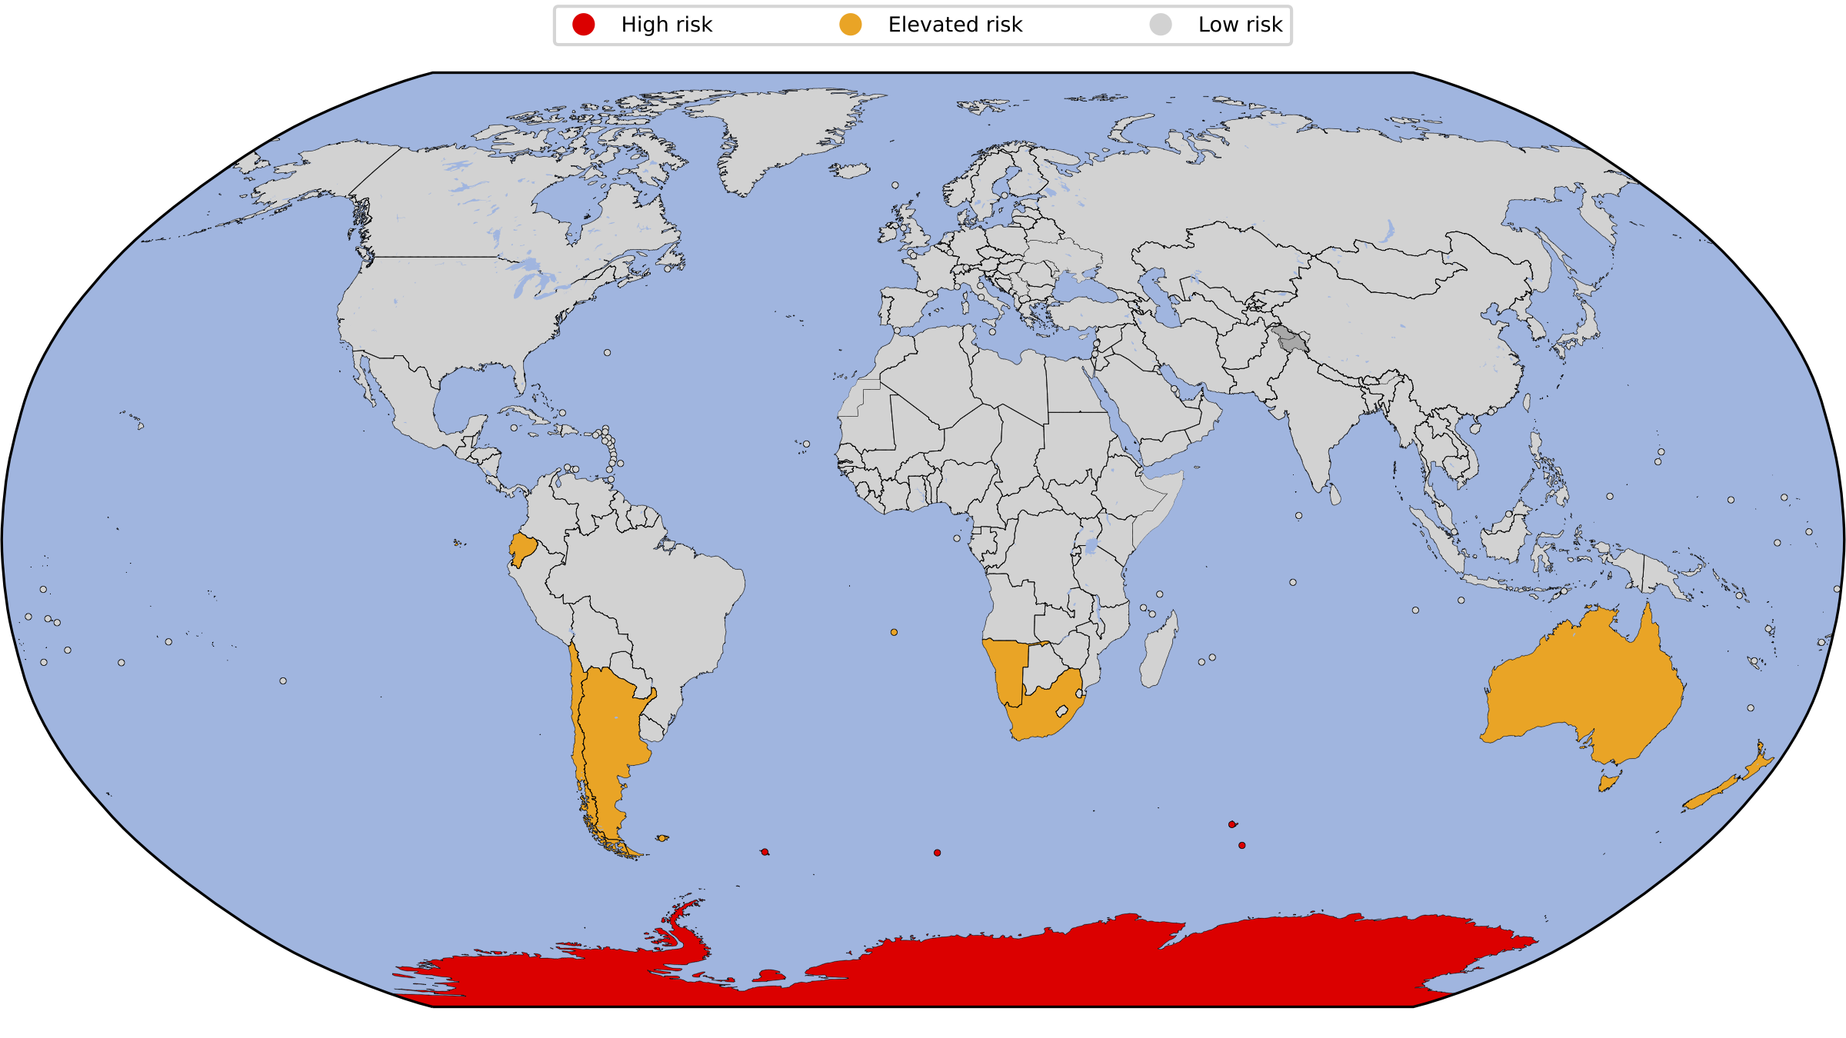
Penguin attacks
Penguins are not naturally aggressive towards humans but will attack with increasing perception of substantial threat increase (Kaiser et al., 2002)
No penguin has ever killed a human although this leaves open the possibility of attacks missing from the historical record (Adelie & Humboldt, 2019)
Habitat destruction will increase the frequency of human-penguin interactions which may increase the frequency of penguin attacks on humans (Macaroni & Rey, 2010)
We used a citizen science project to count penguin attacks
Notes:
This is a bad slide, too much text, bad font, bad colours, plots are too small, labels too small, no key, line weights too small

Slide 8
Penguin attacks are rare
Penguins are not naturally aggressive towards humans but may attack when threatened (Kaiser et al., 2002)
No recorded instances of fatal penguin attacks (Adelie & Humboldt, 2019)
Habitat destruction will increase human-penguin interactions, and possibly attacks (Macaroni & Rey, 2010)
Notes:
Split that slide into multiple slides with more context. Also make sure claims from other works are referenced.

Slide 9
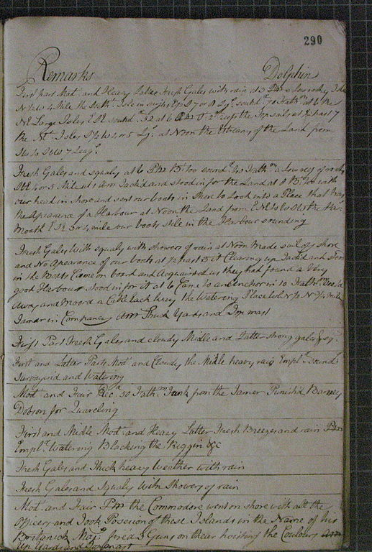
Quantifying penguin attacks
We asked citizen scientists to search through logs from 1500 recent Antarctic expeditions
2510 volunteers found 183 possible attacks
After review we determined that 157 attacks took place
Credit: Joseph Manley/Wikicommons

Slide 10
Danger highest in Antarctica
Notes:
Easier to read this plot, headline gives main takeaway

Slide 11
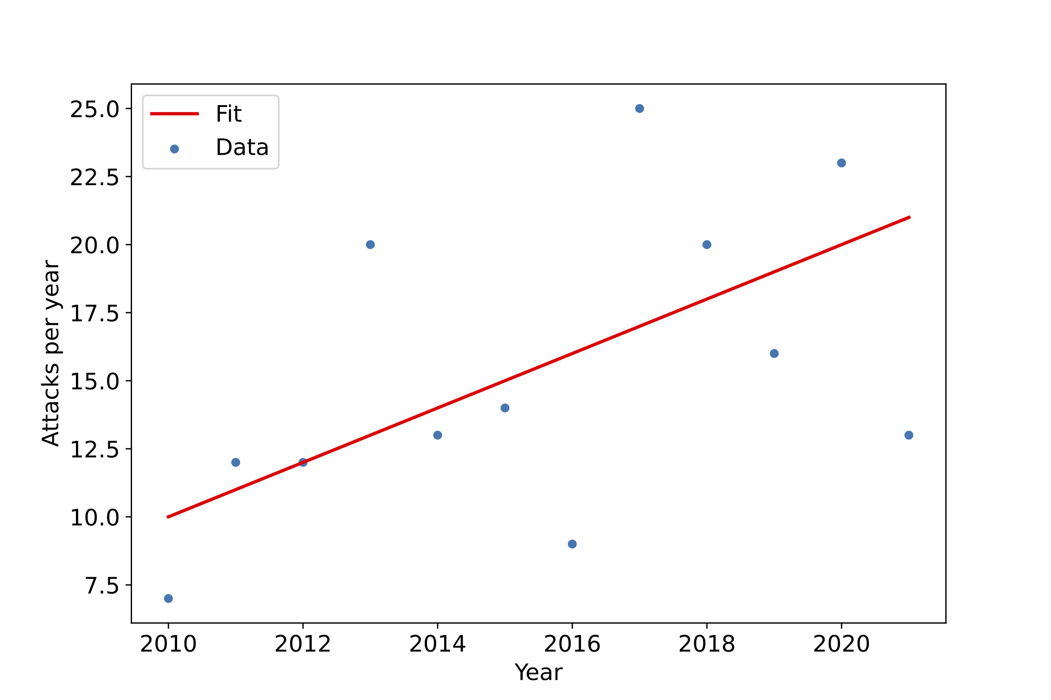
Attacks increasing with time
Notes:
Plot is clearer, bigger points, bigger line weight, bigger text, key

Slide 12
What are slides for
To complement what you are saying
To provide information you can’t communicate orally
To give people who zone out a point to get back in to the flow of your talk

Slide 13
What should slides have
At most three bullet points
OR
One plot (possibly two if really needed)

Slide 14
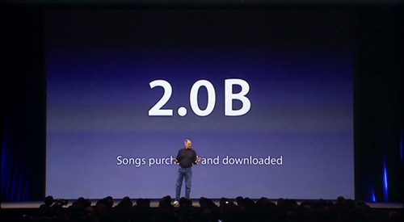
Notes:
Sometimes less information has more impact

Slide 15
What should slides have
Can add annotations/credit/references to plots
Always add credits for images you didn’t make yourself, including licenses for everything that isn’t public domain

Slide 16
In conclusion
We studied ships logs to identify previously unknown penguin attacks
Penguin attacks are increasing over time
This trend needs to be monitored
Contact: deacon@mpia.de
Notes:
Sum up what you did, include contact details so people can get in touch with you

