Slide 1
Biometric Security and Cloud Computing
Drake Csage, Ben Strandskov, Niall Mulcahy, Laurie Fitzek

Slide 2

Our Project
Raspberry Pi camera detects face
Act as a security benchmark for “Turo”
Computer vision algorithms in Python
Scraping gas price data and currency exchange rate for equivalent price
Cloud will compare set list of faces, determine price of car, and determine if in rental zone
If “Yes” email with gas prices, “No”, go away!

Slide 3
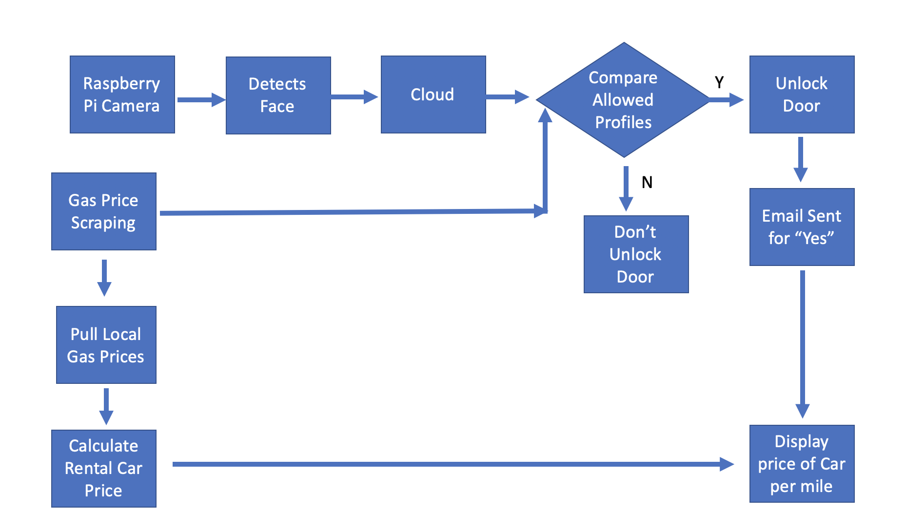
Flow Chart Diagram - Modified

Slide 4
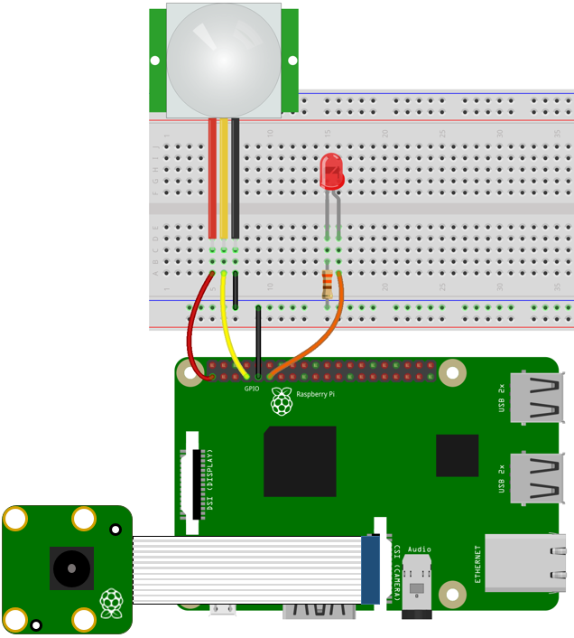
Hardware Attachments
Raspberry Pi Camera
Image Source

Slide 5
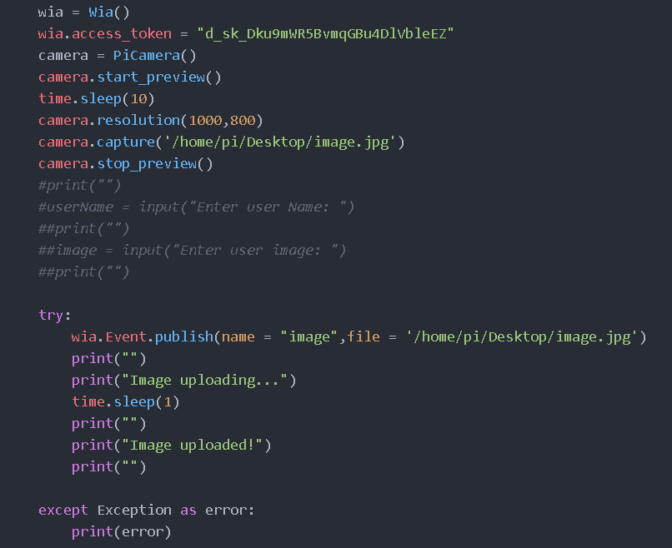
Python Script:
User selects an image, this triggers an event to pass the image up to Wia.

Slide 6
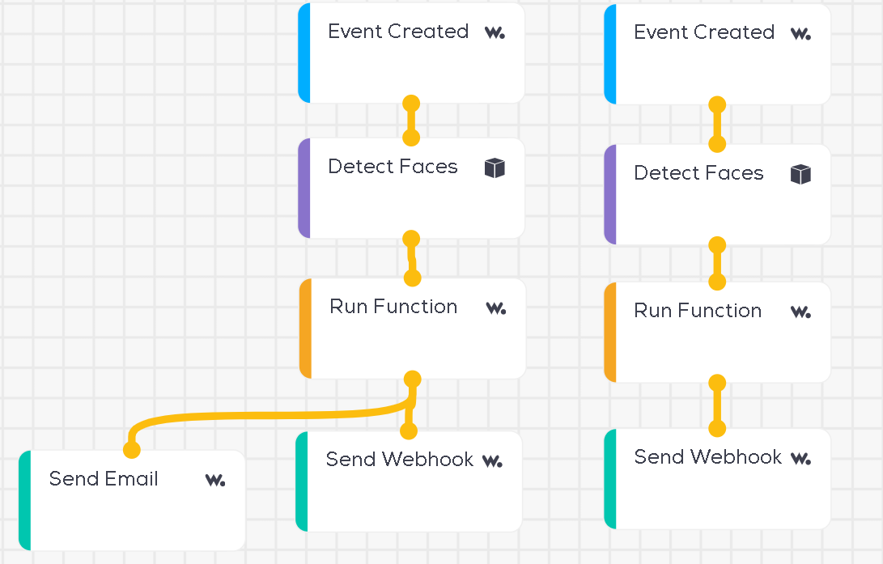
Wia: Wia receives the image and passes it through the AWS Face Detection service.

Slide 7
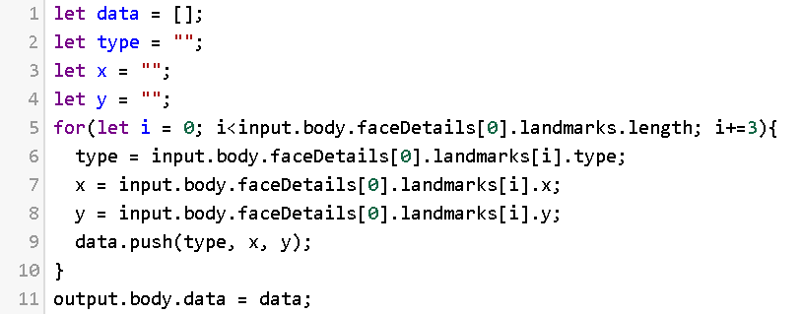
Wia: Using the run function module on wia, we use Javascript to extract the relevant information.

Slide 8
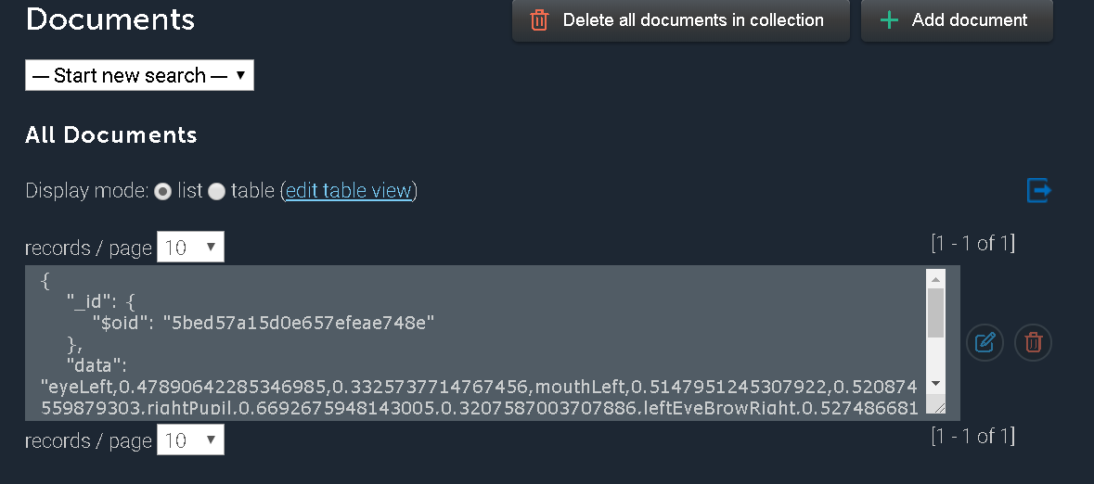
mLab: Using the send webhook module, the data is sent to our noSQL database hosted on mLab.

Slide 9
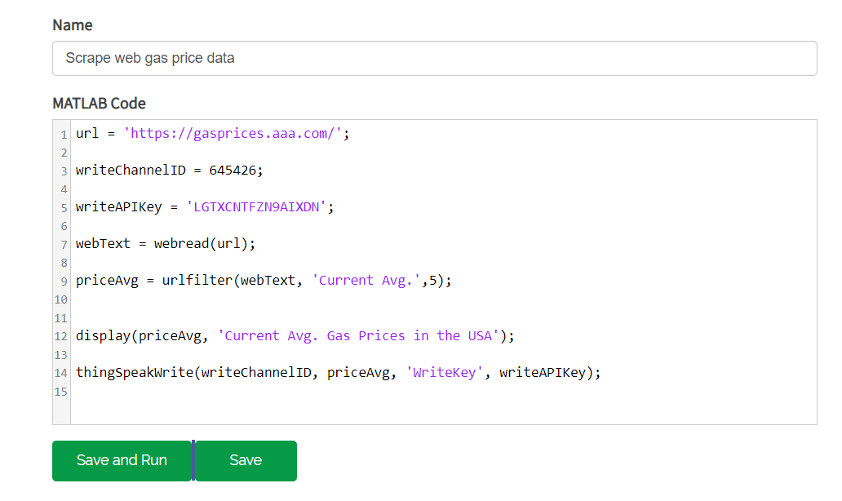
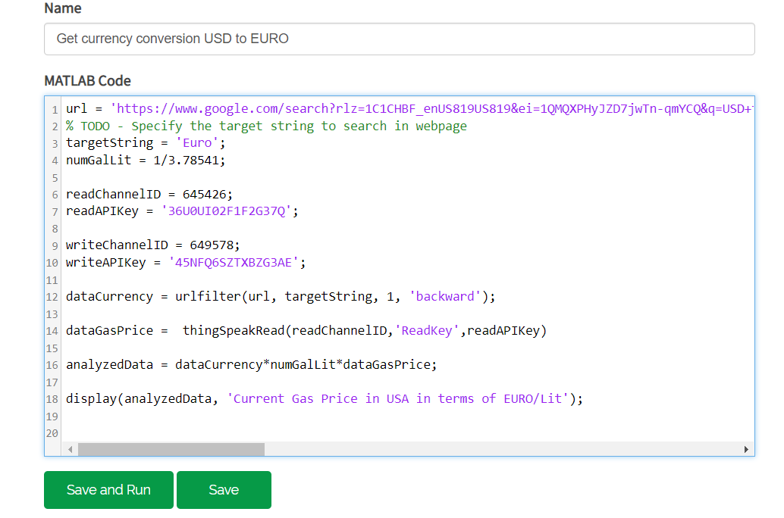
ThingSpeak Gas Price and Currency Conversion Analytics

Slide 10

Thank You!!
Questions?

