Slide 1
IoT Project
CPU Temperature Varied RBG LED

Slide 2


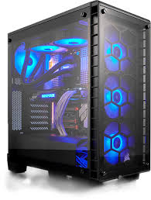
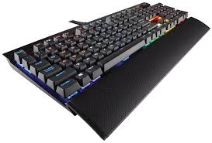
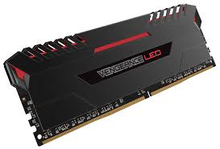
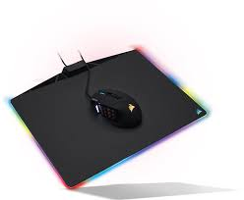
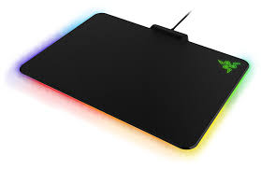
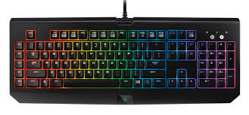
RGB Trend in the gaming industry

Slide 3
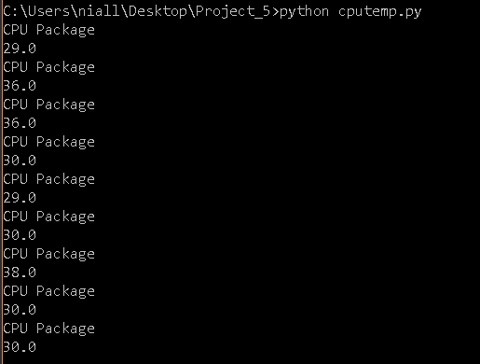
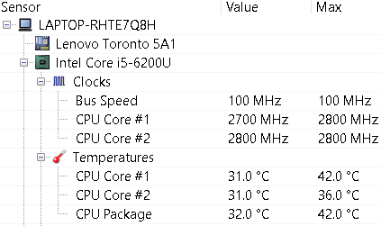
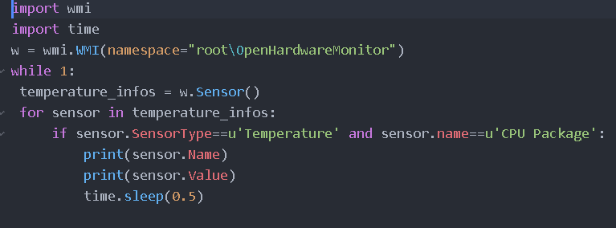
Open Hardware Monitor
Open source software that monitors system temperatures
Python scripts allows user to find specific sensors
Outputs the value of the desired sensor

Slide 4
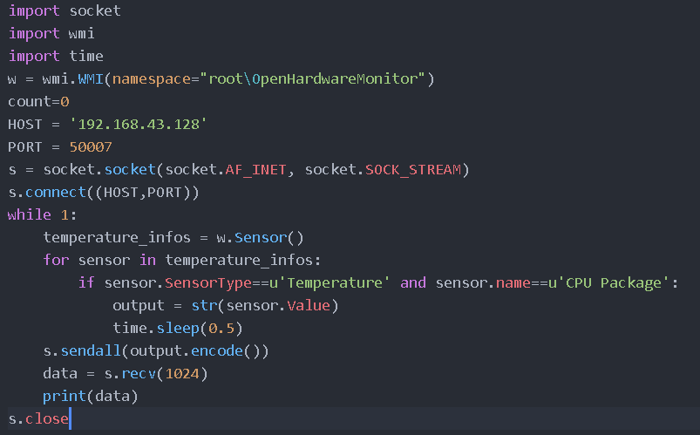
Client Side
Sockets allow us to communicate with other devices on the same network
HOST is set to the IP of the Raspberry Pi (server)
Output from Open Hardware Monitor is sent to the Raspberry Pi
Data is encoded to a “byte-like” object.

Slide 5
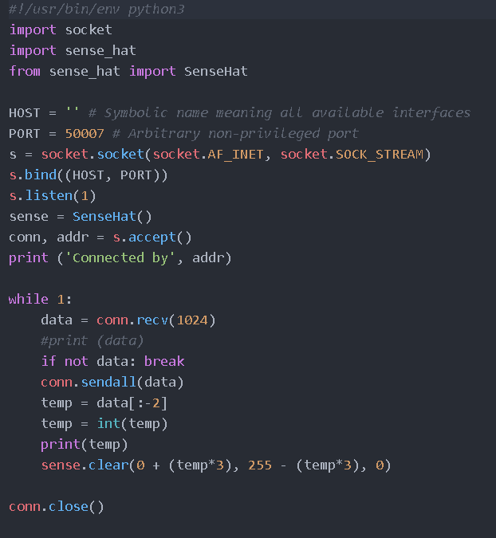
Server Side
Pi receives data from PC python script
Data decoded back into an int i.e Temp variable
Based on the value of the temp variable, the output of the SenseHat changes colour

Slide 6

Questions?

