Slide 1

COMS BC3122:
Data Visualization
9/16/2026

Slide 2
todo
Todo

Slide 3
Logistics
Assignment 1 releases later today
Office hours
  Mon 3pm – 4pm
  Tues 2pm – 4pm
  Thurs 10am – 12pm

Slide 4
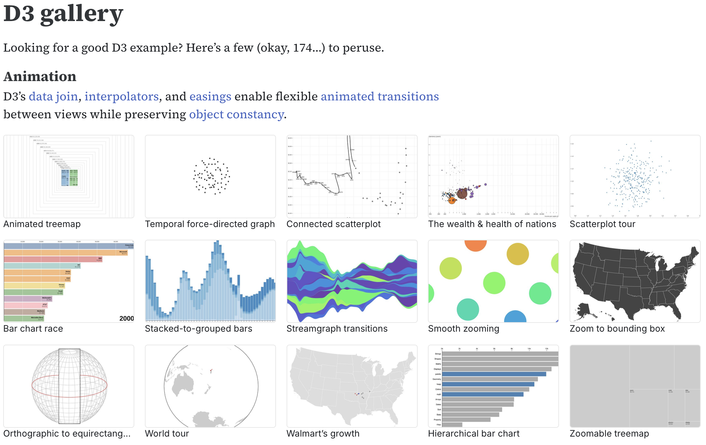
Viz of the day: D3 gallery
https://observablehq.com/@d3/gallery

Slide 5
The web page

Slide 6
Webpages are just files
Webpages consist of HTML, CSS, and JavaScript (JS)
HTML: Specifies the layout of elements
CSS: Specifies the appearance
JavaScript: Enables programmatic scripting (e.g. interaction, dynamic modification) of webpages

Slide 7
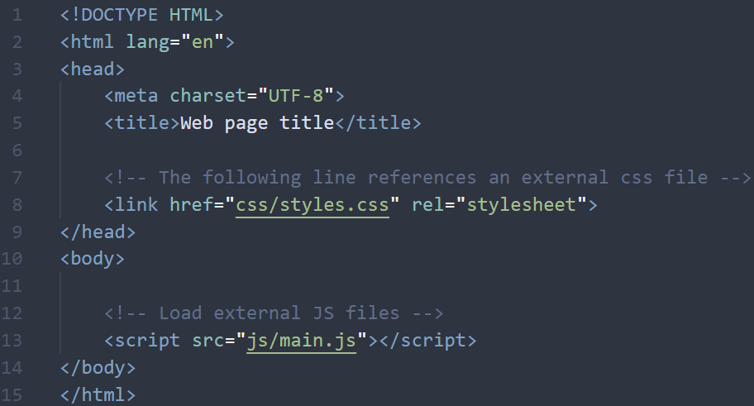
HTML (Hypertext Markup Language)
Used to structure the content of web pages
Allows us to differentiate between content and structure
For this class, use simple boilerplate code for HTML setup
Notes:
Tags come in pairs, opening and closing tags (eg <head>)

Slide 8
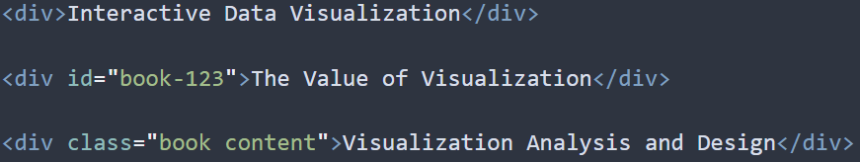
HTML (Hypertext Markup Language)
Classes and IDs let us differentiate instances of the same element in the page
ID attributes are unique. One ID per element, can only be used once per page
Class attributes can be used any number of times, and elements can have multiple class attributes
Notes:
Div element has no attributes, so the only way to identify it is via the div tag name. this is a problem when you have multiple of the same element
You can give the element a unique ID. Each element can only have a single ID, and each ID can only be used once
Class attributes can be used on any number of elements, and you can assign multiple classes to one element. Useful for styling with CSS

Slide 9
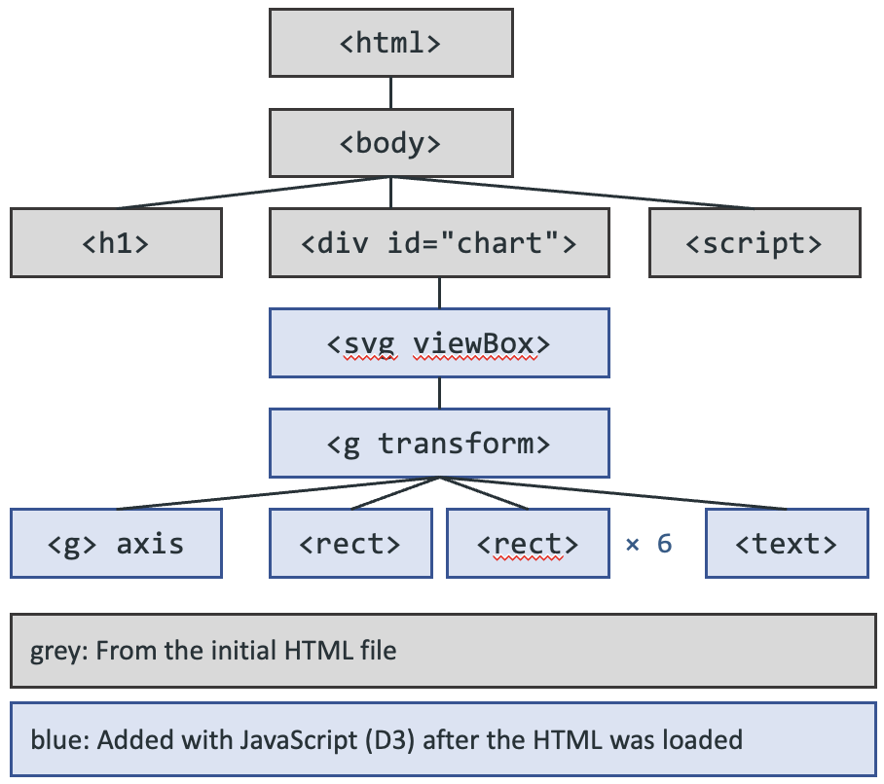
DOM (Document Object Model)
A hierarchical, tree-based representation of the web page document
Defines the way that structure can be accessed by programs (e.g. JavaScript)
Initially built from your HTML content
Notes:
Div element has no attributes, so the only way to identify it is via the div tag name. this is a problem when you have multiple of the same element
You can give the element a unique ID. Each element can only have a single ID, and each ID can only be used once
Class attributes can be used on any number of elements, and you can assign multiple classes to one element. Useful for styling with CSS

Slide 10
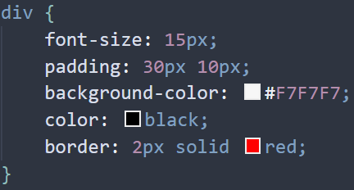

CSS: Appearance styling
Allows you to change the appearance of webpage elements that were defined by HTML
Usually a separate file, so it needs to be linked (like importing) in the HTML file:
There are tons of modifications you can make with CSS!
  See https://developer.mozilla.org/en-US/docs/Web/CSS

Slide 11
Exercise 1: Get a basic webpage running
Setup: Download lec03_exercise.zip from Courseworks and unzip it
Open a terminal window inside that unzipped folder
  Windows: shift + right-click → Open in Powershell
  Mac: right-click → New Terminal at Folder
Run this command: python -m http.server 8000
  Might need to do python3 -m http.server 8000 instead
Open http://localhost:8000/hello.html in your browser
You should see a blank page
In hello.html, between <body> and </body>, add the following:
  <h1>A header</h1>
  <p class="lede">Some text</p>
  <div id="chart"></div>
Reload the page
Add this rule to the bottom of style.css:
  .lede { color: #2b5c8a; font-style: italic; }
Reload. The <p> text should look different
F12 → Console: document.querySelector("h1").textContent = "Hi"

Slide 12
JavaScript

Slide 13
JavaScript (JS)
Most of what you learned from other programming courses applies to JavaScript
There may be subtle language-dependent differences

Slide 14
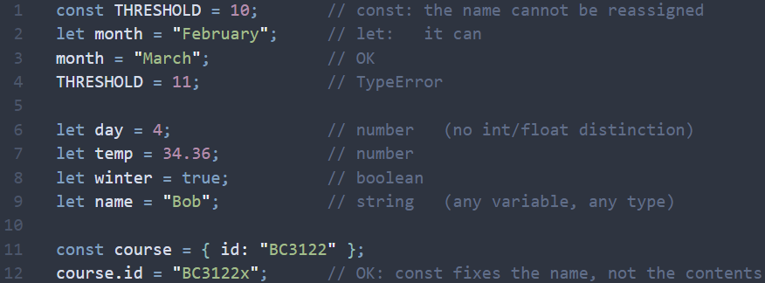
JavaScript (JS): Variables
Notes:
Type these into your console line by line
For const: it locks the variable so it can't be reassigned. Whatever is stored in the variable can be modified
Loosely typed means the type can change

Slide 15
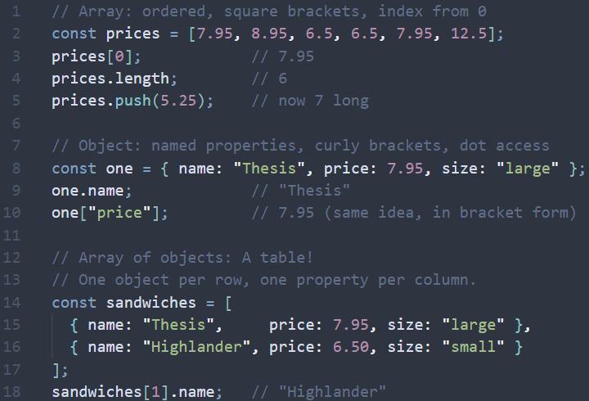
JavaScript (JS): Arrays and Objects
sandwiches.csv
Your datasets will be arrays of objects
name | price | size
Thesis | 7.95 | large
Special | 12.50 | small
One object per row, one property per column
[
{ name: "Thesis", price: 7.95, size: "large" },
{ name: "Special", price: 12.5, size: "small" }
]

Slide 16
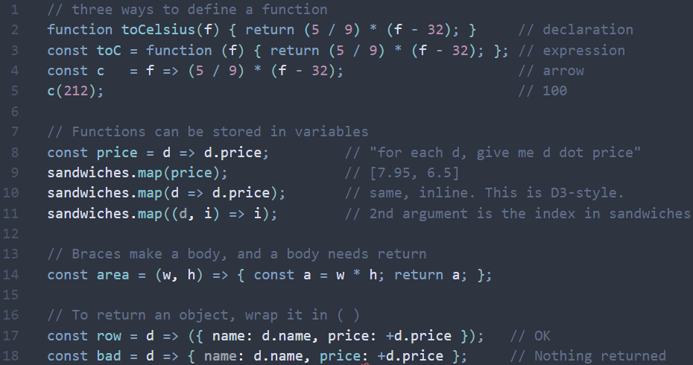
JavaScript (JS): Functions
Functions are vital for your visualizations
Notes:
Can define functions in 3 different ways. Arrow notation is very common in d3, takes some time to get used to
Can store a function in a variable and then use that variable later to invoke the function.
Can usually achieve the same effect with an in-line arrow function
Braces make a code block, which requires a return statement

Slide 17
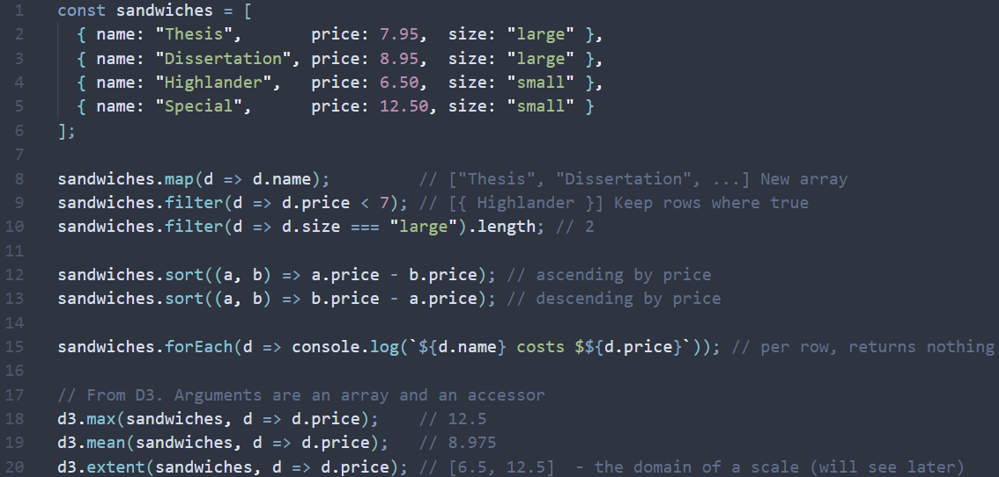
JavaScript (JS): map, filter, sort, forEach
Extremely common operators in D3
Notes:
Map applies a function to all items in the array and returns the result in a new array
Filter returns only the elements in an array for which a condition was true
Sort allows you to sort an array in place (doesn’t make a new array)
forEach loops over each value in the array and does some operation
All four of these take in a function as an argument, which is why arrow notation is so helpful
Max, mean, and extent all come from D3 and they have a similar structure (require an array and a function)

Slide 18
JavaScript (JS) can be weird!
=== vs ==
  == does type coercion (changes the types of the arguments)
  Always use === and !==
Reading from a file → data loaded as strings
  Need to convert your data into the appropriate type
.sort() with no arguments sorts alphabetically
  Will convert your numbers to strings!
  [1, 10, 2] becomes ["1", "10", "2"] for comparison purposes
The string "false" is true
  Boolean() on a string only checks if the string is empty or not

Slide 19
Exercise 2: Sandwich dataset
Setup:
Open http://localhost:8000/index.html
Open the console and paste the following in the console:
// it's in main.js too, as a comment
const sandwiches = [
{ name: "Thesis", price: 7.95, size: "large" },
{ name: "Dissertation", price: 8.95, size: "large" },
{ name: "Highlander", price: 6.50, size: "small" },
{ name: "Just Tuna", price: 6.50, size: "small" },
{ name: "So-La", price: 7.95, size: "large" },
{ name: "Special", price: 12.50, size: "small" }
];
Write JavaScript code to do the following:
Get an array of the names of all the large sandwiches
  Do it in one line, with 2 chained methods
Compute the average price of all sandwiches
Print every sandwich, most expensive one first
Hints:
filter then map; sort accepts (a, b)
Notes:
sandwiches.filter(d => d.size === "large").map(d => d.name)
d3.mean(sandwiches, d => d.price)
sandwiches.sort((a, b) => b.price - a.price).map(d => console.log(d.name))

Slide 20
SVGs

Slide 21
SVG (Scalable Vector Graphics)
A way to draw shapes on the web.
  A kind of language, details don't really matter for this class

Slide 22
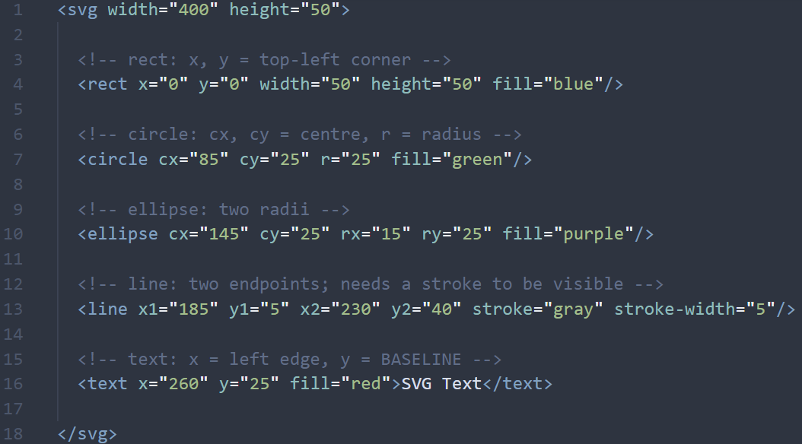

(0,0)
x
y
Notes:
(0,0) is the top-left. y grows downward
Order in the file determines the layering

Slide 23
SVG (Scalable Vector Graphics)
A way to draw shapes on the web.
  A kind of language, details don't really matter for this class
Shapes available: rect, circle, ellipse, line, text, path
Example appearance modifiers: fill, stroke-width, opacity
  And more, check documentation/google
  Similar to CSS, but we will modify them as attributes associated with objects, using JavaScript

Slide 24
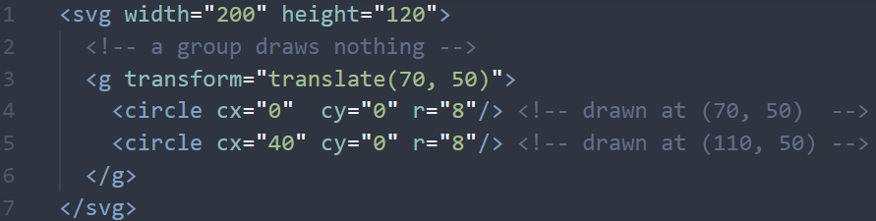
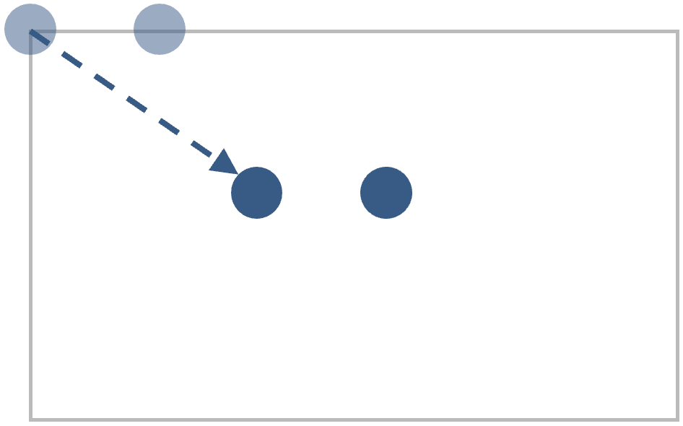
SVG groups
Groups allow you to modify multiple elements at once
Notes:
The group has its own origin in the top left corner!

Slide 25
Exercise 3: Drawing with SVGs
Setup:
Open http://localhost:8000/svg.html
  Should see an empty box
Paste the following inside the <svg> element:
<rect x="10" y="10" width="60" height="100" fill="#2b5c8a"/>
<circle cx="130" cy="60" r="40" fill="#3f7d4e"/>
<line x1="200" y1="20" x2="260" y2="100" stroke="#c1533c" stroke-width="4"/>
<text x="290" y="66" font-size="20">SVG text</text>
Reload the page
Then, F12 → Elements (Inspector on Firefox)
Find the <circle>. Double-click cx's value. Type 300.
Double-click the rect's fill. Type orange.
Reload. What happened and why?
  This is basically how D3 works!

Slide 26
D3

Slide 27
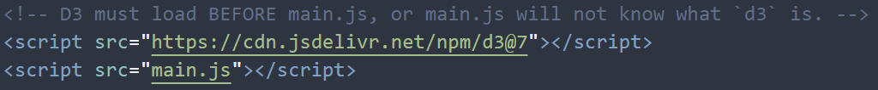
D3
D3 is basically a very powerful custom drawing + data processing library
It allows us to build charts from very low-level, individual components
  If you want to make a bar chart, you must draw the rectangles yourself (using D3)!
Resources:
  https://d3js.org/
  https://www.d3indepth.com/

Slide 28
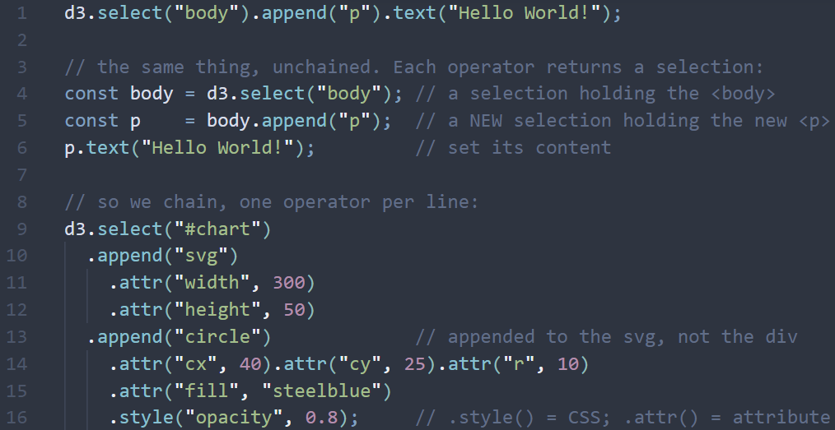
D3: select, append, text, attr, style, method chaining
Operator | What it does to the tree | Returns
d3.select(sel) | find the first element matching a CSS selector | a selection of it
d3.selectAll(sel) | find all matching elements (possibly none) | a selection of them
.append("tag") | make a new child element | a selection of the newly added element
.attr(name, value) | set an attribute: cx, r, fill, class … | the same selection
.text(value) | set the content between the tags | the same selection
.style(prop, value) | set a CSS property inline | the same selection
Everything starts with d3 (the namespace where d3 functions live)
Each operator returns a selection, so you can chain operators
  Make sure to indent under the element it applies to! Keeps you organized

Slide 29
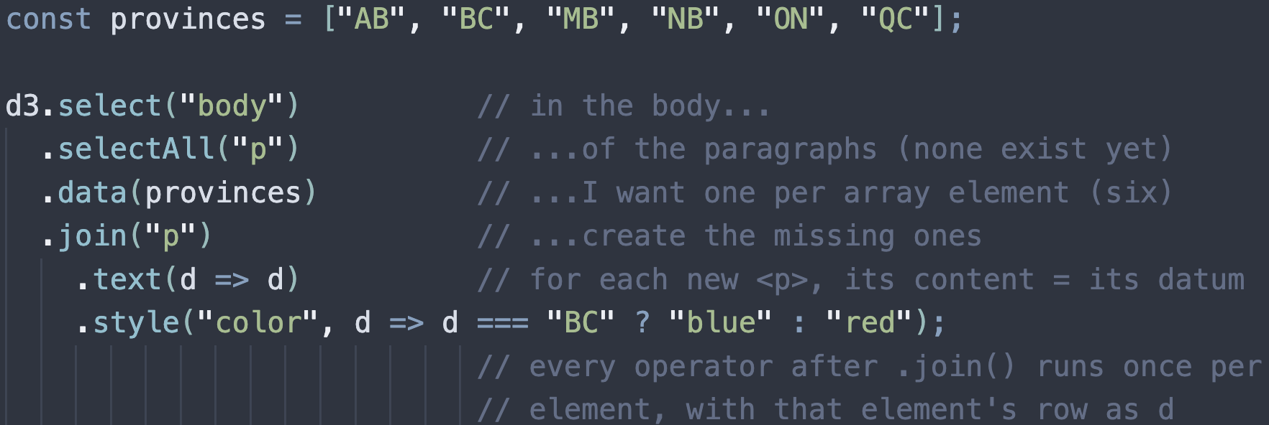
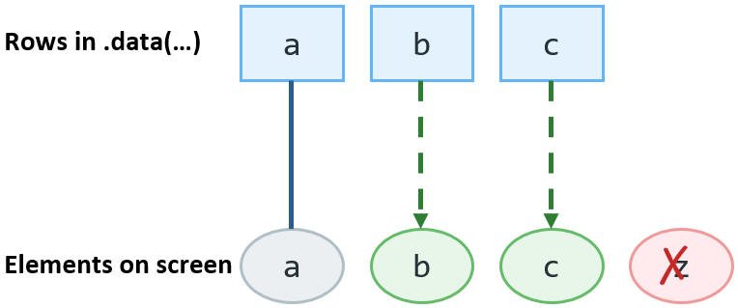
D3: Data join
selectAll gets the set of elements you are going to define in the subsequent code. They don’t exist yet!
.data(arr) declares how many elements there should be. .join("p") creates the corresponding number of <p> elements.
Everything after .join() runs once per element. No need to write a loop
Notes:
"of the paragraphs in body (there are none yet) I want one per province. Create that many paragraph elements."
selectAll selects things that do not exist yet, kinda weird but correct.
data determines how many there should be.
join makes that many elements (ie the number of items in data()'s argument). It creates what is missing, removes what is extra, and keeps the rest.
everything after .join() runs once per element with that element's own row from the input array (from data()) handed to your arrow function as d.

Slide 30
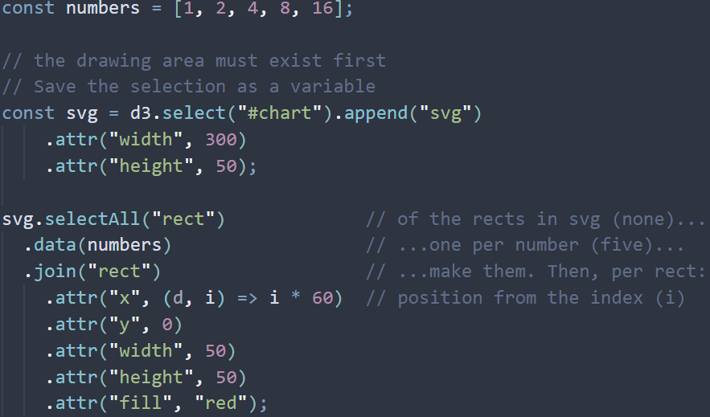
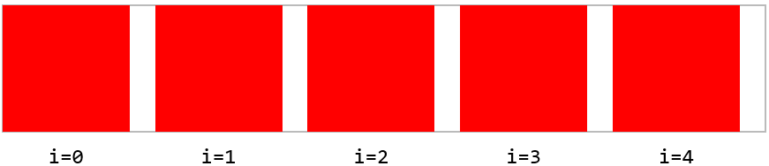
Annotated example
Without specifying x, all five rects land on (0,0), on top of each other

Slide 31
Exercise 4
Then, modify the code to do the following:
Have a thicker outline on the large sandwich circles (use stroke-width and a ternary operator)
Add a <text> under each circle with its name.
  Hint: use a second join on the same array
  svg.selectAll("text")…
Open http://localhost:8000/index.html
Write this code in main.js:
// 1. HELLO - one line, reload, then look in Elements
d3.select("#circles").append("p").text("Hello, D3!");
// 2. ONE CIRCLE PER SANDWICH
const svg = d3.select("#circles").append("svg")
.attr("width", 500)
.attr("height", 100);
svg.selectAll("circle") // of the circles in svg (none yet)...
.data(sandwiches) // ...I want one per sandwich...
.join("circle") // ...make them. Then, per circle:
.attr("cx", (d, i) => 50 + i * 80) // position from the index
.attr("cy", 50)
.attr("r", d => d.size === "large" ? 20 : 10)
.attr("fill", d => d.price < 7 ? "#3f7d4e" : "#c1533c")
.attr("stroke", "#333");

Slide 32
todo
Todo

