Slide 1
Inheritance and Abstract Classes

Slide 2
Outline
Inheritance
Derived constructors
Polymorphism
Virtual members and overriding
Invoking base class functionality
Abstract classes
Casting types: Up-casting, down-casting, is and as operators
Overriding System.Object methods
Sealed classes and members

Slide 3
Inheritance
Inheritance enables you to create new classes that reuse, extend, and modify the behaviour of other classes
The class you inherit from is called the base class or super class
The class that is being derived is called a derived or sub class
Inheritance defines an ‘is a kind of’ relationship
In C#, you can only inherit from one base class
A derived class can be a base class for another class that forms a transitive relationship
If ClassA is a base class and ClassB inherits from ClassA, ClassB is the derived class and inherits the members of ClassA
If ClassC inherits from ClassB , then ClassC inherits the members of ClassB and ClassA
Derived classes do not inherit constructors or finalizers
Notes:
Examples of inheritance are ubiquitous in our model of the real world. Our definition of a cat inherits the features of our definition of a mammal, which in turn inherits the features of our definition of an animal. A chair and a table both inherit the features of furniture. A taxi is a kind of car.
Notice that derived classes take on features of the base class and can add or modify features, but they cannot remove features.
Note: A finalizer is used to perform any necessary clean-up when an object instance is being garbage collected.
Inheritance pertains to classes and not to structs.

Slide 4
Scenario: We need to be able to draw different shapes in our graphics application.
Different shapes have common properties. Each shape needs to be filled with a colour and has a position and an area
Different shapes have common behaviours. Each shape needs to be able to draw itself
Inheritance example:
Graphics Application
System.Object
Shape
Properties: Colour, Position, Area
Methods: Draw
Ellipse
Polygon
Heart
Rectangle
Notes:
An example where inheritance might be a useful tool is a graphics application that needs to draw shapes. Such a program would allow us to create common shapes, such as ellipses, rectangles and triangles. Each of these is likely to be a class in the application's model. However, it quickly becomes apparent that these classes all share common behaviours and properties; shapes are filled with a colour, all need to be drawn, etc.
Good OO practice would have us factor the common elements into a base class, Shape, from which all of the other classes would be derived. These derived classes would then gain the benefit of re-use of the code from the base class. However, the derived types would also need to be able to extend and modify the base class functionality; for example, each separate type would need to be able to provide its own algorithm to calculate the area of the shape, and many would need to add specific fields and constructors to support their different data requirements.
One of the key things that we observe is that we can apply a test to see whether inheritance will work in our model: the "is a kind of" relationship test. A triangle is a kind of shape; an ellipse is a kind of shape; a circle is a kind of ellipse. This test confirms that we are introducing inheritance relationships that make logical sense.
Any class that does not explicitly extend another class implicitly extends the System.Object class. The Object class is the only class that does not have a base class and is the root class of all other classes.
Single inheritance means that each class can only have one direct base class: the direct base class of Circle is Ellipse; the direct base class of Ellipse is Shape. This single chain of inheritance can go many levels deep. Multiple classes can be derived from a single base class, with Rectangle, Ellipse and Triangle all being derived from Shape.

Slide 5
Inheritance example:
Graphics Application
Declare the base class: Shape
Define the derived class: Polygon
Use derived : base to specify an inheritance relationship
Add additional properties and methods as required
public class Shape {
public Color Colour { get; set; }
public Point Position { get; set; }
//other Shape properties and methods
}
public class Polygon : Shape {
public int NumberOfSides { get; set; }
}

Slide 6
Inheritance example:
Graphics Application
A Polygon is a kind of Shape
An Ellipse is a kind of Shape
A Rectangle is a kind of Polygon and a kind of Shape
A Triangle is a kind of Polygon and a kind of Shape
public class Polygon : Shape {
public int NumberOfSides { get; set; }
}
public class Ellipse : Shape {
//ellipse-specific properties and methods
}
public class Rectangle : Polygon {
//rectangle-specific properties and methods
}
public class Triangle : Polygon {
//triangle-specific properties and methods
}
Notes:
In a derived class, you only need to provide code for the things which are different to the base class.
Use a colon after the derived class name followed by the base class you wish to inherit from.
Note: if a base class is omitted, the compiler will implicitly inherit from the base class System.Object.

Slide 7
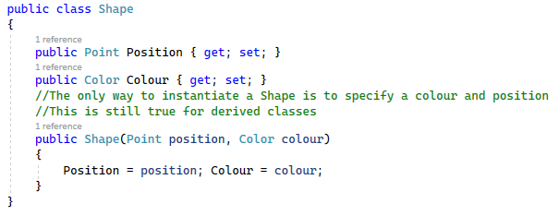
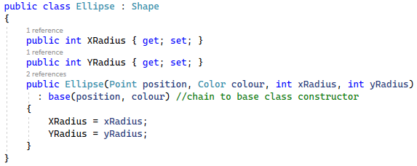

Derived Constructors
Notes:
In the example the Shape class only has one constructor which takes two parameters: position and colour.
Constructors are not inherited. But the rules they encapsulate are. Any class derived from Shape, must have some way of telling its base class what position and colour it should have.
The Ellipse constructor takes four parameters, of which the first two (position and colour) are passed up to the base class constructor. To invoke a constructor in the base class, use the base keyword. To invoke a constructor within the same class, use the this keyword.
It isn't possible to use both this and base in the same constructor; it’s an either / or situation.

Slide 8
Polymorphism
Polymorphism is a Greek word meaning ‘having many forms’
Polymorphism occurs because the runtime type of an object can be different to an object’s declared type
Objects of a derived type may be treated as objects of a base class in places, such as when passed as a parameter to a method, or when stored in a collection
For example:
A Rectangle instance can be used anywhere a Rectangle type is expected
A Rectangle instance can be used anywhere a Polygon type is expected
A Rectangle instance can be used anywhere a Shape type is expected
A Rectangle instance can be used anywhere a System.Object type is expected

Slide 9
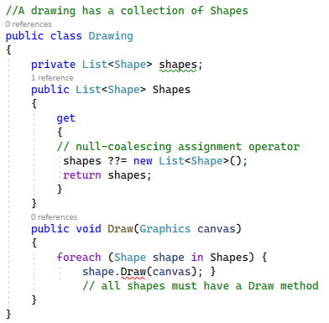
Polymorphism
Scenario
The Drawing class needs to hold a collection of Shapes and be able to iterate over the collection to call each shape’s Draw method
Notes:
In our drawing program, it seems likely that a collection of all of the different shaped objects will be maintained in some kind of a drawing type.
This collection would hold references to Rectangle, Ellipse and Triangle objects, but the code above treats them all as if they were mere Shape objects when it iterates through the collection to draw all the shapes. This generalised approach to working with objects is made even more powerful because of the fact that we can access behaviours of objects polymorphically.
When you generalise a Rectangle as a Shape, polymorphism will call Rectangle-specific methods rather than general Shape methods, if they exist.

Slide 10
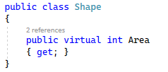
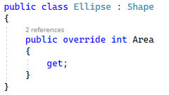

Polymorphism with virtual methods or properties
Inherited methods and properties can be defined as virtual
Virtual members can be overridden in the derived class
This enables you to generalise the type of an object to its base class type, but have the compiler call the more specialised derived version of the member
Notes:
A derived class inherits all of the instance methods and properties of its base class. However, it can also modify inherited behaviour by overriding it. This means that the derived class defines a method or property with exactly the same signature and return type as one in a base class (not necessarily its immediate base class).
In C#, a class must explicitly allow a method to be overridden through the use of the “virtual” keyword. Otherwise, an attempt to override will generate a compiler warning.
C# will call the runtime’s specialized member rather than the declared type’s generalized member. This is polymorphism: treating objects generally but having them act specifically.

Slide 11
Member access modifiers
Members (methods and properties) can be marked as:
public
private
protected
internal
protected internal
private protected
These define how users of the class or a derived class can access the members of that class.
Notes:
A “public” member: access is not restricted. Many classes are marked with the public keyword, as are methods and properties that represent the publicly accessible façade of a type.
A “private” member: access is limited to the containing type. This modifier is very commonly applied to fields and occasionally to some methods and properties.
A “protected” member: access is limited to the containing class or types derived from the containing class.
An “internal” member: access is limited to the current assembly. Certain classes, known as helper classes, and some methods and properties will be specified with internal access.
A “protected internal” member: access is limited to the current assembly or types derived from the containing class.
A “private protected” member is accessible by types deriving from the containing class, but only within its containing assembly.

Slide 12
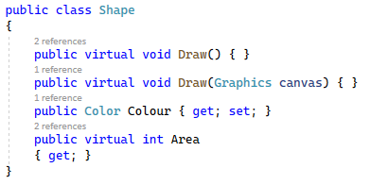
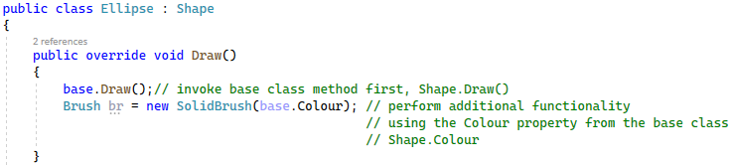
A derived class can access base class members
This avoids code duplication and having to have access to private fields
To call a base class member, use the base keyword
This calls the first matching member in the inheritance hierarchy
Invoking base class functionality
Notes:
Common overriding scenarios are:
Replace the virtual method’s code completely
Call the base class‘s implementation first, then add extra code
Perform some of your own code, then call the base class‘s code
To do this, you use the base keyword and call the appropriate method or property. This will call the matching method in the base class, or in one of its base classes if the method is virtual and hasn't been overridden in the immediate base class.
You cannot call “base.base”. The base keyword can only be used to refer to the immediate base class.
If you omit the base keyword, you are effectively referring to this, which could lead to a stack overflow as your method repeatedly calls itself.

Slide 13
Abstract Classes
The abstract modifier indicates that an item has missing or incomplete implementation
Use the abstract modifier in a class declaration to indicate that a class is intended to be used only as a base class for other classes
Abstract classes can’t be instantiated
Abstract members within an abstract class must be implemented by non-abstract derived classes
Derived classes receive:
Zero or more concrete methods/properties that they inherit
Zero or more abstract methods/properties that they inherit and must implement if they are a non-abstract class

Slide 14
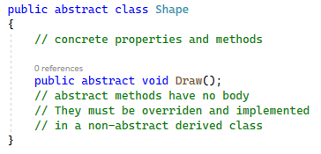

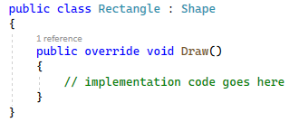
An abstract class can contain abstract members:
The abstract member must be implemented in a non-abstract derived class.
Use the override keyword to implement the member:
Abstract classes example
Notes:
Good practice in OO design is to factor out as much common data and behaviour as possible into a shared base class. If this base class becomes so general or abstract that it is used only as a framework by derived classes and is never instantiated, that class is known as an abstract class.
For example, the author of the Shape class has no real idea of how a specific shape will be drawn, nor can they possibly know how to calculate the area of a specific shape. However, they can determine that all shapes can be drawn and have their area calculated. Therefore, they can add an abstract definition of this behaviour without actually providing any implementation at all.
Derived classes must then replace (via overriding) the abstract member with a concrete implementation.
An abstract class can contain anything a non-abstract class can contain, such as instance variables and instance methods. Abstract classes can also contain abstract members. Abstract members do not contain any implementation code.

Slide 15
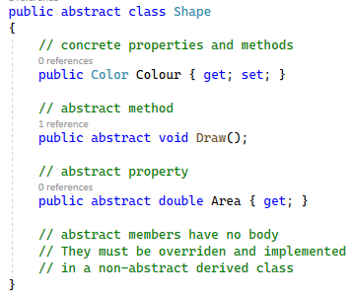
Abstract members are declared using the abstract modifier and a signature only
They do not contain any implementation code
A class with even a single abstract member must be declared as abstract and cannot be instantiated
Each derived class provides its own implementation for the abstract member or declares the inherited member as abstract and itself as an abstract class
Abstract members
Notes:
An abstract method is a method that cannot meaningfully be implemented by a class. Any class that contains one or more abstract methods is an abstract class and must be marked with the abstract keyword. A concrete derived class must implement all of the abstract methods of its base class. The declaration of an abstract method in an abstract base class forces all concrete descendants of that class to implement that method. Any derived class that does not implement all of the abstract methods of a base class is implicitly abstract and cannot be instantiated.
An abstract method has no method body; just a signature that includes the keyword abstract.
If ClassA is abstract and ClassB derives from ClassA and overrides all of ClassA's abstract members (making ClassB a concrete class), then any class that derives from ClassB does not need to provide its own implementation for ClassA's abstract methods. This is because ClassB has overridden all of the necessary members. Any further deriving classes can override these members if they require.

Slide 16
Casting derived and base classes
An object of a derived class can be treated as an object of a base class without explicit casting. This is known as an up-cast and is safe
An object of a base type needs to be explicitly cast to be used as a derived type. This is known as a down-cast and is potentially unsafe
System.Object
Shape
Ellipse
Polygon
Heart
Rectangle
Notes:
Every Rectangle is a Polygon and every Polygon is a Shape. It is therefore safe to use a variable declared as a Shape and pass a Polygon or Rectangle instance. This is an up-cast and happens implicitly.
The reverse is not true. Not every Shape is a Polygon. A Shape may be an Ellipse or a Heart shape. You must therefore perform a down-cast explicitly. If the type is incompatible, an exception will be thrown.

Slide 17
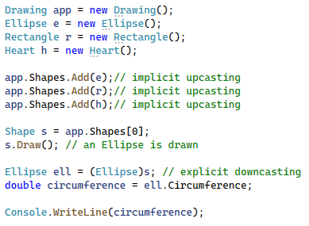
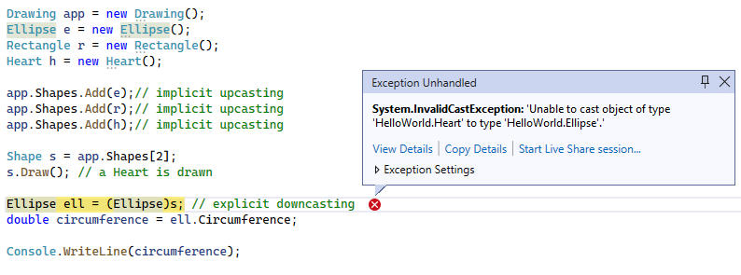
UP-Casting and
Down-Casting
Notes:
You can only invoke methods and properties of the base type when working with a base type reference. For example, in the code above the compiler will check to make sure that the method Draw is defined in the base Shape class. But what happens when we want to call a method or property that is defined in the derived class, such as the Circumference property defined in Ellipse?
In this case, a down-cast must be performed explicitly. This is potentially unsafe. What happens if the Shape extracted from the collection is not an Ellipse? The cast to Ellipse would fail.
To summarise, it is always possible to use a base reference to refer to a derived object (and to implicitly convert a derived reference to a base reference, which is known as an “up cast”). Conversions down the hierarchy (down-casts) require explicit casts which may throw an exception. Extra checking can be performed to prevent the exception being thrown.

Slide 18
Safe Downcasting
To prevent an InvalidCastException being thrown, you can use the following operators:
is
as

Slide 19
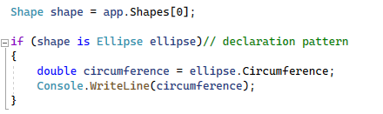

The ‘is’ operator
The is operator checks if the result of an expression is compatible with a given type or matches a pattern:
Notes:
The is operator checks if the run-time type of an expression result is compatible with a given type T. It returns true when an expression is not null and the run-time type matches the type T or is derived from type T. If an implicit reference conversion exists or a boxing or unboxing conversion exists, it also returns true.
From C# 7.0 onwards, you can also use the is operator to test an expression against a pattern. The example uses the declaration pattern whereby you declare a local variable to store the cast expression result if the type match succeeds.
From C# 9.0 onwards, you can use the not, and, and or pattern combinators to create logical patterns.
Best practice recommendation: use the pattern matching syntax whenever possible because it combines the test and the assignment in a single statement.

Slide 20
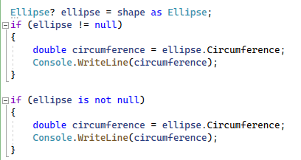
The ‘AS’ Operator
The as operator explicitly converts the result of an expression to a given type
If the conversion isn’t possible, the as operator returns null
Notes:
The as operator prevents an exception being thrown. It returns the cast expression result or null if the conversion is not possible.
The != check uses any overloaded equality operators which may have been customized to return unexpected results when comparing to null.
The is not null check uses reference equality and will always return the expected outcome of a null test.

Slide 21
The Object Class
The ultimate base class of all .NET classes is System.Object.
A class implicitly inherits from Object if no base class is explicitly specified.
Object contains virtual methods that are commonly overridden in derived classes:
Equals: Supports object comparisons
Finalize: Performs clean-up before garbage collection
GetHashCode: Generates a number to support the use of a hash table
ToString: Provides a human-readable text string

Slide 22
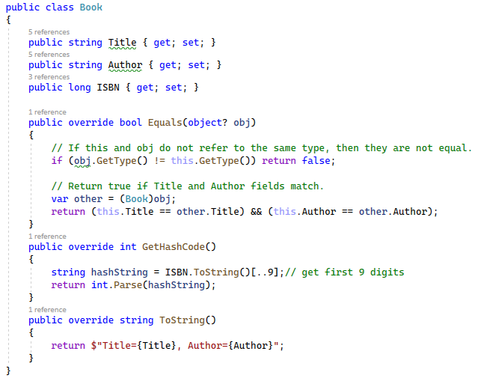
Overriding Object methods example
Notes:
The Book class implicitly inherits from System.Object
The virtual Equals, GetHashCode and ToString methods inherited from Object have all been overridden.

Slide 23
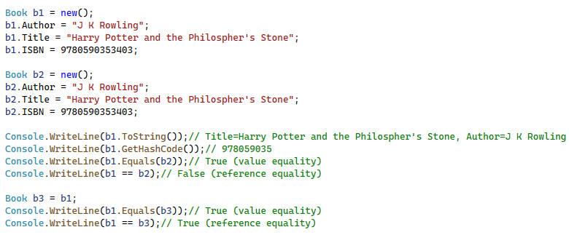
Overriding Object methods example
Notes:
The overridden Equals method compares the Author and Title properties. If they match, it deems the two book objects to be equal.
The == operator compares the object references. Book b1 and Book b2 are different objects in memory and therefore this evaluates as False.
Book b1 and Book b3 point to the same object in memory and therefore this evaluates as True.

Slide 24
Sealed classes and members
All classes can be inherited from unless the sealed modifier is applied
All virtual members can be overridden anywhere within the inheritance hierarchy unless the sealed modifier is applied
Structs are implicitly sealed and so cannot be inherited

Slide 25


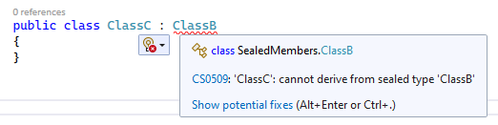
Sealed Classes
ClassA is not sealed so can be used as a base class:
ClassB inherits from ClassA but is marked as sealed:
No classes are allowed to inherit from a sealed class:
Notes:
Note: You cannot seal an abstract class.

Slide 26
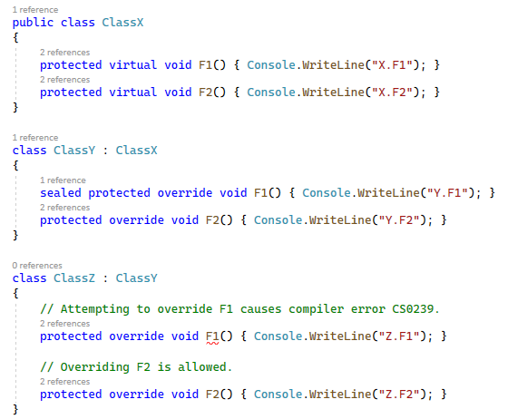
Sealed methods
Notes:
Once a virtual member is sealed, it cannot be further overridden. You must use the sealed modifier with the override modifier for members.

Slide 27
Summary
Inheritance
Derived constructors
Polymorphism
Virtual members and overriding
Invoking base class functionality
Abstract classes
Casting types: Up-casting, down-casting, is and as operators
Overriding System.Object methods
Sealed classes and members

Slide 28
Activity: Exercise 8

