Slide 1
State
Chapter 18

Slide 2
Chapter Overview
Objectives
To understand the various techniques for state management.
Chapter content
HTTP as a stateless protocol
Cookies
Session state and TempData
Exercise
Managing state

Slide 3
HTTP as a Stateless Protocol
HTTP is a “stateless” protocol by default
Every request is independent from every other request
No data is retained from one request to the next
Most modern applications require a concept of state
To remember data from one request to the next
Which user is logged in?
What’s in the user’s shopping basket?
What options have they chosen?
Etc
There are a variety of techniques for adding state to a website

Slide 4
Cookies
A small piece of data (<4Kb) which the server sends to the browser as part of the Response
The browser remembers the data
And sends it back to the server with subsequent Requests
Requests (from the browser):
Response (from the server):
GET /home.aspx HTTP/1.1
HTTP/1.1 200 Ok
Set-Cookie: options=123
Browser displays web page and stores cookie
GET /home.aspx HTTP/1.1
Cookie: options=123
Server receives cookie back from browser, uses it to process next request

Slide 5
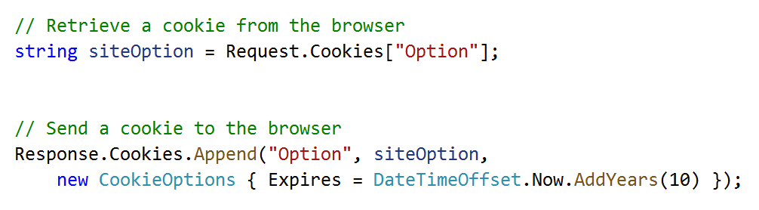
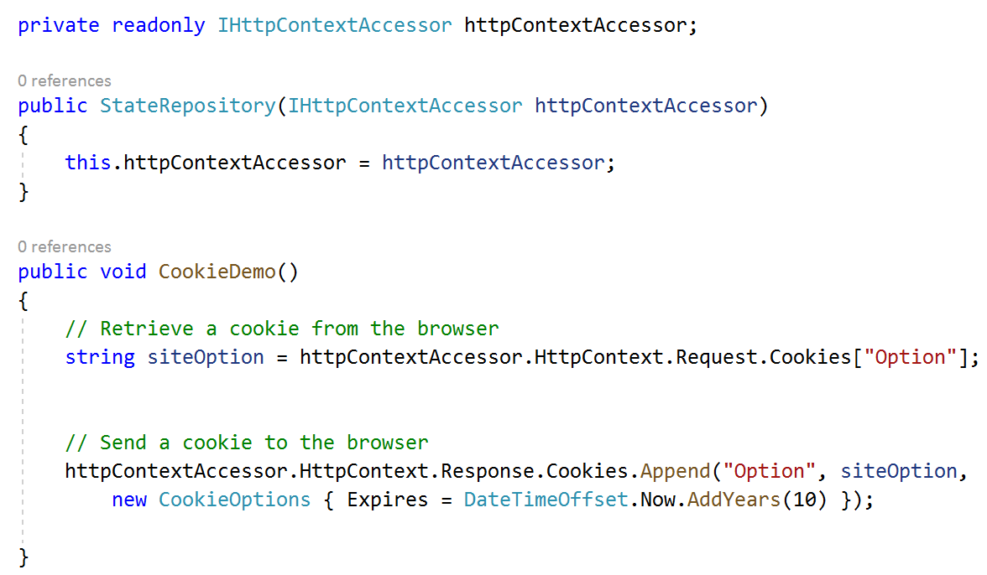
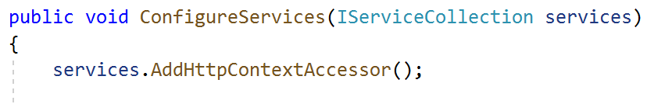
Retrieving and Setting Cookies in ASP.Net Applications
From within a controller:
In other classes, need to get Request and Response objects from the HttpContext
Configure the HttpContextAccessor in ConfigureServices()
Inject using Dependency Injection
Use as required
Returns null if cookie not sent by browser in request
Cookies with no Expires date are called Session Cookies. Deleted when user closes browser

Slide 6
Disadvantages of Cookies
Cookies are a handy way of maintaining state, but have several disadvantages:
Maximum 4kb
Limits on how many cookies can be stored
(50 cookies per domain is required by the standard, some web browsers can support more)
User is in control of cookies
Can easily delete them
A knowledgeable user would be able to change their contents
Need to be transmitted with every request
Can increase network usage

Slide 7
Session State – Storing Data on the Server
The Session State concept works like this:
Each user is allocated a Session ID
A cryptographically strong random number – just because you know your ID, you won’t be able to guess another valid ID
That Session ID is stored in a cookie, and sent with every request
The server can now store state data and relate it to the user
Keyed on the session ID
Can retrieve the data and associate it with the same user, so long as that user continues to send their session ID with every request
Session expires
From user’s point of view, when they log out, or close their browser
From server’s point of view, when ISession.Clear() is called, or after a timeout (default 20 mins)

Slide 8
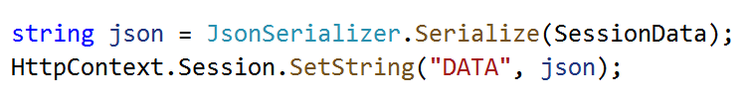
Storing Session State
The Session object can only store byte-arrays
Extension methods also allow it to store strings and ints
You probably need to serialise the data before storing it
This turns it into a string, which can be stored in the Session
Common to serialise as JSON, but any other string or byte-array will work too
The code sample above is from a controller
HttpContext object is inherited from Controller base class
In other classes, use HttpContextAccessor as shown on earlier slide

Slide 9
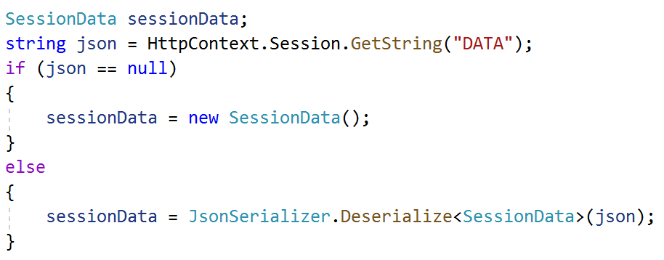
Retrieving Session State
Always check if data was retrieved successfully
If this is a new session, or user has never set this piece of data, Session object returns null
Then de-serialise it

Slide 10
TempData – Passing Data from One Action to the Next
When the user submits a form, it results in two requests in quick succession:
The first is an [HttpPost] request, which contains the submitted data
The server saves the data
Then it returns a 302-Found response, generated by calling RedirectToAction()
The browser receives the 302-Found, and immediately sends another request for the next web page
How to pass data from the action that handles the first request, to the action that handles the second?
Not necessary to store the data for as long as the Session would store it
TempData is ideal for this job
It stores the data from one action, only until it is accessed from another action

Slide 11
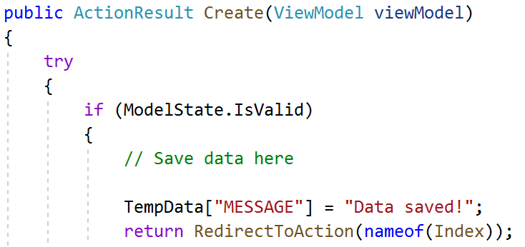
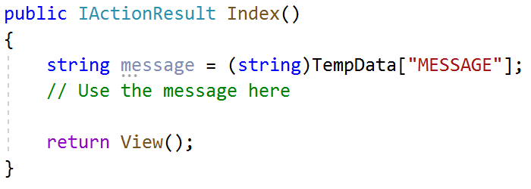
Using TempData
In a controller, add items to TempData by putting a key into [ ]
Retrieve using the same key in a different action
Can store strings, booleans, number types
Attempting to store any complex data type will result in exceptions

Slide 12
Other State Management Approaches
Alternative techniques, less commonly used, include:
Storing state date in the query string (the part of the URL after the ?)
Append it onto the href of every <a> on the page
Hidden fields
<input type=“hidden” value=“” name=“”> is not shown to the user, but is included when user posts form
HttpContext.Items
Can be used to share data between components during a single request. Only keeps data for the duration of the request
Cache
Improve performance and reduce server workload by storing data from one request if it’s likely to be needed in another request
Not suitable for user-specific data, only for data shared between all users

Slide 13
Chapter Review
Objectives
To understand the various techniques for state management.
Chapter content
HTTP as a stateless protocol
Cookies
Session state and TempData
Exercise
Managing state

Slide 14
Hands On Labs
Managing State
Using Session State to maintain a list of recently viewed posts
Using TempData to provide feedback after submitting a form
Using Cookies to store user settings

