Slide 1
VECTOR SEARCH
From brute force to HNSW
kNN · ANN · IVF-PQ · HNSW
Every number in this deck is measured, not estimated.
Companion notebook: notebooks/talk-vector-search.ipynb
Notes:
Welcome. Sixty minutes, four techniques. Everything I claim today, I measured — there's a notebook and every number comes out of it.

Slide 2
Everything is a vector now
A document, an image, a user, a support ticket → a list of 256–1536 numbers.
Similar things land near each other in that space.
So "find me things like this" stops being a text problem…
…and becomes a geometry problem: given a query vector, find the closest vectors.
Notes:
Embeddings turn anything into a list of numbers, and similar things land near each other. So 'find me things like this' becomes a geometry problem.

Slide 3
Four techniques. That's the whole talk.
1. kNN
Exact search. Correct, simple, stops scaling.
2. ANN
Trade a little correctness for a lot of speed.
3. IVF-PQ
Partition the space, then compress what's in it.
4. HNSW
Build a graph and walk it.
Each one exists because of a problem with the one before it.
Notes:
Four techniques, in the order they were invented. Each one exists because of a problem with the one before it. That's the whole talk.

Slide 4
THE RUNNING EXAMPLE
One problem carries the whole talk
SupportBot
200,000 past support tickets. A new ticket arrives — surface the most similar
past tickets so the agent can reuse the resolution.
VECTORS
DIMENSIONS
THROUGHPUT
RAW SIZE
200,000
256
200 QPS
205 MB
Remember 205 MB — in about twenty-five minutes I'm going to make it six.
Notes:
One problem carries the whole talk so every technique is scored on the same task. Swap in whatever your team works on — the numbers barely change.

Slide 5
One piece of vocabulary first
Three distance metrics you'll see: Euclidean, dot product, cosine.
If you normalize vectors to length 1 at write time, all three rank IDENTICALLY.
So normalize once, then stop thinking about it.
Notes:
The thing nobody tells you up front: normalize once at write time and all three metrics rank identically. Then stop thinking about it.

Slide 6
1
Exact kNN
Compare the query to every vector. Keep the best k.
It's a full scan with a heap — and it's better than you think.
Notes:
Let's start with the dumbest thing that works, because it's better than you think.

Slide 7
1 · EXACT KNN
The entire search engine
scores = tickets @ query # cosine sim to every ticket
top = np.argpartition(-scores, k)[:k] # k best, unordered
return top[np.argsort(-scores[top])] # order just those k
If your team is standing up a vector database for 50,000 rows —
this slide is the whole talk.
Notes:
That is a complete, production-viable search engine. One matrix-vector product, one partial sort. If your team is standing up a vector DB for 50k rows, this slide is the talk.

Slide 8
1 · EXACT KNN
What exact kNN buys you
VALUE 1
VALUE 2
Simplest thing
that works
It is your ruler
No index. No training. No tuning.
No new service.
Adding a vector is append().
Deleting is a mask.
Every approximate method is
scored against it.
Run it once on 1,000 queries —
that cached file is your only alarm.
You keep exact search in your stack forever — even after you stop serving from it.
Notes:
Two values, and the second is the one people forget. It's your ruler: every approximate method gets measured against it, forever.

Slide 9
1 · EXACT KNN
So where does it fall over?
4.0 ms
per query, on 200,000 tickets
= 0.8 of a CPU core to sustain 200 QPS
…which is completely fine. Nothing is wrong.
At 200,000 vectors you do not need any of the next fifty minutes.
Notes:
[Pause — this is deliberately anticlimactic.] Which is completely fine. At 200,000 vectors you do not need any of the next fifty minutes.

Slide 10
1 · EXACT KNN
It doesn't fail. It just gets linearly more expensive.
corpus | per query | cores @ 200 QPS
200,000 | 4.0 ms | 0.8 | fine
2,000,000 | 40 ms | 7.9 | p99 blown
20,000,000 | 396 ms | 79.2 | a rack of machines
Ten times the tickets, ten times the bill. Forever.
Seventy cores, burning continuously, to answer a question that ought to fit on a laptop.
Notes:
Here's where it breaks. The cost is exactly linear — ten times the tickets, ten times the bill. And you blew the 50ms p99 somewhere around two million.

Slide 11
1 · EXACT KNN
Isn't this solved? kd-trees, R-trees?
They genuinely work in 2 or 3 dimensions.
They are useless at 256 — above ~20 dims they degrade to scanning everything, plus overhead.
THE CURSE OF DIMENSIONALITY
In high dimensions almost every point sits at almost the same distance from your query.
Distances bunch up — and if everything is equidistant, there is no region to prune.
There is no exact escape hatch. That's not a gap in the literature —
it's the reason this entire field exists.
Notes:
The obvious question: isn't this solved? kd-trees work in 2-3 dimensions and are useless at 256. There is no exact escape hatch — that's why this field exists.

Slide 12
2
ANN
Trade a little correctness for a lot of speed.
Then measure exactly how much you traded.
Notes:
What we give up is being exactly right, and we give up surprisingly little of it.

Slide 13
2 · ANN
recall@k — the one metric
The fraction of the true top-k that you actually returned.
You asked for 10. You got 9 of the right ones. → recall@10 = 0.90
Compute it by running exact search on ~1,000 sampled queries and diffing.
That cached ground truth is the ruler from section 1.
Notes:
Recall@k is the whole definition. You asked for ten, you got nine right ones, recall@10 is 0.9. You compute it by diffing against exact search.

Slide 14
2 · ANN
"Isn't 0.9 just… accepting wrong answers?"
WHY IT'S FINE
WHERE IT ISN'T
Your embeddings were
already approximate.
Dedup and exact
retrieval.
The true #7 by cosine distance
is not a ground truth about
relevance. It's one model's opinion.
Chasing exact geometry on a
fuzzy measurement is false precision.
There a missed neighbour isn't a
ranking nudge — it's a
correctness bug.
Recall 0.95 means 5% wrong
answers. Different conversation.
First question about any vector search feature: which regime am I in?
Notes:
This is the objection you should get. The answer: your embeddings were already approximate. But name the exception honestly — dedup is a different regime.

Slide 15
2 · ANN
Three ideas. That's all that's left.
Partition
Compress
Build a graph
Scan a slice of the data instead of all of it.
Make each comparison cheaper.
Walk toward the answer in log time.
The first two combine — which is why you'll only ever see them written as one word: IVF-PQ.
Notes:
Everything from here is one of three ideas. The first two combine, which is why IVF-PQ is one word.

Slide 16
3
IVF-PQ
Two independent ideas bolted together.
IVF partitions (buys time) · PQ compresses (buys memory).
Notes:
It has a compound name because it is literally two ideas. I'll teach them separately, measure each alone, then combine.

Slide 17
PARTITION · BUYS TIME
3a · IVF — Inverted File Index
You don't scan every book in the building. You walk to the right few shelves.
BUILD — k-means the corpus into 512 buckets (Voronoi cells). ~390 tickets each.
SEARCH — compare the query to the 512 centroids only. That's cheap.
Pick the nprobe closest buckets. Brute-force just those.
Value: you stop looking at data that was never going to win.
Notes:
The library analogy. You don't scan every book in the building — you walk to the right few shelves and scan those.

Slide 18
3A · IVF
The nprobe sweep — the dial
nprobe | scanned | % of corpus | ms/query | recall@10
1 | 391 | 0.2% | 0.022 ms | 0.592
2 | 781 | 0.4% | 0.019 ms | 0.817
4 | 1,562 | 0.8% | 0.034 ms | 0.958
8 | 3,125 | 1.6% | 0.063 ms | 0.999
16 | 6,250 | 3.1% | 0.122 ms | 1.000
64 | 25,000 | 12.5% | 0.603 ms | 1.000
512 | 200,000 | 100.0% | 3.729 ms | 1.000
At nprobe=4 we scanned 0.8% of the corpus and got 96% of the right answers — a ~95× speedup for 4 points of recall.
Notes:
Two things to point at. One row here is a product decision. And recall climbs fast then flattens, while cost keeps climbing linearly and never flattens.

Slide 19
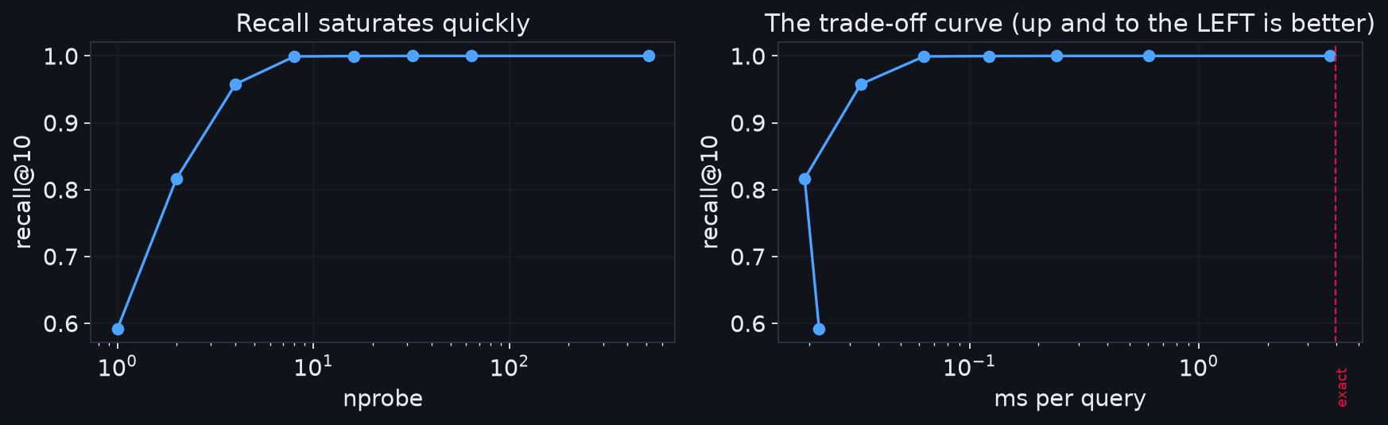
3A · IVF
Recall saturates. Cost doesn't.
1 → 4 probes: +37 points of recall. 64 → 512 probes: +0.000, and 3.2 ms slower.
Notes:
Almost all of the value is in the first few probes. 1→4 buys 37 points of recall. 64→512 buys zero and costs 3.2 milliseconds.

Slide 20
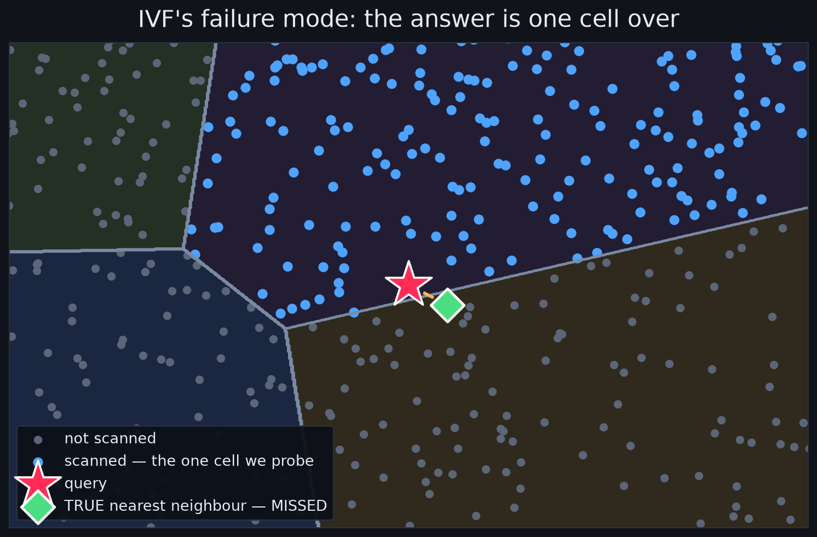
3A · IVF
Where IVF is wrong — and why that's good
The query hugged a boundary. Its true nearest neighbour fell one cell over. nprobe is exactly the fix.
Notes:
This is IVF's whole failure mode, and I love it because it's specific and predictable. Errors you can explain are errors you can debug.

Slide 21
3A · IVF
Where IVF's value runs out
Memory is completely unchanged — still all 205 MB of full float32 vectors.
IVF buys TIME, not SPACE. Hold that thought for ninety seconds.
It needs training — k-means over a sample before you can insert anything.
It drifts. Centroids fitted on last year's tickets go lopsided as topics shift.
Retraining is real, scheduled, operational work.
Notes:
Three things. And hold the memory one — it's the setup for PQ in ninety seconds.

Slide 22
COMPRESS · BUYS MEMORY
3b · PQ — Product Quantization
Don't store every pixel's exact colour. Store an index into a 256-colour palette.
SPLIT — chop each 256-dim vector into 32 sub-vectors of 8 dims.
CLUSTER — k-means each chunk position independently → 32 codebooks of 256 centroids.
ENCODE — replace each chunk with its nearest centroid id: 0–255. One byte.
1,024 bytes → 32 bytes
Notes:
The palette analogy: instead of storing every pixel's exact colour, store an index into a 256-colour palette.

Slide 23
3B · PQ
A ticket, before and after
BEFORE
[-0.0872 0.0147 0.0100 -0.0640 -0.0553 … ] 256 floats = 1,024 bytes
AFTER
[125 195 131 51 129 60 73 33 … ] 32 bytes
205 MB → 6.4 MB
32× smaller
Notes:
There it is. Ticket zero used to be 256 floats. It is now literally these 32 bytes.

Slide 24
3B · PQ
PQ's value is a DEPLOYMENT value
corpus | raw | with PQ | what changes
200,000 | 0.20 GB | 0.01 GB | fits inside your app process
2,000,000 | 2.0 GB | 0.06 GB | growth stopped being an infra project
100,000,000 | 102 GB | 3.2 GB | one big machine, not a cluster
1,000,000,000 | 1,024 GB | 32 GB | billion-scale on a single host
The top row deletes a service from your architecture diagram. The bottom row is why PQ exists.
Notes:
This is a deployment value, not a latency value. Three arguments live in this table and they get better as you go down.

Slide 25
3B · PQ
But the compression dial has a CLIFF
m | bytes/vector | compression | recall@10
16 | 16 | 64× | 0.156
32 | 32 | 32× | 0.388
64 | 64 | 16× | 0.632
128 | 128 | 8× | 0.870
PQ alone is not a search index. It's a SHORTLISTING index.
Hold that for five minutes — three lines of code fix almost all of it.
Notes:
Read these and don't panic — they look alarming on purpose. At 32x compression the reconstruction error is comparable to the gap between the true #1 and the true #40.

Slide 26
3B · PQ
The clever part: you never decompress
Squared distance is SEPARABLE — the distance between two vectors is just the sum
of the distances between their chunks. That's not a trick, it's arithmetic.
Precompute one lookup table per query:
distance from each query chunk to each of its 256 centroids. → 32 × 256 = 8,192 tiny computations, ONCE.
Then the distance to ANY ticket = 32 table lookups + 32 adds.
No multiplications. No 256-dimensional math. The same 32 bytes that saved memory
made the comparison cheaper too — compression and speed usually trade against each other.
Notes:
[Slow down. This is the best idea in the talk.] The natural assumption is that compressed data must be decompressed. PQ never does. Not once.

Slide 27
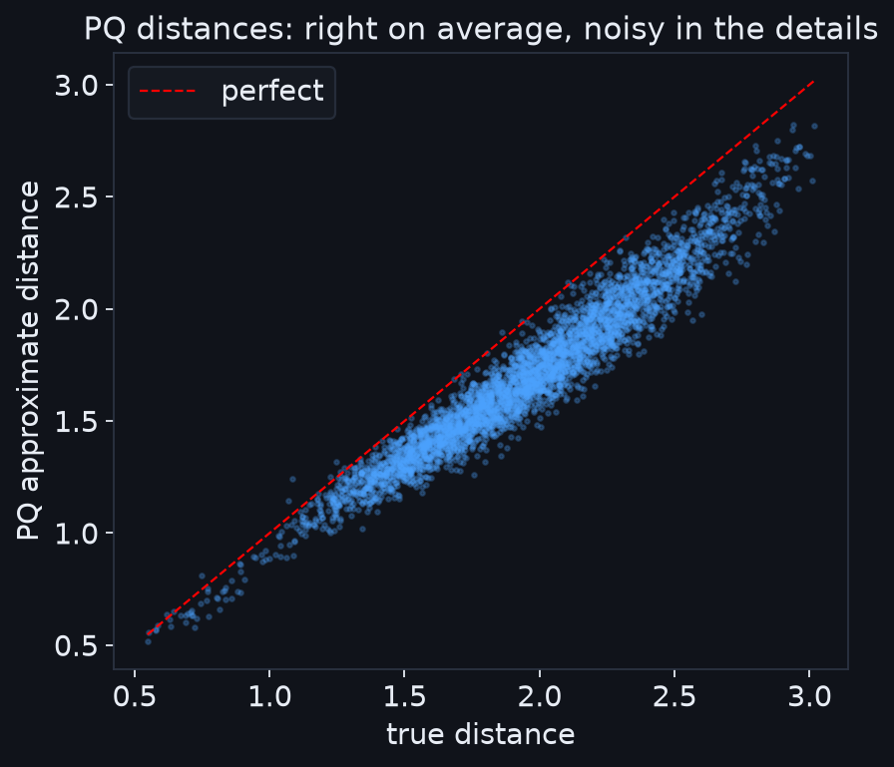
3B · PQ
Right on average. Noisy where it matters.
The scatter around the line is the recall loss. The top-10 live in the bottom-left — exactly where the noise bites.
Notes:
Right on average, noisy in the details. The scatter around the line IS the recall loss — and the top-10 live in the bottom-left corner, where the noise hurts.

Slide 28
PARTITION + COMPRESS
3c · IVF-PQ, combined
"Go to the right shelves — and read compressed summaries once you're there."
LATENCY
MEMORY
RECALL@10
0.093 ms
6.4 MB
0.485
So we're fast, we're small, and we're wrong. Let's fix the wrong part.
Notes:
Now put them together. IVF picks the buckets, PQ makes scanning them cheap. It's fast, it's tiny, and its recall is 0.485 — useless.

Slide 29
3C · IVF-PQ
Rerank — three lines
_, candidates = ivfpq.search(Q, 100) # cheap, approximate shortlist
exact = tickets[candidates] @ query # exact, on 100 vectors only
return candidates[argsort(-exact)[:10]] # true top-10 of the shortlist
100 exact distance computations is nothing.
0.485 → 0.971
recall@10
for +35 microseconds
Notes:
Retrieve top-100 by cheap PQ distance. Load those 100 full vectors. Rescore exactly. A hundred exact distance computations is nothing.

Slide 30
3C · IVF-PQ
The highest payoff in the whole stack
candidates | ms/query | recall@10 | gain
— (no rerank) | 0.093 | 0.485 | —
20 | 0.100 | 0.691 | +0.206
50 | 0.112 | 0.903 | +0.418
100 | 0.127 | 0.971 | +0.486
200 | 0.161 | 0.996 | +0.512
Every few months a team concludes “we tried PQ, quality was terrible.”
What they shipped was a shortlisting index without the second stage.
Notes:
If this room takes home one implementation detail, make it this one. It is routinely missing from hand-rolled vector search.

Slide 31
3C · IVF-PQ
The honest catch
Reranking needs the full vectors — which you just spent a section compressing away.
On SSD
~100 vectors per query, a few hundred KB. Keeps the memory win. Usually right.
In RAM
Fastest — but you just gave back the entire 32× saving. Sometimes correct; know you did it.
In practice it's SSD, and you keep the 32× win that made you choose IVF-PQ in the first place.
Notes:
Name the cost of your own fix — that's what makes the rest of your numbers believable. Reranking needs the vectors you just compressed away.

Slide 32
4
HNSW
Hierarchical Navigable Small World.
Don't partition. Don't compress. Build a graph and walk it.
Notes:
Completely different philosophy. Terrible name, beautiful algorithm.

Slide 33
4 · HNSW
Flight → train → walk
You're in a small town in Japan and need a café in Osaka.
You don't consult a street map of the entire country.
L2: A ------------------------ Z few nodes, long hops
L1: A ------- M -------------- Z
L0: A - c - f - M - p - t - w - Z EVERY node, short hops
If you know skip lists: it's a skip list where the base layer is a proximity graph.
Roughly O(log N) hops.
Notes:
The travel analogy. You don't consult a street map of the whole country. Flight, train, walk. Long hops first, short hops last.

Slide 34
4 · HNSW
The search, in one breath
Start at the entry point in the top layer.
Greedily walk to whichever neighbour is closer to the query.
When no neighbour improves — drop down a layer. Repeat.
At layer 0, keep a candidate list of size efSearch instead of just the best.
Every node lives at layer 0. Upper layers are a routing shortcut, not a filter.
Notes:
The search, in one breath. Greedily walk to whichever neighbour is closer. When none improves, drop a layer. At layer 0 keep a candidate list of size efSearch.

Slide 35
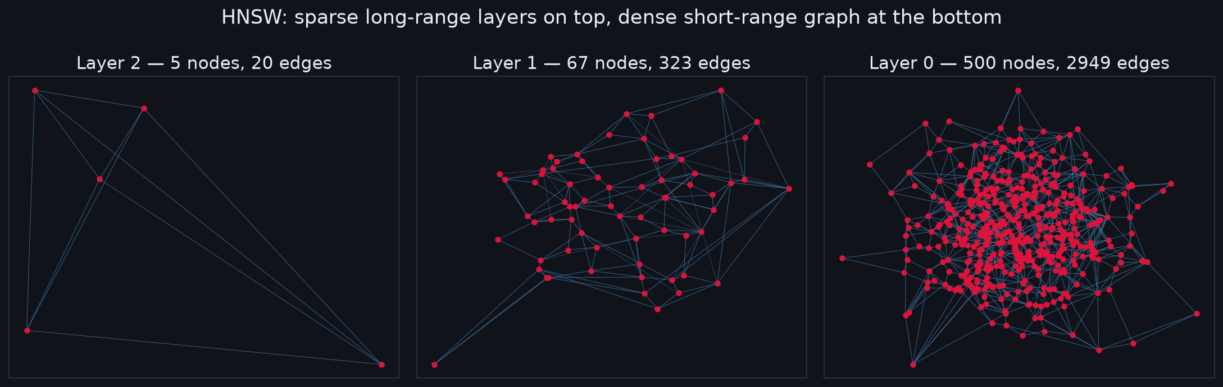
4 · HNSW
The actual graph
Read right to left — the way a search runs. Sparse express lanes on top, every node at the bottom.
levels: 433 nodes stop at layer 0 · 62 reach layer 1 · 5 reach layer 2
Notes:
Read it right to left, the way a search runs. Five nodes span the whole space up top; layer 0 has all 500. That's the flight, the train, and the walk.

Slide 36
4 · HNSW
One index, three products
efSearch | ms/query | recall@10 | plausible use case
10 | 0.033 | 0.749 | type-ahead
50 | 0.091 | 0.963 | standard search
100 | 0.147 | 0.988
200 | 0.238 | 0.998 | RAG / agent context
400 | 0.448 | 0.999 | offline eval
Same index. Same box. No rebuild. It's a per-request parameter.
IVF's nprobe gives you the same freedom. Most teams leave this capability on the floor.
Notes:
Same index, same box, no rebuild — a per-request parameter. Most teams treat this as a config-file setting. It isn't.

Slide 37
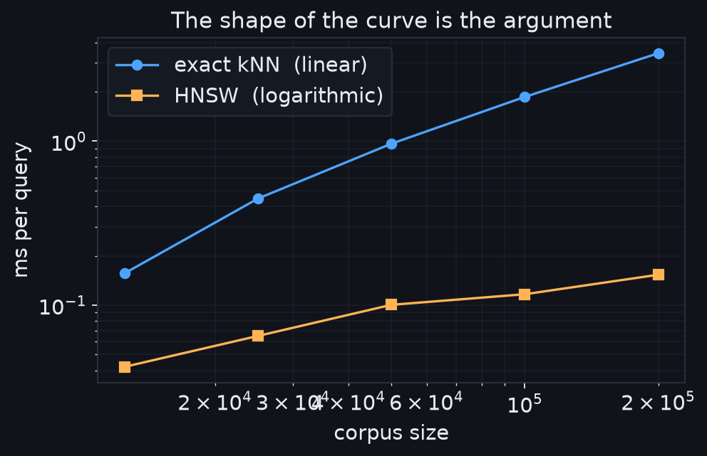
4 · HNSW
O(log N) vs O(N) — the shape is the argument
Corpus grew 16× → exact got 22.0× slower, HNSW got 3.6× slower.
And at 12,500 vectors HNSW is only 3× faster — the data agrees: at small N, don't bother.
Notes:
Not the latency at one size — the SHAPE of the curve as you grow. That's the whole pitch.

Slide 38
4 · HNSW
Where HNSW's value runs out
MEMORY — stores full vectors PLUS the graph: 230 MB vs IVF-PQ's 6.4 MB.
That's 36× more memory.
DELETES are genuinely awkward — you can't cut a node without risking disconnection.
Tombstone and rebuild. For high-churn data that's a real operational cost.
BUILD TIME — 8s for 200k here. At 10M it's hours.
HNSW buys speed with RAM. IVF-PQ buys RAM with accuracy.
Notes:
Three places, and they're serious. Memory is the headline — and it's your one-sentence comparison for the whole talk.

Slide 39
5
The ledger
Everything measured, on one problem, on one machine.
Notes:
Let me put all of it on one scoreboard.

Slide 40
5 · SCOREBOARD
The value ledger
step | ms/query | speedup | memory | recall | what it bought
Exact (numpy) | 3.959 | 1× | 205 MB | 1.000 | correctness + ground truth
+ IVF (nprobe=16) | 0.122 | 32× | 205 MB | 1.000 | 32× less data scanned
+ PQ (IVF-PQ) | 0.093 | 43× | 6.4 MB | 0.485 | 32× less memory
+ rerank (top-100) | 0.127 | 31× | 6.4 MB | 0.971 | recall bought back, ~free
HNSW (ef=100) | 0.147 | 27× | 230 MB | 0.988 | best recall/latency — for RAM
The bottom two rows are the same speed and nearly the same quality —
and one of them uses 36× less memory. That's your decision.
Notes:
Read the memory column and the recall column together. The bottom two rows are the same speed and nearly the same quality — and one uses 36x less memory.

Slide 41
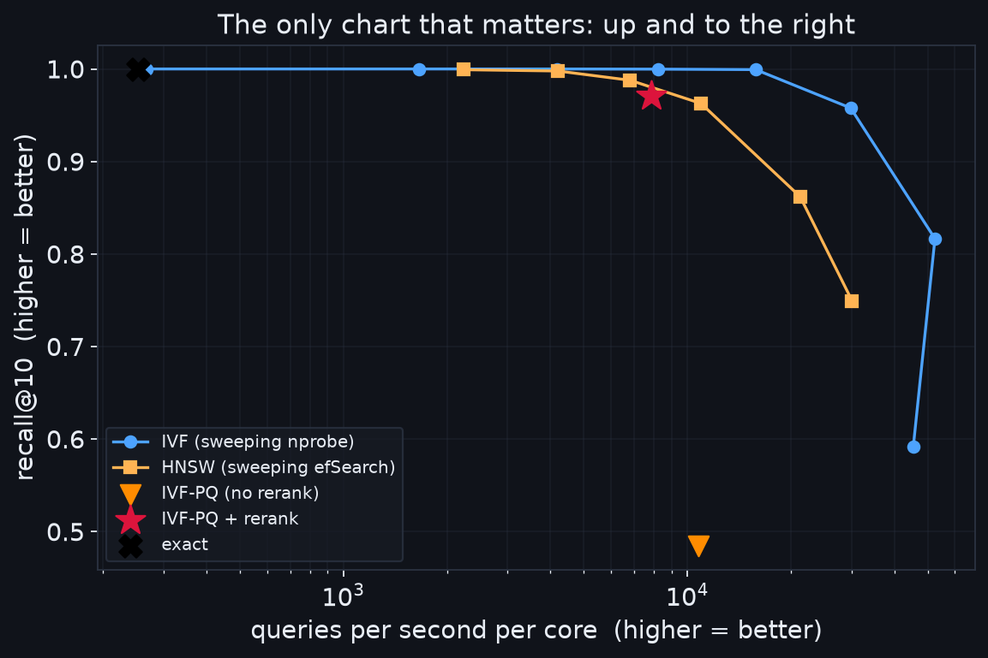
5 · SCOREBOARD
The only chart that matters
Every technique in this talk was a way to push a point up and to the right.
Notes:
The standard chart, built from our numbers. Up and to the right wins. Every technique in this talk was a way to push a point up and to the right.

Slide 42
5 · SCOREBOARD
How to choose — read straight down
Under 100,000 vectors
Brute force. Three lines of numpy. Don't add an index.
Fits in RAM, want best quality/latency
HNSW. The default in every major system for a reason.
RAM is your constraint, or past ~100M
IVF-PQ, with reranking. Non-negotiable on the reranking.
Always
Keep exact search around as the ruler.
Two indexes. Pick by which resource you're short of.
And if you're already on Postgres — pgvector gives you HNSW in the database you already run.
Notes:
Read straight down. And the one I'd lead with in a design review: if you're already on Postgres, pgvector gives you HNSW in the database you already run.

Slide 43
6
The gotcha
Everything so far assumed the query is JUST a vector.
It never is.
Notes:
Four minutes on the thing that will actually bite you.

Slide 44
6 · FILTERING
Real queries are never just a vector
Nearest neighbours WHERE tenant_id = 47 AND status = 'open' AND created_at > monday
The naive approach — POST-FILTERING: run normal ANN search, then drop the results
that fail the predicate. Watch what happens when the predicate is selective.
0.18 / 10
results returned, on average
84% of queries returned ZERO results — with 3,937 matching tickets in the corpus
Notes:
Real queries are never just a vector. Let's break it on purpose.

Slide 45
6 · FILTERING
Push the predicate INTO the search
strategy | avg results out of 10
post-filter (search, then drop) | 0.18
IVF + IDSelector (pushed down) | 10.00
HNSW + IDSelector (pushed down) | 10.00
Same index. Same query. Same filter.
0.18 versus 10 — entirely determined by whether the predicate went in or after.
Pre-filtering wins when the filter is very selective · filtered graph traversal degrades when matches are scattered
Every vector database handles this differently — and this, more than raw QPS, should decide which one you pick.
Notes:
That is a broken product feature, not a tuning problem. The fix is to push the predicate INTO the search so the index keeps walking until it has enough matches.

Slide 46
Three things to leave with
1
Check your row count first.
Under 100k vectors the answer is three lines of numpy. Not a vector database.
2
If you use PQ, rerank.
0.485 → 0.971 for 35 microseconds. The cheapest quality win in the field, and routinely missing.
3
Recall degrades silently.
No exception, no alert, no 500 — just quietly worse results. Ship the ground-truth job WITH the index, not after the incident.
Notes:
Four techniques. Three things I'd like you to actually leave with.

Slide 47
Questions
Everything in this deck is measured by:
notebooks/talk-vector-search.ipynb
Runs in ~5 minutes on a free Colab CPU. Change N_TICKETS at the top and every
table and chart recomputes. There's a “Things to try” section with seven experiments.
Notes:
The notebook is the deliverable. Every number here comes out of it. Questions.

