Slide 1
Binwalk
Presented by
1805091 Ruhul Azgor 1805093 Md. Nazmul Islam Ananto

Slide 2
93 Presenting

Slide 3
Usage
Signature Finding
Entropy Analysis
Forensic Analysis
Reverse Engineering
Developing Compatible Software for Closed-Source Systems
Discovering Hidden Vulnerabilities

Slide 4
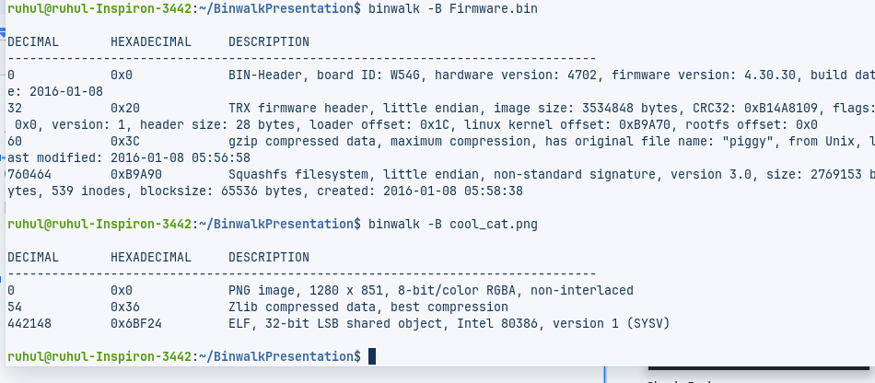
Signature Finding
binwalk -B <file>

Slide 5
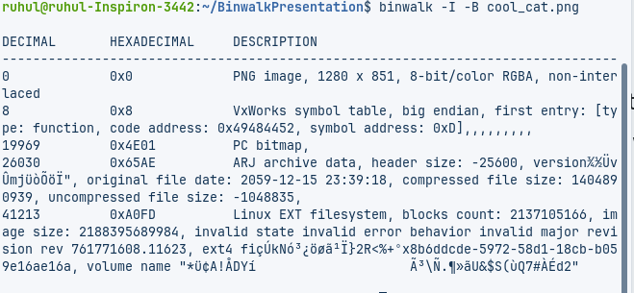
All signatures [ inc. invalid ones]
binwalk -I firmware.bin
Useful when binwalk is treating a valid file as invalid, may mislead with garbages

Slide 6
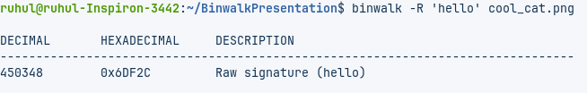
Raw String Finding
binwalk -R ‘<string or escaped in octal>’ <filename>
This allows to search the specified file(s) for a custom string.

Slide 7
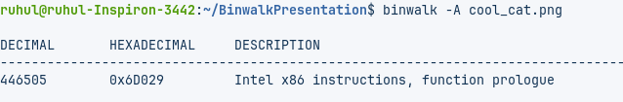
Opcode Analysis
binwalk -A <file_name> or binwalk -- opcode <file_name>
Searches for opcode to determine the architecture of the file. Can be misleading.

Slide 8
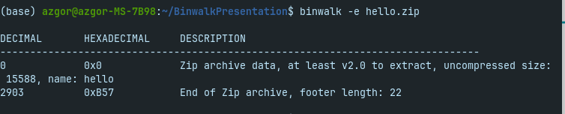
Extraction
binwalk -e firmware.bin
Loads common --dd extraction rules from a predefined file

Slide 9
Extraction
binwalk -e --dd=”.*” firmware.bin
--dd =<type[:ext[:cmd]]> extracts files identified during a --signature scan

Slide 10

Example
What could be under this seemingly Innocent picture?

Slide 11
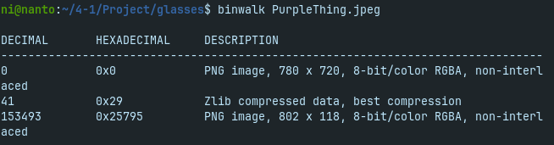
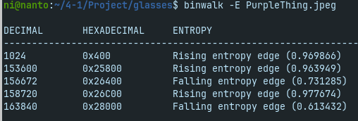
Example

Slide 12
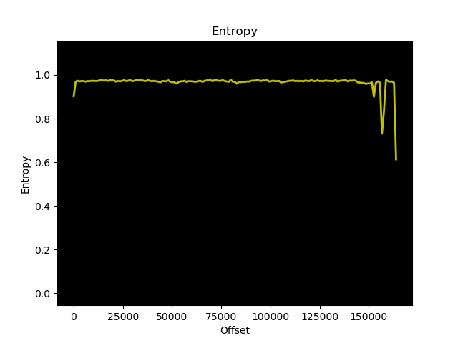
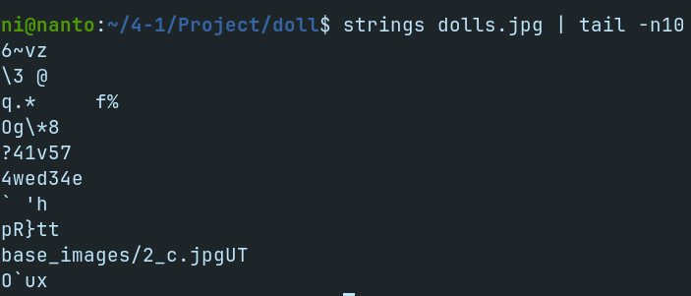
Example

Slide 13
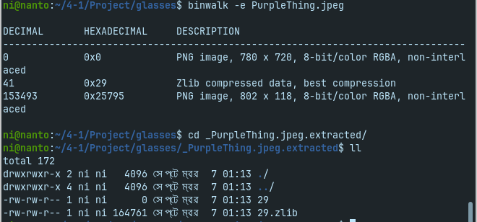
Example

Slide 14
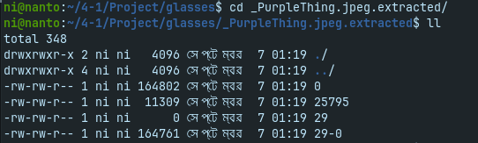
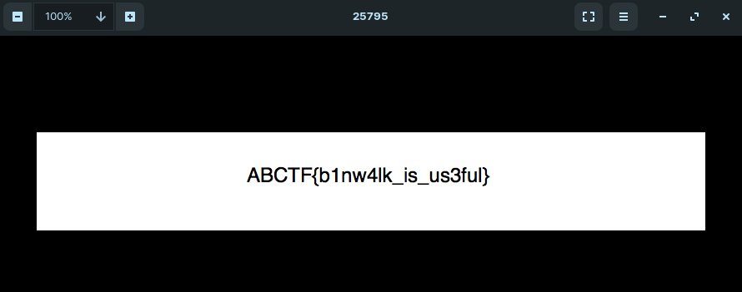
Example

Slide 15

Demo
Now what about this doll? Does this shape look familiar?

Slide 16
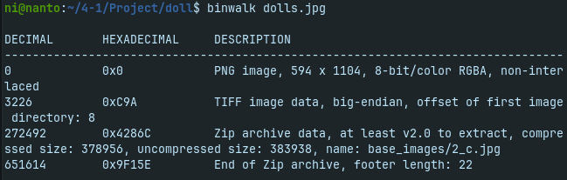
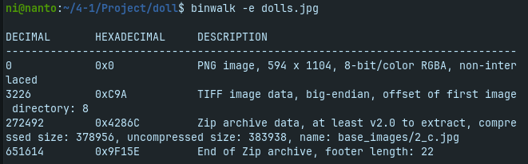
Demo

Slide 17
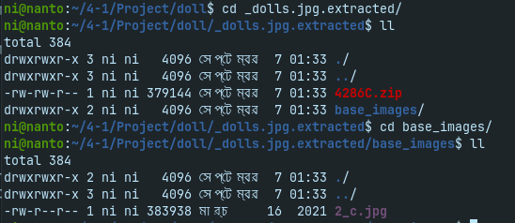
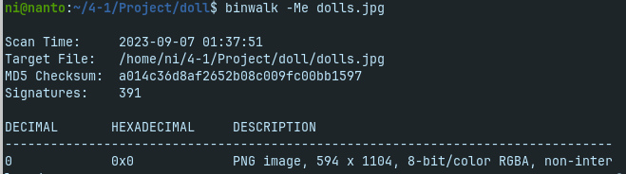
Demo

Slide 18
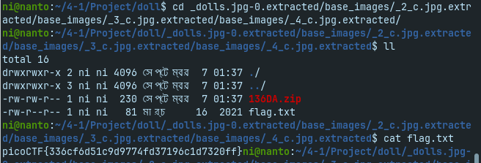
Demo

Slide 19
91 Presenting

Slide 20
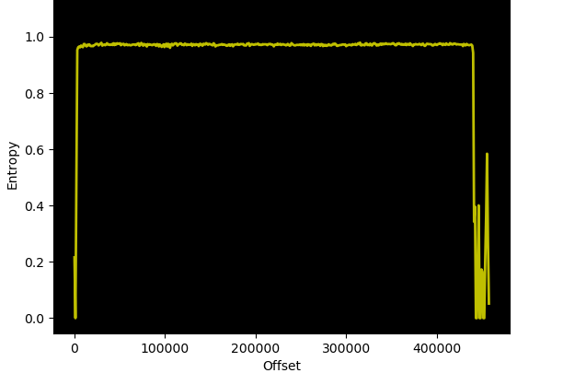
Entropy
binwalk -E firmware.bin
Performs an entropy analysis on the input file(s), prints raw entropy data and generates entropy graphs

Slide 21
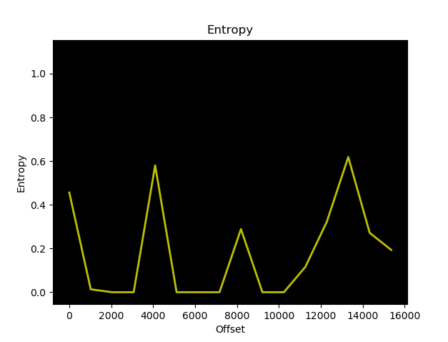
Entropy
Entropy of a regular file:

Slide 22
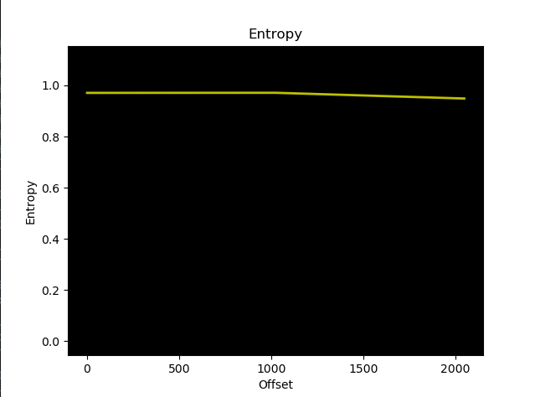
Entropy
Entropy of a zipped file:

Slide 23
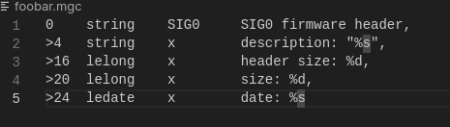
Finding Custom magic signature
binwalk -m <file.mgc> <firmware.bin
Search for customize file signature. File signature may look like this:
More info about Magic Signature

Slide 24
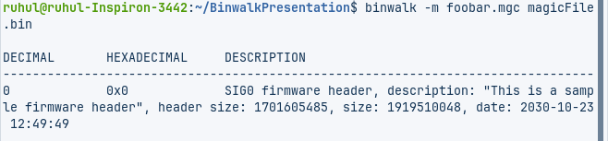
Finding Custom magic signature Continue…
binwalk -m <file.mgc> <firmware.bin
Search for customize file signature. Example:
More info about Magic Signature

Slide 25
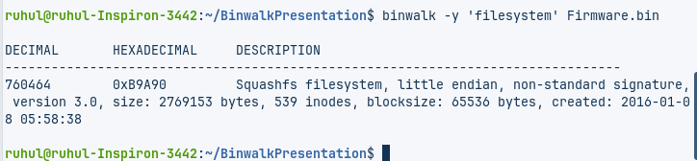
Signatures that match the specified include filter
binwalk -y 'filesystem' firmware.bin # only search for filesystem signatures
Useful when searching only for specific signatures or types of signature

Slide 26
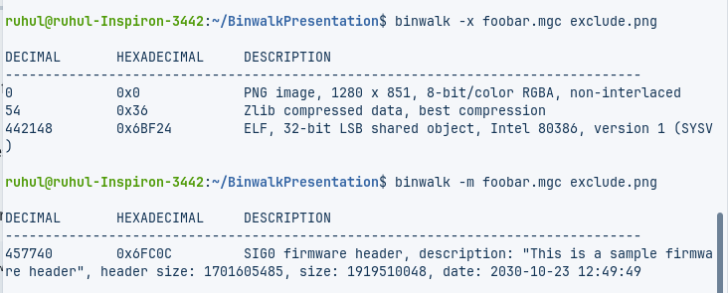
Excludes signatures that match the specified exclude filter
binwalk -x 'mach-o' -x '^hp' firmware.bin # exclude HP calculator and OSX mach-o signatures
Useful for excluding unneeded or uninteresting results

Slide 27
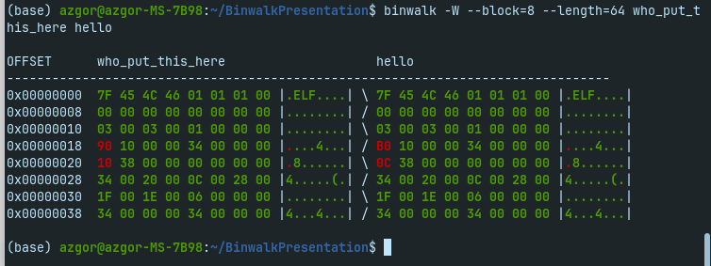
Hexdump
Command:binwalk -W --block=8 --length=64 firmware1.bin firmware2.bin firmware3.bin
Performs a hex dump of the input file(s) and color-codes bytes

Slide 28
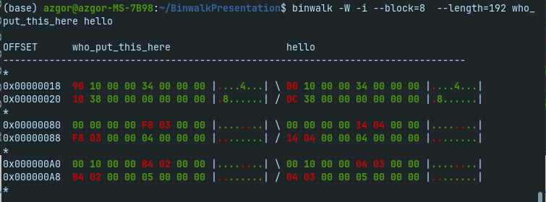
Hexdump continue…
-G =>Only display lines that contain green bytes
-i =>Only display lines that contain red bytes

Slide 29
Demo 03
Cool Cat

Slide 30
Demo 04
Firmware

Slide 31
Disables "smart" signature matching.
Command: binwalk -b firmware.bin
Useful when smart signature keywords in false positive signatures cause other valid signatures to be missed

