Slide 1
RED Light GREEN Light
A Microcontroller project to simulate Traffic Signals

Slide 2
Group Members
Ishika Tarin Ime 1805092
Nazmul Islam Ananto 1805093
Sanjida Islam Era 1805116

Slide 3
BLOCK DIAGRAM
IR Sensor (x8)
Arduino Uno
Traffic LED light (x4)

Slide 4
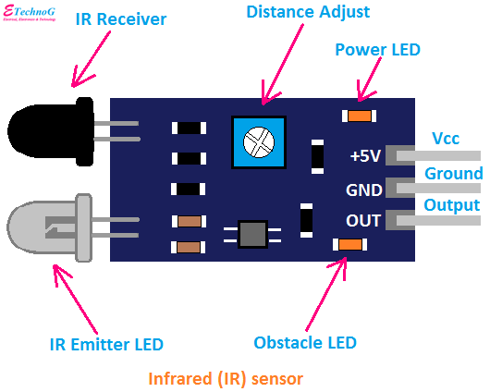
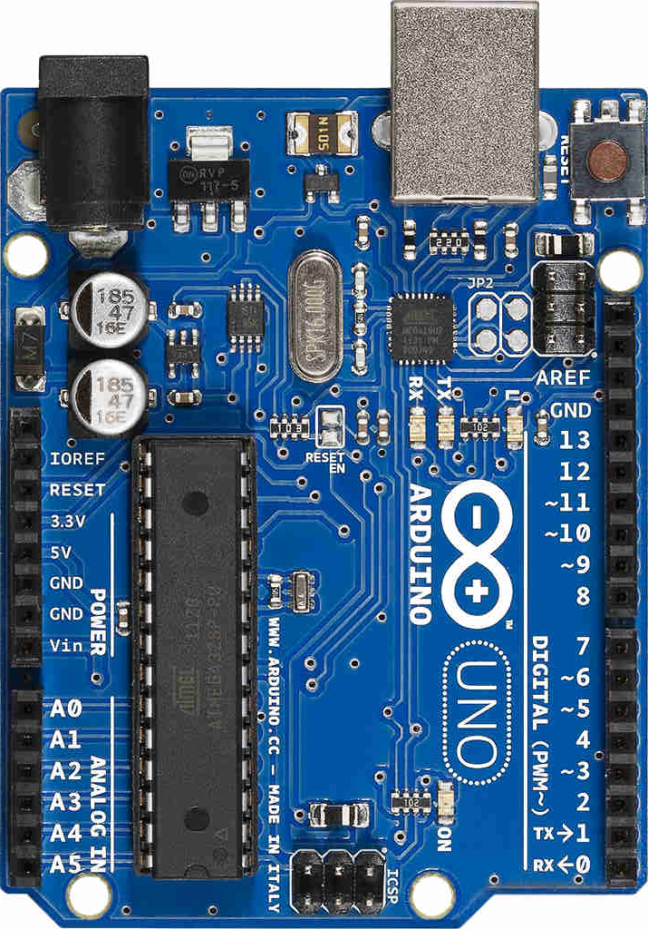
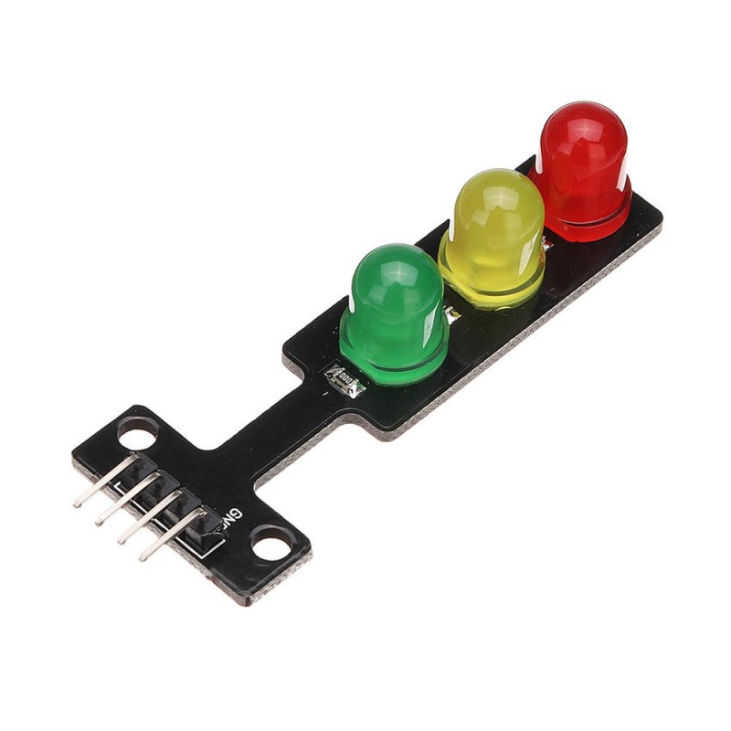
BLOCK DIAGRAM
IR Sensor (x8)
Traffic LED light (x4)
Arduino Uno

Slide 5
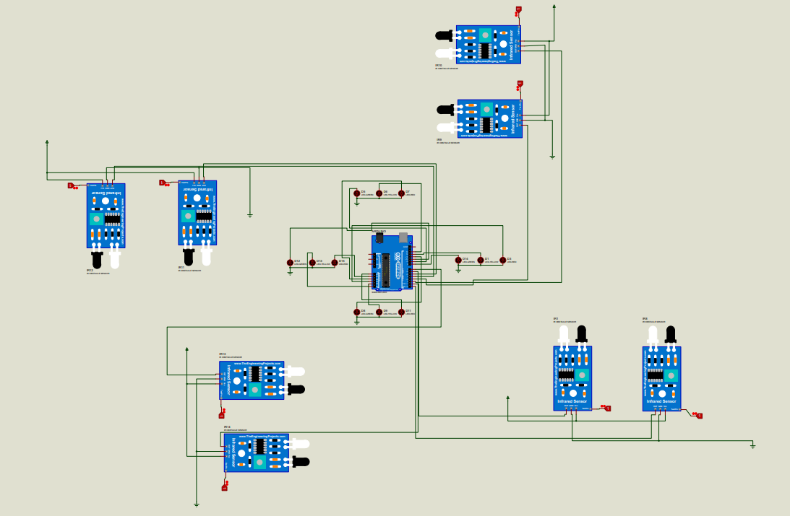
CIRCUIT DIAGRAM

