Slide 1


Greening multi-tenant data center demand response with parameterized supply function bidding
Niangjun Chen
Xiaoqi Ren, Shaolei Ren, and Adam Wierman
Notes:
----- Meeting Notes (10/9/15 11:49) -----
thanks for the introduction, today I will be talking about how to do demand response for multi-tenant data center efficiently, and how can we make it more environmentally friendly

Slide 2
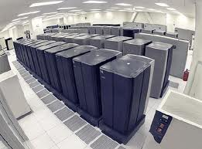
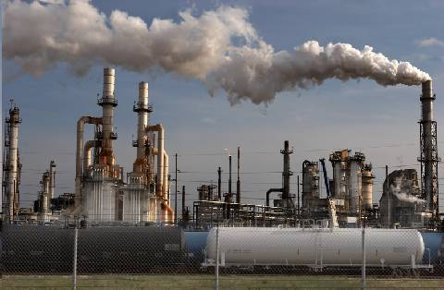
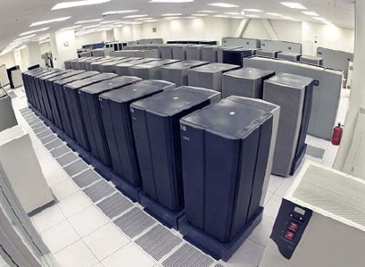

2 stories about energy and data centers
Typical story: data centers are energy hogs
Emerging story: data centers are valuable resources
Idea: use data centers for demand response (DR)
Notes:
Data center experience a large growth in demand and energy consumption in the recent year, when we look at this trend from an energy perspective, the typical story is that, data centers are energy hogs, and the power grid need to invest more in transmission lines and fast generation units in order to deal with the peak demand from data centers, as a result, the environmental impact of data centers is negative. However, we can also look at it from the other side and notice that, which DC load is large, they are also very flexible, and DC have automated control over their power consumption, we can utilize this flexibility and view them as a storage in the grid that can provide ancillary services: helping to reduce peak load and providing regulation in frequency. As a result, the power grid can actually benefit from the increasing presence of data centers and reduce the need to rely on generators. the key difference here is that whether we can make data centers participate in demand response program, which is program for balance power from the demand side.
large load, flexible load, and power control is fully automated => good opportunity

Slide 3
Data centers have great potential for DR
~$5 million cost!
20 MW Data Center with 20% flexibility
700 kWh fast charging, optimally placed storage
[Liu et al 2014]
Current practice: turn on diesel generator upon utility’s request
costly and inefficient!
This talk: Efficient DR in Multi-tenant Data Centers
Notes:
huge potential social benefit
mention that participation is rare, and when they do
increase efficiency – for multitenant case

Slide 4
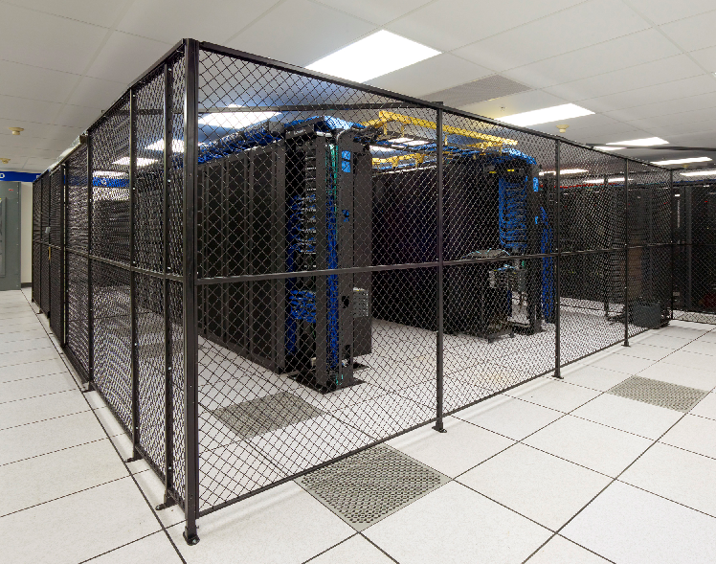
Multi-tenant (colocation) data centers
Multiple tenants house and manage their own servers independently in shared space
Data center operator is mainly responsible for facility support (e.g., power supply, cooling)
Notes:
they own the servers, pay subscription for electrcity and cooling

Slide 5
Multi-tenant (colocation) data centers
Multiple tenants house and manage their own servers independently in shared space
Data center operator is mainly responsible for facility support (e.g., power supply, cooling)
Hyper-scale (e.g. google): 7.8%
Colocation: 37%
Enterprise: 53%
…of total data center industry electricity usage
Notes:
they own the servers, pay subscription for electrcity and cooling
----- Meeting Notes (10/16/15 14:19) -----
color contrast of the pie chart

Slide 6

Why target multi-tenant data center for DR?
Most multi-tenant data centers are in metropolitan areas
Downtown Los Angeles, New York, Silicon Valley, etc.
This is where demand response is most needed!
Example: On July 22, 2011, hundreds of multi-tenant colocation data centers participated in emergency demand response and contributed by cutting their electricity usage before a nation-wide blackout occurred in the U.S. and Canada.
--- A. Misra, “Responding Before Electric Emergencies.”
CoreSite’s “One Wilshire” (Photo: CoreSite)
Notes:
we want to target multi-tenant data centers because they are strategically located (why?)

Slide 7
Our contribution: a simple and provably efficient mechanism to incentivize tenants’ reduction
Goal:
Operator’s challenge:
No direct control of tenants’ reduction s_{i}
Tenants’ private cost c_{i} unknown
cost of local generation
cost of load reduction
meets energy reduction target
Our proposal: use supply function bidding
y: amount of local generation α: unit price of diesel δ: reduction target
s_{i}: load reduction of tenant i c_{i}: cost of reduction of tenant i
Notes:
----- Meeting Notes (10/16/15 14:19) -----
flip 1 and 2,
first uncontrollable, even controllable, ...

Slide 8
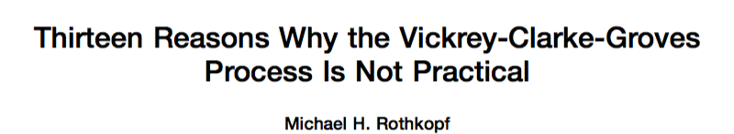
Why supply function bidding?
VCG type mechanisms are problematic in energy settings
[Zhang et al 2015] [Rothkopf 2007]
among them:
tenants required to submit complex bid
allocation problem for operator is NP hard
price differentiation …
Notes:
Complex bidding process
Differentiated price
Expose private information
Unbounded payment
----- Meeting Notes (10/15/15 12:54) -----
reorder 2 1 3
list the problem of VCG
add by text difference
spend more time on this slide
----- Meeting Notes (10/16/15 14:19) -----
not emphasize privacy too much, talk about pricing

Slide 9
Why supply function bidding?
VCG type mechanisms are problematic in energy settings
[Zhang et al 2015] [Rothkopf 2007]
Supply function bidding is widely used in electricity market
[Baldick et al 2004] [Day et al 2002] [David and Wen 2000]
Prior work on supply function bidding
[Klemperer and Meyer 1989] [Niu et al 2005]
[Johari and Tsitsiklis 2011] [Xu et al 2015]
Unconstrained supply function, no performance guarantee
parameterized supply function, good performance guarantee
Key difference with our work: we consider operator has a backup supply option
Notes:
Complex bidding process
Differentiated price
Expose private information
Unbounded payment
----- Meeting Notes (10/15/15 12:54) -----
reorder 2 1 3
list the problem of VCG
add by text difference
spend more time on this slide
----- Meeting Notes (10/16/15 14:19) -----
not emphasize privacy too much, talk about pricing

Slide 10



A parameterized supply function mechanism
Cut energy δ
Diesel energy
y = δ - Σ_{i}s_{i}
Cut energy by
s_{i}=δ-b_{i}/p
Utility
Supply bid b_{i}
Operator
Price p
Tenants
Operator announces supply function s(b, p) = δ-b/p
Tenant i submits bid b_{i}
Operator sets market price p to minimize it own cost (payment to tenants plus diesel cost)
DR is exercised
Notes:
----- Meeting Notes (10/9/15 12:56) -----
this function indicates that for a price p, tenant will be offering s reduction specified by this equation, more constraint the tenant is, b specified the inconvenience incurred by the tenant to reduce energy
----- Meeting Notes (10/16/15 14:19) -----
explain what is supply function
for each price how
bid reflects tenants unwillingness to reduce
the process is to get flexibility from the tenants through bidding

Slide 11
A parameterized supply function mechanism
Cut energy δ
Diesel energy
y = δ - Σ_{i}s_{i}
Cut energy by
s_{i}=δ-b_{i}/p
Utility
Supply bid b_{i}
Operator
Price p
Tenants
How does operator set p and y?
min_{p,y} p(δ-y) + αy subject to Σ_{i} (δ- b_{i}/p)+y = δ
equivalent to quadratic minimization problem, have closed form solution
Notes:
----- Meeting Notes (10/9/15 12:56) -----
this function indicates that for a price p, tenant will be offering s reduction specified by this equation, more constraint the tenant is, b specified the inconvenience incurred by the tenant to reduce energy
----- Meeting Notes (10/16/15 14:19) -----
explain what is supply function
for each price how
bid reflects tenants unwillingness to reduce
the process is to get flexibility from the tenants through bidding

Slide 12
A parameterized supply function mechanism
Cut energy δ
Diesel energy
y = δ - Σ_{i}s_{i}
Cut energy by
s_{i}=δ-b_{i}/p
Utility
Supply bid b_{i}
Operator
Price p
Tenants
How does tenant i bid b_{i}?
price-taking
price-anticipating
Notes:
----- Meeting Notes (10/9/15 12:56) -----
this function indicates that for a price p, tenant will be offering s reduction specified by this equation, more constraint the tenant is, b specified the inconvenience incurred by the tenant to reduce energy
----- Meeting Notes (10/16/15 14:19) -----
explain what is supply function
for each price how
bid reflects tenants unwillingness to reduce
the process is to get flexibility from the tenants through bidding

Slide 13
A parameterized supply function mechanism
Cut energy δ
Diesel energy
y = δ - Σ_{i}s_{i}
Cut energy by
s_{i}=δ-b_{i}/p
Utility
Supply bid b_{i}
Operator
Price p
Tenants
Simple: tenant only need to communicate one parameter
Fair: no price differentiation
Cost saving for operator: cost of dispatch decrease compared to diesel only
Equilibrium: always exists and unique
Notes:
----- Meeting Notes (10/9/15 12:56) -----
this function indicates that for a price p, tenant will be offering s reduction specified by this equation, more constraint the tenant is, b specified the inconvenience incurred by the tenant to reduce energy
----- Meeting Notes (10/16/15 14:19) -----
explain what is supply function
for each price how
bid reflects tenants unwillingness to reduce
the process is to get flexibility from the tenants through bidding

Slide 14
A parameterized supply function mechanism
Cut energy δ
Diesel energy
y = δ - Σ_{i}s_{i}
Cut energy by
s_{i}=δ-b_{i}/p
Utility
Supply bid b_{i}
Operator
Price p
Tenants
Applicable to any problem of satisfying an inelastic demand δ with N suppliers with an (expensive) backup option
Notes:
----- Meeting Notes (10/9/15 12:56) -----
this function indicates that for a price p, tenant will be offering s reduction specified by this equation, more constraint the tenant is, b specified the inconvenience incurred by the tenant to reduce energy
----- Meeting Notes (10/16/15 14:19) -----
explain what is supply function
for each price how
bid reflects tenants unwillingness to reduce
the process is to get flexibility from the tenants through bidding

Slide 15
Characterizing the equilibrium
Theorem: When tenants are price-taking, the market equilibrium is unique and characterized by
Due to strategic behavior of operator

Slide 16
Characterizing the equilibrium
Theorem: When tenants are price-anticipating, the market equilibrium is unique and characterized by
where
Strategic behavior of tenants
Strategic behavior of operator

Slide 17
How good is the equilibrium?
What is the social cost?
What are tenants’ costs?
What is operator’s cost?
What is the reduction in diesel usage?
We answer these questions with both theoretical guarantees and trace-based simulations
Notes:
----- Meeting Notes (10/9/15 12:56) -----
this function indicates that for a price p, tenant will be offering s reduction specified by this equation, more constraint the tenant is, b specified the inconvenience incurred by the tenant to reduce energy

Slide 18
What are we comparing to?
Benchmark: Centrally controlled social cost minimization (SCM)
Case study: DR signals issued by PJM on January 7, 2014, due to cold weather.
Notes:
----- Meeting Notes (10/9/15 12:56) -----
explain setting where taking vs anticipating occurs

Slide 19
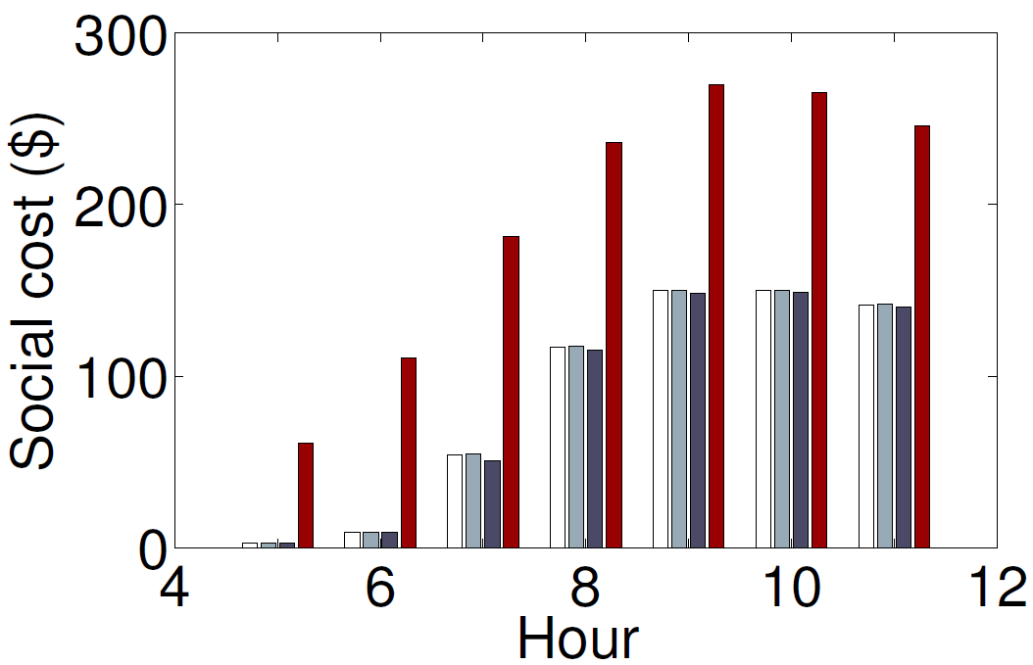
1. What is the social cost?
Theorem: For both price-taking and price-anticipating tenants,
Near optimal when N is small
Vanishing when N is large,
what if N is small?
➔ ColoDR(price-taking) ColoDR(price-anticipating) SCM Diesel-only
Notes:
----- Meeting Notes (10/9/15 12:56) -----
this function indicates that for a price p, tenant will be offering s reduction specified by this equation, more constraint the tenant is, b specified the inconvenience incurred by the tenant to reduce energy
----- Meeting Notes (10/15/15 12:54) -----
add the difference between price-taking and price-anticipating, spend more time explaining the figures
----- Meeting Notes (10/16/15 14:19) -----
talk about axis meanings

Slide 20
2&3. What are tenants’ and operator’s costs?
Theorem: For both price-taking and price-anticipating tenants,
Higher utility for tenants with larger flexibility
Operator have
lower cost than SCM
➔ ColoDR(price-taking) ColoDR(price-anticipating) SCM Diesel only
Notes:
----- Meeting Notes (10/9/15 12:56) -----
this function indicates that for a price p, tenant will be offering s reduction specified by this equation, more constraint the tenant is, b specified the inconvenience incurred by the tenant to reduce energy

Slide 21
4. What is the reduction in diesel usage?
Theorem: For price-taking tenants,
For price-anticipating tenants,
In worst case, ColoDR may use a lot
more diesel than optimal
➔ ColoDR(price-taking) ColoDR(price-anticipating) SCM
Notes:
----- Meeting Notes (10/9/15 12:56) -----
this function indicates that for a price p, tenant will be offering s reduction specified by this equation, more constraint the tenant is, b specified the inconvenience incurred by the tenant to reduce energy
----- Meeting Notes (10/16/15 14:19) -----
move on more quickly to emphasize the first set of result

Slide 22
How good is the equilibrium?
Social cost
Tenants’ cost
Operator’s cost
Diesel reduction
Notes:
----- Meeting Notes (10/16/15 14:19) -----
change profit to cost

Slide 23
Key Message
Multi-tenant data center demand response can be “green” by incentivizing tenants’ cooperation
Our supply function bidding mechanism achieve this goal with a provably-efficient outcome
Cut energy δ
Diesel energy
y = δ - Σ_{i}s_{i}
Utility
Cut energy by
s_{i}=δ-b_{i}/p
Supply bid b_{i}
Operator
Price p
Tenants
Notes:
1. doing DCDR efficiently and in an environmentally

Slide 24
Backup Slides

Slide 25










DR is crucial for renewable integration
generation
demand
DR
Notes:
----- Meeting Notes (10/16/15 13:52) -----
on the generation side, they can use large scale storage to deal with the (renewable), but really expensive ...

Slide 26
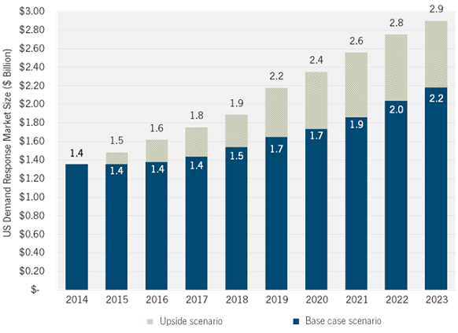



Finding DR resources is challenging
How much can data center contribute?
Aggressive
estimate
Conservative
estimate
GTM research, “U.S. Demand Response Outlook 2014”
Notes:
----- Meeting Notes (10/16/15 13:52) -----
currently (DR) are distributed, using them alone is difficult to satisfy DR needs,
some suggestions: how to find DR resources?

Slide 27








Multi-tenant (colocation) data centers
Multiple tenants house and manage their own servers independently in shared space
Data center operator is mainly responsible for facility support (e.g., power supply, cooling)
ATS
Diesel Generator
Utility Substation
AC/DC
UPS
Operator
DC/AC
PDU
Tenants
Notes:
they own the servers, pay subscription for electrcity and cooling

Slide 28
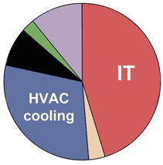
How do multi-tenant data center provide DR?
Turn on diesel generator upon utility’s request
Costly and environmentally unfriendly
Opportunity:
Tenants typically have great flexibility in energy usage
[LBNL,HP] workload management can save 10-30+% in server energy 10-60min
We should buy energy reduction from tenants!
Notes:
we need to do better, it is not hard to see that this solution is suboptimal because it is not using the flexibility of workload to reduce server consumption energy
----- Meeting Notes (10/16/15 14:19) -----
talk about (change the graph) - currently the power system is incentive the customer to do demand response (we can do the similar thing), but this is a really challenging problem which Im going to show in a few slides

Slide 29


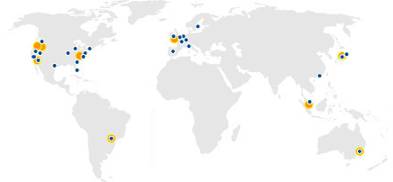

Who are using colocations?
Almost all industry sectors
Including top-brand websites, e.g., Wikipedia, Twitter
Many clouds
Our Internet
According to Cisco, 55% Internet traffic will be processed through CDN providers, e.g., Akamai, by 2018 (up from 33% in 2013)

Slide 30
How do capacity constrained tenant bid b_{i}?
We know that operator will not offer a price higher than α
Suppose tenant i cannot reduce load by more than K
With no information about how other tenants behave
start bidding b_{i} ≥ α(δ-K)
load reduction s_{i} = δ– b_{i}/p ≤ δ-b_{i}/α ≤K
adjust bid according to result of interaction in the mechansim

Slide 31
How do operator decides price p?
minimize cost of DR
min p(δ-y) + αy
Given bi and y,
Σ_{i} s_{i} + y = Σi (δ-b_{i}/p) + y = δ, p = Σ_{i} b_{i} / ((N-1)δ+y)
Operator solves the following problem

Slide 32
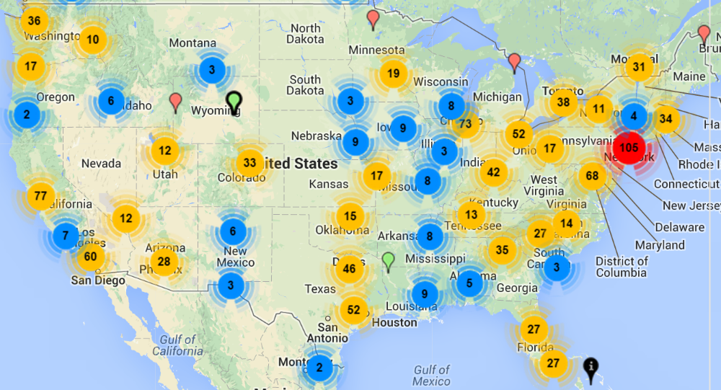
Why does colocation matter?
There’re over 1,400 colocation data centers in the U.S.
Projected to grow to US$ 43 billion by 2018*
Annual compound growth rate of 11%
www.datacentermap.com
* Source: http://www.marketsandmarkets.com/Market-Reports/colocation-market-1252.html

Slide 33
In fact…
“Most large data centers are built to host servers from multiple companies (often called colocation data centers, or ‘colos’).”
--- The Datacenter as a Computer, a study by Google Research in 2013

