Slide 1


Greening Multi-Tenant Data Center Demand Response
Niangjun Chen
Joint work with Xiaoqi Ren, Shaolei Ren, and Adam Wierman
Notes:
----- Meeting Notes (10/9/15 11:49) -----
thanks for the introduction, today I will be talking about how to do demand response for multi-tenant data center efficiently, and how can we make it more environmentally friendly

Slide 2
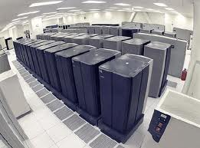
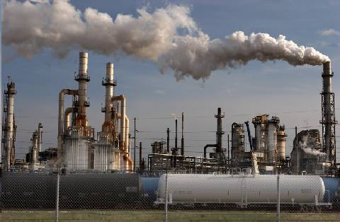
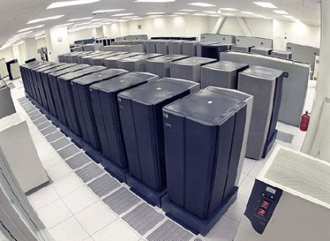

2 stories about energy and data centers
Typical story: data centers are energy hogs
Emerging story: data centers are valuable resources
Idea: use data centers for demand response (DR)
Notes:
----- Meeting Notes (10/16/15 13:52) -----
data center has flexibility in terms of power consumption, ... virtual battery ... (flexibility can be valuable for demand response)

Slide 3










DR is crucial for renewable integration
generation
demand
DR
Notes:
----- Meeting Notes (10/16/15 13:52) -----
on the generation side, they can use large scale storage to deal with the (renewable), but really expensive ...

Slide 4
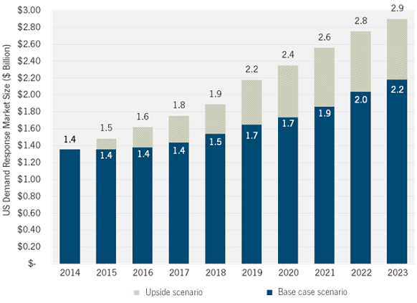



Finding DR resources is challenging
How much can data center contribute?
Aggressive
estimate
Conservative
estimate
GTM research, “U.S. Demand Response Outlook 2014”
Notes:
----- Meeting Notes (10/16/15 13:52) -----
currently (DR) are distributed, using them alone is difficult to satisfy DR needs,
some suggestions: how to find DR resources?

Slide 5
Data centers have great potential for DR
~$5 million cost!
20 MW Data Center with 20% flexibility
700 kWh fast charging, optimally placed storage
[Liu et al 2014]
However, current participation is still inefficient
This talk: Efficient DR in Multi-tenant Data Centers
Notes:
we live in an age of mobile computing where a lot of computation and storage is offloaded to the cloud, which are data centers, as a result, we can see the graph on the left showing a rapid increase in the,
studied shown that a data center 20MW has the potential to offer ancillary service to the power system via demand response that is of optimally place storage that is worth 5 million,
we can do the math …
massive potential social benefit -> we should understand how to do this efficiently -> but first we need to understand better what are (the typical) data centers

Slide 6
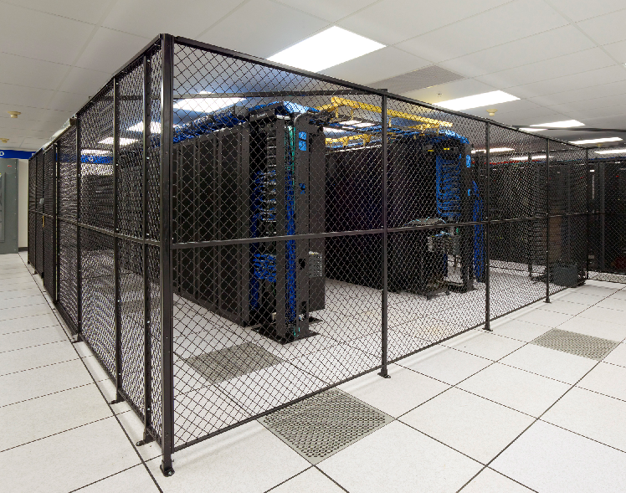
Multi-tenant (colocation) data centers
Multiple tenants house and manage their own servers independently in shared space
Notes:
they own the servers, pay subscription for electrcity and cooling

Slide 7








Multi-tenant (colocation) data centers
Multiple tenants house and manage their own servers independently in shared space
Data center operator is mainly responsible for facility support (e.g., power supply, cooling)
ATS
Diesel Generator
Utility Substation
AC/DC
UPS
Operator
DC/AC
PDU
Tenants
Notes:
they own the servers, pay subscription for electrcity and cooling

Slide 8
Multi-tenant (colocation) data centers
Multiple tenants house and manage their own servers independently in shared space
Data center operator is mainly responsible for facility support (e.g., power supply, cooling)
Hyper-scale (e.g. google): 7.8%
Colocation: 37%
Enterprise: 53%
CoreSite’s “One Wilshire” (Photo: CoreSite)
…of total data center industry electricity usage
Notes:
they own the servers, pay subscription for electrcity and cooling
----- Meeting Notes (10/16/15 14:19) -----
color contrast of the pie chart

Slide 9

Why target multi-tenant data center for DR?
Most multi-tenant data centers are in metropolitan areas
Downtown Los Angeles, New York, Silicon Valley, etc.
This is where demand response is most needed!
Example: On July 22, 2011, hundreds of multi-tenant colocation data centers participated in emergency demand response and contributed by cutting their electricity usage before a nation-wide blackout occurred in the U.S. and Canada.
--- A. Misra, “Responding Before Electric Emergencies.”
CoreSite’s “One Wilshire” (Photo: CoreSite)

Slide 10
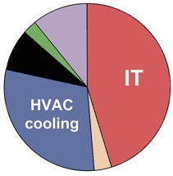
How do multi-tenant data center provide DR?
Turn on diesel generator upon utility’s request
Costly and environmentally unfriendly
Opportunity:
Tenants typically have great flexibility in energy usage
[LBNL,HP] workload management can save 10-30+% in server energy 10-60min
We should buy energy reduction from tenants!
Notes:
we need to do better, it is not hard to see that this solution is suboptimal because it is not using the flexibility of workload to reduce server consumption energy
----- Meeting Notes (10/16/15 14:19) -----
talk about (change the graph) - currently the power system is incentive the customer to do demand response (we can do the similar thing), but this is a really challenging problem which Im going to show in a few slides

Slide 11
Our contribution: a simple and provably efficient mechanism to incentivize tenants’ reduction
Goal:
Operator’s challenge:
No direct control of tenants’ reduction s_{i}
Tenants’ private cost c_{i} unknown
cost of local generation
cost of load reduction
meets energy reduction target
y: amount of local generation α: price for diesel
s_{i}: load reduction of tenant i c_{i}: cost of reduction of tenant i
Notes:
----- Meeting Notes (10/16/15 14:19) -----
flip 1 and 2,
first uncontrollable, even controllable, ...

Slide 12

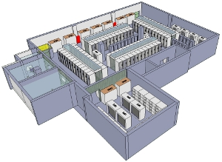

ColoDR: a supply function mechanism for DR
Cut energy δ
Diesel energy
y = δ - Σ_{i}s_{i}
Cut energy by
s_{i}=δ-b_{i}/p
Utility
Supply bid b_{i}
Operator
Price p
Tenants
Operator announces supply function s(b, p) = δ-b/p
Tenant i submits bid b_{i}
Operator sets market price p to minimize it own cost (payment to tenants plus diesel cost)
DR is exercised
Notes:
----- Meeting Notes (10/9/15 12:56) -----
this function indicates that for a price p, tenant will be offering s reduction specified by this equation, more constraint the tenant is, b specified the inconvenience incurred by the tenant to reduce energy
----- Meeting Notes (10/16/15 14:19) -----
explain what is supply function
for each price how
bid reflects tenants unwillingness to reduce
the process is to get flexibility from the tenants through bidding

Slide 13
ColoDR: a supply function mechanism for DR
Cut energy δ
Diesel energy
y = δ - Σ_{i}s_{i}
Cut energy by
s_{i}=δ-b_{i}/p
Utility
Supply bid b_{i}
Operator
Price p
Tenants
Simple: tenant only need to communicate one parameter
Fair: no price differentiation
Cost saving for operator: cost of dispatch decrease compared to diesel only
Equilibrium: always exists and unique(more on this later)
Notes:
----- Meeting Notes (10/9/15 12:56) -----
this function indicates that for a price p, tenant will be offering s reduction specified by this equation, more constraint the tenant is, b specified the inconvenience incurred by the tenant to reduce energy
----- Meeting Notes (10/16/15 14:19) -----
explain what is supply function
for each price how
bid reflects tenants unwillingness to reduce
the process is to get flexibility from the tenants through bidding

Slide 14
Why supply function bidding?
VCG type mechanisms are problematic
[Zhang et al 2015] [Rothkopf 2007]
Supply function bidding is widely used in electricity market
[Baldick et al 2004] [Day et al 2002] [David and Wen 2000]
Prior work on supply function bidding
[Klemperer and Meyer 1989] [Niu et al 2005] [Johari and Tsitsiklis 2011] [Xu et al 2015]
Notes:
Complex bidding process
Differentiated price
Expose private information
Unbounded payment
----- Meeting Notes (10/15/15 12:54) -----
reorder 2 1 3
list the problem of VCG
add by text difference
spend more time on this slide
----- Meeting Notes (10/16/15 14:19) -----
not emphasize privacy too much, talk about pricing

Slide 15
How well does ColoDR work?
What is the social cost?
What are tenants’ costs?
What is operator’s cost?
What is the reduction in diesel usage?
We answer these questions with both theoretical guarantees and trace-based simulations
Notes:
----- Meeting Notes (10/9/15 12:56) -----
this function indicates that for a price p, tenant will be offering s reduction specified by this equation, more constraint the tenant is, b specified the inconvenience incurred by the tenant to reduce energy

Slide 16
What should we compare to?
Benchmark: Centrally controlled social cost minimization (SCM)
Tenant behavior for ColoDR
Price-taking: Consider the price as is:
Price-anticipating: Consider the impact of bidding decisions on the market price:
Notes:
----- Meeting Notes (10/9/15 12:56) -----
explain setting where taking vs anticipating occurs

Slide 17
What should we compare to?
Case study
DR signals issued by PJM on January 7, 2014, due to cold weather.
Three different types of workload with different tolerance to delay.

Slide 18
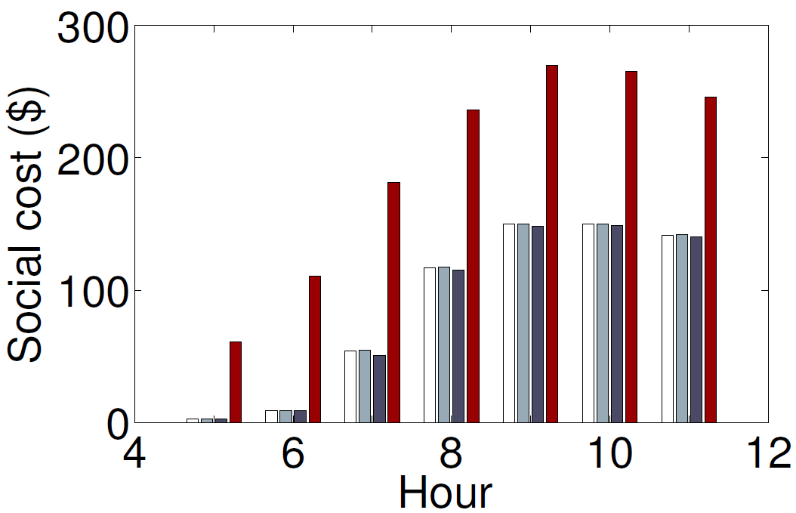
1. What is the social cost?
Theorem: For both price-taking and price-anticipating tenants,
Near optimal when N is small
Vanishing when N is large,
what if N is small?
➔ ColoDR(price-taking) ColoDR(price-anticipating) SCM Diesel-only
Notes:
----- Meeting Notes (10/9/15 12:56) -----
this function indicates that for a price p, tenant will be offering s reduction specified by this equation, more constraint the tenant is, b specified the inconvenience incurred by the tenant to reduce energy
----- Meeting Notes (10/15/15 12:54) -----
add the difference between price-taking and price-anticipating, spend more time explaining the figures
----- Meeting Notes (10/16/15 14:19) -----
talk about axis meanings

Slide 19
2&3. What are tenants’ and operator’s costs?
Theorem: For both price-taking and price-anticipating tenants,
Higher utility for tenants with larger flexibility
Operator have
lower cost than SCM
➔ ColoDR(price-taking) ColoDR(price-anticipating) SCM Diesel only
Notes:
----- Meeting Notes (10/9/15 12:56) -----
this function indicates that for a price p, tenant will be offering s reduction specified by this equation, more constraint the tenant is, b specified the inconvenience incurred by the tenant to reduce energy

Slide 20
4. What is the reduction in diesel usage?
Theorem: For both price-taking tenants,
for price-anticipating tenants,
In worst case, ColoDR may use a lot
more diesel than optimal
➔ ColoDR(price-taking) ColoDR(price-anticipating) SCM
Notes:
----- Meeting Notes (10/9/15 12:56) -----
this function indicates that for a price p, tenant will be offering s reduction specified by this equation, more constraint the tenant is, b specified the inconvenience incurred by the tenant to reduce energy
----- Meeting Notes (10/16/15 14:19) -----
move on more quickly to emphasize the first set of result

Slide 21
How well does ColoDR work?
What is the social cost?
What is tenants’ cost?
What is operator’s profit?
What is the reduction in diesel usage?
All these follow from one key characterization lemma
Notes:
----- Meeting Notes (10/16/15 14:19) -----
change profit to cost

Slide 22
A characterization lemma
Characterize equilibrium as the outcome of an optimization problem
Lemma: When tenants are price-taking, the market equilibrium is unique and characterized by
Due to strategic behavior of operator

Slide 23
A characterization lemma
Characterize equilibrium as the outcome of an optimization problem
Lemma: When tenants are price-anticipating, the market equilibrium is unique and characterized by
where
Strategic behavior of tenants
Strategic behavior of operator

Slide 24
Two messages
#1: Multi-tenant data center DR is a billion dollar market
Turning an energy hog into a social asset!
#2: Multi-tenant data center demand response can be “green” by incentivizing tenants’ cooperation
Our proposed mechanism based on supply function bidding incentivizes and coordinates tenants’ energy shedding, with a provably-efficient outcome.
Notes:
1. doing DCDR efficiently and in an environmentally

Slide 25
Backup Slides

Slide 26


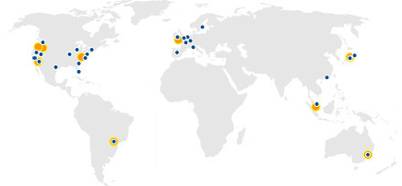

Who are using colocations?
Almost all industry sectors
Including top-brand websites, e.g., Wikipedia, Twitter
Many clouds
Our Internet
According to Cisco, 55% Internet traffic will be processed through CDN providers, e.g., Akamai, by 2018 (up from 33% in 2013)

Slide 27
How do capacity constrained tenant bid b_{i}?
We know that operator will not offer a price higher than α
Suppose tenant i cannot reduce load by more than K
With no information about how other tenants behave
start bidding b_{i} ≥ α(δ-K)
load reduction s_{i} = δ– b_{i}/p ≤ δ-b_{i}/α ≤K
adjust bid according to result of interaction in the mechansim

Slide 28
How do operator decides price p?
minimize cost of DR
min p(δ-y) + αy
Given bi and y,
Σ_{i} s_{i} + y = Σi (δ-b_{i}/p) + y = δ, p = Σ_{i} b_{i} / ((N-1)δ+y)
Operator solves the following problem

Slide 29
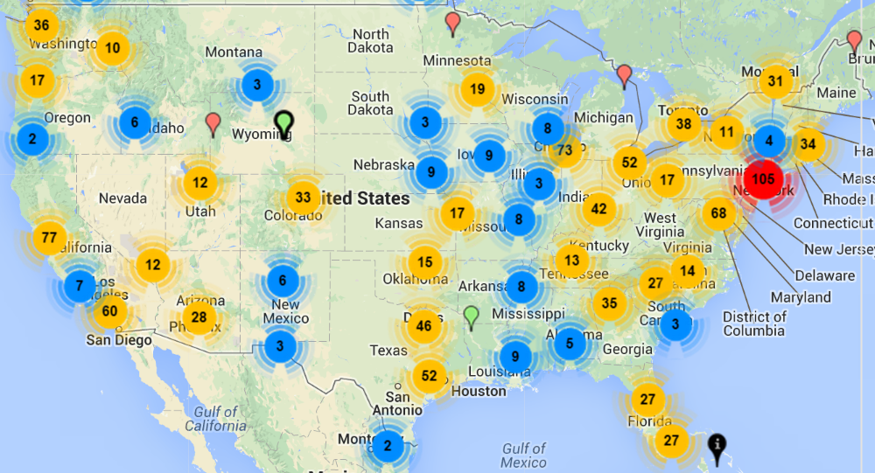
Why does colocation matter?
There’re over 1,400 colocation data centers in the U.S.
Projected to grow to US$ 43 billion by 2018*
Annual compound growth rate of 11%
www.datacentermap.com
* Source: http://www.marketsandmarkets.com/Market-Reports/colocation-market-1252.html

Slide 30
In fact…
“Most large data centers are built to host servers from multiple companies (often called colocation data centers, or ‘colos’).”
--- The Datacenter as a Computer, a study by Google Research in 2013

Slide 31
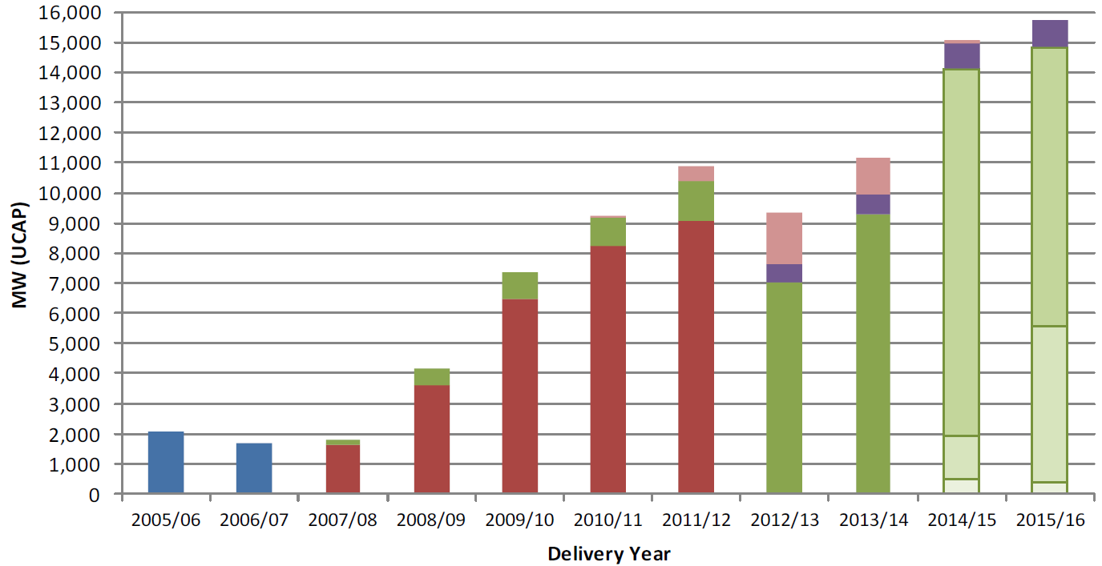
Emergency demand response
Reduce energy to a certain level during emergencies
The last line of protection against grid-wide blackouts to avoid billions of dollars’ loss
Participation is booming
e.g., PJM Interconnection
www.pjm.com

Slide 32
ColoDR: a supply function mechanism for DR
Cut energy δ
Diesel energy
y = δ - Σ_{i}s_{i}
Cut energy by
s_{i}=δ-b_{i}/p
Utility
Supply bid b_{i}
Operator
Price p
Tenants
Operator announces supply function s(b, p) = δ-b/p
Tenant i submits bid b_{i}
Operator sets market price p to minimize it own cost (payment to tenants plus diesel cost)
DR is exercised
Notes:
----- Meeting Notes (10/9/15 12:56) -----
this function indicates that for a price p, tenant will be offering s reduction specified by this equation, more constraint the tenant is, b specified the inconvenience incurred by the tenant to reduce energy
----- Meeting Notes (10/16/15 14:19) -----
explain what is supply function
for each price how
bid reflects tenants unwillingness to reduce
the process is to get flexibility from the tenants through bidding

Slide 33
ColoDR: a supply function mechanism for DR
Cut energy δ
Diesel energy
y = δ - Σ_{i}s_{i}
Cut energy by
s_{i}=δ-b_{i}/p
Utility
Supply bid b_{i}
Operator
Price p
Tenants
Simple: tenant only need to communicate one parameter
Fair: no price differentiation
Cost saving for operator: cost of dispatch decrease compared to diesel only
Equilibrium: always exists (more on this later)
Notes:
----- Meeting Notes (10/9/15 12:56) -----
this function indicates that for a price p, tenant will be offering s reduction specified by this equation, more constraint the tenant is, b specified the inconvenience incurred by the tenant to reduce energy
----- Meeting Notes (10/15/15 12:54) -----
equilibrium always exists and unique

Slide 34
ColoDR: a supply function mechanism for DR
Cut energy δ
Diesel energy
y = δ - Σ_{i}s_{i}
Cut energy by
s_{i}=δ-b_{i}/p
Utility
Supply bid b_{i}
Operator
Price p
Tenants
Simple: tenant only need to communicate one parameter
Fair: no price differentiation
Cost saving for operator: cost of dispatch decrease compared to diesel only
Equilibrium: always exists (more on this later)
Notes:
----- Meeting Notes (10/9/15 12:56) -----
this function indicates that for a price p, tenant will be offering s reduction specified by this equation, more constraint the tenant is, b specified the inconvenience incurred by the tenant to reduce energy
----- Meeting Notes (10/15/15 12:54) -----
equilibrium always exists and unique

