Slide 1
B
BONKERS CORNER
CAMPAIGN STRATEGY — INDIA — 2026
PLAY AGAIN
BONKERS:
PLAY
AGAIN
A long-term cultural platform that gives India's burnout generation permission to play.
Not a nostalgia campaign. Not a product drop. A movement.
Research + Context
Competitive Brief
Brand Manifesto
Campaign Ecosystem
Social + KPIs

Slide 2
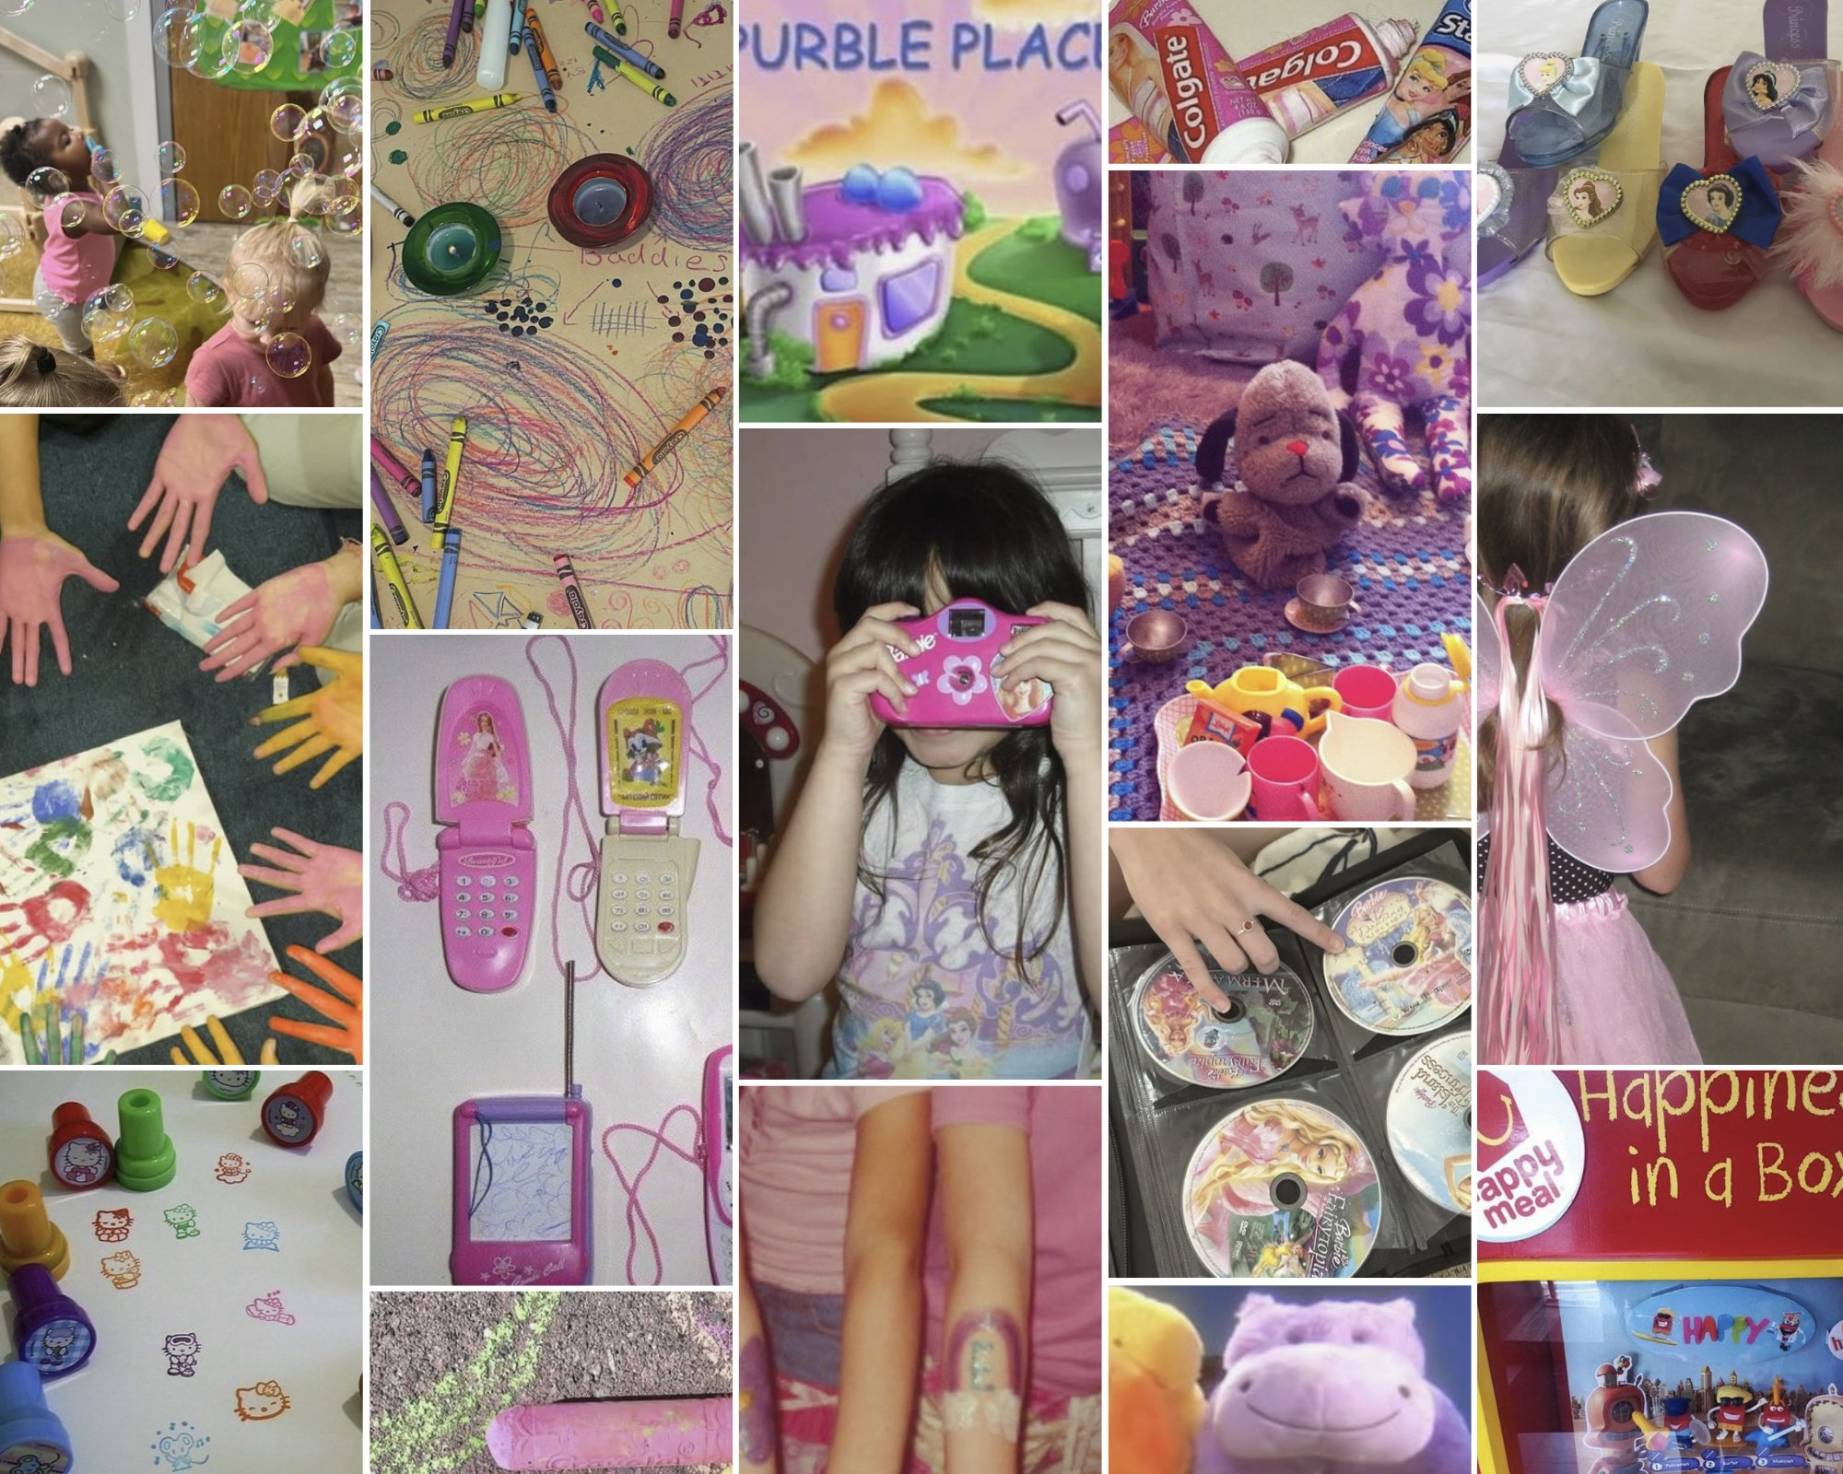
BONKERS — PLAY AGAIN
01 / 04 · RESEARCH + CONTEXT
THE INDIA CONTEXT
NOSTALGIA MOODBOARD — THE FEELING WE ARE EVOKING
A generation that grew
too fast — and knows it.
We don't miss being children. We miss having permission to play.
377M
48%
GEN Z IN INDIA
ACTIVE BURNOUT
World's largest youth cohort
Knowledge workers — BCG 2024
726%
$20B+
KIDULT YOY GROWTH
STREETWEAR BY 2033
Pop Mart — adult play is real
7.58% CAGR — Inc42, 2026
India's generation grew up on Cartoon Network and craft periods — then got handed hustle culture at 22. PLAY AGAIN closes the gap between who they perform online and who they actually feel inside.
Crayons · Fairy wings · Princess DVDs · Barbie cameras · Tea sets · Happy meals

Slide 3
BONKERS — PLAY AGAIN
02 / 04 · STRATEGY + MANIFESTO
THE OPEN FIELD
THE 12-MONTH ECOSYSTEM
Bonkers already owns the space. PLAY AGAIN scales it.
01
MONTH 1–2
The Question
Seeded teaser — no brand reveal. 'What made you happy at 8?' Micro-creators. No product.
The Souled Store
Licensed fandom — product-led only, no experience layer
02
MONTH 2–3
Play Personality Quiz
Mobile-first web quiz. 6 play personalities. Shareable result cards. Outfit curation.
Bewakoof
Value + casual — shallow nostalgia, no cultural depth
03
MONTH 3–5
Snitch
Fashion-forward D2C — aspirational, zero joy layer
Playground for Grown-Ups
Pop-ups: Mumbai, Bengaluru, Delhi, Hyderabad. Crayon walls, bracelet bars, plush stations, CN throwback corner. Free entry.
Bonkers ◆
HK, Bratz, Kuromi, Sanrio — fashion AND play, at scale
04
MONTH 4+
Bonkers Buddies Drops
BONKERS REWARDS BEING:
Limited character drops — mini plush + nostalgia card + charm. Tied to collab IP. No restocks.
Weird
Loud
Colourful
Obsessed
Playful
unapologetically original
taking up space without apology
refusing to be muted
loving fictional characters seriously
treating lightness as intelligence
05
MONTH 6–12
The Play Tribe
Monthly Play Nights. Physical Play Passport. Birthday Recess Pass. Year-end exclusive drop.

Slide 4
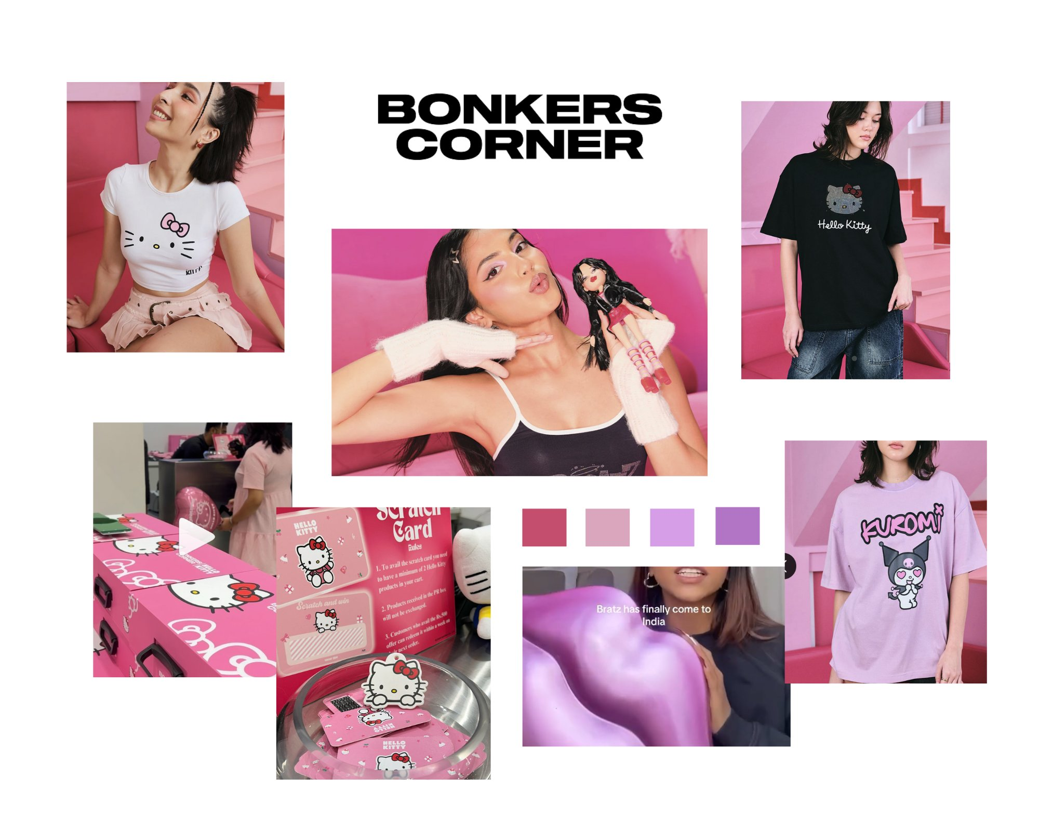
BONKERS — PLAY AGAIN
04 / 04 · KPIs
BONKERS ALREADY DOES THIS — EXISTING COLLABS
SUCCESS METRICS
EMOTIONAL KPIs
Saves per Instagram post
5%+ rate
Comment-to-like ratio on prompts
1:8 or better
Repeat Play Night attendees
40%+
Unprompted brand mentions
Track monthly
BUSINESS KPIs
Hello Kitty 50th Anniversary · Bratz India Launch · Kuromi · Sanrio Scratch Cards · Pop-Up Activations
Playground footfall per city
5,000+
PLAY AGAIN doesn't pivot Bonkers — it platforms what already works. No competitor has this collab history, this activation DNA, or this brand permission.
Character drop sell-through
100% / 48h
Other brands sell identity.
Bonkers sells joy.
Growing up is mandatory. Playing isn't.
Quiz completions
100K / 3mo
New follower acq. during campaign
2× baseline

