Slide 1



Slide 2


Requirement
Design
Demo on
Development environment
SSH frameworks
Implementation
Summary

Slide 3

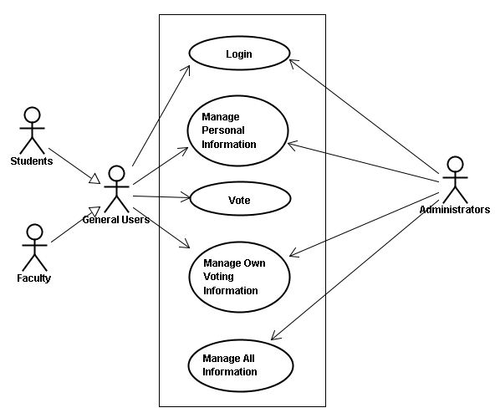
Use case diagrams

Slide 4

Architecture Diagram
Business Flow Diagram
Sequence Diagram
Class Diagram
Database
Web pages

Slide 5
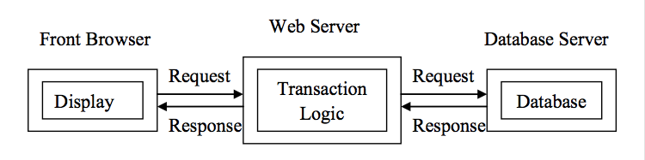
Architecture Diagram

Slide 6
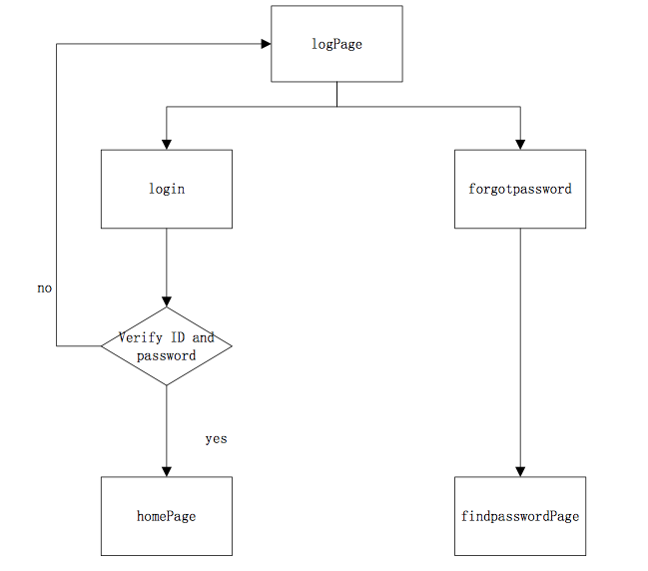
Business Flow Diagram of Login

Slide 7
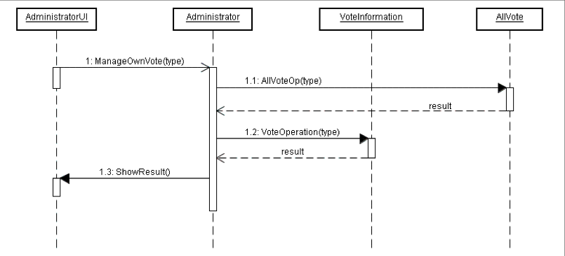
Sequence Diagram of Manage Own Voting Information

Slide 8

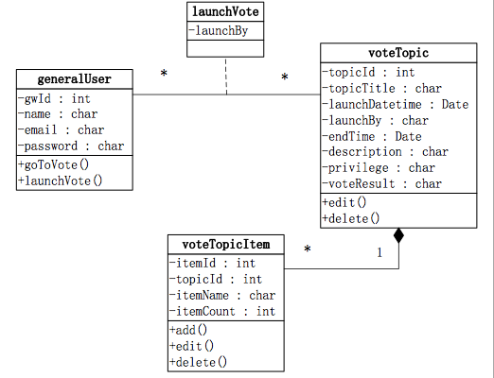
General Users Class Diagram

Slide 9
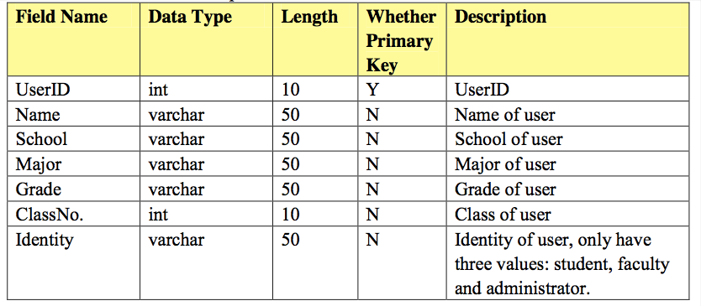
Description of Detail Table

Slide 10
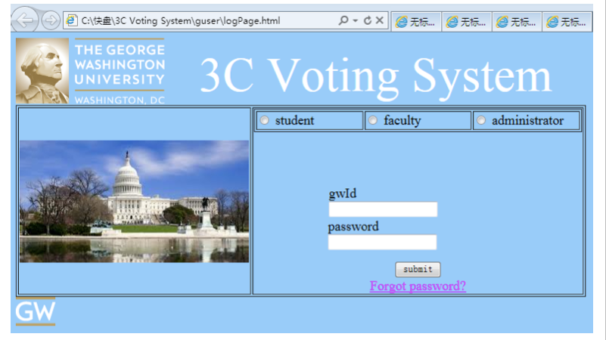
Login Page

Slide 11

Let’s take a look…

Slide 12

Tools
Myeclipse 8.5
Tomcat
Oracle sqldeveloper
Tests
Import or new a java project
Web server
Database connection

Slide 13

Add struts
A controller framework
Based on Front Controller pattern
Create MVC (Model View Controller) architecture.
Add Spring
IoC (Inversion of Control)
AOP(Aspect Oriented Programming)
Create a coherent architecture.
Add hibernate
DOA(Data Access Objects)
Get rid of writing complex and tedious SQL statement.

Slide 14

.jsp
.java
.xml

Slide 15

MyEclipse
Spring
Struts
Hibernate
Dreamweaver
CSS
Framework sets

Slide 16



Slide 17



