Slide 1
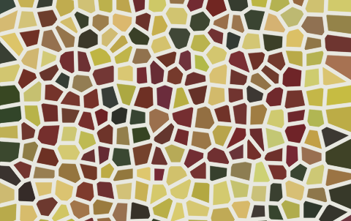
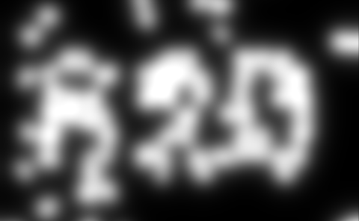
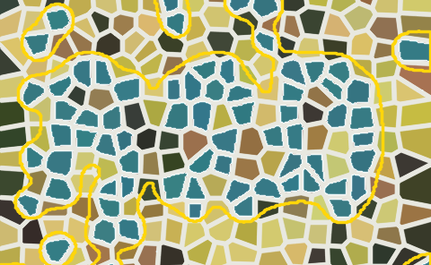
CHROMARECOVER · RESEARCH ARCHITECTURE
Evidence first. Semantics last.
DIGITAL · CAMERA · BURST
mask-first / top-k / explainable / willing to abstain
A local-first pipeline that preserves observations, tests competing masks, and abstains before it guesses.
1
Safe input
2
Capture model
3
Evidence hypotheses
4
Conservative decision
5
Audit trail
files · arrays · burst
GEOMETRY
ROI · quadrilateral · curved ribbon
Pixel cues
Lab · opponent
local residual
separation + structure
boundary + consensus
PHOTOMETRY
illumination · color cast · shadow
Masks
clusters · projections
both polarities
quality penalties
complement · margin
scale stability
CAPTURE
glare invalidation · moiré · banding
Primitives
contours · graph
tile roles
100 MiB / 50 MP
EXIF · ICC · decode checks
TRACEABILITY
density map
spatial envelope
ok
raw + corrected + inverse map
Structure
uncertain
mask · structure
evidence · overlay
quality · provenance
schema 0.5 · digits
retry
CONTINUOUS RED / BLUE VALIDATION
Every new capability ships with evidence that can fail it.
failure ledger → new hypothesis or stricter abstention
BLUE TEAM · make signal real
GATES · prove invariance, not one lucky fixture
RED TEAM · break shortcuts
generated positives · matched negatives
licensed geometry · held-out captures
top-k IoU · hard negatives · scale/rotation metamorphics
confidence contract · memory/security
complements · glare · moiré · blur
ordinary photos · scale flips · resource limits
No hallucinated pixels. Missing evidence stays missing.
ChromaRecover 0.3.0a4 · experimental public alpha
Notes:
[Sources]
- ChromaRecover repository: README.md, docs/algorithm.md, docs/roadmap.md, docs/security-model.md, PROJECT_SPEC.md (system architecture, safeguards, and status contract).
- https://github.com/c-narcissus/paper-framework-figure-studio-pro (semantic-graph and pre-audit workflow inspiration only; no code, images, or text copied; repository exposes no license metadata as of 2026-08-29).
- https://github.com/Rss3208/Visiomaster (editable-diagram delivery inspiration; MIT license; no code or assets copied).
- Repository-owned images: examples/digital/demo_input.png, examples/digital/demo_result/evidence_01.png, examples/digital/demo_result/overlay_01.png.
[/Sources]

