Slide 1

From LDA to BERTopic
01.04.02 Applied Mathematics and Computer Science
Student: [Your Name], Group [Your Group]
Project topic:
Improving Topic Modeling on the 20 Newsgroups Dataset
Scientific Advisor:
[Advisor Name]

Slide 2
Statement of the Problem
Large text collections are difficult to explore manually.
Traditional LDA can discover latent topics, but it relies on bag-of-words features and may miss semantic similarity.
The project asks whether a transformer-based topic model can improve topic discovery and category alignment on the 20 Newsgroups dataset.

Slide 3
Purpose and Objectives
Purpose: compare traditional LDA and transformer-based BERTopic for topic discovery on 20 Newsgroups.
Objectives:
1. Rebuild the LDA baseline from the previous project.
2. Add ground-truth category evaluation.
3. Train and analyze BERTopic.
4. Compare topic quality using heatmaps and metrics.
5. Summarize strengths, weaknesses, and future work.

Slide 4
Review of Similar Solutions / Research
Latent Dirichlet Allocation (LDA): probabilistic bag-of-words topic model; interpretable, but sensitive to preprocessing.
Transformer embeddings: capture semantic similarity beyond exact word overlap.
BERTopic: combines sentence embeddings, UMAP dimensionality reduction, HDBSCAN clustering, and c-TF-IDF topic representations.
Gap addressed: compare the older LDA baseline with an embedding-based topic model using the same dataset and label-based evaluation.

Slide 5
Research Methods and Tools
Dataset: 20 Newsgroups, loaded with scikit-learn.
LDA pipeline: text cleaning, stopword removal, lemmatization, bigrams, dictionary filtering, coherence-based topic selection.
BERTopic pipeline: all-MiniLM-L6-v2 embeddings, UMAP, HDBSCAN, CountVectorizer with English stopword filtering.
Evaluation: topic-category heatmaps, NMI, ARI, purity, and qualitative keyword interpretation.

Slide 6
Scientific Novelty
The previous project used LDA as a single topic modeling method.
This extension adds:
- a transformer-based BERTopic model;
- ground-truth category alignment analysis;
- quantitative comparison using NMI, ARI, and purity;
- improved BERTopic keyword extraction with stopword filtering;
- a clearer discussion of interpretability vs. semantic clustering quality.

Slide 7
Solution Flow
The workflow extends the previous LDA project into a reproducible comparative experiment.
Dataset
20 Newsgroups
18k+ posts, 20 classes
LDA
cleaning, lemmatization,
bigrams, coherence
BERTopic
sentence embeddings,
UMAP + HDBSCAN
Evaluation
NMI, ARI, purity,
category heatmaps

Slide 8
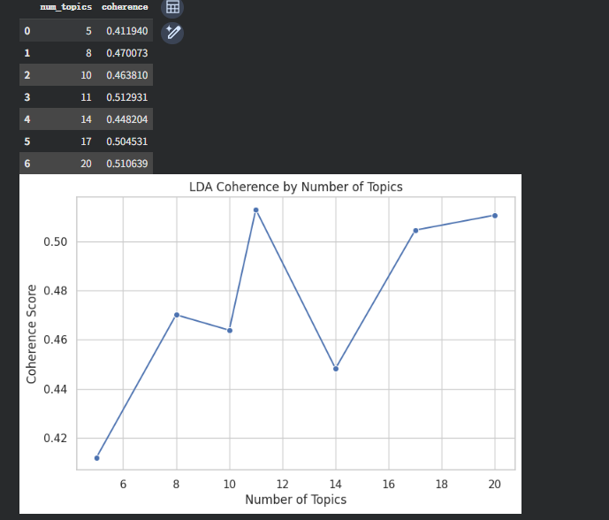
LDA Baseline: Topic Number Selection
The coherence curve selected 11 topics as the final LDA configuration.
Final LDA coherence: 0.5089.
Highest coherence at K = 11

Slide 9
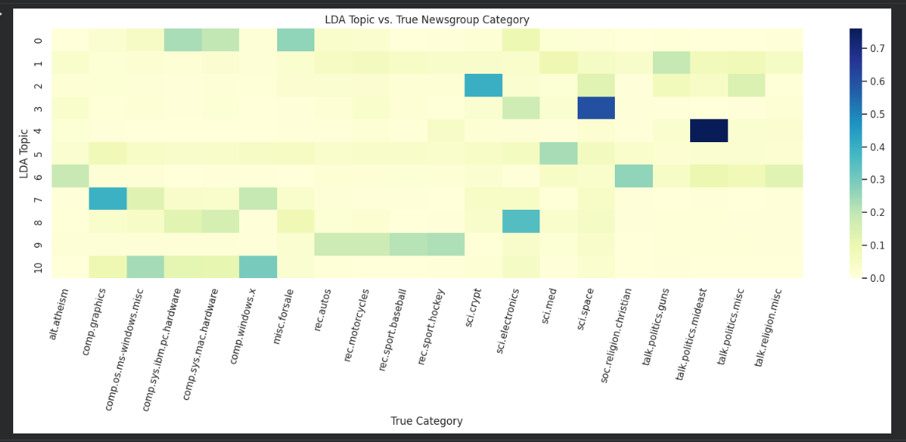
LDA Results: Topic-Category Alignment
LDA finds interpretable themes such as space, sports, politics, hardware, and graphics.
However, several topics mix related categories, which limits label alignment.
Model Accuracy F1-score Training Time ResNet50 91% 0.88 2 h EfficientNetB0 92% 0.89 1.5 h

Slide 10
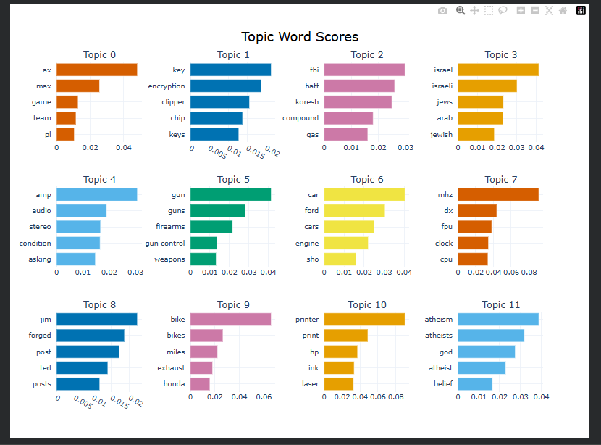
BERTopic Results: Cleaner Semantic Topics
After adding CountVectorizer stopword filtering, BERTopic keywords became more meaningful.
Examples: encryption, Middle East politics, gun control, computer hardware, atheism, and sports.

Slide 11
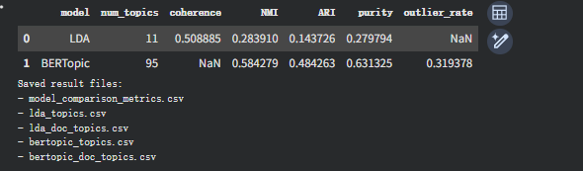
Key Results: Quantitative Comparison
BERTopic achieves substantially stronger alignment with the original newsgroup categories.
Model | Topics | NMI | ARI | Purity
LDA | 11 | 0.2839 | 0.1437 | 0.2798
BERTopic | 95 | 0.5843 | 0.4843 | 0.6313
Result | fine-grained | +106% | +237% | +126%

Slide 12
Conclusion
The project successfully extends the previous LDA topic modeling work.
Main findings:
- LDA is compact, interpretable, and easy to reproduce.
- BERTopic produces more fine-grained semantic topics.
- BERTopic has much stronger category alignment based on NMI, ARI, and purity.
Future work: tune BERTopic topic reduction, evaluate topic coherence for BERTopic, and test the approach on another text corpus.

Slide 13

THANK YOU
FOR YOUR TIME!

Slide 14
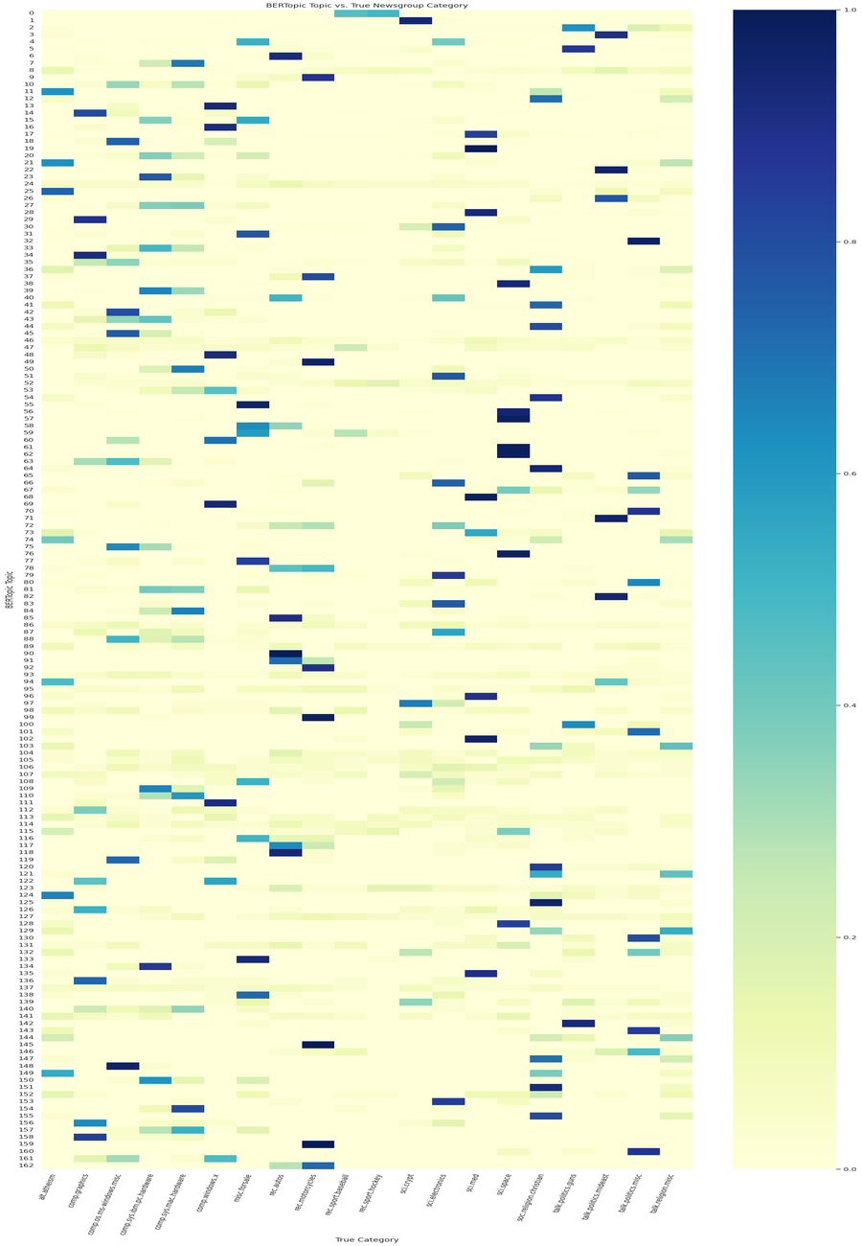
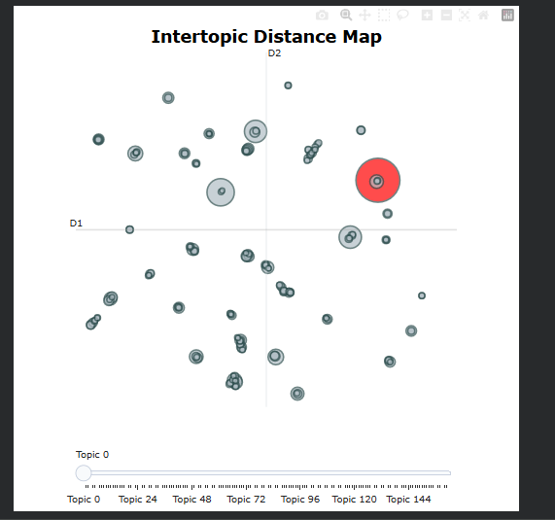
Appendix: BERTopic Visualizations
Intertopic distance map and topic-category overview provide additional visual evidence for semantic clustering.

