Slide 1
Examples of my work
Table of Contents
Overview & Domains
Platform & Internal Products – Case Study
Market Stats – Product Walkthrough
Identity Privacy & Access Management – Case Study
Monetization & Operational Workflows – Case Study
Delivery Artifacts & Execution Evidence
*The portfolio represents the selected case studies from production systems and platform design work across Enterprise SaaS, Identity, Data, and Internal Platforms.

Slide 2
Overview & Domains
This portfolio presents selected product work by
Niara Mamontova, a Product Manager with experience across platform, internal, and data products in both enterprise and consumer environments.
Domains: Enterprise & B2B/B2C SaaS ٠ FinTech & Payments ٠ Identity & Privacy ٠ Data & Analytics ٠ Internal Platforms & Tooling

Slide 3
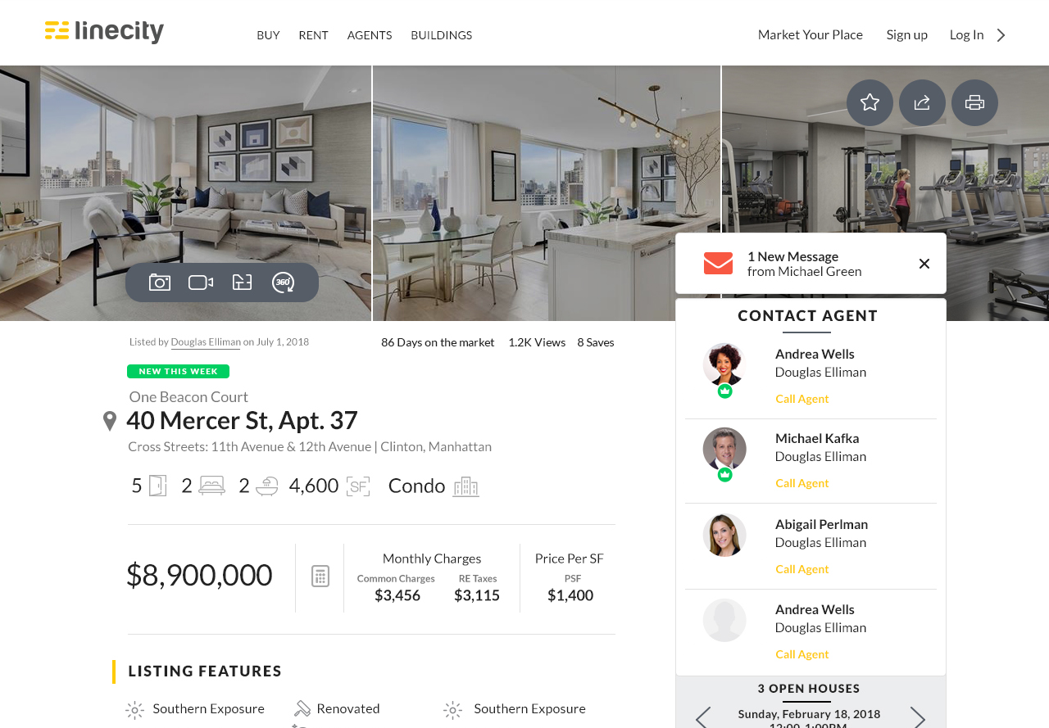
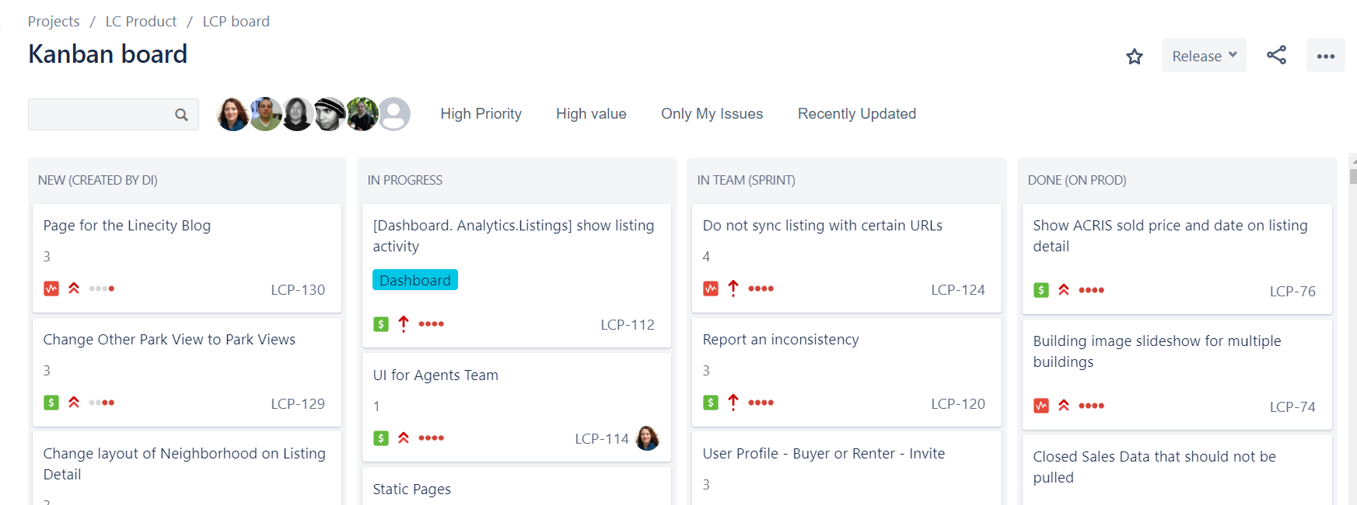
Platform & Internal Product Ownership
Linecity.com – End-to-end delivery ownership via Jira ٠ Consumer-facing platform screen

Slide 4
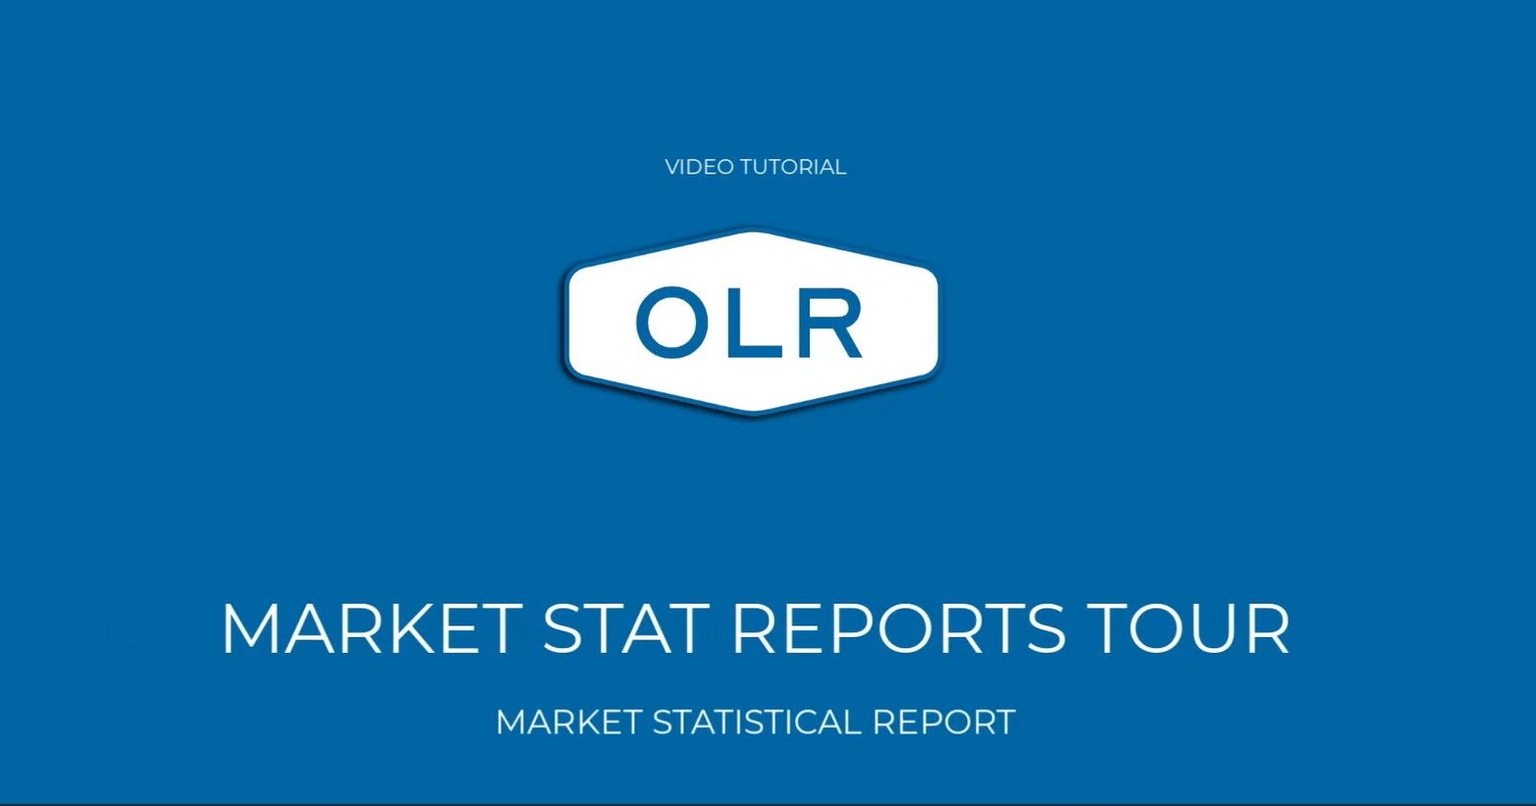
Market Stats – Product Walkthrough
OLR.com – Market Stats is an internal analytics product providing consolidated market insights for Business.
The video demonstrates the final production user walkthrough of the tool, designed and delivered end-to-end by me and my team.
▶ Click to watch the product walkthrough
*Product walkthrough recorded from production environment

Slide 5
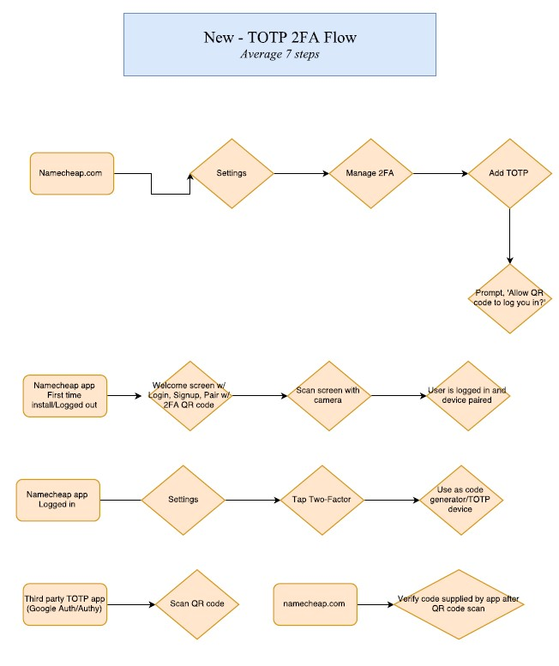
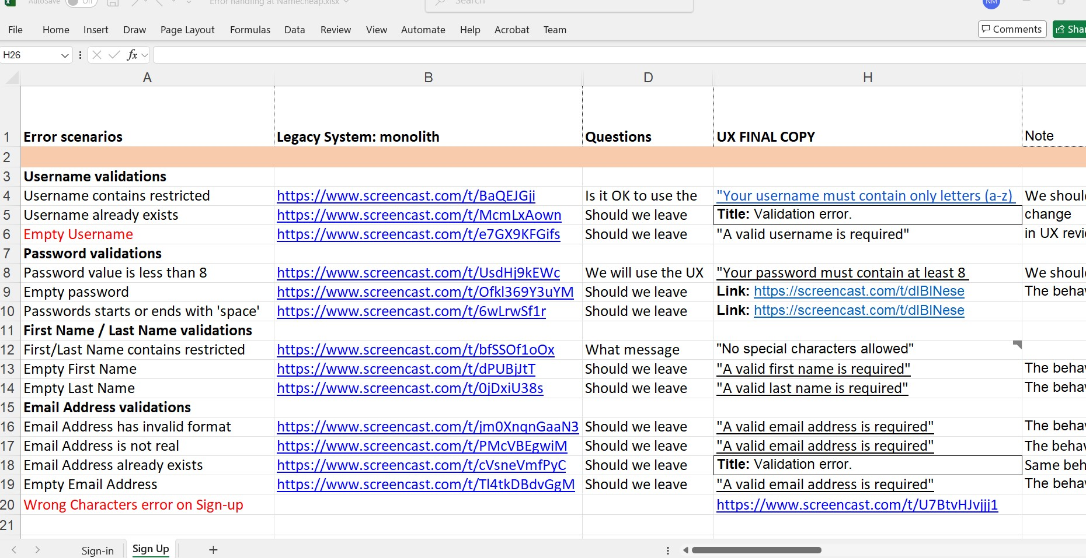
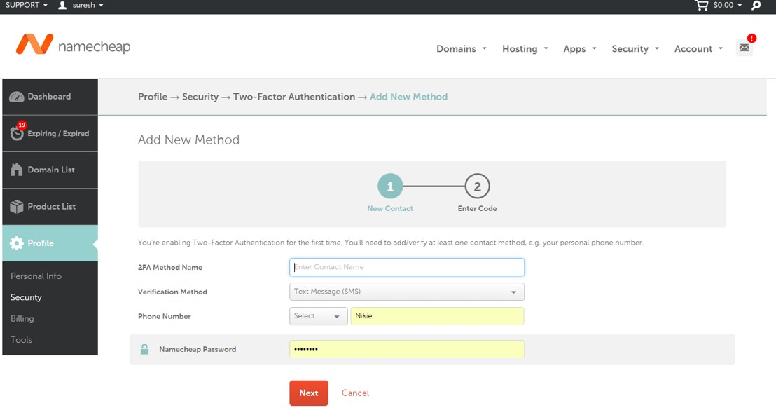
Identity Privacy & Access Management
Namecheap.com – 2FA workflow for an enterprise Auth-system ٠
2FA UI execution ٠ QA Validation and error-handling matrix

Slide 6
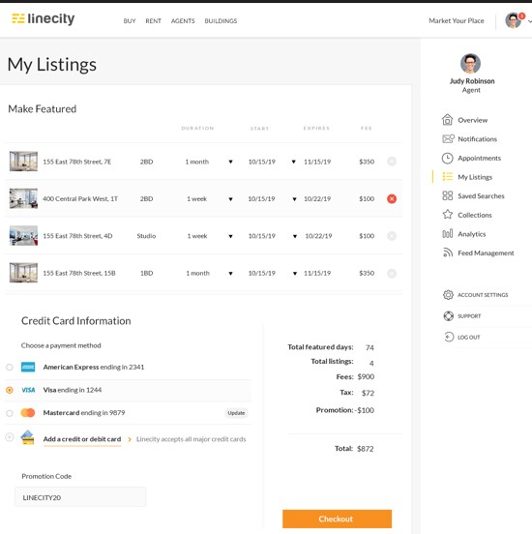
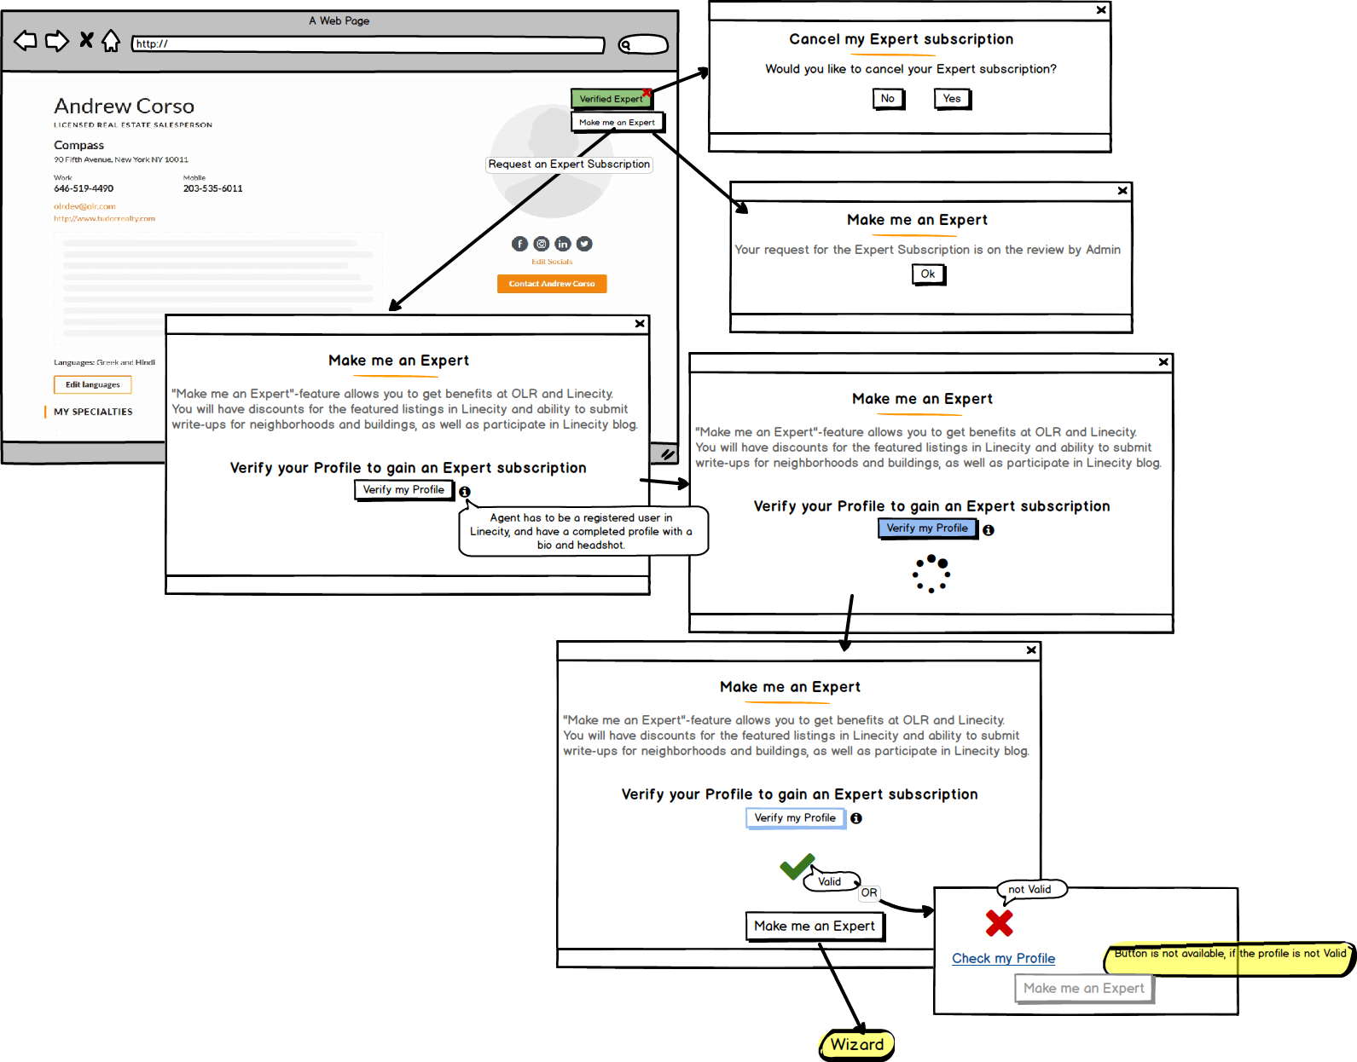
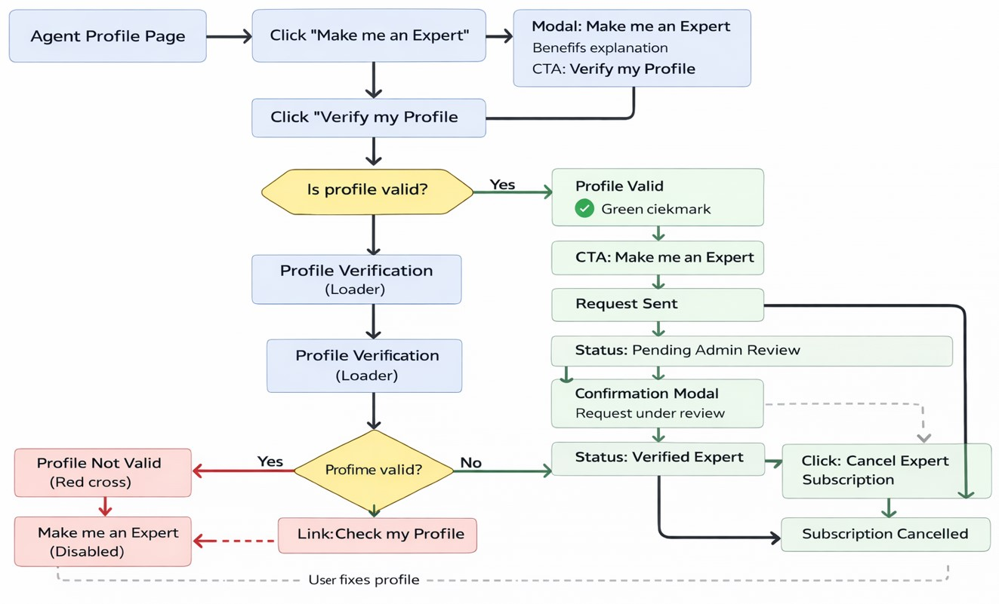
Monetization & Operational Workflows
Linecity.com – Expert Subscription Flow
Workflow diagram illustrating the Expert onboarding flow
٠ UI mockup of the “Make me an Expert” feature ٠ Checkout UI for Expert subscription

Slide 7
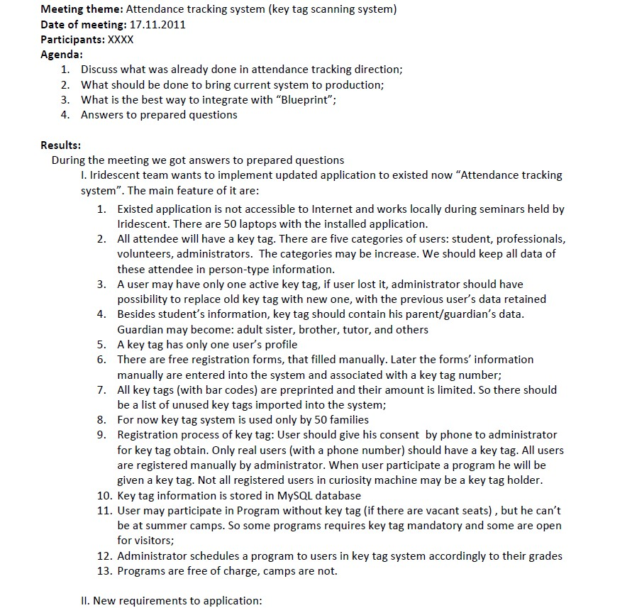
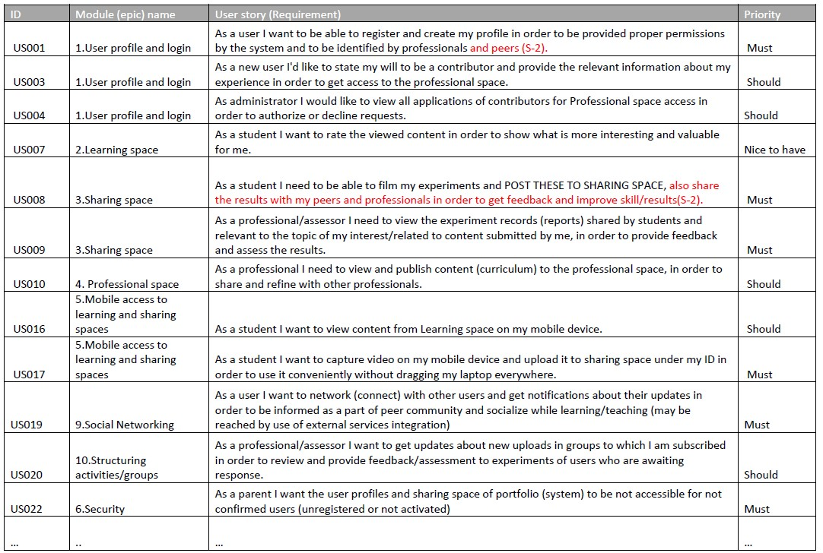
Delivery Artifacts & Execution Evidence
Technovation (via SoftServe) – examples of product ownership artifacts created and used during delivery:
Meeting Minutes ٠ Epic Scope Definition

Slide 8
Thank you for your time!

