Slide 1

WELCOME2GH · A STORY ABOUT BELONGING IN A NEW CITY
Akwaaba.
Every newcomer deserves to feel at home. This is the story of how one of them did.
Mohamed
Wisconsin International University College (WIUC) · Accra, 2026
LIVE · welcome2gh.vercel.app

Slide 2
ACT I · ARRIVAL
Meet Amara
A
Amara
21 · International student · From Lagos, Nigeria
Today she lands in Accra for the very first time - a new face at WIUC, four hundred miles and a whole border from everything familiar. She is full of hope. She is also completely on her own.
First time in Ghana
Knows no one yet
One phone, one dream
first time in Accra
Welcome2GH · Amara's Journey
Act I

Slide 3
ACT I · DAY ONE
The City Starts to Test Her
She steps out of Kotoka Airport into the noise and the heat. Within hours, Accra asks three questions she cannot answer.
🧭
💸
⚠️
Which way is home?
Is this the real price?
Is it safe here?
The streets blur together. Every junction looks the same, and the map on her phone does not speak Accra.
A taxi driver names a number. She has no idea it is three times too high. Tired and unsure, she pays.
A classmate warns, 'don't go there after dark.' But Amara has no way of knowing where 'there' even is.
Welcome2GH · Amara's Journey
Act I

Slide 4
By the end of her first week,
Accra felt less like a welcome
and more like a wall.
She was not unwelcome. She was just unguided.

Slide 5
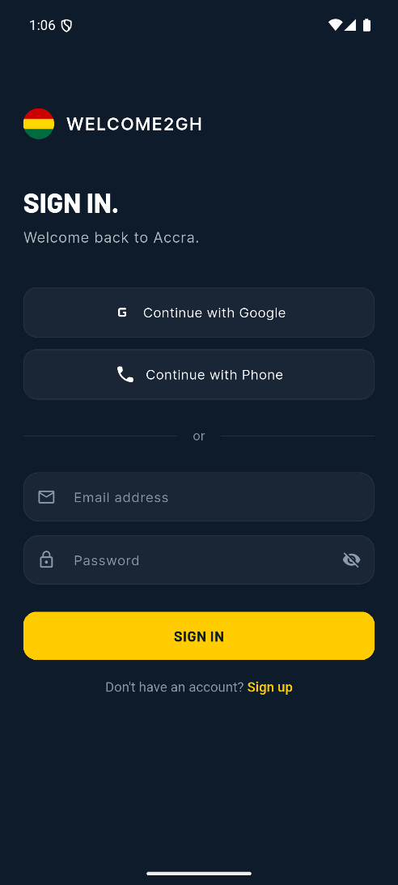
ACT II · THE TURN
Then a Classmate Showed Her One App
Welcome2GH. A guide built for exactly this moment - made by someone who had arrived as a stranger too. For the first time since she landed, Amara was not facing Accra alone.
Find her way - confidently
Pay what locals pay
Ask anything, anytime
Belong to a community
Know where is safe
Welcome2GH · Amara's Journey
Act II

Slide 6
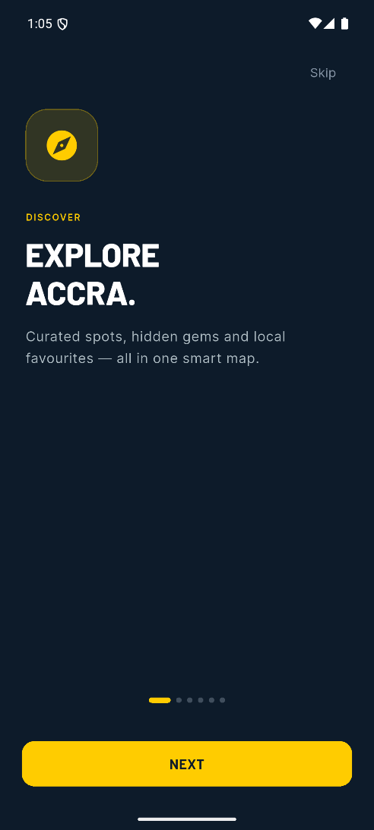
ACT II · SCENE ONE
Finally, She Knew Where She Was
The map knew Accra better than she did. Live directions that actually fit the city. Real walking and taxi times, not guesses. And a glowing dot that followed her every step of the way home. No more wrong turns. No more standing on a corner, lost.
Powered by OpenStreetMap + OSRM routing + live GPS - turn-by-turn, no API keys.
Welcome2GH · Amara's Journey
Act II

Slide 7
ACT II · SCENE TWO
The Next Driver Tried the Same Trick
But this time, Amara already knew the fair price - submitted and verified by people who had stood exactly where she stood. She smiled, named the real number, and paid it. A small moment. A huge feeling.
WHAT TOURISTS PAY
GHS 60
THE FAIR PRICE
GHS 20
Community-reported, verified prices - so no one pays the 'visitor tax'.
Welcome2GH · Amara's Journey
Act II

Slide 8
ACT II · SCENE THREE
She Asked. Accra Answered.
🤖
"Where can I find good, safe, fairly-priced jollof near Osu - and is it okay to walk there tonight?"
The AI guide replied like a local friend who never sleeps - a recommendation, a route, and a little reassurance. Amara realised she could simply ask Accra anything, and it would answer in her language, in seconds.
Claude AI, served securely through a Supabase Edge Function - no keys ever shipped in the app.
Welcome2GH · Amara's Journey
Act II

Slide 9
ACT II · SCENE FOUR
Slowly, Accra Stopped Feeling So Big
She was not the first to arrive knowing no one. And the people who came before had left a trail for her to follow.
⚡
A living feed
⭐
Honest reviews
Questions answered in minutes, by people who get it.
Real photos and ratings - places worth her time.
📍
Hidden gems
❤️
A place to belong
Spots she would never have found, shared by locals.
Accra started to feel less like a city, more like a community.
Welcome2GH · Amara's Journey
Act II

Slide 10
ACT II · SCENE FIVE
When It Wasn't Safe, She Knew First
The map did not just show her where to go. It showed her where not to. Danger zones drawn with a real radius. Alerts that reached her before she arrived, not after. Accra felt less like a risk to survive, and more like a place she could explore.
ALERT
Amara
Geo-fenced safety alerts with a real radius and auto-expiry.
Welcome2GH · Amara's Journey
Act II

Slide 11
ACT III · THREE MONTHS LATER
A Different Story
Same city. Same Amara. A completely different experience.
DAY ONE
TODAY
Lost in unfamiliar streets
Overcharged at every turn
Anxious about where was safe
Far from home, and alone
Moves through Accra with ease
Always pays the fair price
Explores new places freely
Part of a community - at home
Welcome2GH · Amara's Journey
Act III

Slide 12
'Akwaaba' means welcome.
Welcome2GH makes sure Accra keeps that promise.
For every Amara who arrives far from home.
Designed in Ghana's colours · named for its welcome · built with Adinkra spirit

Slide 13
BEHIND THE STORY · ENGINEERING
Every Scene Runs on Real Engineering
Amara is fiction. The technology behind her story is not.
📱
💾
🌐
Frontend
Backend
External
Flutter (Dart)
Supabase
OSM · OSRM · Claude
Android, iOS and Web from one codebase. 22 routes, Material 3 dark and light themes.
Auth · PostgreSQL + PostGIS · Storage · Realtime · Edge Functions, via one service layer.
Map tiles, real per-mode routing and the Claude AI guide - keyless where possible.
Welcome2GH · Amara's Journey
Behind the story

Slide 14
BEHIND THE STORY · PROOF
Not a Prototype. A Working Product.
3
22
12
Platforms - Android, iOS & Web
Navigation routes in the app
Supabase database tables
4
6
100%
Public storage buckets
Custom onboarding illustrations
Shared cross-platform code
Welcome2GH · Amara's Journey
Behind the story

Slide 15
REAL & SHIPPED
Amara Is Fictional. The App Is Live.
🚀
Live on the web
📦
Truly cross-platform
welcome2gh.vercel.app - auto-deploys from GitHub in under a minute.
One codebase ships an Android APK, an iOS build and a hosted web app.
⚙️
One-command deploy
🧪
Tested foundations
A single script runs analyze, tests and the web build, then pushes.
Unit tests cover the geo-math and marker-layout core of the map.
WHAT'S NEXT: Google OAuth · deploy the AI guide · secure the admin secret · push notifications · real-device QA
Welcome2GH · Amara's Journey
Real & shipped

Slide 16
Akwaaba - Thank You
Every newcomer deserves to feel at home.
Mohamed · WIUC, Accra
welcome2gh.vercel.app
Questions?

