Slide 2
CREATE TABLE users (
username text PRIMARY KEY,
firstname text,
lastname text,
birth_year int,
country text
)
CREATE INDEX ON users(birth_year);

Slide 3
CREATE TABLE posts (
userid text,
blog_title text,
posted_at timestamp,
entry_title text,
content text,
category int,
PRIMARY KEY (userid, blog_title, posted_at)
)

Slide 4
select_statement ::= SELECT [ JSON | DISTINCT ] ( select_clause | '*' )
FROM table_name
[ WHERE where_clause ]
[ GROUP BY group_by_clause ]
[ ORDER BY ordering_clause ]
[ PER PARTITION LIMIT (integer | bind_marker) ]
[ LIMIT (integer | bind_marker) ]
[ ALLOW FILTERING ]
select_clause ::= selector [ AS identifier ] ( ',' selector [ AS identifier ] )
selector ::= column_name
| term
| CAST '(' selector AS cql_type ')'
| function_name '(' [ selector ( ',' selector )* ] ')'
| COUNT '(' '*' ')'
where_clause ::= relation ( AND relation )*
relation ::= column_name operator term
'(' column_name ( ',' column_name )* ')' operator tuple_literal
TOKEN '(' column_name ( ',' column_name )* ')' operator term
operator ::= '=' | '<' | '>' | '<=' | '>=' | '!=' | IN | CONTAINS | CONTAINS KEY
group_by_clause ::= column_name ( ',' column_name )*
ordering_clause ::= column_name [ ASC | DESC ] ( ',' column_name [ ASC | DESC ] )*
Notes:
Les instructions SELECT lisent une ou plusieurs colonnes pour une ou plusieurs lignes dans une table. Il renvoie un ensemble de résultats des lignes correspondant à la requête, où chaque ligne contient les valeurs de la sélection correspondant à la requête. De plus, des fonctions incluant des fonctions d' agrégation peuvent être appliquées au résultat.
Une instruction SELECT contient au moins une clause de sélection et le nom de la table sur laquelle la sélection est activée (notez que CQL ne joint pas ou ne sous-interroge pas et donc qu'une instruction select ne s'applique qu'à une seule table). Dans la plupart des cas, un select aura aussi une clause where et il peut éventuellement avoir des clauses supplémentaires pour commander ou limiter les résultats. Enfin, les requêtes nécessitant un filtrage peuvent être autorisées si le drapeau est fourni.ALLOW FILTERING
Clause de sélection
Il select_clausedétermine quelles colonnes doivent être interrogées et renvoyées dans le jeu de résultats, ainsi que toute transformation à appliquer à ce résultat avant de retourner. Il se compose d'une liste de sélecteurs séparés par des virgules ou, alternativement, du caractère générique ( *) pour sélectionner toutes les colonnes définies dans la table.
Sélecteurs
A selectorpeut être l'un des suivants:
Un nom de colonne de la table sélectionnée, pour récupérer les valeurs de cette colonne.
Un terme, qui est habituellement utilisé imbriqué dans d'autres sélecteurs comme les fonctions (si un terme est sélectionné directement, alors la colonne correspondante du jeu de résultats aura simplement la valeur de ce terme pour chaque ligne retournée).
Un casting, qui permet de convertir un sélecteur imbriqué en un type (compatible).
Un appel de fonction, où les arguments sont eux-mêmes sélecteurs. Voir la section sur les fonctions pour plus de détails.
L'appel spécial COUNT(*)à la fonction COUNT , qui compte tous les résultats non NULL.

Slide 5
SELECT * FROM users WHERE birth_year = 1981 AND country = 'FR';
SELECT * FROM users WHERE birth_year = 1981 AND country = 'FR' ALLOW FILTERING;

Slide 6
insert_statement ::= INSERT INTO table_name ( names_values | json_clause )
[ IF NOT EXISTS ]
[ USING update_parameter ( AND update_parameter )* ]
names_values ::= names VALUES tuple_literal
json_clause ::= JSON string [ DEFAULT ( NULL | UNSET ) ]
names ::= '(' column_name ( ',' column_name )* ')'

Slide 7
INSERT INTO NerdMovies (movie, director, main_actor, year)
VALUES ('Serenity', 'Joss Whedon', 'Nathan Fillion', 2005)
USING TTL 86400;
INSERT INTO NerdMovies JSON '{"movie": "Serenity",
"director": "Joss Whedon",
"year": 2005}';

Slide 8
update_statement ::= UPDATE table_name
[ USING update_parameter ( AND update_parameter )* ]
SET assignment ( ',' assignment )*
WHERE where_clause
[ IF ( EXISTS | condition ( AND condition )*) ]
update_parameter ::= ( TIMESTAMP | TTL ) ( integer | bind_marker )
assignment ::= simple_selection '=' term
| column_name '=' column_name ( '+' | '-' ) term
| column_name '=' list_literal '+' column_name
simple_selection ::= column_name
| column_name '[' term ']'
| column_name '.' `field_name
condition ::= simple_selection operator term

Slide 9
UPDATE NerdMovies USING TTL 400
SET director = 'Joss Whedon',
main_actor = 'Nathan Fillion',
year = 2005
WHERE movie = 'Serenity';
UPDATE UserActions
SET total = total + 2
WHERE user = B70DE1D0-9908-4AE3-BE34-5573E5B09F14
AND action = 'click';

Slide 10
delete_statement ::= DELETE [ simple_selection ( ',' simple_selection ) ]
FROM table_name
[ USING update_parameter ( AND update_parameter )* ]
WHERE where_clause
[ IF ( EXISTS | condition ( AND condition )*) ]

Slide 11
DELETE FROM NerdMovies USING TIMESTAMP 1240003134
WHERE movie = 'Serenity';
DELETE phone FROM Users
WHERE userid IN (C73DE1D3-AF08-40F3-B124-3FF3E5109F22, B70DE1D0-9908-4AE3-BE34-5573E5B09F14);

Slide 13
Les types
native_type ::= ASCII
| BIGINT
| BLOB
| BOOLEAN
| COUNTER
| DATE
| DECIMAL
| DOUBLE
| DURATION
| FLOAT
| INET
| INT
| SMALLINT
| TEXT
| TIME
| TIMESTAMP
| TIMEUUID
| TINYINT
| UUID
| VARCHAR
| VARINT

Slide 14
Collections
CQL supports 3 kind of collections: Maps, Sets and Lists.
Les valeurs possibles
collection_type ::= MAP '<' cql_type ',' cql_type '>'
| SET '<' cql_type '>'
| LIST '<' cql_type '>'
collection_literal ::= map_literal | set_literal | list_literal
map_literal ::= '{' [ term ':' term (',' term : term)* ] '}'
set_literal ::= '{' [ term (',' term)* ] '}'
list_literal ::= '[' [ term (',' term)* ] ']'

Slide 15
Exemple
CREATE TABLE users (
id text PRIMARY KEY,
name text,
favs map<text, text> // A map of text keys, and text values
);
INSERT INTO users (id, name, favs)
VALUES ('jsmith', 'John Smith', { 'fruit' : 'Apple', 'band' : 'Beatles' });
// Replace the existing map entirely.
UPDATE users SET favs = { 'fruit' : 'Banana' } WHERE id = 'jsmith';

Slide 16
Set
//Updating or inserting one or more elements:
UPDATE users SET favs['author'] = 'Ed Poe' WHERE id = 'jsmith';
UPDATE users SET favs = favs + { 'movie' : 'Cassablanca', 'band' : 'ZZ Top' } WHERE id = 'jsmith';
//Removing one or more element (if an element doesn’t exist, removing it is a no-op but no error is thrown):
DELETE favs['author'] FROM users WHERE id = 'jsmith';
UPDATE users SET favs = favs - { 'movie', 'band'} WHERE id = 'jsmith';

Slide 17
Set
CREATE TABLE images (
name text PRIMARY KEY,
owner text,
tags set<text> // A set of text values
);
INSERT INTO images (name, owner, tags)
VALUES ('cat.jpg', 'jsmith', { 'pet', 'cute' });
// Replace the existing set entirely
UPDATE images SET tags = { 'kitten', 'cat', 'lol' } WHERE name = 'cat.jpg';

Slide 18
//Adding one or multiple elements (as this is a set, inserting an already existing element is a no-op):
UPDATE images SET tags = tags + { 'gray', 'cuddly' } WHERE name = 'cat.jpg';
//Removing one or multiple elements (if an element doesn’t exist, removing it is a no-op but no error is thrown):
UPDATE images SET tags = tags - { 'cat' } WHERE name = 'cat.jpg';

Slide 19
List
CREATE TABLE plays (
id text PRIMARY KEY,
game text,
players int,
scores list<int> // A list of integers
)
INSERT INTO plays (id, game, players, scores)
VALUES ('123-afde', 'quake', 3, [17, 4, 2]);
// Replace the existing list entirely
UPDATE plays SET scores = [ 3, 9, 4] WHERE id = '123-afde';

Slide 20
List
//Appending and prepending values to a list:
UPDATE plays SET players = 5, scores = scores + [ 14, 21 ] WHERE id = '123-afde';
UPDATE plays SET players = 6, scores = [ 3 ] + scores WHERE id = '123-afde';
//Setting the value at a particular position in the list. This imply that the list has a pre-existing element for that position or an error will be thrown that the list is too small:
UPDATE plays SET scores[1] = 7 WHERE id = '123-afde';

Slide 21
List
//Removing an element by its position in the list. This imply that the list has a pre-existing element for that position or an error will be thrown that the list is too small. Further, as the operation removes an element from the list, the list size will be diminished by 1, shifting the position of all the elements following the one deleted:
DELETE scores[1] FROM plays WHERE id = '123-afde';
//Deleting all the occurrences of particular values in the list (if a particular element doesn’t occur at all in the list, it is simply ignored and no error is thrown):
UPDATE plays SET scores = scores - [ 12, 21 ] WHERE id = '123-afde';

Slide 22
User-Defined Types
CQL support the definition of user-defined types (UDT for short).
Such a type can be created, modified and removed using the create_type_statement, alter_type_statement and drop_type_statement
But once created, a UDT is simply referred to by its name:
user_defined_type ::= udt_name
udt_name ::= [ keyspace_name '.' ] identifier

Slide 23
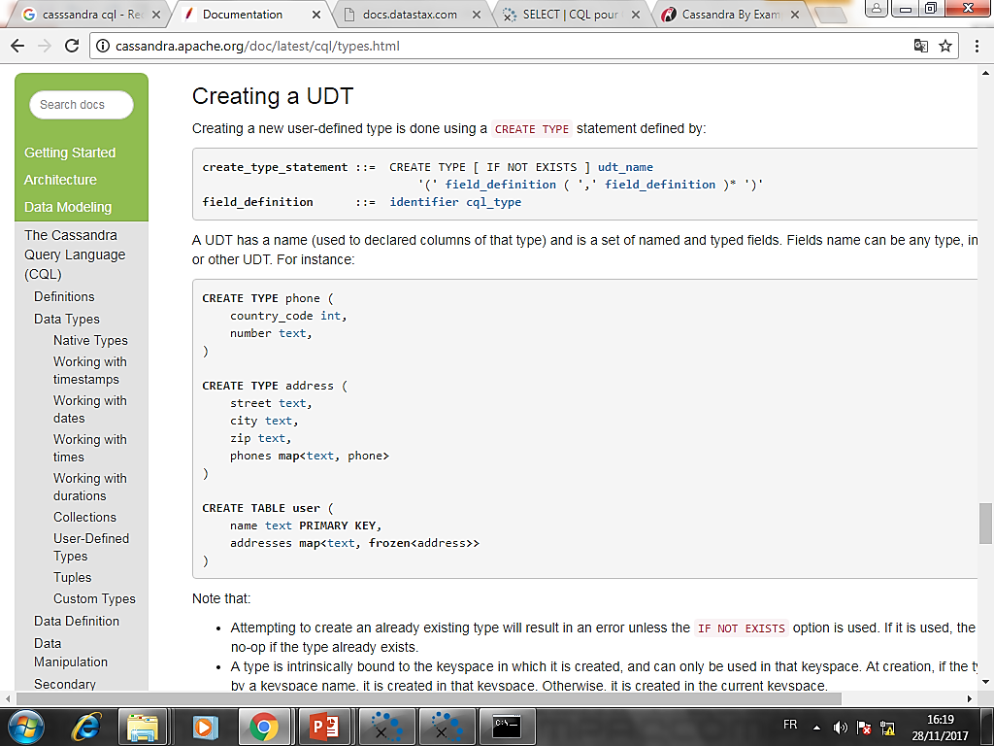
Creating a UDT
Creating a new user-defined type is done using a CREATE TYPE statement defined by:

Slide 24
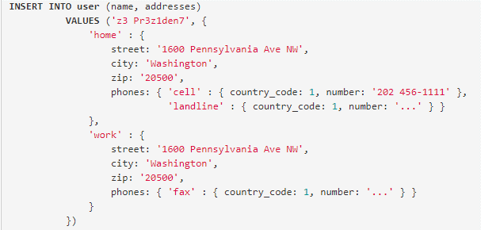
UDT literals
udt_literal ::= '{' identifier ':' term ( ',' identifier ':' term )* '}‘

Slide 25
Altering a UDT
alter_type_statement ::= ALTER TYPE udt_name alter_type_modification
alter_type_modification ::= ADD field_definition
| RENAME identifier TO identifier ( identifier TO identifier )*

Slide 28
Timeuuid functions
SELECT * FROM myTable WHERE t = now()
currentTimeUUID is an alias of now.
La fonction minTimeuuid(resp. maxTimeuuid) Prend une timestamp valeur t(qui peut être soit un timestamp soit une chaîne de date <timestamps> ) et renvoie un faux timeuuid correspondant au plus petit (resp. Plus grand ) possible timeuuid ayant pour timestamp t. Ainsi par exemple:
SELECT * FROM myTable
WHERE t > maxTimeuuid('2013-01-01 00:05+0000')
AND t < minTimeuuid('2013-02-02 10:00+0000')

Slide 29
Fonctions Datetime
Nom de la fonction | Le type de sortie
currentTimestamp | timestamp
currentDate | date
currentTime | time
currentTimeUUID | timeUUID

Slide 30
Fonctions Datetime
Nom de la fonction | Type d'entrée | La description
toDate | timeuuid | Convertit l' timeuuidargument en un datetype
toDate | timestamp | Convertit l' timestampargument en un datetype
toTimestamp | timeuuid | Convertit l' timeuuidargument en un timestamptype
toTimestamp | date | Convertit l' dateargument en un timestamptype
toUnixTimestamp | timeuuid | Convertit l' timeuuidargument en une bigIntvaleur brute
toUnixTimestamp | timestamp | Convertit l' timestampargument en une bigIntvaleur brute
toUnixTimestamp | date | Convertit l' dateargument en une bigIntvaleur brute
dateOf | timeuuid | Similaire à toTimestamp(timeuuid)(PÉRIMÉ)
unixTimestampOf | timeuuid | Similaire à toUnixTimestamp(timeuuid)(PÉRIMÉ)

Slide 31
User-defined functions
CREATE FUNCTION sample ( arg int ) ...;

Slide 32
Exemple
CREATE FUNCTION some_function ( arg int )
RETURNS NULL ON NULL INPUT
RETURNS int
LANGUAGE java
AS $$ return arg; $$;
SELECT some_function(column) FROM atable ...;
UPDATE atable SET col = some_function(?) ...;

Slide 33
Création d’une fonction
create_function_statement ::= CREATE [ OR REPLACE ] FUNCTION [ IF NOT EXISTS]
function_name '(' arguments_declaration ')'
[ CALLED | RETURNS NULL ] ON NULL INPUT
RETURNS cql_type
LANGUAGE identifier
AS string
arguments_declaration ::= identifier cql_type ( ',' identifier cql_type )*

Slide 34
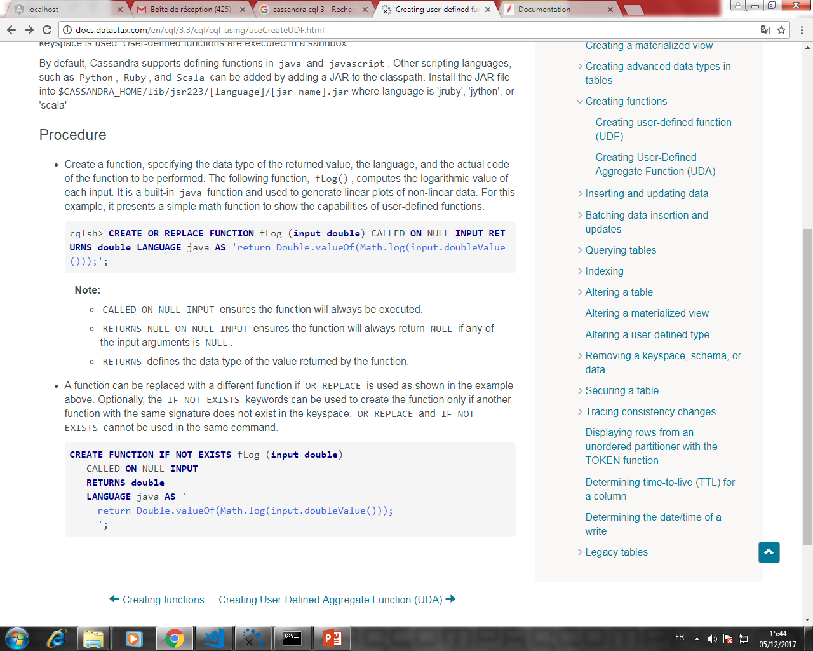
exemple

Slide 35
Exemple
CREATE FUNCTION IF NOT EXISTS akeyspace.fname(someArg int)
CALLED ON NULL INPUT
RETURNS text
LANGUAGE java
AS $$
// some Java code
$$;

Slide 36
DROP FUNCTION
drop_function_statement ::= DROP FUNCTION [ IF EXISTS ] function_name [ '(' arguments_signature ')' ]
arguments_signature ::= cql_type ( ',' cql_type )*
Exemple
DROP FUNCTION myfunction;
DROP FUNCTION mykeyspace.afunction;
DROP FUNCTION afunction ( int );
DROP FUNCTION afunction ( text );

Slide 37
Fonctions agrégées
Les fonctions d'agrégation fonctionnent sur un ensemble de lignes. Ils reçoivent des valeurs pour chaque ligne et renvoie une valeur pour l'ensemble.
Exemples :
SELECT COUNT (*) FROM plays;
SELECT COUNT (1) FROM plays;
SELECT MIN (players), MAX (players) FROM plays WHERE game = 'quake';
SELECT SUM (players) FROM plays;
SELECT AVG (players) FROM plays;

Slide 38
User-Defined Aggregates
create_aggregate_statement ::= CREATE [ OR REPLACE ] AGGREGATE [ IF NOT EXISTS ]
function_name '(' arguments_signature ')'
SFUNC function_name
STYPE cql_type
[ FINALFUNC function_name ]
[ INITCOND term ]
--------------------------------------------------------------
drop_aggregate_statement ::= DROP AGGREGATE [ IF EXISTS ] function_name [ '(' arguments_signature ')' ]

