Slide 2
System Architecture

Slide 3
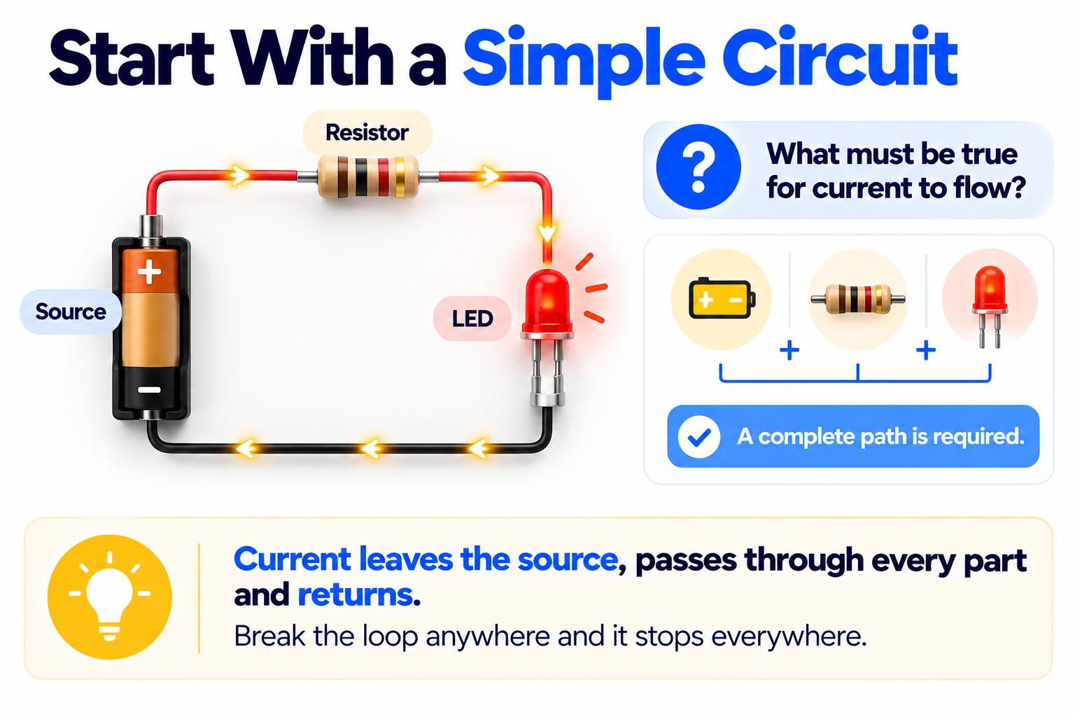
System Architecture
What this module covers
A0 · Product specification
A1 · Overall system architecture
A2 · Operating modes, failure behaviour and decisions
Reference: the verification stack and version control
Notes:
Three units build the System Architecture Document; two reference pages stay open for the rest of the course.
Sources: A0, A1, A2, REF-verification-stack, REF-version-control

Slide 4
Product Specification
Notes:
Sources: A0

Slide 5
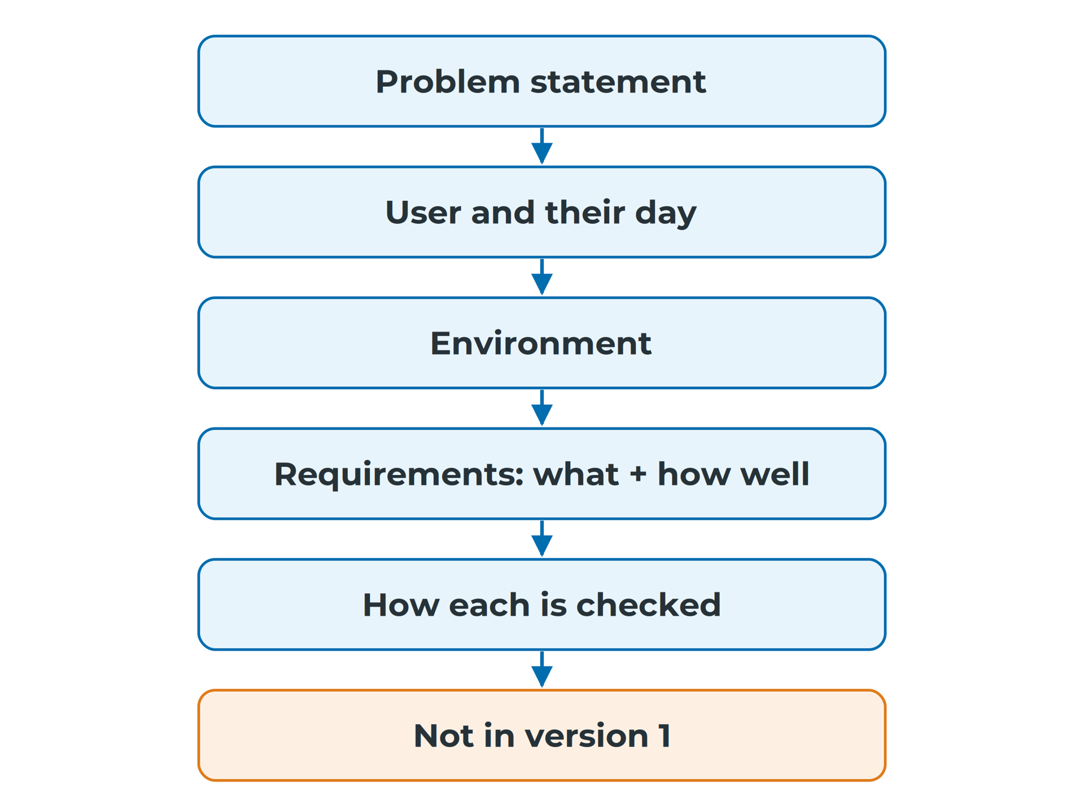
System Architecture
Wishes are not requirements
Same parts: one device flat before lunch, one too thick to wear
"Long battery life" and "small" are wishes
A specification adds a number, a condition and a check
It says what and how well, not how
The order a specification is built in
Notes:
Two students buy the same parts; neither made an electrical mistake, but nobody wrote down how long the device must last or how thick it may be. A spec says what the product must do and how well, not how: 'measures heart rate' belongs in a spec, 'uses a MAX30102' is a later design choice. Read more: A0 — Product Specification
Sources: A0#wishes-are-not-requirements, A0#what-a-specification-is

Slide 6
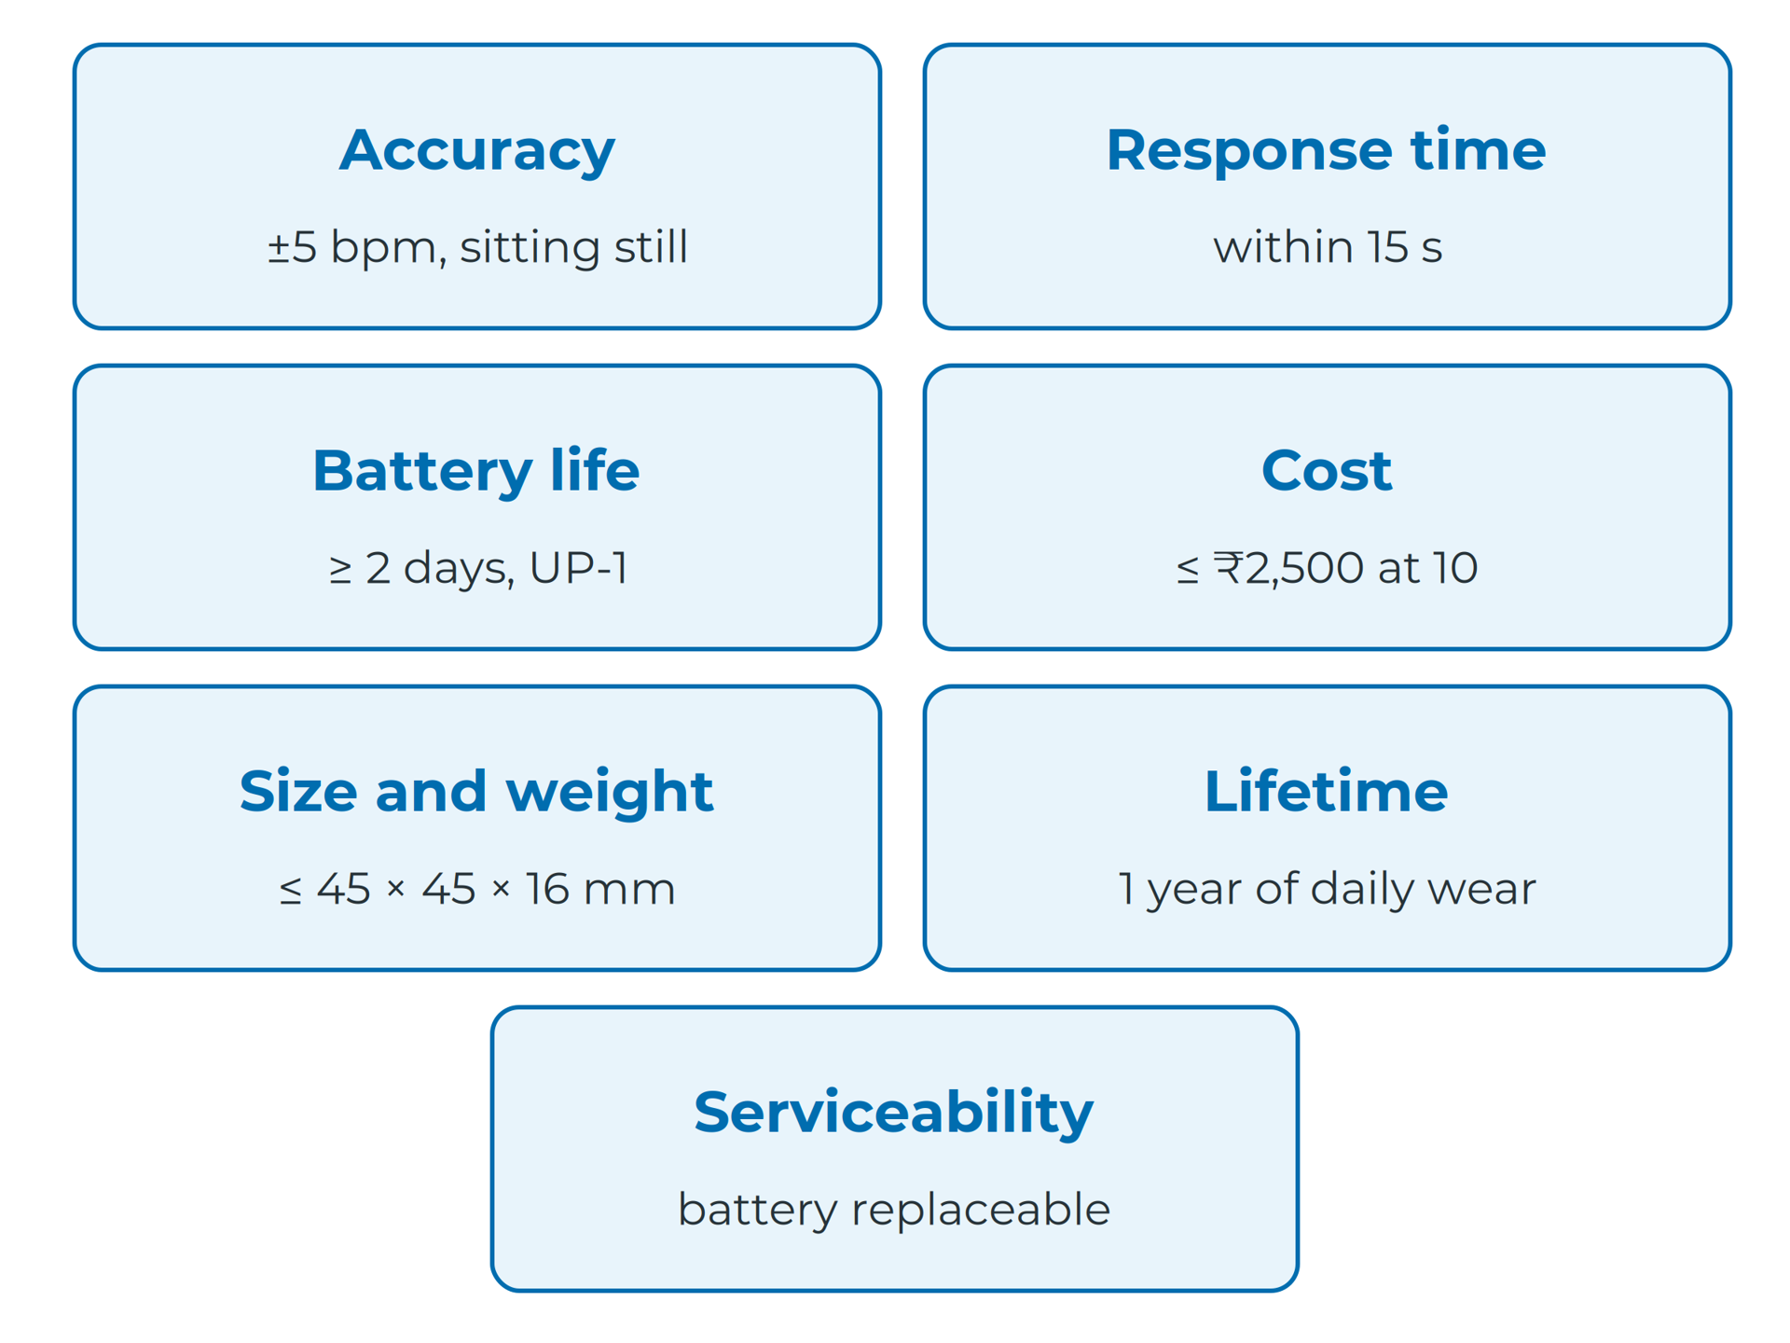
System Architecture
Functional vs non-functional
Functional: a behaviour you could watch happen
Non-functional: accuracy, speed, battery life, cost, size
Cover each category
Add conditions: "wearer sitting still"
Seven non-functional categories (example values)
Notes:
A functional requirement is something the product does; a non-functional one is how well it does it, or the limits it stays within. For a wearable these often matter most: a watch that measures perfectly but is 25 mm thick will not be worn. Read more: A0 — Product Specification
Sources: A0#two-kinds-of-requirement

Slide 7
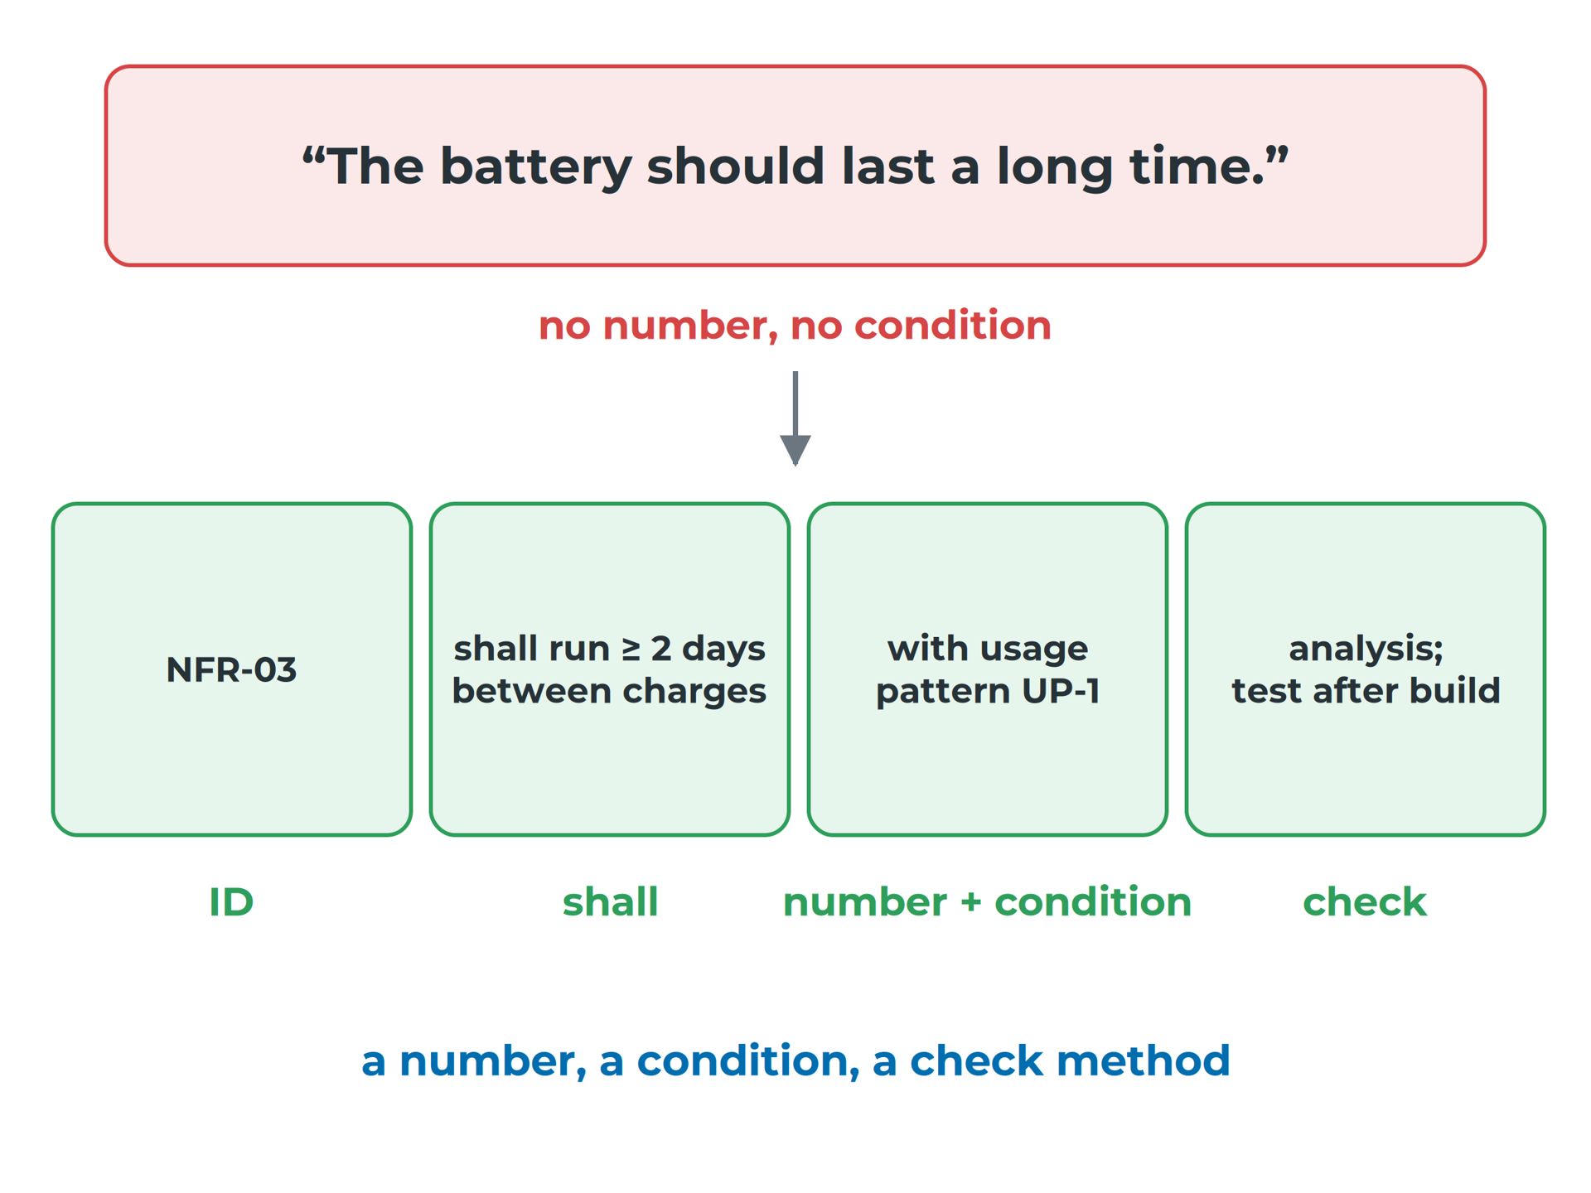
System Architecture
Make every requirement checkable
ID, a "shall" statement, a number with unit and condition, a check method
Nothing is built: check by inspection, analysis, simulation or review
Accuracy needs real hardware: mark it test (after build)
A wish rewritten as a checkable requirement
Notes:
Every requirement has four parts: an ID, a shall statement, a number with a unit and a condition, and a check method. NASA's handbook uses the same checklist. Some requirements, such as heart-rate accuracy, can only be proven on real hardware. Read more: A0 — Product Specification
Sources: A0#making-a-requirement-checkable, A0#checking-without-building

Slide 8

System Architecture
The user's day sets the numbers
Write a use scenario, then a usage pattern table (UP-1)
Skin contact, sweat, knocks and drops, heat
Write down a water and dust target (IP code)
Write the user's normal day, not yours at a desk
Notes:
A spec that does not describe its user assumes the user is you, at a desk, next to a charger. The use scenario holds a wake count, a charging interval and a battery target; turn it into usage pattern UP-1. A wrist is a harsh place: skin, sweat, knocks and heat each lead to a requirement. Read more: A0 — Product Specification
Sources: A0#the-user-their-day-and-their-environment

Slide 9
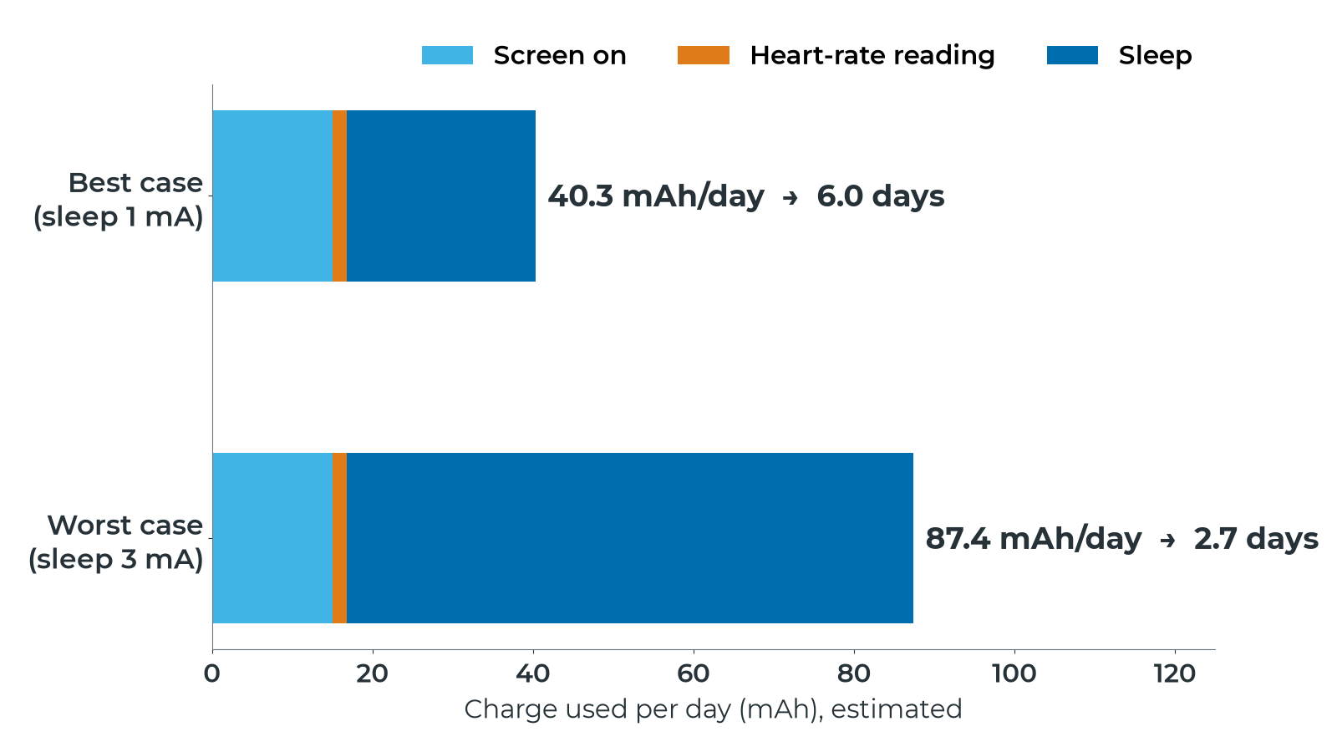
System Architecture
Sleep current decides battery life
esp_watch, estimated: 240 mAh usable lasts 2.7 to 6.0 days
Notes:
Multiply current by time for each activity in UP-1. Sleep uses 58% of the daily charge in the best case and 81% in the worst. With Seeed's pessimistic 4 mA light-sleep figure it is 2.2 days, so the 2-day requirement still holds, just. Read more: A0 — Product Specification
Sources: A0#worked-example-can-espwatch-last-two-days

Slide 10
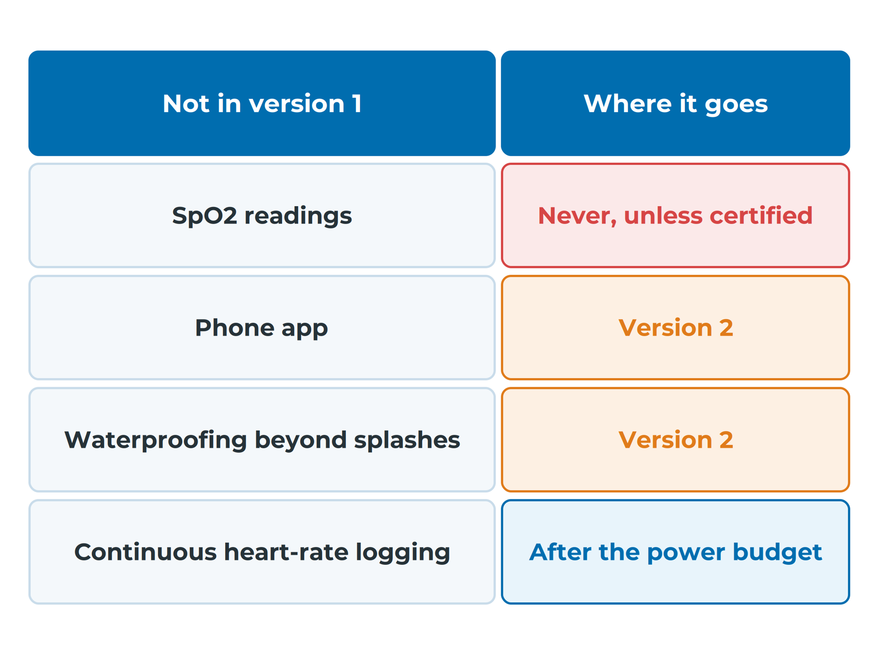
System Architecture
Write down what version 1 will not do
Most student projects fail from growth, not a wrong part
Each entry: the feature, why, where it goes
"We ran out of time" is not a reason
An out-of-scope list: feature, why, where it goes
Notes:
Blood-oxygen readings because the sensor can do it anyway, then an app, then notifications, until nobody finishes. The defence is an out-of-scope list where every entry names the feature, why it is left out, and where it goes instead. Read more: A0 — Product Specification
Sources: A0#deciding-what-version-1-will-not-do

Slide 11
System Architecture
Carry this forward
A requirement is only real if someone else can check it.
Notes:
Next, the whole system goes on one page, and every requirement gets an owner. Read more: A0 — Product Specification
Sources: A0#what-comes-next

Slide 12
Overall System Architecture
Notes:
Sources: A1

Slide 13
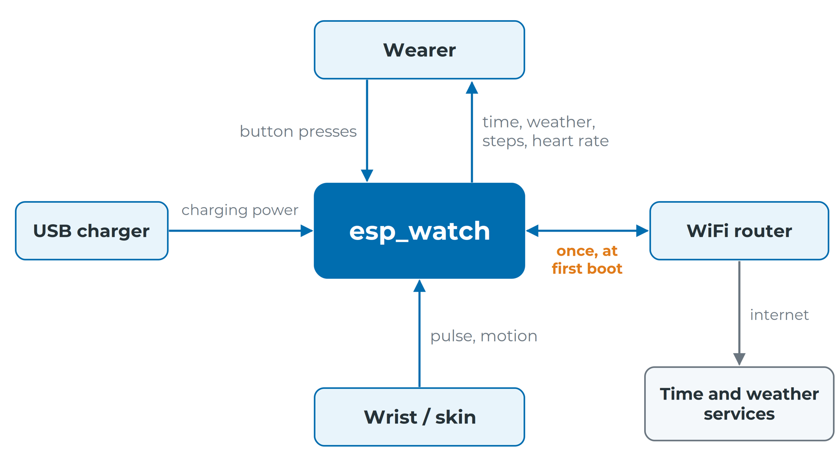
System Architecture
One box, every actor, labelled arrows
esp_watch's context diagram: no phone, no server
Notes:
Test for the boundary: could I change it by editing my design files? If not, it is an external actor. One box for the product, every actor from the spec, every arrow labelled with what flows, and direction that means something. Read more: A1 — Overall System Architecture
Sources: A1#inside-and-outside, A1#the-context-diagram

Slide 14
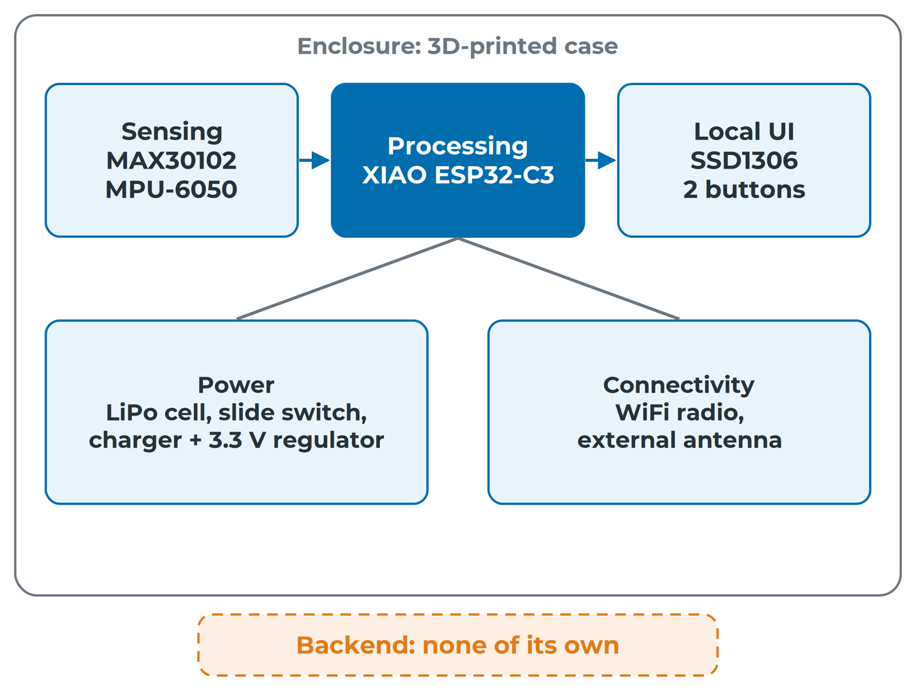
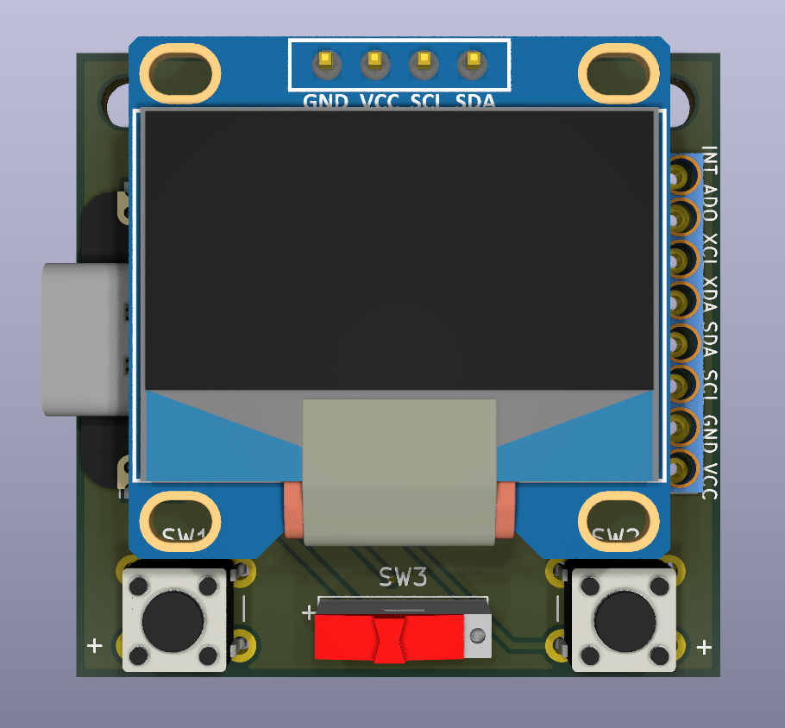
System Architecture
Seven subsystems, one diagram
Enclosure and backend are the ones forgotten
Notes:
Sensing, processing, power, connectivity, local UI, enclosure, backend: a starting point, not a law. The render shows sensing, processing, local UI and power; connectivity is mostly inside the ESP32-C3 board, and the enclosure and backend do not appear. Read more: A1 — Overall System Architecture
Sources: A1#seven-standard-subsystems, A1#the-reference-watch-broken-down

Slide 15
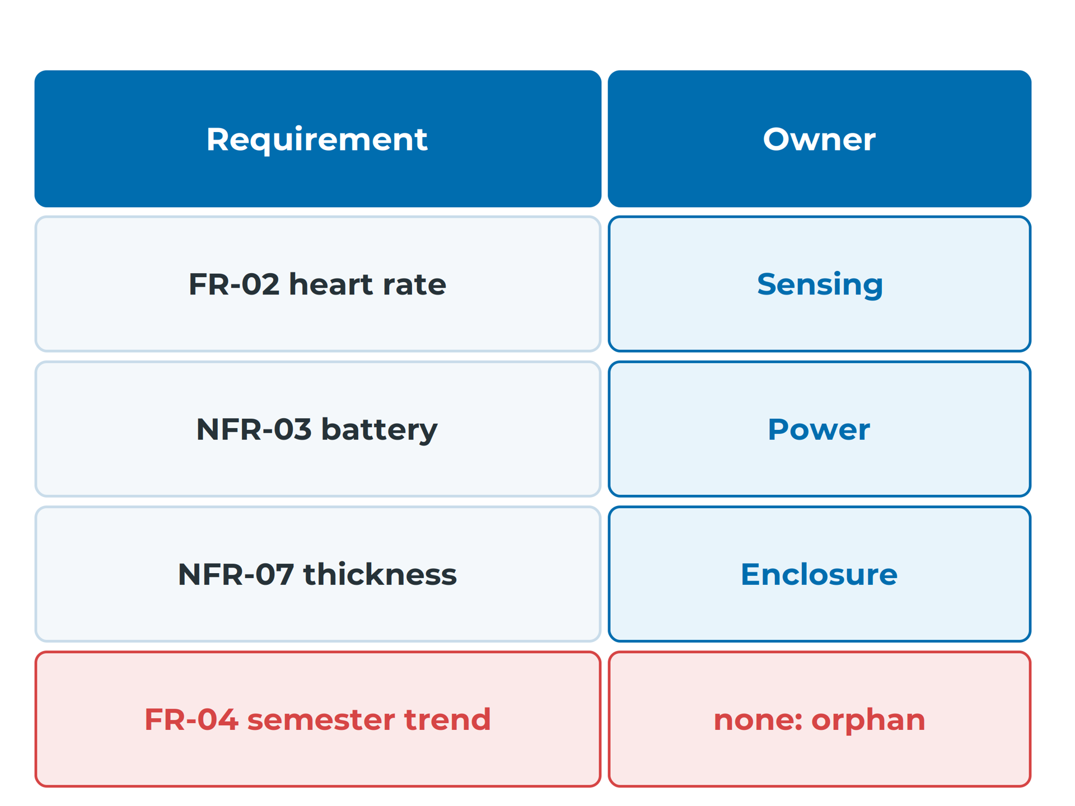
System Architecture
Every requirement gets one owner
One owner is responsible; others support
Budget requirements: owned by the subsystem that manages the budget
Orphan: a requirement no subsystem can own
Unused subsystem: a forgotten requirement, or unnecessary
esp_watch: 8 of 9 requirements owned; FR-04 orphan
Notes:
If two subsystems share a requirement equally, each assumes the other is handling it. Battery life, cost, weight and thickness are budgets that every subsystem spends. NFR-07 is in trouble too: the board alone is 14.044 mm high, leaving about 2 mm for the case. Read more: A1 — Overall System Architecture
Sources: A1#allocating-every-requirement, A1#worked-example-holding-espwatch-against-a-problem-statement

Slide 16
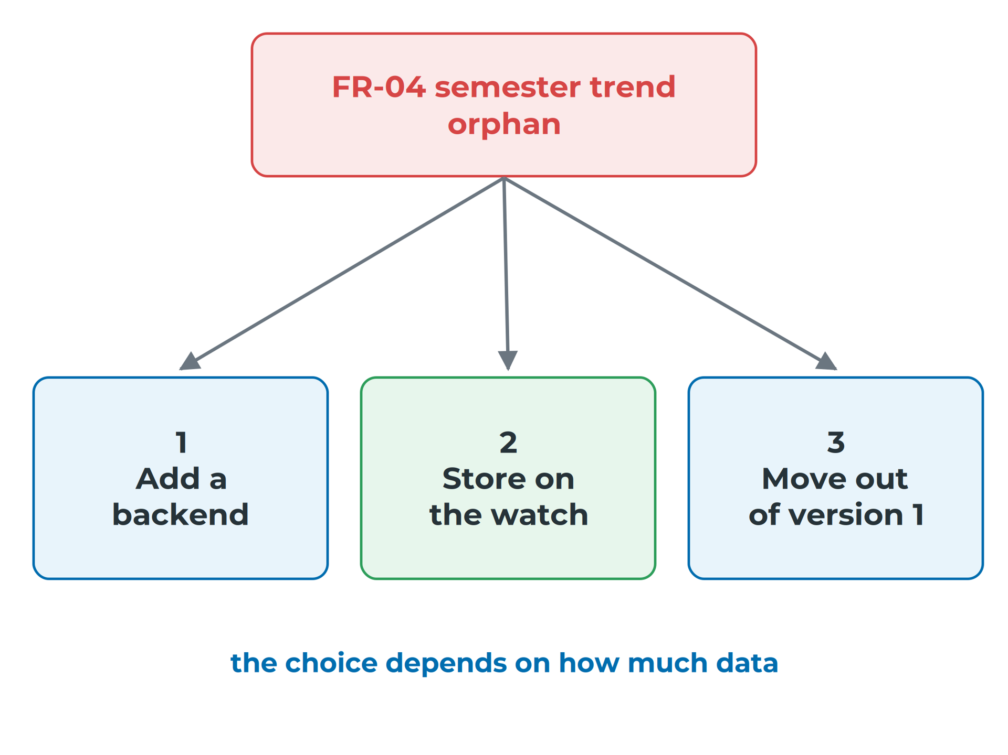
System Architecture
An orphan has three honest ways out
FR-04: nothing stores readings across a semester
Add a backend that the watch uploads to
Let processing own it: store a few bytes per day
Or move it out of version 1, and say so
The best choice depends on how much data
Notes:
FR-04 is the heart of the hostel problem statement, and nothing in esp_watch delivers it: there is no storage for history and no backend. Also check for unused subsystems: connectivity fetches weather, but no requirement asks for it. Read more: A1 — Overall System Architecture
Sources: A1#worked-example-holding-espwatch-against-a-problem-statement

Slide 17
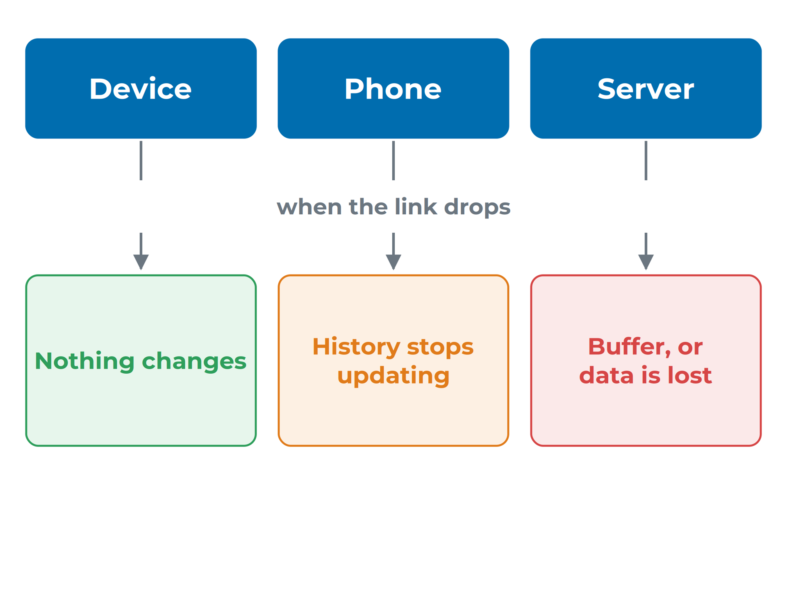
System Architecture
What's needed now runs on the device
Decide where each job runs: device, phone or server
Ask what the wearer sees when the link drops
Heart rate, time and steps must work with no signal
Only work that can wait should depend on a link
Where the work runs decides what survives a dropped link
Notes:
Device-only work works anywhere. A phone gives a big screen and more memory. A server keeps data safe from a lost phone, but watch and phone must buffer until the link returns. Read more: A1 — Overall System Architecture
Sources: A1#where-does-the-work-happen

Slide 18
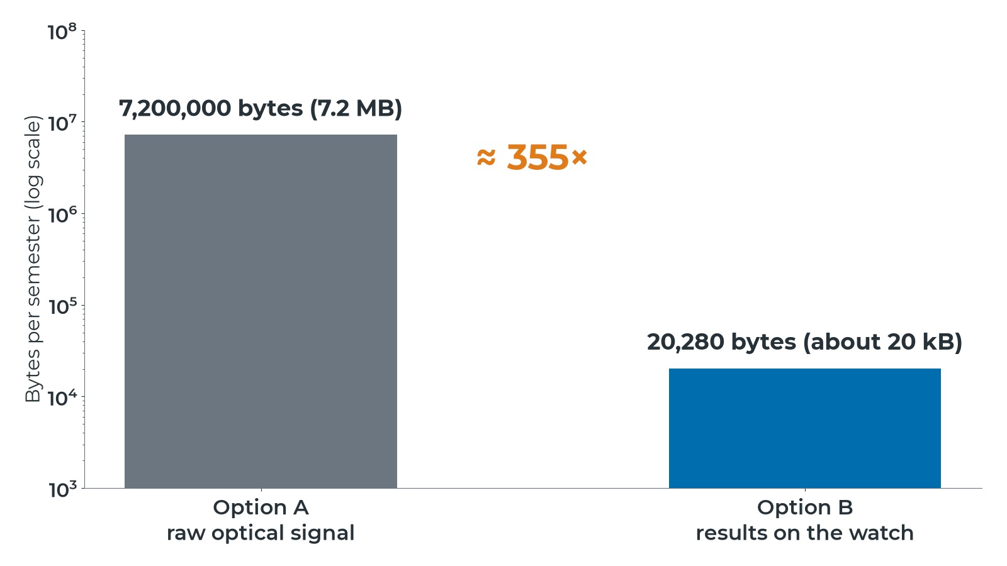
System Architecture
Send results, not raw signal
Raw signal sends about 355 times more data
Notes:
More data keeps the radio on longer, which costs battery. With Option B a whole semester of history is about 20 kB, so storing it on the watch itself becomes realistic and a backend may not be needed for version 1. Read more: A1 — Overall System Architecture
Sources: A1#how-much-data

Slide 19
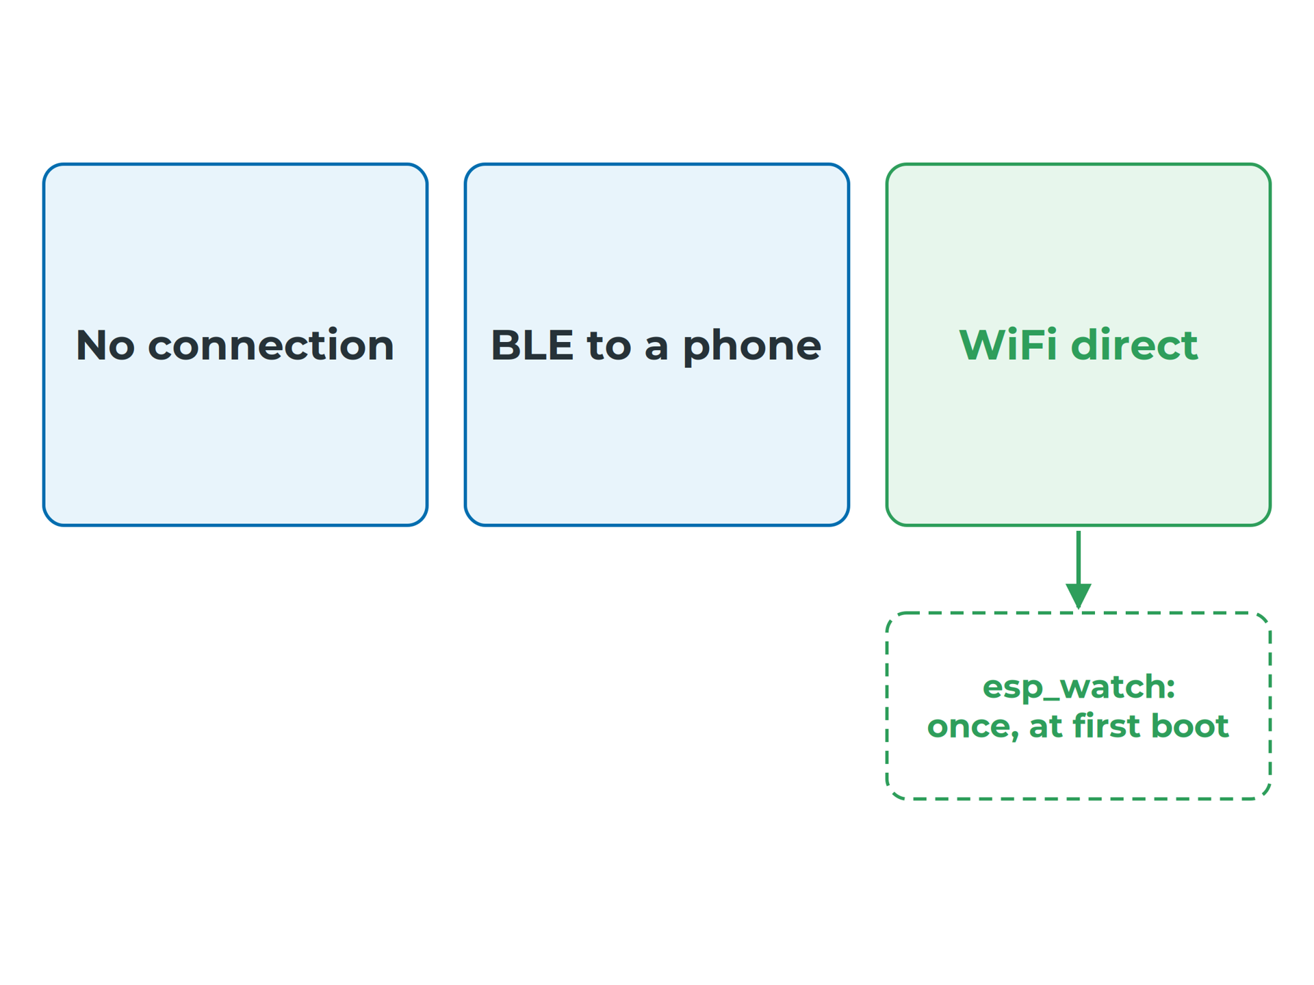
System Architecture
One connection, one-line reason
No connection: no history beyond what the watch stores
BLE to a phone: you build or depend on an app
WiFi direct: higher power while connected; campus logins often block a watch
esp_watch: WiFi once at first boot, then off
Three realistic routes for a wearable
Notes:
esp_watch only needs the time and the weather, so one short connection costs almost nothing in the battery budget. For the hostel problem statement, with its semester history, that choice would need revisiting. Read more: A1 — Overall System Architecture
Sources: A1#which-connection

Slide 20
Operating Modes, Failure Behaviour and Decisions
Notes:
Sources: A2

Slide 21
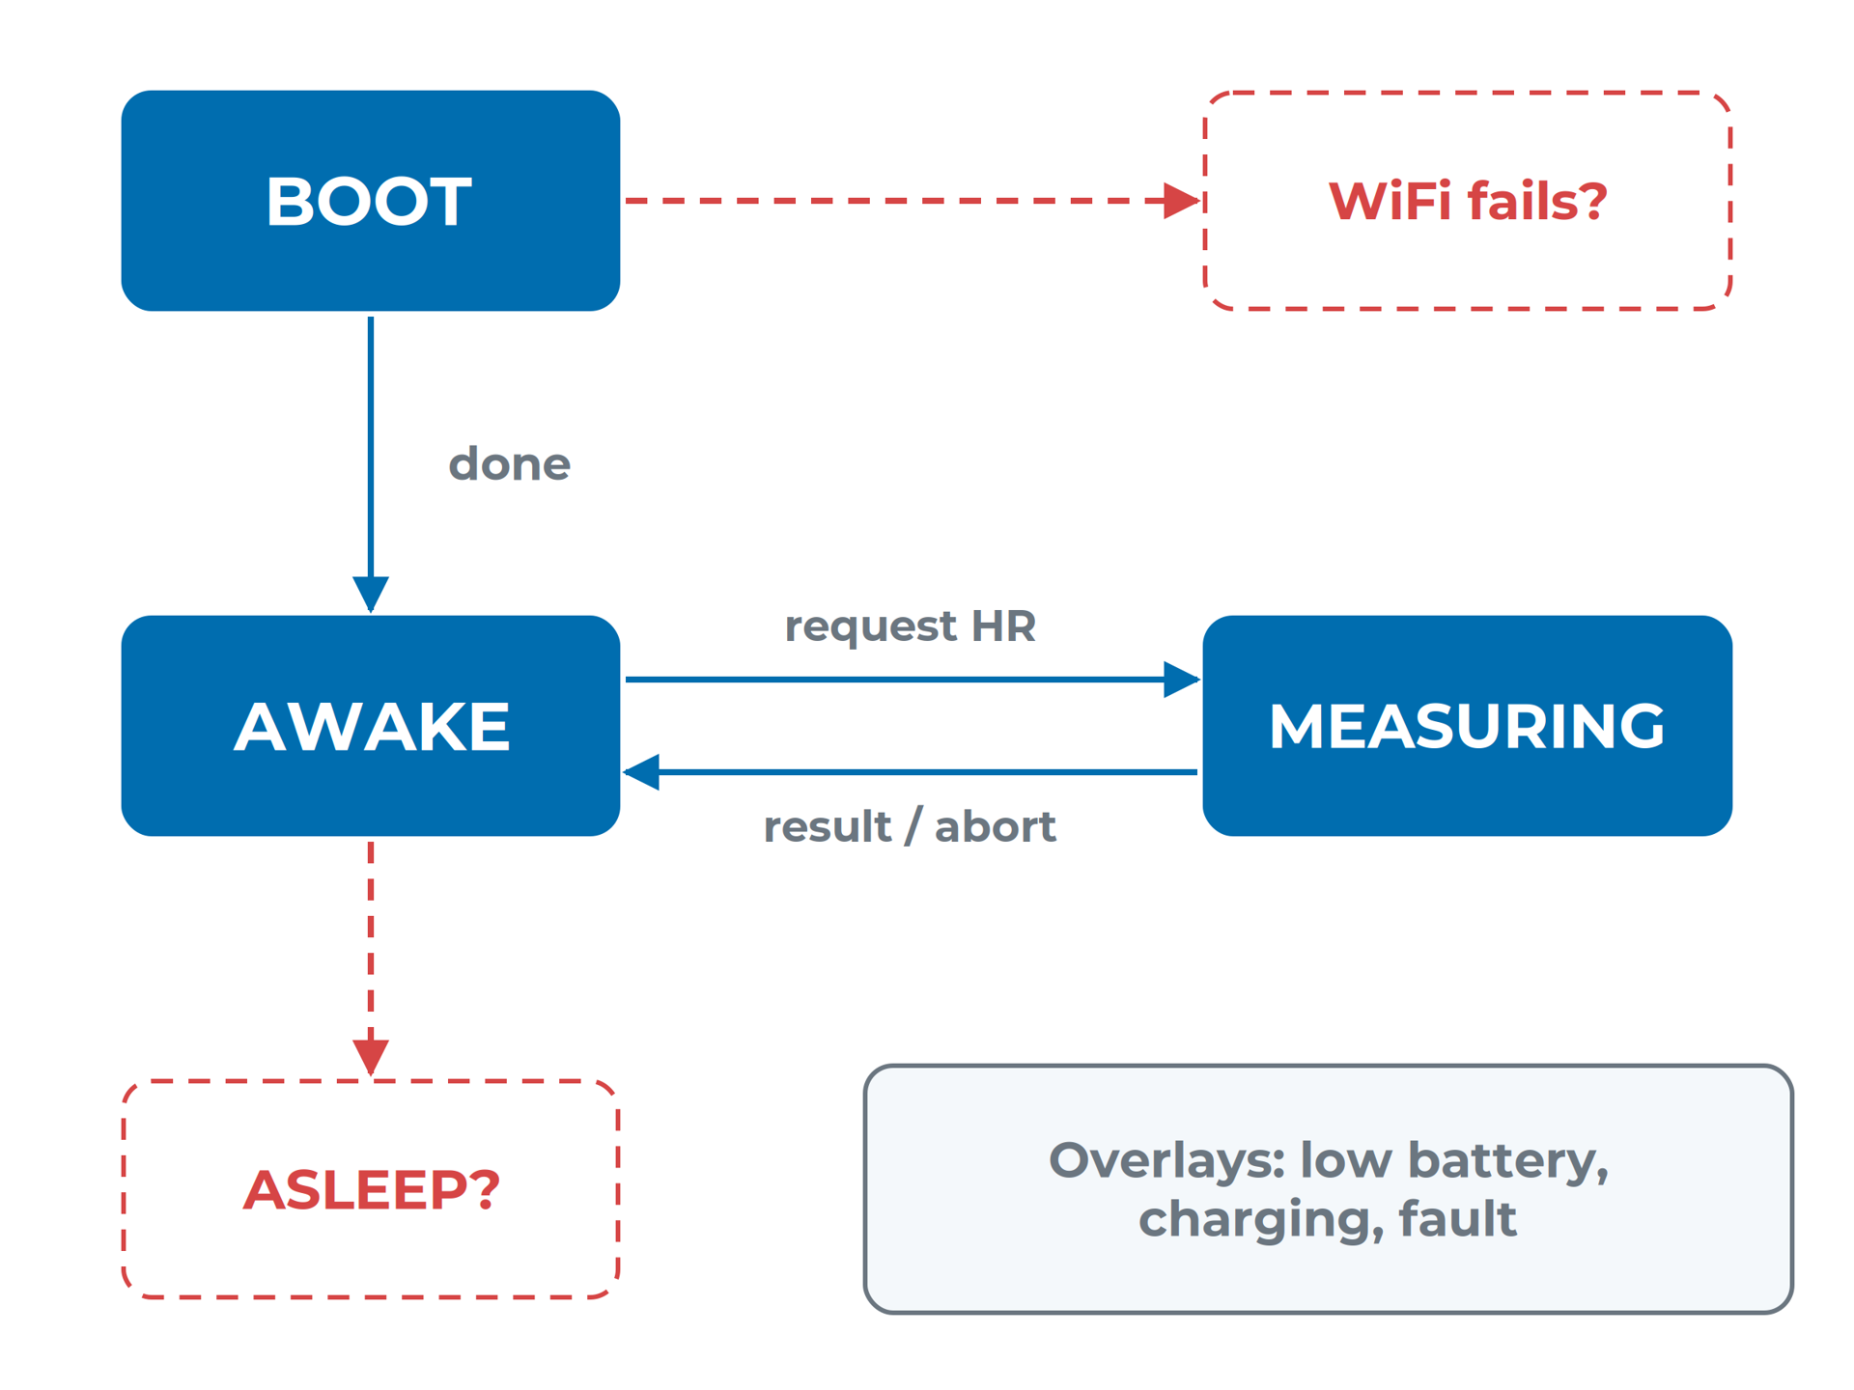
System Architecture
States, events and transitions
State: a mode the system stays in until an event
Draw charging as an overlay, not a box
Gap: no arrow for WiFi failing at boot
Gap: no sleep state, so the screen stays on all day
esp_watch: always on, with gaps marked
Notes:
A state is a mode, an event is what happens, and a transition is the move it causes. The XIAO has no battery-measurement pin and esp_watch adds none, so a LOW BATTERY state would first need a divider on an ADC pin. Read more: A2 — Operating Modes, Failure Behaviour and Decisions
Sources: A2#states-what-mode-is-the-system-in, A2#worked-example-the-reference-watchs-states

Slide 22
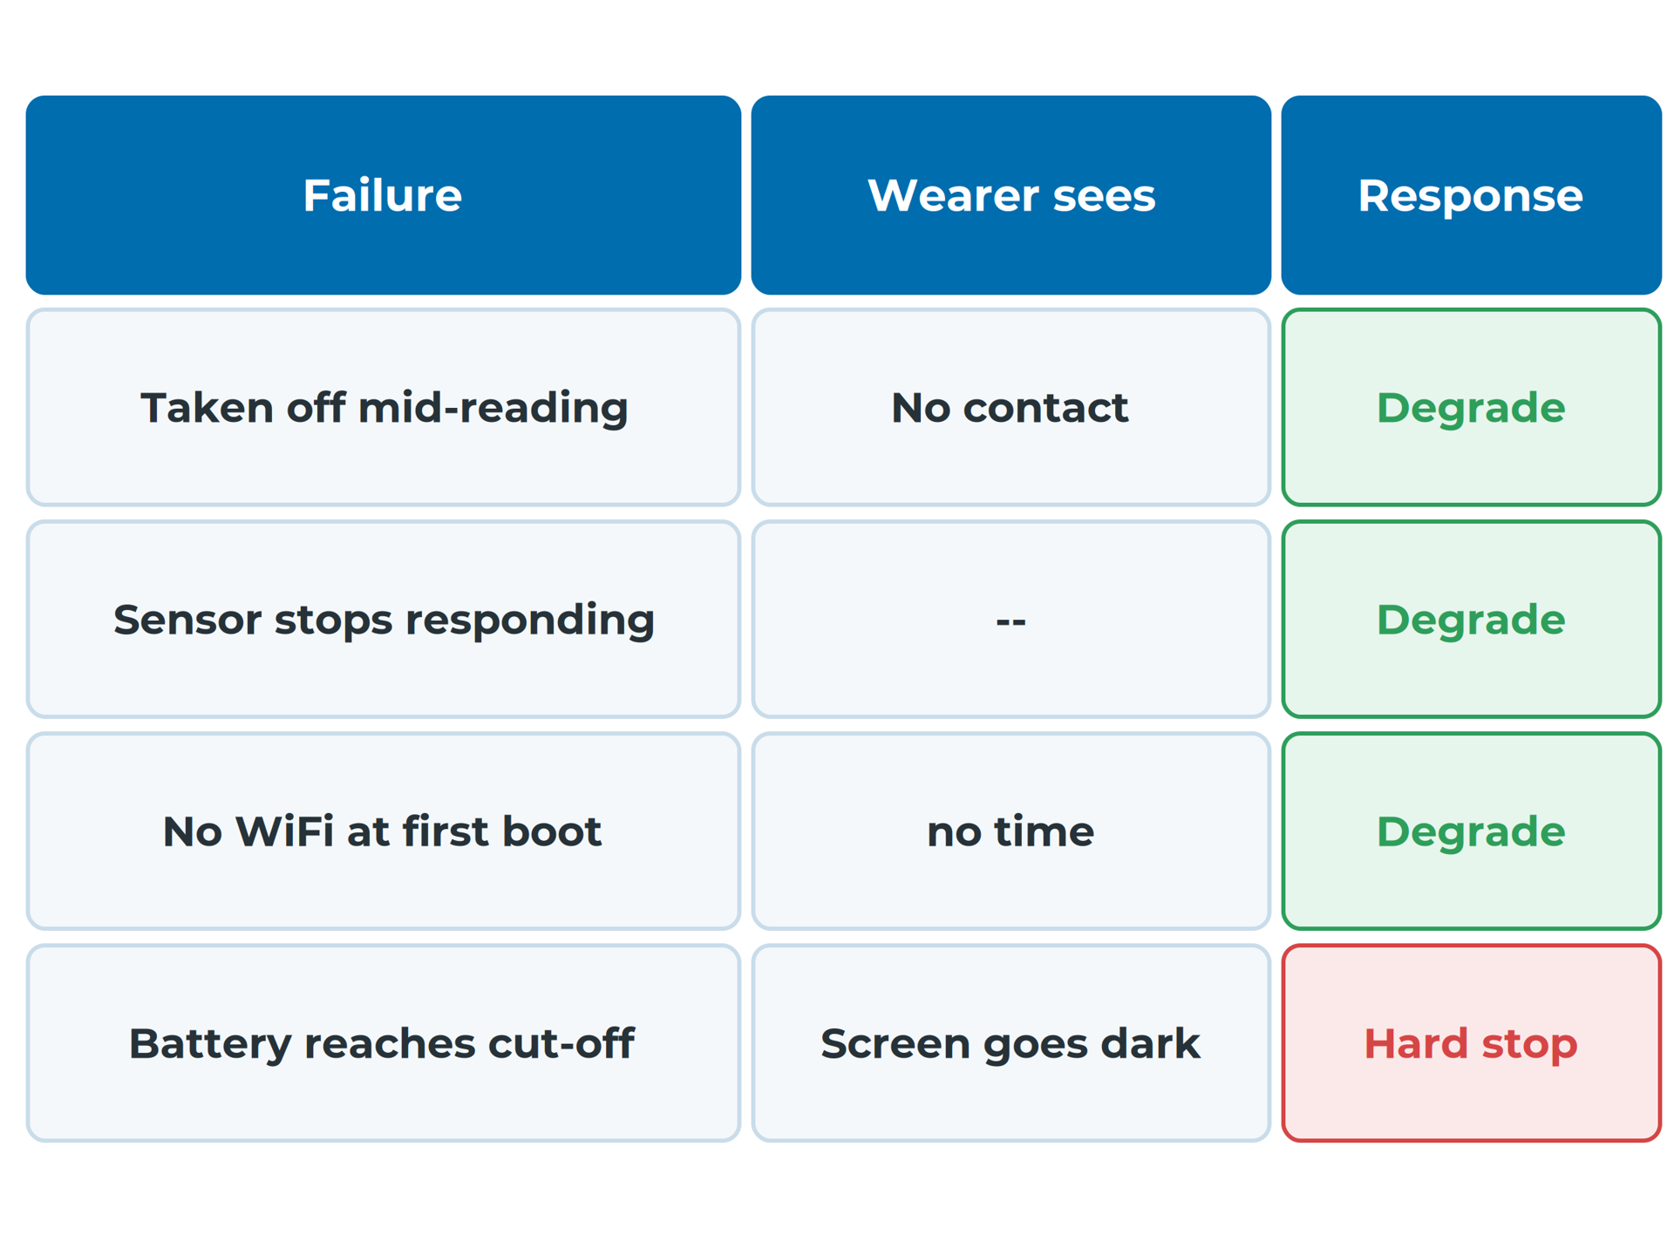
System Architecture
Degrade gracefully by default
Graceful degradation: keep working, say plainly what is not
Hard stop: continuing could damage something or mislead
Each failure: how it is detected, what the wearer sees
Proposed failure mode table for esp_watch
Notes:
Choose graceful degradation by default. Choose a hard stop when carrying on could damage something, or would show a number the wearer might trust and act on. Read more: A2 — Operating Modes, Failure Behaviour and Decisions
Sources: A2#failure-behaviour

Slide 23
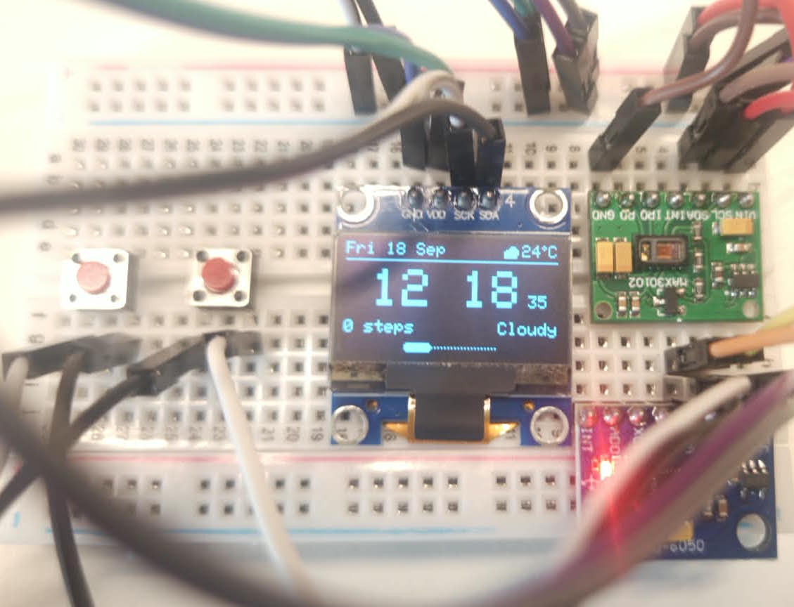
System Architecture
Judge bus health by reading a device
A faulty heart-rate module corrupted the shared I²C bus
The display showed garbage; the firmware reported nothing
A failure you cannot detect is a failure you cannot handle
esp_watch breadboard: three devices on one I²C bus
Notes:
Nothing is read back from a display, so its failure is detected indirectly, through a sensor on the same bus. Every 'how it is detected' entry needs something in the design: a timeout on bus reads, a check on signal quality. Read more: A2 — Operating Modes, Failure Behaviour and Decisions
Sources: A2#failure-behaviour

Slide 24

System Architecture
The safest data never leaves the device
Where does it live: device, phone or server?
Who can read it?
Does it leave the device, and is it protected?
esp_watch: readings stay on the watch
Every copy you send elsewhere must be protected
Notes:
Heart rate is health data. India's Digital Personal Data Protection Act, 2023 requires reasonable security safeguards against a data breach. esp_watch's privacy comes as a side effect of keeping WiFi off; the cost is that there is nowhere to see a semester's trend. Read more: A2 — Operating Modes, Failure Behaviour and Decisions
Sources: A2#where-health-data-lives

Slide 25
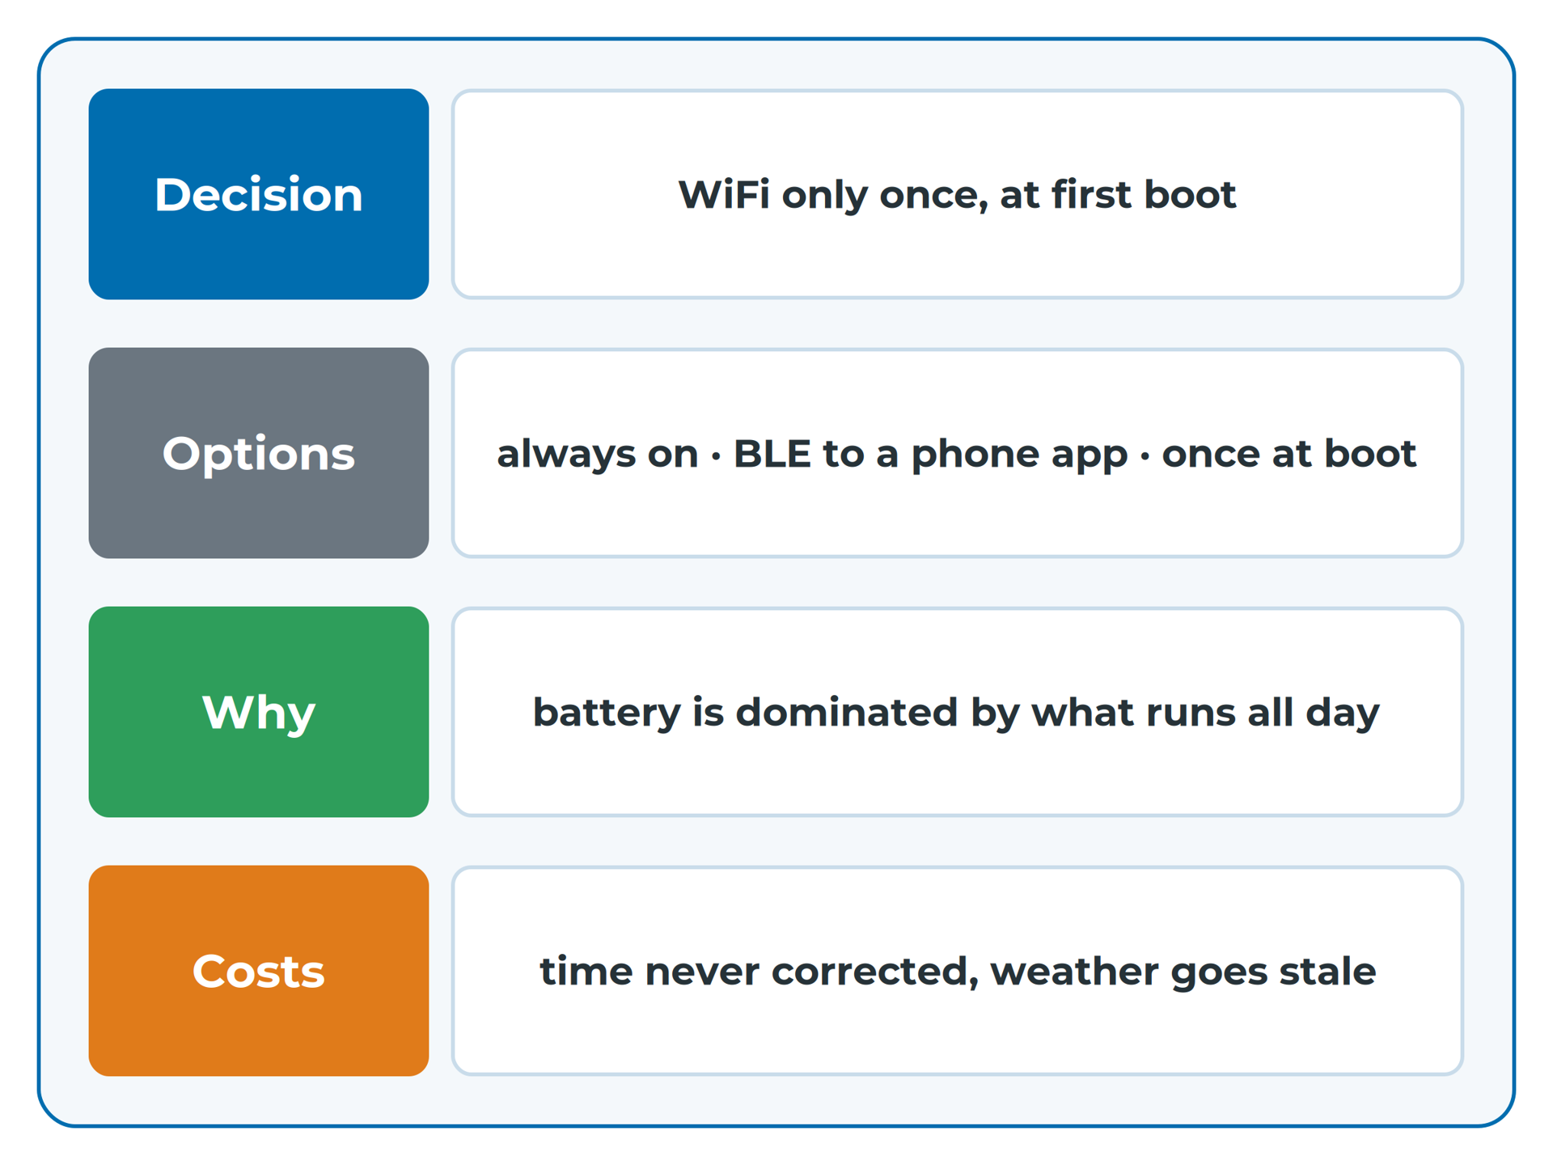
System Architecture
A decision note in four parts
Tie the "why" to a requirement from A0
"What it costs" becomes a list of follow-on work
Changed your mind? Write a new note, keep the old
Reconstructed decision note for esp_watch
Notes:
In three weeks you will not remember why, and a reviewer will ask. The esp_watch note is rebuilt from the watch's behaviour; its first follow-on item is exactly the missing arrow found in the state diagram. Read more: A2 — Operating Modes, Failure Behaviour and Decisions
Sources: A2#writing-down-your-decisions, A2#worked-example-a-reconstructed-decision-note-for-the-reference-watch

Slide 26
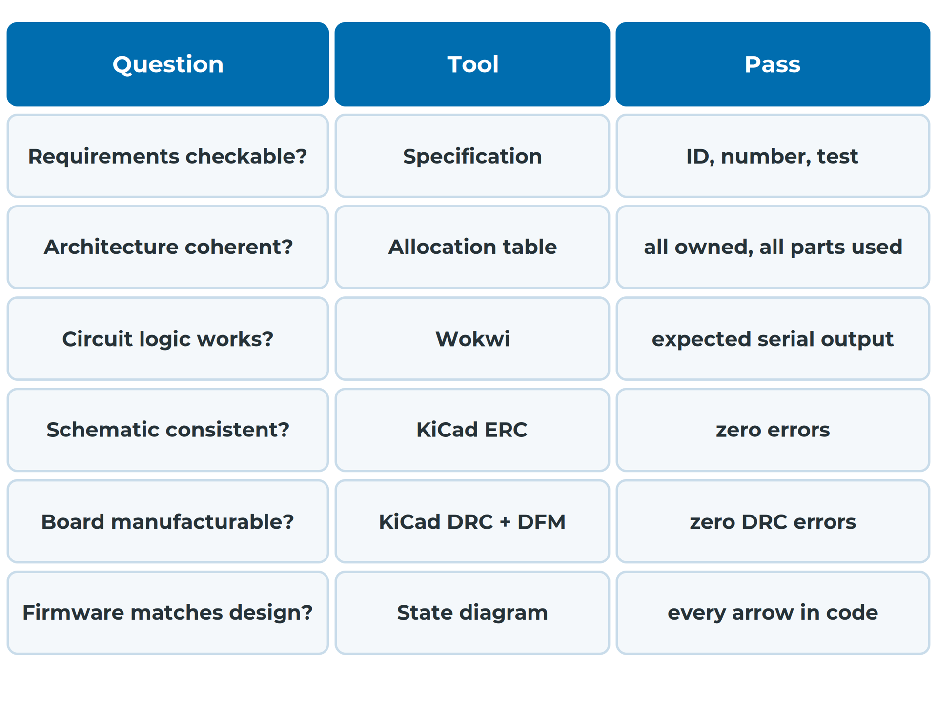
System Architecture
Every stage has a pass/fail check
Find the row, run the check
Record the check, the date and the verdict
Explain every difference from the reference watch
Part of the verification stack
Notes:
Nothing is built until the funded build, so each stage names a check with a clear pass or fail. The record shows a reviewer that every part of the design was checked by something other than your own confidence. Read more: REF — The Verification Stack
Sources: REF-verification-stack#the-full-table, REF-verification-stack#how-to-use-this-page

Slide 27
System Architecture
What a pass does not tell you
A clean DRC means "can be made", not "will work".
Notes:
DRC cannot know you wired a sensor to the wrong pin, or that the heart-rate sensor faces away from the wrist. A board can pass DRC perfectly and still be useless. Read more: REF — The Verification Stack
Sources: REF-verification-stack#what-a-pass-does-not-tell-you

Slide 28
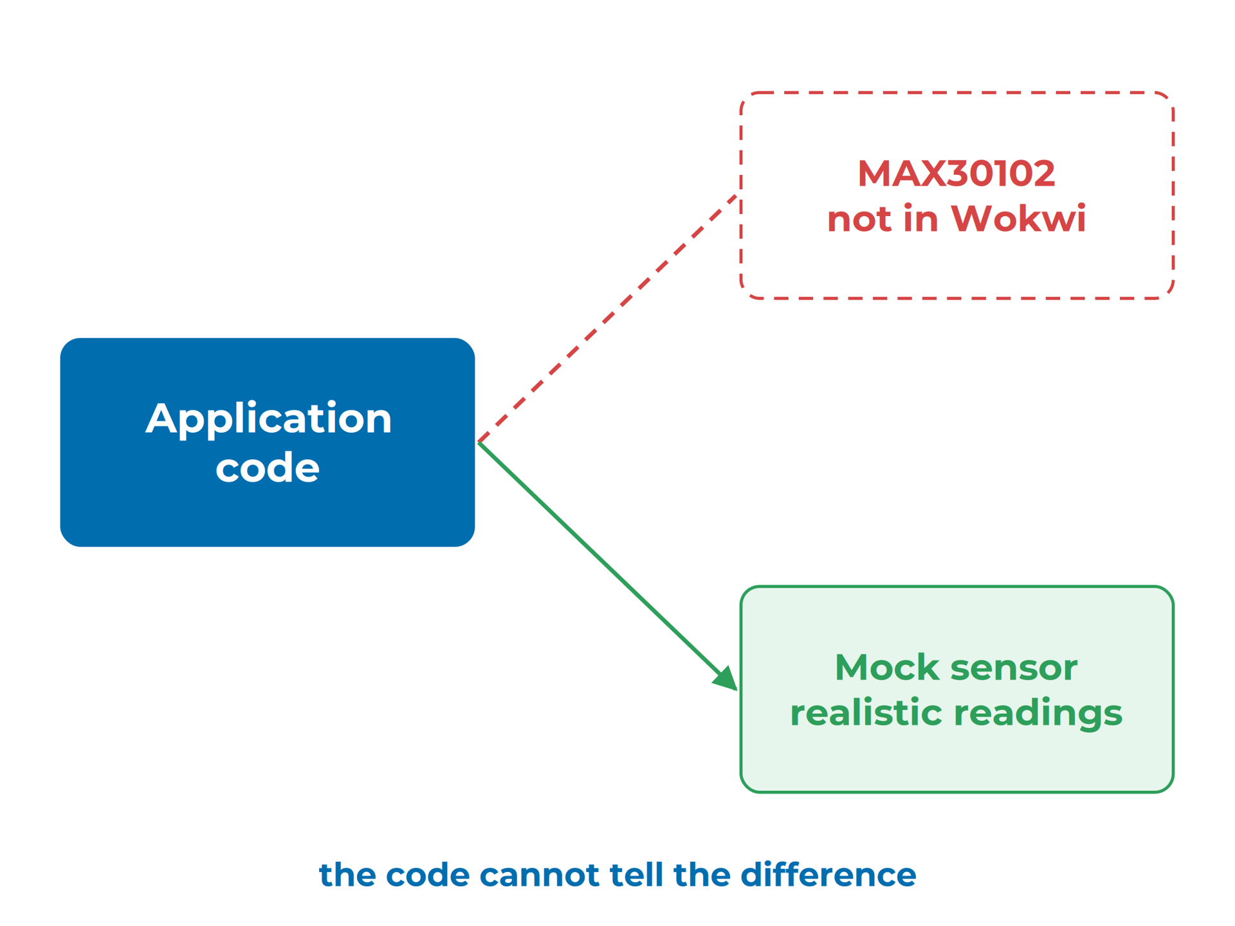
System Architecture
Simulators don't model everything
Wokwi has no MAX30102 heart-rate sensor
A mock sensor returns made-up but realistic readings
A simulator pass means "my logic is right"
A mock sensor stands in for the real one
Notes:
Wokwi simulates the ESP32-C3, MPU-6050, SSD1306, buttons and switches. No simulator reproduces a badly soldered joint, a weak battery or a noisy wrist. You write the mock sensor in B5. Read more: REF — The Verification Stack
Sources: REF-verification-stack#what-a-pass-does-not-tell-you

Slide 29
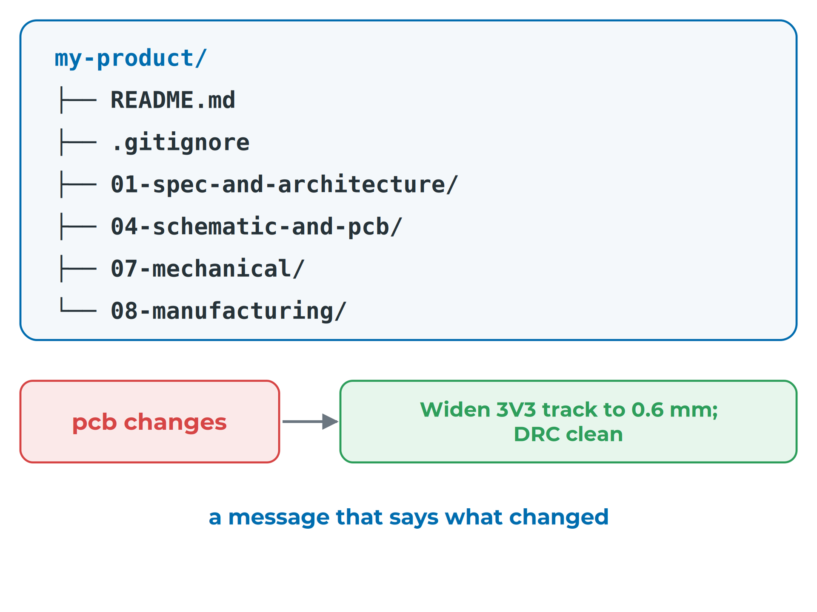
System Architecture
One repo, small commits, clear messages
Keep the whole design pack in one repository
Commit small, commit often; say what changed
Commit what you made; ignore what tools make
The repo is the design pack
Notes:
One commit can then record a board change together with the case change it caused. Use GitHub Desktop; no command line needed. Ignore KiCad backups, lock files and the PlatformIO build folder. Read more: REF — Version Control for a Hardware Project
Sources: REF-version-control#step-1-one-repository-for-the-whole-design-pack, REF-version-control#step-2-set-it-up-with-github-desktop, REF-version-control#step-3-commit-small-commit-often, REF-version-control#step-4-decide-what-git-ignores

Slide 30
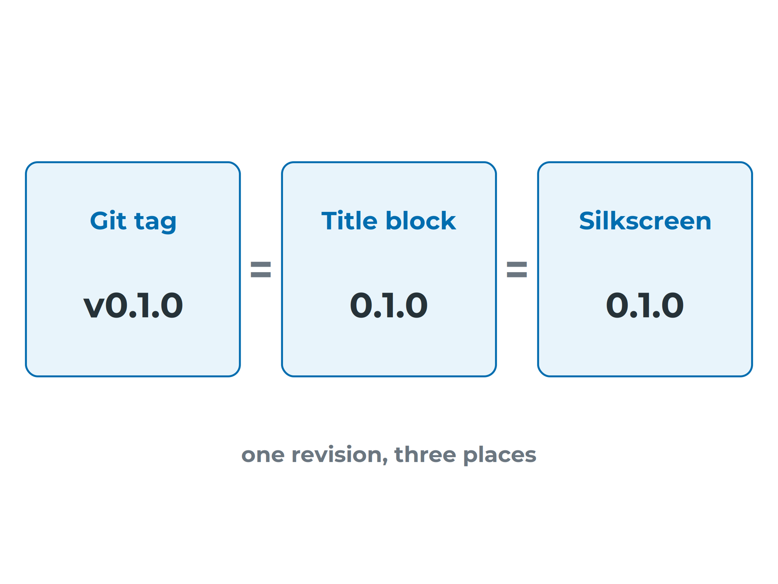
System Architecture
Tag exactly what you sent to the fab
Commit the fabrication files and Gerber zip together
Tag that commit with the board's revision
Same revision in tag, title block and silkscreen
Never move or reuse a tag
One revision, three places
Notes:
Then anyone holding a board can read its revision and find the exact files that made it. esp_watch's board and title block say 0.1.0, but its repository has no tags. Read more: REF — Version Control for a Hardware Project
Sources: REF-version-control#step-5-tag-the-version-you-send-to-the-fab

Slide 31
System Architecture
Recap
A0 · Requirements with a number, a condition and a check
A1 · One page, and every requirement has an owner
A2 · States, failures and decisions written down
Reference · Check every stage; tag what you send
Notes:
Together these make the System Architecture Document that every later module refers back to.
Sources: A0, A1, A2, REF-verification-stack, REF-version-control

