Slide 2
Sensing & Hardware Architecture

Slide 3
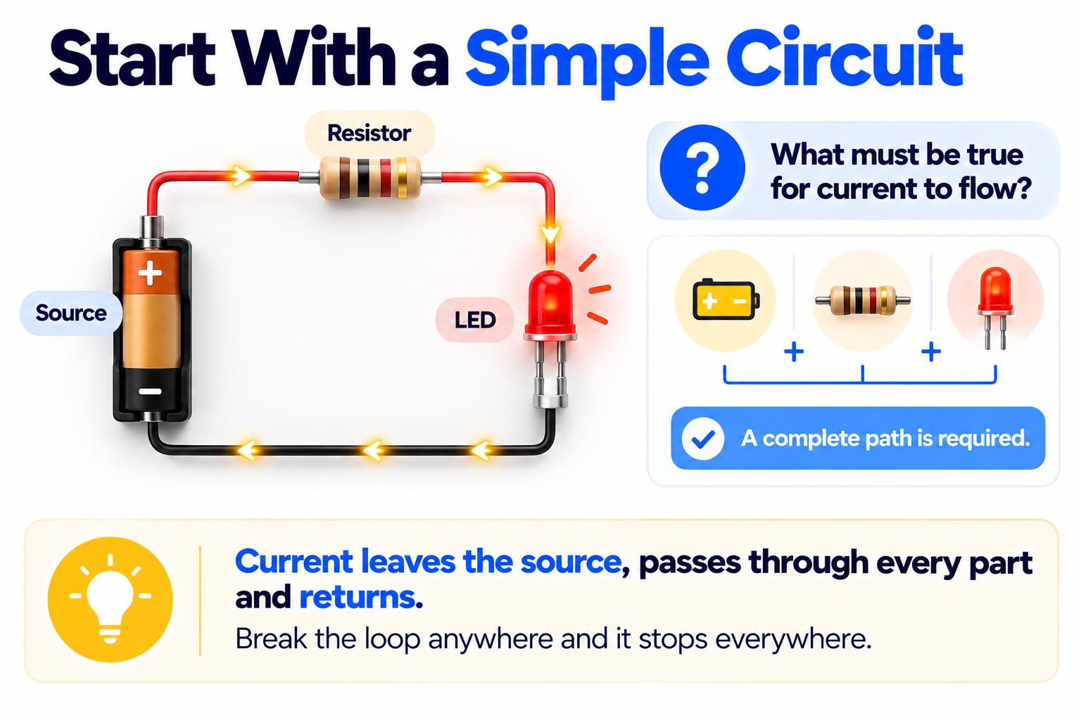
Sensing & Hardware Architecture
What this module covers
B0–B1 · Choosing sensors and the interface each one uses
B2–B3 · Hardware block diagram and electrical architecture
B4–B5 · Component selection and virtual prototyping

Slide 4
Sensors and Interfaces
Notes:
Sources: B0, B1

Slide 5
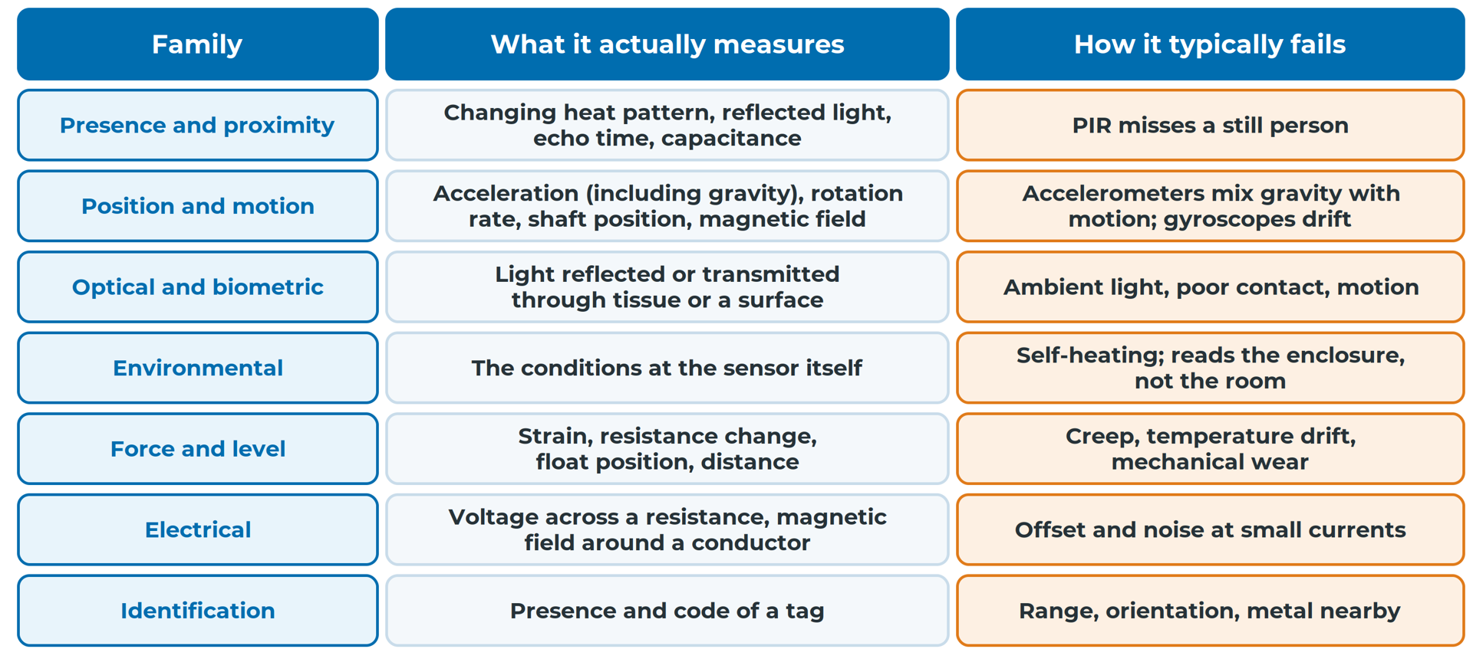
Sensing & Hardware Architecture
Seven families, seven ways to fail
Know what each family actually measures, and how it fails
Notes:
Most sensors in connected products fall into seven families. The middle column matters most: what the sensor actually measures is often not the thing you care about. Families overlap, so use the table to widen your search, not to limit it. Read more: B0 — Common Sensors, and Choosing the Right One for the Job
Sources: B0#seven-families

Slide 6
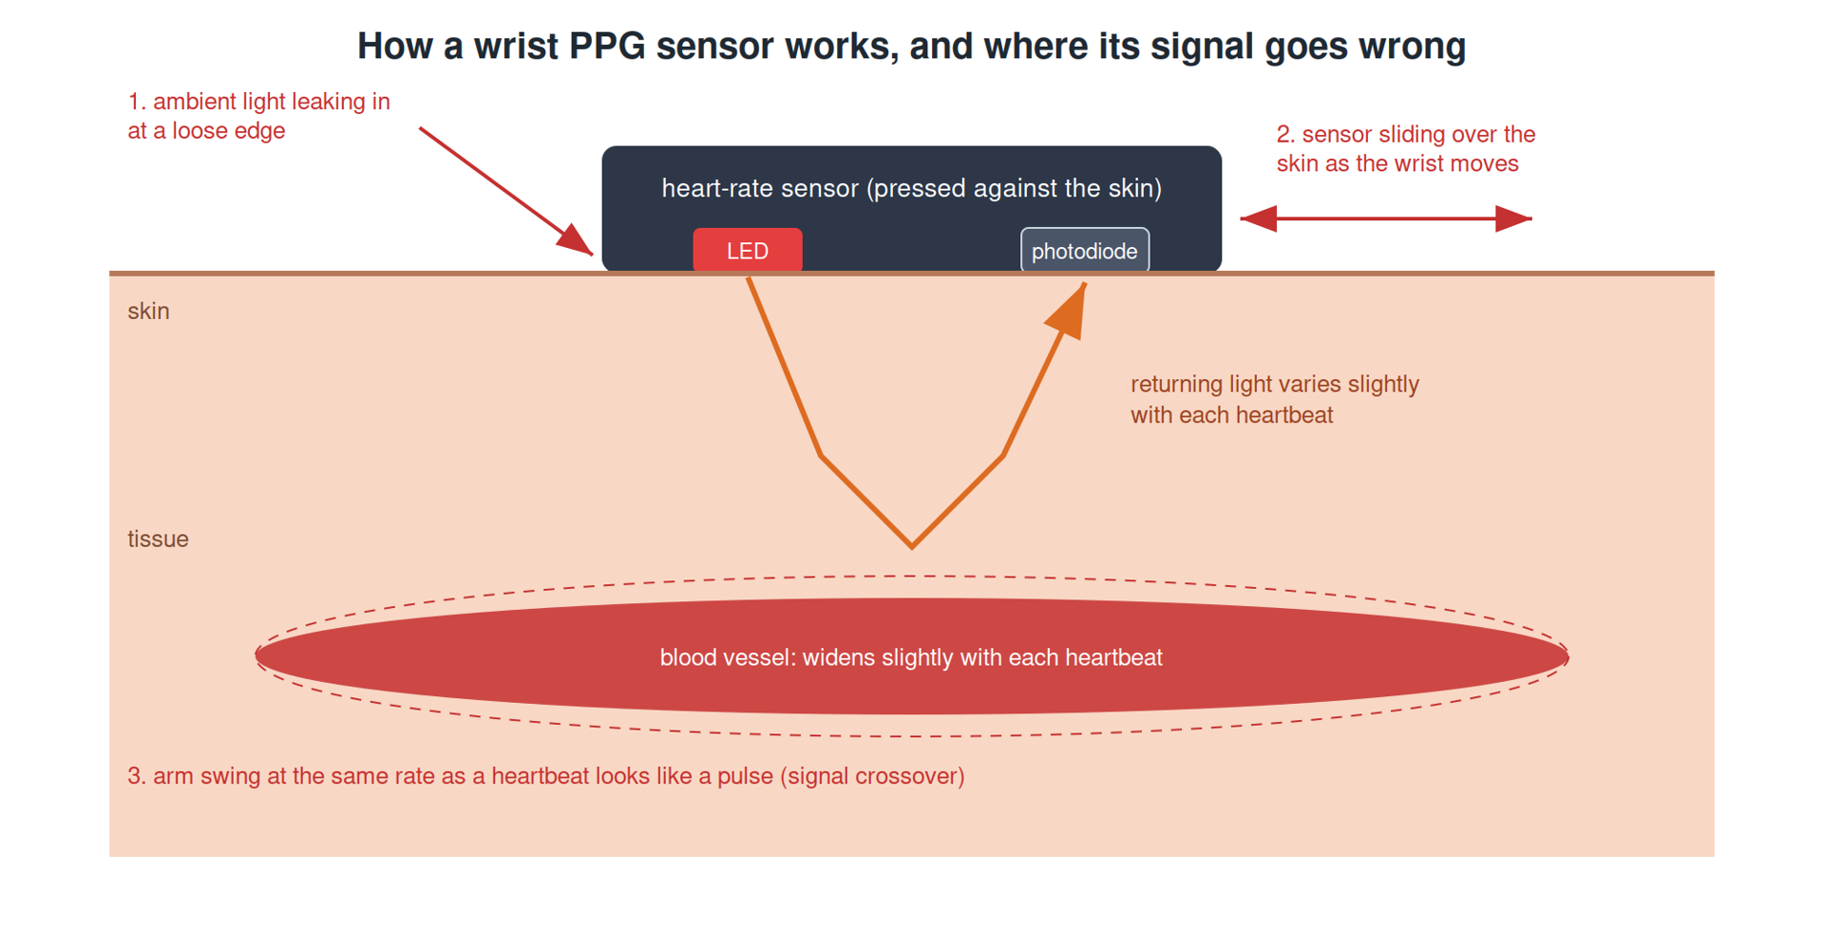
Sensing & Hardware Architecture
Every sensor measures a stand-in
Measurand: what you want. Proxy: what the sensor responds to
Accelerometer: acceleration; a step is inferred
PPG: changing reflected light, not heart rate
Write down when each proxy lies
Wrist PPG, and where its signal goes wrong
Notes:
A proxy usually moves with the measurand, but not always: clapping looks like steps, a still person is invisible to PIR. Every inference adds a way to be wrong. The list of when each proxy lies becomes part of your A2 failure table. Read more: B0 — Common Sensors, and Choosing the Right One for the Job
Sources: B0#sensing-is-measuring-a-stand-in, B0#seven-families

Slide 7
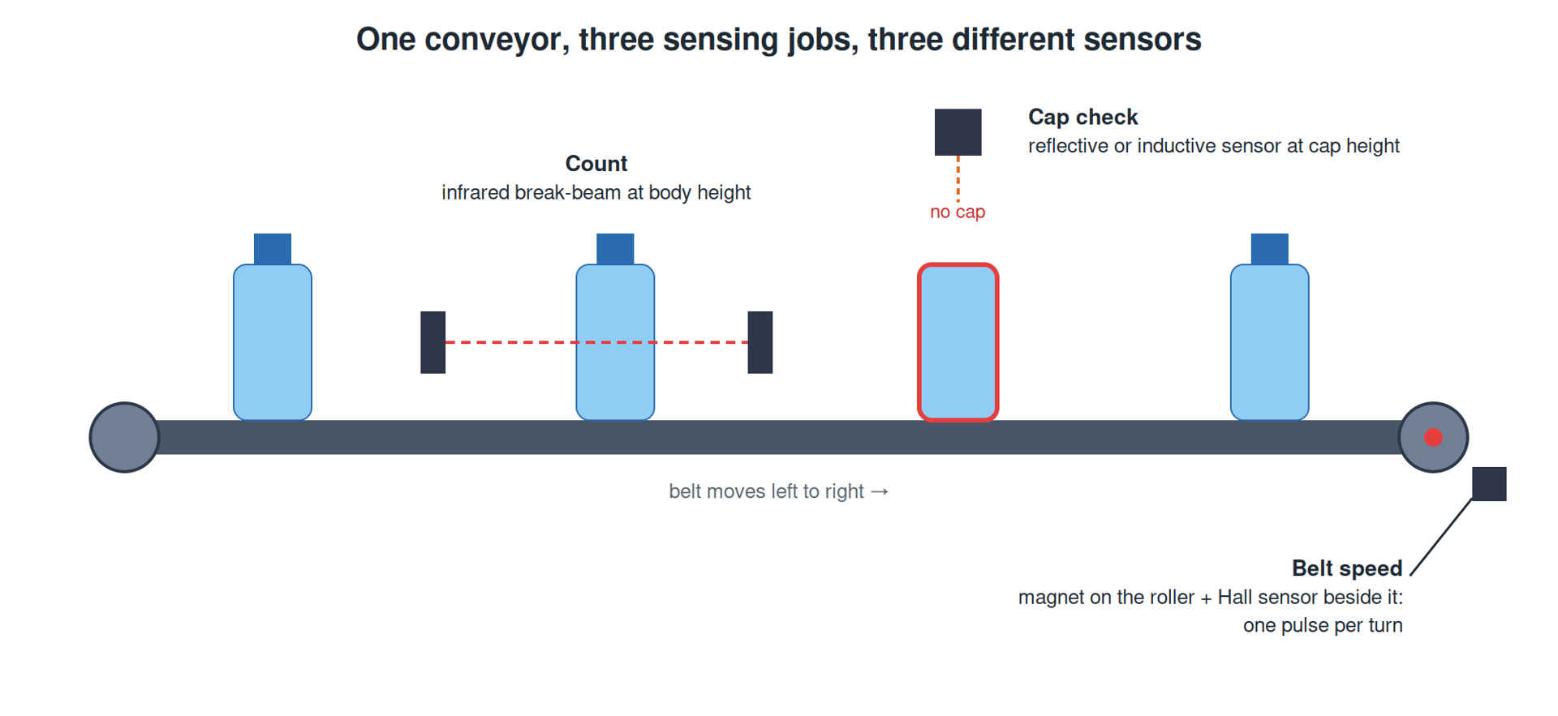
Sensing & Hardware Architecture
The costlier error picks the sensor
False positive: reports what did not happen
False negative: misses what did happen
A break-beam counts bottles; it is hopeless for caps
Uncapped bottle passed as capped: reaches a customer
One conveyor, three sensing jobs, three sensors
Notes:
Work through the questions in order: physical quantity, contact, range and resolution, response time, environment, output type, power, cost, and which error is more expensive. The last one changes decisions most. On the conveyor, the cap check is where money should go. Read more: B0 — Common Sensors, and Choosing the Right One for the Job
Sources: B0#the-questions-in-order, B0#worked-example-2-three-sensing-jobs-in-one-machine

Slide 8
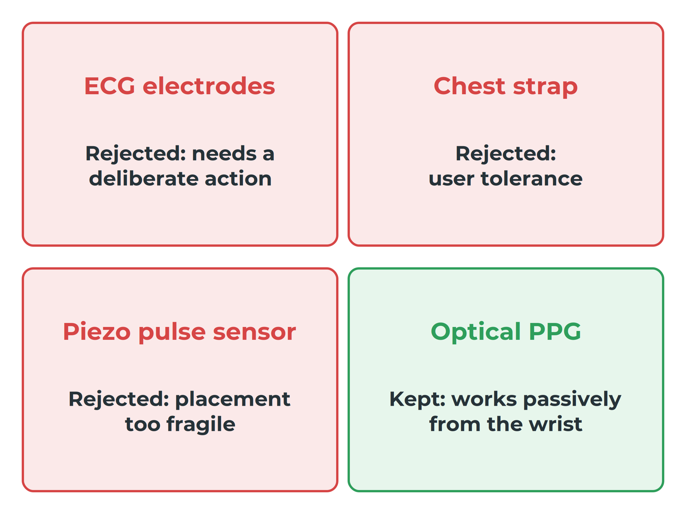
Sensing & Hardware Architecture
"Measure heart rate" is not a spec
Test each candidate against the requirement's conditions
Optical PPG works passively from the wrist
Its weaknesses: motion, loose fit, ambient light
Matrix row: sensor, a rejected alternative, and why
Wrist-worn, without the wearer doing anything
Notes:
The wearing position, the user's tolerance and the failure modes decided it. Heart-rate error during activity was on average about 30% higher than at rest, and PPG can lock on to the rhythm of walking: signal crossover. A gym machine with metal hand grips would reasonably choose ECG. Read more: B0 — Common Sensors, and Choosing the Right One for the Job
Sources: B0#worked-example-1-heart-rate-from-a-wrist-without-the-wearer-doing-anything, B0#the-matrix

Slide 9
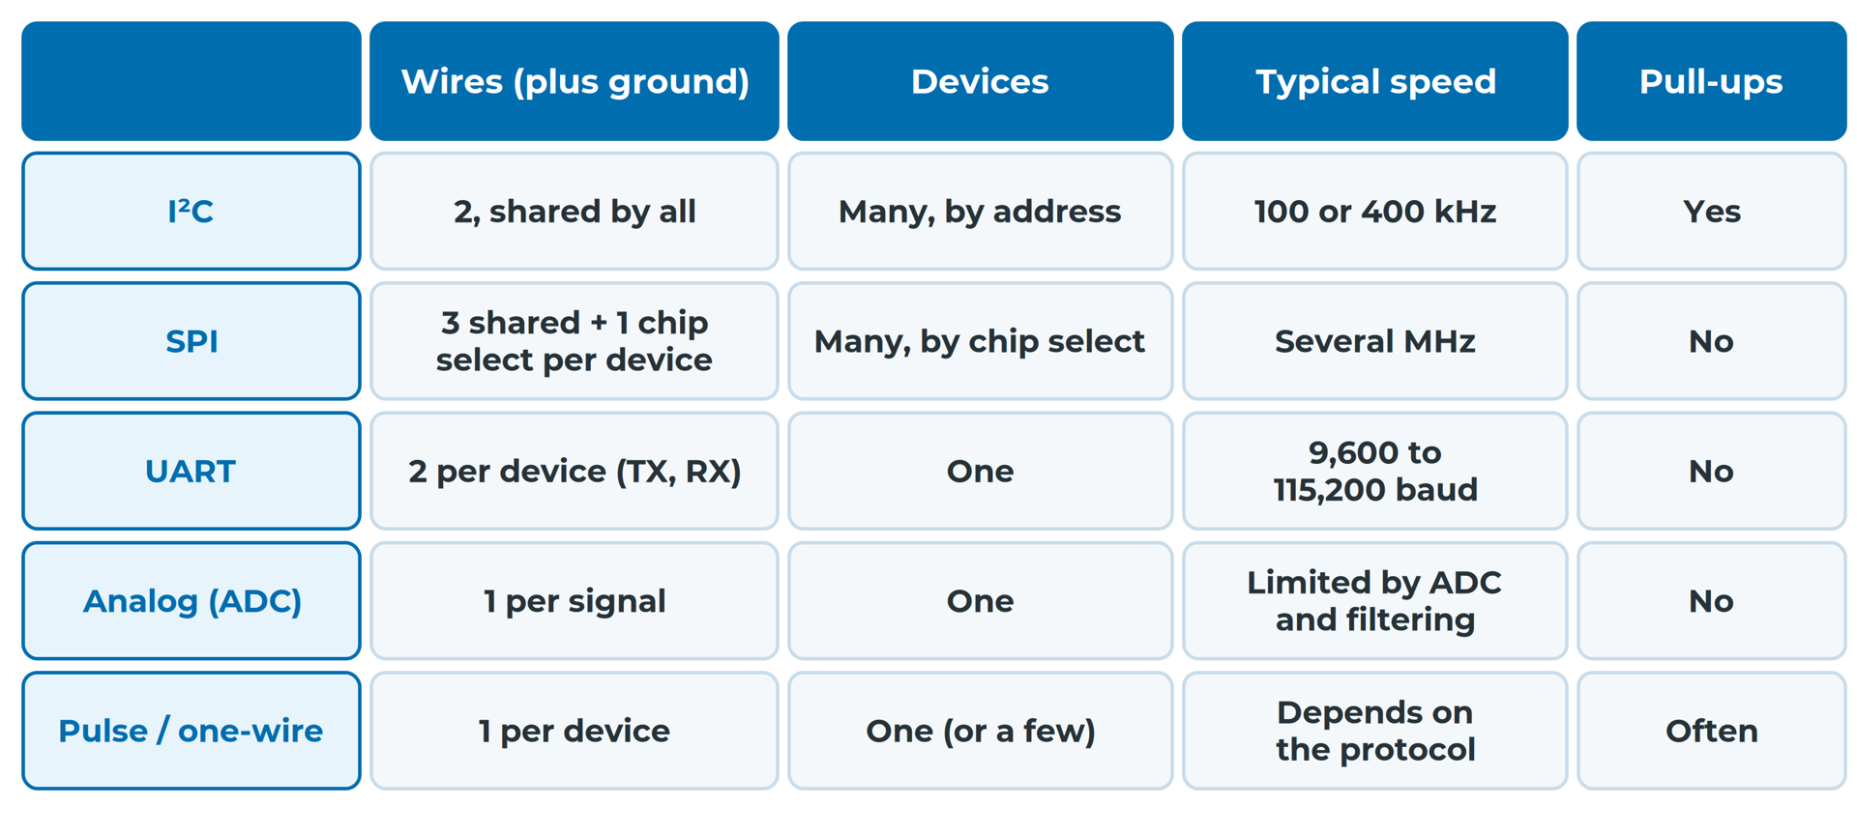
Sensing & Hardware Architecture
Five interfaces, side by side
Typical values; your parts' datasheets decide
Notes:
Pins cost more than speed on a small board. Sharing is both the strength and the weakness of a bus: devices share bus time, pull-ups and the fate of the bus. And some interfaces cannot read back: the SSD1306 in SPI mode allows only write operations. Read more: B1 — Talking to Sensors: Choosing the Interface
Sources: B1#the-interfaces-side-by-side

Slide 10
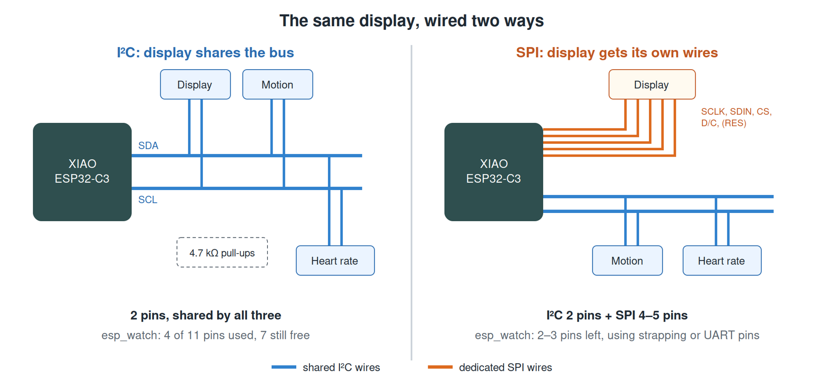
Sensing & Hardware Architecture
Keep the display on I²C
SPI: about 30 times faster, but 4 to 5 pins
They would need a strapping pin or the debug UART
The real problem was bus time, not bus speed
Redraw only on change: no pins, no hardware
The same display, wired two ways
Notes:
One full screen at 10 MHz SPI takes 0.82 ms, against about 25 ms on I²C at 400 kHz. For each peripheral, ask what the part offers, how many pins you can spend, how much data, how many devices share the connection, how far it travels and how it fails. Writing down the reasoning lets someone make the call later. Read more: B1 — Talking to Sensors: Choosing the Interface
Sources: B1#worked-example-should-espwatchs-display-move-to-spi, B1#choosing-peripheral-by-peripheral

Slide 11
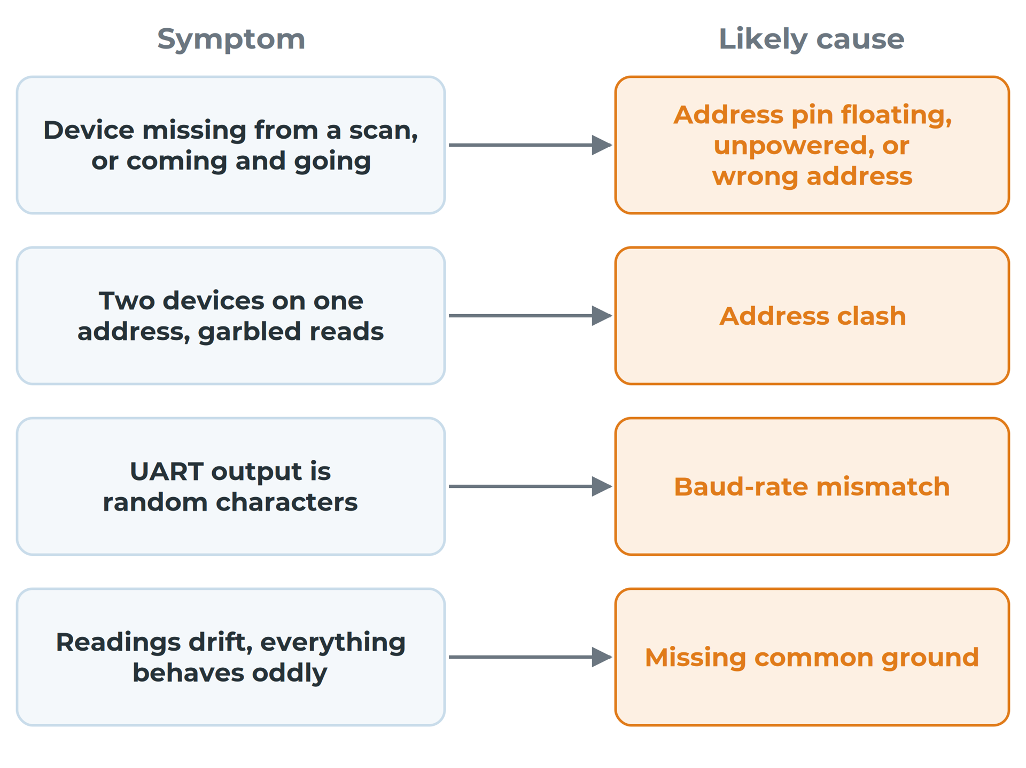
Sensing & Hardware Architecture
Read the fault from its symptom
esp_watch: floating AD0 made the motion sensor come and go
Floating ADC pins read 142 mV; it looks like data
A write-only display can hide a broken bus
Judge the bus by a device you read from
Most interface faults come down to a handful of causes
Notes:
With the motion sensor's AD0 unconnected, it appeared and disappeared between scans, with 6% to 80% of reads failing. An analog reading from a floating pin looks like data. Because nothing is read back from a write-only display, check the bus with a device you read from. Read more: B1 — Talking to Sensors: Choosing the Interface
Sources: B1#when-interfaces-fail

Slide 12
Hardware and Electrical Architecture
Notes:
Sources: B2, B3

Slide 13
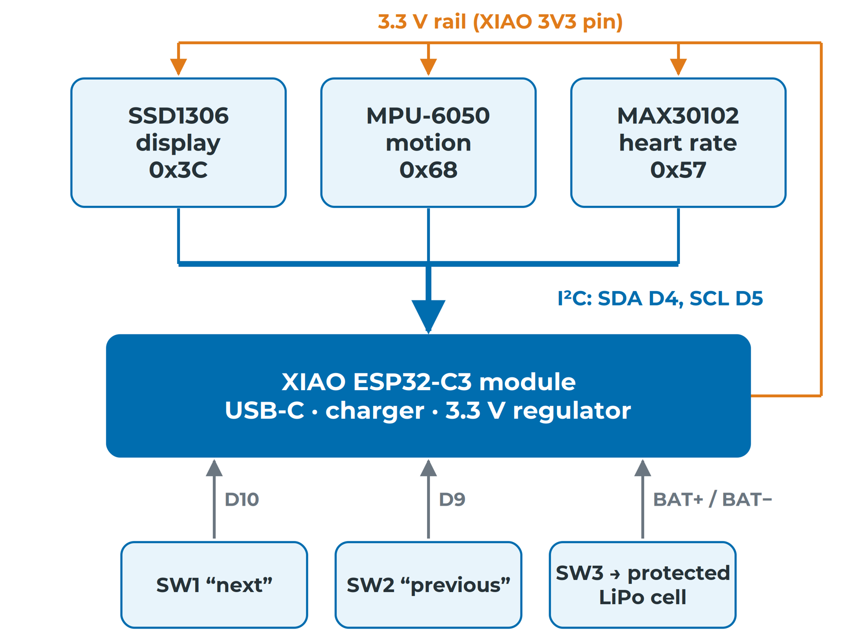
Sensing & Hardware Architecture
One box per part, one bus drawn shared
One box per physical part or module
Every connection recorded, including power and ground
Each line labelled: I²C, INT, 3V3, analog
Three devices on one bus: one bus, three taps
esp_watch's hardware block diagram (ground lines not drawn)
Notes:
The block diagram sits between the subsystem breakdown and the schematic. It is not a sketch to throw away: it is the document you check the schematic against. A schematic connection the block diagram lacks is either an undocumented decision or a mistake. Read more: B2 — Hardware Architecture and Block Diagram
Sources: B2#what-a-hardware-block-diagram-shows, B2#the-block-diagram

Slide 14
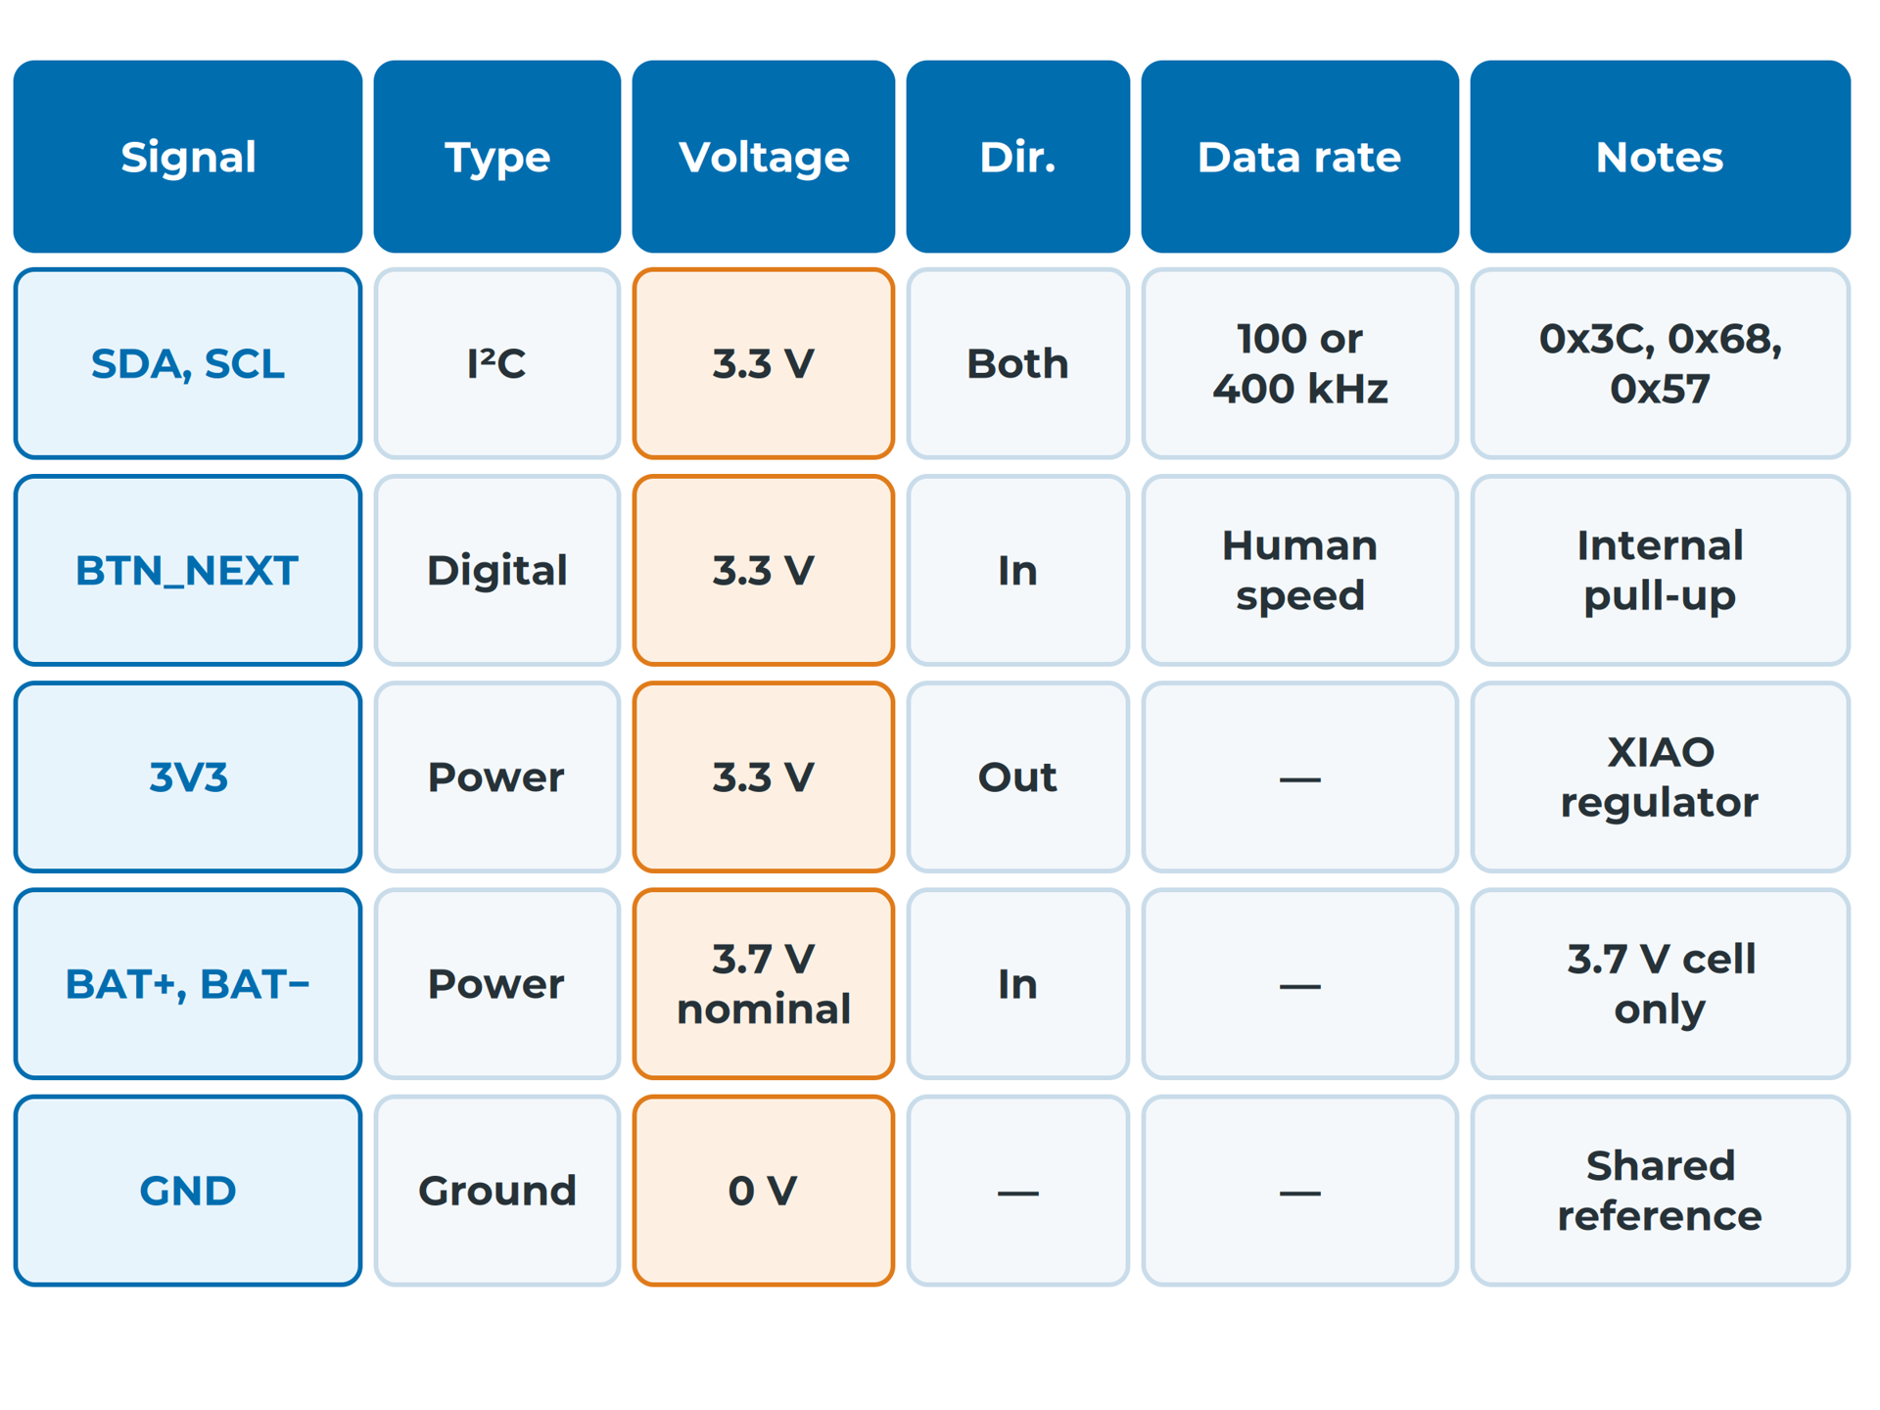
Sensing & Hardware Architecture
Every connection gets a table row
Columns: signal, from → to, type, voltage, direction, data rate, notes
The voltage column catches 5 V meeting a 3.3 V pin
Record the voltage of a module's I²C lines
Write "AD0 tied to GND", not just "0x68"
Part of esp_watch's interface table
Notes:
The block diagram shows that two blocks connect; the interface table says exactly how. A green MAX30102 module held the shared bus at 1.82 V instead of 3.3 V, and powering the MPU-6050 module from 5 V stopped it responding. The data-rate column is the one students skip. Read more: B2 — Hardware Architecture and Block Diagram
Sources: B2#the-interface-table, B2#the-interface-table-1, B2#what-the-reference-watch-learned-the-hard-way

Slide 15
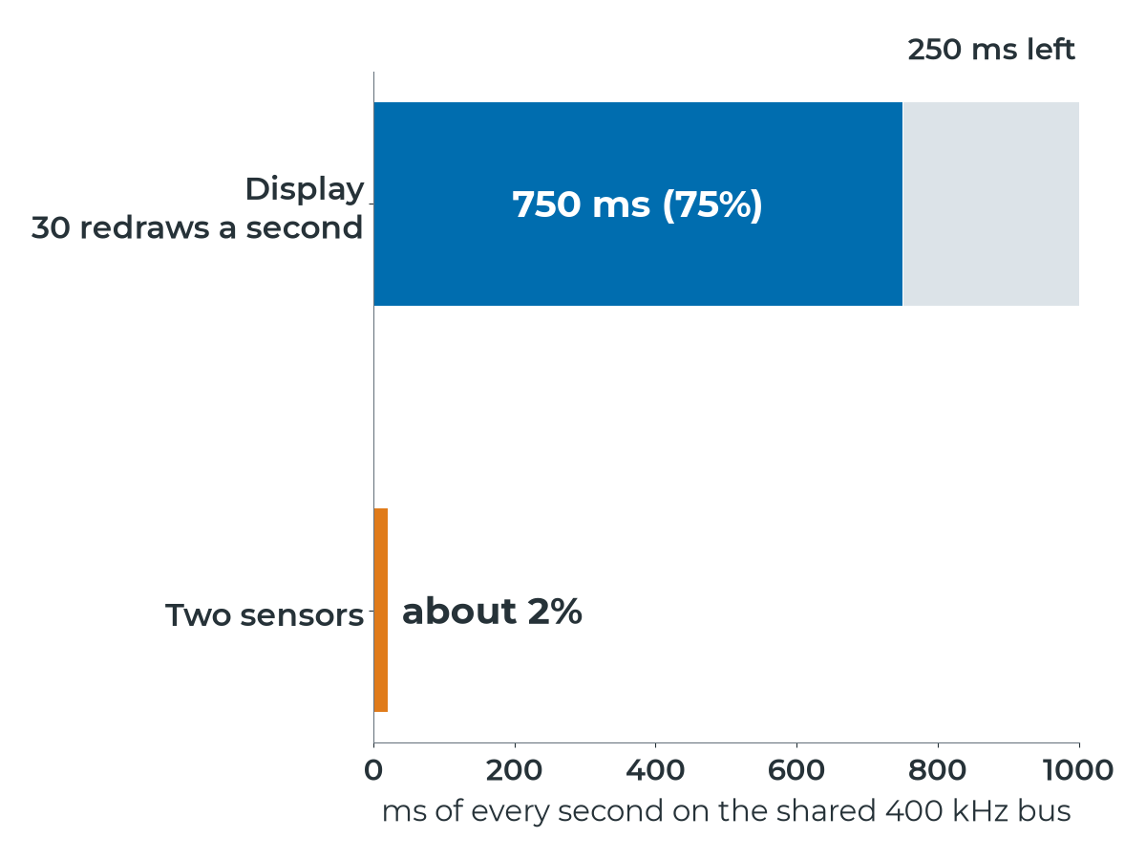
Sensing & Hardware Architecture
A constant redraw eats 75% of the bus
Full screen: 1,024 bytes × 9 clocks = 9,216 clocks
400 kHz: 23 ms predicted, about 25 ms measured
The two sensors need about 2% of the bus
Redraw the display only when something on it changes
Display redrawn 30 times a second, at 400 kHz
Notes:
On I²C every byte is followed by an acknowledge bit, so each byte takes 9 clock pulses. The prediction is close at both speeds; at 400 kHz the ignored overheads become a bigger share. One decision, visible from a data-rate column, protects the sensors' share of the bus. Read more: B2 — Hardware Architecture and Block Diagram
Sources: B2#worked-example-predicting-a-display-update

Slide 16
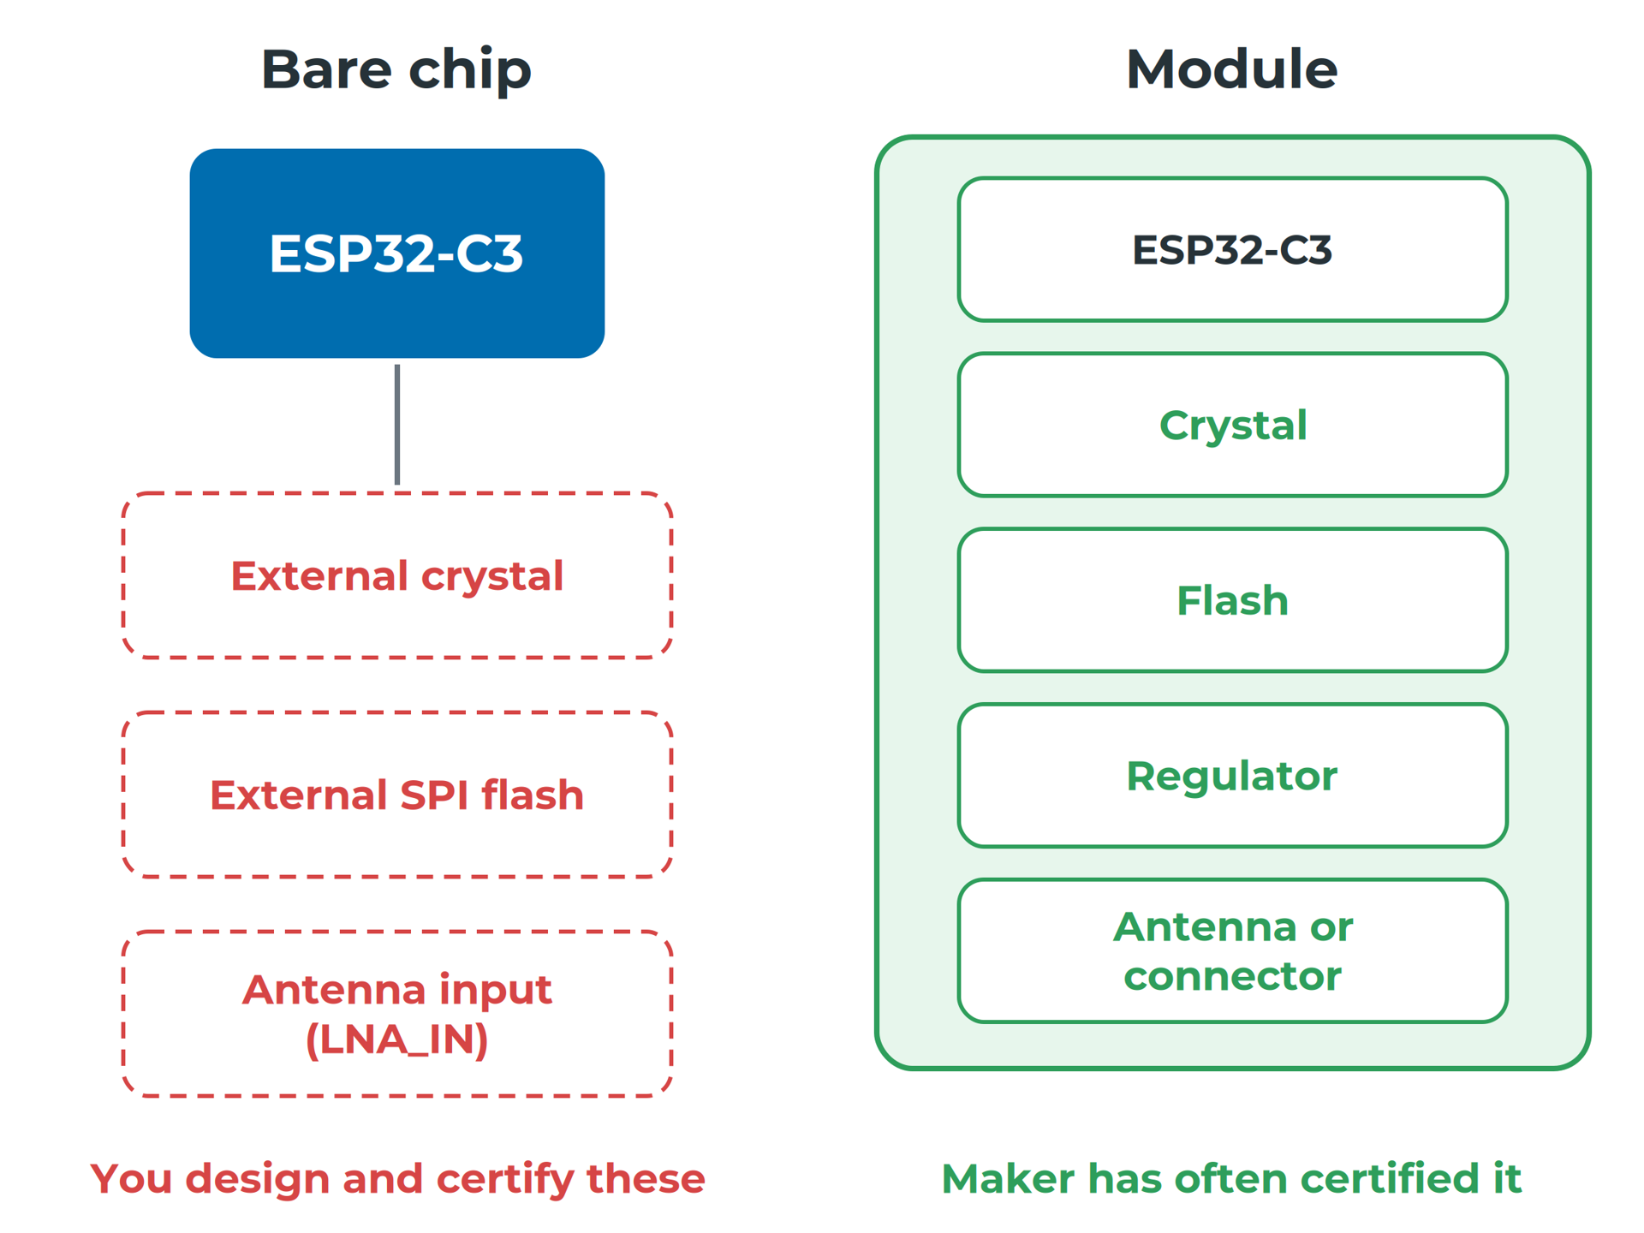
Sensing & Hardware Architecture
Choose a module for a first product
Choose a class first: flash, RAM, pins, radio
Count pins from the interface table, plus 20%
Radio products need approval before sale in India
A pre-certified module saves most of that work
A module has the crystal, flash and antenna already inside
Notes:
esp_watch uses the Seeed Studio XIAO ESP32-C3: WiFi and Bluetooth, 400 KB of SRAM, 4 MB of flash and 11 pins. Its interface table needs only four signal pins. The XIAO carries an FCC certification, which is the work a module saves you. Read more: B3 — Electrical Architecture: MCU, Power, Buses and Pins
Sources: B3#what-do-you-actually-need, B3#module-or-bare-chip

Slide 17
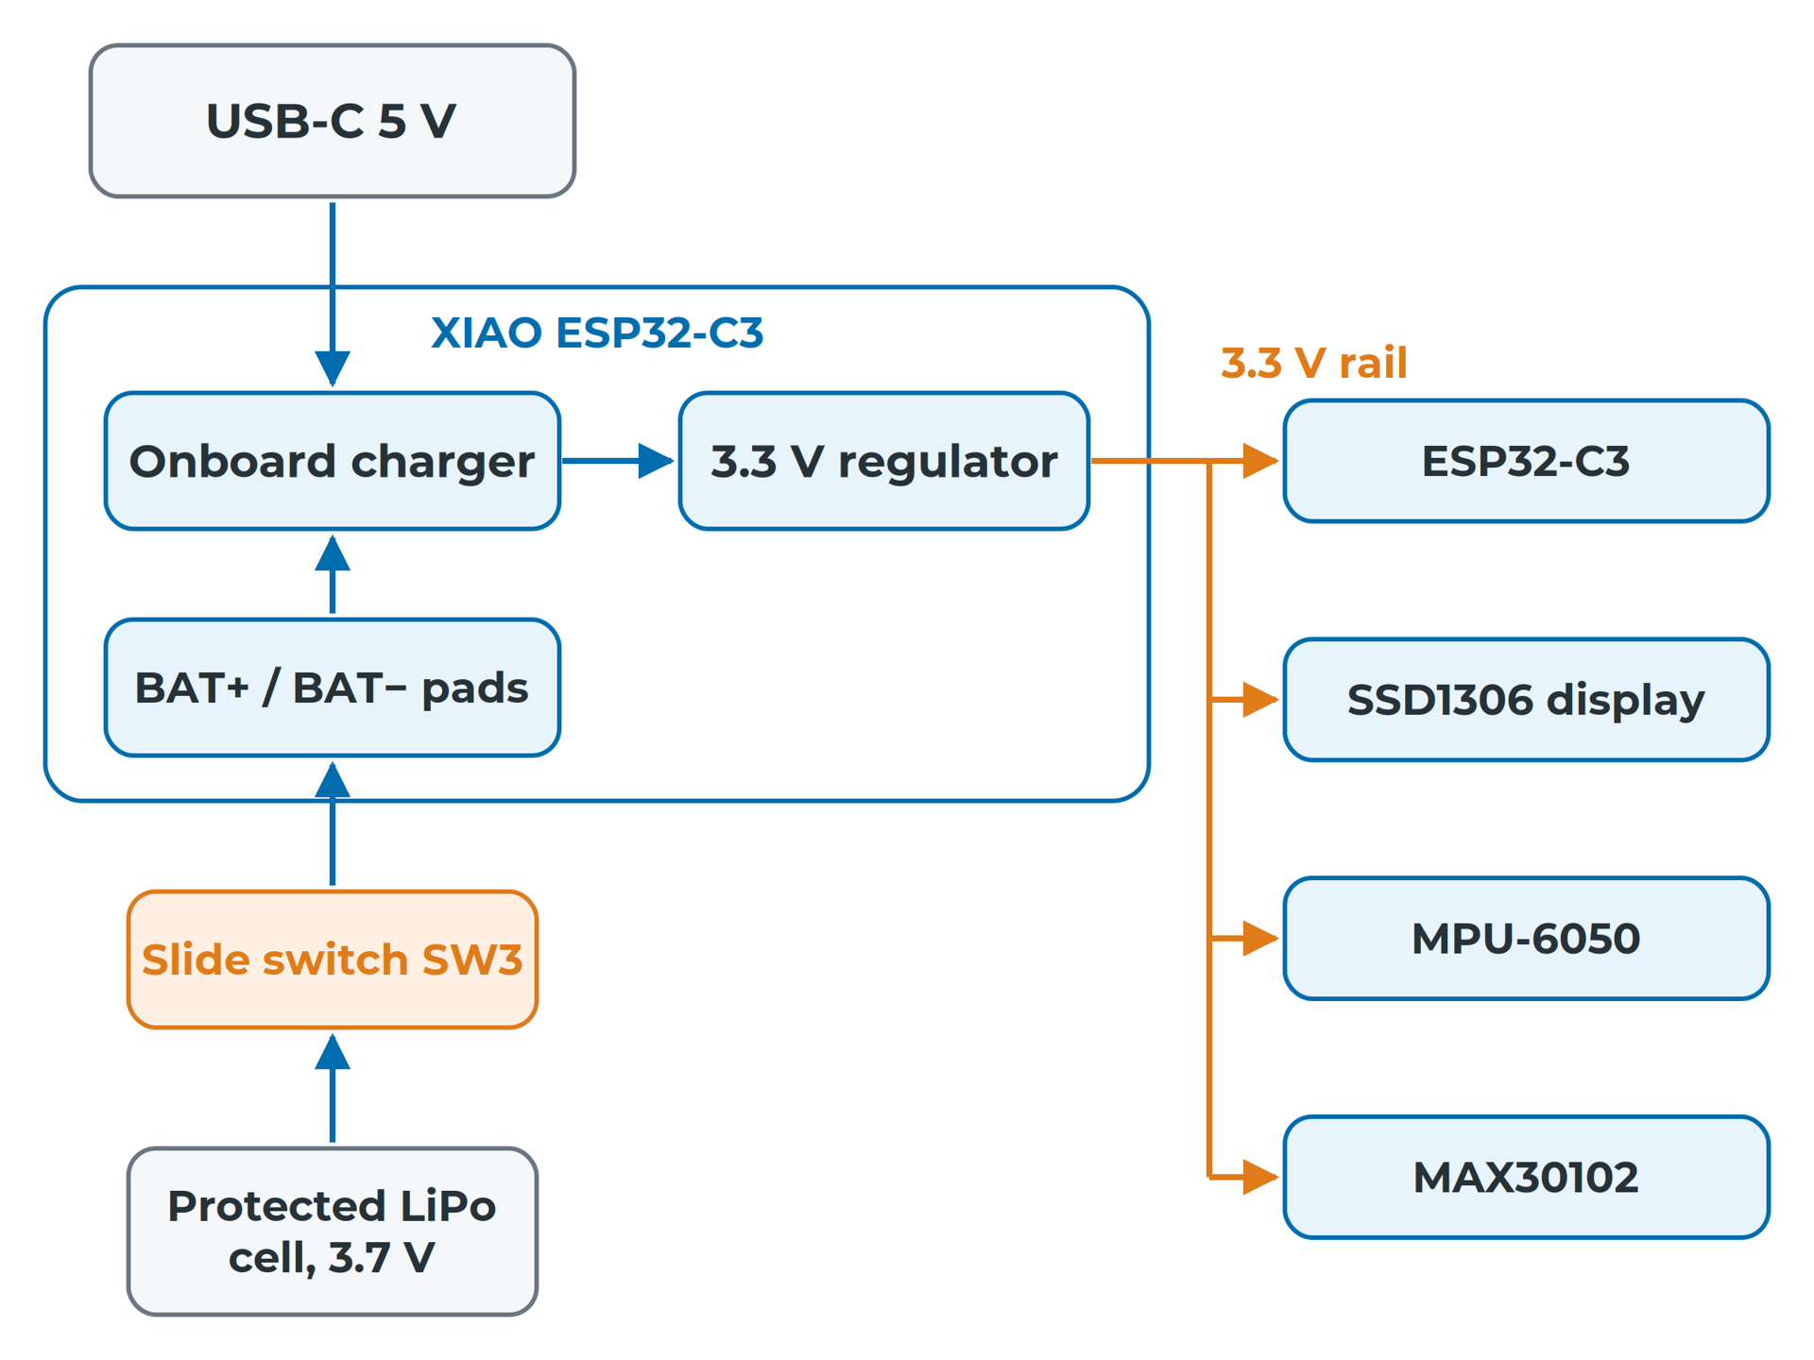
Sensing & Hardware Architecture
Draw the power tree first
Every source, conversion and switch, to every load
Switch off, USB in: the watch runs but cannot charge
No battery divider: no battery level, no warning
Most modules carry decoupling; check, don't add by habit
esp_watch's power tree
Notes:
The charger and regulator are on the XIAO. The slide switch sits between the cell and the BAT pads, so with it off the cell is disconnected from everything, including the charger. Seeed lists a maximum 3.3 V output current of 500 mA; the largest modelled load, a WiFi burst, averages about 100 mA. Read more: B3 — Electrical Architecture: MCU, Power, Buses and Pins
Sources: B3#the-power-tree, B3#decoupling-and-protection

Slide 18
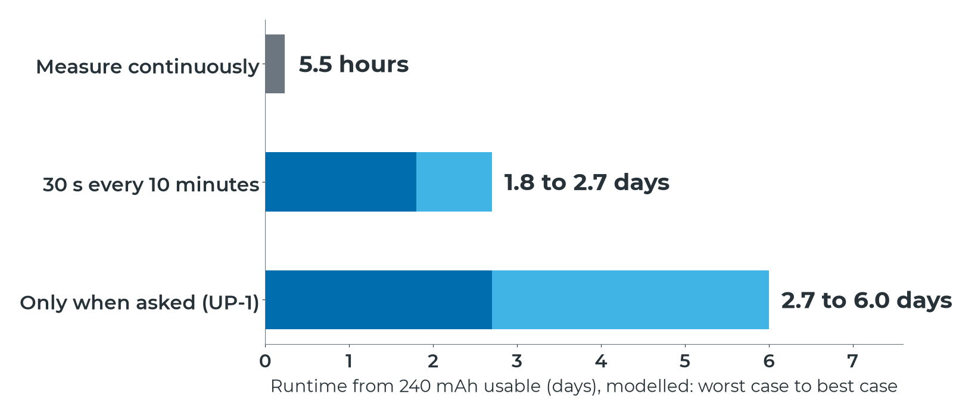
Sensing & Hardware Architecture
Firmware decides hours or days
Same hardware, modelled figures: only the sensor's on-time changes
Notes:
A current budget lists every operating mode, its current and how long the device spends there. esp_watch's figures come from a power model, not from measurement. The electrical architecture sets the ceiling; the firmware decides how close you get to it, so write the budget per mode, not as one number. Read more: B3 — Electrical Architecture: MCU, Power, Buses and Pins
Sources: B3#worked-example-hours-or-days-duty-cycling-the-heart-rate-sensor, B3#the-current-budget

Slide 19
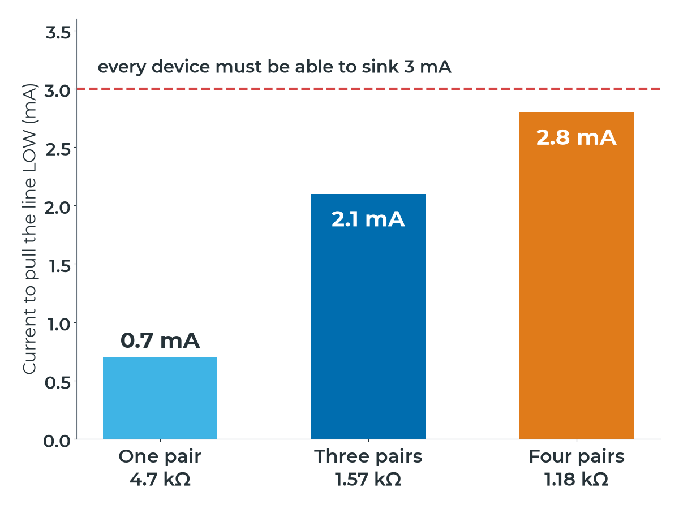
Sensing & Hardware Architecture
Count pull-ups before adding any
Too large: edges rise too slowly. Too small: too much sink current
400 kHz, 50 pF: about 1 kΩ to 7 kΩ is legal
Three modules' 4.7 kΩ pairs: 1.57 kΩ, 2.1 mA
Add a carrier pair: 1.18 kΩ, 2.8 mA, near 3 mA
4.7 kΩ pairs in parallel on a 3.3 V bus
Notes:
I²C lines are open-drain: devices only pull LOW, and a pull-up resistor pulls the line back HIGH. The specification turns both limits into R_min and R_max. esp_watch's carrier board adds no pull-ups: the three modules' own pairs stay fitted. Read more: B3 — Electrical Architecture: MCU, Power, Buses and Pins
Sources: B3#sizing-pull-up-resistors, B3#worked-example-how-many-pull-ups-is-too-many

Slide 20
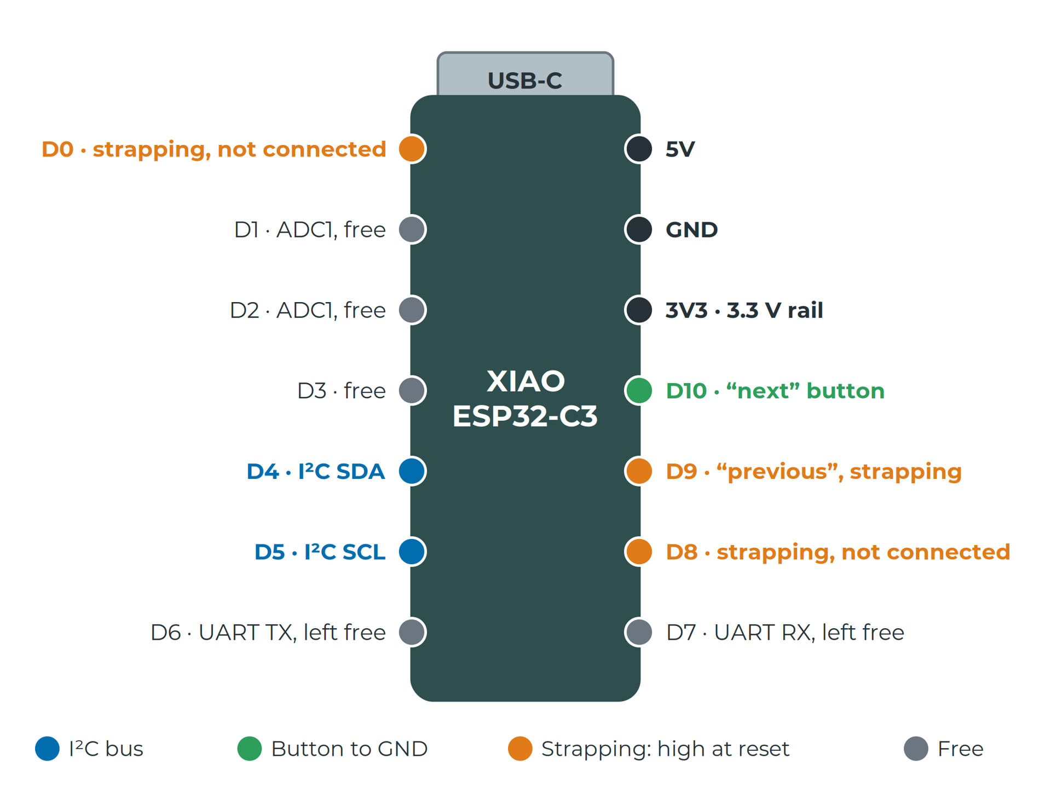
Sensing & Hardware Architecture
Keep strapping pins high at reset
Strapping pins D0, D8 and D9 decide how the chip starts
An interrupt that idles low must stay off them
Analog inputs go on ADC1 pins, D0 to D2
esp_watch: D1, D2 and D3 are fully free
esp_watch's pin map, strapping pins marked
Notes:
Strapping pins are read at the moment the chip starts up. On the ESP32-C3 they are GPIO2, GPIO8 and GPIO9, brought out as D0, D8 and D9; the simplest safe rule is to keep all three high at reset. Espressif no longer supports single ADC2 readings, so use ADC1 for analog. Read more: B3 — Electrical Architecture: MCU, Power, Buses and Pins
Sources: B3#not-all-pins-are-equal, B3#worked-example-espwatchs-pin-map

Slide 21
Parts and Simulation
Notes:
Sources: B4, B5

Slide 22
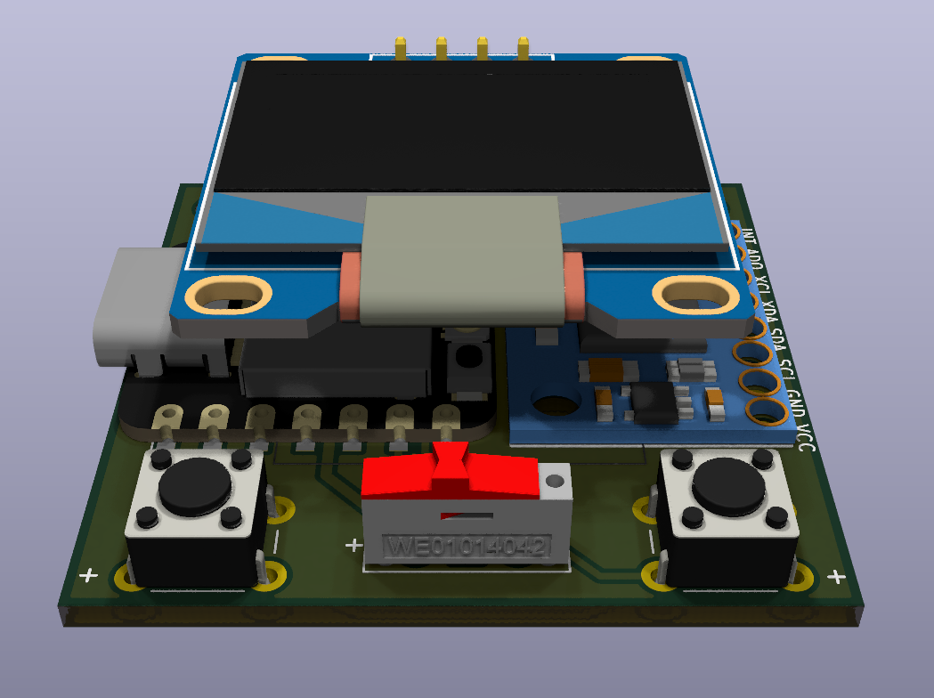
Sensing & Hardware Architecture
Module or chip: decide per part
Module: faster to design with, hand solderable, often certified
Chip: cheaper at volume, smaller; you own the circuit
Ask: does it fit? Can we assemble it? What quantity?
esp_watch: modules for every active part, so it is thick
The display module stands above the other modules
Notes:
A marketplace module has no datasheet of its own, no revision history and no promise that next month's batch is the same design. For a first, hand-soldered design, a module is often the correct engineering choice; what matters is that you can say why. Read more: B4 — Component Selection: Modules or Discrete ICs?
Sources: B4#what-you-gain-and-what-you-give-up, B4#deciding-per-part

Slide 23
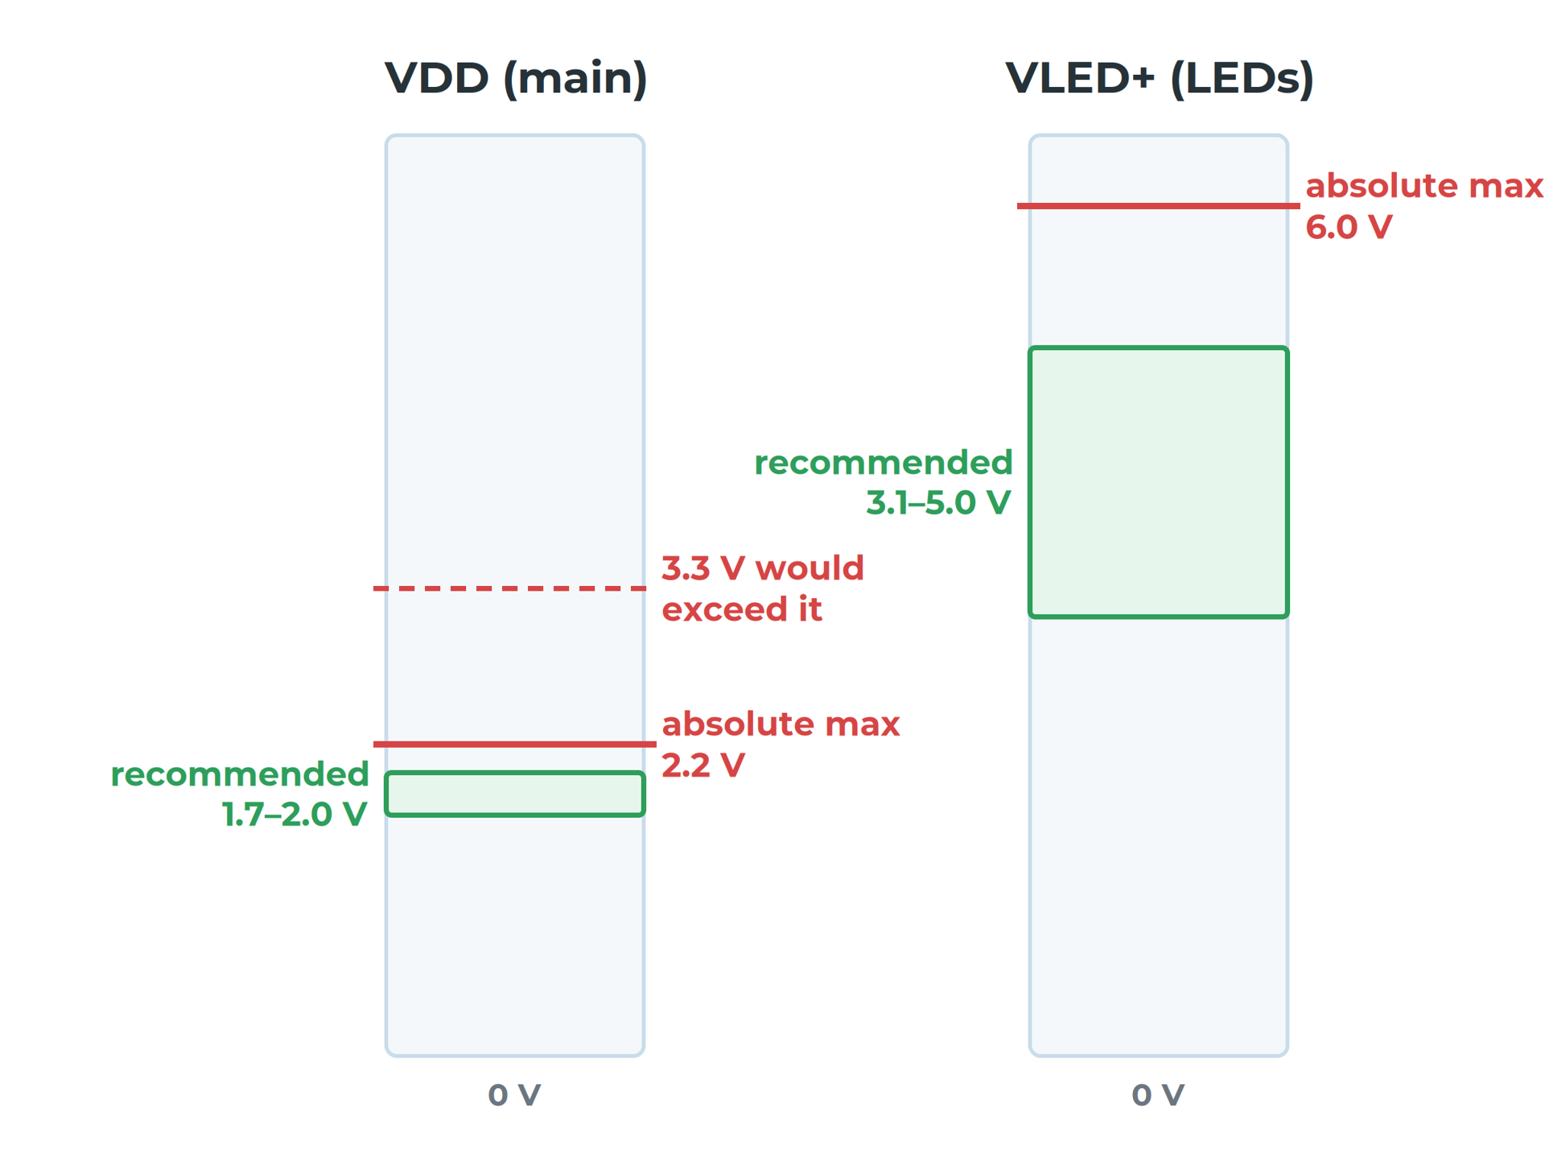
Sensing & Hardware Architecture
Absolute maximum is a damage limit
Recommended operating conditions: guaranteed to work as specified
MAX30102 VDD: 1.7 to 2.0 V; absolute maximum 2.2 V
A module's listing is not the chip's datasheet
Find how a module's pull-up voltage is set
MAX30102: two supplies, two different ranges
Notes:
Absolute maximum ratings are where the part may be permanently damaged; they are not operating conditions. The MAX30102 needs two supplies, so a module built around it must generate 1.8 V somewhere. esp_watch's green module tied its I²C lines to 1.8 V and broke the bus; the black one used 3.3 V and worked. Read more: B4 — Component Selection: Modules or Discrete ICs?
Sources: B4#absolute-maximum-vs-recommended-operating-conditions, B4#the-modules-listing-is-not-the-chips-datasheet

Slide 24
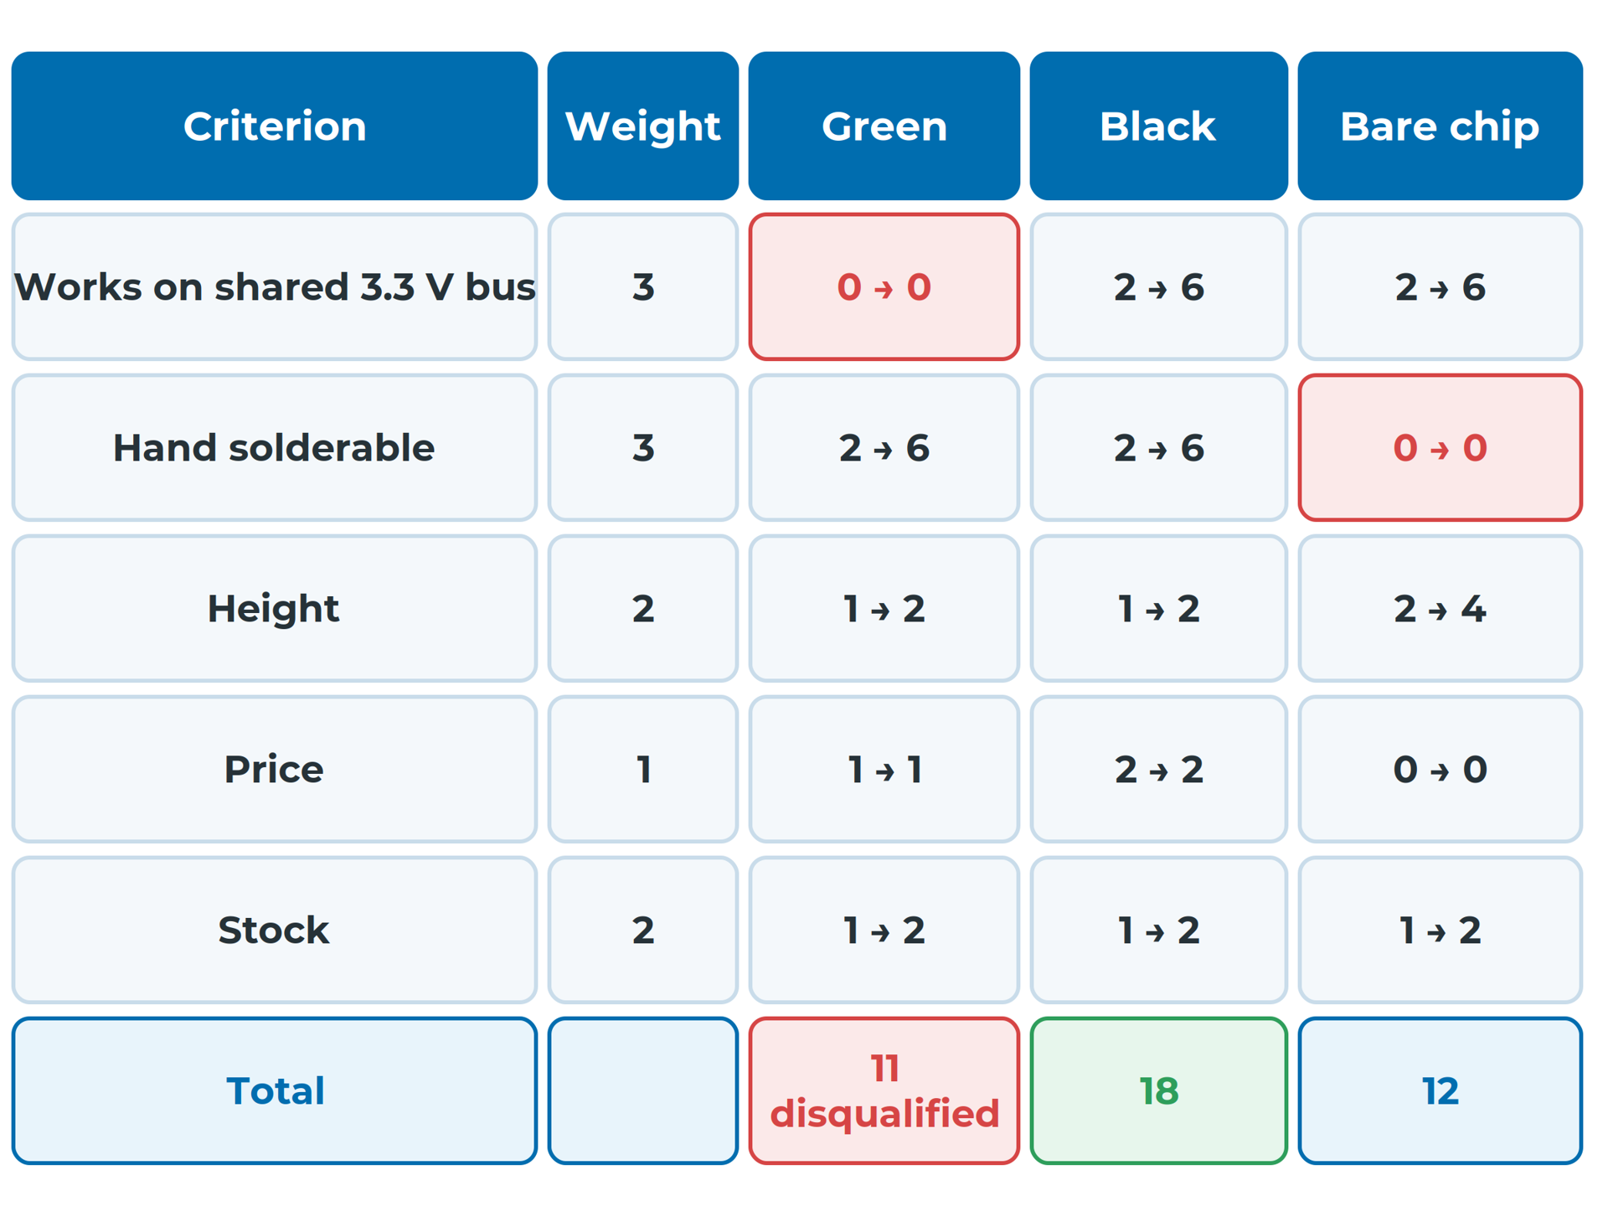
Sensing & Hardware Architecture
A zero on a critical row disqualifies
Criteria from your spec, not the product page
Black wins: it scores on both critical criteria
Record stock at more than one supplier, dated
Preliminary BOM: price at 1 and 10, lifecycle, second source
Three ways to measure heart rate, weighted
Notes:
Weights run from 1, minor, to 3, critical; scores from 0, fails, to 2, good. A matrix makes your reasoning visible but does not make the decision for you. On the day the unit was written, three of esp_watch's four modules were out of stock at Robu, so a second supplier is not a luxury. Read more: B4 — Component Selection: Modules or Discrete ICs?
Sources: B4#the-comparison-matrix, B4#worked-example-three-ways-to-measure-heart-rate, B4#parametric-search-and-stock, B4#the-preliminary-bom

Slide 25
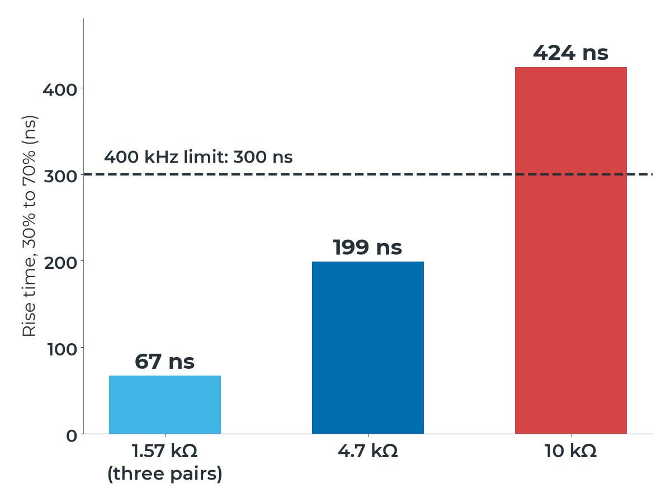
Sensing & Hardware Architecture
Pull-up size sets the rise time
Falstad shows voltages and edges; Wokwi runs your firmware
Rise time from 30% to 70% is 0.8473 × R × C
Limit: 300 ns at 400 kHz, 1,000 ns at 100 kHz
10 kΩ may seem to work, with less margin for noise
Rise time on a 50 pF bus, against the 400 kHz limit
Notes:
A resistor charging a capacitor produces a curve, not a step. 4.7 kΩ passes at 400 kHz with margin; 10 kΩ breaks the 300 ns limit but passes easily at 100 kHz; 1.57 kΩ gives very fast edges but asks every device to sink more current. Build all three in Falstad and compare the scopes. Read more: B5 — Virtual Prototyping
Sources: B5#two-simulators-two-questions, B5#pull-up-rise-time, B5#worked-example-three-pull-up-values

Slide 26
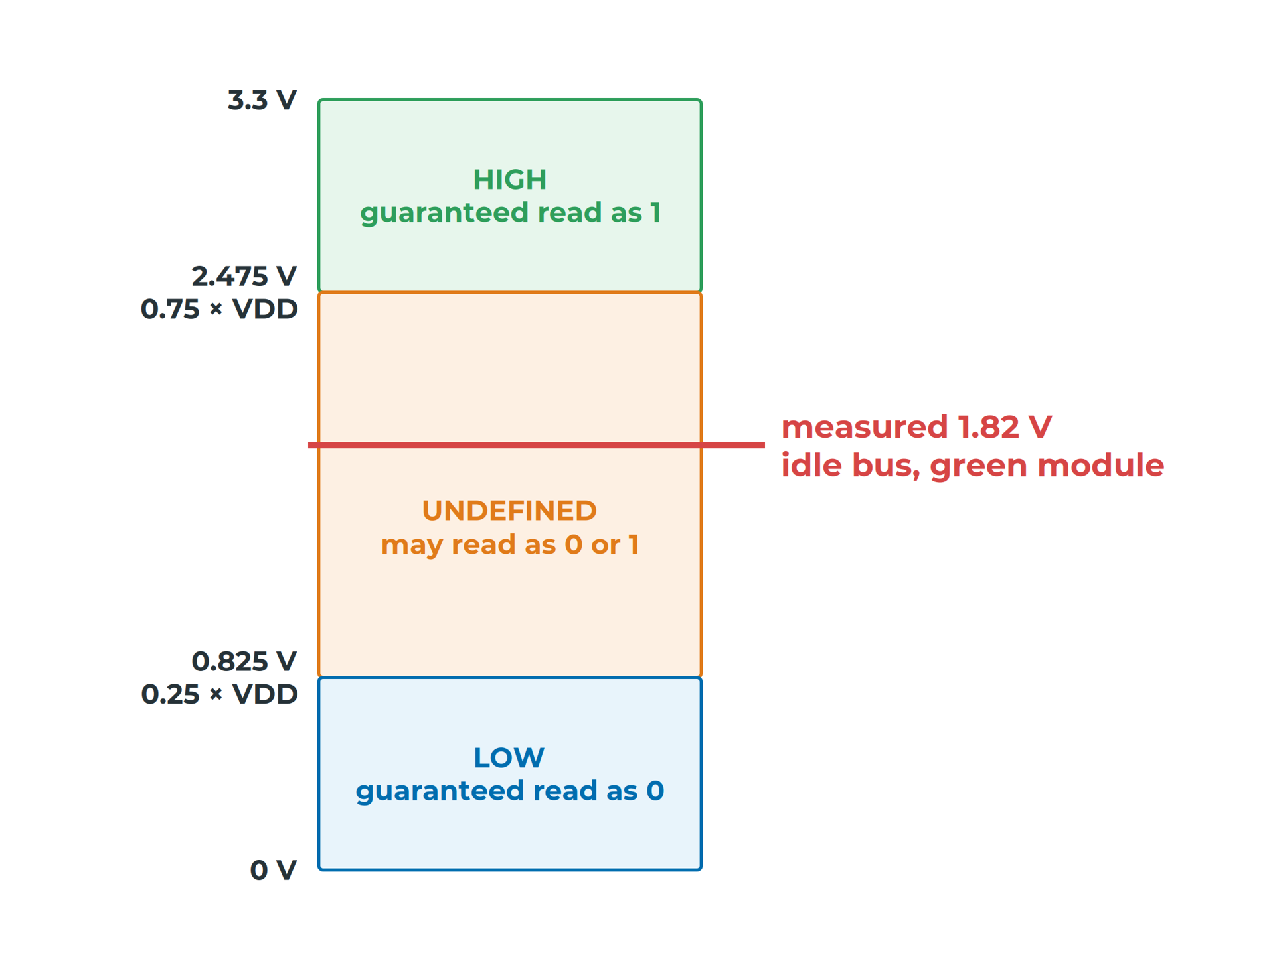
Sensing & Hardware Architecture
1.82 V sits in the undefined band
ESP32-C3: HIGH above 0.75 × VDD, LOW below 0.25 × VDD
The green module held the idle bus at 1.82 V
80% failures on one device, not a clean "not working"
Fix: matching module, jumper if present, level shifter
esp_watch's bus with the green module
Notes:
Every device on a bus must agree on the voltage that means HIGH. Sometimes a receiver read the idle line as HIGH, sometimes as LOW, which produces 80% failures on one device and occasional success on another. The fixes, in order: a module whose bus sits at your voltage, its pull-up jumper, or a bidirectional level shifter. Read more: B5 — Virtual Prototyping
Sources: B5#when-the-bus-sits-at-the-wrong-voltage, B3#bus-voltage-and-addresses

Slide 27
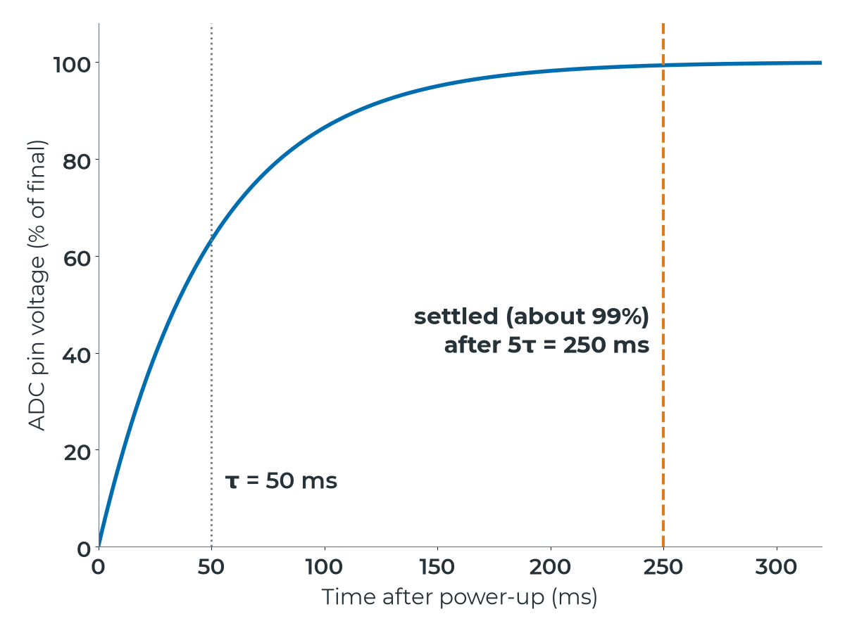
Sensing & Hardware Architecture
Wait for the divider; watch the dip
Example values: τ = 500 kΩ × 100 nF = 50 ms
Settled after about 250 ms; wait before trusting a reading
A battery's voltage drops when current is drawn
A radio burst on a low cell can dip the 3.3 V rail
Example values: 1 MΩ / 1 MΩ divider, 100 nF
Notes:
esp_watch does not measure its battery, but many battery products do, with a divider. A reading in the first 250 ms after power-up will be low. With example values, below about 3.65 V at rest a 300 mA radio burst pulls the regulator's input too low; if the rail dips far enough, the brownout detector resets the microcontroller. Read more: B5 — Virtual Prototyping
Sources: B5#a-battery-dividers-settling-time, B5#supply-dips-under-load

Slide 28
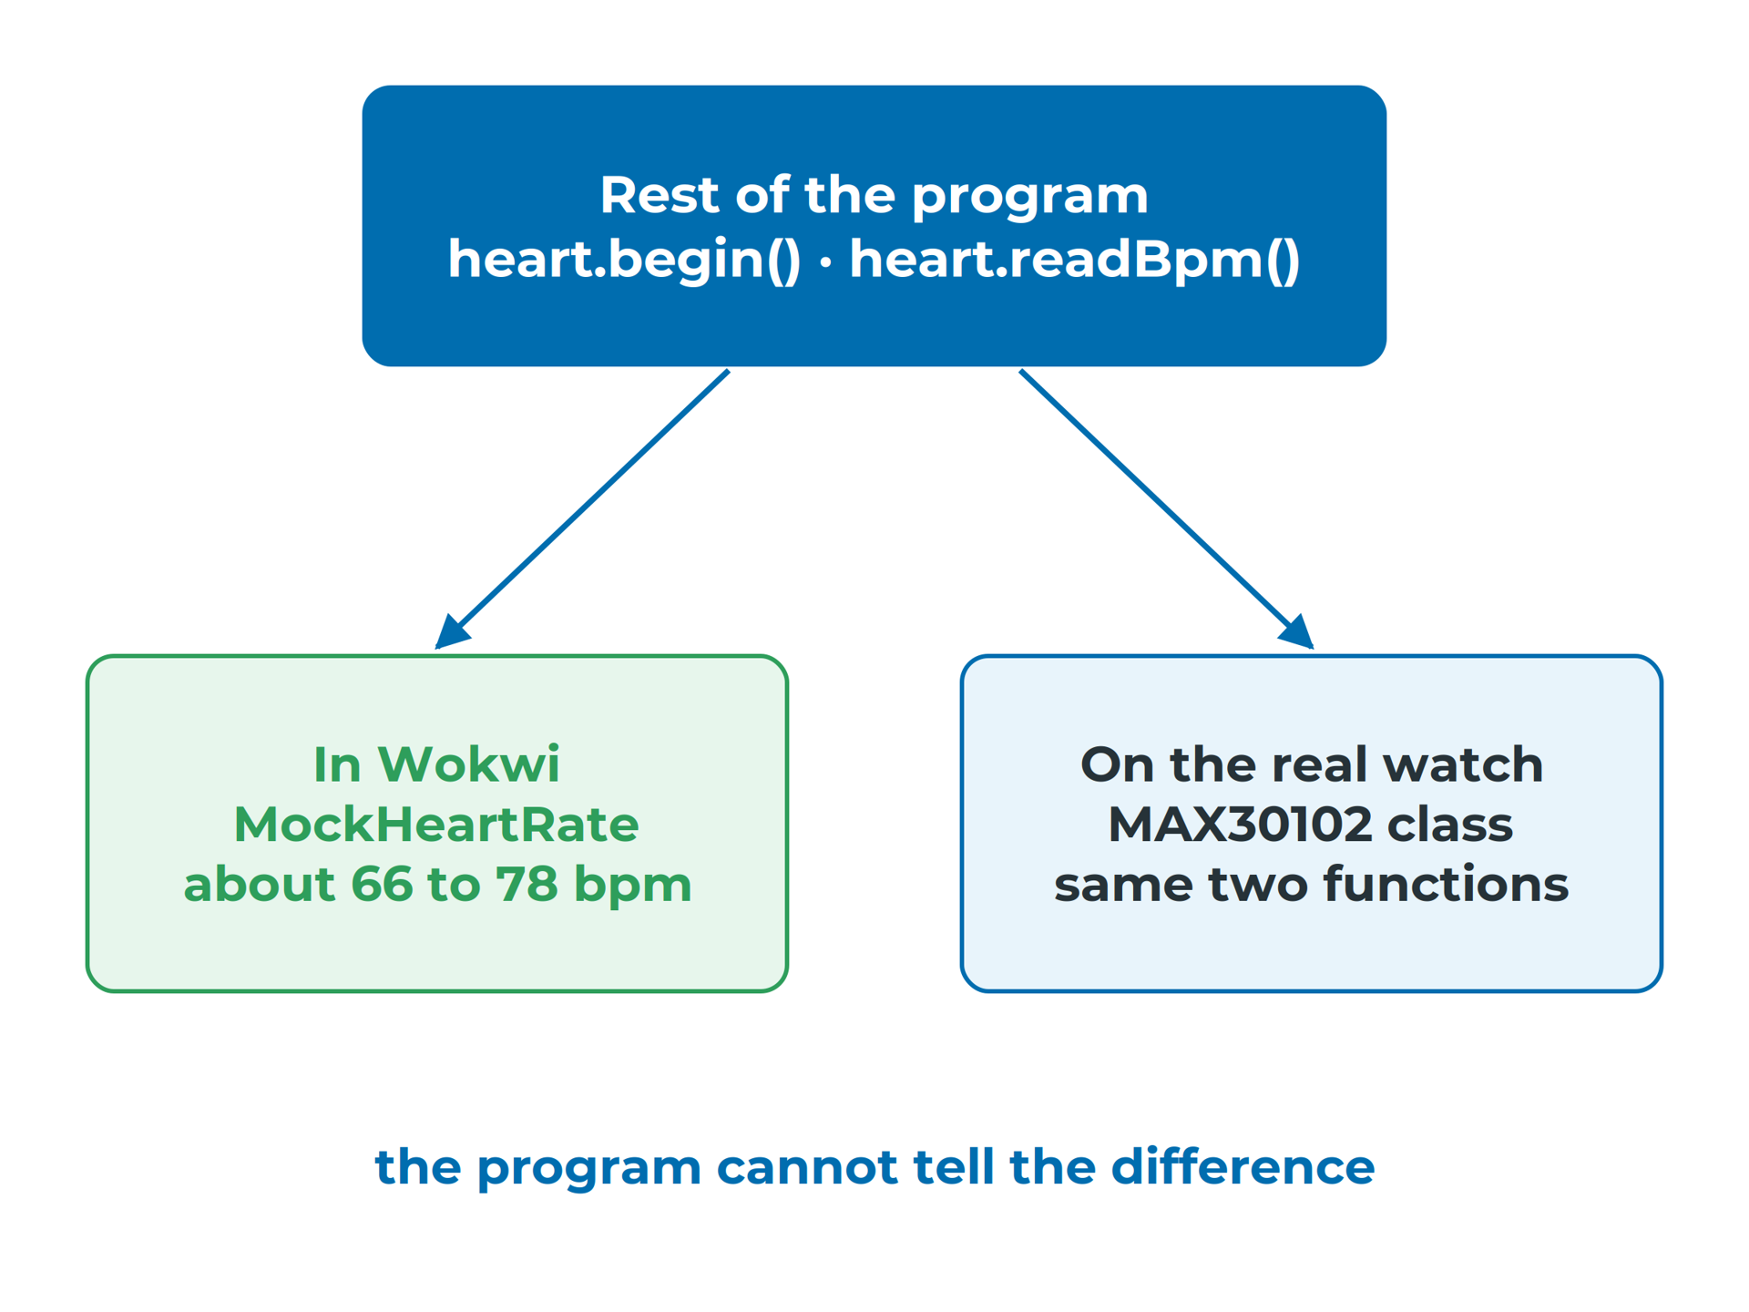
Sensing & Hardware Architecture
A mock stands in for the missing sensor
Wokwi runs real Arduino code on a simulated XIAO ESP32-C3
Wokwi has no MAX30102
A mock class returns made-up but realistic values
The real class replaces the mock; nothing else changes
Same two functions, so the program cannot tell
Notes:
Wokwi simulates the ESP32-C3, the SSD1306, the MPU-6050 and pushbuttons, so the sketch you test is the sketch you would flash. The mock returns a heart rate that drifts slowly between about 66 and 78 bpm. The bus scan should find 0x3C and 0x68, but not 0x57, because the mock has no bus address. Read more: B5 — Virtual Prototyping
Sources: B5#building-the-virtual-watch, B5#the-mock-sensor

Slide 29
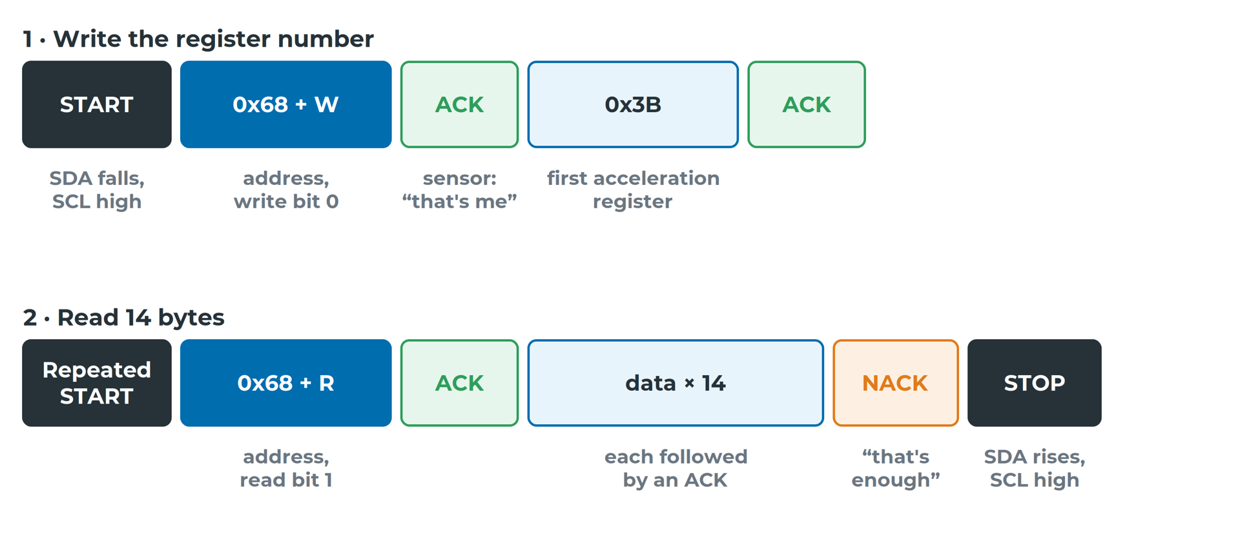
Sensing & Hardware Architecture
Read a trace from START to STOP
17 bytes × 9 clocks ≈ 0.4 ms at 400 kHz
Notes:
The Wokwi logic analyser saves a .vcd file; open it in PulseView and add the I²C decoder. One screen update takes as long as about 65 sensor reads, which confirms B2 from the other direction: on a shared bus, the display is the heavy user. Read more: B5 — Virtual Prototyping
Sources: B5#what-an-i²c-transaction-looks-like, B5#worked-example-how-long-does-one-sensor-read-take

Slide 30
Sensing & Hardware Architecture
Write down what you did not simulate
"Passed in Wokwi" means the logic is right, not that the voltages are.
Notes:
esp_watch's two worst breadboard faults, a floating address pin and a module on the wrong voltage, fall between the two tools. Next to each simulation result, write down what it did not include, so the funded build knows what to check first. Read more: B5 — Virtual Prototyping
Sources: B5#what-each-simulator-cannot-tell-you, B5#what-comes-next

Slide 31
Sensing & Hardware Architecture
Recap
B0–B1 · Choose the measurand first, then the interface, with reasons
B2–B3 · Draw every wire; budget power, pull-ups and pins
B4–B5 · Choose parts by their limits; simulate, then list the gaps
Notes:
Together these turn the subsystem breakdown into a block diagram, interface table and parts list the schematic is built from.
Sources: B0, B1, B2, B3, B4, B5

