Slide 1
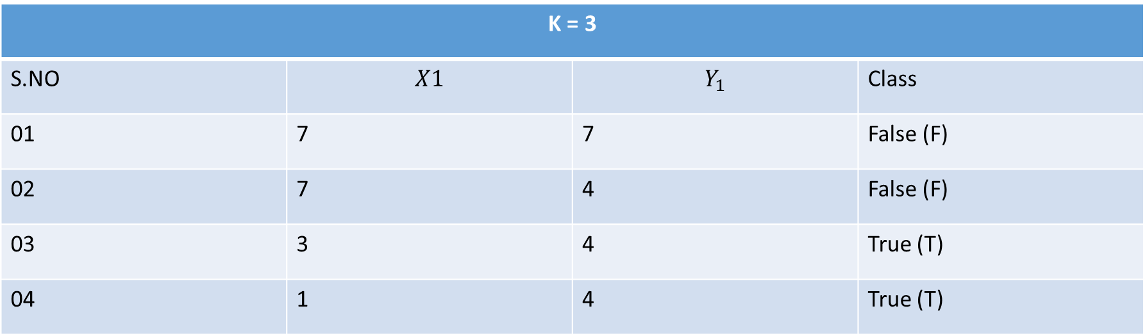
KNN (K Nearest Neighbor Algorithm)
$$Eucleadian Distance Formula=E.D= \sqrt{{(X − X_{1})}^{2}+{(Y − Y_{1})}^{2}}$$
K = 3
S.NO | $$X﷮1$$ | $$Y_{1}$$ | Class
01 | 7 | 7 | False (F)
02 | 7 | 4 | False (F)
03 | 3 | 4 | True (T)
04 | 1 | 4 | True (T)
$Predict (X=3, Y=7, belong to which class$)

Slide 2
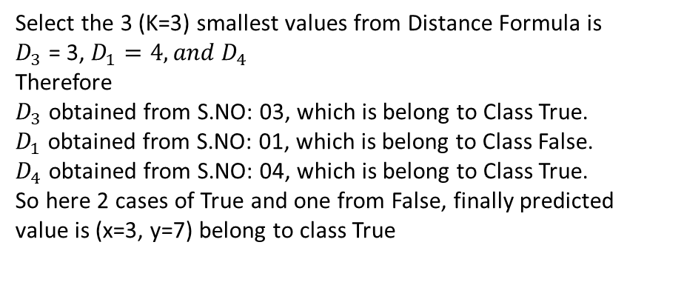
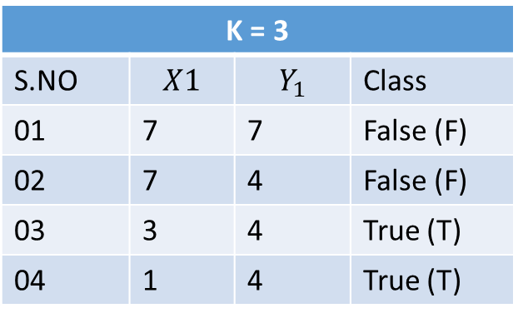




KNN (K Nearest Neighbor Algorithm)
$$Eucleadian Distance Formula=D= \sqrt{{(X − X_{1})}^{2}+{(Y − Y_{1})}^{2}}$$
Step-01:
$Predict (X=3, Y=7, belong to which class$)
$$D_{1}= \sqrt{{(X − X_{1})}^{2}+{(Y − Y_{1})}^{2}}= \sqrt{{(3 −7)}^{2}+{(7 −7)}^{2}}$$
$$D_{1}= \sqrt{{(−4)}^{2}+{(0)}^{2}}=\sqrt{16}=4$$
K = 3
S.NO | $$X﷮1$$ | $$Y_{1}$$ | Class
01 | 7 | 7 | False (F)
02 | 7 | 4 | False (F)
03 | 3 | 4 | True (T)
04 | 1 | 4 | True (T)
Step-02:
$$D_{2}= \sqrt{{(X − X_{1})}^{2}+{(Y − Y_{1})}^{2}}= \sqrt{{(3 −7)}^{2}+{(7 −4)}^{2}}$$
$$D_{2}= \sqrt{{(−4)}^{2}+{(3)}^{2}}=\sqrt{16+9}=\sqrt{25}=5$$
Step-03:
$$D_{3}= \sqrt{{(X − X_{1})}^{2}+{(Y − Y_{1})}^{2}}= \sqrt{{(3 −3)}^{2}+{(7 −4)}^{2}}$$
$$D_{3}= \sqrt{{(0)}^{2}+{(3)}^{2}}=\sqrt{9}=3$$
Select the 3 (K=3) smallest values from Distance Formula is
$D_{3}$ = 3, $D_{1}=4,{and D}_{4}$
Therefore
$D_{3}$ obtained from S.NO: 03, which is belong to Class True.
$D_{1}$ obtained from S.NO: 01, which is belong to Class False.
$D_{4}$ obtained from S.NO: 04, which is belong to Class True.
So here 2 cases of True and one from False, finally predicted value is (x=3, y=7) belong to class True
Step-04:
$$D_{4}= \sqrt{{(X − X_{1})}^{2}+{(Y − Y_{1})}^{2}}= \sqrt{{(3 −1)}^{2}+{(7 −4)}^{2}}$$
$$D_{4}= \sqrt{{(2)}^{2}+{(3)}^{2}}=\sqrt{13}=3.6 ≈4$$

Slide 3
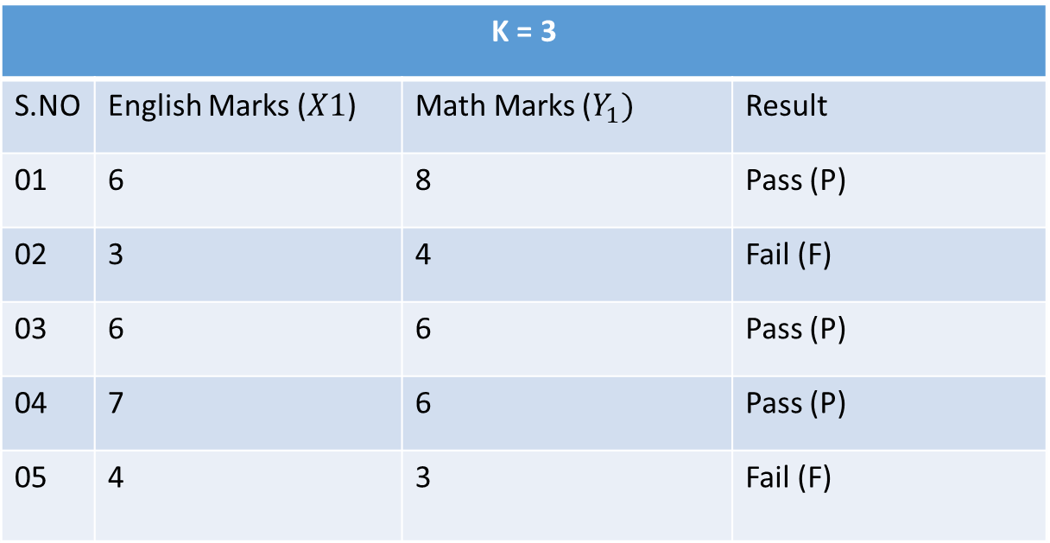
KNN (K Nearest Neighbor Algorithm)
$$Eucleadian Distance Formula=E.D= \sqrt{{(X − X_{1})}^{2}+{(Y − Y_{1})}^{2}}$$
K = 3
S.NO | English Marks ($X﷮1$) | Math Marks ($Y_{1})$ | Result
01 | 6 | 8 | Pass (P)
02 | 3 | 4 | Fail (F)
03 | 6 | 6 | Pass (P)
04 | 7 | 6 | Pass (P)
05 | 4 | 3 | Fail (F)
$$Predict (English (X=8), Math (Y=6), either student is Pass or Fail$$

Slide 4
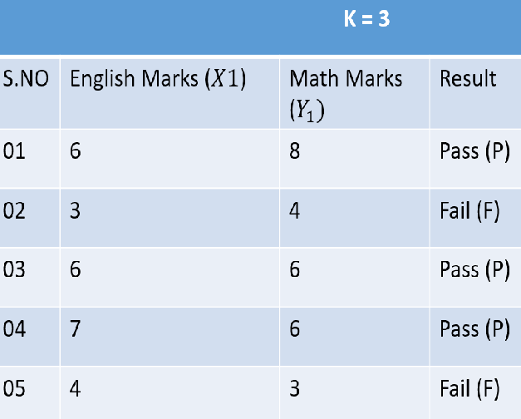
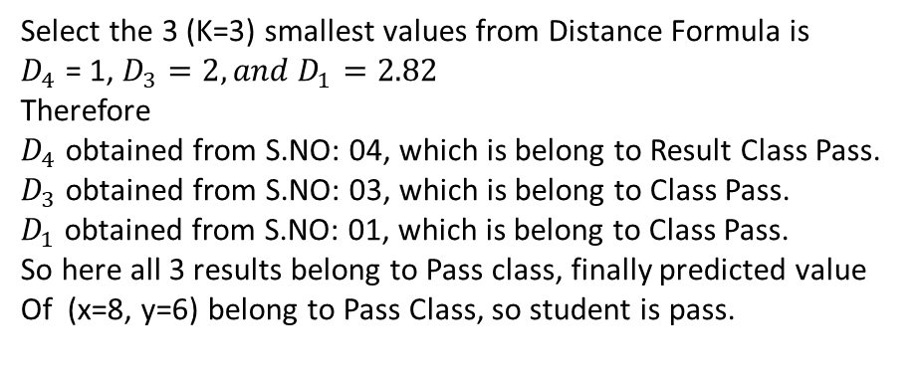
KNN (K Nearest Neighbor Algorithm)
$$Eucleadian Distance Formula=D= \sqrt{{(X − X_{1})}^{2}+{(Y − Y_{1})}^{2}}$$
Step-01:
$$Predict (English (X=8), Math (Y=6)$$
$$D_{1}= \sqrt{{(X − X_{1})}^{2}+{(Y − Y_{1})}^{2}}= \sqrt{{(8 −6)}^{2}+{(6 −8)}^{2}}=2.82$$
Step-02:
$$D_{2}= \sqrt{{(X − X_{1})}^{2}+{(Y − Y_{1})}^{2}}= \sqrt{{(8 −3)}^{2}+{(6 −4)}^{2}}=5.39$$
Step-03:
$$D_{3}= \sqrt{{(X − X_{1})}^{2}+{(Y − Y_{1})}^{2}}= \sqrt{{(8 −6)}^{2}+{(6 −6)}^{2}}=2$$
Step-04:
$$D_{4}= \sqrt{{(X − X_{1})}^{2}+{(Y − Y_{1})}^{2}}= \sqrt{{(8 −7)}^{2}+{(6 −6)}^{2}}=1$$
Select the 3 (K=3) smallest values from Distance Formula is
$D_{4}$ = 1, $D_{3}=2,{and D}_{1}=2.82$
Therefore
$D_{4}$ obtained from S.NO: 04, which is belong to Result Class Pass.
$D_{3}$ obtained from S.NO: 03, which is belong to Class Pass.
$D_{1}$ obtained from S.NO: 01, which is belong to Class Pass.
So here all 3 results belong to Pass class, finally predicted value
Of (x=8, y=6) belong to Pass Class, so student is pass.
Step-05:
$$D_{5}= \sqrt{{(X − X_{1})}^{2}+{(Y − Y_{1})}^{2}}= \sqrt{{(8 −4)}^{2}+{(6 −3)}^{2}}=5$$

