Slide 1
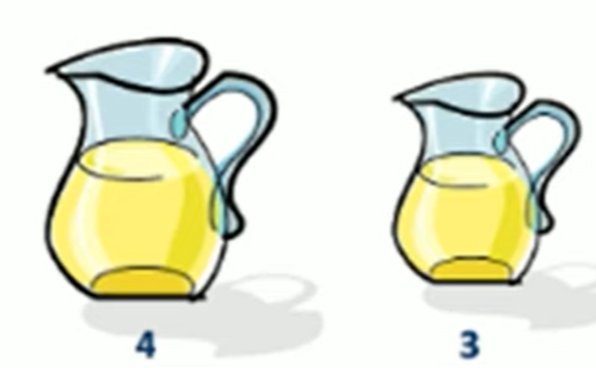
Q: You are given two jugs, a 4-liter one and a 3-liter one. Neither has any measuring markers on it. There is a pump that can be used to fill the jugs with water. How can you get exactly 2 liters of water into a 4-liter jug.
SOLUTION: Our Target is to put exact amount of 2-liter water in 4-liter Jug
(4-Litres Jug = Jug X, 3-Litres Jug = Jug Y) | (x, y)
(Empty Jug X, Empty Jug Y) | (0,0)
(Fill 4-Litres Water in Jug X, Fill 3-Litres Water in Jug Y) | (4,3)
(Remove Water from Jug X, Fill 3-Litres Water in Jug Y) | (0,3)
(Fill 3-Litres Water in Jug X, Remove Water from Jug Y) | (3,0)
(Fill 3-Litres Water in Jug X, Fill 3-Litres Water in Jug Y) | (3,3)
(Fill 4-Litres Water in Jug X, Fill 2-Litres Water in Jug Y) | (4,2)
(Remove Water from Jug X, Fill 2-Litres Water in Jug Y) | (0,2)
(Fill 2-Litres Water in Jug X, Remove Water from Jug Y) | (2,0) Target is Achieved

Slide 2
