Slide 1
Maximum Power Transfer Theorem

Slide 2
Maximum Power Transfer Theorem Statement
The Maximum Power Transfer Theorem states that in a linear, bilateral DC network, Maximum Power is delivered to the load when the load resistance is equal to the internal resistance of the source.

Slide 3
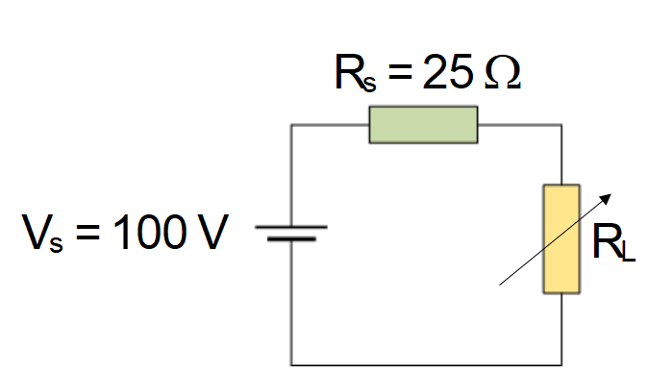

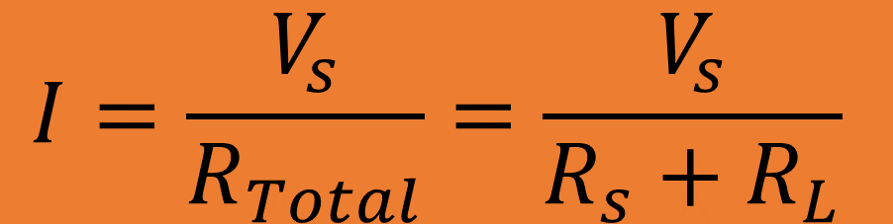
Example: Apply a Maximum Power Transfer Theorem to calculate maximum power in the Circuit given below. The Value of supply voltage V_{s} = 100 V, source resistance R_{s} = 25 ohm , when the value of variable load resistance R_{L} = 0, 5, 10, 15, 20, 25, 30, 40, 60, and 100 volts.
$$I=\frac{V_{s}}{R_{Total}}=\frac{V_{s}}{R_{s}+R_{L}}$$
$P=$ $I^{2}R_{L}$

Slide 4
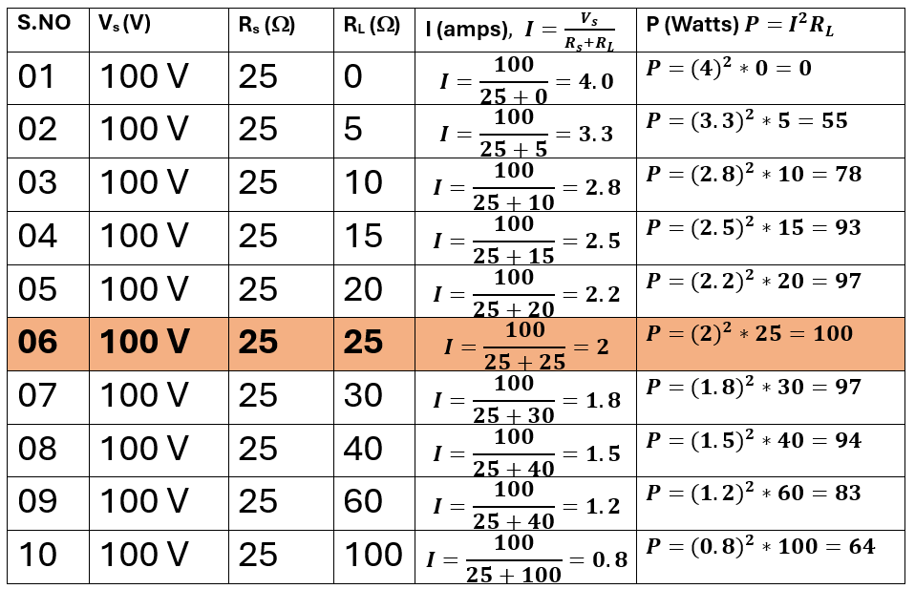

Slide 5
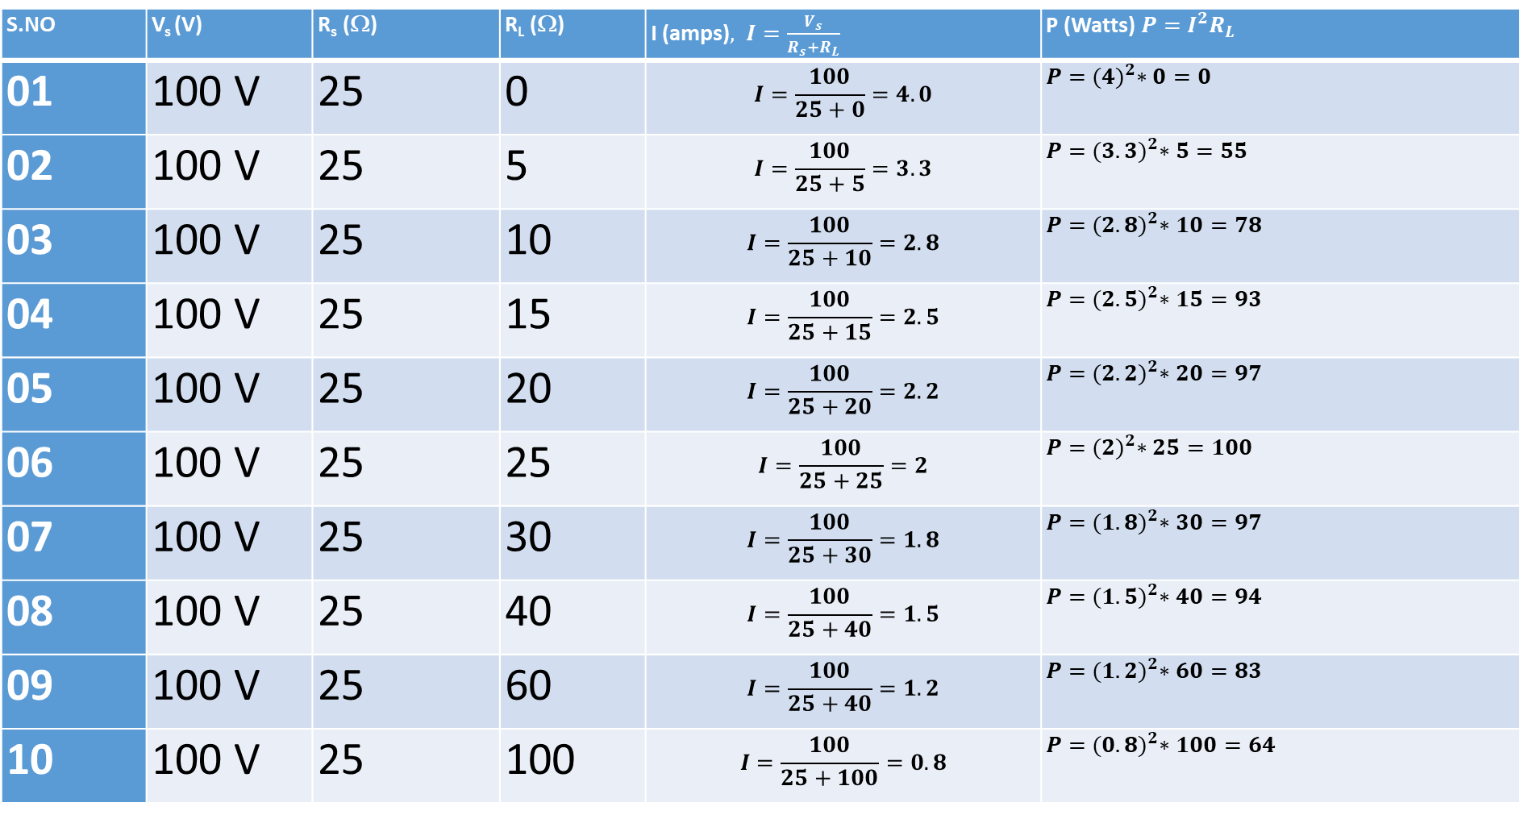
S.NO | V_{s} (V) | R_{s} (Ω) | R_{L} (Ω) | I (amps)$, I=\frac{V_{s}}{R_{s}+R_{L}}$ | P (Watts) $P=$ $I^{2}R_{L}$
01 | 100 V | 25 | 0 | $$I=\frac{100}{25+0}=4.0$$ | $P=$ ${(4)}^{2}∗0=0$
02 | 100 V | 25 | 5 | $$I=\frac{100}{25+5}=3.3$$ | $P=$ ${(3.3)}^{2}∗5=55$
03 | 100 V | 25 | 10 | $$I=\frac{100}{25+10}=2.8$$ | $P=$ ${(2.8)}^{2}∗10=78$
04 | 100 V | 25 | 15 | $$I=\frac{100}{25+15}=2.5$$ | $P=$ ${(2.5)}^{2}∗15=93$
05 | 100 V | 25 | 20 | $$I=\frac{100}{25+20}=2.2$$ | $P=$ ${(2.2)}^{2}∗20=97$
06 | 100 V | 25 | 25 | $$I=\frac{100}{25+25}=2$$ | $P=$ ${(2)}^{2}∗25=100$
07 | 100 V | 25 | 30 | $$I=\frac{100}{25+30}=1.8$$ | $P=$ ${(1.8)}^{2}∗30=97$
08 | 100 V | 25 | 40 | $$I=\frac{100}{25+40}=1.5$$ | $P=$ ${(1.5)}^{2}∗40=94$
09 | 100 V | 25 | 60 | $$I=\frac{100}{25+40}=1.2$$ | $P=$ ${(1.2)}^{2}∗60=83$
10 | 100 V | 25 | 100 | $$I=\frac{100}{25+100}=0.8$$ | $P=$ ${(0.8)}^{2}∗100=64$

Slide 6
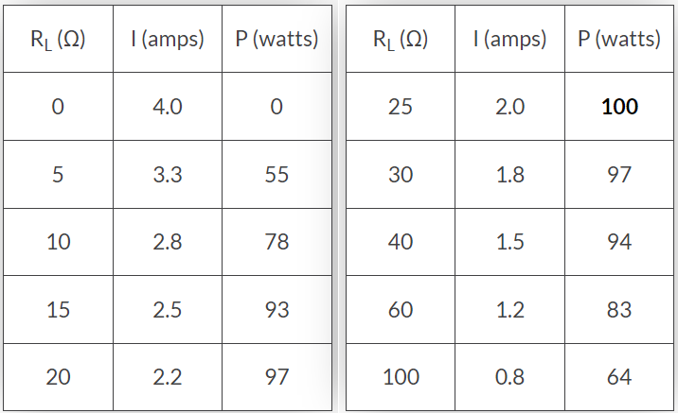

Slide 7
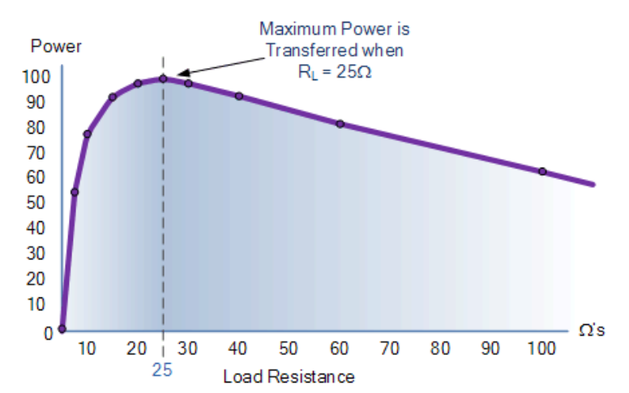
Graph of Power Against Load Resistance

