Slide 1
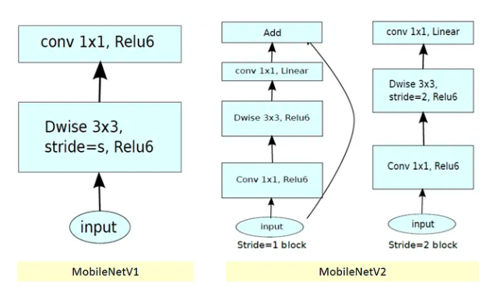
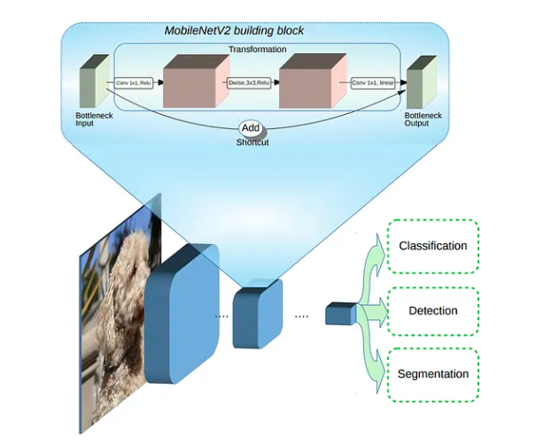
Input
Conv + ReLU
Dwise + ReLU
Conv + Linear
+
Block-1: Stride

Slide 2
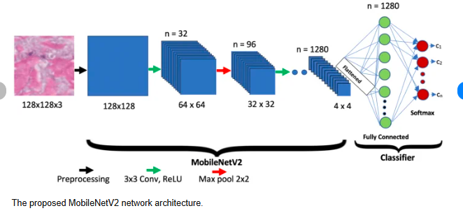
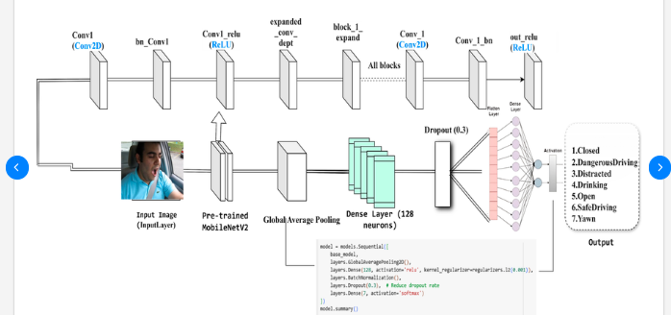

Slide 3


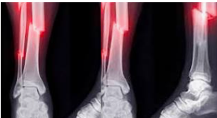


Normal Bone
Input
MobileNetV2
Global Avg Pooling
Dense1
Dense 2
Conv
Batch Normalization
Fractured Bone

