Slide 1
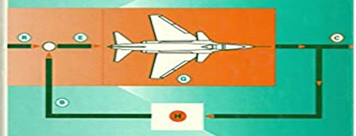
SECOND-WEEK
Dr. Wazir Muhammad
Electrical Engineering Department
BUET, Khuzdar

Slide 2
Root Locus Method
It is the combination of two words: root-loci
We are interested in the roots of the Denominator of the closed loop transfer function, that is the closed loop poles.
Locus is a path (or route) one might follow. Loci is the plural form.
The root locus is the path of the roots of the characteristic equation traced out in the s-plane as a system parameter varies from zero to infinity.
It is a graphical method for examining the change in the roots of a system when gain of the system varies.
Root-loci are the paths followed by the closed loop poles as K changes, because poles are tell us about stability and behavior.

Slide 3
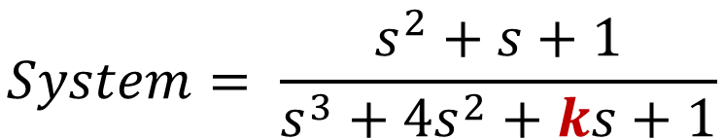
Root Locus Method
System
Parameter K,
Where K is unknown Parameters and what affect on the stability of the system
Input
Output
$$System= \frac{s^{2}+s+1}{s^{3}+{4s}^{2}+ks+1}$$
So here two problems occur due to K
First what value of K we should select to meet my system performance requirements.
Second what is the effect of a variation of K on the system

Slide 4
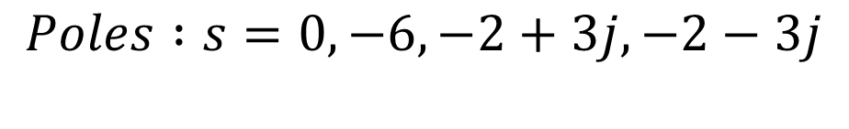
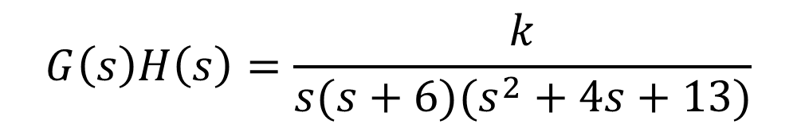



Procedure of Root Locus
$$G\left(s\right)H\left(s\right)=\frac{k}{s(s+6)(s^{2}+4s+13)}$$
Step-1: Calculate the Starting Points (Poles)
$$Poles :s=0, −6, −2+3j, −2−3j$$
$$No of Poles values=P=4$$
Step-2: Calculate the Ending Points (Zeros)
$$Zeros:s=0$$
$$No of Zeros values=Z=0$$
Step-3: Calculate the Numerator of root locus N
P>Z (4>0) than N = P
$N=4$

Slide 5


Procedure of Root Locus
$$jσ$$
Step-4: Existence of Root Locus in S-Plane
$$Poles :s=0, −6, −2+3j, −2−3j$$
3j 2j j
$$Zeros:s=None, No:of Zeros=0$$
$$−σ$$
$$σ$$
-6 -5 -4 -3 -2 -1
1 2 3 4 5
-j -2j -3j
Shaded because odd poles on right side
Shaded because 3 poles on right side so
it is odd poles we shaded it
So, root locus exists between 0 to -6.
$$−jσ$$

Slide 6
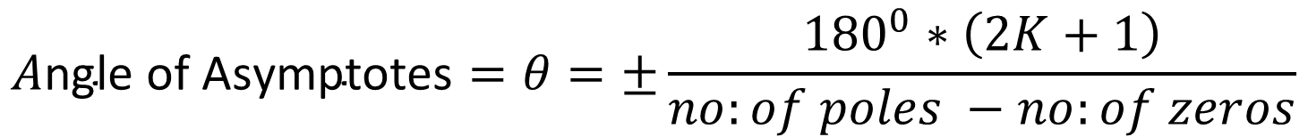
Procedure of Root Locus
Step-5: Angle of Asymptotes
$$A\text{ngle} \text{of} \text{Asymptotes}=θ=±\frac{{180}^{0}∗\left(2K+1\right)}{no:of poles −no:of zeros}$$
$K=p−z−1=4−0−1=3,$ So value of K = 0,1,2,3
$$If K=0 than −→A\text{ngle} \text{of} \text{Asymptotes}=θ_{1}=\frac{{180}^{0}∗\left(2K+1\right)}{no:of poles −no:of zeros}=\frac{{180}^{0}∗\left(2∗0+1\right)∗}{\left(4−0\right)}=\frac{{180}^{0}}{4}={45}^{0}$$
$$If K=1 than −→A\text{ngle} \text{of} \text{Asymptotes}=θ_{2}=\frac{{180}^{0}∗\left(2K+1\right)}{no:of poles −no:of zeros}=\frac{{180}^{0}∗\left(2∗1+1\right)∗}{\left(4−0\right)}=\frac{{180}^{0}∗3}{4}={135}^{0}$$
$$If K=2 than −→A\text{ngle} \text{of} \text{Asymptotes}=θ_{3}=\frac{{180}^{0}∗\left(2K+1\right)}{no:of poles −no:of zeros}=\frac{{180}^{0}∗\left(2∗2+1\right)∗}{\left(4−0\right)}=\frac{{180}^{0}∗5}{4}={225}^{0}$$
$$If K=3 than −→A\text{ngle} \text{of} \text{Asymptotes}=θ_{4}=\frac{{180}^{0}∗\left(2K+1\right)}{no:of poles −no:of zeros}=\frac{{180}^{0}∗\left(2∗3+1\right)∗}{\left(4−0\right)}=\frac{{180}^{0}∗7}{4}={315}^{0}$$

Slide 7
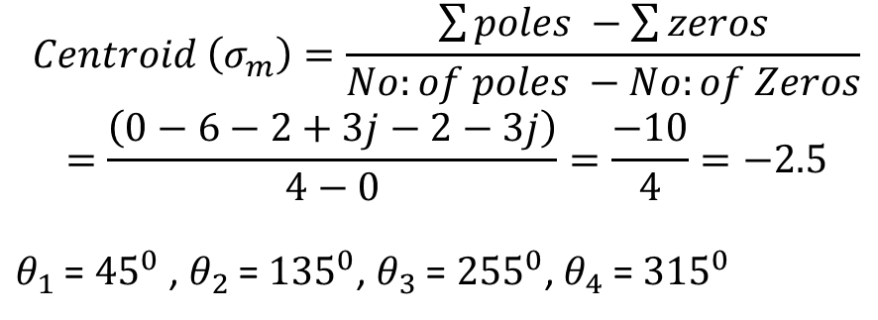
Procedure of Root Locus
$$jσ$$
Step-6: Find the Centroid
$$Centroid \left(σ_{m}\right)=\frac{\sum{poles −\sum{zeros}}}{No:of poles −No:of Zeros}$$
$$=\frac{\left(0−6−2+3j−2−3j\right)}{4−0}=\frac{−10}{4}=−2.5$$
$θ_{1}$ = ${45}^{0}$ , $θ_{2}$ = ${135}^{0}$, $θ_{3}$ = ${255}^{0}$, $θ_{4}$ = ${315}^{0}$
3j 2j j
$$−σ$$
$$σ$$
-6 -5 -4 -3 -2 -1
1 2 3 4 5
-j -2j -3j
$$−jσ$$

Slide 8
Procedure of Root Locus
Step-7: Break Away Point and Break In Point
Break Point
Break Point at which two or more poles are meet (in the real order roort of locus branches) is called Break Point
Homework

