Slide 1
Polar Plot

Slide 2
Polar Plot
Polar plot is a technique to design a plot of magnitude versus phase angle of sinusoidal transfer function G(jw) as w varies from 0 to ∞.
Polar plot is used for analysis and design of feedback control system by means of Nyquist criterion of complex signal (a + jb)

Slide 3
Draw Polar Plot

Slide 4
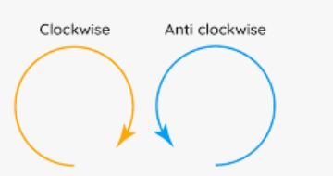
STEP-A: Find the Starting Point and Ending Point Is
Omega | Magnitude | Phase
0 | 1 | 0⁰
∞ | 0 | -180⁰
Starting Point is = 0⁰
Starting Point is = -180⁰
-180⁰
0⁰

Slide 5
STEP-B: Find the Rotation of Direction
The Starting Point of Polar Plot is At Zero Degree and Ending Point is at -180⁰ , which means plot should be rotated -180 clockwise directions, because rotation = final point – initial point = -180⁰ – 0⁰ = - 180⁰
Omega | Magnitude | Phase
0 | 1 | 0⁰
∞ | 0 | -180⁰
0<-180⁰
1<0⁰
-180⁰
0⁰

Slide 6
STEP-A: Find the Starting Point and Ending Point Is
Omega | Magnitude | Phase
0 | 25 | 0⁰
∞ | 0 | -90⁰
Starting Point is = 0⁰
Starting Point is = -90⁰
-180⁰
0⁰
-90⁰

Slide 7
STEP-B: Find the Rotation of Direction
The Starting Point of Polar Plot is At Zero Degree and Ending Point is at -90⁰ , which means plot should be rotated -90⁰ clockwise directions, because rotation = final point – initial point = -90⁰ – 0⁰ = - 90⁰
Omega | Magnitude | Phase
0 | 25 | 0⁰
∞ | 0 | -90⁰
5<0⁰
-180⁰
0⁰
0<-90⁰
-90⁰

Slide 8
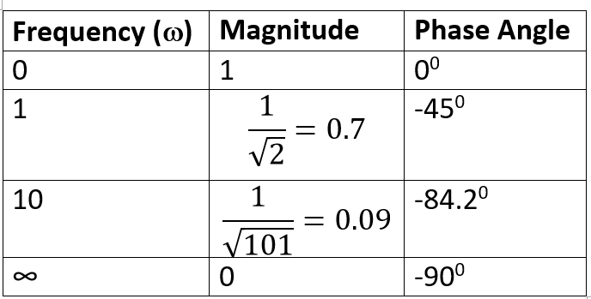
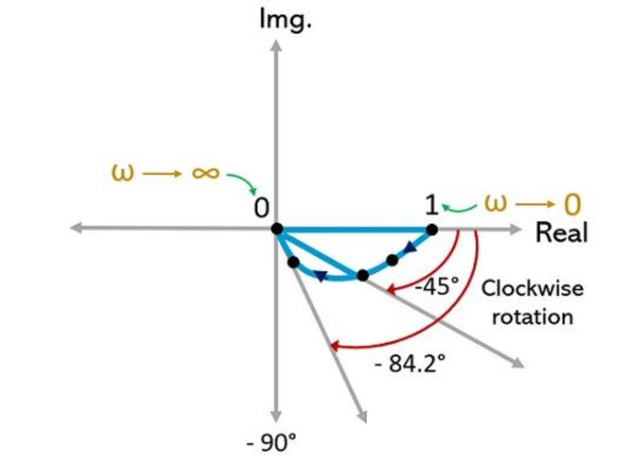
STEP-A: Draw Magnitudes

Slide 9
STEP-B: Draw Phases

Slide 10
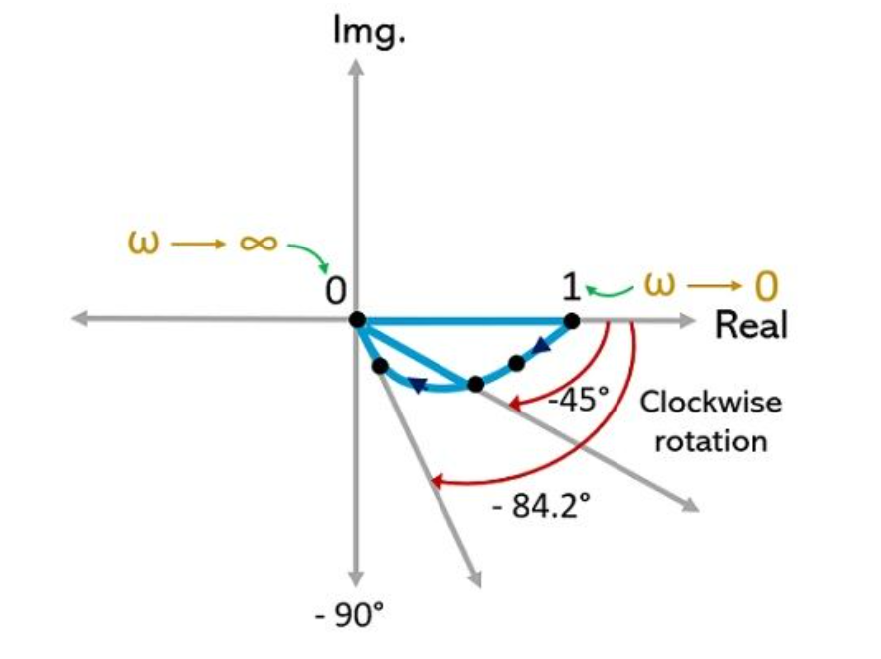
Final Polar Plot

Slide 11
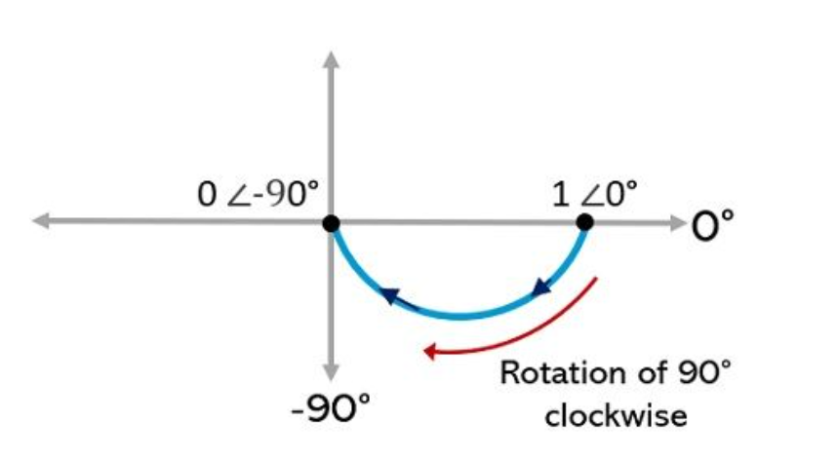
Q: Draw the Polar Plot of ω = 0, Magnitude is one and Phase is zero (1<0⁰) and ω = ∞ , Magnitude is zero and phase is minus 90 degree (0<-90⁰).

Slide 12
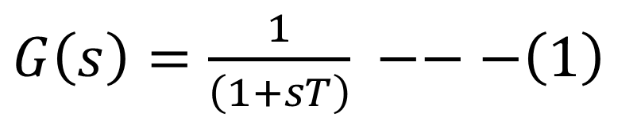
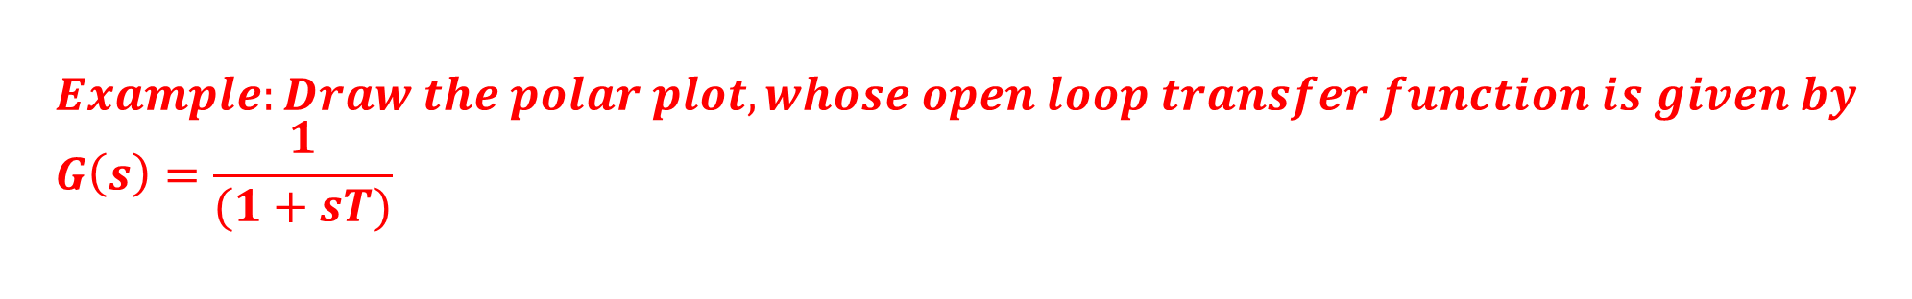

$$Example:Draw the polar plot, whose open loop transfer function is given by \\ G\left(s\right)=\frac{1}{(1+sT)}$$
SOLUTION
$G\left(s\right)=\frac{1}{\left(1+sT\right)} −−−\left(1\right)$
STEP-I: Put s = j ω in Equation (1)
$$G\left(jω\right)=\frac{1}{\left(1+jωT\right)}$$

Slide 13
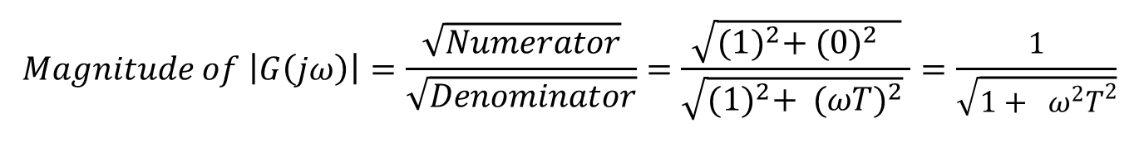
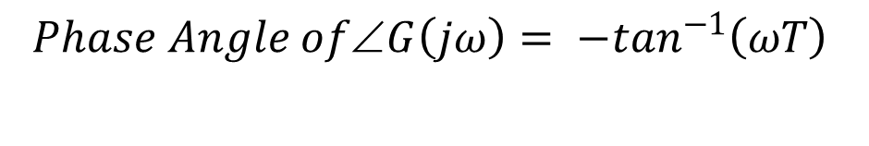
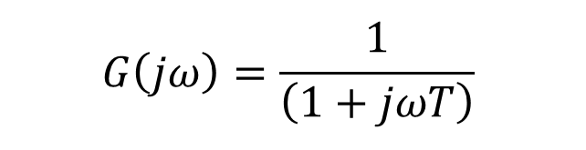
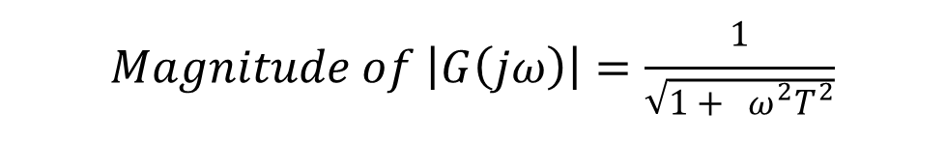
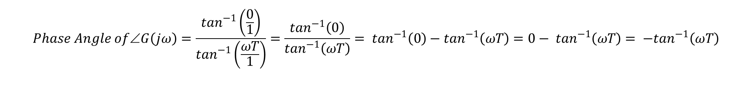
STEP-II: Find the Magnitude and Phase angle of $G\left(jω\right)$
$$G\left(jω\right)=\frac{1}{\left(1+jωT\right)}$$
$$Magnitude of \left|G\left(jω\right)\right|=\frac{\sqrt{Numerator}}{\sqrt{Denominator}}=\frac{\sqrt{{(1)}^{2}+ {(0)}^{2} }}{\sqrt{{(1)}^{2}+ {(ωT)}^{2}} }=\frac{1}{\sqrt{1+ ω^{2}T^{2}}}$$
$$Magnitude of \left|G\left(jω\right)\right|=\frac{1}{\sqrt{1+ ω^{2}T^{2}}}$$
$$Phase Angle of∠G\left(jω\right)=\frac{\tan^{−1}\left(\frac{0}{1}\right)}{\tan^{−1}\left(\frac{ωT}{1}\right)}=\frac{\tan^{−1}\left(0\right)}{\tan^{−1}\left(ωT\right)}= \tan^{−1}\left(0\right)−\tan^{−1}\left(ωT\right)=0− \tan^{−1}\left(ωT\right)= −\tan^{−1}\left(ωT\right)$$
$$Phase Angle of∠G\left(jω\right)= −\tan^{−1}\left(ωT\right)$$

Slide 14


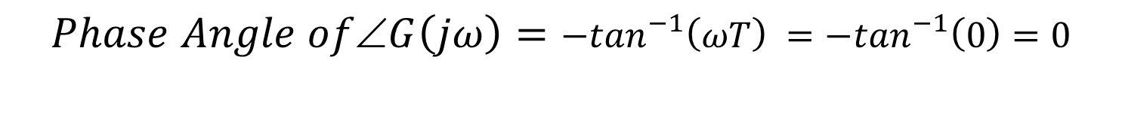
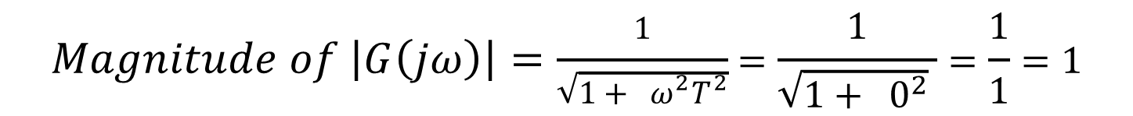
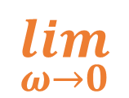
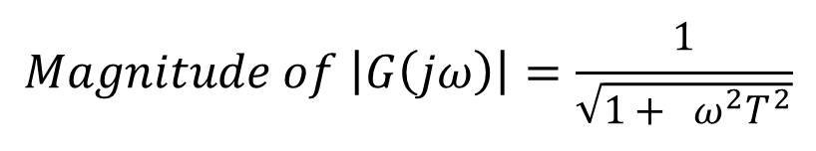
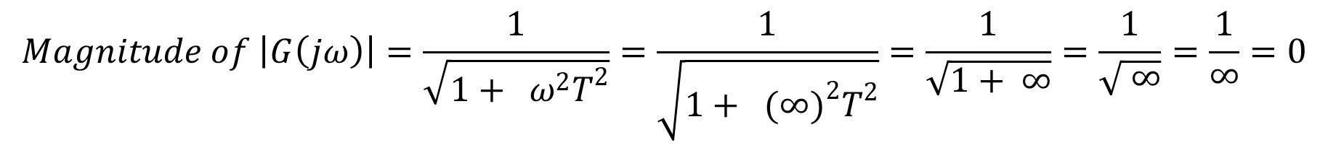
STEP-III: Put the limit $ω→0 and ω→∞$in Magnitude and Phase angle of $G\left(jω\right)$
$$\lim_{ω→0}$$
$$Magnitude of \left|G\left(jω\right)\right|=\frac{1}{\sqrt{1+ ω^{2}T^{2}}}$$
$$Phase Angle of∠G\left(jω\right)=−\tan^{−1}\left(ωT\right)$$
$$Magnitude of \left|G\left(jω\right)\right|=\frac{1}{\sqrt{1+ ω^{2}T^{2}}}=\frac{1}{\sqrt{1+ 0^{2}} }=\frac{1}{1}=1$$
$$Phase Angle of∠G\left(jω\right)=−\tan^{−1}\left(ωT\right) =−\tan^{−1}\left(0\right)=0$$
$$\lim_{ω→∞}$$
$$Magnitude of \left|G\left(jω\right)\right|=\frac{1}{\sqrt{1+ ω^{2}T^{2}}}=\frac{1}{\sqrt{1+ {(∞)}^{2}T^{2}}}=\frac{1}{\sqrt{1+ ∞}}=\frac{1}{\sqrt{ ∞}}=\frac{1}{∞}=0$$
$$Phase Angle of∠G\left(jω\right)=−\tan^{−1}\left(ωT\right)= − \tan^{−1}\left(∞∗T\right)=−\tan^{−1}\left(∞\right)= {−90}^{0}$$

Slide 15
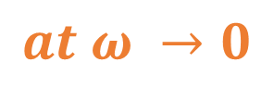





STEP-IV: Draw Polar Plot
$$at ω →0$$
$$at ω →∞$$
$$Magnitude of \left|G\left(jω\right)\right|=1$$
$$Magnitude of \left|G\left(jω\right)\right|=0$$
$$Phase Angle of∠G\left(jω\right)= 0^{0}$$
$$Phase Angle of ∠G\left(jω\right)= −90^{0}$$

Slide 16
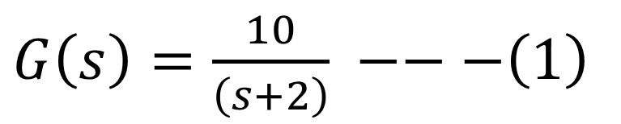
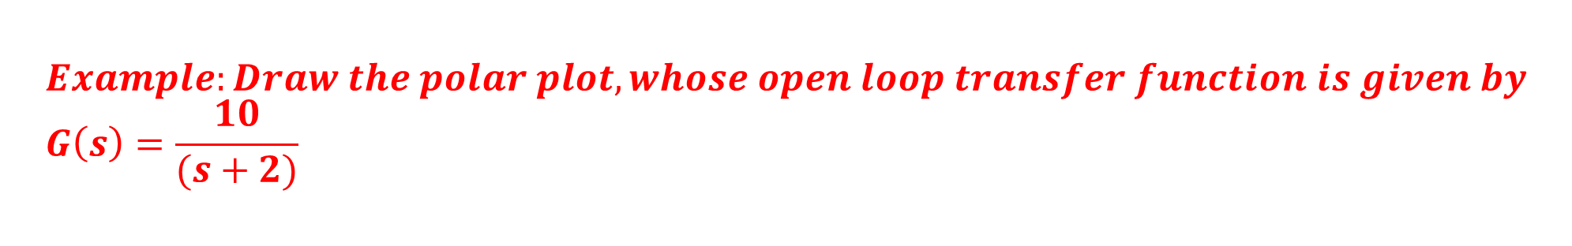
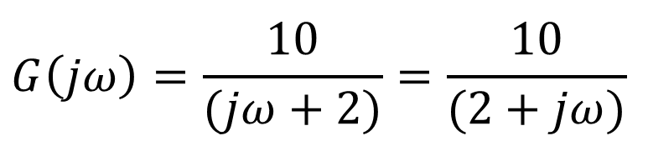
$$Example:Draw the polar plot, whose open loop transfer function is given by \\ G\left(s\right)=\frac{10}{(s+2)}$$
SOLUTION
$G\left(s\right)=\frac{10}{\left(s+2\right)} −−−\left(1\right)$
STEP-I: Put s = j ω in Equation (1)
$$G\left(jω\right)=\frac{10}{(jω+2)}=\frac{10}{(2+jω)}$$

Slide 17
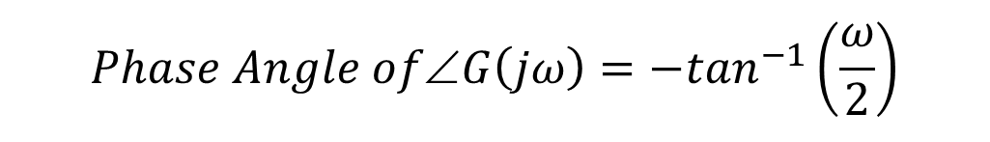
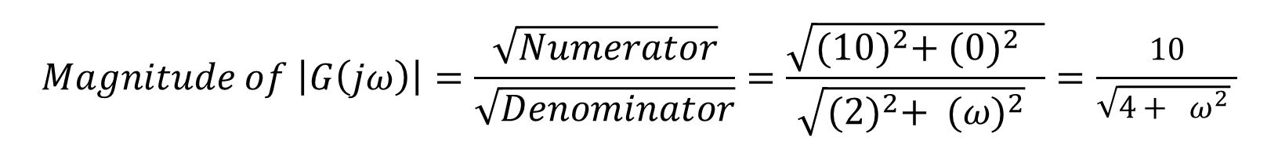
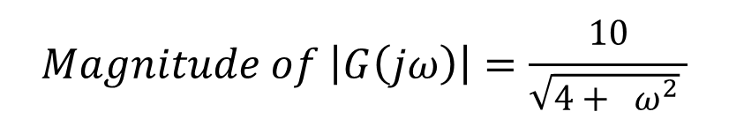
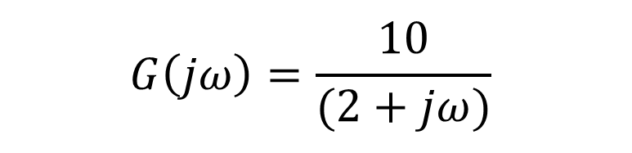
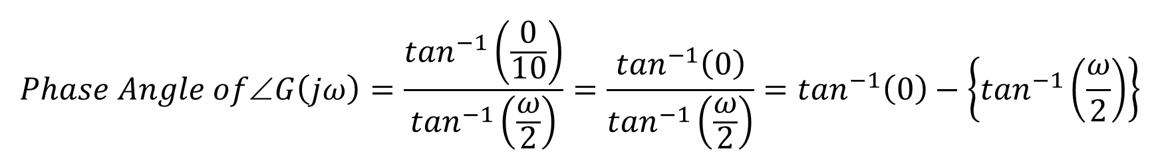
STEP-II: Find the Magnitude and Phase angle of $G\left(jω\right)$
$$G\left(jω\right)=\frac{10}{(2+jω)}$$
$$Magnitude of \left|G\left(jω\right)\right|=\frac{\sqrt{Numerator}}{\sqrt{Denominator}}=\frac{\sqrt{{(10)}^{2}+ {(0)}^{2} }}{\sqrt{{(2)}^{2}+ {(ω)}^{2}} }=\frac{10}{\sqrt{4+ ω^{2}} }$$
$$Magnitude of \left|G\left(jω\right)\right|=\frac{10}{\sqrt{4+ ω^{2}} }$$
$$Phase Angle of∠G\left(jω\right)=\frac{\tan^{−1}\left(\frac{0}{10}\right)}{\tan^{−1}\left(\frac{ω}{2}\right)}=\frac{\tan^{−1}\left(0\right)}{\tan^{−1}\left(\frac{ω}{2}\right)}=\tan^{−1}\left(0\right)−\left\{\tan^{−1}\left(\frac{ω}{2}\right)\right\}$$
$$Phase Angle of∠G\left(jω\right)=\tan^{−1}\left(0\right)−\tan^{−1}\left(\frac{ω}{2}\right)=0^{0}−\tan^{−1}\left(\frac{ω}{2}\right)=−\tan^{−1}\left(\frac{ω}{2}\right)$$
$$Phase Angle of∠G\left(jω\right)=−\tan^{−1}\left(\frac{ω}{2}\right)$$

Slide 18
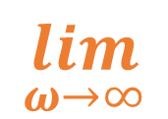
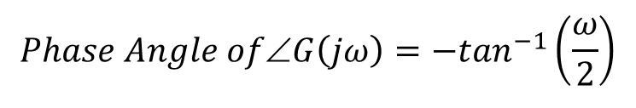
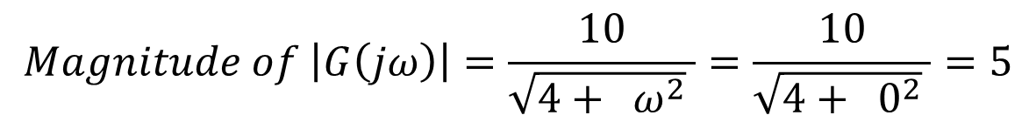
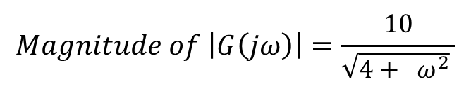
STEP-III: Put the limit $ω→0 and ω→∞$in Magnitude and Phase angle of $G\left(jω\right)$
$$\lim_{ω→0}$$
$$Magnitude of \left|G\left(jω\right)\right|=\frac{10}{\sqrt{4+ ω^{2}} }$$
$$Phase Angle of∠G\left(jω\right)=−\tan^{−1}\left(\frac{ω}{2}\right)$$
$$Magnitude of \left|G\left(jω\right)\right|=\frac{10}{\sqrt{4+ ω^{2}} }=\frac{10}{\sqrt{4+ 0^{2}} }=5$$
$$Phase Angle of∠G\left(jω\right)= −\tan^{−1}\left(\frac{ω}{2}\right)=−\tan^{−1}\left(\frac{0}{2}\right)=−\tan^{−1}\left(0\right)=0$$
$$\lim_{ω→∞}$$
$$Magnitude of \left|G\left(jω\right)\right|=\frac{10}{\sqrt{4+ ω^{2}} }=\frac{10}{\sqrt{4+ ∞^{2}} }=\frac{10}{\sqrt{∞^{2}} }=\frac{10}{∞}=0$$
$$Phase Angle of∠G\left(jω\right)= −\tan^{−1}\left(\frac{ω}{2}\right)=−\tan^{−1}\left(\frac{∞}{2}\right)=−\tan^{−1}\left(∞\right)=−{90}^{0}$$

Slide 19

STEP-IV: Draw Polar Plot
$$at ω →0$$
$$at ω →∞$$
$$Magnitude of \left|G\left(jω\right)\right|=5$$
$$Magnitude of \left|G\left(jω\right)\right|=0$$
$$Phase Angle of∠G\left(jω\right)= 0^{0}$$
$$Phase Angle of ∠G\left(jω\right)= −90^{0}$$

Slide 20
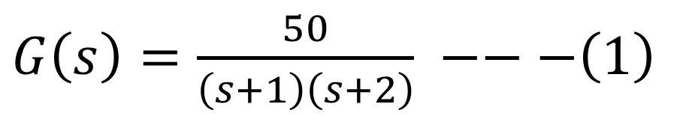
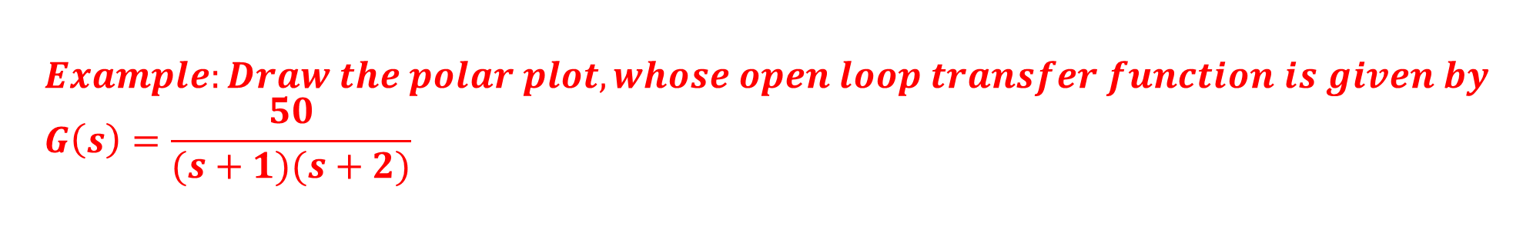
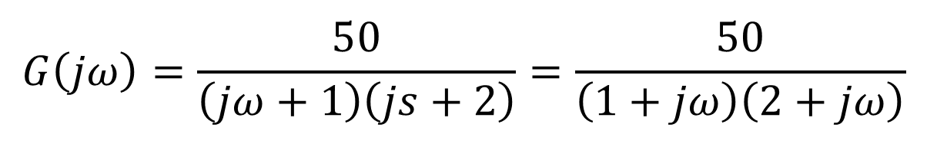
$$Example:Draw the polar plot, whose open loop transfer function is given by \\ G\left(s\right)=\frac{50}{(s+1)(s+2)}$$
SOLUTION
$G\left(s\right)=\frac{50}{\left(s+1\right)\left(s+2\right)} −−−\left(1\right)$
STEP-I: Put s = j ω in Equation (1)
$$G\left(jω\right)=\frac{50}{\left(jω+1\right)\left(js+2\right)}=\frac{50}{\left(1+jω\right)\left(2+jω\right)}$$

Slide 21
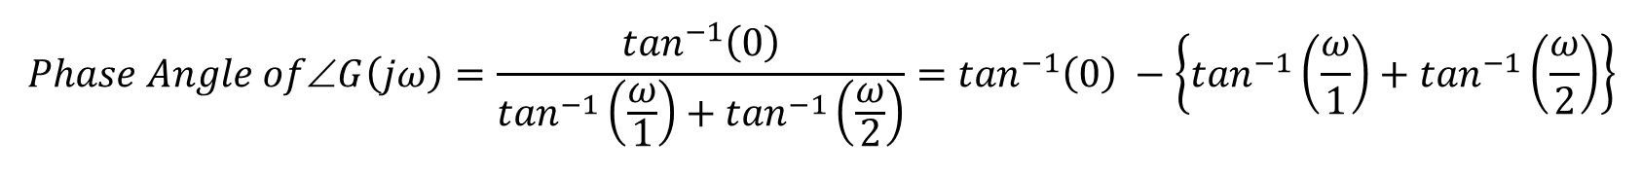
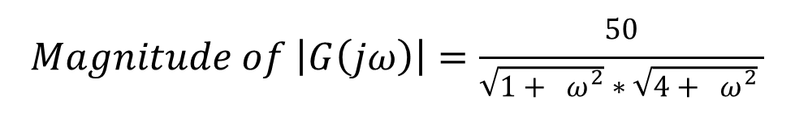
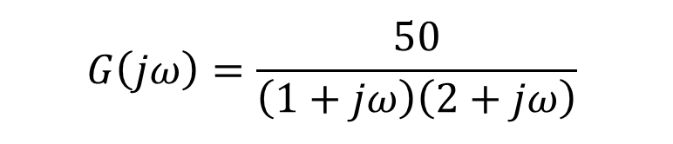
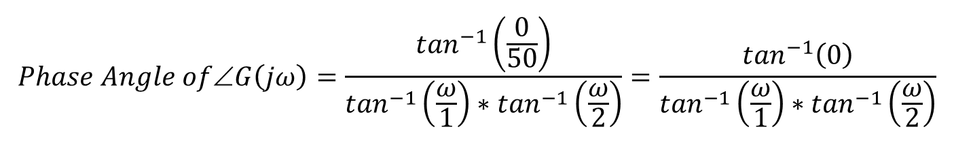
STEP-II: Find the Magnitude and Phase angle of $G\left(jω\right)$
$$G\left(jω\right)=\frac{50}{\left(1+jω\right)\left(2+jω\right)}$$
$$Magnitude of \left|G\left(jω\right)\right|=\frac{\sqrt{Numerator}}{\sqrt{Denominator}}=\frac{\sqrt{{(50)}^{2}+ {(0)}^{2} }}{\sqrt{{(1)}^{2}+ {(ω)}^{2}}∗\sqrt{{(2)}^{2}+ {(ω)}^{2}} }=\frac{50}{\sqrt{1+ ω^{2}}∗\sqrt{4+ ω^{2}} }$$
$$Magnitude of \left|G\left(jω\right)\right|=\frac{50}{\sqrt{1+ ω^{2}}∗\sqrt{4+ ω^{2}} }$$
$$Phase Angle of∠G\left(jω\right)=\frac{\tan^{−1}\left(\frac{0}{50}\right)}{\tan^{−1}\left(\frac{ω}{1}\right)∗\tan^{−1}\left(\frac{ω}{2}\right)}=\frac{\tan^{−1}\left(0\right)}{\tan^{−1}\left(\frac{ω}{1}\right)∗\tan^{−1}\left(\frac{ω}{2}\right)}$$
$$Phase Angle of∠G\left(jω\right)=\frac{\tan^{−1}\left(0\right)}{\tan^{−1}\left(\frac{ω}{1}\right)+\tan^{−1}\left(\frac{ω}{2}\right)}=\tan^{−1}\left(0\right) −\left\{\tan^{−1}\left(\frac{ω}{1}\right)+\tan^{−1}\left(\frac{ω}{2}\right)\right\}$$
$$Phase Angle of∠G\left(jω\right)=0 −\tan^{−1}\left(\frac{ω}{1}\right) −\tan^{−1}\left(\frac{ω}{2}\right)=−\tan^{−1}\left(\frac{ω}{1}\right) −\tan^{−1}\left(\frac{ω}{2}\right)$$

Slide 22

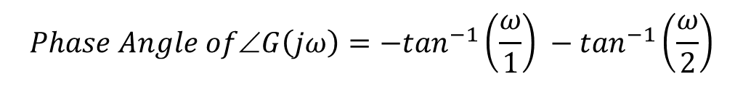
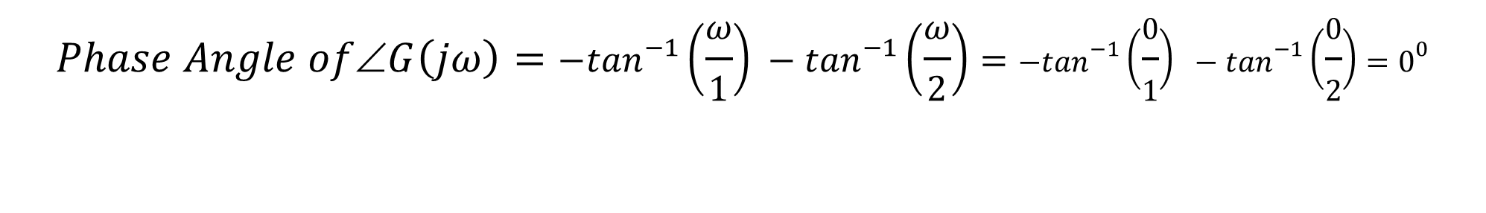
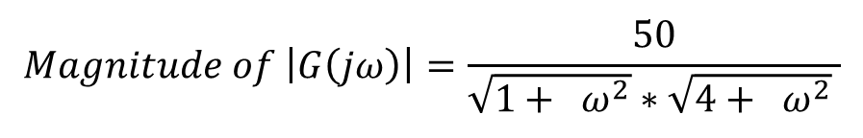
STEP-III: Put the limit $ω→0 and ω→∞$in Magnitude and Phase angle of $G\left(jω\right)$
$$\lim_{ω→0}$$
$$Magnitude of \left|G\left(jω\right)\right|=\frac{50}{\sqrt{1+ ω^{2}}∗\sqrt{4+ ω^{2}} }$$
$$Phase Angle of∠G\left(jω\right)=−\tan^{−1}\left(\frac{ω}{1}\right) −\tan^{−1}\left(\frac{ω}{2}\right)$$
$$Magnitude of \left|G\left(jω\right)\right|=\frac{50}{\sqrt{1+ ω^{2}}∗\sqrt{4+ ω^{2}} }=\frac{50}{\sqrt{1+ 0^{2}}\sqrt{4+ 0^{2}} }=\frac{50}{2}=25$$
$$Phase Angle of∠G\left(jω\right)=−\tan^{−1}\left(\frac{ω}{1}\right) −\tan^{−1}\left(\frac{ω}{2}\right)=−\tan^{−1}\left(\frac{0}{1}\right) −\tan^{−1}\left(\frac{0}{2}\right)=0^{0}$$
$$\lim_{ω→∞}$$
$$Magnitude of \left|G\left(jω\right)\right|=\frac{50}{\sqrt{1+ ω^{2}}∗\sqrt{4+ ω^{2}} }=\frac{50}{\sqrt{1+ ∞^{2}}\sqrt{4+ ∞^{2}} }=\frac{50}{\sqrt{ ∞^{2}}\sqrt{ ∞^{2}} }=\frac{50}{∞∞}=0$$
$$Phase Angle of∠G\left(jω\right)=−\tan^{−1}\left(\frac{ω}{1}\right)−\tan^{−1}\left(\frac{ω}{2}\right)=−\tan^{−1}\left(\frac{∞}{1}\right)−\tan^{−1}\left(\frac{∞}{2}\right)=−\tan^{−1}\left(∞\right)−\tan^{−1}\left(∞\right)$$
$$Phase Angle of∠G\left(jω\right)=−\tan^{−1}\left(∞\right)−\tan^{−1}\left(∞\right)=−{90}^{0}−{90}^{0}=−{180}^{0}$$

Slide 23


STEP-IV: Draw Polar Plot
$$at ω →0$$
$$at ω →∞$$
$$Magnitude of \left|G\left(jω\right)\right|=25$$
$$Magnitude of \left|G\left(jω\right)\right|=0$$
$$Phase Angle of∠G\left(jω\right)= 0^{0}$$
$$Phase Angle of ∠G\left(jω\right)= −180^{0}$$

Slide 24
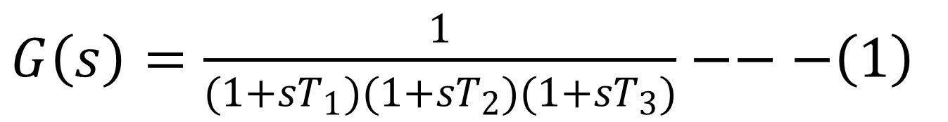
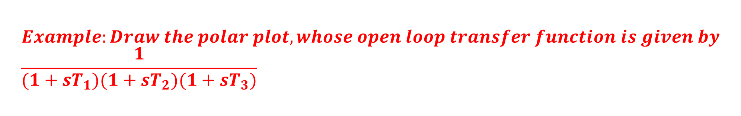
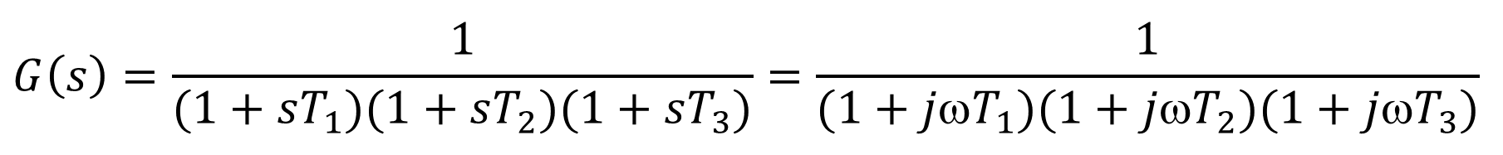
$$Example:Draw the polar plot, whose open loop transfer function is given by \\ \frac{1}{(1+sT_{1})(1+sT_{2})(1+sT_{3})}$$
SOLUTION
$G\left(s\right)=\frac{1}{(1+sT_{1})(1+sT_{2})(1+sT_{3})}−−−\left(1\right)$
STEP-I: Put s = j ω in Equation (1)
$$G\left(s\right)=\frac{1}{(1+sT_{1})(1+sT_{2})(1+sT_{3})}=\frac{1}{(1+jωT_{1})(1+jωT_{2})(1+jωT_{3})}$$

Slide 25
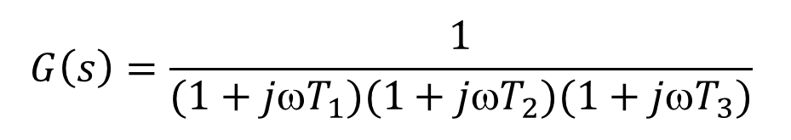
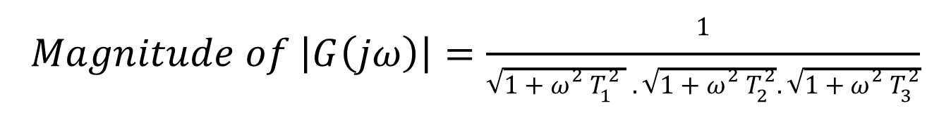
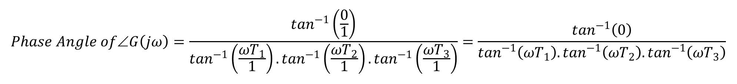
STEP-II: Find the Magnitude and Phase angle of $G\left(jω\right)$
$$G\left(s\right)=\frac{1}{(1+jωT_{1})(1+jωT_{2})(1+jωT_{3})}$$
$$Magnitude of \left|G\left(jω\right)\right|=\frac{\sqrt{Numerator}}{\sqrt{Denominator}}=\frac{\sqrt{{(1)}^{2}+ {(0)}^{2} }}{\sqrt{{(1)}^{2}+ {(ωT_{1})}^{2}} .\sqrt{{(1)}^{2}+ {(ωT_{2})}^{2}}. \sqrt{{(1)}^{2}+ {(ωT_{3})}^{2}}}=\frac{1}{\sqrt{1+ω^{2} T_{1}^{2} } .\sqrt{1+ω^{2} T_{2}^{2}}. \sqrt{1+ω^{2} T_{3}^{2}}}$$
$$Magnitude of \left|G\left(jω\right)\right|=\frac{1}{\sqrt{1+ω^{2} T_{1}^{2} } .\sqrt{1+ω^{2} T_{2}^{2}}. \sqrt{1+ω^{2} T_{3}^{2}}}$$
$$Phase Angle of∠G\left(jω\right)=\frac{\tan^{−1}\left(\frac{0}{1}\right)}{\tan^{−1}\left(\frac{ωT_{1}}{1}\right).\tan^{−1}\left(\frac{ωT_{2}}{1}\right).\tan^{−1}\left(\frac{ωT_{3}}{1}\right)}=\frac{\tan^{−1}\left(0\right)}{\tan^{−1}\left(ωT_{1}\right).\tan^{−1}\left(ωT_{2}\right).\tan^{−1}\left(ωT_{3}\right)}$$
$$Phase Angle of∠G\left(jω\right)=\frac{\tan^{−1}\left(0\right)}{\tan^{−1}\left(ωT_{1}\right)+\tan^{−1}\left(ωT_{2}\right)+\tan^{−1}\left(ωT_{3}\right)}=\tan^{−1}\left(0\right)−\left\{\tan^{−1}\left(ωT_{1}\right)+\tan^{−1}\left(ωT_{2}\right)+\tan^{−1}\left(ωT_{3}\right)\right\}$$
$$Phase Angle of∠G\left(jω\right)=0^{0}−\tan^{−1}\left(ωT_{1}\right)−\tan^{−1}\left(ωT_{2}\right)−\tan^{−1}\left(ωT_{3}\right)$$
$$Phase Angle of∠G\left(jω\right)=−\tan^{−1}\left(ωT_{1}\right)−\tan^{−1}\left(ωT_{2}\right)−\tan^{−1}\left(ωT_{3}\right)$$

Slide 26
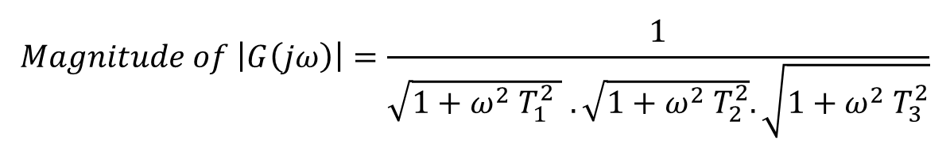
STEP-III: Put the limit $ω→0 and ω→∞$in Magnitude and Phase angle of $G\left(jω\right)$
$$Magnitude of \left|G\left(jω\right)\right|=\frac{1}{\sqrt{1+ω^{2} T_{1}^{2} } .\sqrt{1+ω^{2} T_{2}^{2}}. \sqrt{1+ω^{2} T_{3}^{2}}}$$
$$\lim_{ω→0}$$
$$Phase Angle of∠G\left(jω\right)=−\tan^{−1}\left(ωT_{1}\right)−\tan^{−1}\left(ωT_{2}\right)−\tan^{−1}\left(ωT_{3}\right)$$
$$Magnitude of \left|G\left(jω\right)\right|=\frac{1}{\sqrt{1+ω^{2} T_{1}^{2} } .\sqrt{1+ω^{2} T_{2}^{2}}. \sqrt{1+ω^{2} T_{3}^{2}}}=\frac{1}{\sqrt{1+ 0^{2}}\sqrt{1+ 0^{2}}\sqrt{1+ 0^{2}} }=\frac{1}{1}=1$$
$$Phase Angle of∠G\left(jω\right)=−\tan^{−1}\left(ωT_{1}\right)−\tan^{−1}\left(ωT_{2}\right)−\tan^{−1}\left(ωT_{3}\right)=−\tan^{−1}\left(0\right)−\tan^{−1}\left(0\right)−\tan^{−1}\left(0\right)= 0^{0}$$
$$\lim_{ω→∞}$$
$$Magnitude of \left|G\left(jω\right)\right|=\frac{1}{\sqrt{1+ω^{2} T_{1}^{2} } .\sqrt{1+ω^{2} T_{2}^{2}}. \sqrt{1+ω^{2} T_{3}^{2}}} =\frac{1}{\sqrt{1+ ∞^{2}}\sqrt{1+ ∞^{2}}\sqrt{1+ ∞^{2}} }=\frac{1}{\sqrt{ ∞^{2}}\sqrt{ ∞^{2}}\sqrt{ ∞^{2}} }=\frac{50}{∞∞∞}=0$$
$$Phase Angle of∠G\left(jω\right)=−\tan^{−1}\left(ωT_{1}\right)−\tan^{−1}\left(ωT_{2}\right)−\tan^{−1}\left(ωT_{3}\right)=−\tan^{−1}\left(∞\right)−\tan^{−1}\left(∞\right)−\tan^{−1}\left(∞\right)$$
$$Phase Angle of∠G\left(jω\right)=−\tan^{−1}\left(∞\right)−\tan^{−1}\left(∞\right) −\tan^{−1}\left(∞\right)=−90−90−90=−{270}^{0}$$

Slide 27

STEP-IV: Draw Polar Plot
$$at ω →0$$
$$at ω →∞$$
$$Magnitude of \left|G\left(jω\right)\right|=1$$
$$Magnitude of \left|G\left(jω\right)\right|=0$$
$$Phase Angle of∠G\left(jω\right)= 0^{0}$$
$$Phase Angle of∠G\left(jω\right)= −270^{0}$$

